Slide 1

EE3070 Project Design
Main Theme: Smart Electricity Meters

Slide 2
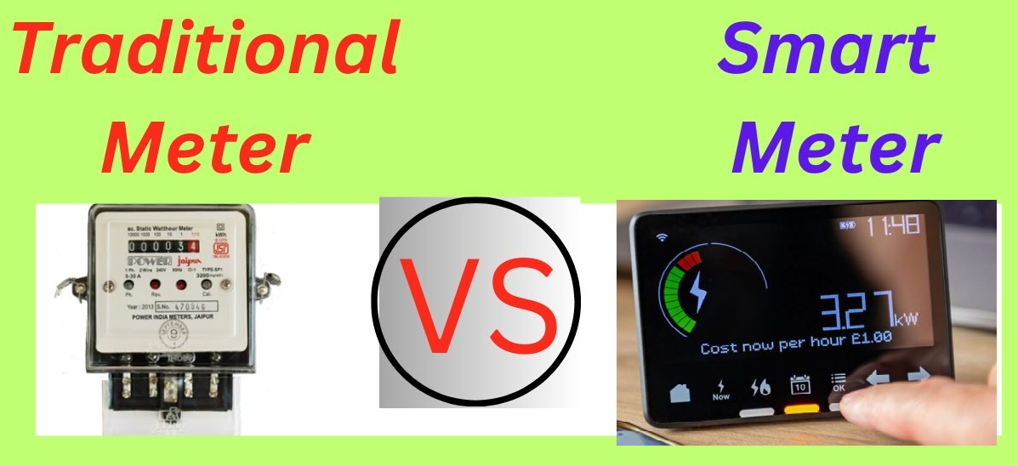
Notes:
https://www.youtube.com/watch?v=54m2_udmtdU

Slide 3

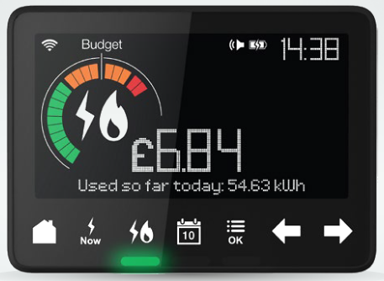
What Are Smart Electricity Meters?
Smart electricity meters are advanced devices that record electricity consumption at frequent intervals and transmit the data to utility providers.
These meters eliminate the need for manual meter readings and provide real-time data to both users and utilities.

Slide 4
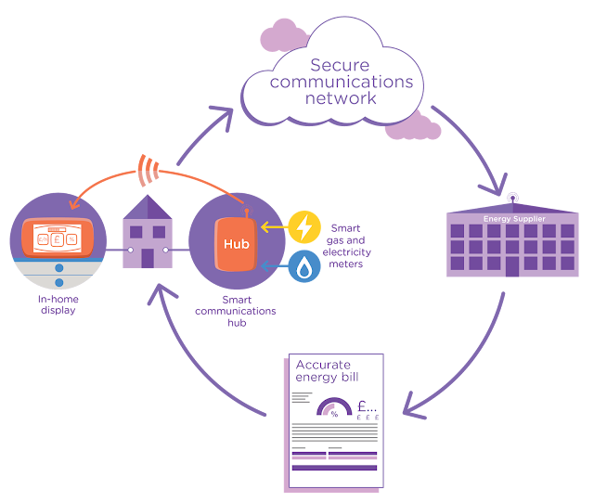
How Smart Meters Work
Smart meters use wireless technology to send electric consumption data securely to the electricity provider. This information helps in accurate billing and better energy management.
Notes:
Source: GREEN CITY TIMES

Slide 5
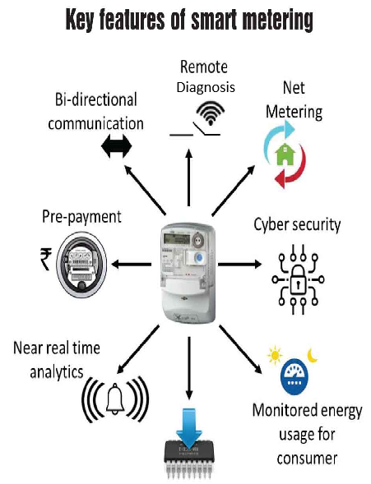
Key Features of Smart Meters
Smart meters provide real-time tracking, detailed energy usage statistics, and support for remote monitoring and diagnosis, helping users make data-driven decisions about energy consumption, etc..
Notes:
Source: PowerLine Company

Slide 6
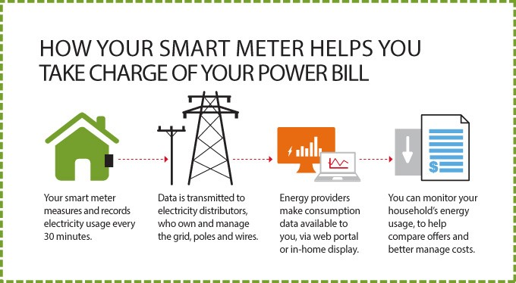
Notes:
Source: https://neroelectronics.com/

Slide 7
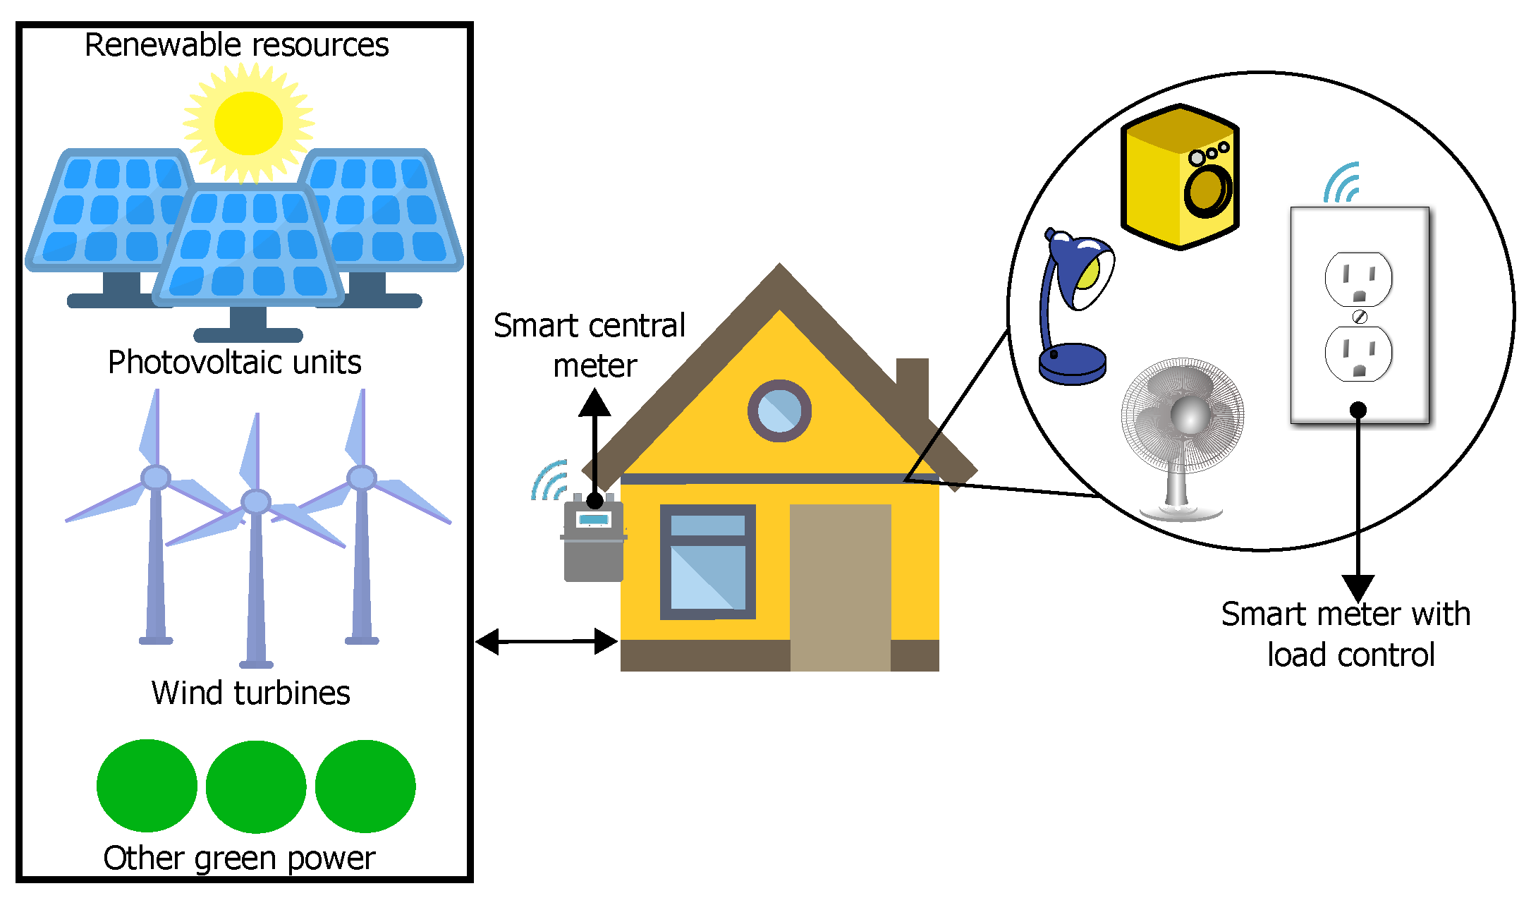
Smart meters play a key role in integrating renewable energy sources into the grid by providing real-time data on energy generation and consumption. It is vital for managing the variability of energy supplies from different renewable resources, ensuring efficient grid balancing, and supporting demand response programs.
Notes:
Source: Design and Development of an IoT Smart Meter with Load Control for Home Energy Management Systems, Sensors 2022, 22(19)

Slide 8
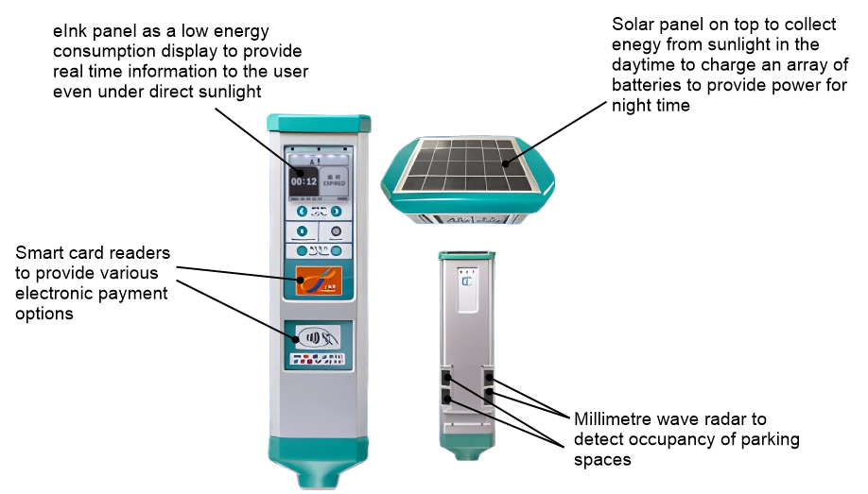
In 2021, the Transport Department launched new on-street smart parking meters with innovative applications of parking vacancy sensors, eInk display, solar energy, onsite payment with smart cards, and remote payment with smartphone app.
https://www.3rgit.com/

Slide 9
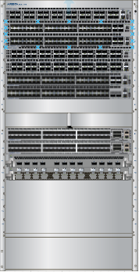
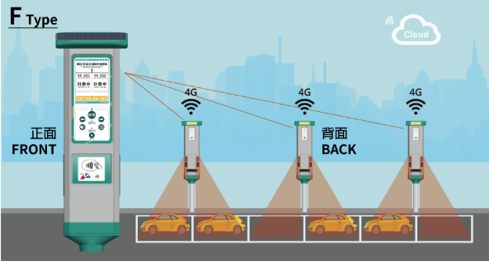
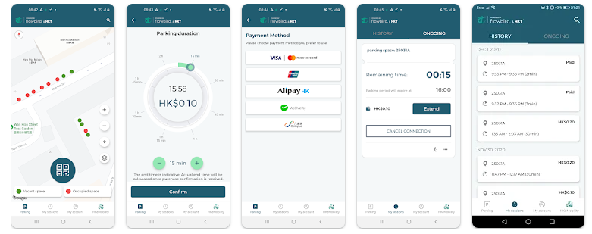
Illustration of the technology
Data such as the meter location,
parking time and payment information, parking attendance, and even the health status including the battery conditions and tamper alert are transmitted to the cloud by 4G telemetry
Central servers as the cloud
Payment information uploaded to the cloud and parking vacant on-street downloaded to motorists’ smartphone
Motorists may choose to pay remotely by a smartphone app and learn real-time occupancy information of metered parking spaces
https://www.3rgit.com/Solutions/Solution/Smart_Parking_Meter_Solution__%E2%91%A0

Slide 10
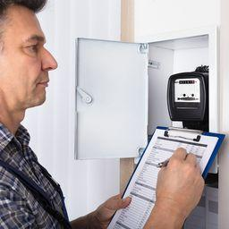
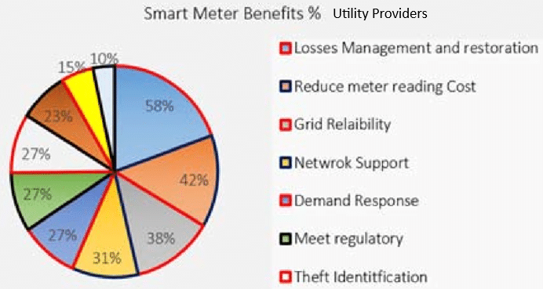
Benefits for Utility Providers
Utilities benefit from operational savings, reduced energy theft, and better load forecasting, which improves overall grid reliability and reduces outages.
Notes:
Issues and Challenges of Existing Electricity Pre-Paid Smart Metering Systems: A Review
January 2017 Science Technology and Development· 36(1):44-52

Slide 11
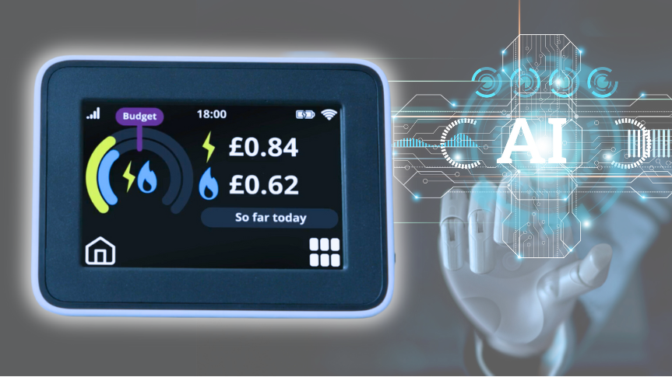
Future of Smart Electricity Meters
Smart meters will incorporate artificial intelligence (AI) in the future, making them even more intelligent and efficient. With AI, smart meters could learn your energy usage habits and adjust your energy usage accordingly, further reducing your energy bills.
Notes:
Source: SMS Company

Slide 12
Purpose and Aim of the Design Project
The purpose of the design project is to design and build a smart meter which goes well beyond the elementary functions of a traditional electricity meter.
Smart meters can provide support for remote monitoring and diagnostics, dynamic pricing, tamper notification, consumption analysis, and more smart functions.
Above all smart features, the distinguishing quality of a smart meter is to allow bi-directional communication between the electricity company and consumers. This is the key that opens the door to all other "smart" functions and the benefits thereof.
Students are encouraged to use AI as a critical tool for implementing dynamic pricing strategies, enabling companies to adjust prices in real-time based on market demand, consumer behavior, and other external factors.

Slide 13

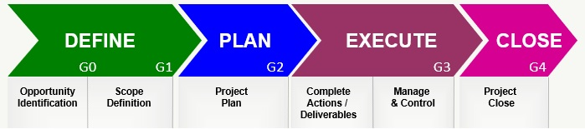
Project Management
https://accendoreliability.com/simplified-project-management-part-1/
https://accendoreliability.com/simplified-project-management-part-2/

Slide 14
Questions to Ask
Define Phase
What smart ideas that you are designing in your smart electricity meter?
How can your idea enhance features of smart electricity meter?
What is your design implementation?
Plan
How can the design platform fit your design?
What are needed to further advance your design?
What the team needs to do? Can it be completed within the timeframe?
What are the risks?

Slide 15
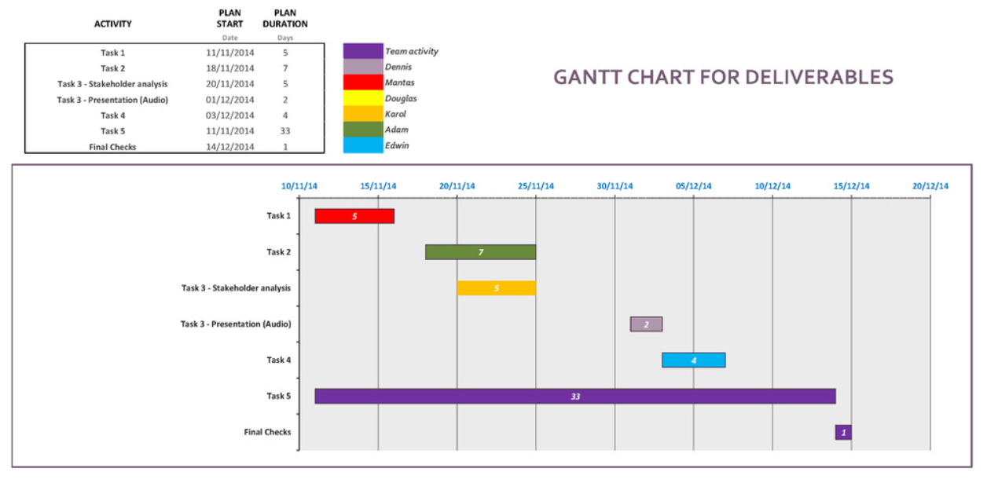
Plan
Project Management
How will the team perform the project?
What will each member do (actions and deliverables)?
Schedule and milestones (Gantt Chart)?
Any risk?
Example of Gantt Chart
Tools: Excel or others

Slide 16
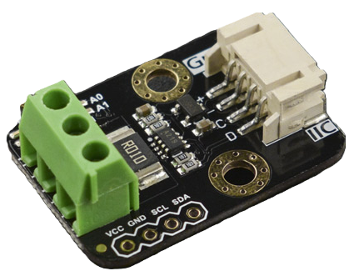
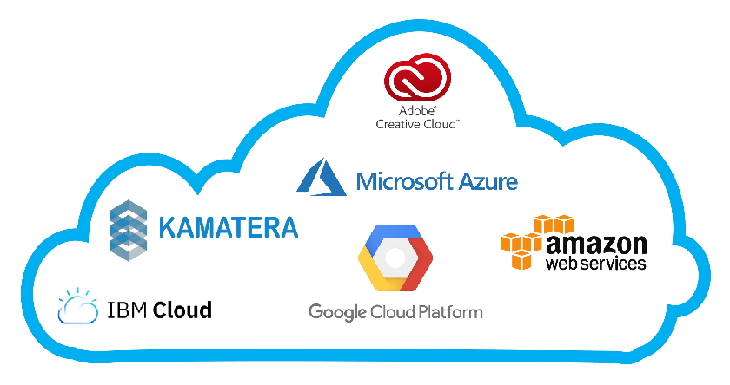
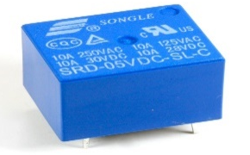
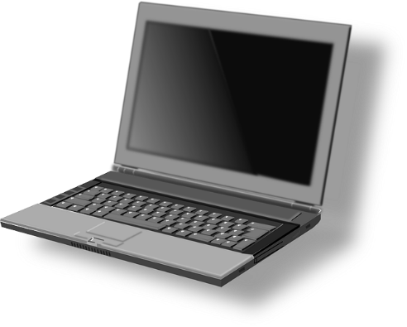
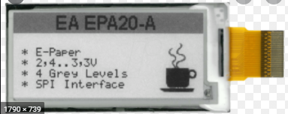
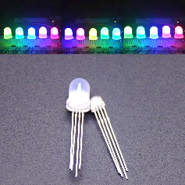
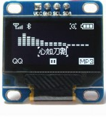
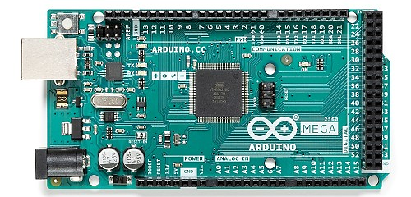
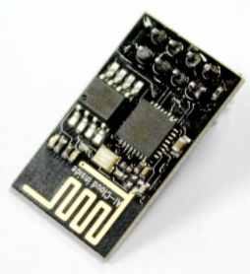
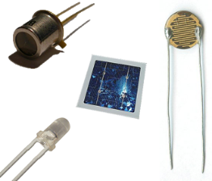
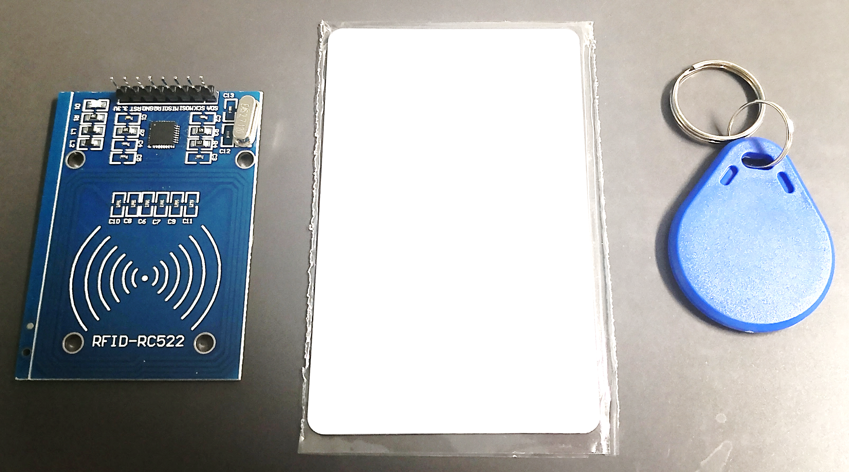
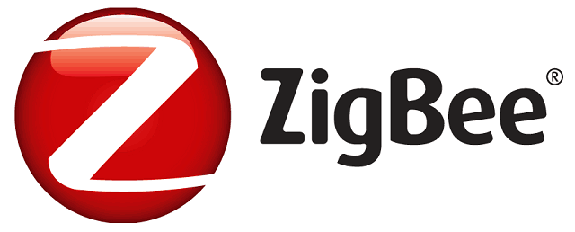

General System Architecture of Smart Meters
Electric appliance
Renewable energy source
Appliance
Relays
Digital Wattmeter
Cloud service
Displays
Wifi module
Micro-controllers
Wireless communication modules
Sensors

Slide 17
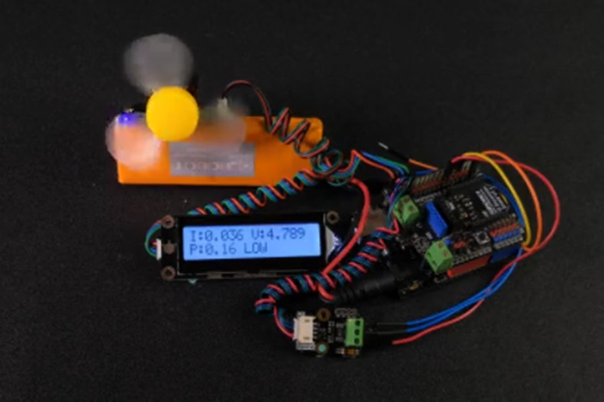

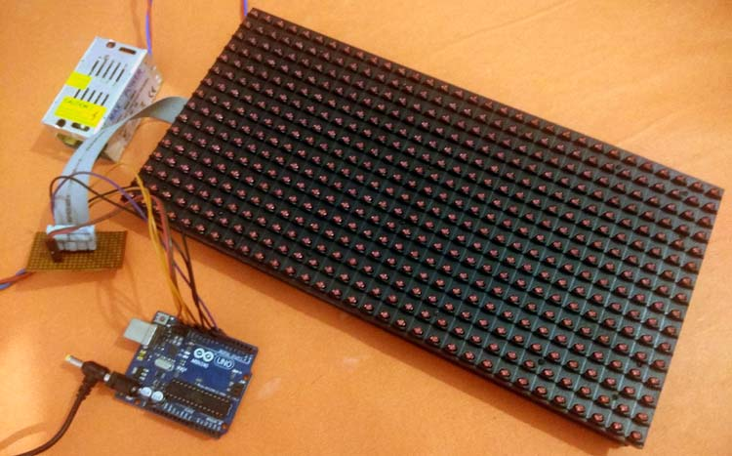

Example 1: Electric Fan & LED Display
Examples
CLOUD
Current
Voltage
Power Consume
status
Notes:
Source: DFRobot Company

Slide 18
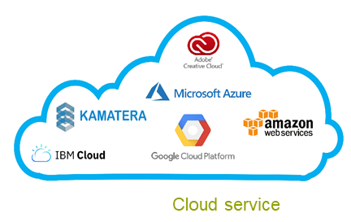
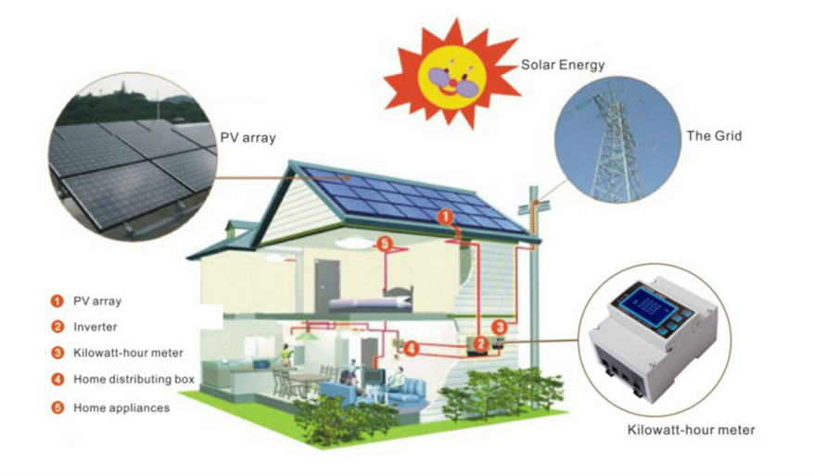


Examples
Example 2: Solar Energy Generation, Consumption and Export Control
Smart meter
Wifi module
Micro-controllers
Notes:
Source: fresh-energy-systems.com

Slide 19
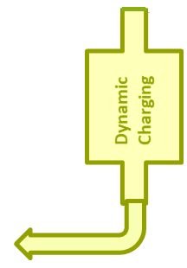
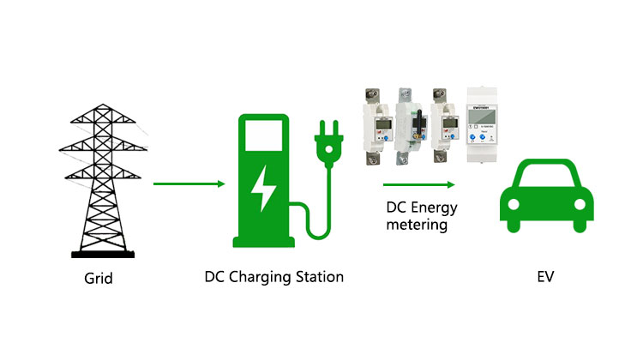
Example 3: Dynamic Price Charging
Examples
CLOUD
Energy consumption
Car flow number
Peak Hour
Smart Meter
status
[1]
Wastereduction.gov.hk
Notes:
Source: Ivy Metering Company

Slide 20
Key To Success
The project proposal and outcome are to be
Creative/Innovative (solution to a problem)
Practical and Effective Solutions
Attractive Outputs
Demonstrates solid and advanced (in UG level) technical contents
  Multiple and interdependent functions
  User-machine OR machine-machine communications
  …

Slide 21
Proposal Writing
Project Management
A project proposal outlines your project’s core value proposition
What is novel in your proposition
Be creative
That will summarize what you have in Define and Plan Phase
A template will be given in CANVAS
https://www.projectmanager.com/academy/how-to-make-a-project-proposal

