Slide 1
GE1202 Managing Your Personal Finance
Week 2 Tutorial
Introduction to Personal Finance Management

Slide 2
Question 1 True/False
Explain whether the statements are true or false.
  Personal financial planning is a process that should be carried out on a regular five-yearly basis.
  The whole financial planning process should be revisited on regular basis.
  Or when personal or economic circumstances change
False

Slide 3
Question 1 True/False
  It is far more important for older people to engage with personal financial planning, than younger people.
Personal financial planning is important to people who have financial goals but limited financial resources.
Both young people and older people face the same situation.
False

Slide 4
Question 1 True/False
  If inflation is measured at 3% per annum and a savings account is paying interest at 3% per annum, the purchasing power of the savings made will remain unchanged.
% △ Real value = % △ Nominal value – Inflation%
0%
3%
3%
True

Slide 5
Question 1 True/False
False
  Career planning is not a part of financial planning.
  Eight major personal financial planning areas
    Obtaining – the receipt of income and other financial resources
    Planning – actions to determine future financial directions
    Saving – set aside funds for expected and unexpected expenses
    Borrowing – appropriate use of short-and-long-term credit plans
    Spending – analysis of purchasing decisions for wise money use
    Managing Risk – insurance and other methods to reduce financial uncertainty
    Investing – accumulation of funds for long-term financial security
    Retirement and Estate Planning – efforts to provide for post-career years and transfer of assets

Slide 6
Question 1 True/False
  Once you have set your financial goals, you should try to achieve them by all means.
Financial goals should take a SMART approach
If the goal is unrealistic, it is very unlikely for you to achieve it
Six-step financial planning process
False
Determine your current financial situation
  Review and revise the plan
  Develop your financial goals
  Create and implement your plan
  Evaluate alternatives
  Identify alternative courses of actions

Slide 7
Question 2 Case study
Peter, aged forty, and his wife Ming have three young children and together they are buying their own home. Peter works in the public sector and has joined the Mandatory Pension Fund for the last fifteen years. Ming runs a small business from home that generates an income for her of HK$5000 each month.
They have a large mortgage and owe significant sums on their credit cards. Peter has never considered undertaking any kind of personal financial planning. His view is as follows:
  “Given my current financial predicament, I have absolutely no choices to make as I have no spare cash to consider investing. Personal financial planning is for people with cash to save.”

Slide 8
Question 2 Case study
Do you agree with Peter’s view on personal financial planning?
Personal financial planning is important not only for people who has spare money but also for people who are in financial difficulty
It requests people to spend in a manageable way
And ultimately help people to built up their savings

Slide 9
Question 2 Case study
Suggest a SMART financial goal to them.
As the interest charged on credit card is high, it will be at the top priority to cut down the debt on it.
First of all, stop using credit card for making payment further.
Second, increasing the payment every month.
  Cutting unnecessary expenses, like entertainments.
  Loans restructuring
  Etc

Slide 10
Question 2 Case study
Describe some of the benefits that personal financial planning could offer to them?
Built up their saving
Increasing the payment of the mortgage
Giving more resources to their children
Enjoy a higher living standard

Slide 11
Question 3 Calculation
Your friend is now working in an insurance company. He is prompting an investment project of his company to you:
“Our company is now offering a plan, which is a very good project. You just need to pay $3000 at the end of each month from January 2017 for ten years. Then you can get back HK$1million on 31st December 2046.”

Slide 12
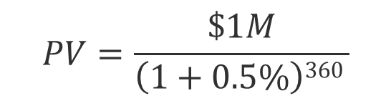
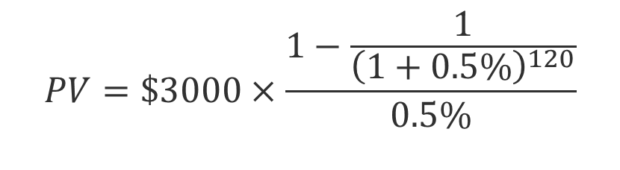
Question 3 Calculation
Assume that the market interest rate is 6%p.a. and is stable during the period, will you consider the project?
PV of your investment
PV of the return
$$PV=\$3000×\frac{1−\frac{1}{{\left(1+0.5\%\right)}^{120}}}{0.5\%}$$
= $270,220
$$PV=\frac{\$1M}{\left(1+0.5\%\right)360 }$$
= $166,042
NO!!!

