Slide 1
CS2311 Computer Programming
LT6: Array (1D and 2D)
Computer Science, City University of Hong Kong
Semester A 2021-22

Slide 2
Example
Input the marks for 10 students
Store the marks in variables
Compute the average marks
Print the marks of the students and the average
100 30 44 66 50 60 80 75 80 100
The mark of the students are: 100, 30, 44, 66, 50, 60, 80, 75, 80, 100
Average mark=68

Slide 3
The program
int mark1, mark2, mark3, mark4, mark5,
mark6, mark7, mark8, mark9, mark10, average;
cin >> mark1 >> mark2 >> mark3 >> mark4 >> \\
mark5 >> mark6 >> mark7 >> mark8 >> mark9 >> mark10;
cout << “The mark of the students are: “ << mark1 \\
<< mark2 << mark3 << mark4 << mark5 << mark6 \\
<< mark7 << mark8 << mark9 << mark10 << endl;
average=(mark1+mark2+mark3+mark4+mark5
+mark6+mark7+mark8+mark9+mark10)/10;
cout << "Average mark"<< average << endl;

Slide 4
A program
100 30 44 66 50 60 80 75 80 100 The mark of the students are: 100 30 44 66 50 60 80 75 80 100 Average mark=68

Slide 5
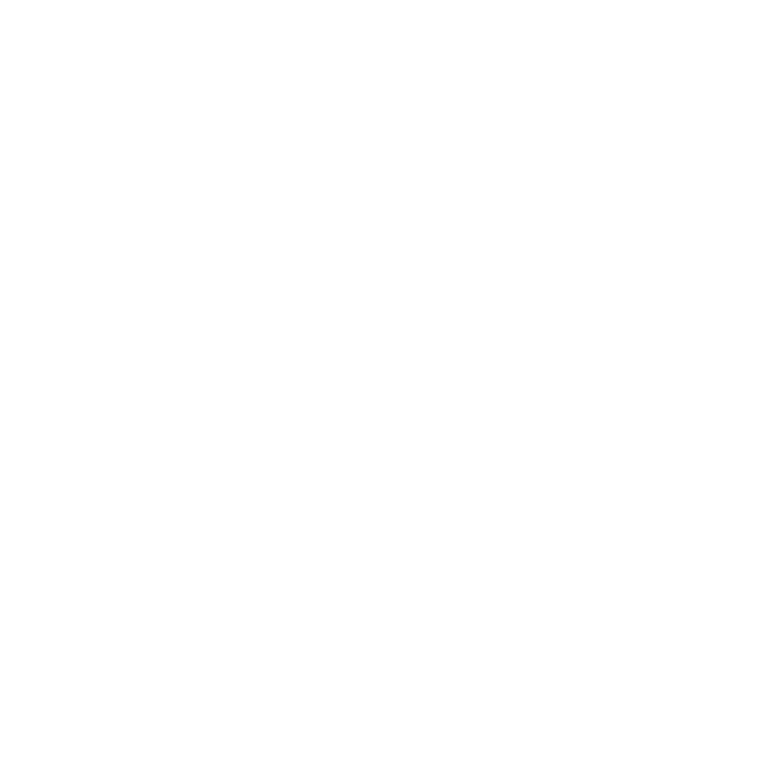
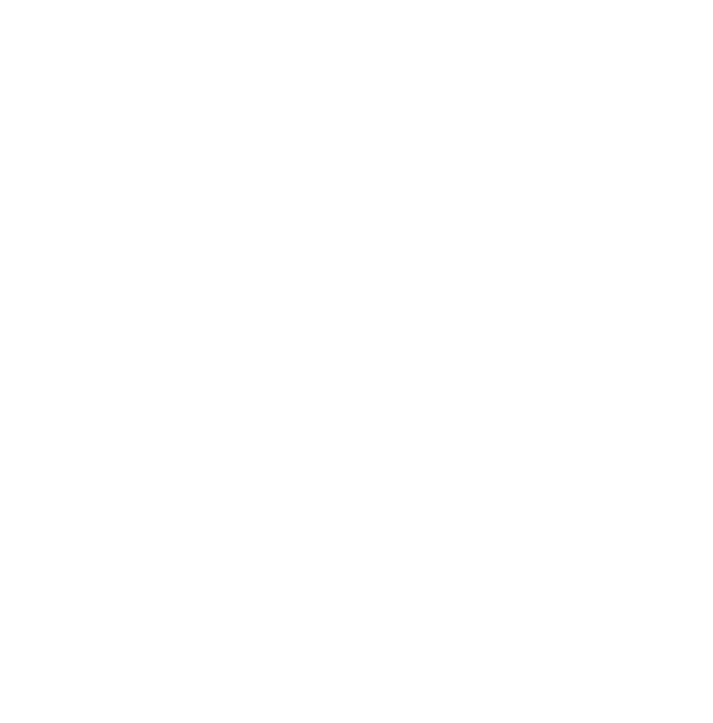
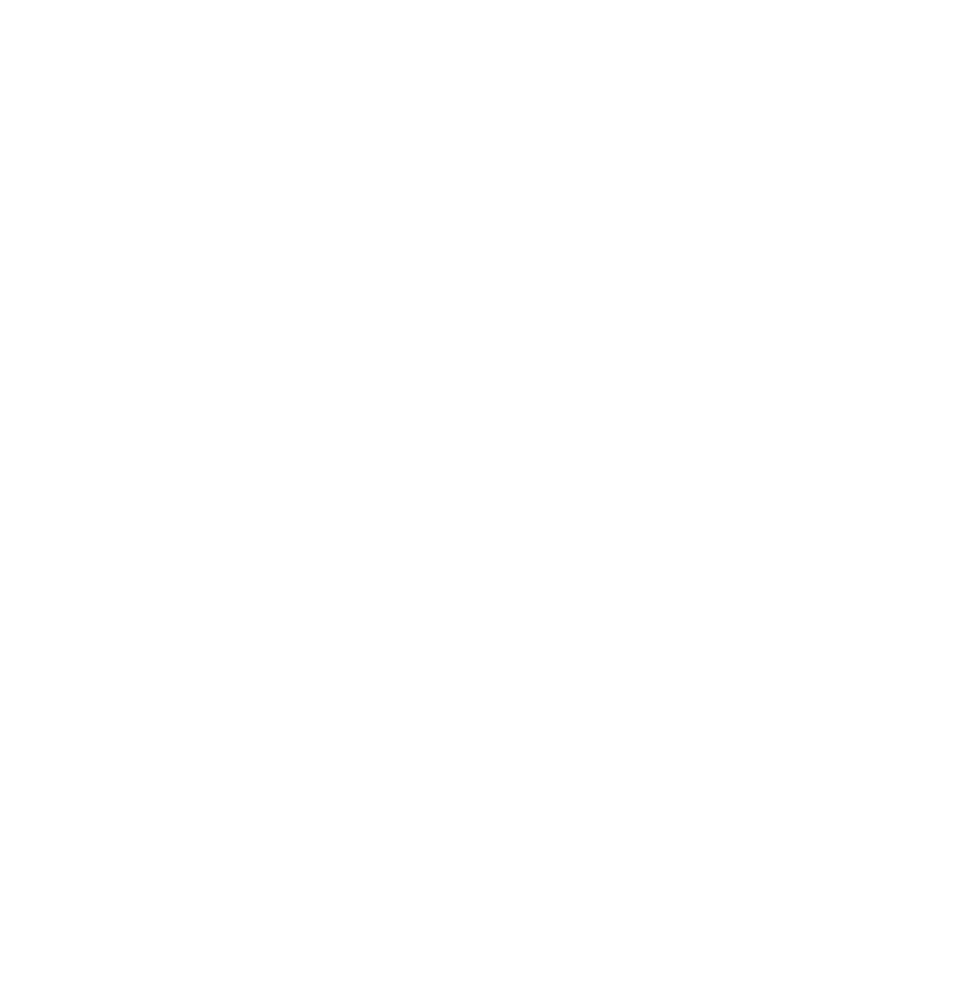
What is an Array?
Sequence of data items of the same type
  Stored contiguously
  Can be accessed by index, or subscript
data_type array_name[size];
int x
;
5
x
=
5
;
int a
[
6
]
;
a
[
0
]=
5
;
a
[
0
]
a
[
1
]
a
[
2
]
a
[
3
]
a
[
4
]
a
[
5
]
a
[
1
]=
7
;
a
[
2
]=
2
;
5
7
2

Slide 6
Outcomes
Array definition
Array initialization
Updating array elements
Printing the content of arrays

Slide 7
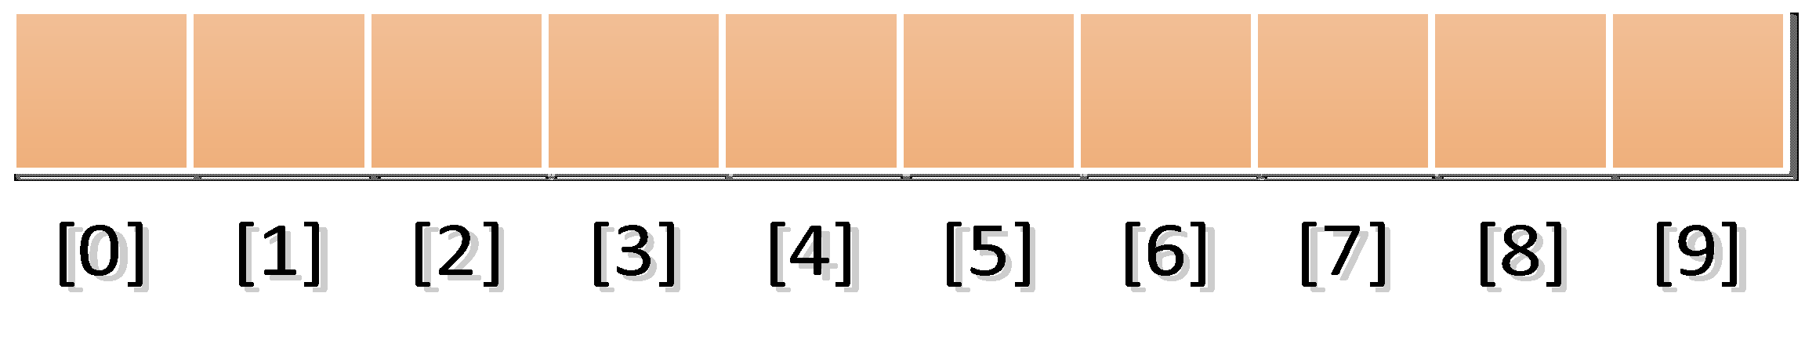
Array definition
Data type of the array element
Size of the array
int mark[10];
Name of the array
There are ten elements in this array
mark[0], mark[1], ……, mark[9]
The i^{th} array element is mark[i-1].
The range of the subscript i ranges from 0 to array_size-1
The location mark[10] is invalid. Array out of bound!

Slide 8
Array definition
Array size
  Constant
  int mark[50*50];
  int n=10;
  int mark[n]
  int const n=10;
  int mark[n]

Slide 9
Storing values to array elements
int mark[10]
Suppose the mark for the first student is 30. We can use the notation
mark[0] = 30;
Input the marks of the second student
cin >> mark[1];
Input the marks for all 10 students
for (i=0;i<10;i++)
cin >> mark[i];
for (i=1;i<=10;i++)
cin >> mark[i-1];

Slide 10
Retrieving the values of an array element
Print the mark of the second student
cout << mark[1];
Print and Sum the marks of all the students
for (i=0;i<10;i++) {
cout << mark[i];
sum += mark[i];
}

Slide 11
Example 1 (using an integer array with 10 elements)
/*define variables for storing10 students' mark*/
int marks[10], sum=0, average;
int i;
/*input marks of student*/
for (i=0;i<10;i++)
cin >> mark[i];
/*print the marks*/
cout << "The mark of the students are:";
for (i=0;i<10;i++) {
cout << mark[i];
sum=sum + mark[i];
}
/*compute and print the average*/
average=sum/10;
cout << "Average mark=“ << average << endl;

Slide 12
C++ Macro: #define
#define is a C++ predefined macro keyword. It is very useful. It globally replaces all occurrences of A to B in the ENTIRE source code listing (all .cpp and all .h files).
#define A B
#define N 100
#define SIZE 10

Slide 13
Using #define
#define N 10
int main() {
int marks[N], sum=0, average;
int i;
for (i=0;i<N;i++)
cin >> mark[i];
cout << "The mark of the students are:";
for (i=0;i<N;i++) {
cout << mark[i];
sum=sum + mark[i];
}
average=sum/N;
cout << "Average mark=“ << average << endl;
}

Slide 14
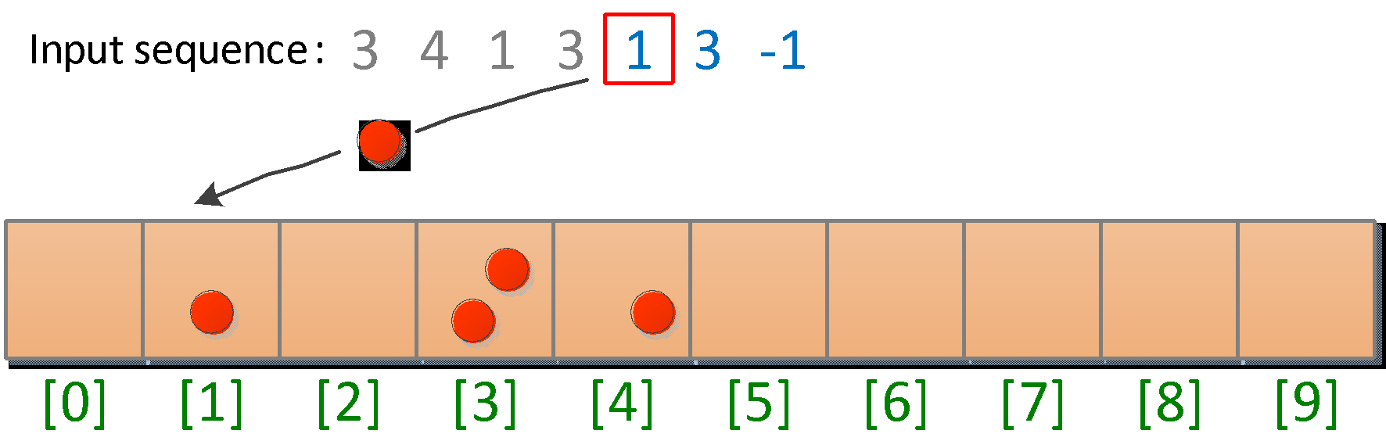
Example 2: counting digits
Input a sequence of digits {0, 1, 2, …, 9}, which is terminated by -1
Count the occurrence of each digit
Use an integer array count of 10 elements
  count[i] stores the number of occurrence of digit i

Slide 15
The program: buggy version
#include <iostream>
using namespace std;
void main(){
int count[10]; //number of occurrence of digits
int digit; //input digit
int i; //loop index
//read the digits
do {
cin >> digit;
if (digit>=0 && digit<=9) //necessary to avoid out-of-bound
count[digit]++;
} while(digit != -1); //stop if the input number is -1
//print the occurances
for (i=0; i<10;i++){
cout << "Frequency of " << i << " is " << count[i] << endl;
}
}

Slide 16
The actual output (incorrect!)
3 4 1 3 1 3 -1
Frequency of 0 is 2089878893
Frequency of 1 is 2088886165
Frequency of 2 is 1376256
Frequency of 3 is 3
Frequency of 4 is 1394145
Frequency of 5 is 1245072
Frequency of 6 is 4203110
Frequency of 7 is 1394144
Frequency of 8 is 0
Frequency of 9 is 1310720

Slide 17
It's a good practice to initialize arrays
Otherwise, the values of the elements in the array is unpredictable
A common way to initialize an array is to set all the elements to zero
for (i=0; i<10; i++)
count[i]=0;

Slide 18
Array initializer
int mark[2]={100, 90};
int mark[10]={100, 90};
Define an array of 10 elements, set the 1st element to 100 and the 2nd element to 90.
We list fewer values than the array size (10). The remaining elements are set to 0 by default
To initialize all elements to 0,
int mark[10]={0};

Slide 19
Correct program for example 2
#include<iostream>
using namespace std;
void main(){
int count[10]={0}; //number of occurrence of digits, and initialization
int digit; //input digit
int i; //loop index
//read the digits
do {
cin >> digit;
if (digit>=0 && digit<=9)
count[digit]++;
} while(digit != -1); //stop if the input number is -1
//print the frequency
for (i=0; i<10;i++){
cout << "Frequency of " << i << " is " << count[i] << endl;
}
}

Slide 20
Array Initializer
char array
  char univ[5]={‘C’, ‘i’, ‘t’, ‘y’, ‘U’};
  char univ[] = “CityU"; or
  char * univ = “CityU";

Slide 21
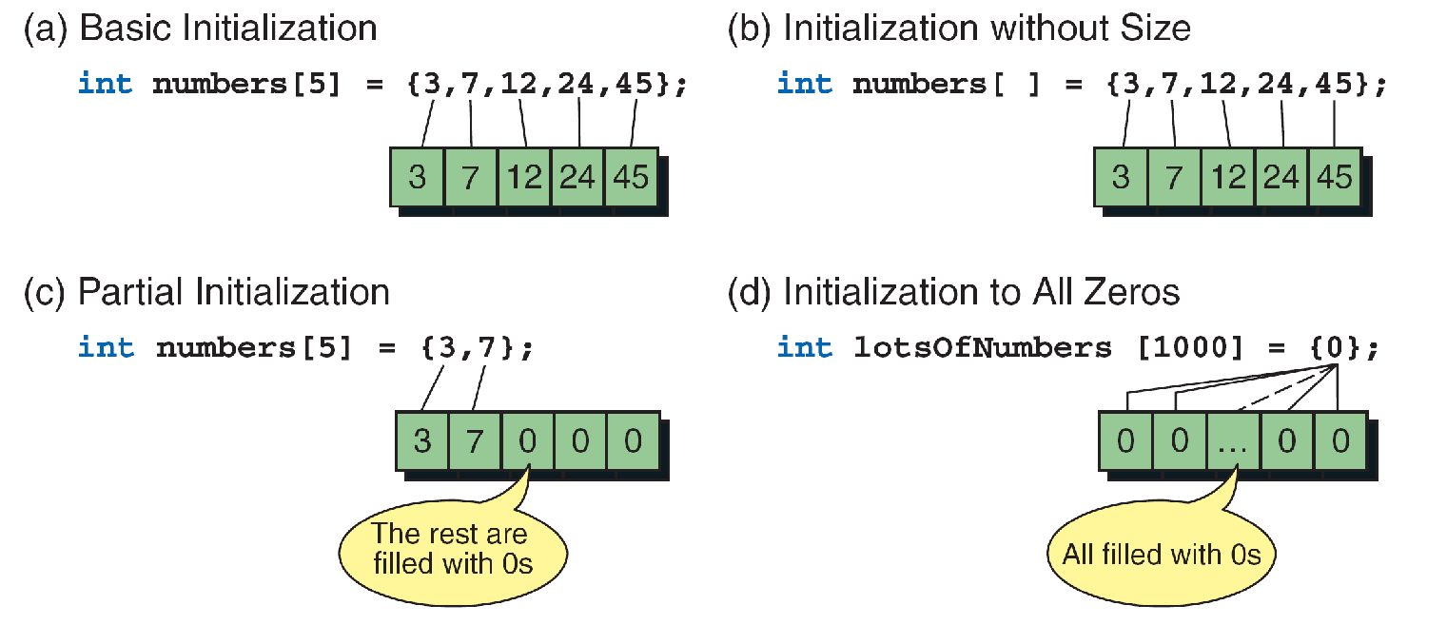
Array Initialization Summary
Only fixed-length arrays can be initialized when they are defined.
Variable length arrays must be initialized by inputting or assigning the values.

Slide 22
Summary of Array Declaration and Access
Type | Variable | Array | Variable Access | Array Access
int | int x; | int x[20]; | x=1; | x[0]=1
float | float x; | float x[10]; | x=3.4; | x[0]=3.4; x[9]=1.2;
double | double x; | double x[20]; | x=0.7; | x[0]=0.7; x[3]=3.4;
char | char x; | char x[5]; | x='a'; | x[0]=‘c’; X[1]=‘s’;

Slide 23
Example 3: Comparing 2 arrays
We have two integers arrays, each with 5 elements
int array1[5]={10, 5, 3, 5, 1};
int array2[5];
The user inputs the values of array2
Compare whether all of the elements in array1 and array2 are the same

Slide 24
Array equality
Note that you have to compare array element 1 by 1.
The following code generates incorrect results
if (array1 == array2)
cout << "The arrays are equal ";
else
cout << "The arrays are not equal ";

Slide 25
The Program
void main(){
int array1[5]={10, 5, 3, 5, 1};
int array2[5];
int i;
bool arrayEqual=true;
cout << "Input 5 numbers\n";
for (i=0;i<5;i++)
cin >> array2[i];
for (i=0; i<5 && arrayEqual; i++){
if (array1[i]!=array2[i]){
arrayEqual=false;
}
}
if (arrayEqual)
cout << "The arrays are equal";
else
cout << "The arrays are not equal";
}
Input 5 numbers
10 5 3 5 1
The arrays are equal
Input 5 numbers
10 4 3 5 2
The arrays are not equal

Slide 26
Example 4: Searching
Read 10 numbers from the user and store them in an array
User input another number x
The program checks if x is an element of the array
  If yes, output the index of the element
  If no, output -1

Slide 27
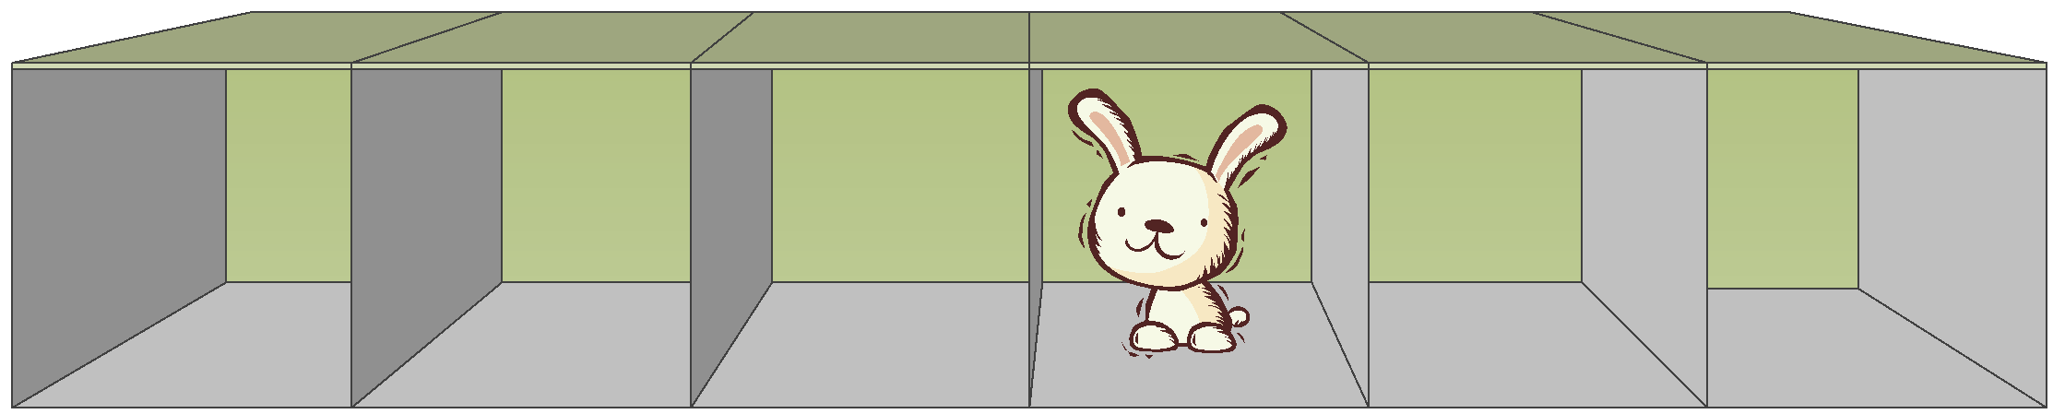
Searching for the rabbit (Case I)
Search sequentially
If found, skip the rest

Slide 28
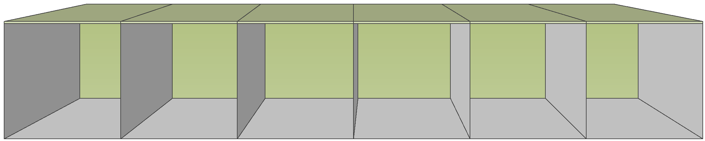
Searching for the rabbit (Case II)

Slide 29
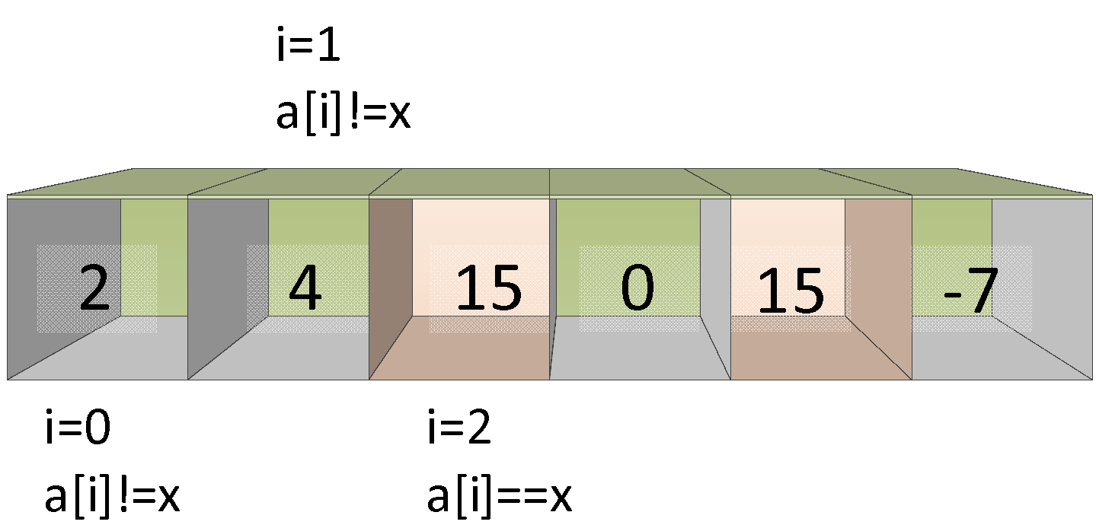
Searching for x=15 (Case 1)
Output i=2
break out of the loop

Slide 30
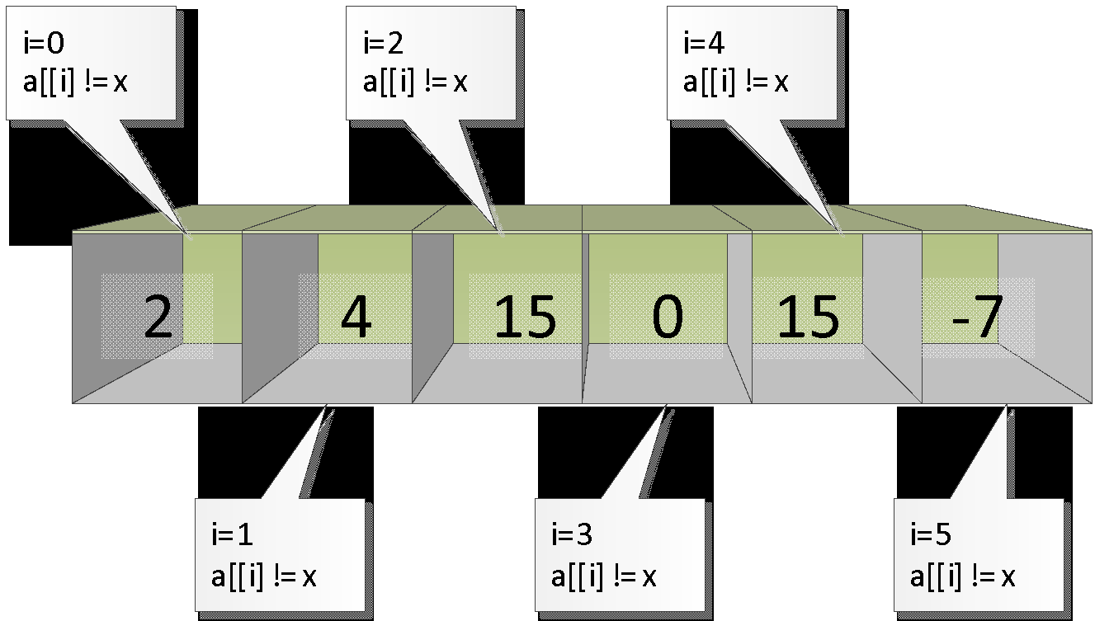
Searching for x=8 (Case 2)
Output -1

Slide 31
The program
void main()
{
const int N = 6;
int a[N], i, x, position = -1;
for (i=0; i<N; i++)
cin >> a[i];
cout << "Input your target: ";
cin >>x;
for (i=0; i<N; i++)
if (a[i] == x) {
position=i;
break;
}
if (position == -1)
cout << "Target not found!\n");
else
cout << "Target found at position“ << position << endl;
}

Slide 32
Example 5: Sorting
One of the most common applications in CS is sorting
  arranging data by their values: {1, 5, 3, 2} 🡪 {1, 2, 3, 5}
There are many algorithms for sorting
  Selection Sort
  Bubble Sort
  Insertion Sort
  Quick Sort
  Quicker Sort
  Merge Sort
  Heap Sort
Based on iteratively swapping two elements in the array so that eventually the array is ordered.
  The algorithms differ in how they choose the two elements.
"Classic" sorting algorithms
Faster, more complex sorting algorithms

Slide 33
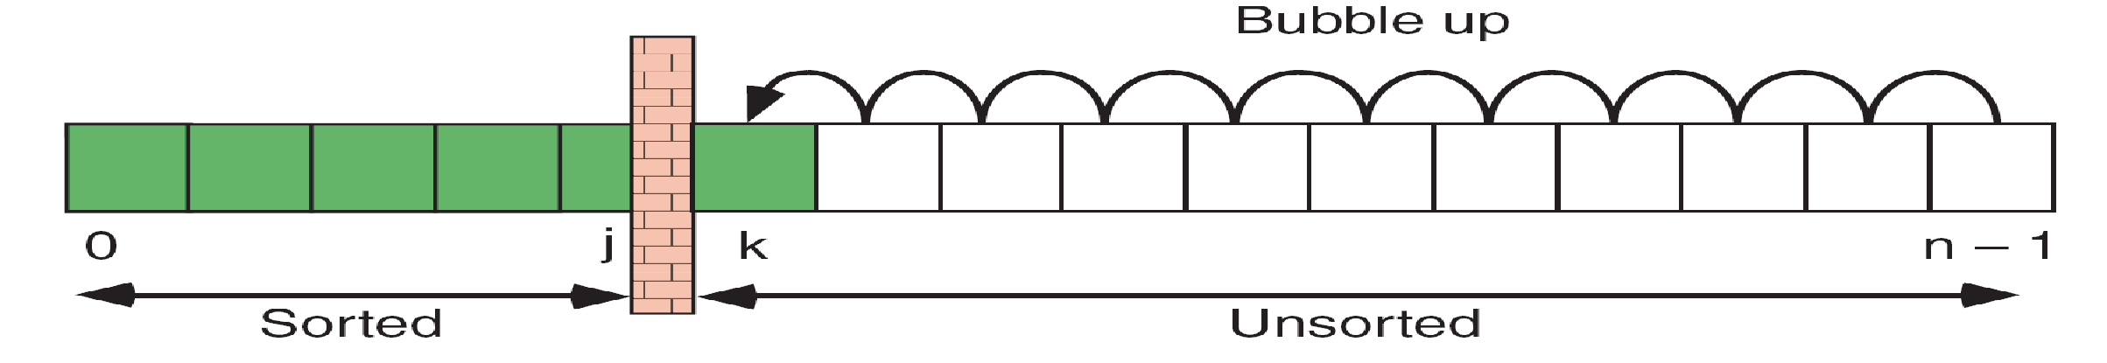
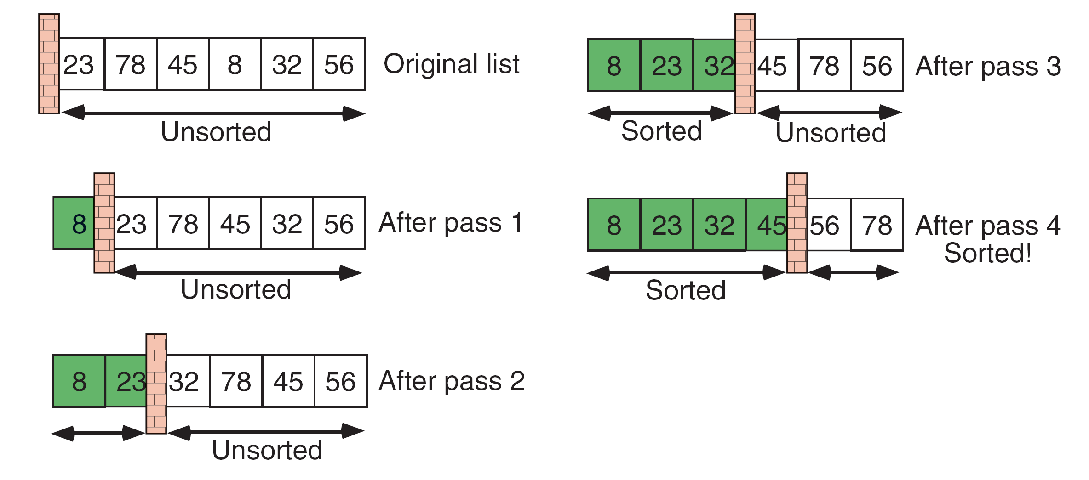
Bubble Sort
In each pass, start at the end, and swap neighboring elements if they are out of sequence ("bubbling up")
After i passes, the first i elements are sorted
Inner Loop (Bubbling)
Outer Loop (Pass)
23 | 78 | 45 | 8 | 32 | 56
Bubbling
23 | 78 | 45 | 8 | 32 | 56
Original
23 | 78 | 45 | 8 | 32 | 56
23 | 78 | 8 | 45 | 32 | 56
After Pass 1
23 | 8 | 78 | 45 | 32 | 56
8 | 23 | 78 | 45 | 32 | 56
Sorted

Slide 34
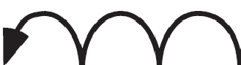
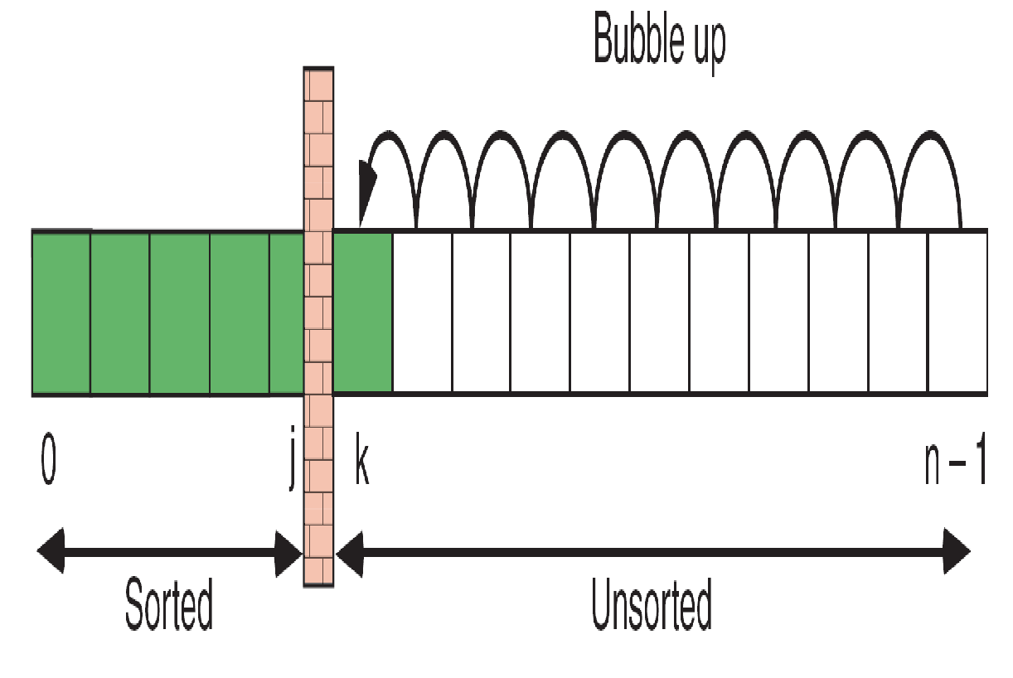


Bubble Sort

Slide 35
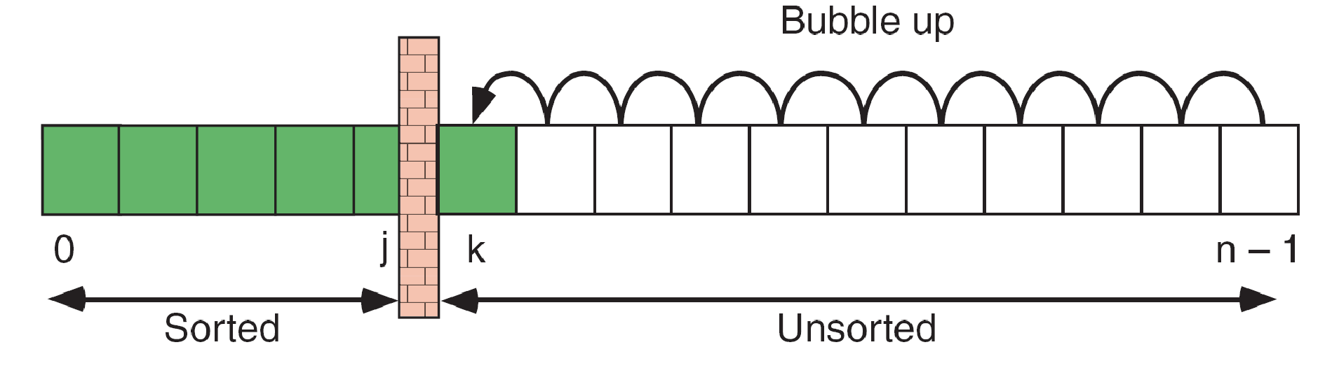
Bubble Sort
void main() {
const int n = 10;
int a[n], j, k, tmp;
cout <<"Input" << n <<" numbers: ";
for (j=0; j<n; j++)
cin >> a[j];
for(j=0; j<n-1; j++) // outer loop
for(k=n-1; k>j; k--) // bubbling
if (a[k]<a[k-1]) {
tmp = a[k]; // swap neighbors
a[k] = a[k-1];
a[k-1] = tmp;
}
cout << "Sorted: ";
for(j=0; j<n; j++)
cout << a[j];
}
a[j]

Slide 36
Multi-dimensional Array
More than one index
  Logical representation
  On physical storage, the multi-dimensional array is same as single dimensional array (stored contiguously in memory space)
To define a two-dimensional array, we specify the size of each dimension as follows
  int page[2][3]; //[row][column]
Stored in the “row-major” order, i.e.
  First block of memory will be used to store page [0][0] to page [0][2], the next block for page [1][0] to page [1][2]
34 11
56 99

Slide 37
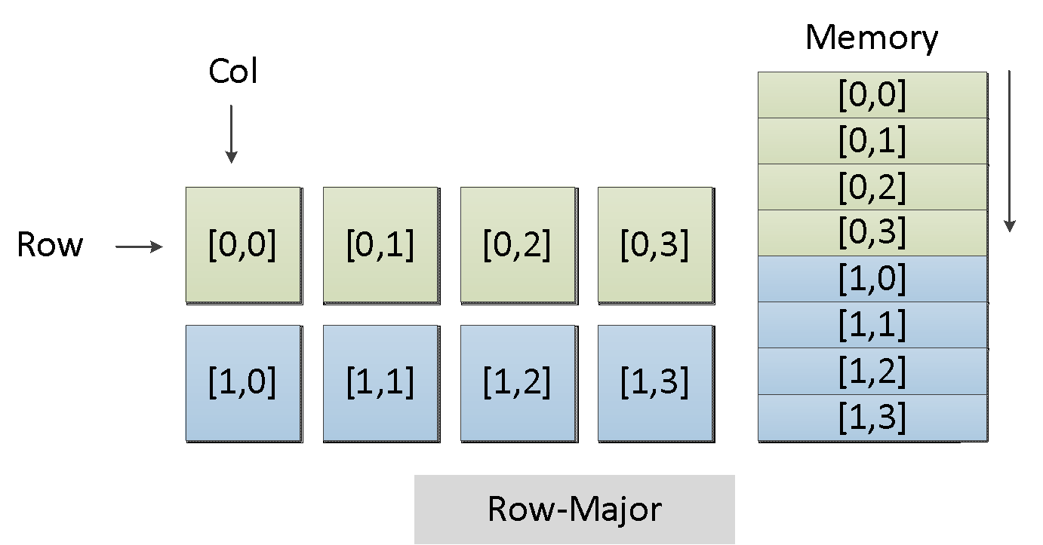
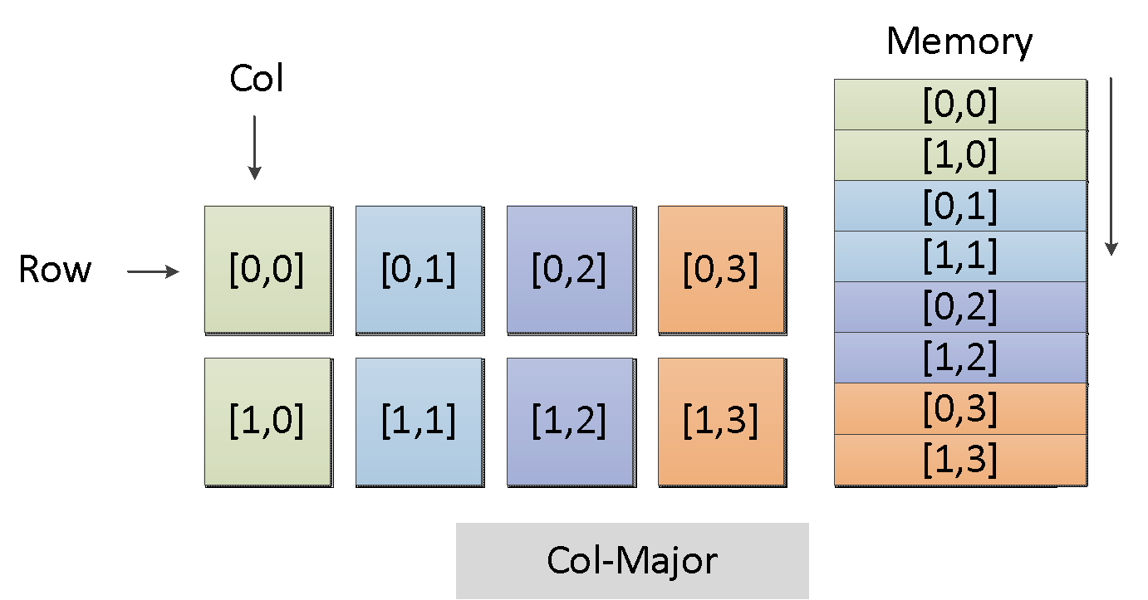

Slide 38
Two-dimensional Array Initialization
Assign initial values row by row:
int page[2][3] = {{1,2,3},{4,5,6}};
Assign initial values to the elements in the order they are arranged:
int page[2][3] = {1,2,3,4,5,6};
Only assign initial values to some elements:
int page[2][3] = {{1},{4,5}};
If all elements are assigned initial values, the length of the first dimension can be left unspecified:
int page[][3] = {1,2,3,4,5,6};
int page[2][] = {1,2,3,4,5,6};
1 0 0
4 5 0
x

Slide 39

Example: swapping row and column
Swap elements of rows and columns of a two-dimensional array with 2 rows and 3 columns;
Output the swapped array (please control the precision of each element, so that it contains only one digit in the decimal part).
1.2 | 3.0
1.3 | 4.1
2.6 | 4.0
1.2 | 1.34 | 2.564
3 | 4.123 | 4

Slide 40
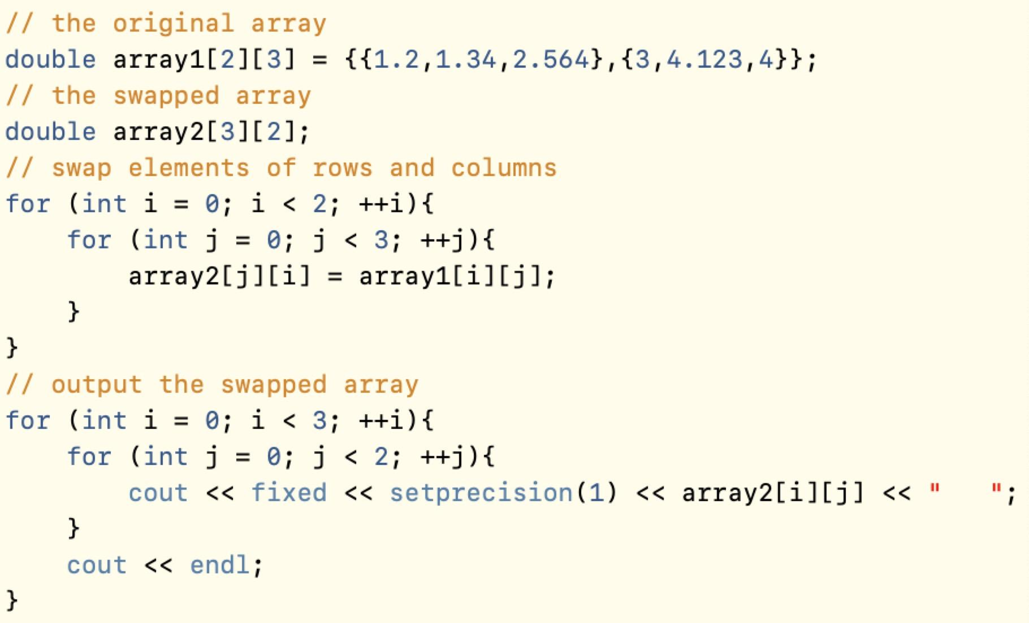
Example: swapping row and column

Slide 41
Multi-dimensional Array
To access an element of the array, we specify an index for each dimension:
  cin >> page [i][j]; //[row][column]
The above statement will input an integer into row i and column j of the array

Slide 42
BMI Program
void main()
{
const int N=10;
double data[N][2];// N records, each holds weight and height
int i, position;
for (i=0; i<N; i++){
cout << "Weigth(kg) Height(m):";
cin >> data[i][0];
cin >> data[i][1];
}
for (i=0; i<count; i++){
cout << "BMI for " << i+1 << “is :”;
cout << data[i][0]/(data[i][1]*data[i][1]) << endl;
}
}

Slide 43
Summary
Array is a sequence of variables of the same data type
Array elements are indexed and can be accessed by the use of subscripts, e.g. array_name[1], array_name[4]
Array elements are stored contiguously in memory space
Array Declaration, Initialization, Searching and Sorting

