Slide 1
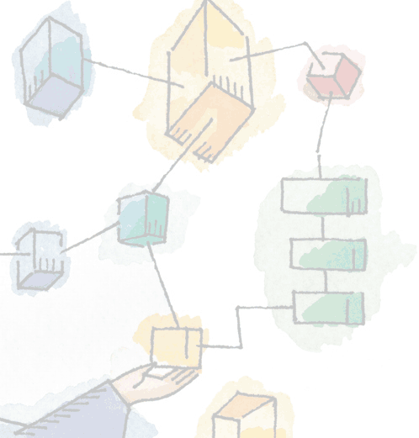
Chapter 6
Concurrency:
Deadlock and Starvation
Operating Systems:
Internals and Design Principles
William Stallings

Slide 2
Roadmap
Principles of Deadlock
Deadlock Prevention
Deadlock Avoidance
Deadlock Detection
Dining Philosophers Problem

Slide 3
Deadlock
Deadlock is the permanent blocking of a set of processes that either compete for system resources or communicate with each other.
A set of processes is deadlocked when each process in the set is blocked awaiting an event that can only be triggered by another blocked process in the set.
  The event is typically the freeing up of some requested and obtained resources
No efficient solution in the general case.

Slide 4

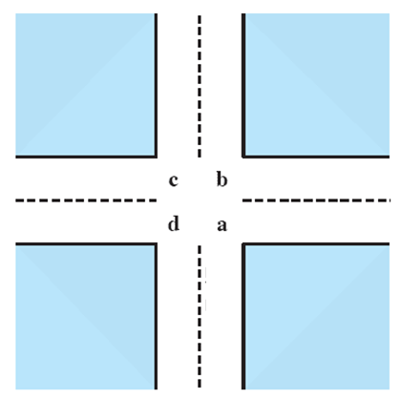
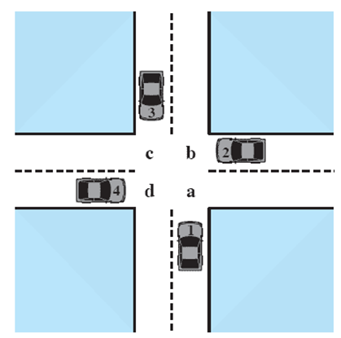



Potential Deadlock
I need quad c and d
I need quad b and c
I need quad a and b
I need quad d and a

Slide 5
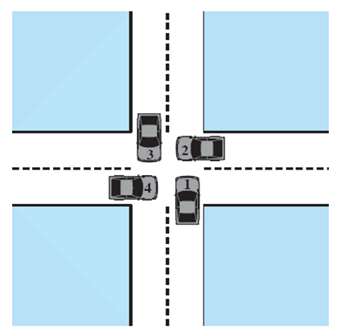
Actual Deadlock
HALT until d is free
HALT until c is free
HALT until b is free
HALT until a is free

Slide 6
Resource Categories
Two general categories of resources:
  Reusable resources
    can be safely used by only one process at a time and is not depleted by that use.
    Examples: processors, main and secondary memory, devices, and data structures such as files, databases, and semaphores
  Consumable resources
    can be created (produced) and destroyed (consumed).
    Examples: interrupts, signals, messages, and information in I/O buffers

Slide 7
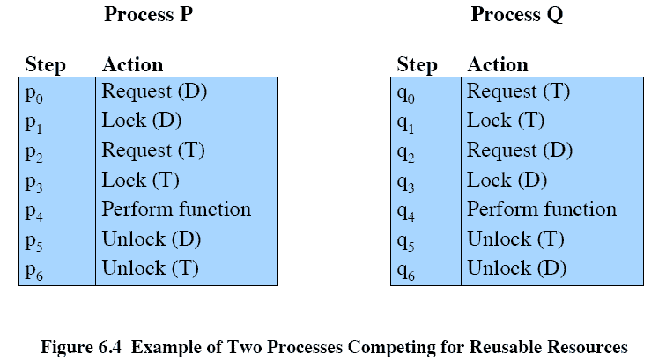
Reusable Resources:
Example of Deadlock
Consider two processes that compete for exclusive access to a disk file D and a tape drive T.
Deadlock occurs if each process holds one resource and requests the other, e.g., execution of p₀ p₁ q₀ q₁ p₂ q₂.

Slide 8
Example 2:
Memory Request
Space is available for allocation of 200Kbytes, and the following sequence of events occur.
Deadlock occurs if both processes progress to their second request.
P1
P2
. . .
. . .
Request 80 Kbytes;
Request 70 Kbytes;
. . .
. . .
Request 60 Kbytes;
Request 80 Kbytes;

Slide 9
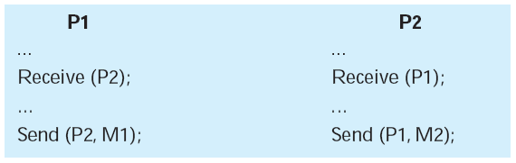
  Consumable Resources:
  Example of Deadlock
Consider a pair of processes, in which each process attempts to receive a message from the other process and then send a message to the other process.
Deadlock occurs if the Receive is blocking (i.e., the receiving process is blocked until the message is received).
Such design errors are often embedded in complex program logic, making it difficult to detect.

Slide 10
Conditions for possible Deadlock
Mutual exclusion
  Only one process may use a resource at a time.
  No process may access a resource unit that has been allocated to another process
Hold-and-wait
  A process may hold allocated resources while awaiting assignment of others.
No pre-emption
  No resource can be forcibly removed from a process holding it.
These three conditions are necessary but not sufficient for a deadlock to exist.

Slide 11
Actual Deadlock
Requires …
Given that the first 3 conditions exist, a sequence of events may occur that lead to the following fourth condition:
Circular wait
  A closed chain of processes exists, such that each process holds at least one resource needed by the next process in the chain.
  It is in fact the definition of deadlock.
  These four conditions, taken together, constitute necessary and sufficient conditions for deadlock.

Slide 12
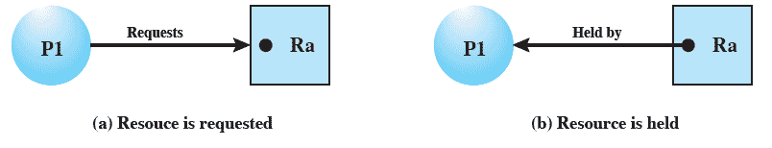
Resource Allocation
Graphs
A useful tool that characterizes the allocation of resources to processes.
Directed graph that depicts a state of the system of resources and processes.
An instance of a resource

Slide 13
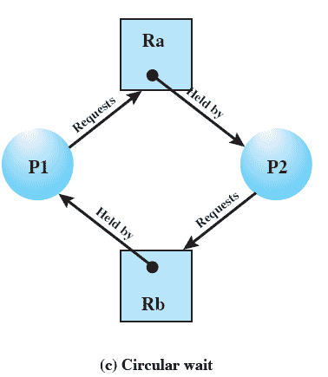
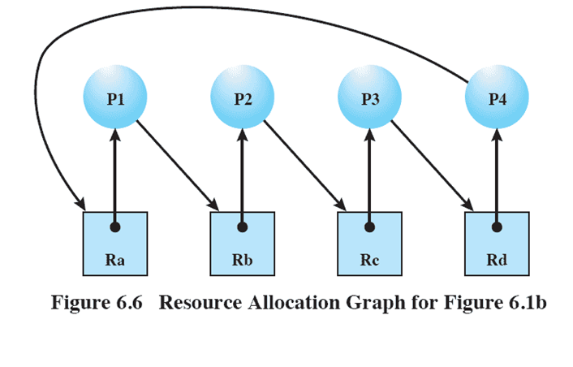
Resource Allocation Graphs
(with deadlock)
(the traffic deadlock shown in slide 5)

Slide 14
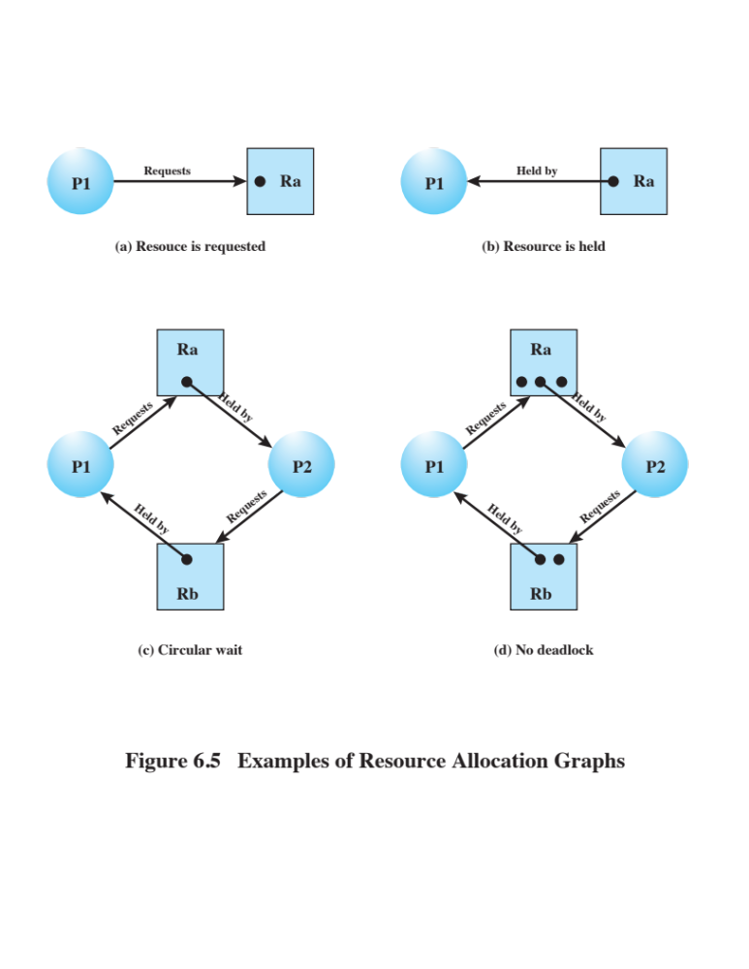
Resource Allocation Graph
(no deadlock)
There is no deadlock because multiple instances of each resource type are available.
If graph contains no cycles ⇒ no deadlock.
If graph contains a cycle ⇒
  if only one instance per resource type, then deadlock.
  if several instances per resource type, then deadlock MAY exist.

Slide 15
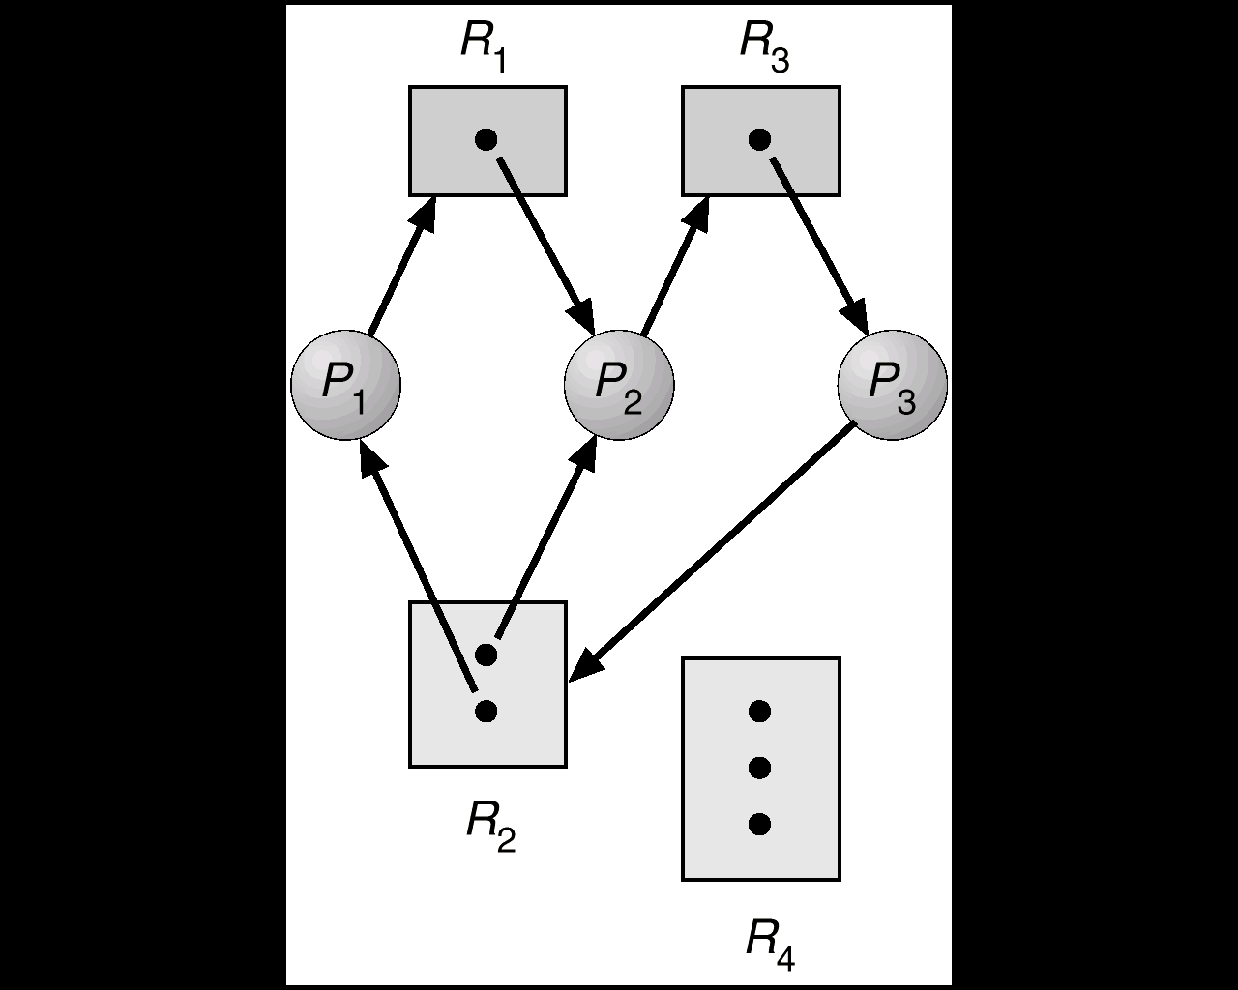
How to find out whether there is a deadlock?
Find a process that can have all its current requests satisfied
  The “available amount” of any resource it wants is enough to satisfy the request.
Erase that process
  Grant the request, let it run, and eventually it will release the resource.
Continue until we either erase the graph or have an irreducible component. In the latter case, we’ve identified a deadlock.
Example:
No such a process can be found to reduce the graph. Deadlock exists.

Slide 16
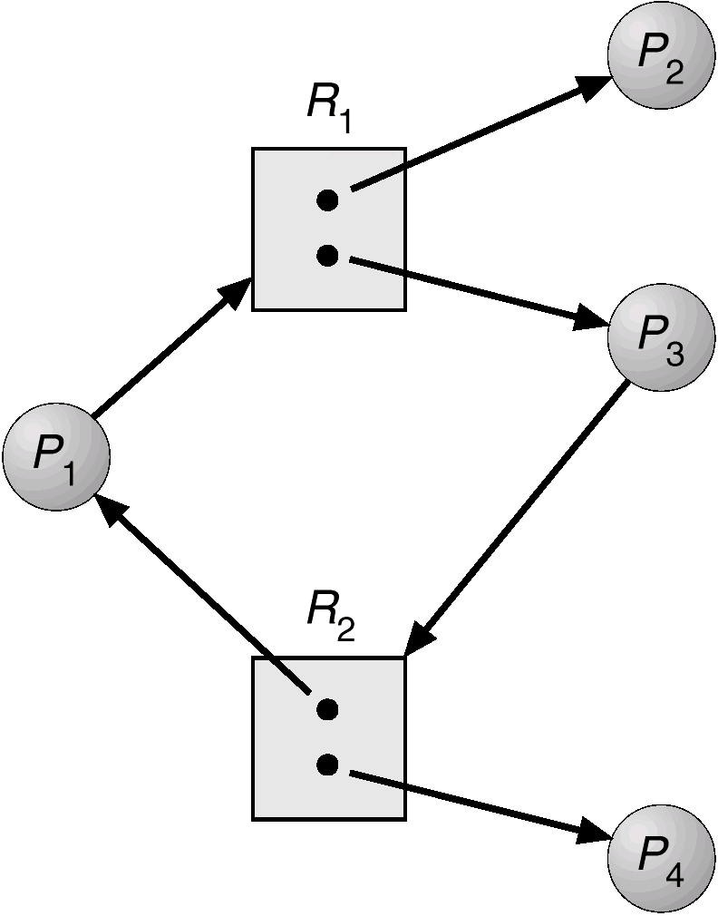
Reduce the
Resource Allocation Graph
Another example:
This graph can be fully reduced. Thus, there is no deadlock.

Slide 17
Dealing with Deadlock
Three common approaches dealing with deadlock.
  Deadlock prevention
    Disallow one of the three necessary conditions for deadlock occurrence, or prevent circular wait condition from happening
  Deadlock avoidance
    Do not grant a resource request if this allocation might lead to deadlock
  Deadlock detection
    Grant resource requests when possible, but periodically check for the presence of deadlock and take action to recover

Slide 18
Roadmap
Principles of Deadlock
Deadlock Prevention
Deadlock Avoidance
Deadlock Detection
Dining Philosophers Problem

Slide 19
Deadlock Prevention
Strategy
Design a system in such a way that the possibility of deadlock is excluded.
Two main methods
  Indirect
    prevent the occurrence of one of the three necessary conditions
  Direct
    prevent the occurrence of a circular wait

Slide 20
Deadlock Prevention
Conditions 1 & 2
Mutual Exclusion
  If access to a resource requires mutual exclusion, then it must be supported by the OS
Hold and Wait
  Require a process request all of its required resources at one time and OS will block the process until all requests can be granted simultaneously
   Inefficient and may be impractical

Slide 21
Deadlock Prevention
Conditions 3
No Preemption
  If a process holding certain resources is denied a further request, that process must release its original resources and request them again
  If a process requests a resource that is currently held by another process, the OS may preempt the second process and require it to release its resources.
  Practical only for resources whose state can be easily saved and restored later, e.g., processor

Slide 22
Deadlock Prevention
Condition 4
Circular Wait
  Define a linear ordering of resource types
    If a process has been allocated resources of type R, then it may subsequently request only those resources of types following R in the ordering
   Inefficient, slowing down processes and denying resource access unnecessarily

Slide 23
Roadmap
Principles of Deadlock
Deadlock Prevention
Deadlock Avoidance
Deadlock Detection
Dining Philosophers Problem

Slide 24
Deadlock Avoidance
A decision is made dynamically whether the current resource allocation request will, if granted, potentially lead to a deadlock
 Allows more concurrency than prevention
 Requires knowledge of future process requests

Slide 25
Two Approaches to
Deadlock Avoidance
Process Initiation Denial
  Do not start a process if its demands might lead to deadlock
Resource Allocation Denial
  Do not grant an incremental resource request to a process if this allocation might lead to deadlock

Slide 26
Process
Initiation Denial
A process is only started if the maximum claim (maximum requirement for each resource) of all current processes plus those of the new process can be met by the total amount of resources in the system.
 Not optimal
  Assumes the worst case that all processes will make their maximum claims together.

Slide 27
Resource
Allocation Denial
Referred to as the banker’s algorithm
  A strategy of resource allocation denial
Consider a system with fixed number of resources
  State of the system is the current allocation of resources to processes
  Safe state is one in which there is at least one sequence of resource allocations to processes that does not result in deadlock, i.e., all processes can be run to completion.
  Unsafe state is a state that is not safe

Slide 28
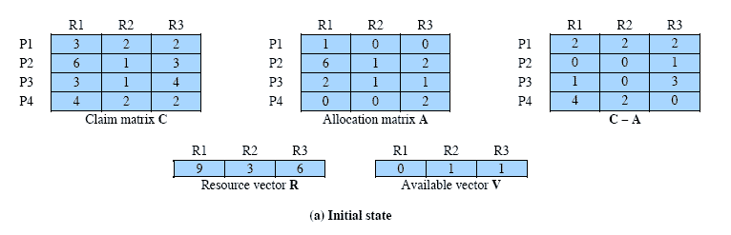
Determination of
Safe State
A system consisting of four processes and three resources.
Is this a safe state?
current allocation to process i of resource j
requirement of process i for resource j
amount of each resource available for allocation
total amount of each resource

Slide 29
Process i
A process i can run to completion if it meets the following condition:
  C_{ij} - A_{ij} ≤ V_{j}, for all j
This is not possible for P1,
  which has only 1 unit of R1 and requires 2 more units of R1, 2 units of R2, and 2 units of R3.
If we assign one unit of R3 to process P2,
  Then P2 has its maximum required resources allocated and can run to completion and return resources to ‘available’ pool

Slide 30
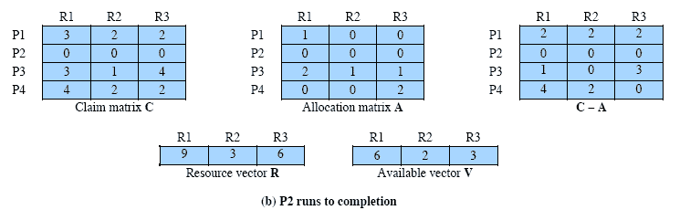
After P2 runs to completion
Can any of the remaining processes be completed?
P2 is completed already

Slide 31
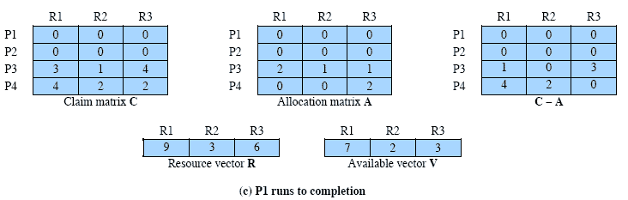
After P1 completes

Slide 32
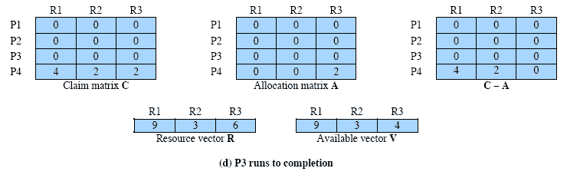
P3 Completes
Thus, the initial state is a safe state.

Slide 33
Determination of
Granting a Request
When a process makes a request for a set of resources,
  assume that the request is granted,
  update the system state accordingly
Then determine if the result is a safe state
  If so, grant the request and,
  if not, block the process until it is safe to grant the request.

Slide 34
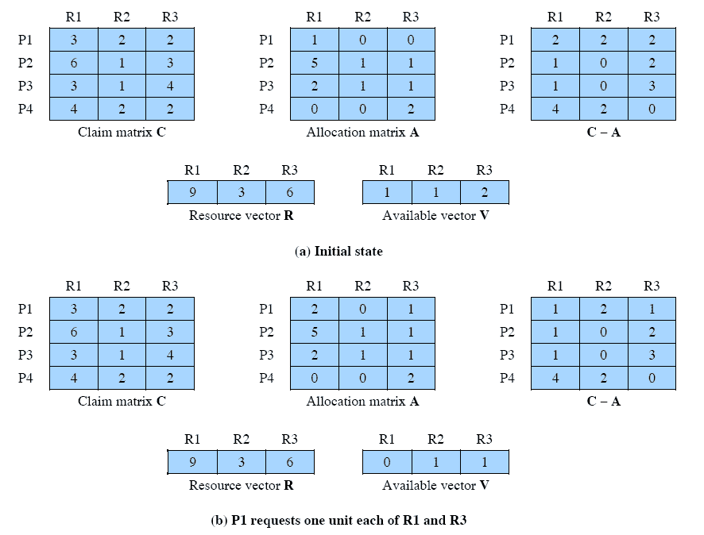
Determination of
Granting a Request
Suppose that P2 requests one additional unit each of R1 and R3. Is it safe to grant this request?

Slide 35
Determination of
Granting a Request
This time, suppose that P1 requests one additional unit each of R1 and R3. Is it safe to grant this request?

Slide 36
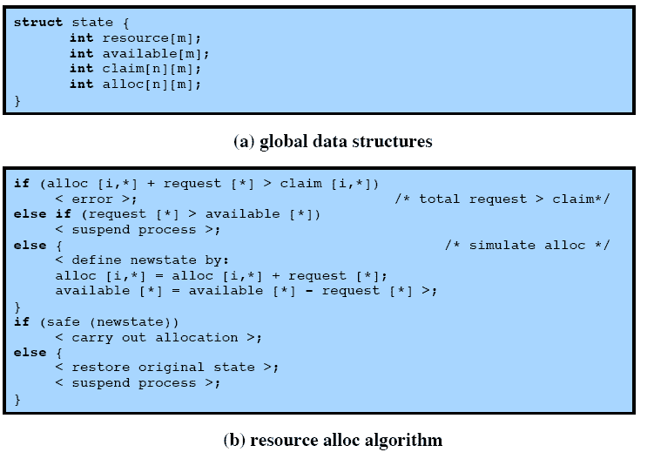
Deadlock Avoidance
Logic
n processes and m different types of resources
request[*] is a vector defining the resources requested by process i

Slide 37
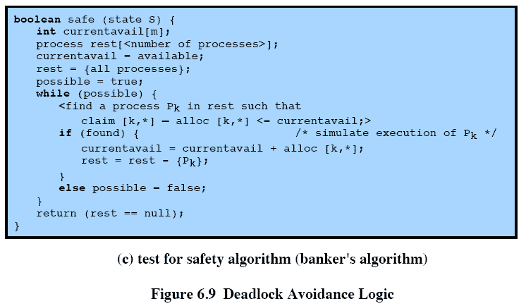
Deadlock Avoidance
Logic
The process can run to completion
The process returns resources upon completion

Slide 38
Deadlock Avoidance Advantages
 It is less restrictive than deadlock prevention.
 It is not necessary to preempt and rollback processes, as in deadlock detection (to be discussed)

Slide 39
Deadlock Avoidance Restrictions
 Maximum resource requirement for each process must be stated in advance
 Processes under consideration must be independent and with no synchronization requirements
 There must be a fixed number of resources to allocate
 No process may exit while holding resources

Slide 40
Roadmap
Principles of Deadlock
Deadlock Prevention
Deadlock Avoidance
Deadlock Detection
Dining Philosophers Problem

Slide 41
Deadlock Detection
Deadlock prevention strategies are very conservative
  limit access to resources and impose restrictions on processes.
Deadlock detection strategies do the opposite
  Resource requests are granted whenever possible.
  Regularly check for deadlock.

Slide 42
A Common
Detection Algorithm
Main idea:
  Find and mark a process whose resource requests can be satisfied with the available resources
  Assume that those resources are granted and that the process runs to completion and releases all its resources
  Look for another process to satisfy
  A deadlock exists if and only if there are unmarked processes at the end

Slide 43
A Common
Detection Algorithm
Use a Allocation matrix and Available vector as in the Banker’s algorithm
Also use a Request matrix Q
  Where Q_{ij} indicates that an amount of resource j is requested by process i
First, ‘un-mark’ all processes.

Slide 44
Detection Algorithm
1. Mark each process that has a row in the Allocation matrix of all zeros.
2. Initialize a temporary vector W to equal the Available vector.
3. Find an index i such that process i is currently unmarked and the i th row of Q is less than or equal to W.
  i.e. Q_{ik} ≤ W_{k} for 1 ≤ k ≤ m for m different types of resources
  If no such row is found, terminate

Slide 45
Detection Algorithm cont.
4. If such a row is found,
  mark process i and add the corresponding row of the allocation matrix to W.
  i.e. set W_{k} = W_{k} + A_{ik}, for 1 ≤ k ≤ m;
  Return to step 3.
A deadlock exists if and only if there are unmarked processes at the end
Each unmarked process is deadlocked.

Slide 46
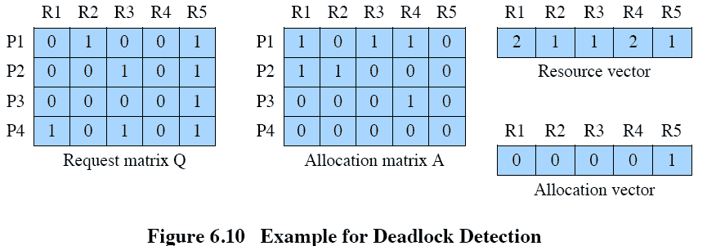

Detection Algorithm
Example
✓
✓
W = (0 0 0 0 1)
W = W + (0 0 0 1 0) = (0 0 0 1 1)
P1 and P2 are deadlocked

Slide 47
Deadlock Detection
A check for deadlock can be made
  as frequently as each resource request,
     It leads to early detection.
     The algorithm is relatively simple.
     Frequent checks consume considerable processor time.
  or, less frequently, depending on how likely it is for a deadlock to occur.

Slide 48
Recovery Strategies
Once Deadlock Detected
Abort all deadlocked processes
Back up (rollback) each deadlocked process to some previously defined checkpoint, and restart all processes
  Risk of deadlock recurring
Successively abort deadlocked processes until deadlock no longer exists
Successively preempt resources and rollback the preempted process until deadlock no longer exists

Slide 49
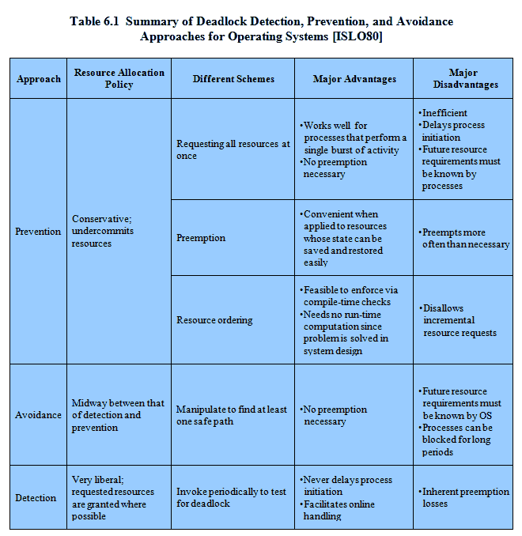
Advantages and Disadvantages

Slide 50
Roadmap
Principles of Deadlock
Deadlock Prevention
Deadlock Avoidance
Deadlock Detection
Dining Philosophers Problem

Slide 51
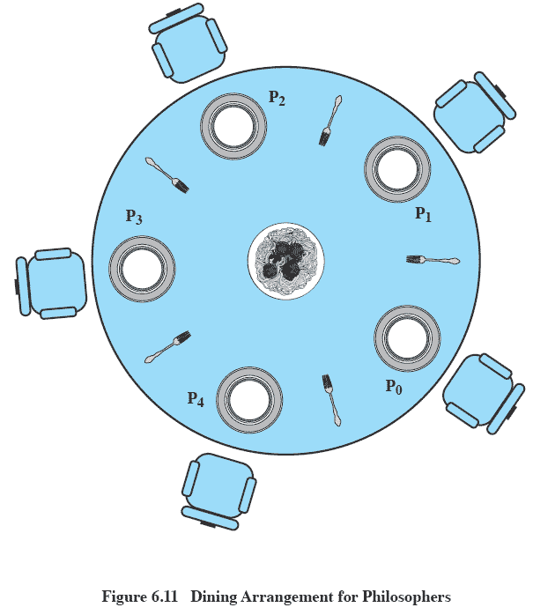
Dining Philosophers
Problem: Scenario
The life of a philosopher consists of thinking and eating spaghetti.
A philosopher requires two forks to eat spaghetti.
A philosopher wishing to eat goes to his assigned place and uses the two forks on either side of the plate to eat some spaghetti.

Slide 52
The Problem
Devise a ritual (algorithm) that will allow the philosophers to eat.
  No two philosophers can use the same fork at the same time (mutual exclusion)
  No philosopher must starve to death (avoid deadlock and starvation … literally!)
This is a representative problem to illustrate basic problems in deadlock and starvation.

Slide 53
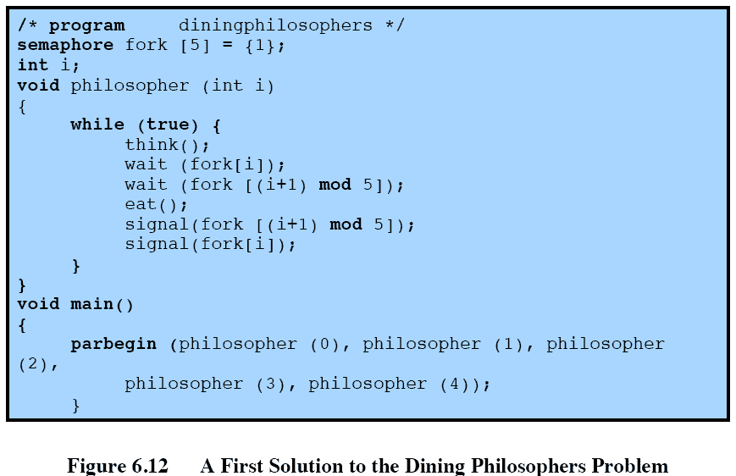
Solution Using Semaphores
Each philosopher picks up first the fork on the left and then the fork on the right.
What will happen if all of the philosophers are hungry at the same time?
After eating, the two forks are replaced on the table.

Slide 54
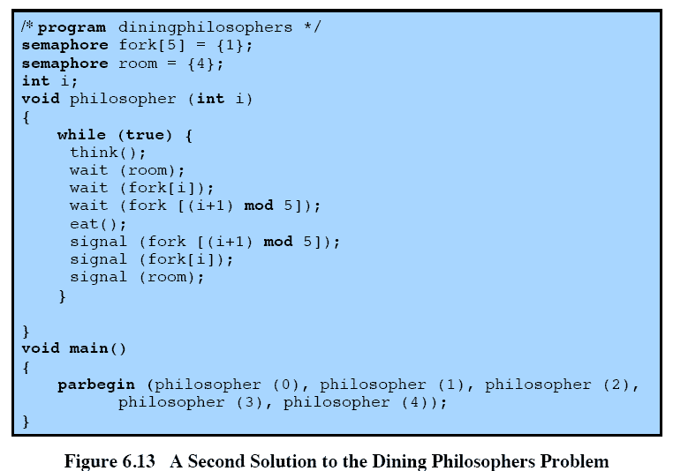
Avoiding Deadlock
An attendant only allows four philosophers at a time into the dining room.
This solution is free of deadlock and starvation.

