Slide 1
EE3114 Systems and Control
3. Dynamic Response
Semester B, 2018-19
2018-9-19

Slide 2
Framework of Lectures
System
Time Domain Frequency Domain
→ Laplace Transform →
State-Space Formulation Frequency Analysis
(dynamic responses, transients,
steady-states, root-locus,
PID controllers)
← mixed →
(State-feedback,
Controllability, controller
Observability, observer
Optimal control)
Today:
Dynamic responses

Slide 3
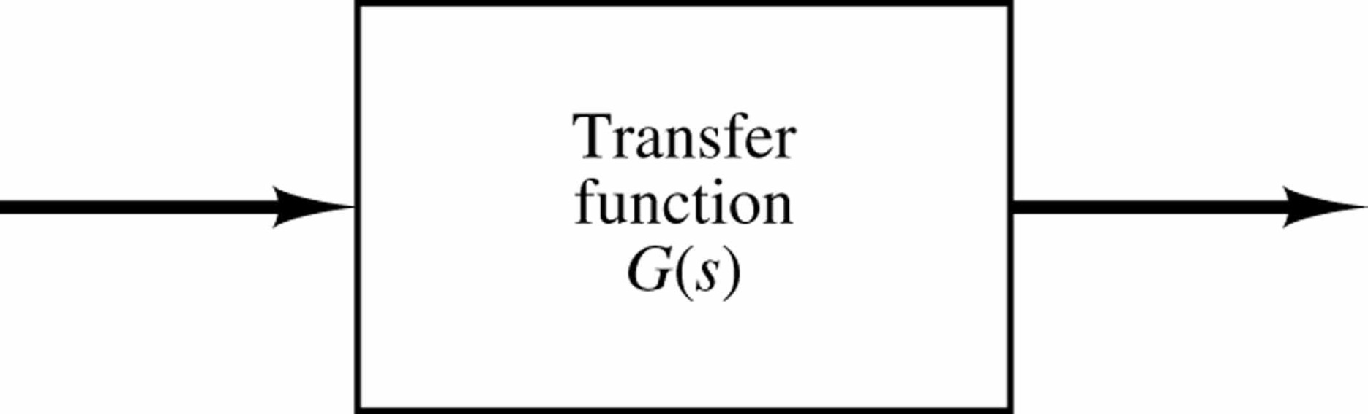
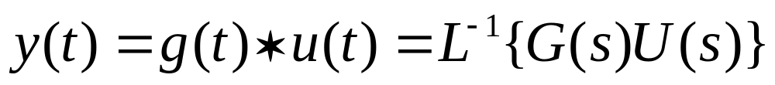

Given Transfer Function G(s) and Input U(s):
Y(s) = G(s)U(s)
Output obtained by Inverse Laplace Transform:
U(s)
Y(s)
G(s)
Convolution

Slide 4
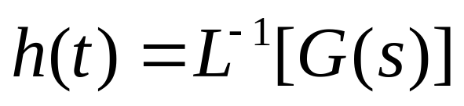
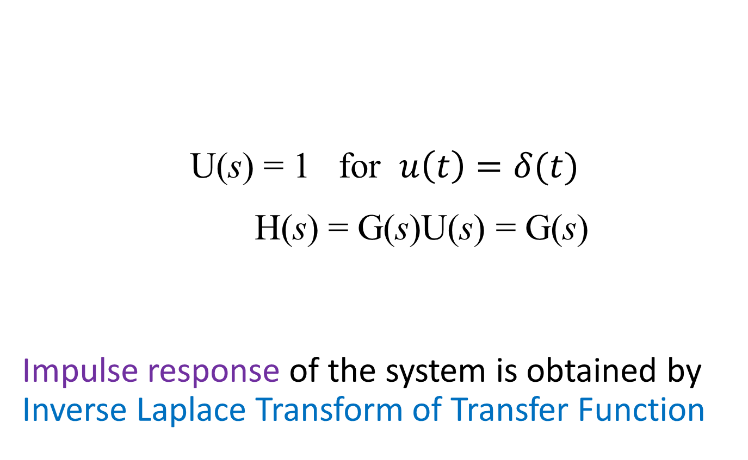
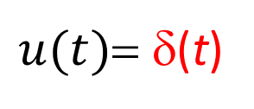
Impulse Response
U(s) = 1 for $u\left(t\right)=δ(t)$
H(s) = G(s)U(s) = G(s)
Impulse response of the system is obtained by Inverse Laplace Transform of Transfer Function
Impulse input
Impulse response
$u(t)$= δ(t)
h(t)=?
G(s)

Slide 5
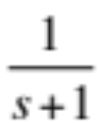
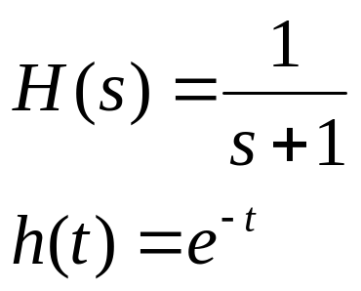
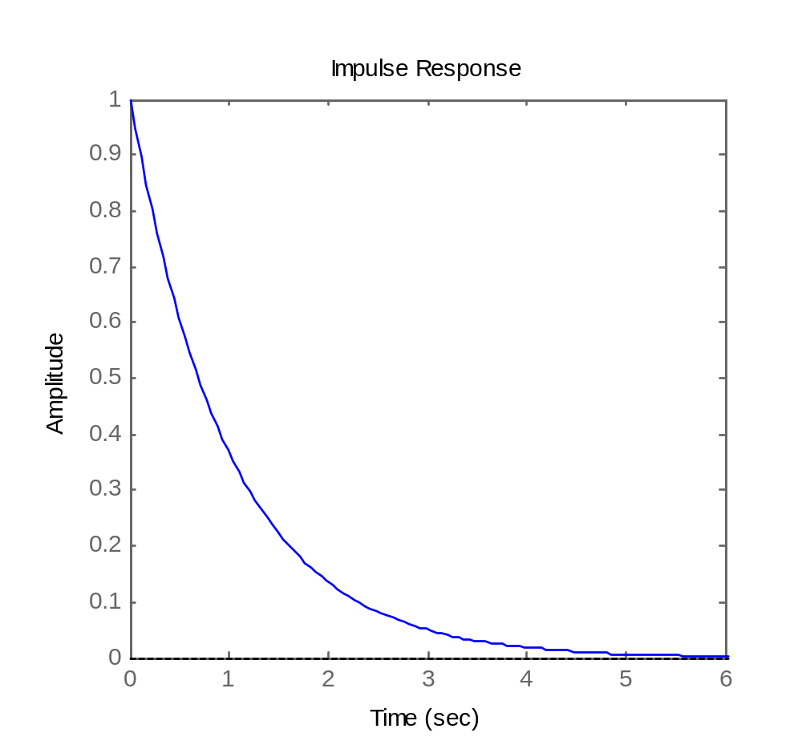

Example:
δ(t)
h(t)=?
Inverse Laplace Transform of H(s)
→
%MatLab code
Hs = tf(1,[1 1]);
impulse(Hs);

Slide 6
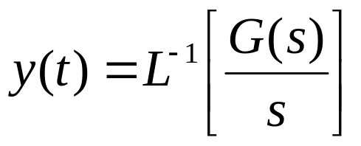
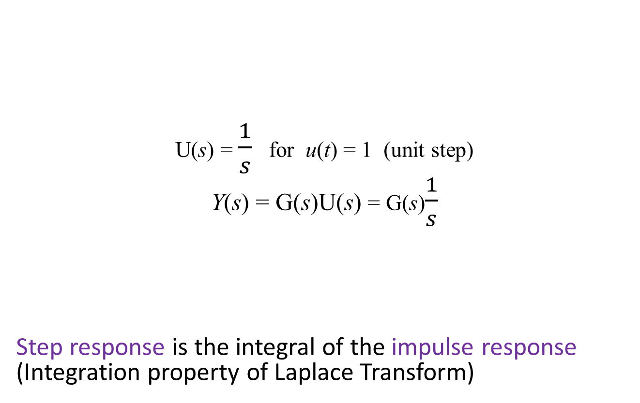
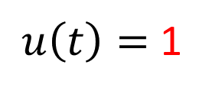
Step Response
Step input
Step response
U(s) = $\frac{1}{s}$ for u(t) = 1 (unit step)
Y(s) = G(s)U(s) = G(s)$\frac{1}{s}$
Step response is the integral of the impulse response (Integration property of Laplace Transform)
$u\left(t\right)=$ 1
y(t)=?
G(s)

Slide 7
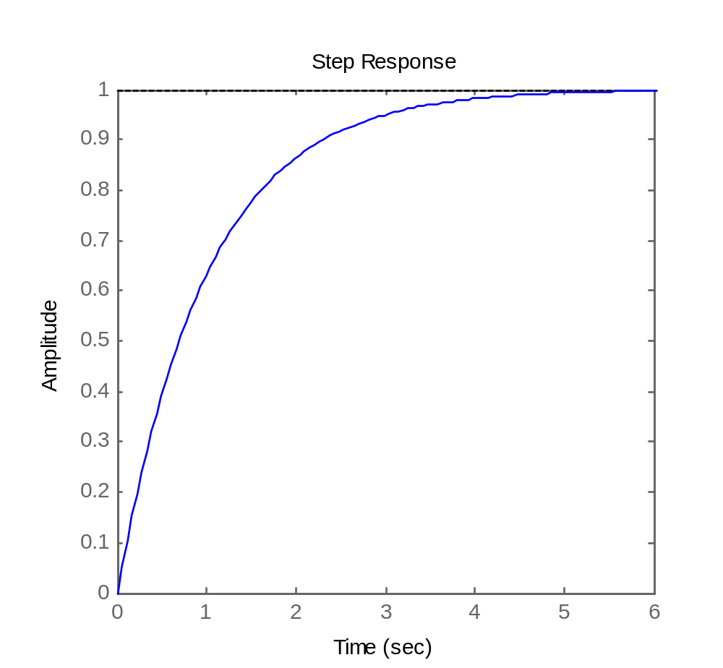
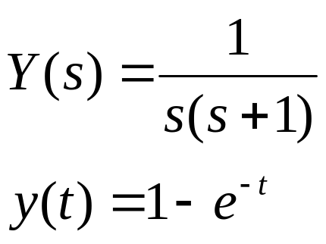
1
y(t)=?
Example
%MatLab code
Hs = tf(1,[1 1]);
step(Hs);
[y,t] = step(Hs,6); %Time [0,6]
plot (t, y);

Slide 8

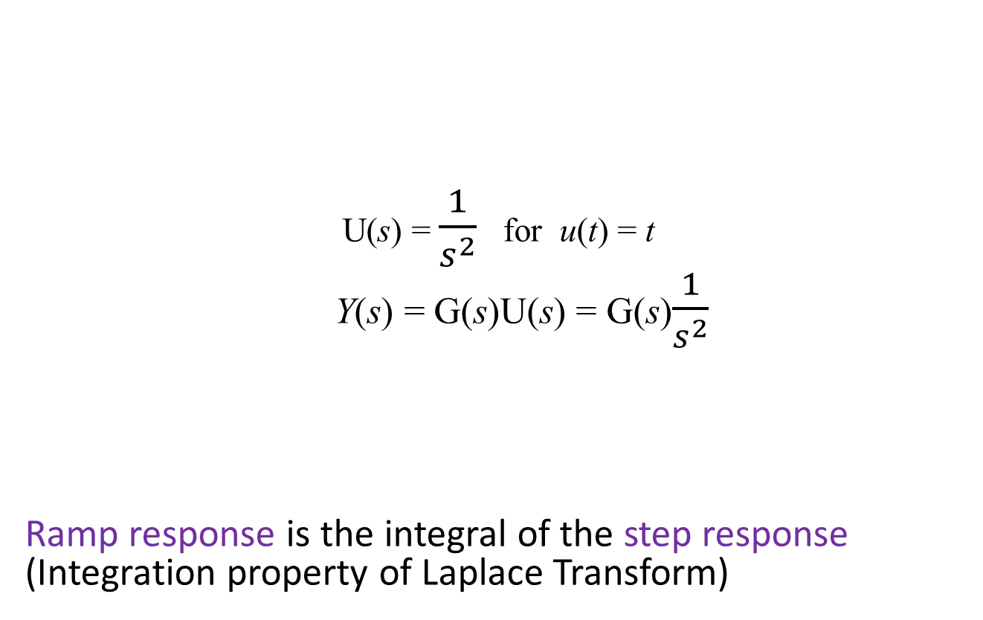
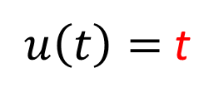
Ramp Response
Ramp input
Ramp response
U(s) = $\frac{1}{s^{2}}$ for u(t) = t
Y(s) = G(s)U(s) = G(s)$\frac{1}{s^{2}}$
Ramp response is the integral of the step response (Integration property of Laplace Transform)
$u\left(t\right)=$t
y(t)=?
G(s)

Slide 9
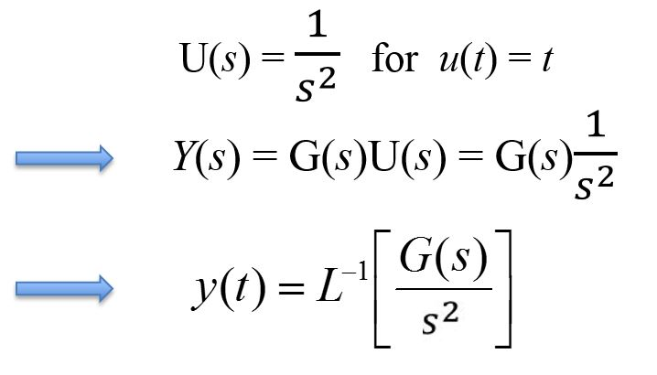
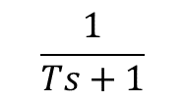

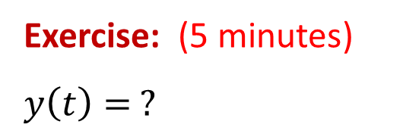
t
y(t)
Example:
$$\frac{1}{Ts+1}$$
(Constant $T>0)$
Exercise: (5 minutes)
$$y\left(t\right)= ?$$

Slide 10
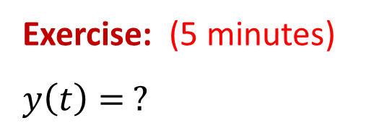
t
y(t)
Example:
$$\frac{1}{Ts+1}$$
(Constant $T>0)$
Exercise: (5 minutes)
$$y\left(t\right)= ?$$

Slide 11
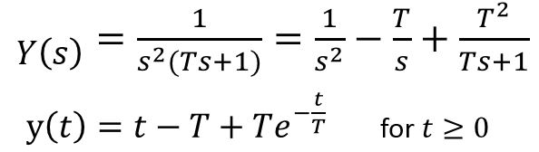
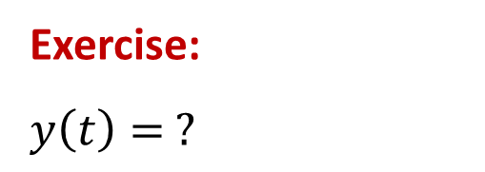
t
y(t)
Example:
$$\frac{1}{Ts+1}$$
(Constant $T>0)$
Exercise:
$$y\left(t\right)= ?$$
Answer:

Slide 12


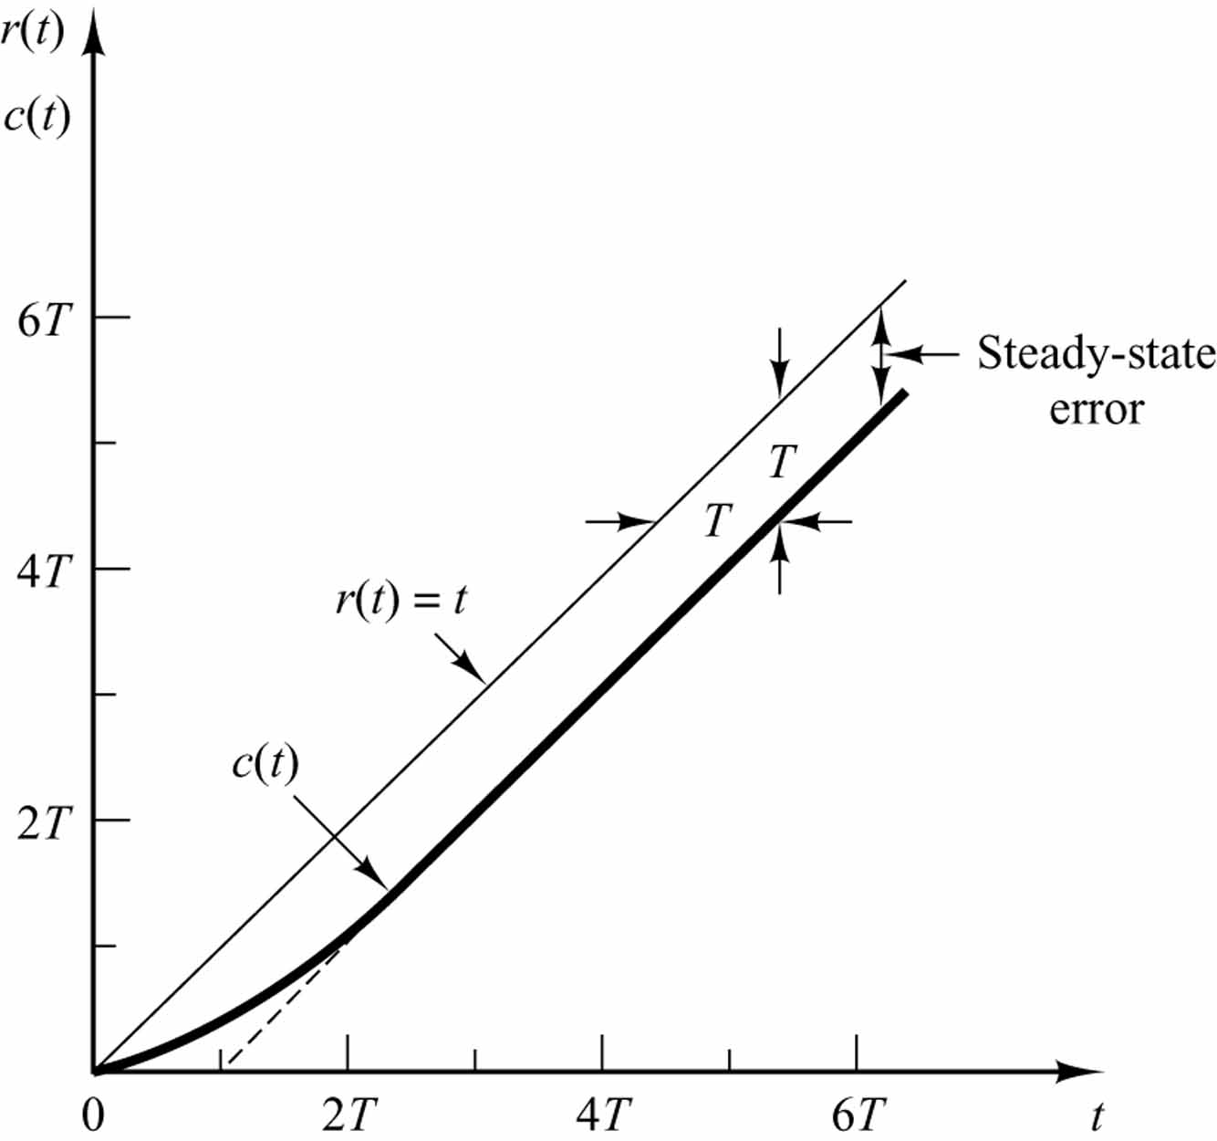


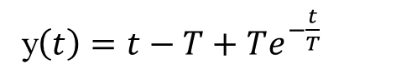
t
y(t)
$$\frac{1}{Ts+1}$$
u(t)
y(t)
$$\lim_{t→∞}{e\left(t\right)=t−y(t)=T}$$
$$T$$
%MatLab code
%lsim(num,den,u,t) %for any input u
num = [1];
den = [1 1 0 0]; %T=1
t = 0:0.01:3;
u = t;
y = lsim(num,den,u,t);
plot(t,u,'-',t,y,'.')
u(t)
y(t)
y$\left(t\right)=t−T+Te^{−\frac{t}{T}}$

Slide 13
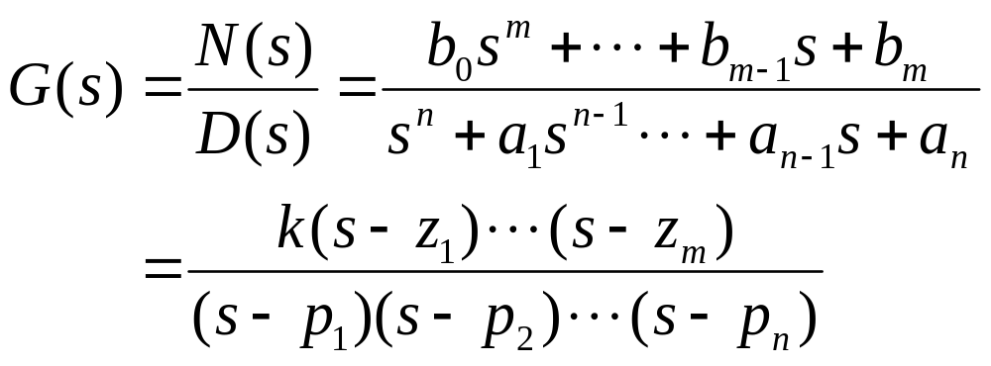
Poles and Zeros
Transfer Function
p_{i} are poles:
D(s) = 0 → G(s) → ∞
z_{i} are zeros:
N(s) = 0 → G(s) = 0

Slide 14
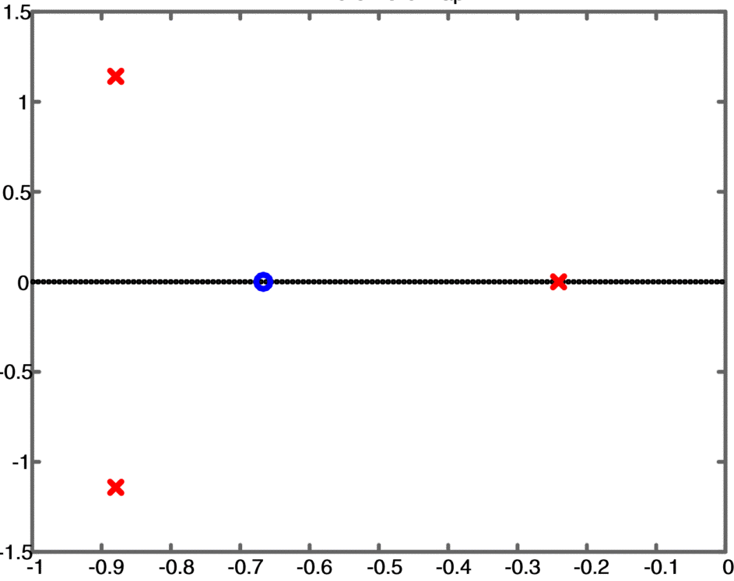
Pole-Zero Plot
System dynamics can be represented graphically by plotting the locations of poles and zeros on the complex s-plane
A zero location is marked by a circle (o)
A pole location is marked by a cross (x)
Im
Example:
Re

Slide 15

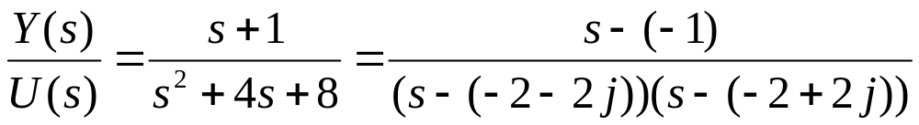
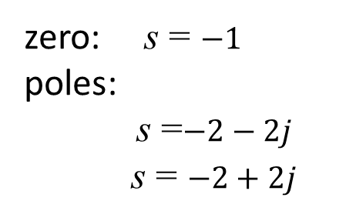
Example:
A linear system is described by the differential equation
Plot the system transfer function poles and zeros.
Solution:
System transfer function:
It has
zero: s = $−1$
poles:
s =$−2−2j$
s = $−2+2j$

Slide 16
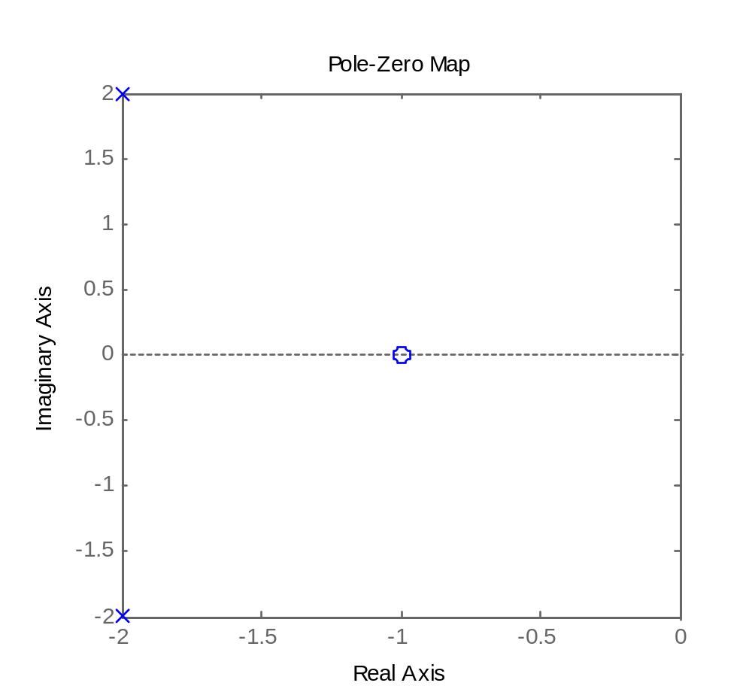
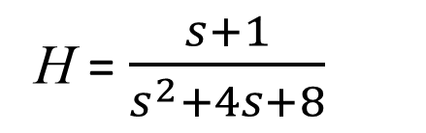
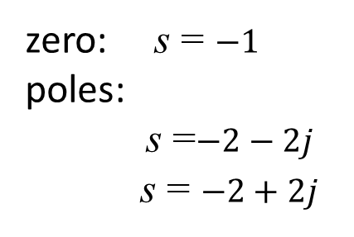
H = $\frac{s+1}{s^{2}+4s+8}$
zero: s = $−1$
poles:
s =$−2−2j$
s = $−2+2j$
%MatLab code
H = tf([1 1],[1 4 8]);
pzmap(H);

Slide 17
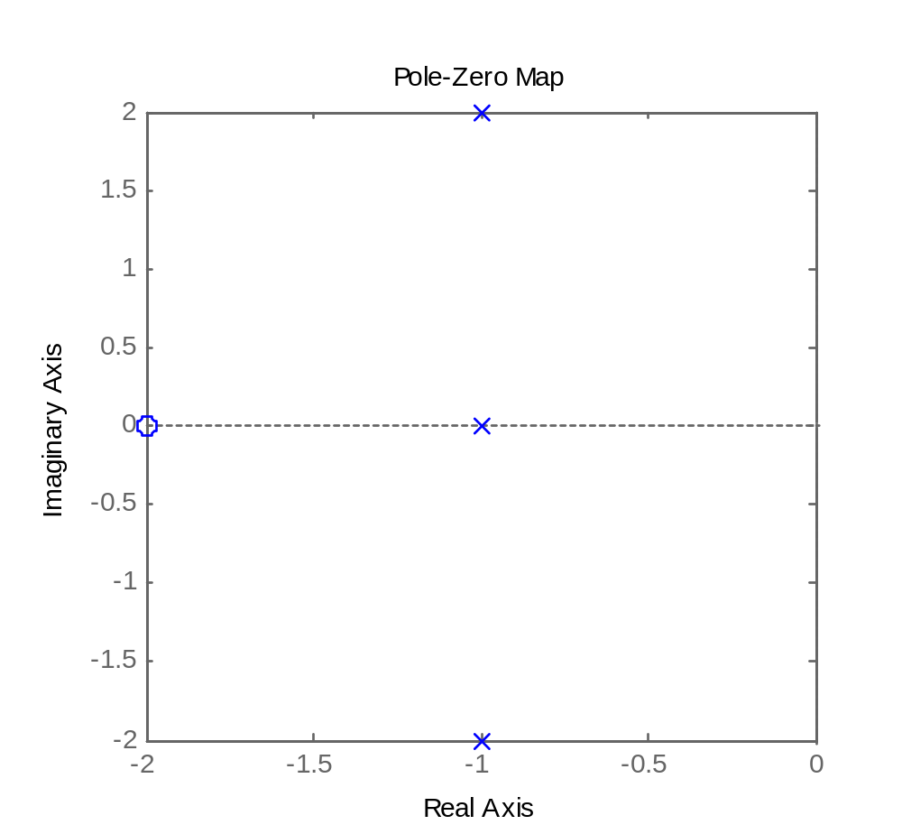
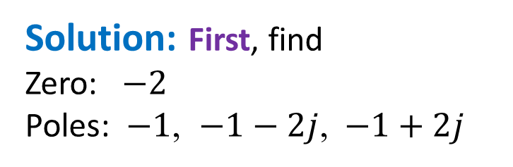
Inverse Problem
Example:
Given the pole-zero plot of a third-order system, with gain k
Find its differential equation
(0,0)
Solution: First, find
Zero: $−2$
Poles: $−1$, $−1−2j$, $−1+2j$
Notes:
H = zpk(-2,[-1 -1-2j -1+2j],1);pzmap(H);
tf(H)

Slide 18
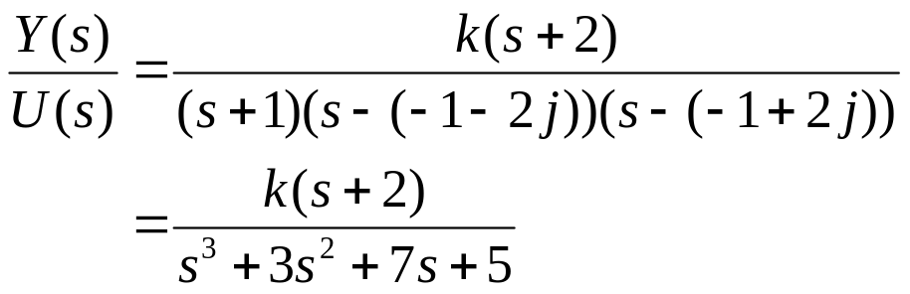
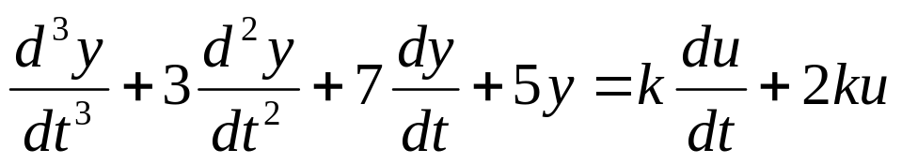
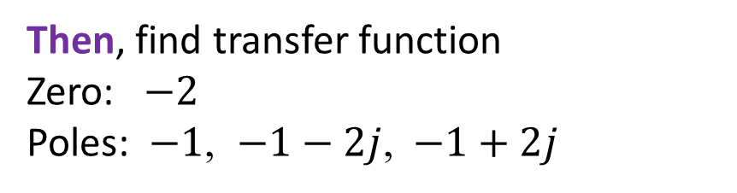
Then, find transfer function
Zero: $−2$
Poles: $−1$, $−1−2j$, $−1+2j$
%MatLab code
H = zpk(-2,[-1 -1-2j -1+2j],1);
tf(H)
s + 2
--------------------------
s^3 + 3 s^2 + 7 s + 5
OR
→
Finally, Inverse Laplace Transform →

Slide 19
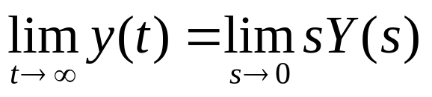
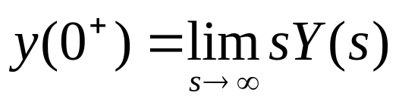
Recall:
Final Value Theorem
If all poles of sY(s) are on LHP, then
Note: “on LHP” does not include the boundary
Initial Value Theorem
For any Laplace Transform pair (y, Y):

Slide 20
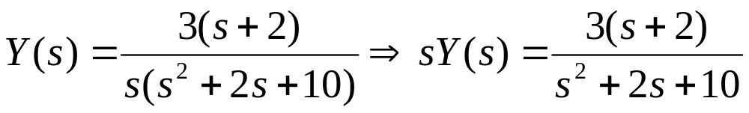
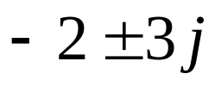
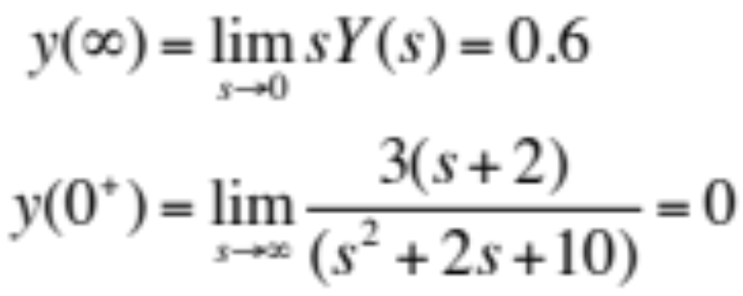
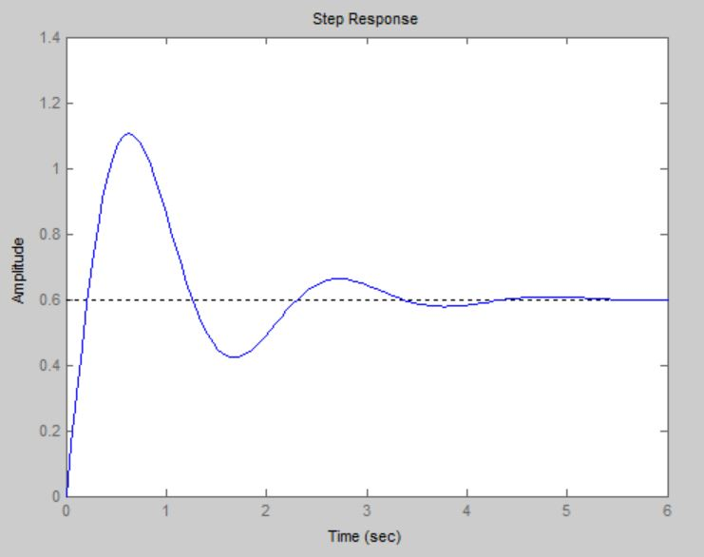
Example:
Poles of sY(s) are , which are on LHP, so
%MatLab code
num=[3 6];
den=[1 2 10 0];
Ys = tf(num,den);
impulse(Ys)
6/10 = 0.6
% OR
num=[3 6];
den=[1 2 10];
Ys = tf(num,den);
step(Ys)

Slide 21
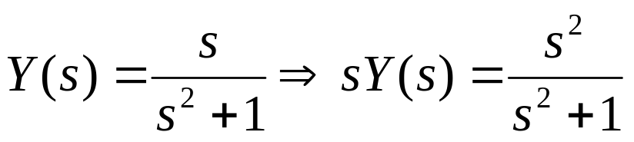
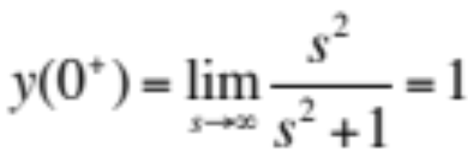
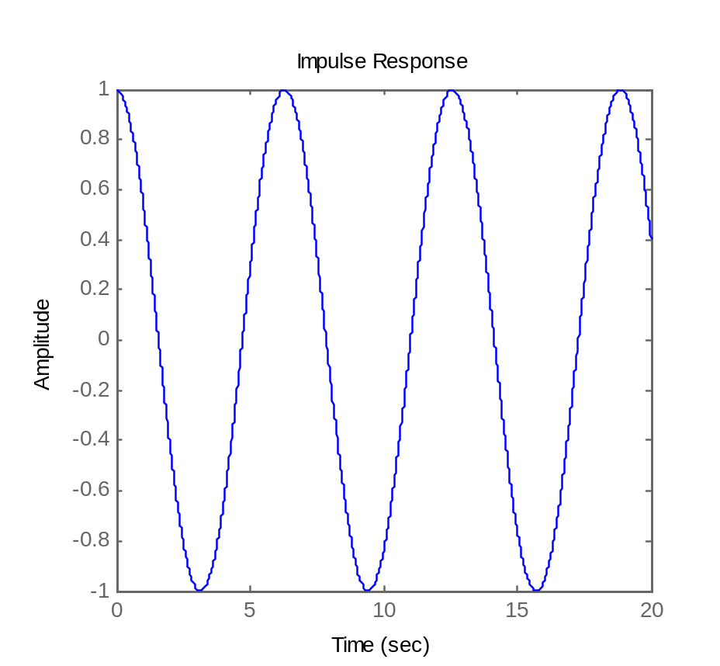

Example:
Poles of sY(s) are ± j , which are not on LHP.
So, the final value theorem is not applicable.
But, there is no condition for initial value theorem.
%MatLab code
num = [1 0];
den = [1 0 1];
Ys = tf(num,den)
impulse(Ys, 0:0.01:20);

Slide 22
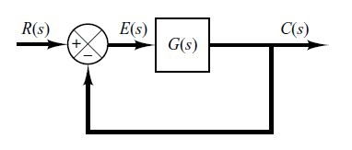
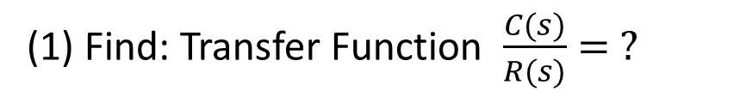
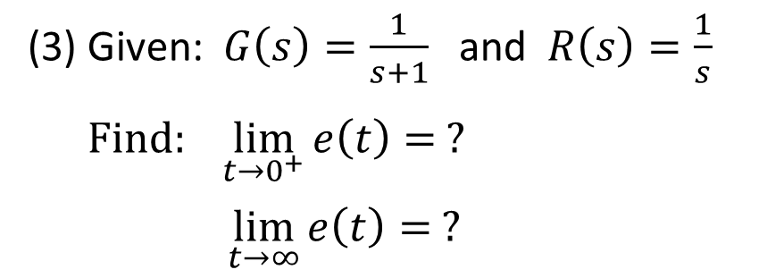
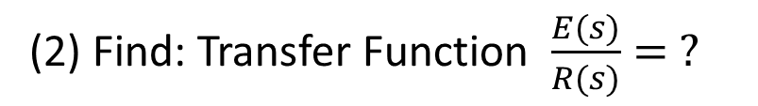
Exercise: (10 minutes)
(1) Find: Transfer Function $\frac{C(s)}{R(s)}= ?$
(2) Find: Transfer Function $\frac{E(s)}{R(s)}= ?$
(3) Given: $G\left(s\right)=\frac{1}{s+1}$ and $R\left(s\right)=\frac{1}{s}$
$Find: \lim_{t→0^{+}}{e\left(t\right)= ?}$
$\lim_{t→∞}{e\left(t\right)= ?}$

Slide 23
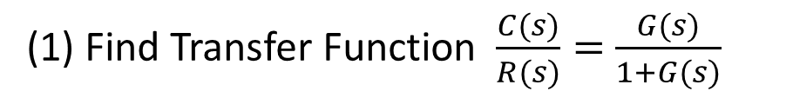
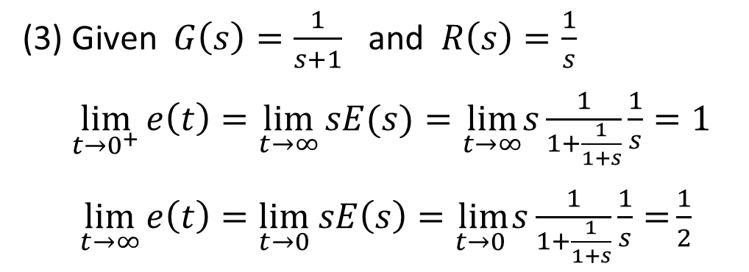

Answer:
(1) Find Transfer Function $\frac{C(s)}{R(s)}=$ $\frac{G(s)}{1+G(s)}$
(2) Find Transfer Function $\frac{E(s)}{R(s)}= \frac{1}{1+G(s)}$
(3) Given $G\left(s\right)=\frac{1}{s+1}$ and $R\left(s\right)=\frac{1}{s}$
$\lim_{t→0^{+}}{e\left(t\right)=\lim_{t→∞}{sE(s)}=\lim_{t→∞}s\frac{1}{1+\frac{1}{1+s}}\frac{1}{s}=1}$
$\lim_{t→∞}{e\left(t\right)=\lim_{t→0} sE\left(s\right)=\lim_{t→0 }s\frac{1}{1+\frac{1}{1+s}}\frac{1}{s}=}\frac{1}{2}$

Slide 24








Complex Conjugate Poles
Closed-loop Transfer Function:
Recall:
$$=\frac{ω_{n}^{2}}{(s−p)(s−p^{∗})}$$

Slide 25



Physical Meaning of Complex Conjugate Poles
ζ – Damping Ratio
If ζ < 1 then ω_{n} > σ (under damped)
If ζ = 1 then ω_{n} = σ (un-damped) [Also called Critically damped]
If ζ > 1 then ω_{n} < σ (over damped)
[see next page for details]

Slide 26

More precisely:
(or, critically damped)

Slide 27

Performances of Different Damping Ratios
Under damped
Un- damped
Over damped

Slide 28







What will happen as $ζ→0 ?$
$$(0<ζ<1)$$
$$y\left(t\right)=$$
$$( ζ=0)$$
$$={ ω}_{n}\sin{{(ω}_{n}t) }$$

Slide 29




Effects of Poles on System Response
Example: Oscillatory Time Response
Show the relation between the poles of
and the Impulse Response of the system, and find the exact Impulse Response
Solution:
The poles of the transfer function: $p,p^{∗}=−1±2j$
Recall:
→
→
$$σ=1, { ω}_{d}=2$$
$ζ=\frac{1}{\sqrt{5}}=0.447<1$ (under damped) and $ω_{n}=\sqrt{5}=2.24 rad/s$

Slide 30




Input: $u\left(t\right)=δ(t)$
Impulse Response: $h\left(t\right)=2e^{−t}\cos\left(2t\right)−\frac{1}{2}e^{−t}\sin\left(2t\right)$
Plot shows:
How the sinusoidal terms behave
How the envelope attenuates the sinusoidal terms

Slide 31

Effects of Poles on System Response
Example: Oscillatory Time Response
Show the relation between the poles of
and the Step Response of the system, and find the exact Step Response
Solution:
The poles of the transfer function: $p,p^{∗}=−1±2j$
Recall:
→
→
$$σ=1, { ω}_{d}=2$$
$ζ=\frac{1}{\sqrt{5}}=0.447<1$ (under damped) and $ω_{n}=\sqrt{5}=2.24 rad/s$

Slide 32







Input: $u\left(t\right)=1(t)$
Step Response:
$$y\left(t\right)=$$
$ζ=\frac{1}{\sqrt{5}}=0.447$ and $ω_{n}=\sqrt{5}=2.24$
$$y\left(t\right)=\frac{5}{2}e^{−t}sin⁡(2t)$$
Damped Sinewave

Slide 33



Pole Location and System Response
$$\cos{ω_{d}t }$$

Slide 34

Effects of Zeros on System Responses
Example:
$H_{1}\left(s\right)=\frac{2}{(s+1)(s+2)}=\frac{2}{s+1}−\frac{2}{s+2}$ → $h\left(t\right)=2e^{−t}−2e^{−2t}$
$H_{2}\left(s\right)=\frac{2(s+1.1)}{1.1(s+1)(s+2)}=\frac{0.18}{s+1}+\frac{1.64}{s+2}$ → $h\left(t\right)=0.18e^{−t}+1.64e^{−2t}$
Both have the same poles and same DC gain (Direct Current)
(DC gain := ratio of the magnitude of the steady-state step
response to the magnitude of the step input
= transfer function value at s = 0)
A zero $s=−1.1$ near a pole $p=−1.0$significantly reduces the coefficient (magnitude), from 2 to 0.18
→
A zero near a pole reduces the effect of the pole on response

Slide 35





Plots of the step response with zero $−$ασ (ζ = 0.5)
Example:
A second-order system with zero s = $−$αζω_{n} = $−$ασ
$$H\left(s\right)=\frac{s+αζω_{n}}{s^{2}+2ζω_{n}s+ω_{n}^{2}}$$
If α > 0 → a zero on LHP →
If α ≅ 1
→ value of zero is close to
real part of the poles
→ substantial influence on step response
If α is large
→ zero is far from poles → zero has only a little
effect on the response
(α > 0)

Slide 36

If α < 0 → a zero on RHP: non-minimum-phase system
Step Response
Overshoot is reduced
An LTI system is said to be minimum-phase
if the system and its inverse are causal and stable

Slide 37




Effect of Zeros on Transient Response
Example:
A second-order system with a finite zero and a unit DC gain:
Determine the effect of the zero location ($s=−z$) on the unit step response when z = {1, 2, 3, 6}
Solution:
Step Response:

Slide 38


Effect of Zero on Transient Responses
Recall: zero is given by $s=−z$
poles are: $p_{1}=−4, { p}_{2}=−6$
Real zero on LHP moving towards imaginary axis will increase overshoot

Slide 39


Effect of Complex Zeros on Transient Responses
Example:
Consider a third-order feedback system with the transfer function having a pair of lightly-damped poles and a pair of complex zeros:
Determine the effect of the complex zero location on the unit step response of the system, when
(α,β) = (0.5, 1)
(α,β) = (0.25, 1)
(α,β) = (0.1, 1)
$β=1$ is fixed
$α=0.5, 0.25, 0.1$
→ Complex conjugate zeros moves to the right

Slide 40


Effect of Complex Zeros on Transient Responses
Reducing
Moving

Slide 41





Effect of Real Poles on Transient Responses
Example:
Real pole:
Step response of the system (ζ = 0.5)
Smaller
(Pole still on LHP) increases rise time
(Takes longer time to reach value 1.0)
$H\left(s\right)=\frac{1}{(s+αζω_{n})[s^{2}+2ζω_{n}s+ω_{n}^{2}]}$
$$−αζω_{n}$$
$$α>0$$

Slide 42
Summary
Effects of Poles/Zeros on System Responses
Locations of poles in the s-plane determine the characteristics of the system responses
A real zero on LHP, moving toward imaginary axis, will increase the overshoot
A pair of complex conjugate zeros on LHP, moving toward imaginary axis, will decrease the overshoot
A real pole on LHP, moving toward imaginary axis, will increase the rise time

Slide 43
END

