Slide 1
EE2004
Timer

Slide 2
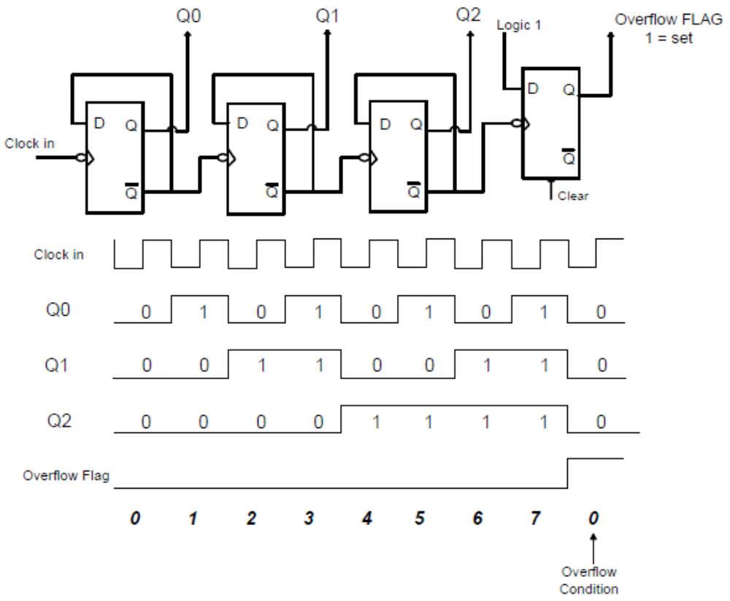
Basic Timer
A Timer/Counter can be configured in various modes, typically based on 8-bit or 16-bit operation. It is used to counter the number of input pulse.

Slide 3
Introduction
Timer
Set the initial value of registers (by software)
Start the timer (by software) and then the timer counts up.
Input from internal system clock (machine cycle)
When the timer : FFFF --> 0, the time sets a bit to denote time out.
Counter
Set the initial value of registers (by software)
Start the timer (by software) and then the 8051 counts up.
Input from external signal
When the timer: FFFF --> 0, the timer sets a bit to denote time out.
3
Notes:
3

Slide 4
Introduction
- Time is represented by the count in a timer.
- There are many applications that cannot be implemented without a timer:
1. Event arrival time recording and comparison
2. Periodic interrupt generation
3. Pulse width and period measurement
4. Frequency and duty cycle measurement
5. Generation of waveforms with certain frequency and duty cycle
6. Event counting
4
Notes:
4

Slide 5
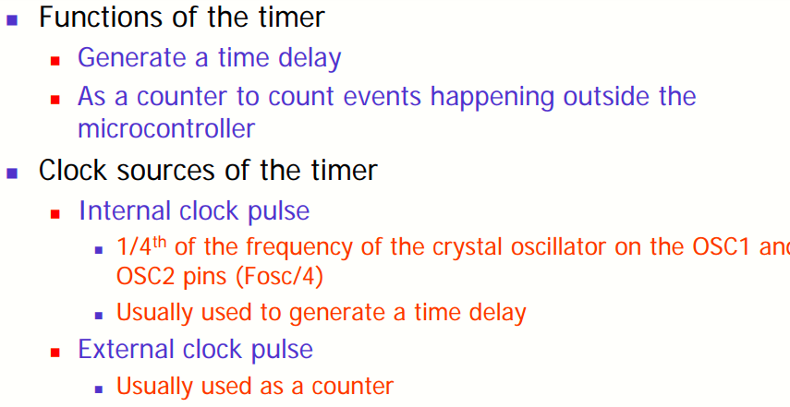
PIC18 Timer

Slide 6
PIC18 Timer
PIC18 has two to five timers
  Depending on the family number
These timers can be used as
  Timers to generate a time delay
  Counters to count events happening outside the PIC18
Every timer needs a clock pulse to tick

Slide 7
PIC18 Timer
Clock source can be
  Internal → 1/4th of the frequency of the crystal oscillator on OSC1 and OSC2 pins (Fosc/4) is fed into timer
  External: pulses are fed through one of the PIC18’s pins → Counter
Timers are 16-bit wide (TMRxL & TMRxH)
  Each timer has TCON (timer Control) reg.

Slide 8
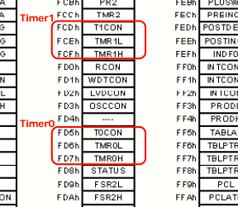
Registers of the timer
Special Function Registers

Slide 9
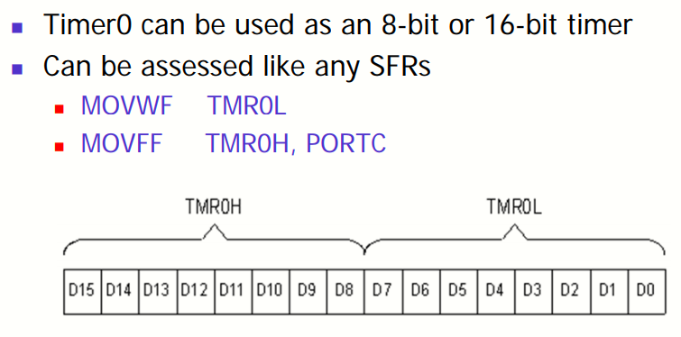
Timer0

Slide 10
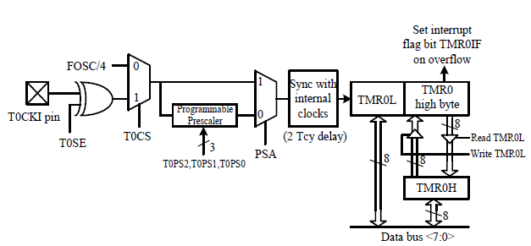
TIMER0
Can be configured as an 8-bit or 16-bit timer or counter.
Can select the internal instruction cycle clock or the T0CKI signal as the clock signal.
The user can choose to divide the clock signal by a prescaler before connecting it to the clock input to Timer0.
The T0CON register controls the operation of Timer0.
10

Slide 11
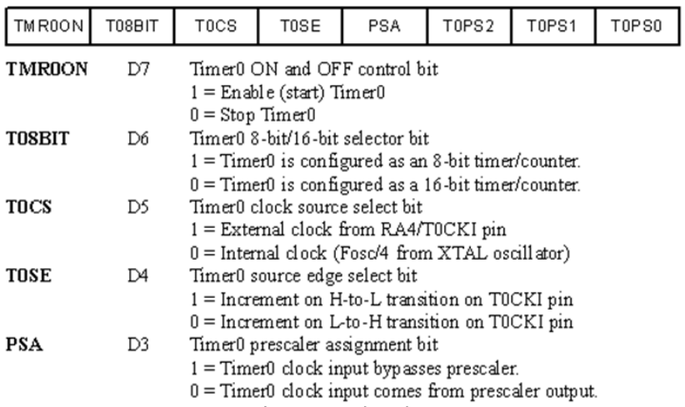
T0CON (Timer0 control) register
Set various timer operation mode

Slide 12

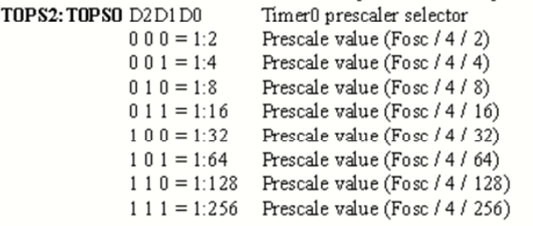
TOPS2: TOPS0 Prescaler

Slide 13
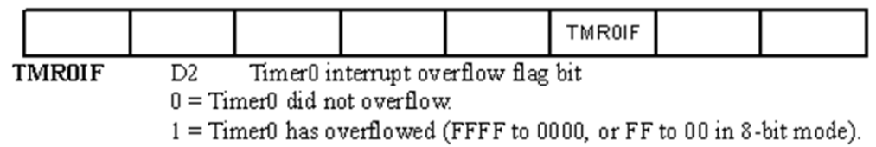
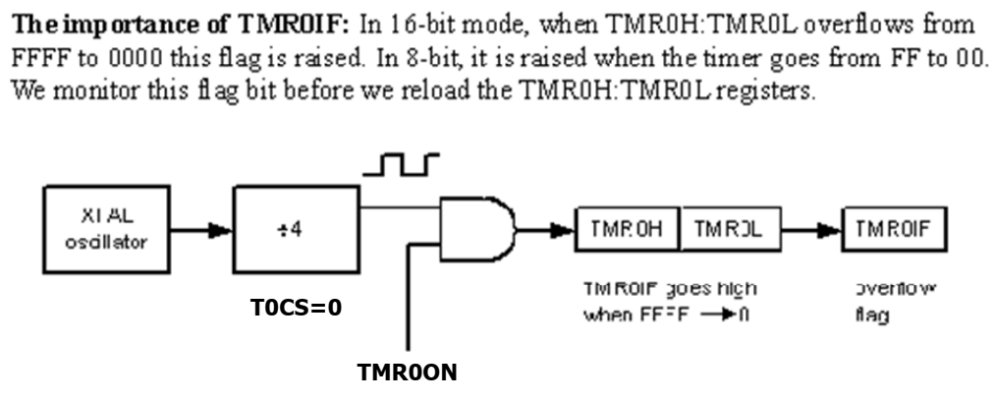
TMR0IF (Flag Bit) in INTCON

Slide 14
TIMER0 Programming
Find the value for T0CON if we want to program Timer0 in :
16-bit mode,
no prescaler.
Use internal clock Fosc/4 crystal oscillator for the clock source,
increment on positive-edge.

Slide 15
TIMER0 Programming
16-bit mode,
no prescaler.
fosc/4
positive-edge.
PSA = 1
TCON = 0000 1000

Slide 16
Example
Find the timer’s clock frequency and its period for various PIC18-based systems, with the following frequencies. Assume that no prescaler is used.
10 MHz (2) 16 MHz (3) 4 MHz
¼ x 10 MHz = 2.5 MHz and T = 0.4 μs
¼ x 16 MHz = 4 MHz and T = 0.25 μs
¼ x 4 MHz and T = 1 μs

Slide 17
TIMER0 – 16 BIT Mode
16-bit timer, 0000 to FFFFH.
After loading TMR0H and TMR0L, the timer must be started.
Count up, till it reaches FFFFH, then it rolls over to 0000 and activate TMR0IF bit.
Then TMR0H and TMR0L must be reloaded with the original value and deactivate TMR0IF bit.

Slide 18
TIMER0 for Time Delay Programming
Using Timer0 in 16 bit mode for time delay
Steps:
Load the value into the T0CON register
Load reg. TMR0H followed by reg. TMR0L with initial value
Start the timer with instruction
BSF T0CON, TMR0ON
Keep monitoring the timer flag (TMR0IF) to see if it is raised.
Get out of the loop when TMR0IF become HIGH

Slide 19
TIMER0 for Time Delay Programming
Using Timer0 in 16 bit mode for time delay
Steps:
Stop the timer with INSTRUCTION
BCF T0CON, TMR0ON ; clear the enable bit
Clear the TMR0IF flag for next round at INTCON
Go Back to step 2 to load TMR0H and TMR0L again

Slide 20
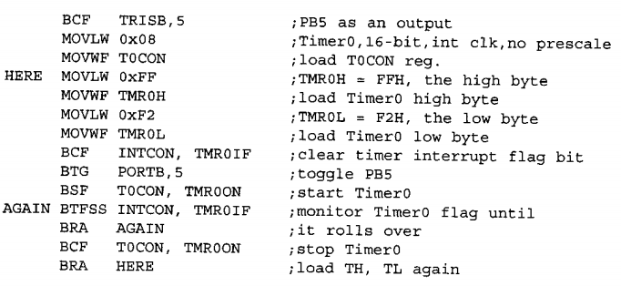
Programming Example
A square wave of 50% duty cycle on the PORTB.5

Slide 21
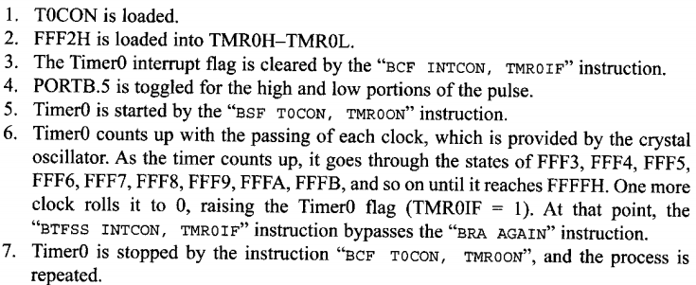
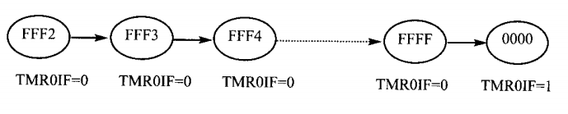
Programming Action

Slide 22
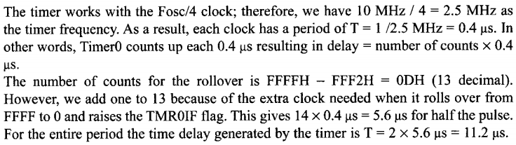
Delay Time
In the previous example, calculate the amount of time delay generated the timer. Assume that the clock frequency is 10MHz.

Slide 23
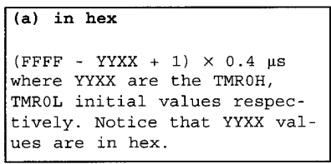
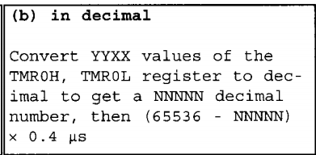
Delay Calculation Formula
a source frequency at 10 MHz, Fosc
Fosc/4 = 10 /4 ; 0.4 µsec

Slide 24
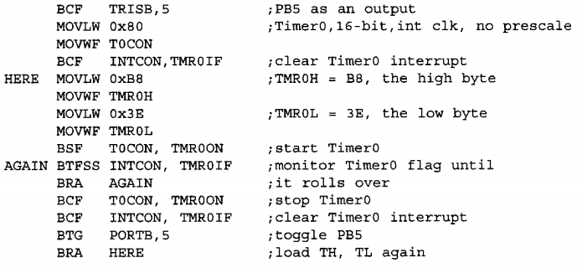
In Class Exercise
Find the delay generated by the following code

Slide 25
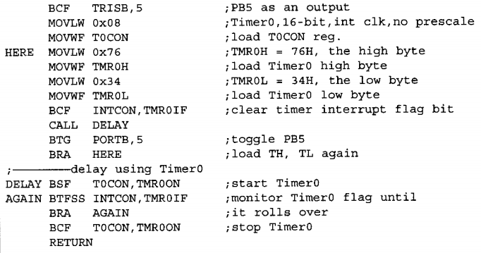
Problem 2

Slide 26
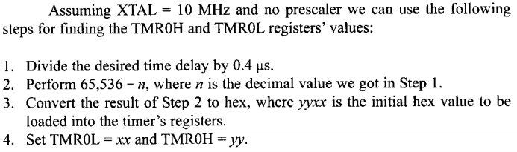
Determine Timer Value

Slide 27

Example
Given Fosc = 10 MHz

Slide 28
In Class Exercise
Fosc = 10 MHz
Write a program to generate a square ware with a period of 10 ms on pin PORTB.3 (Using Delay Subrotine)

Slide 29
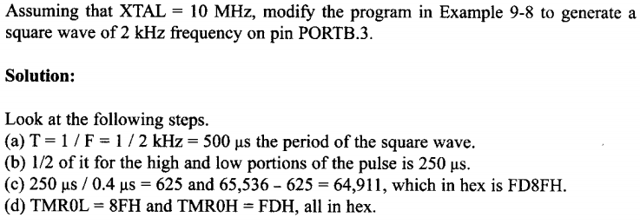
More on TIMER0 Value

Slide 30
More on TIMER0 Value
What will be the value for TImer0 for largest possible delay
To get largest delay, TRM0H and TRM0L should be ’00’
This will count up from 0000 to FFFF the roll over back to 0000.

Slide 31
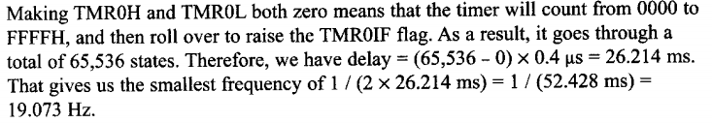
More on TIMER0 Value
What will be the value for TImer0 for largest possible delay

