Slide 1
CS2311 Computer Programming
LT1: Introduction to Programming
Computer Science, City University of Hong Kong
Semester A 2021-22

Slide 2
About the Course
Teaching pattern
  Lectures
    Explain the terminologies, concepts, methodologies, …
  Labs
    Hands-on programming practice
    Analyzing example problems and implementing programs
Canvas-based course website
  Teaching materials are all in Canvas
  It is your own responsibility to check Canvas and University emails regularly for updates

Slide 3
About the Course
Assessment
    Coursework (40%)
      Assignments (15%)
      Midterm quiz (15%)
        23 Oct. 2021 (Week 8)
      Lab Exercises (10%)
        Randomly choose 7~8 labs to assess
        Deadline is 24 hours after your lab session
    Final examination (60%)

Slide 4
About the Course
Assessment
  To pass the course you must obtain:
    At least 30% of the final exam marks (No. 1 reason to fail this course)
Student | Coursework | Exam | Final Mark | Grade
1 | 94.3 | 95.5 | 95.14 | A+
2 | 33.8 | 34 | 34 | D
3 | 86.8 | 26.5 | 44.59 | F

Slide 5
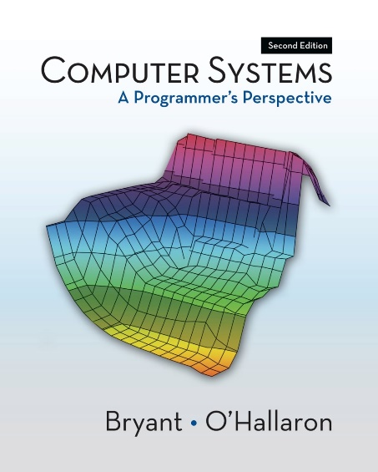
About the Course
Resources
  Textbook (NIL)
  Reference books
    Computer Systems: A Programmer‘s Perspective, by Randal E. Bryant and David R. O'Hallaron, Prentice Hall, 2011
  Microsoft Visual Studio 2019 (Windows)
    Develop environment for compiling & debugging
  PASS (Program Assignment aSsessment System)
    Program testing and submission

Slide 6
About the Course
Key to success
Just Do It
But, do it yourself

Slide 7
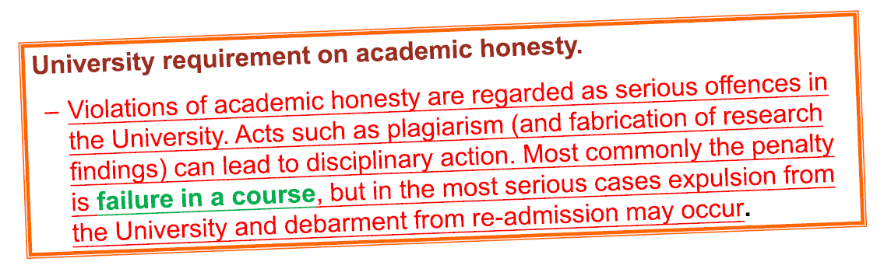
About the Course
“Do it yourself” means
  Discuss the problems with any other people
  Study materials on the internet
  Refer to any books
But, the details and write-ups must be entirely your own work

Slide 8
About the Course
Things draw your attentions
  Plagiarism
    Punishment ranges from warning to course failure
    May cause you be forced out of CityU
    Can be automatically detected by PASS system
  How to prevent
    In plagiarism cases, both the giver and copier get punishments
    Protect your code
  As instructors
    We have the responsibility to report academic dishonesty cases so as not to compromise the quality of education
    We take suspected plagiarism cases very seriously.

Slide 9
About the Course
How to get an A
  Studying
    Be prepared to the class (try to read the materials before hand)
    Attend and participate in all classes (lec & lab)
  Practice
    Do labs yourself and repeat the practice
    Don’t be afraid of asking questions
  Assignments
    Start as early as possible and submit on time
    Many times, debugging takes much longer time than you expect, so make a good plan

Slide 10
Outline for Today
What is a Computer?
What is a Computer Program?
Programming Language
Programmer
Basic Concept of programming
Simple Program

Slide 11


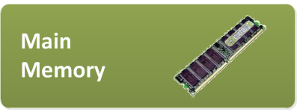

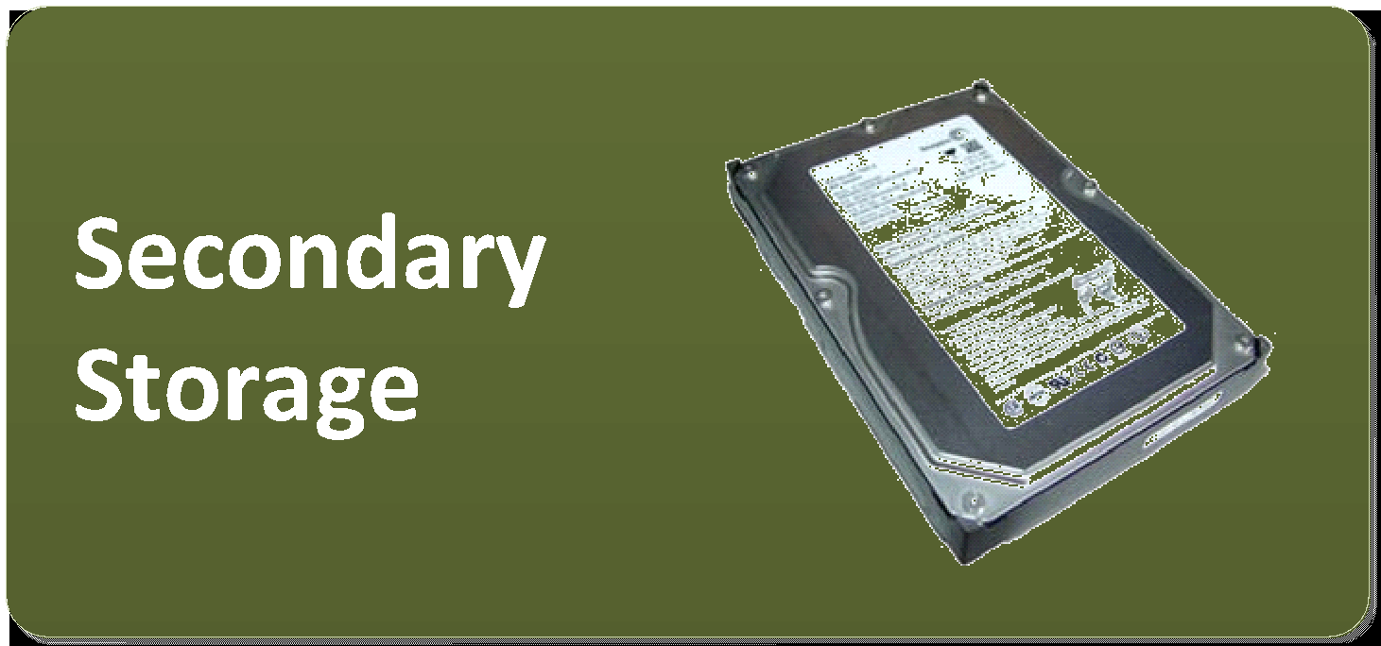
Personal Computer
CPU (Central Processing Unit): Read instructions from main memory and execute the instruction. Update main memory value or send instruction to motherboard
Main Memory: fast storage of program and data in action
Secondary Storage: (Slow) storage of program and data files (e.g., maintain them after shutting down the computer).

Slide 12
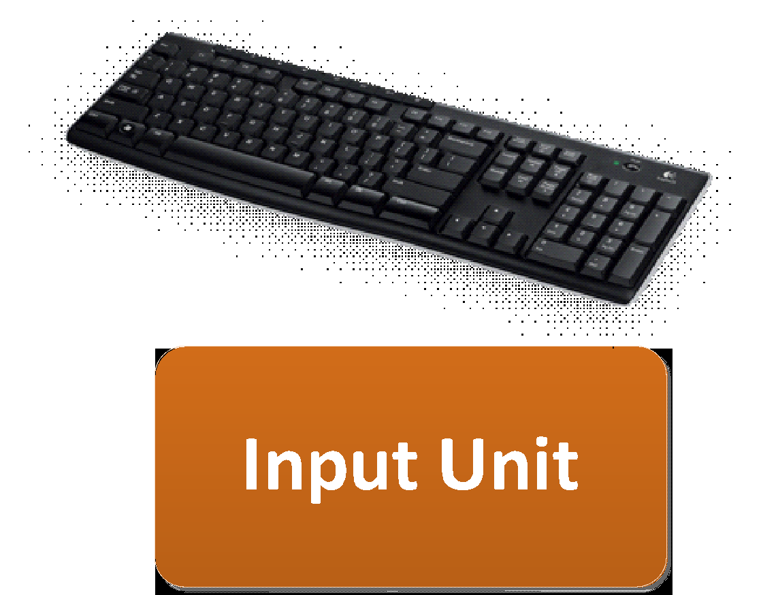
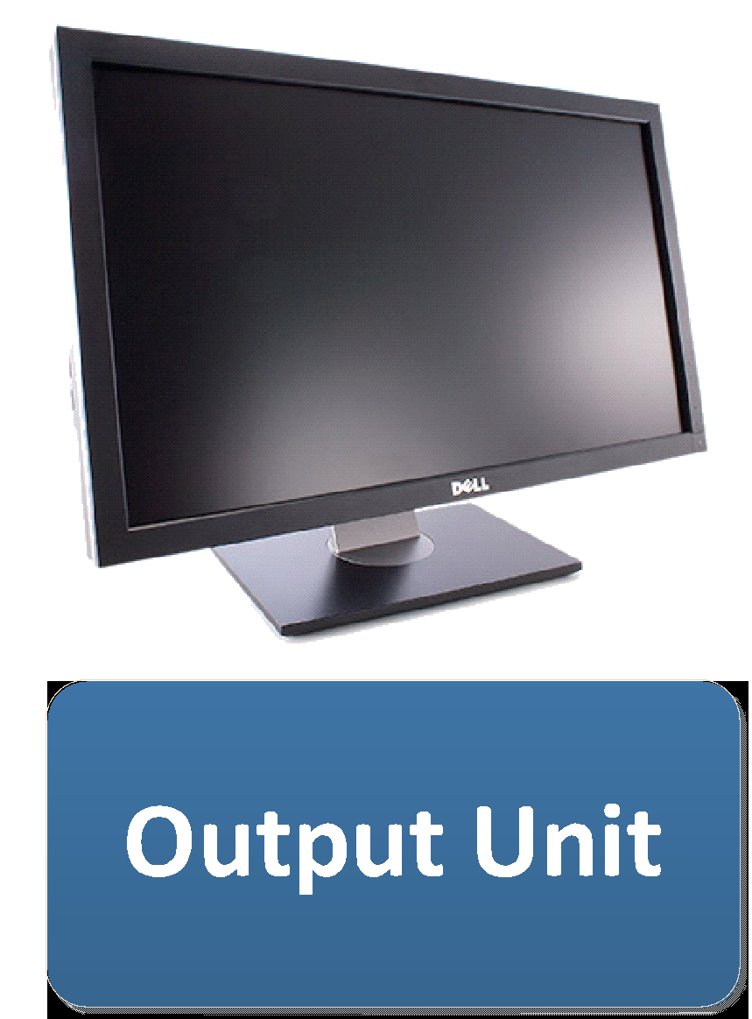
Personal Computer
Input Unit: Get input from user or external environment
Output Unit: Show result to user or other programs

Slide 13
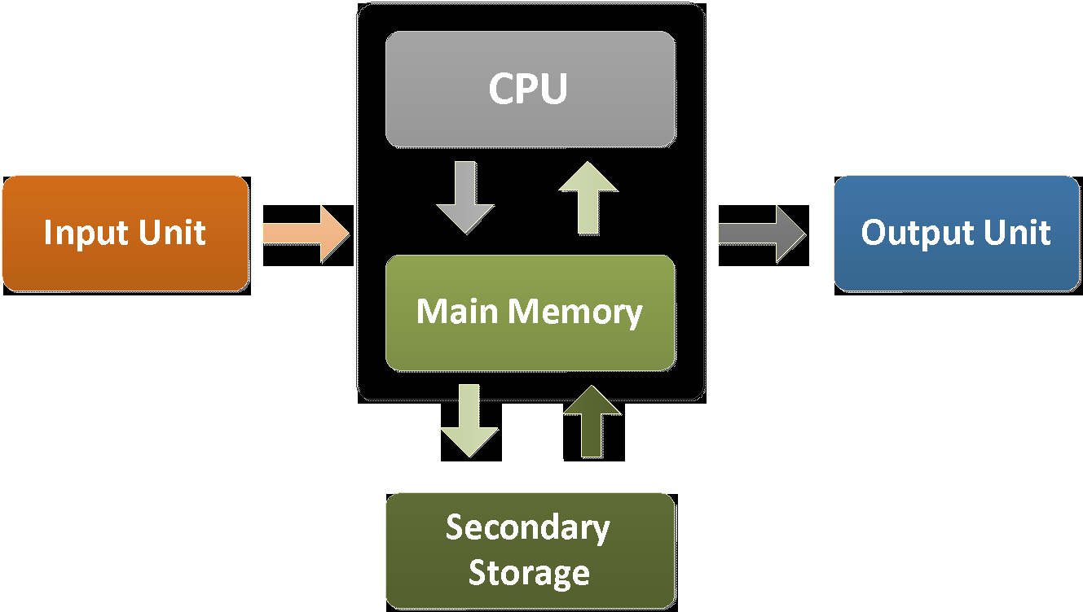
Stored Program Computer (Von Neumann Machines)

Slide 14


What is a Computer Program?
A way to communicate with computers
Written in Programming Languages

Slide 15
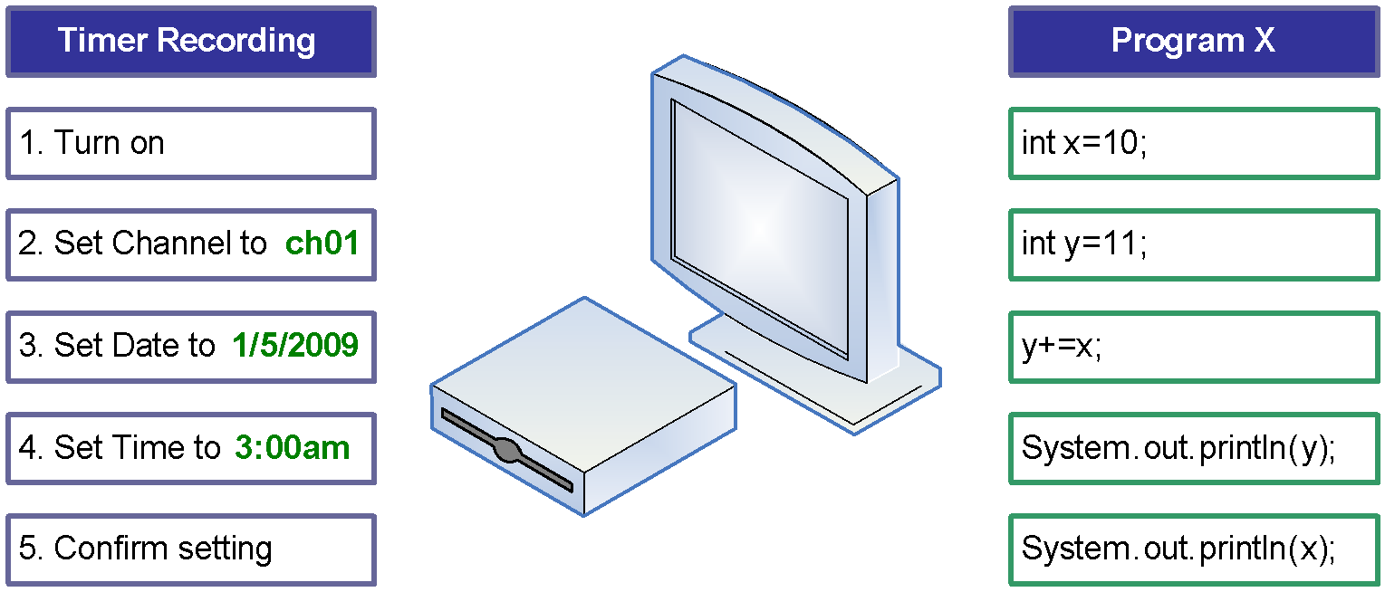
What is a Computer Program?
A list of instructions that instructs a computer to do some tasks

Slide 16
Programming Languages
To write a program for a computer, we must use a computer language.
Machine Language
Language directly understood by the computer
binary code

Slide 17
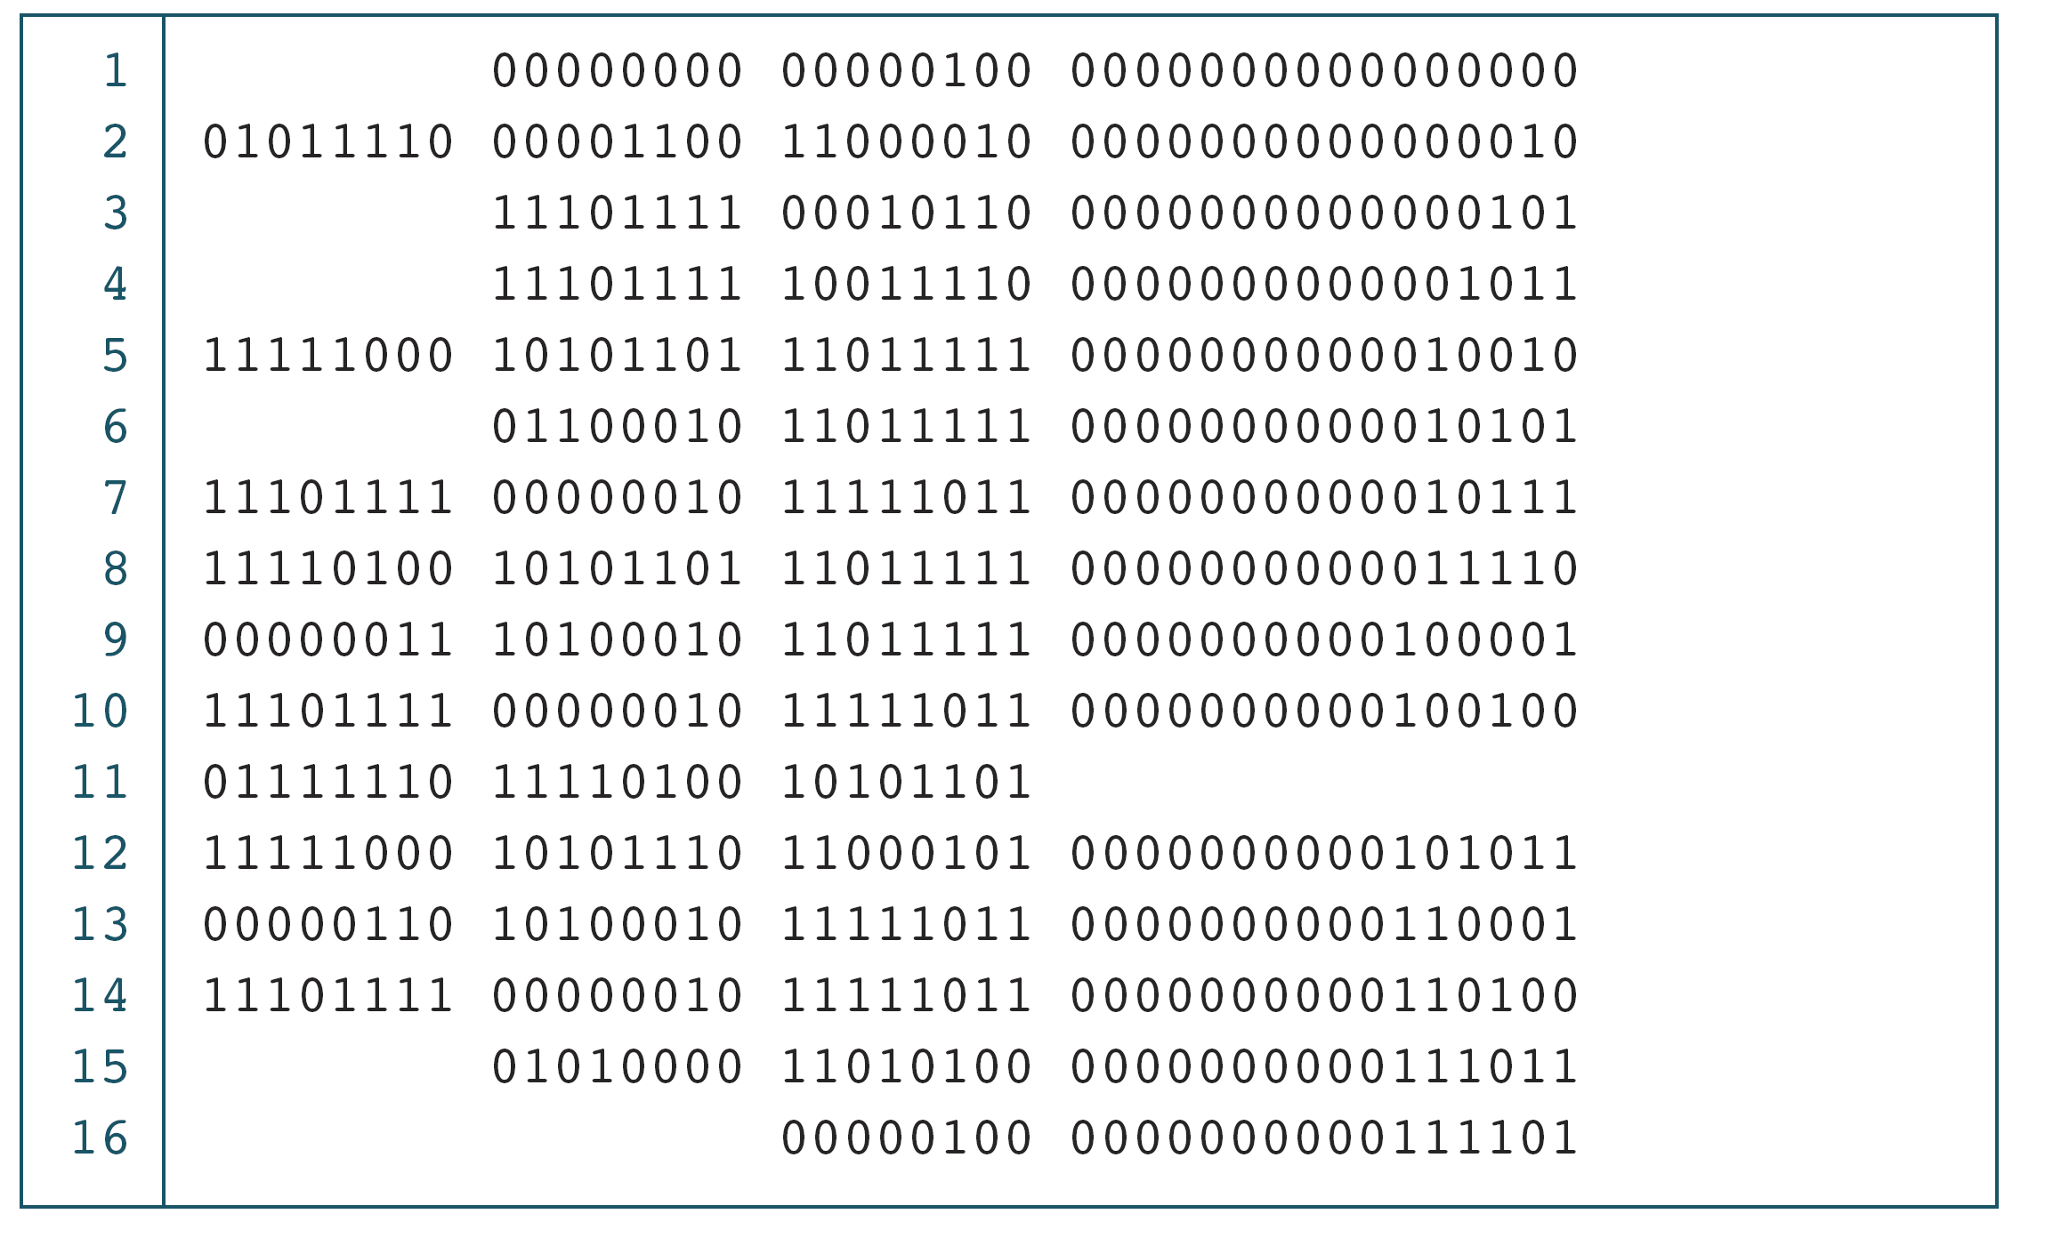
PROGRAM 1-1
The Multiplication Program in Machine Language
The only language understood by computer
hardware is machine language.

Slide 18
Programming Languages
To write a program for a computer, we must use a computer language.
Machine Language
Language directly understood by the computer
Symbolic Language
English-like abbreviations representing elementary computer operations
binary code
assembly language

Slide 19
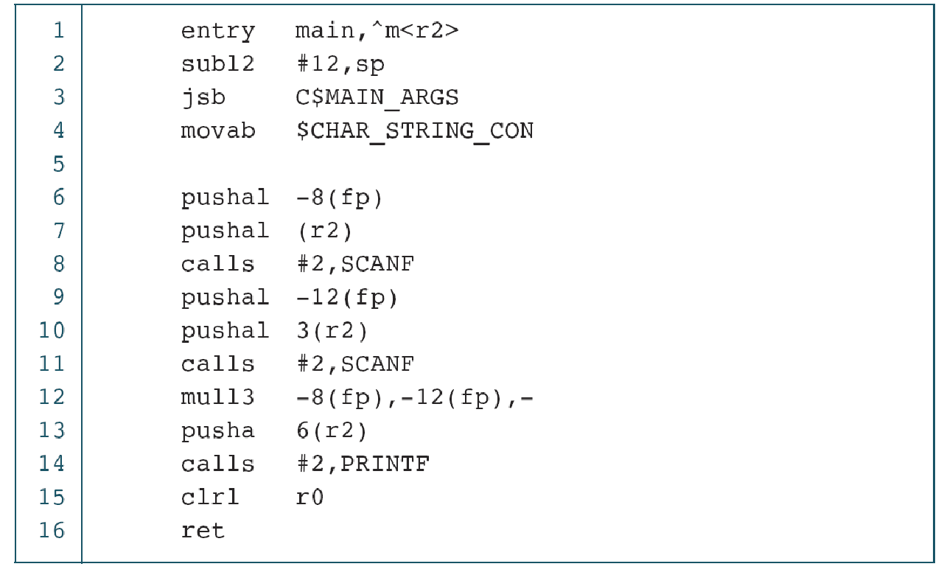
PROGRAM 1-2
The Multiplication Program in Symbolic Language
Symbolic language uses symbols, or mnemonics, to represent the various machine language instructions.

Slide 20
Programming Languages
To write a program for a computer, we must use a computer language.
Machine Language
Language directly understood by the computer
Symbolic Language
English-like abbreviations representing elementary computer operations
High-level Language
Close to human language.
Example: a = a + b
  [add values of a and b, and store the result in a, replacing the previous value]
binary code
assembly language
C, C++, Java, Basic

Slide 21
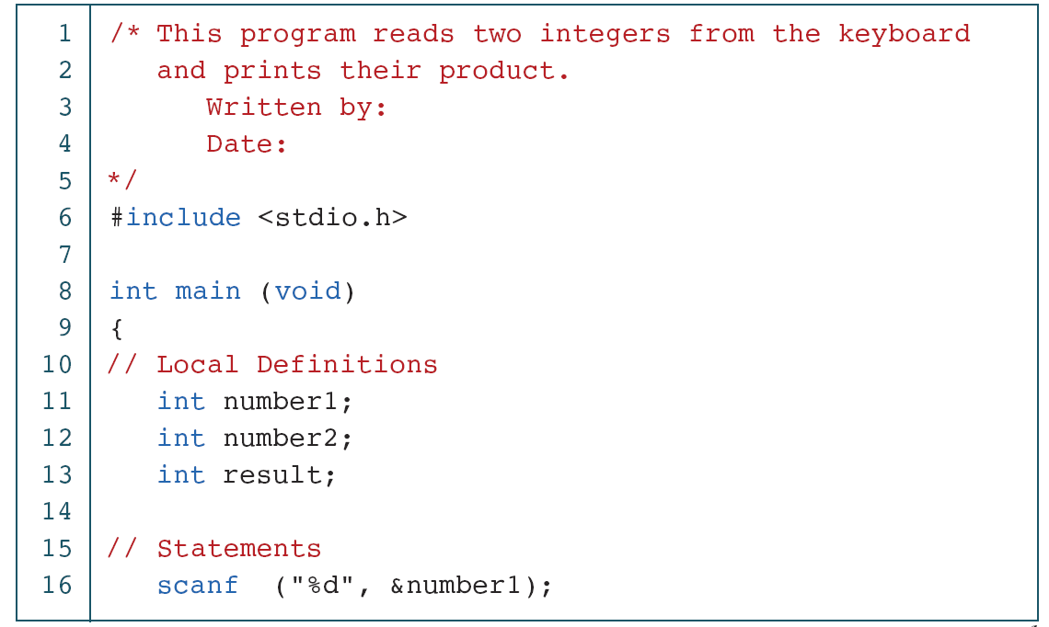
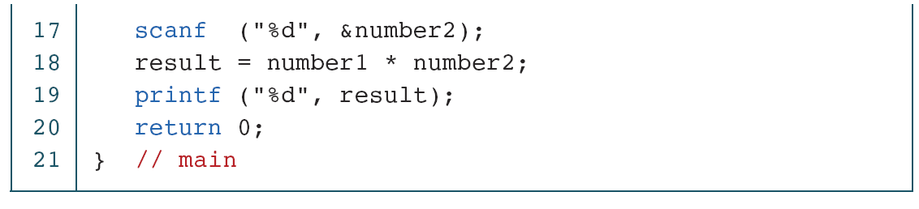
PROGRAM 1-3
The Multiplication Program in C
high-level languages are easier for us to understand.

Slide 22
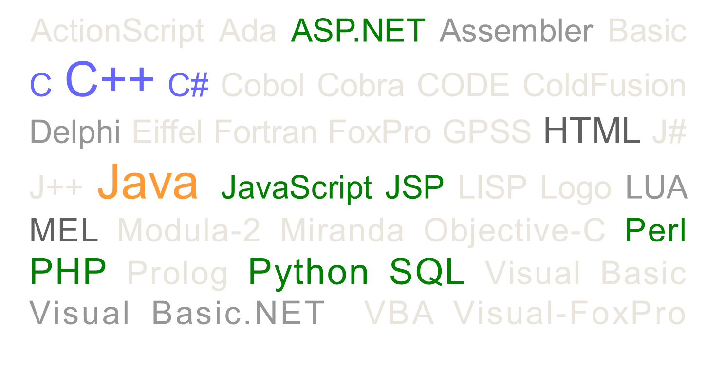
Different Programming Languages

Slide 23
Programming Languages
Programming languages usually differ in two aspects
  Language Syntax
  Standard libraries/SDKs/functions
Java
  if (a>b){
    System.out.println(“a is larger than b”);
  }else{
    System.out.println(“a is smaller than or equal to b”);
  }
Pascal
  if a>b then
    writeln(‘a is larger than b’);
  else
  writeln(‘a is smaller than or equal to b’);

Slide 24
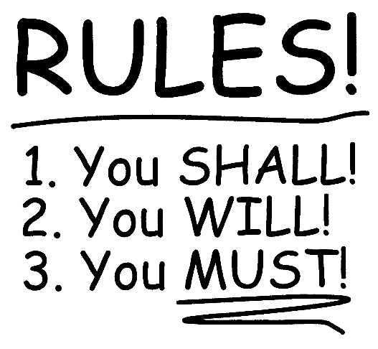
Programming Languages
Syntax is well-defined, NO exceptions
  if (…){…}else{…};
  for (;;;){…}
  while (){…}
Basic Components:
  Variable / structure /function declaration
  Variable / structure /function access
  Conditional statement
  Iteration statement
  SDK/built-in functions

Slide 25
Basic Concept of Programming

Slide 26
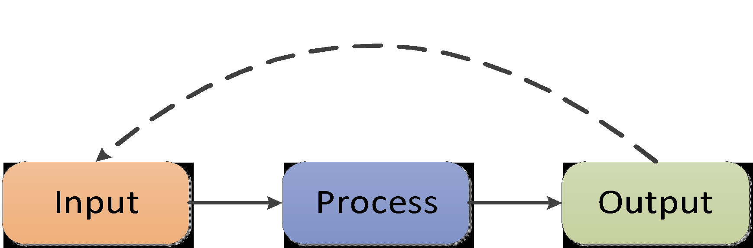
Computer Program (External View)
Basic elements of a Computer Program
  Input
  Process
  Output

Slide 27
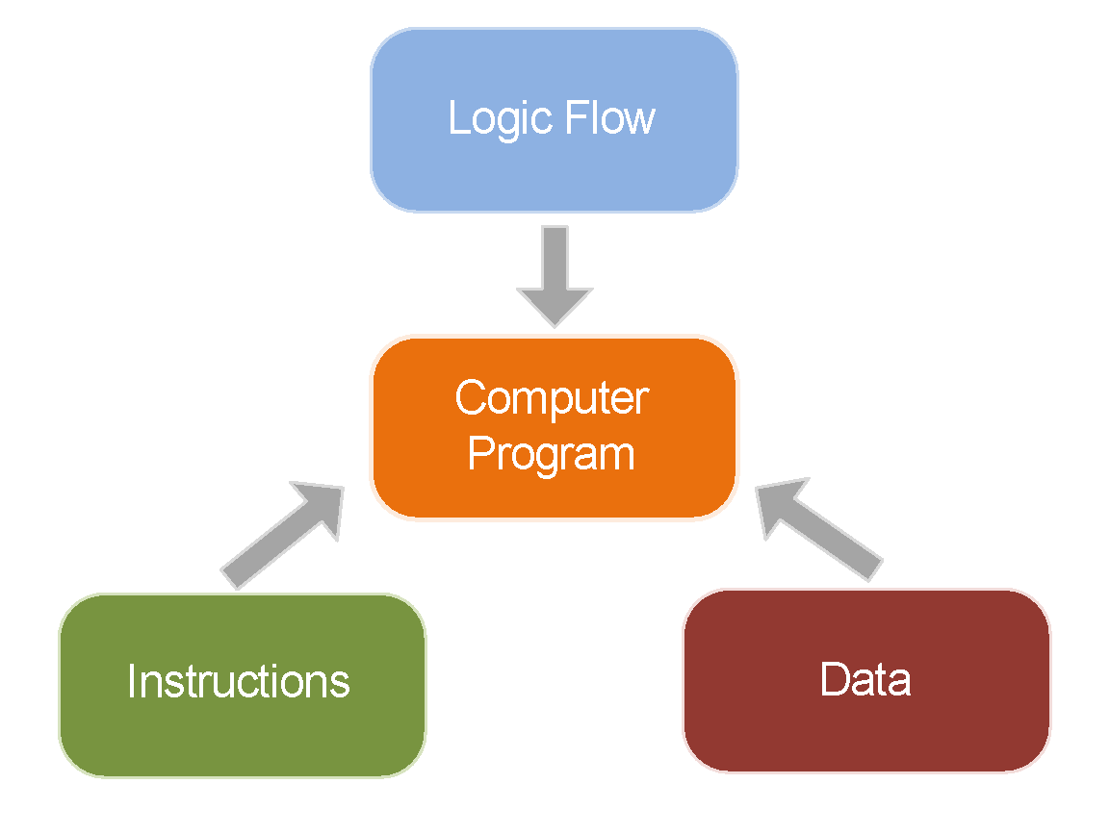
Computer Program (Internal View)
A list of instructions ordered logically
Usually involve data access

Slide 28
Computer Program
Instructions
  A set of predefined actions that a computer can perform
  E.g. addition, subtraction, read , write
Logic Flow
  Arrangement of Instructions
  E.g. Calculate BMI (Body Mass Index‎)
    Read weight from keyboard
    Read height from keyboard
    Weight x weight/height
    Write BMI to screen
Data
  Variable (data)
    A space for temporarily store value for future process
  Constant (data)
    A value that will not be changed for the whole processing

Slide 29
Logic Flow
Turn on the mobile
Hang up
Key in xxxx - xxxx
Key in xxxx - xxxx
Wait for connection
Wait for connection
Turn on the mobile
Talking
Talking
Hang up

Slide 30
Logic Flow
Turn on the mobile
Turn on the mobile
Key in xxxx - xxxx
Key in xxxx - xxxx
Wait for connection
Wait for connection
No
Connection made?
Connection made?
Yes
Yes
No
Talking
Talking
Hang up
Hang up

Slide 31
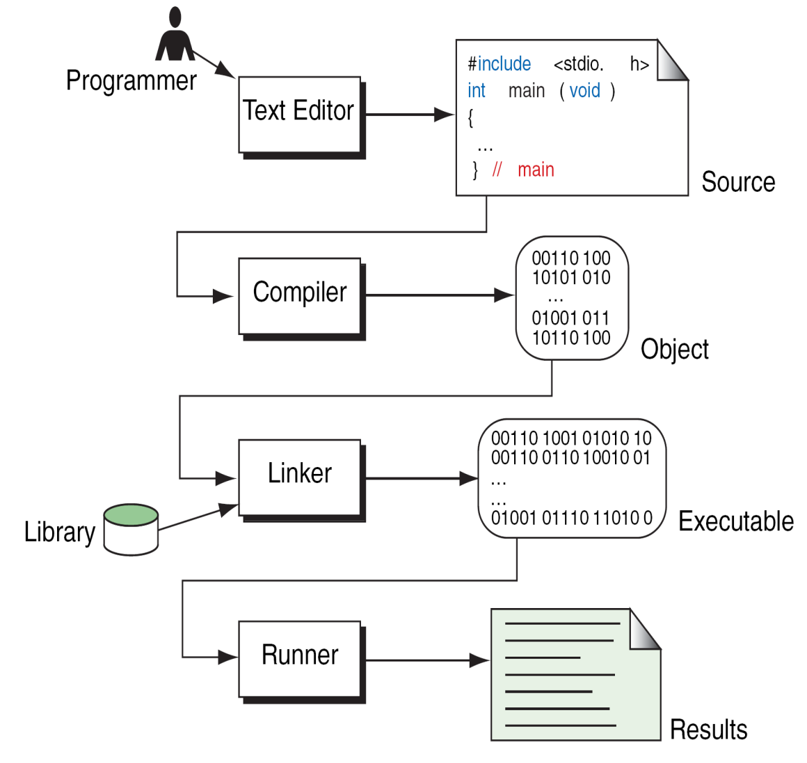
Building a C++ program
Writing source code as an C++ file.
  e.g. “hello.cpp” file
Preprocessing
  Processes the source code for compilation.
Compilation
  Checks the grammatical rules (syntax).
  Source code is converted to object code in machine language (e.g. “hello.obj” file)
Linking
  Combines object code and libraries to create an executable (e.g. “hello.exe” file).
  Library: common functions (input, output, math, etc).

Slide 32
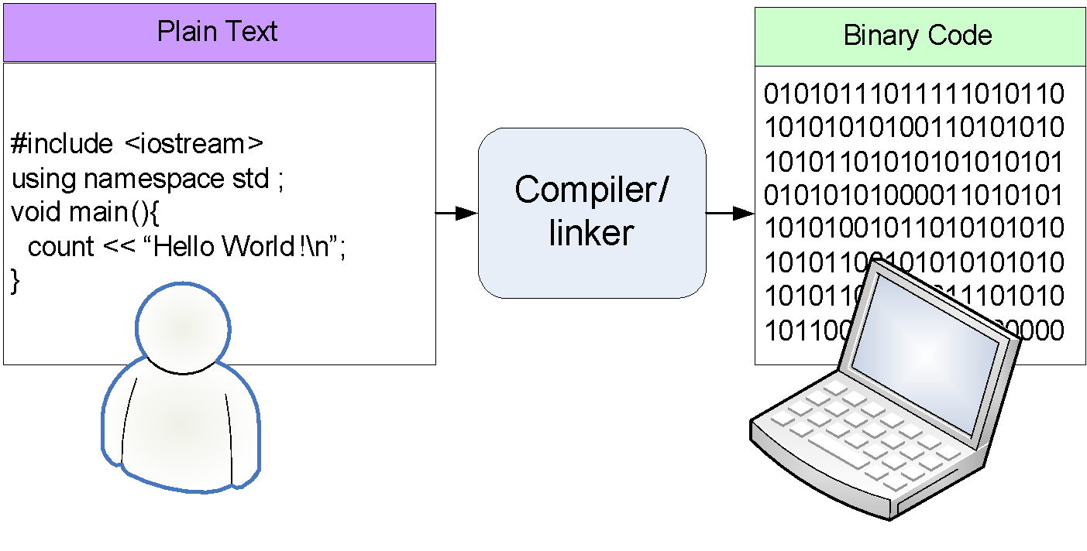
Sample Program (Framework)

Slide 33
Simple Program
/* The traditional first program in honor of
Dennis Ritchie who invented C at Bell Labs
in 1972 */
#include <iostream>
using namespace std;
void main()
{
cout << "Hello, world!\n";
}
#include <iostream>
using namespace std;
int main()
{
cout << "Hello, world!\n";
return 0;
}
Win
Mac

Slide 34
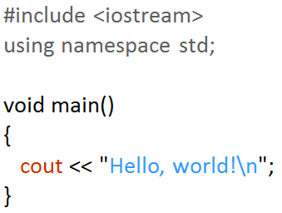
Function - main
void main()
  void means there is NO return value
  main is the name of the function
  No semi-colon after main()
  C++ is case sensitive:
  E.g., void Main(), VOID main() are incorrect
{ }
  Braces: left brace begins the body of a function. The corresponding right brace must end the function

Slide 35
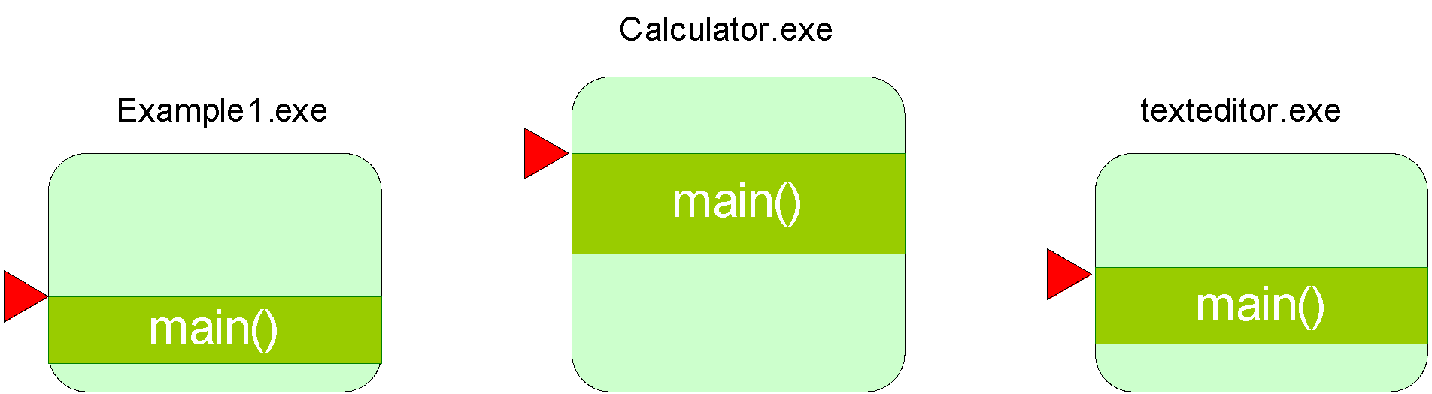
Function - main
void main()
{
}
The starting point of program (the first function called by the computer)

Slide 36
Simple Program
/* The traditional first program in honor of
Dennis Ritchie who invented C at Bell Labs
in 1972 */
#include <iostream>
using namespace std;
void main()
{
cout << "Hello, world!\n”;
}

Slide 37


Library / SDK /Package
Normally, we won’t write a program all by ourselves. Instead, we will reuse the code written by ourselves / other developers. Especially for the repeating tasks or low-level operations like disk I/O
The reusing code is well designed and pack a library / SDK / Package
Standard C++ program comes with a set of package to make programmer task easier
cout is one of the example

Slide 38
Object - cout
cout << "Hello, world!\n“ ;
cout: “Console OUTput” allows our program to output values to the standard output stream (the screen)
cout: object provided by iostream library (package) for screen (console) output (we will elaborate this concept in future classes)
<<: output (also called insertion) operator that output values to an output device. In this case, the output device is cout (the screen)
The value on the right hand side of the operator ("Hello, world!\n“ ) is the string you want to output
  Any literal (character string) that is to be output must be in between a pair of double quotes

Slide 39
Object - cout
\n
  escape sequence: the character following \ is not interpreted in the normal way
  represents a newline character: the effect is to advance the cursor on the screen to the beginning of the next line
  newline: position the character to the beginning of next line
\\
  backslash: Insert the backslash character \ in a string
\"
  double quote: Insert the double quote character " in a string
endl
  Same as the string “\n”.
  No \ before endl

Slide 40
Syntax errors
The texts to output should be placed in a pair of double quotes “ texts”.
/* The traditional first program in honor of
Dennis Ritchie who invented C at Bell Labs
in 1972 */
#include <iostream>
using namespace std;
void main()
{
cout < Hello, world! < endl
cout < Hello, world Again! < endl
}
< is not an operator of cout. We need to use <<.
We need ; at the end of each statement

Slide 41
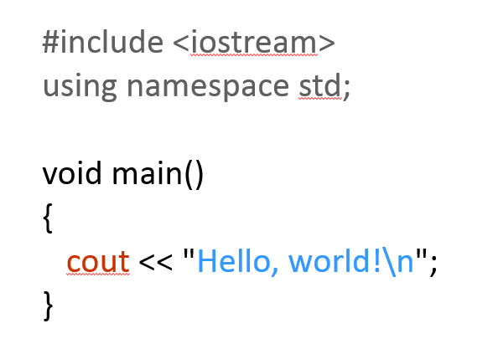
Preprocessor directive
Give information / instruction to compiler for program creation
using namespace std;
Standard (std) namespace is used such that we can use a shorthand name for the element cout
  std::cout <-> cout
#include <iostream>
Include library iostream into the program as it contains the definition of cout, which is used to print something to the screen.
Load contents of a certain file / library
NO semi-colon at the end of the include directive

Slide 42
Simple Program
/* The traditional first program in honor of
Dennis Ritchie who invented C at Bell Labs
in 1972 */
Enclosed by “/*” and “*/” or begin with “//”
  // single line comments
  // this is a single line comment
  // each line must begin with the “//” sign

