Slide 1
GE1202 Managing Your Personal Finance
Lecture 4
Consumer Credits and Loans

Slide 2
What is Consumer Credit?
Credit is an arrangement to receive cash, goods, or services now and pay for them in the future
Consumer credit refers to the use of credit for personal needs (except a home mortgage) by individuals and families
It is based on trust in people’s ability and willingness to pay bills when due
It works because people by and large are honest and responsible
The advancement of payment technology has popularized the use of credit

Slide 3
Two Types of Credit
Closed-end credit
  One-time loans that the borrower pays back in a specified period of time and in payments of equal amounts
  Three most common types of closed-end credit
      Instalment sales credit
        A loan that allows you to receive merchandise
        Make a down payment and repay the balance (plus interest) in equal instalments over a specified period
      Instalment cash credit
        Direct loan of money
        Make no down payment and repay the balance (plus interest) in equal instalments over a specified period
      Single lump-sum credit
        A loan that must be repaid in total on a specified day
        Usually 30 – 90 days

Slide 4
Two Types of Credit
Open-end credit
  A line of credit in which loans are made on a continuous basis and the borrower is billed periodically for at least partial payment
  Line of credit
    The maximum dollar amount of credit the lender has made available to you
  You may have to pay interest, a periodic charge, or other finance charges
  Two common types of open-end credit
    Credit card
    Revolving credit line

Slide 5
Revolving Credit Line
This is a prearranged loan for a specified amount
  Similar to a cash advance as funds are available up front
Revolving credit differs from an installment loan
  Installment loan has a fixed number of payments over a set period of time whereas revolving funds only require payment of interest plus any applicable fees
  new loan application and credit reevaluation does not need to be completed upon utilizing revolving credit
  Revolving credit is intended for shorter, smaller loans
Revolving credit differs from credit card
  Revolving credit does not require a specific purchase
  Typically has significantly lower interest rates compared to credit cards
Example: DBS

Slide 6
Three Types of Revolving Credit
Overdraft Protection
  A line of credit linked to a checking account that allows a depositor to overdraw the account up to a specified amount
Unsecured Personal Credit Line
  A line of credit made available to an individual on an as needed basis
Home Equity Line of Credit
  A line of credit extended to a homeowner that uses the borrower's home as collateral
  Second mortgage on your home
  It provides access to a lot of relatively inexpensive credit
  You could lose your home

Slide 7
Home Equity Line of Credit
Example:
A couple buys a home for $2,850,000
10 years later, it’s worth $3,650,000
The couple now has an asset worth $3,650,000 on which all they owe is the original mortgage, which may now have a balance of $2,200,000.
The amount of equity in the house is $3,650,000 – $2,200,000 = $1,450,000
In order for them to tap that equity without having to sell their home, they can use the home equity credit line
75% loan-to-market-value ratio
75% of $3,650,000 = $2,737,500
$2,737,500-$2,200,000(remaining mortgage) = $537,500

Slide 8
Advantages of Credit
Using credit increases the amount of money a person can spend to purchase goods and services now
  Solution to the inconsistence between income and spending
Advantages:
  Allows us to allocate our financial resources more effectively
  Cushion for financial emergencies
  Grip the chance of low price
  Convenient when shopping
  Can take advantage of grace period
  Indicates financial stability

Slide 9
Uses of Credit
If you decide to use credit, make sure the benefits of purchasing now outweigh the costs
Ask yourself the following questions before you decide how and when to make a major purchase:
  Do I have the cash I need for the down payment?
  Do I want to use my savings for this purchase?
  Does the purchase fit my budget?
  Could I use the credit I need for this purchase in some better way?
  Could I postpone the purchase?
  What are the OC of postponing the purchase?
  What are the dollar costs and psychological costs of using credit?

Slide 10
Misuses of Credit
Use your credit card to make everyday purchases
  Using your credit card as a substitute for cash is a habit that can quickly lead to debt
Make impulse purchases
  Research findings suggest that emotions and feelings play a decisive role in purchasing, triggered by seeing the product or upon exposure to a well crafted promotional message
Use your credit card to buy things you cannot afford
  Living a borrowed lifestyle is the quickest way to get into debt.
  If you cannot afford a purchase today, chances are you will not be able to afford it tomorrow, or even next month
Get into the habit of making minimum monthly payments
  To pay your debts off quicker and cheaper, you should pay as much as you can on your balance each month

Slide 11
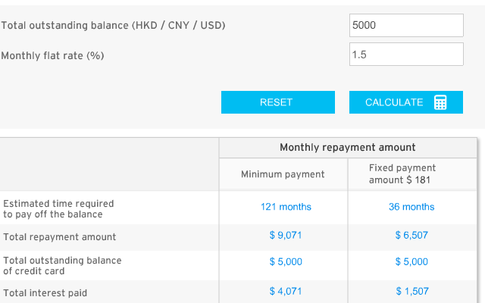
Avoid the Minimum-Monthly-Payment Trap
The minimum monthly payment is the smallest amount you can pay and still be a cardholder in good standing
It is typically the greater of HK$50 or between 2% or 3% of the balance

Slide 12
Bank Credit Cards
Line of credit depends on applicant’s financial status and ability to pay
Cash advances and balance transfers
  A loan that can be obtained by a bank credit cardholder at any participating bank of financial institution
You have the option to pay the bill in full within the grace period without interest charges
  Some creditors allow you a grace period of 20 to 25 days to pay a bill in full
The outstanding balance will attract interest at a relatively high rate
  Interest rates on credit cards are amongst the highest rates charged on debt

Slide 13
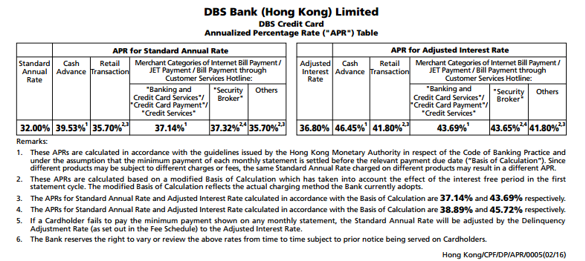
Charges

Slide 14

Comparison
How high is the finance charge on credit card balance?
The annualized return on the Dow Jones Index from 1987 to 2012
  8%
The annual return of Warren Buffett from 1967 to 2007
  21.1%

Slide 15
Other Fees
Annual fees
Transaction fees
Late-payment fees
Over-the-limit fees
Balance transfer fees
Foreign transaction fees

Slide 16
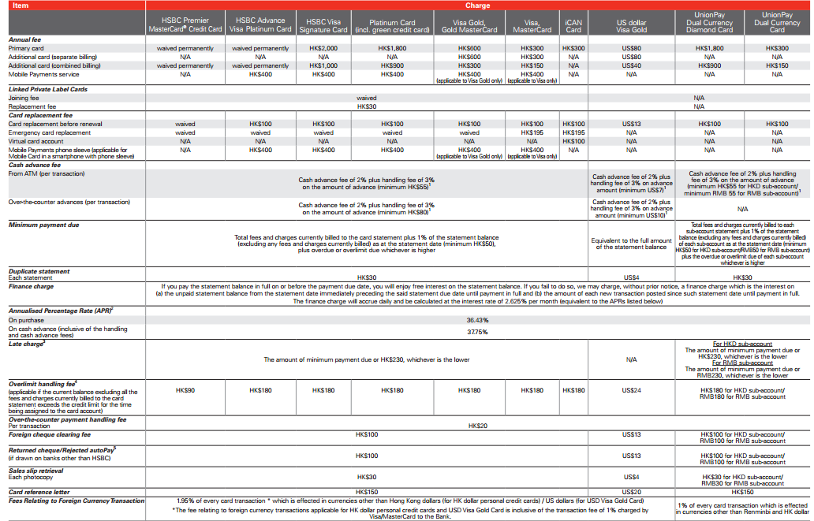

Slide 17
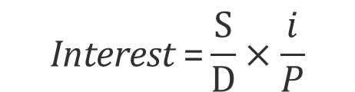
Computing Finance Charge
The Average Daily Balance method (ADB)is a way of calculating interest by considering the balance owed at the end of each day of the period rather than the balance owed at the end of the week, month or year.
If interest compounds monthly, then use the following formula to calculate interest under the average daily balance method:
S = the sum of the daily balances in the billing period
D = number of days in the billing period
i = annual interest rate
P = number of billing periods per year (usually 12)
$$\text{Interest} \text{=}\frac{\text{S}}{\text{D}}×\frac{i}{P}$$

Slide 18
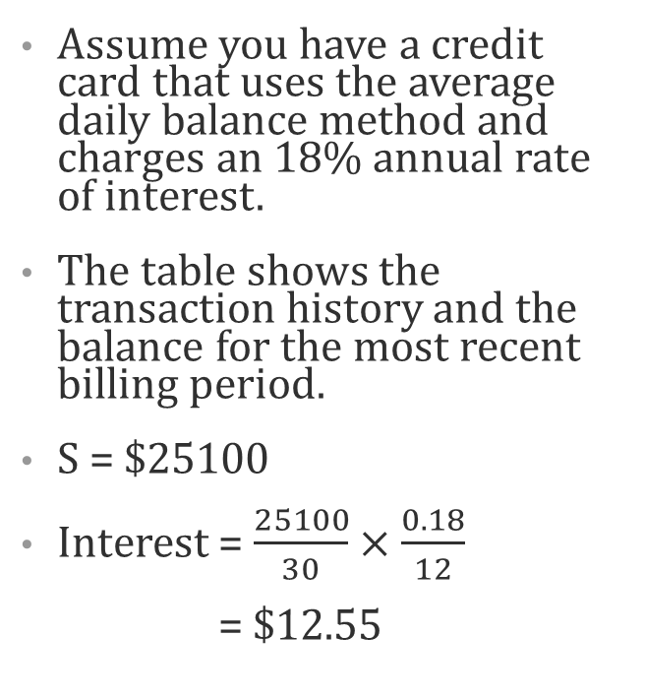
Example of ADB
Day of Billing Cycle | Beginning Balance | Charges | Payments | Ending Balance
1 | $ - | $ 200.00 |  | $ 200.00
2 | $ 200.00 |  |  | $ 200.00
3 | $ 200.00 |  |  | $ 200.00
4 | $ 200.00 | $ 350.00 |  | $ 550.00
5 | $ 550.00 |  |  | $ 550.00
6 | $ 550.00 |  |  | $ 550.00
7 | $ 550.00 |  |  | $ 550.00
8 | $ 550.00 | $ 100.00 |  | $ 650.00
9 | $ 650.00 |  | -$ 50.00 | $ 600.00
10 | $ 600.00 |  |  | $ 600.00
11 | $ 600.00 | $ 400.00 |  | $ 1,000.00
12 | $ 1,000.00 |  |  | $ 1,000.00
13 | $ 1,000.00 |  |  | $ 1,000.00
14 | $ 1,000.00 |  |  | $ 1,000.00
15 | $ 1,000.00 |  |  | $ 1,000.00
16 | $ 1,000.00 |  |  | $ 1,000.00
17 | $ 1,000.00 |  |  | $ 1,000.00
18 | $ 1,000.00 |  |  | $ 1,000.00
19 | $ 1,000.00 |  |  | $ 1,000.00
20 | $ 1,000.00 |  |  | $ 1,000.00
21 | $ 1,000.00 | $ 75.00 |  | $ 1,075.00
22 | $ 1,075.00 |  |  | $ 1,075.00
23 | $ 1,075.00 |  |  | $ 1,075.00
24 | $ 1,075.00 |  | -$ 100.00 | $ 975.00
25 | $ 975.00 |  |  | $ 975.00
26 | $ 975.00 |  |  | $ 975.00
27 | $ 975.00 | $ 200.00 |  | $ 1,175.00
28 | $ 1,175.00 |  |  | $ 1,175.00
29 | $ 1,175.00 |  |  | $ 1,175.00
30 | $ 1,175.00 |  |  | $ 1,175.00
Assume you have a credit card that uses the average daily balance method and charges an 18% annual rate of interest.
The table shows the transaction history and the balance for the most recent billing period.
S = $25100
Interest = $\frac{25100}{30}×\frac{0.18}{12}$
= $12.55

Slide 19
Loan Restructuring
New loan that replaces the outstanding balance on an older loan
  Paid over a longer period
  Usually with a lower installment amount
Loans are commonly rescheduled to accommodate a borrower in financial difficulty and to avoid a default
  Failure to make a payment
Also called rescheduled loan

Slide 20
Consumer Loans
Loans made for specific purposes using formally negotiated contracts that specify the borrowing terms and repayment
  Education loans
  Auto loans
  Personal Loans
  Other durable good loans
  Consolidation loans
Different from line of credit
  One-time transaction
  No more credit is available once repaid

Slide 21
Consumer Loans
Single-Payment Loan
  Specified period
    Ranging from 30 days to a year
  Repaid in full with a single payment on a given due date
  Include the principal and all interest charges
  Can be secured or unsecured
Installment Loan
  Repay debt in a series of equal payments
  Payments includes principal and interest
  Long-term loan
    6 months to 10years or longer

Slide 22
Important Loan Features
Loan application
  Information about the purpose of the loan as well as the applicant’s financial condition.
Total cost of transaction
  Finance Charges
  Sometimes the bank may manipulate both the sticker prices and interest rates, so it is better to compare monthly payments to get a handle on total cost.
Collateral
  Properties or other marketable assets that a borrower offers as a way for a lender to secure the loan
Loan Maturity
  When the original principal amount is due
  The cost of credit increases with the length of the repayment period
Other consideration
  Banks may charge a prepayment penalty

Slide 23
Computing Finance Charges
Single-payment loan
  Simple Interest Method
  Discount Method
Installment Loan
  Simple Interest Method
  Add-On Method

Slide 24
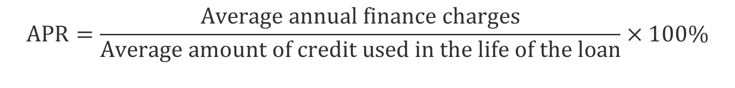
Annual Percentage Rate
Annual Percentage Rate (APR) is a finance charge expressed as an annual rate
APR is a true measure of the interest fees charged by credit card companies & banks.
$$APR=\frac{Average annual finance charges}{\text{A}\text{verage} \text{amount} \text{of} \text{credit} \text{used} \text{in} \text{the} \text{life} \text{of} \text{the} \text{loan}}×100\%$$

Slide 25

Simple Interest Method (Single-Payment Loan)
$$\text{F}\text{C}\text{=}\text{P}×i×T$$
FC = finance charge; P = Principal loan amount;
i = stated annual interest rate; T = term of loan
Example
  How much is the finance charge and APR on a $1,000 loan for 2 years at 8% interest rate (Assume interest is the only finance charge)
  FC = $1,000 x 8% x 2 = $160
  APR = ($160/2)/$1000 = 8%
  Receive full loan amount ($1,000) but pay back $1,160 (loan amount + finance charge)
APR on a simple interest loan will always be equal to the stated annual interest rate

Slide 26
Discount Method (Single-Payment Loan)
Interest (calculated on principal) is subtracted from loan amount and remainder goes to borrower
Finance charges paid in advance
APR will be higher than stated interest rate
Example
  How much is the finance charge and APR on a $1,000 loan for 2 years at 8% interest rate (Assume interest is the only finance charge)
  FC = $1,000 x 8% x 2 = $160
  Borrower receives $840 now, pays back $1,000
  APR = $80/$840 = 9.52%

Slide 27
Simple Interest Method (Installment Loan )
Calculated on outstanding balance each period
The principal balance declines with each payment
The amount goes to interest decreases while the amount that goes to principal increases
Example
  Calculate the finance charges and APR on a $1,000 loan to be repaid in 12 monthly installments at an annual interest rate of 8%
  Assume interest is the only finance charge

Slide 28
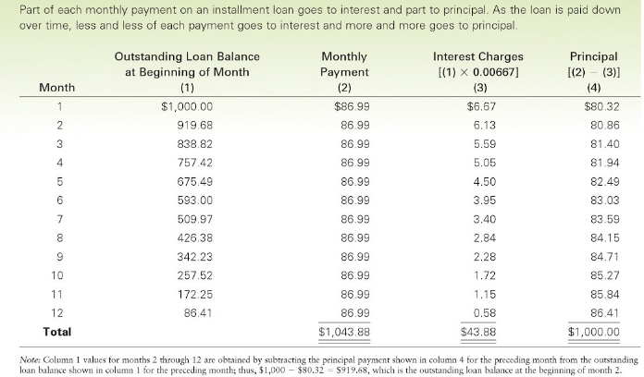

Slide 29
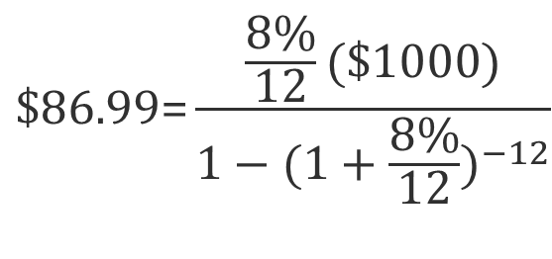
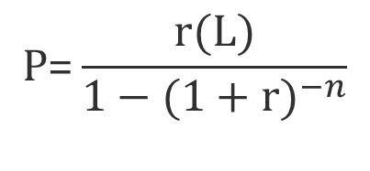
Simple Interest Method (Installment Loan )
How much is the monthly installment?
P = installment; L = Present value of the loan; r = interest rate per period; n = number of periods
$$\text{P}\text{=}\frac{r(L)}{1−{(1+r)}^{−n}}$$
$$\text{\$86.99}\text{=}\frac{\frac{8\%}{12}(\$1000)}{1−{(1+\frac{8\%}{12})}^{−12}}$$

Slide 30
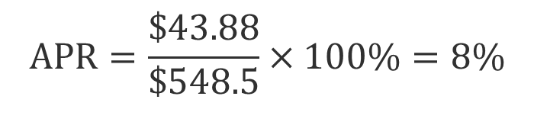
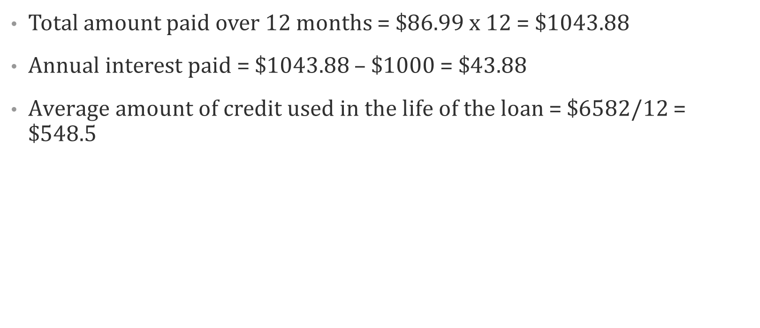
Simple Interest Method (Installment Loan )
Total amount paid over 12 months = $86.99 x 12 = $1043.88
Annual interest paid = $1043.88 – $1000 = $43.88
$\text{A}\text{verage} \text{amount} \text{of} \text{credit} \text{used} \text{in} \text{the} \text{life} \text{of} \text{the} \text{loan}$ = $6582/12 = $548.5
$$APR=\frac{\$43.88}{\text{\$548.5}}×100\%=8\%$$
APR on a simple interest loan will always be equal to the stated annual interest rate

Slide 31
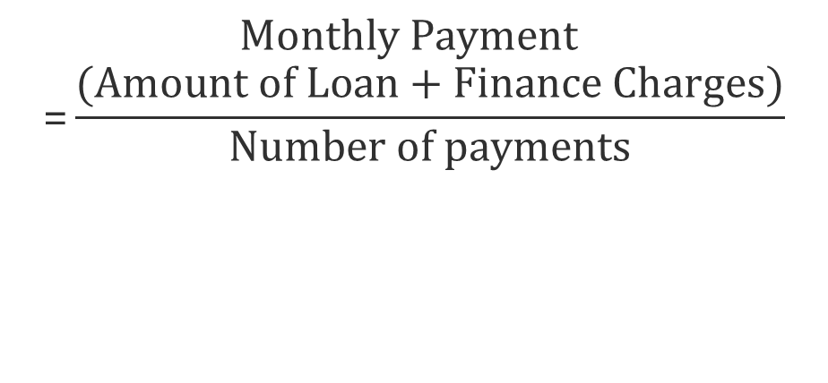
Add-On Method (Installment Loan )
Finance charges calculated on the original loan balance
It is then added to principal to determine the total amount to be repaid
$$\text{Monthly} \text{Payment} \text{=}\frac{(Amount of Loan+Finance Charges)}{Number of payments}$$

Slide 32
Add-On Method (Installment Loan )
Example
Calculate the finance charges and APR on a $1,000 loan to be repaid in 12 monthly installments at an annual interest rate of 8% (Assume interest is the only finance charge)
Finance charges on the original loan amount
  $1,000 x 8% x 1 = $80
Add these charges to principal
  $80 + $1,000 = $1,080
Divide this amount by the number of periods to arrive at payment
  $1,080/12 = $90.00
Higher interest is charged than under Simple Interest Method

Slide 33
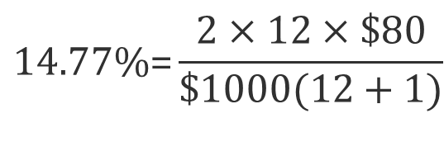
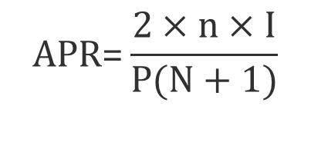
Add-On Method (Installment Loan )
To find the APR under Add-On Method
APR = Approximate APR; n = Number of payment periods in one year
I = Total dollar cost of credit; P = Principal;
N = Total number of payments scheduled to pay off the loan
$$\text{APR}\text{=}\frac{2×n×I}{P(N+1)}$$
$$\text{14.77\%}\text{=}\frac{2×12×\$80}{\$1000(12+1)}$$

Slide 34
Establishing Credit
Open checking and savings accounts
Get one card and make small purchases
  Use them periodically, even if you prefer paying cash
  Build a record of being a reliable credit customer
Obtain small loan

Slide 35
Build a Good Credit History
Not getting overextended
Fulfilling all credit terms
Paying on time
Notifying creditors if unable to pay
Being truthful

Slide 36
Credit Rating
When you apply for a loan, the lender will review your credit history
The record of your complete credit history is called your credit report or credit file
  Name, address, birth date
  Your employer, position, income, your previous employer, etc
It is collected and maintained by credit bureaus
  An agency that collects information on how promptly people and business pay their bills
A credit rating is a measure of a person’s ability and willingness to make credit payment on time
Creditors use different combinations of the 5 Cs to reach their decisions

Slide 37
The 5 C’s of Credit
Character
  Will you repay the loan?
  The borrower’s attitude toward his or her credit obligations
Capacity
  Can you repay the loan?
  The borrower’s financial ability to meet credit obligations - income
Collateral
  What if you don’t repay the loan?
  A valuable asset that is pledged to ensure loan payments

Slide 38
The 5 C’s of Credit
Capital
  What are your assets and net worth?
  Ability to repay a loan if you lost your source of income
Condition
  What if your job is insecure ?
  General economic conditions that can affect a borrower’s ability to repay a loan

Slide 39
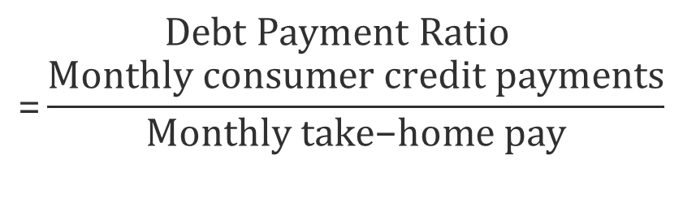
How Much Credit Can You Stand?
Monthly consumer credit payments (excluding mortgage) should not exceed 20% of monthly net income
Example:
  If you have $10,000 income, using the 20% ratio, you should have monthly consumer credit payments of no more than $2,000
$$\text{Debt} \text{Payment} \text{Ratio}\text{ =}\frac{\text{Monthly} \text{consumer} \text{credit} \text{payments}}{\text{Monthly} \text{take}\text{−}\text{home} \text{pay}}$$

