Slide 1

EE4803: Analog IC Design
Building Blocks: Amplifiers & Current Mirrors
Department of Electrical Engineering
City University of Hong Kong
Prof. Arindam Basu

Slide 2
Outline
Single stage amplifiers: CS, CG
Cascode Amplifiers
Current Mirrors: Simple, Cascode, Regulated Cascode
*With inputs from Phillip Allen’s course at Georgia Tech and Willy Sansen’s book

Slide 3
Outline
Single stage amplifiers: CS, CG
  Common Source (CS)
Cascode Amplifiers
Current Mirrors: Simple, Cascode, Regulated Cascode
*With inputs from Phillip Allen’s course at Georgia Tech and Willy Sansen’s book

Slide 4
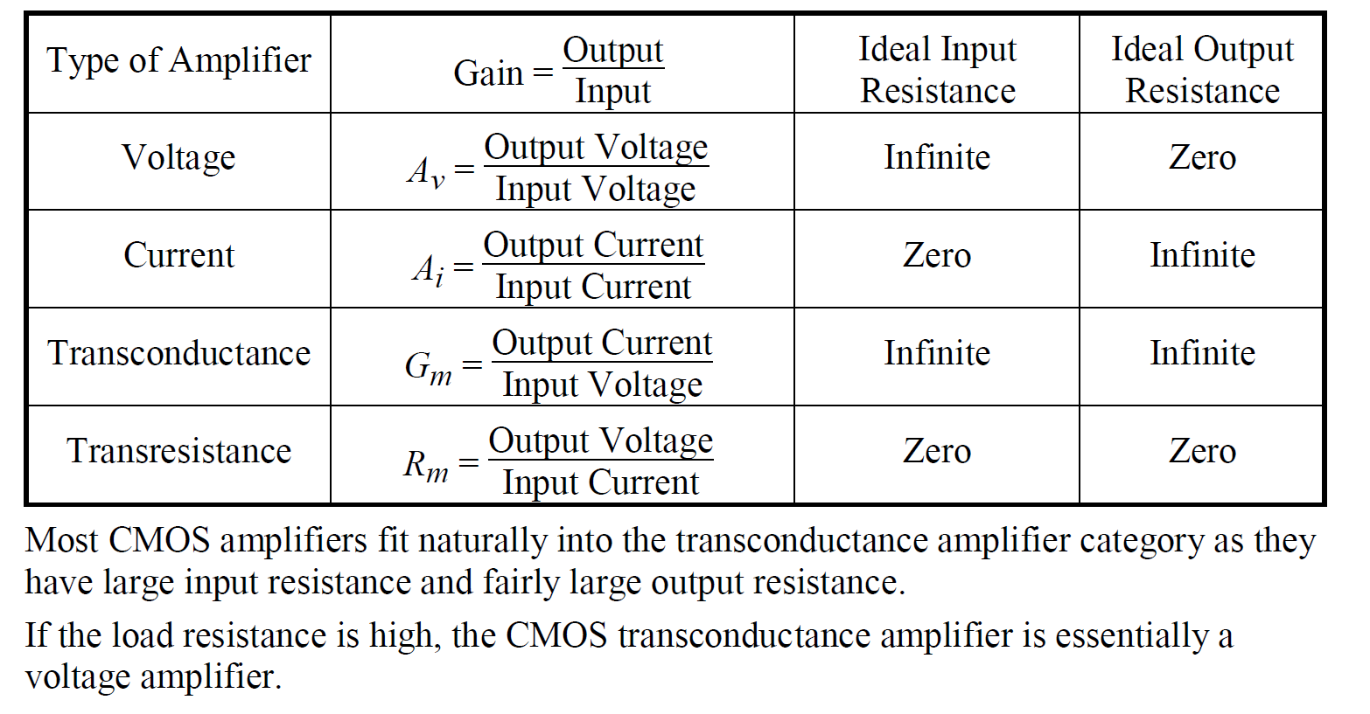
Types of Amplifiers

Slide 5
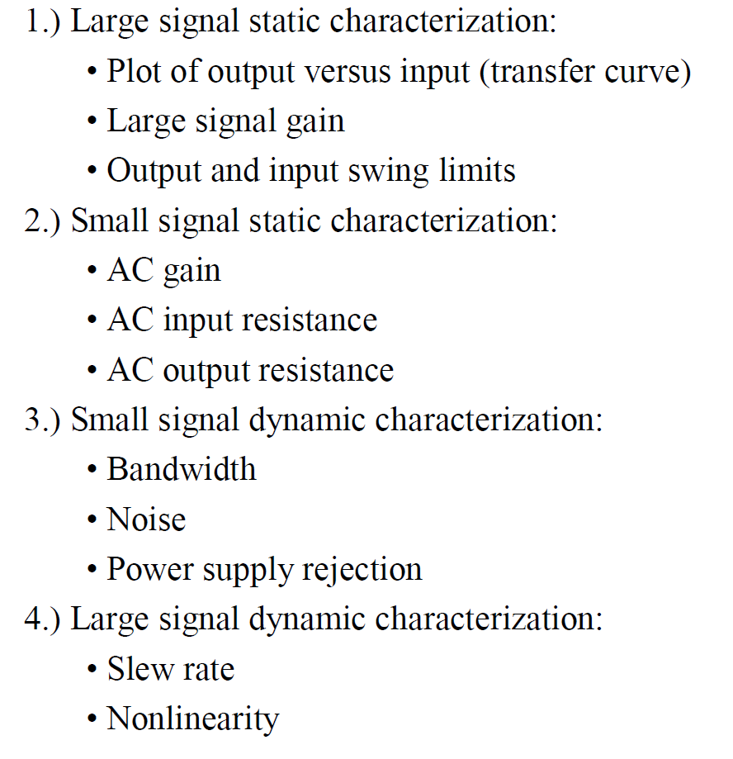
Characterization of Amplifiers

Slide 6
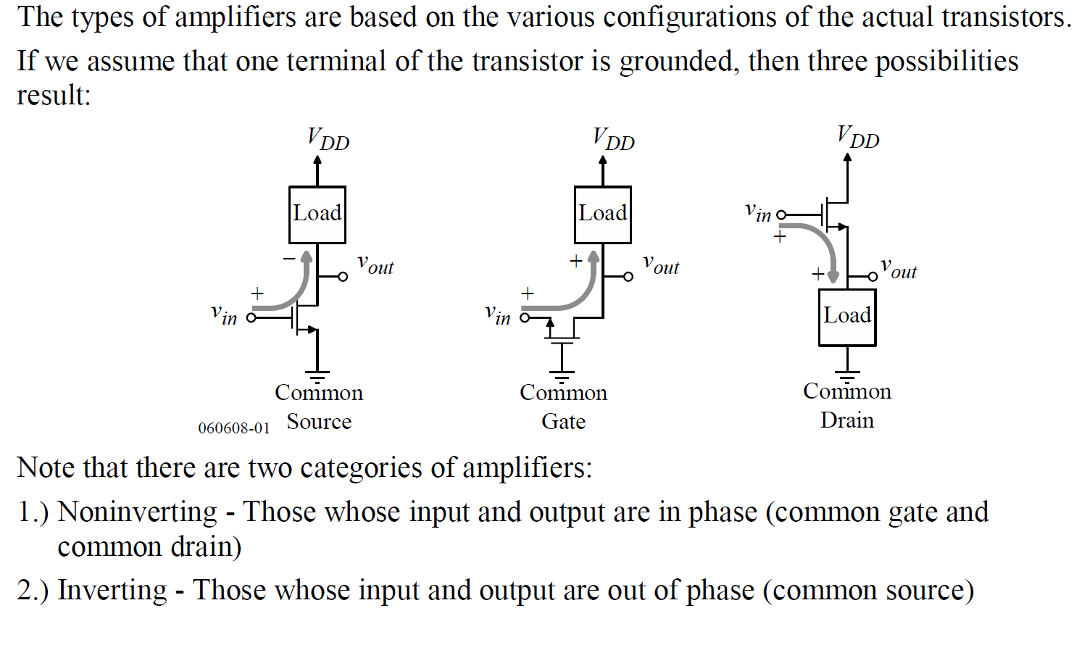
Inverting and Non-inverting amplifiers

Slide 7
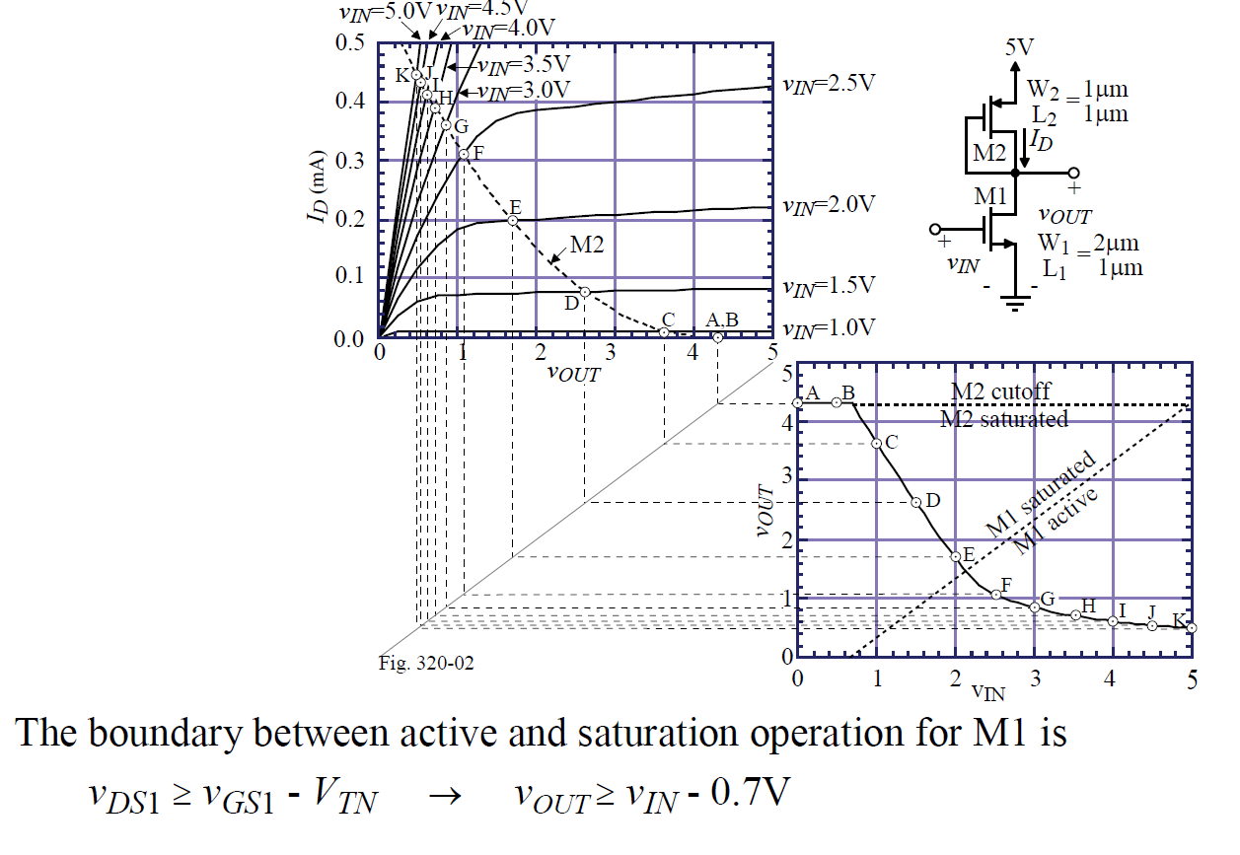
Common Source with Diode Load

Slide 8
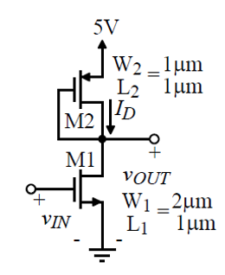
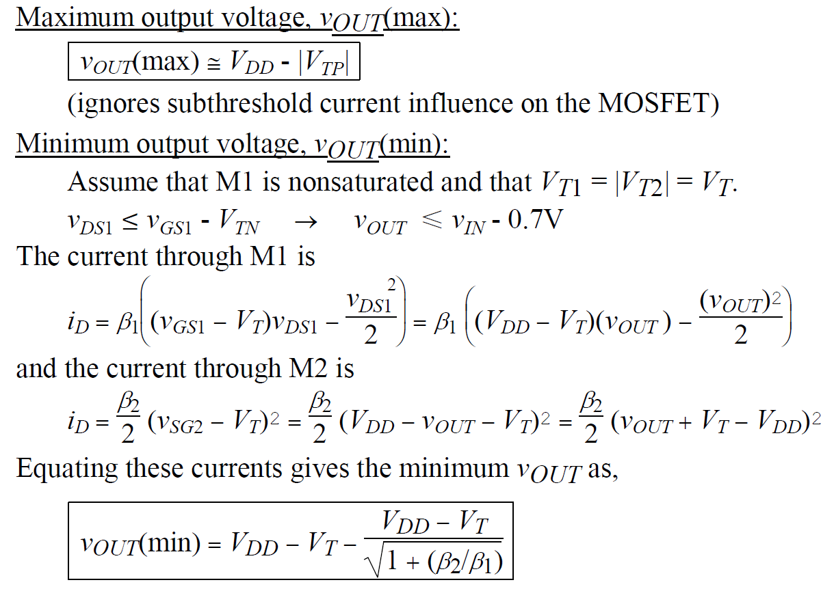
Common Source with Diode Load

Slide 9
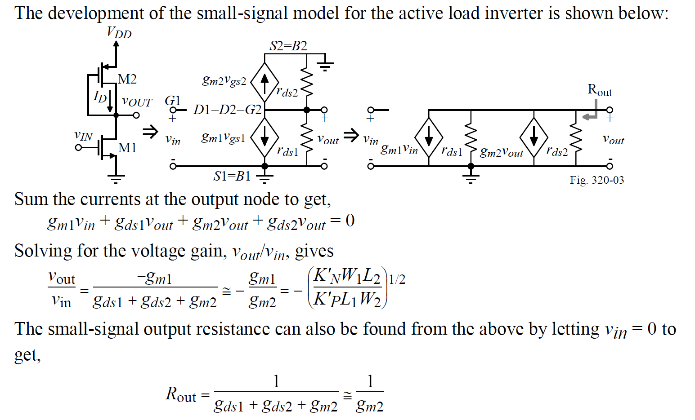
CS with Diode Load: Small Signal

Slide 10
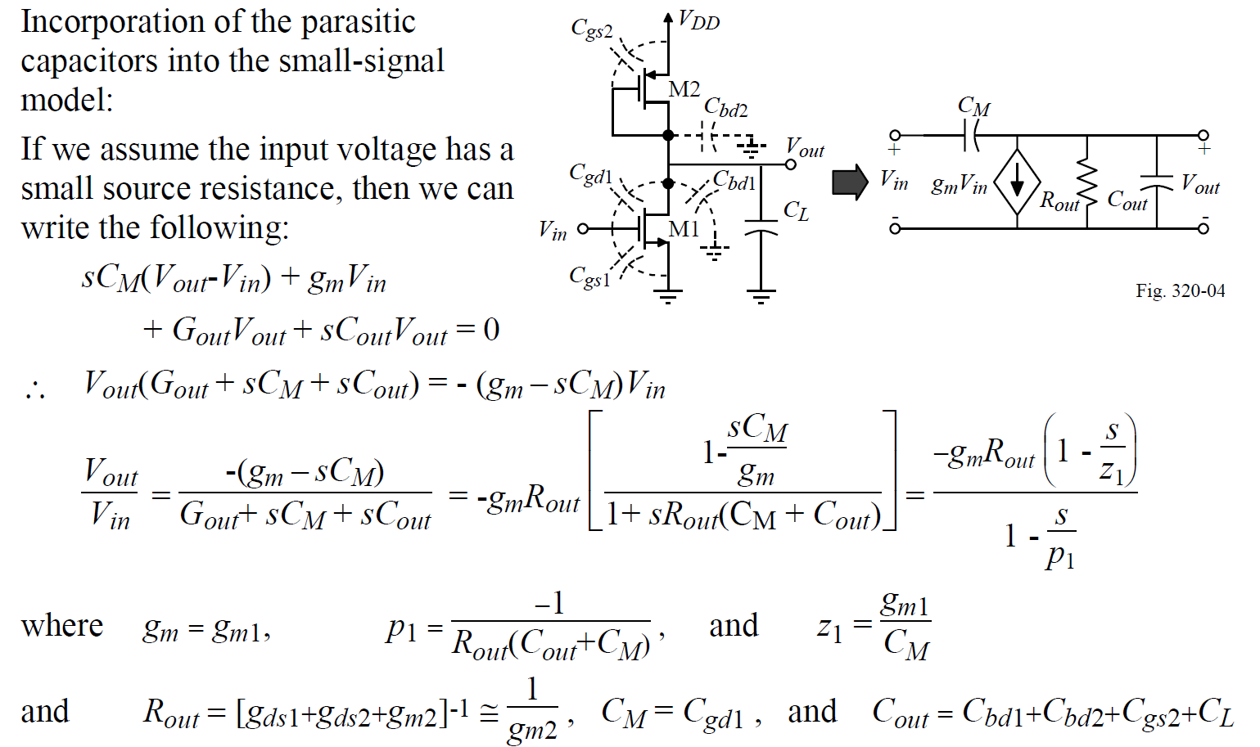
CS with Diode Load: Frequency Response

Slide 11
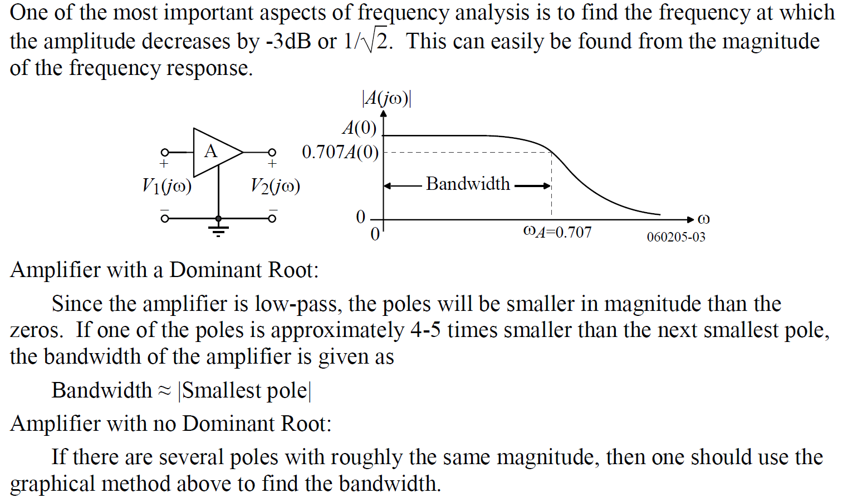
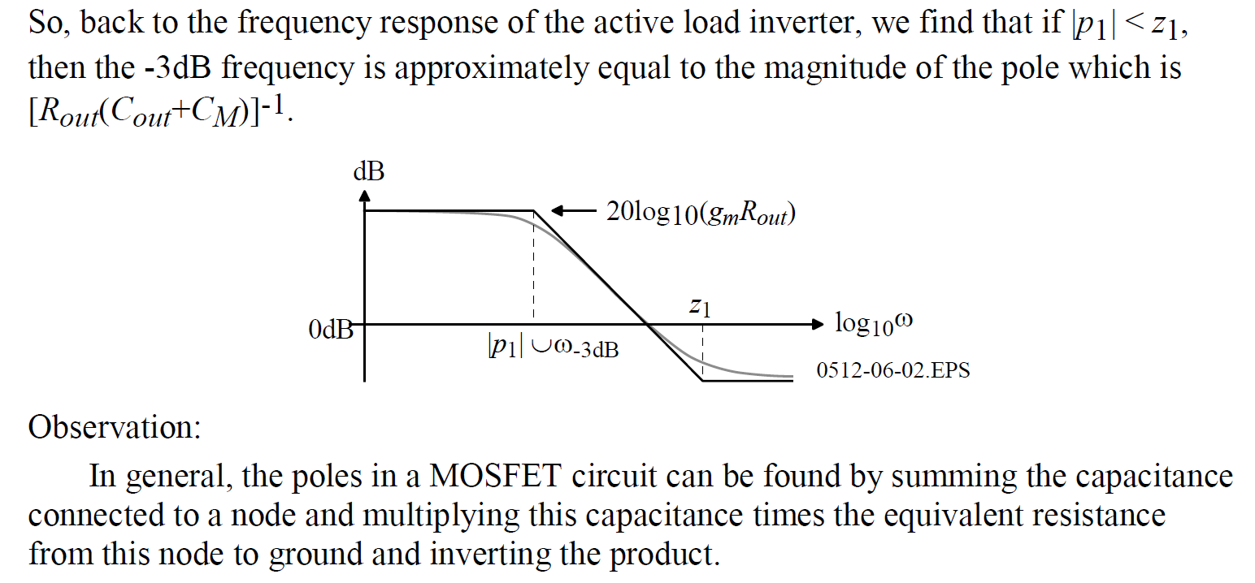
CS with Diode Load: Bandwidth

Slide 12
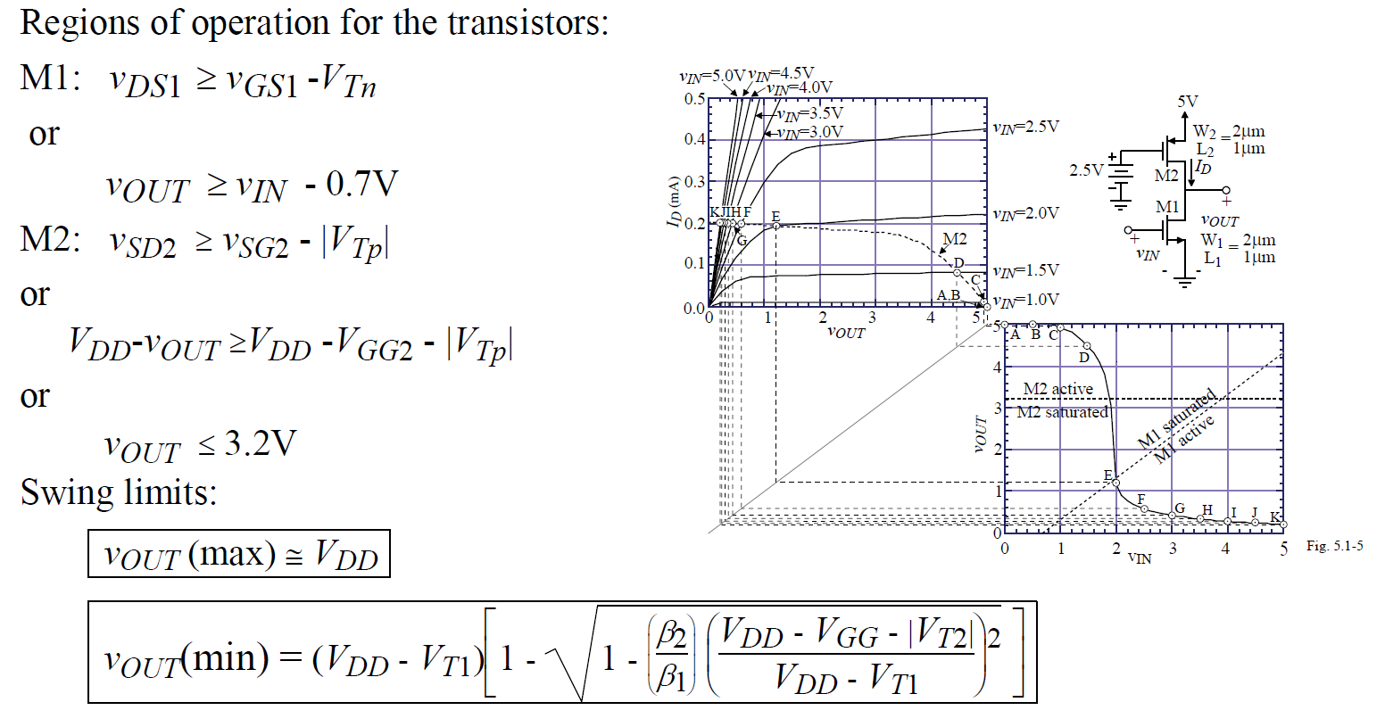
Common Source with Current Source Load

Slide 13
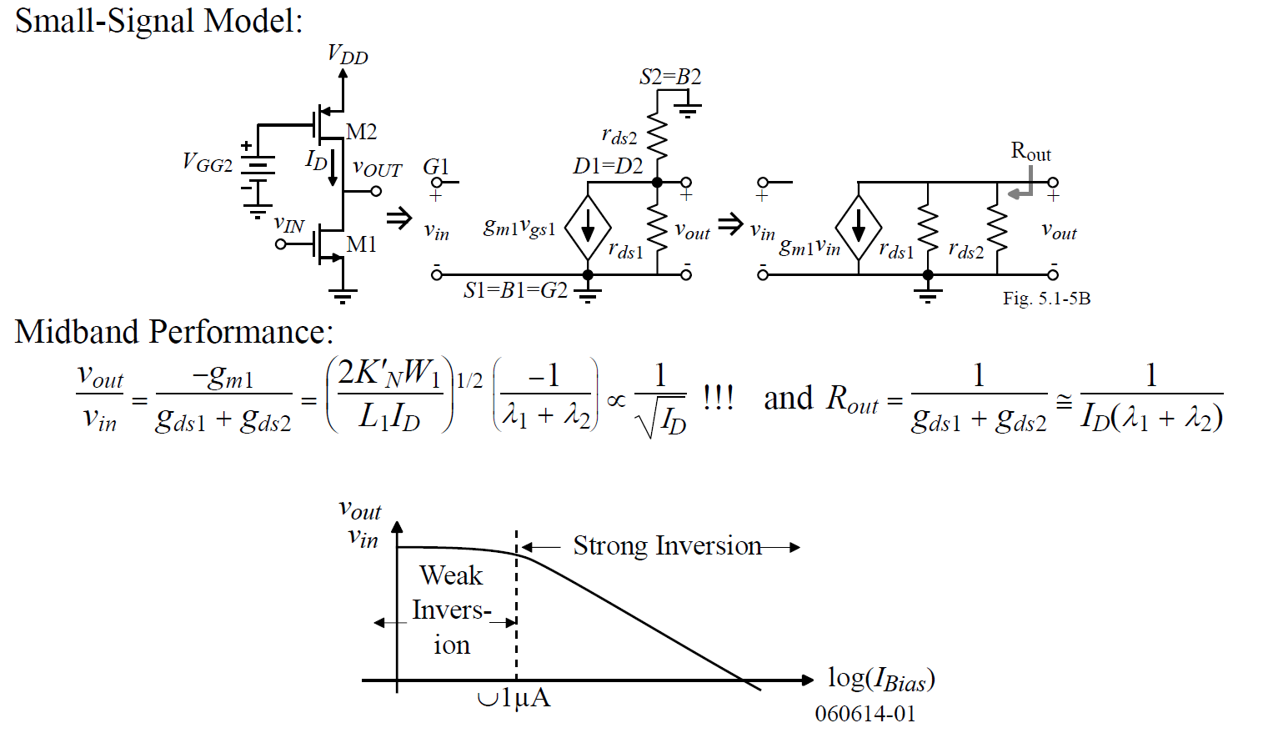
CS with Current Source Load: Small Signal

Slide 14
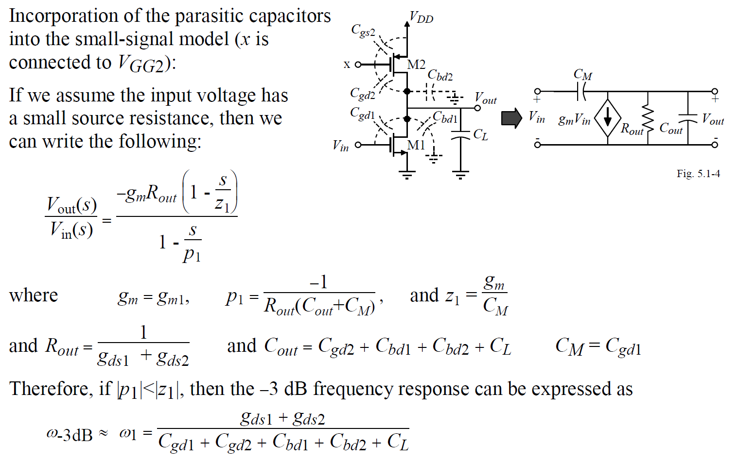
CS with I-Load: Frequency Response

Slide 15
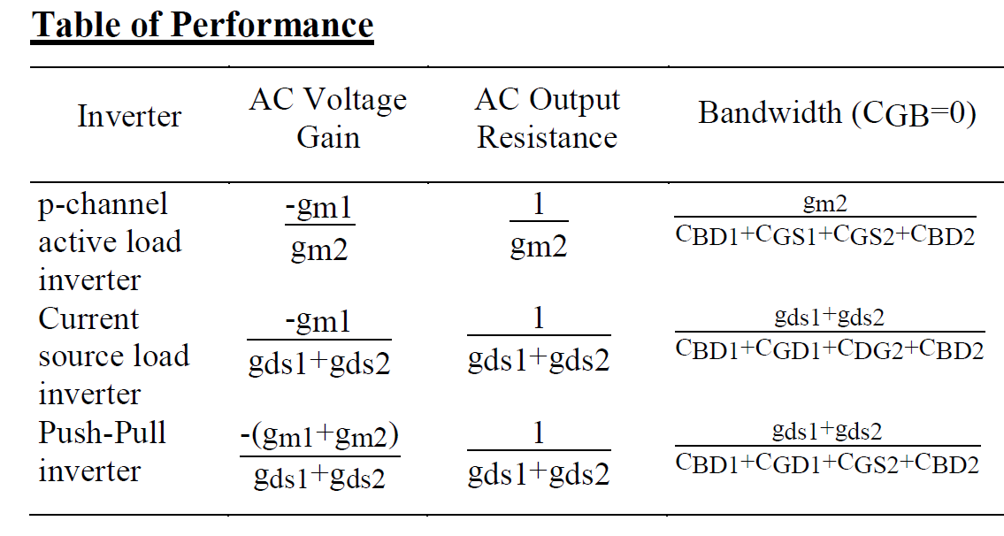
Summary of Common-Source

Slide 16
Outline
Single stage amplifiers: CS, CG
  Common Gate (CG)
Cascode Amplifiers
Current Mirrors: Simple, Cascode, Wilson
*With inputs from Phillip Allen’s course at Georgia Tech and Willy Sansen’s book

Slide 17
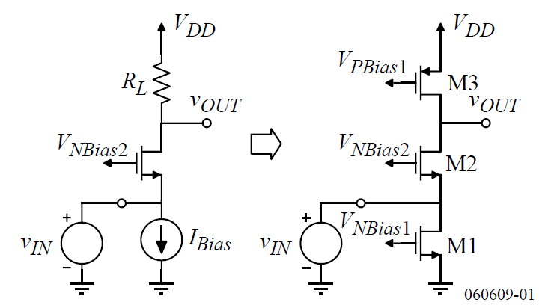
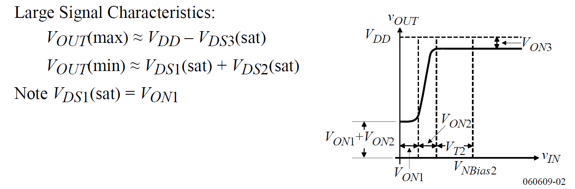
Common Gate Amplifier

Slide 18
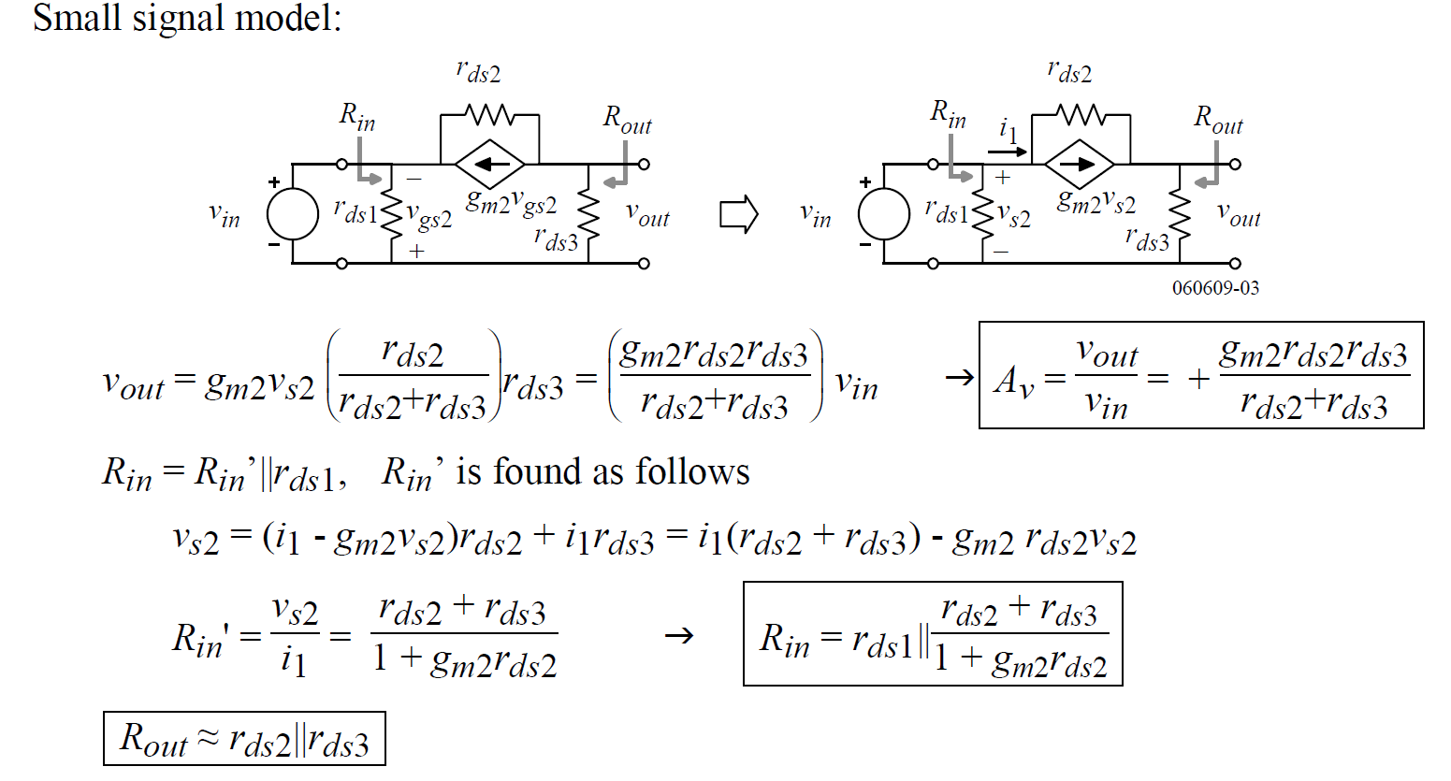
Common Gate: Small-Signal
r_{ds1} || (1/g_{m2} + r_{ds3}/g_{m2}r_{ds2})

Slide 19
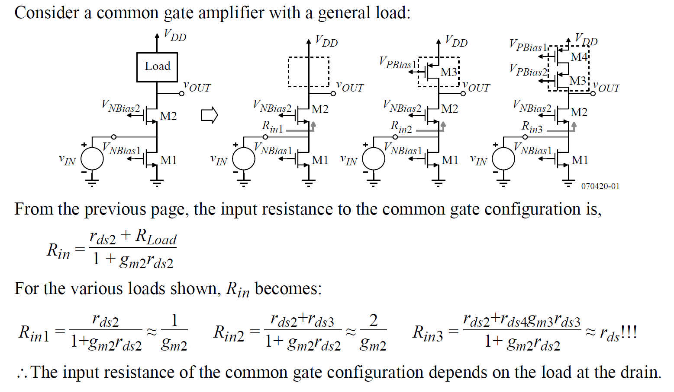
Common Gate: R_{in} details

Slide 20
Outline
Single stage amplifiers: CS, CG
Cascode Amplifiers
Current Mirrors: Simple, Cascode, Regulated Cascode
*With inputs from Phillip Allen’s course at Georgia Tech and Willy Sansen’s book

Slide 21
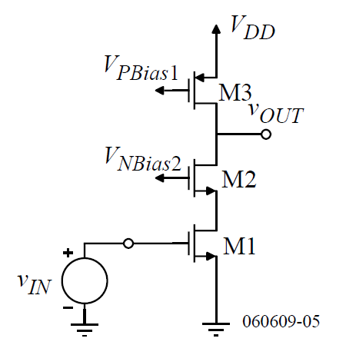
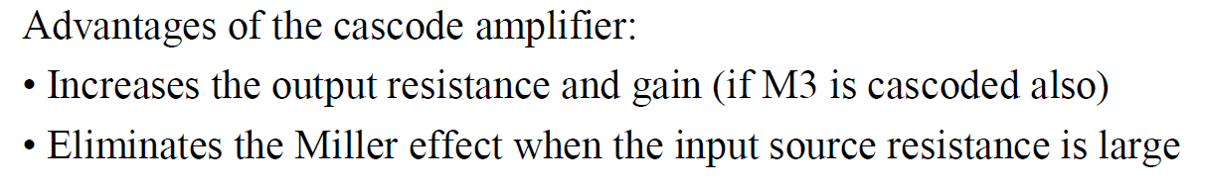
Cascode amplifiers
Cascode amplifier like Common-gate with Current input!
Common gate
g_{m}V_{in}

Slide 22
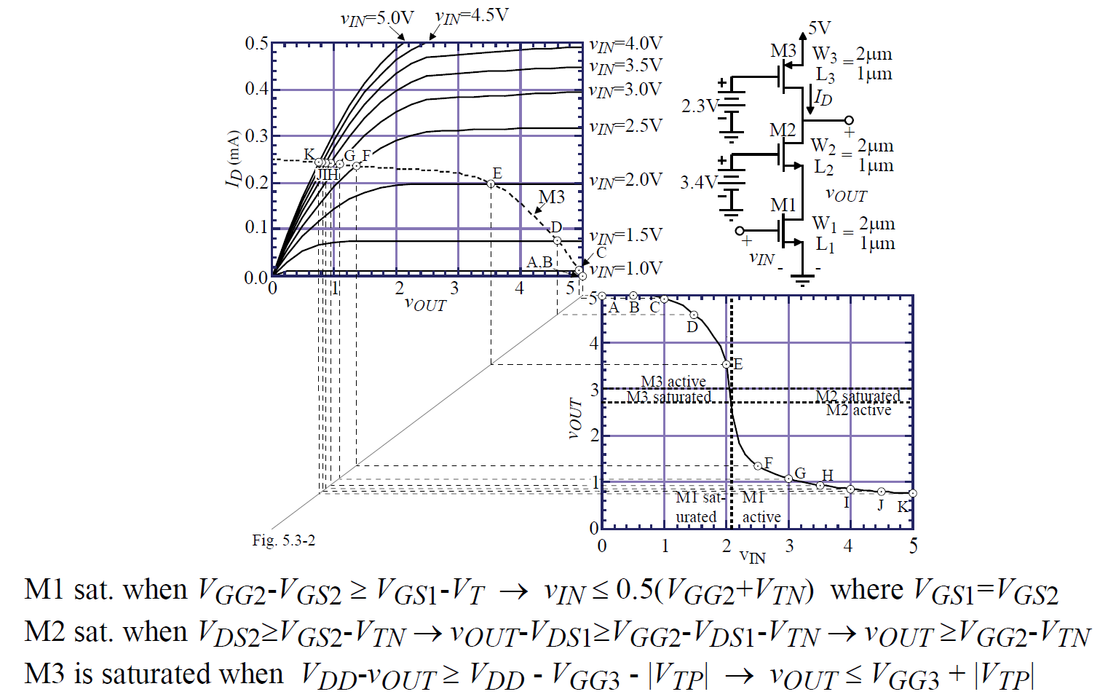
Cascode amplifiers

Slide 23
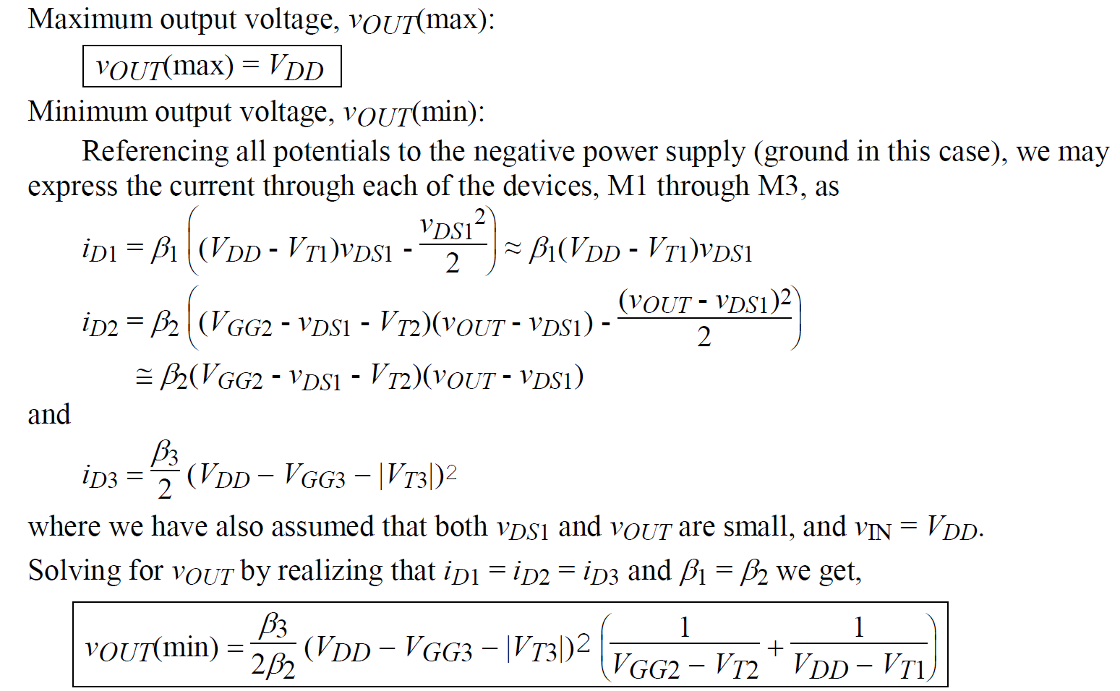
Cascode amplifiers

Slide 24
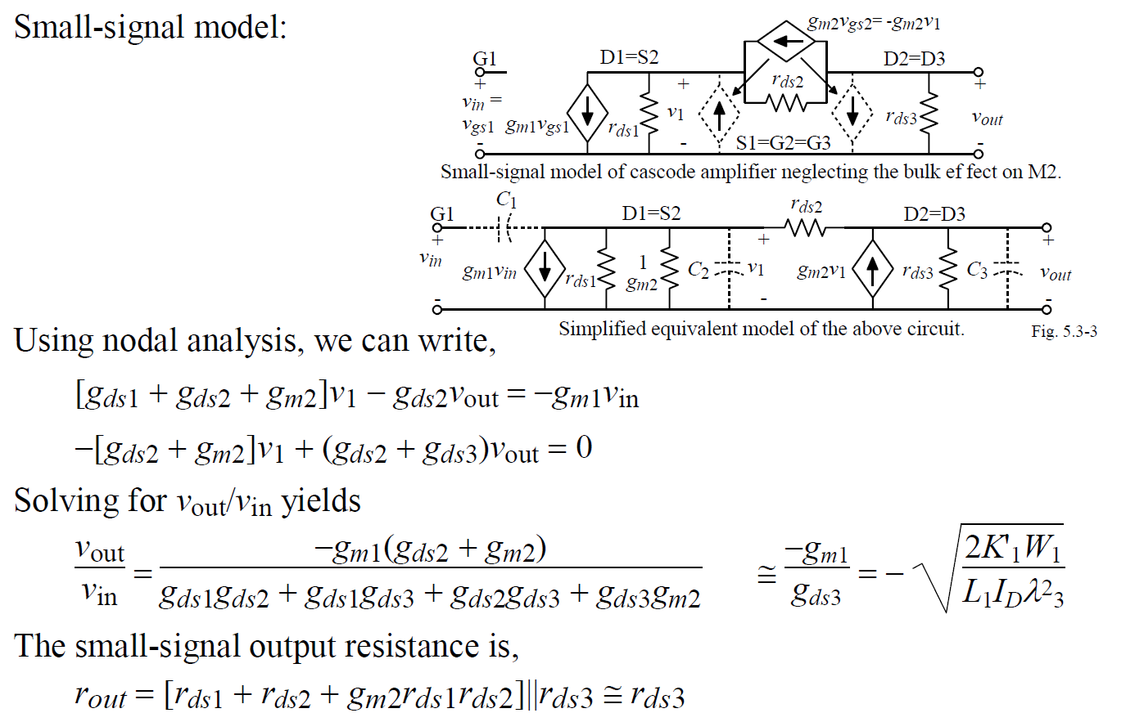
Cascode amplifiers: Small Signal

Slide 25
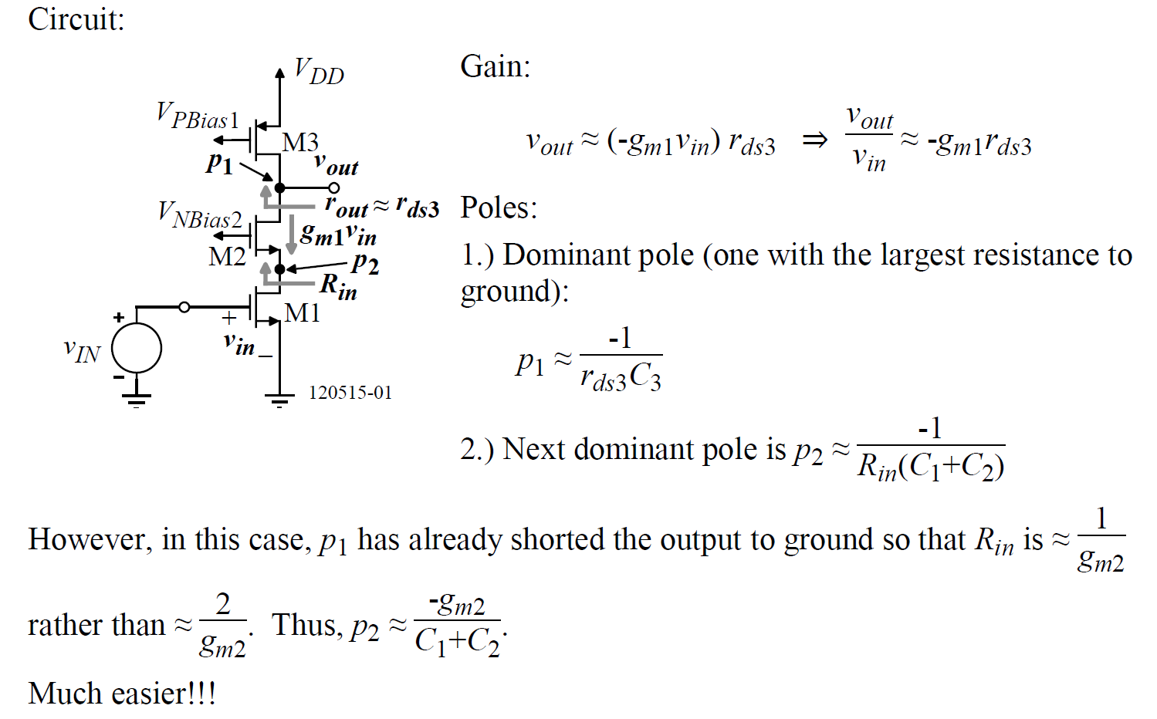
Cascode amplifiers: Intuitive

Slide 26
Outline
Single stage amplifiers: CS, CG
Cascode Amplifiers
Current Mirrors: Simple, Cascode, Regulated Cascode
*With inputs from Phillip Allen’s course at Georgia Tech and Willy Sansen’s book

Slide 27
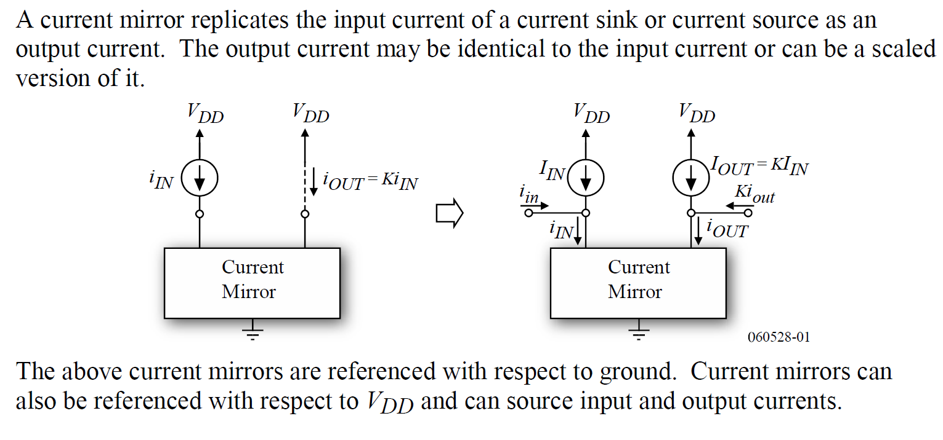
Current Mirrors

Slide 28
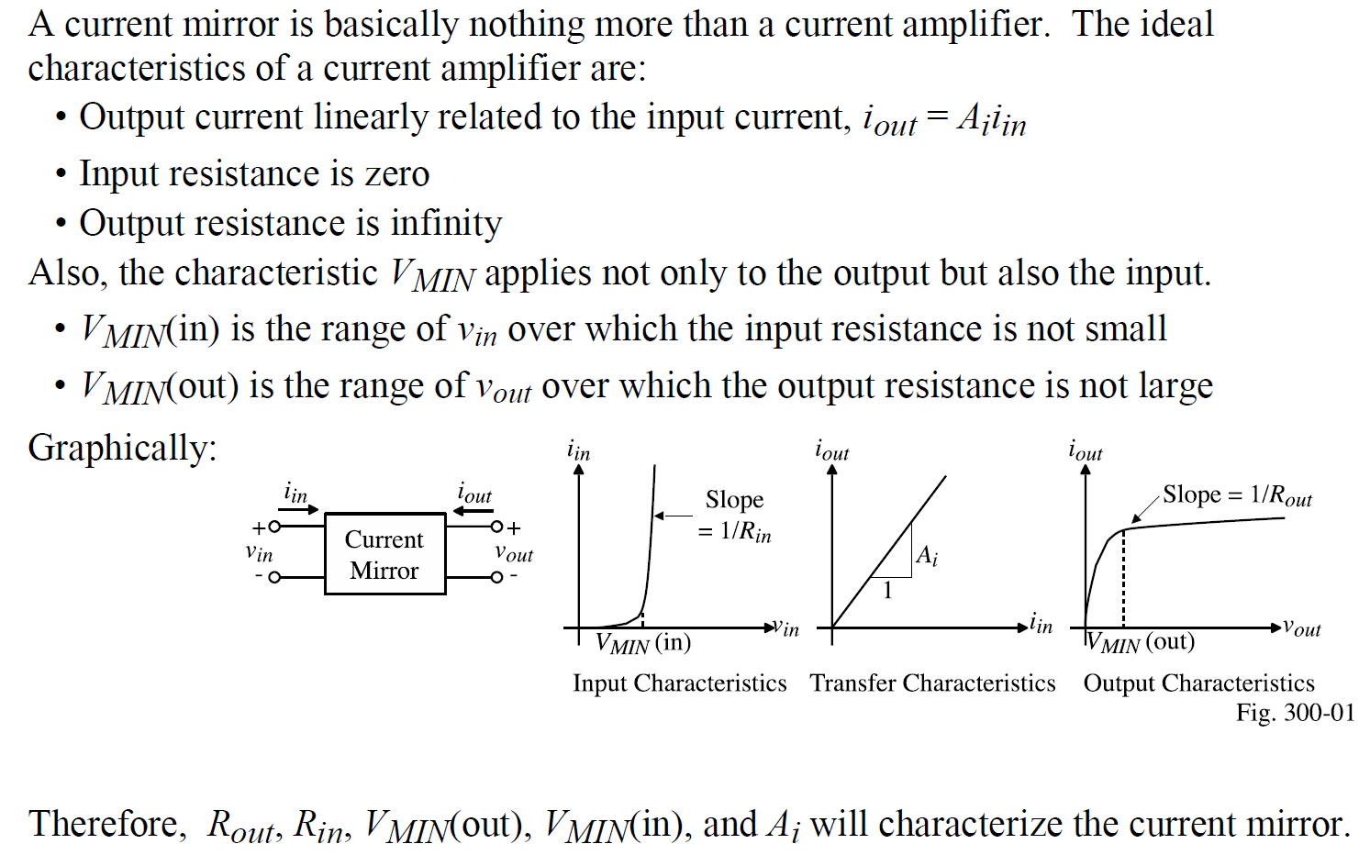
Current Mirrors: Characterization

Slide 29
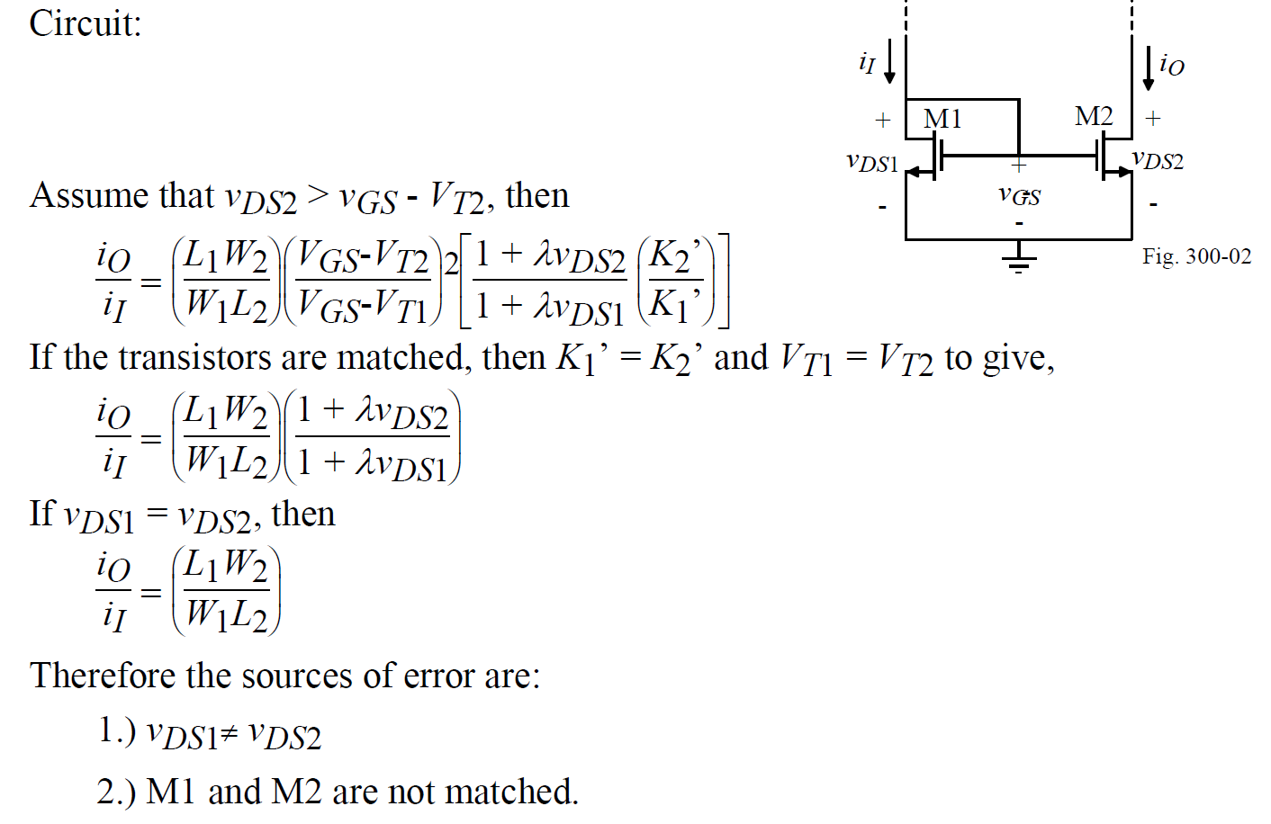
Current Mirrors: Simple

Slide 30
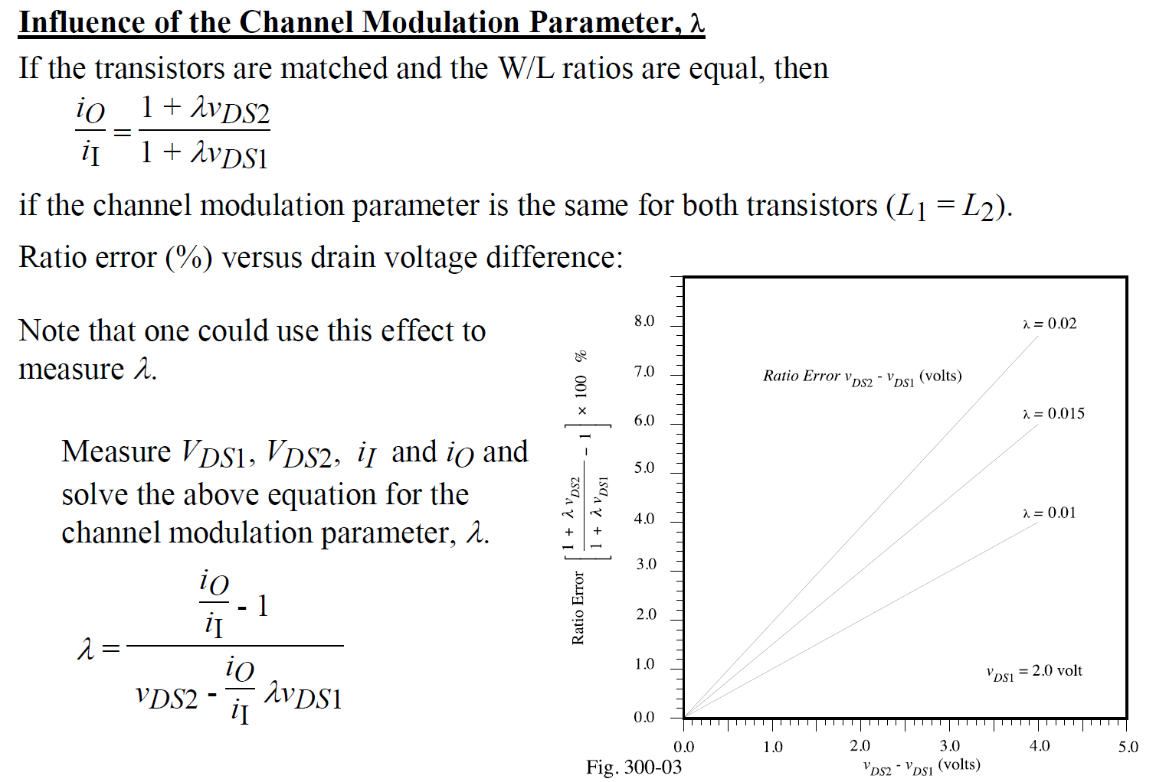
Current Mirrors: Errors

Slide 31
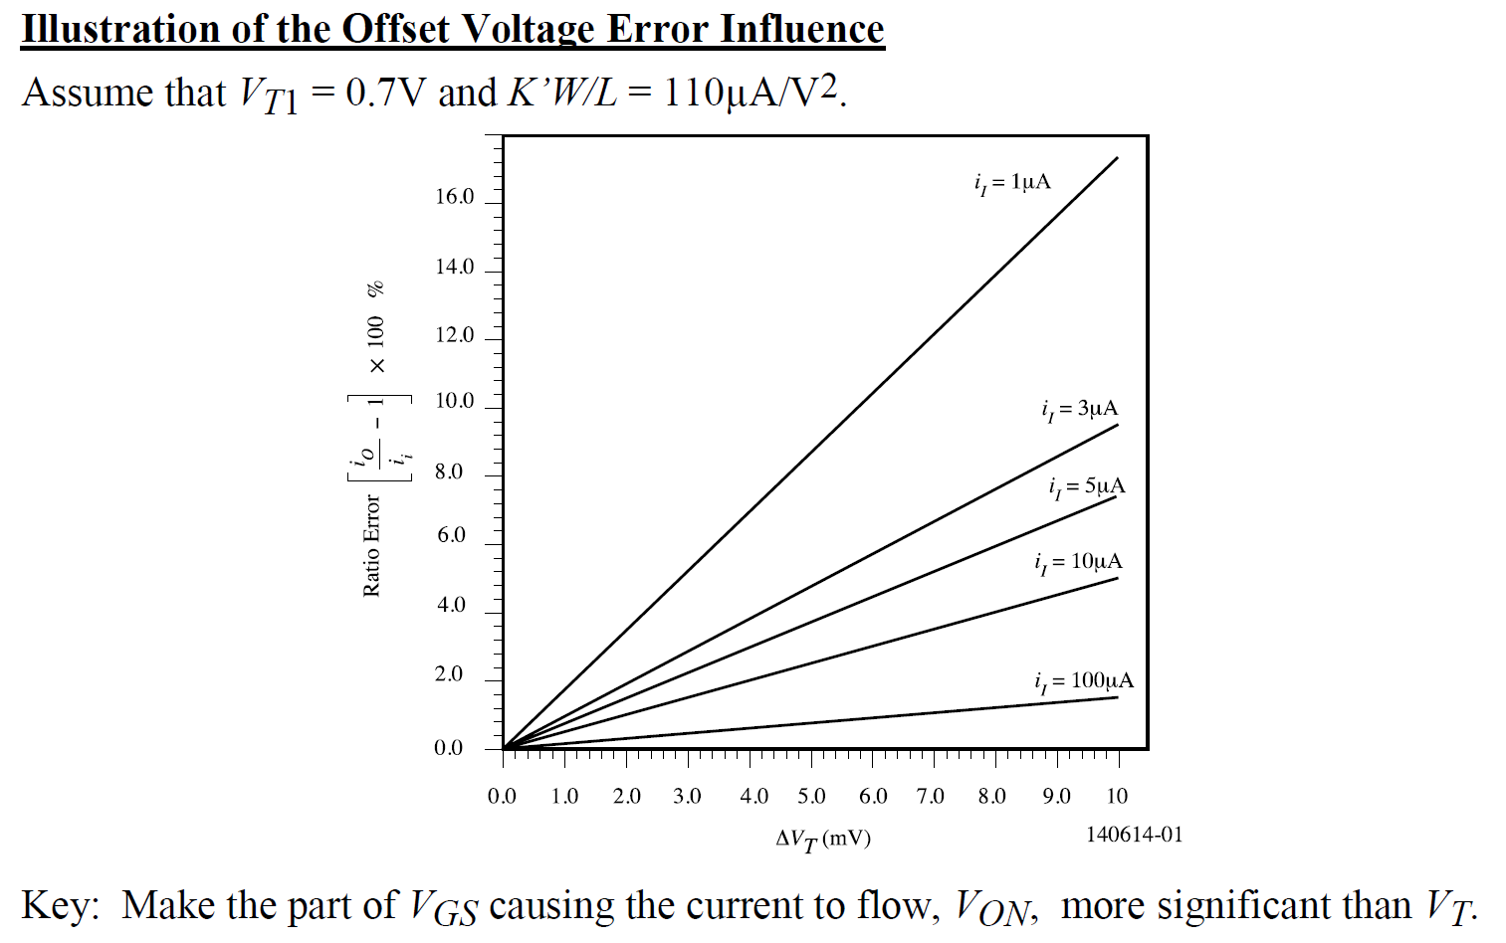
Current Mirrors: Errors

Slide 32
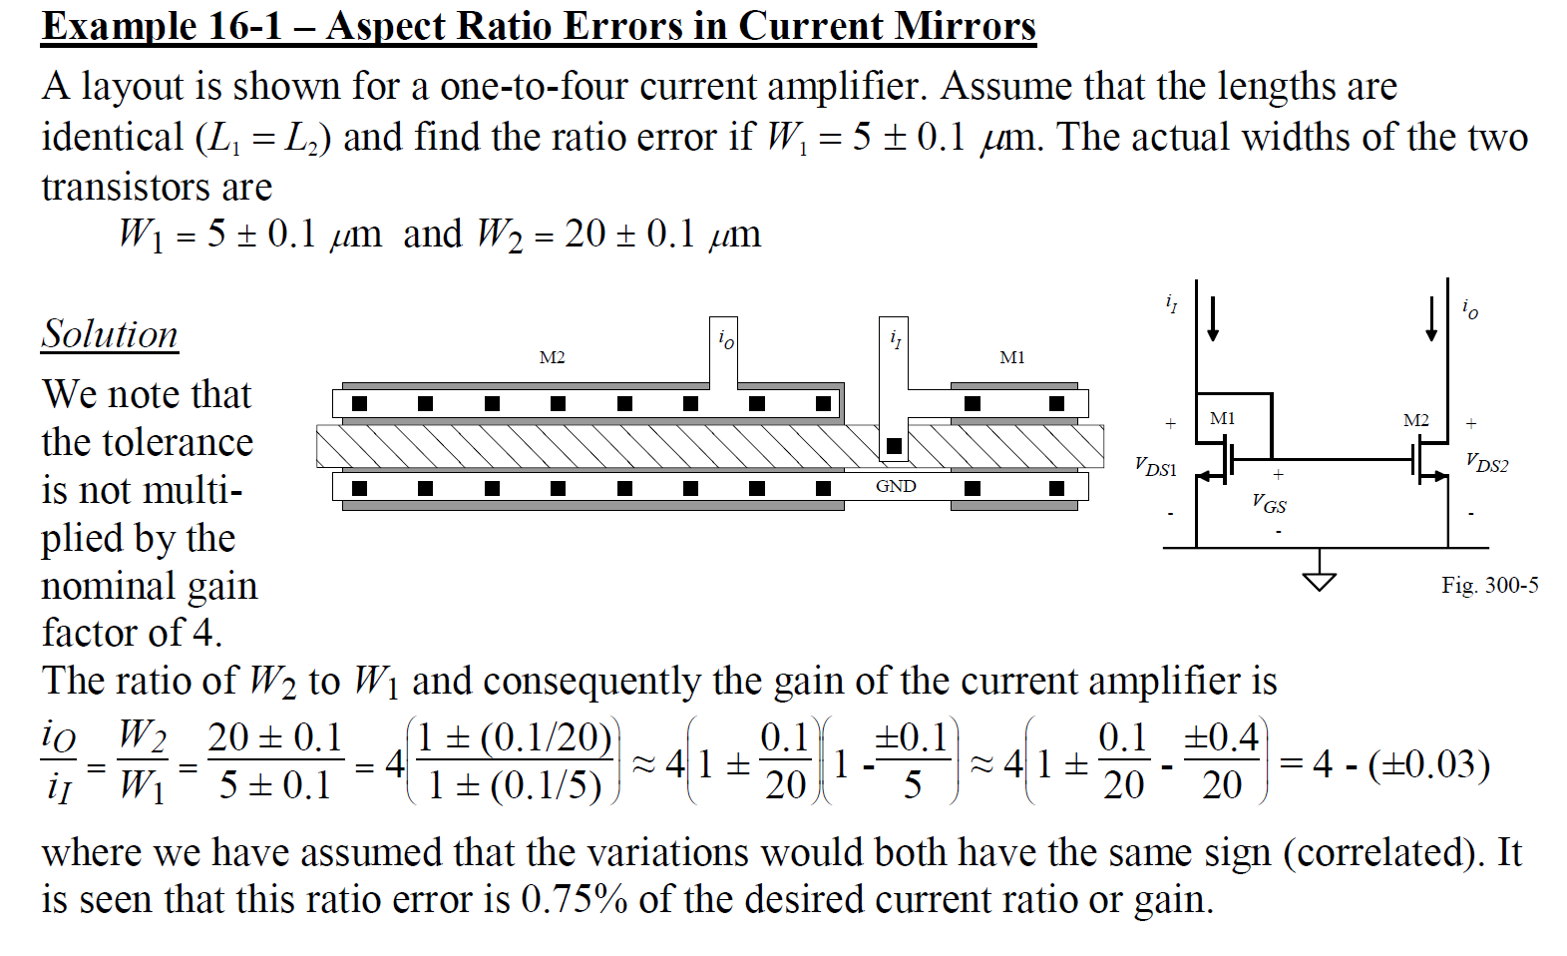
Current Mirrors: Errors
.06
1.5

Slide 33
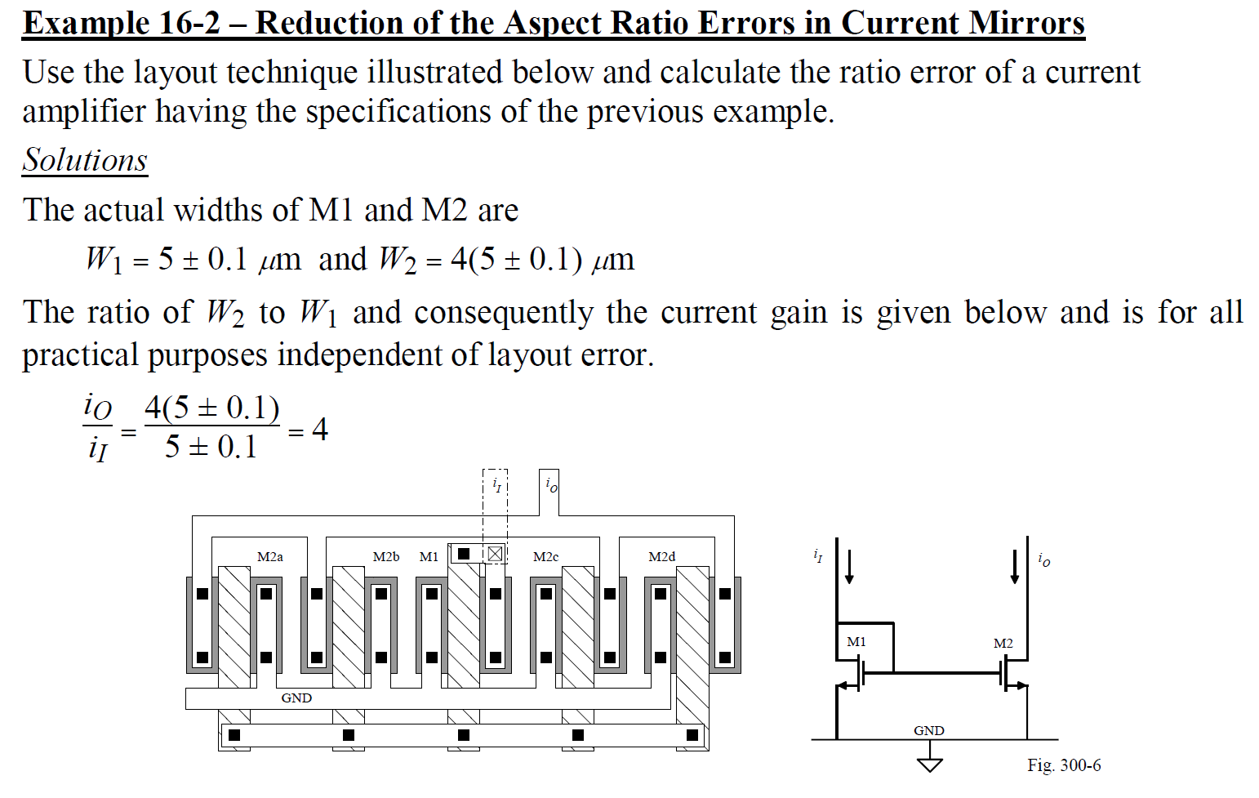
Current Mirrors: Errors

Slide 34
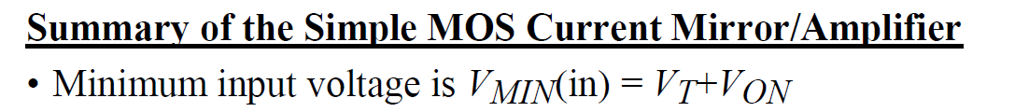
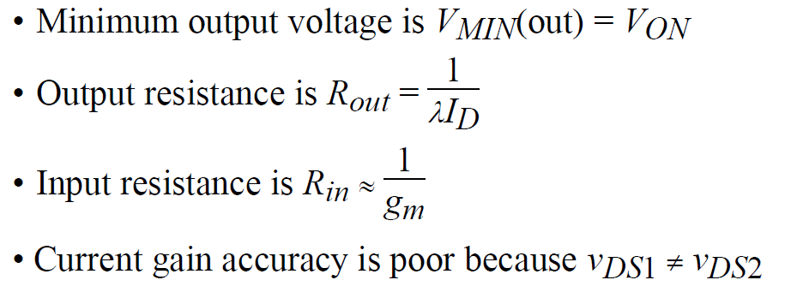
Current Mirrors: Summary

Slide 35
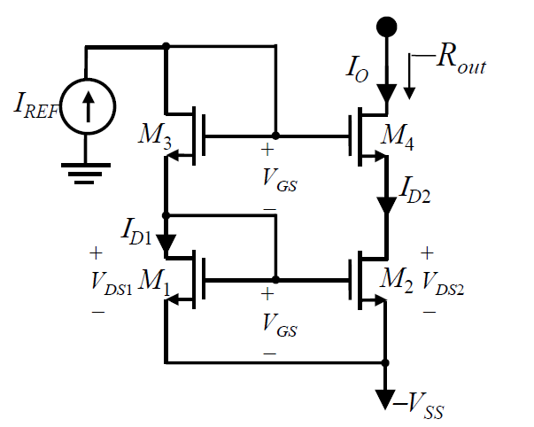
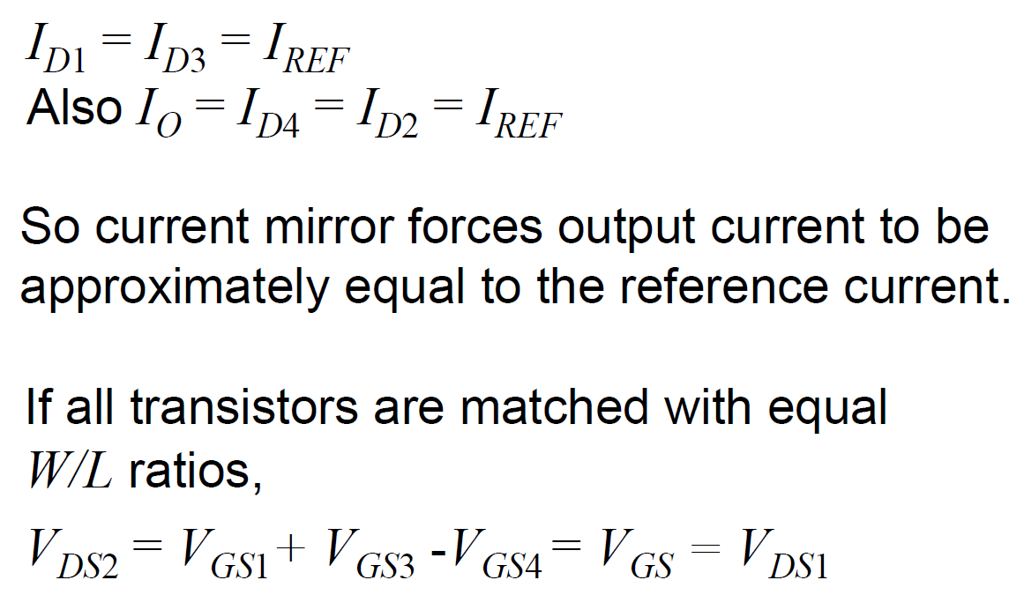
Improved Current Mirrors—Cascode

Slide 36
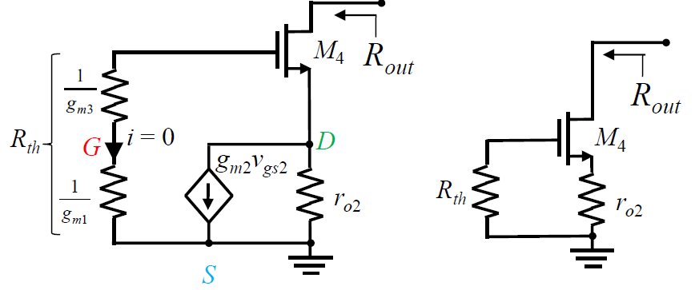
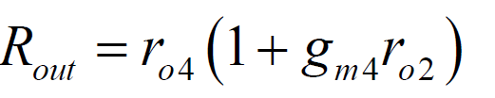
Improved Current Mirrors—Cascode

Slide 37
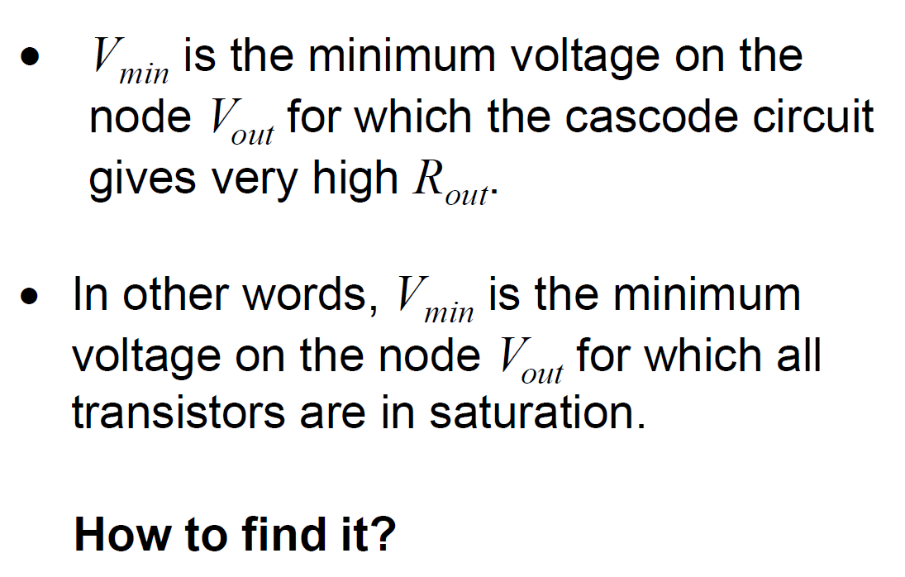
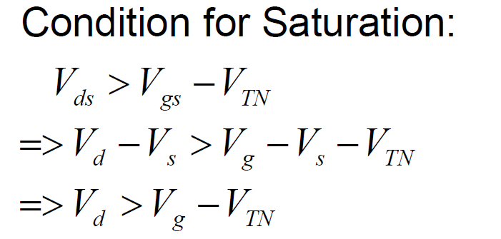
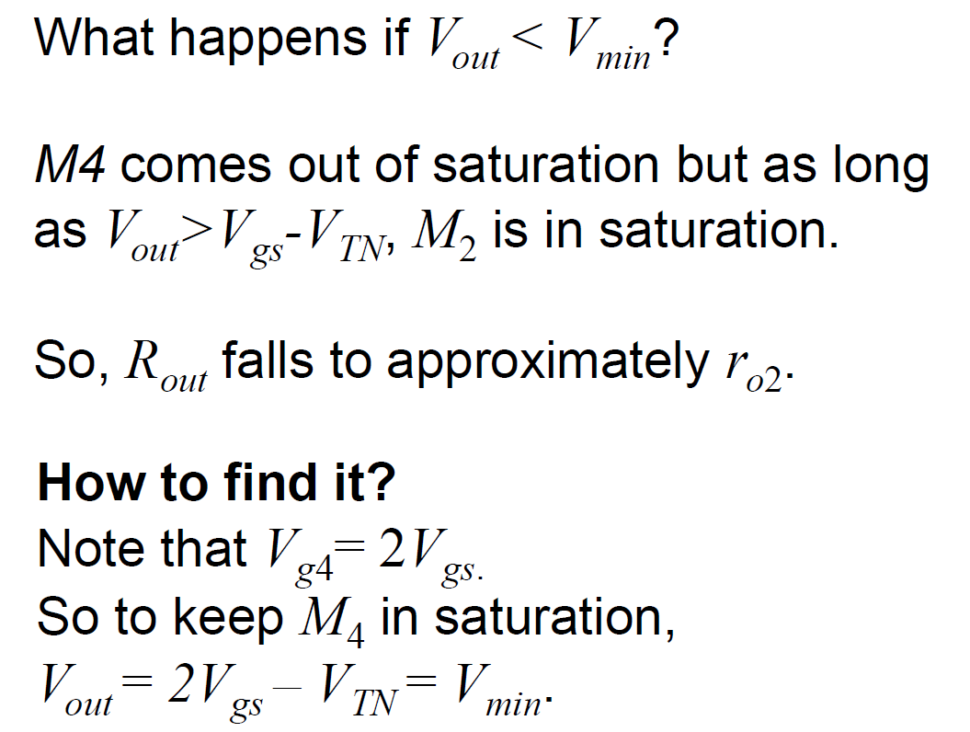
Improved Current Mirrors—Cascode V_{min}
V_{T} + 2V_{ov}

Slide 38
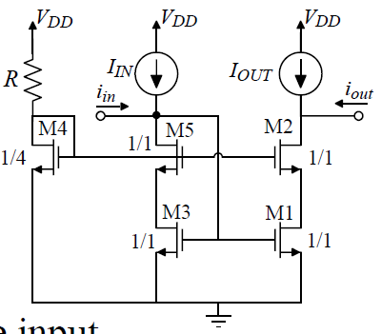
Reducing Cascode V_{min}: Wide swing
Assume same current in M4 and M3/M5
For M2, V_{D2} > V_{G2} – V_{T2} → V_{min,out} = V_{T} + 2V_{ov} –V_{T} = 2V_{ov}
For M3, V_{G3} = V_{T} + V_{ov} → V_{min,in} = V_{T} + V_{ov}
V_{ov}
V_{GS} = V_{T} + V_{ov}
V_{GS} = V_{T} + 2V_{ov}

Slide 39

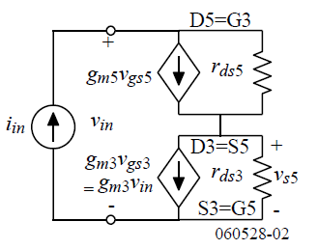
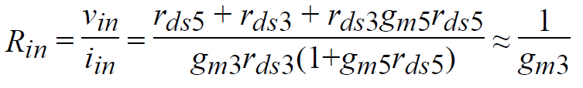
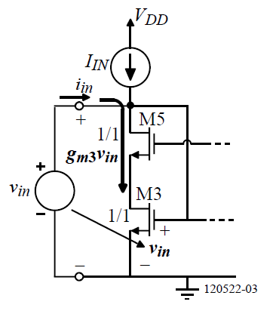
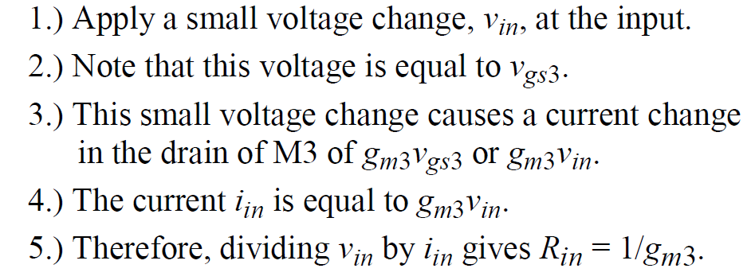
Wide swing Cascode: AC
Assume same current in M4 and M3/M5
Intuitive Analysis

Slide 40
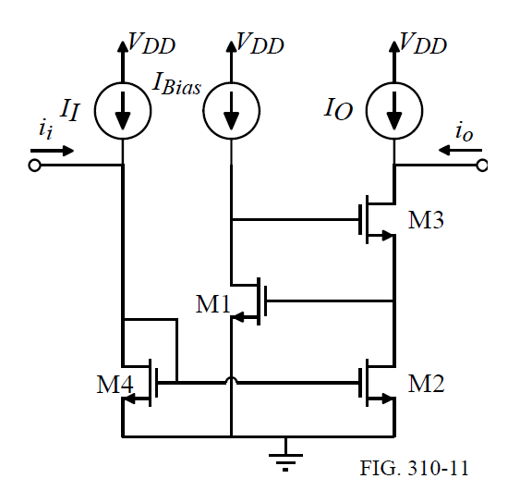
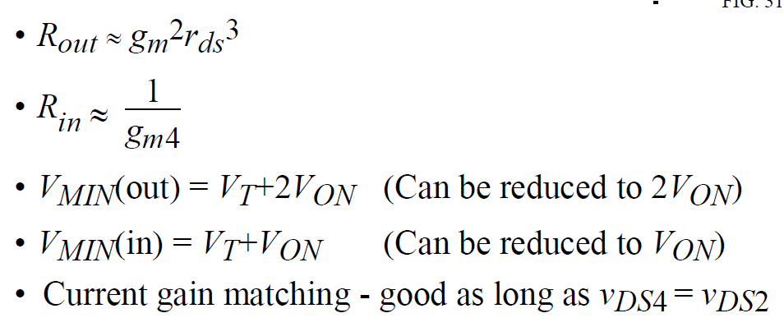
Regulated Cascode

Slide 41
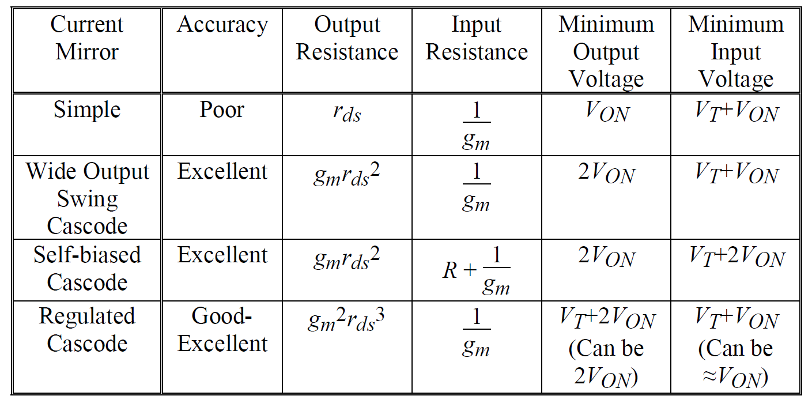
Summary

