Slide 1
EE2000 Logic Circuit Design
Registers and Counters

Slide 2
Outline
  1 Registers
  - Registers
  Parallel load, Bidirectional shift
  Serial Adder, Accumulator
  2 Counters
  - Asynchronous Counters
  Ripple counters
  - Synchronous Counters
  Up-down counters,
  Modulo counters,
  Ring counters, Twist Ring counters

Slide 3
Applications of Flip-Flops
Flip-Flops are basic element of Static Random Access Memory (SRAM) in CPUs, ALUs, microcontrollers.
Shift register is an example of this kind of memories. This includes:
    Parallel loading shift register : can be used for parallel to serial conversion in serial data communication
    Serial in, parallel out shift register: can be used for serial to parallel conversion in a serial data communication system.

Slide 4
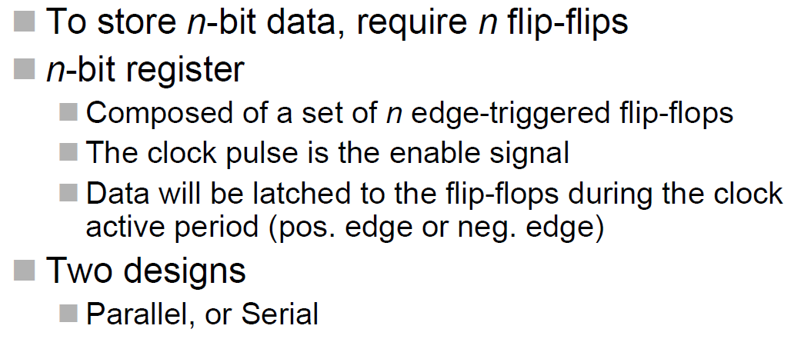
Registers

Slide 5
Shift Register
e.g. 3bit shift register by D-type FFs
Q₀ Q₁ Q₂
Q Q Q
^{D}in
D D D
Q Q
Q
CLK
serial input, D_{in} and parallel output Q₀, Q₁ and Q₂.
data moves one position to the right on each clock edge.

Slide 6
Shift Register
Preset and Clear inputs on the FFs can be utilised to provide a parallel data input feature
Data can then be clocked out through Q₂ in a serial fashion, i.e., we now have a parallel in, serial out arrangement
This along with the previous serial in, parallel out shift register arrangement can be used as the basis for a serial data link

Slide 7
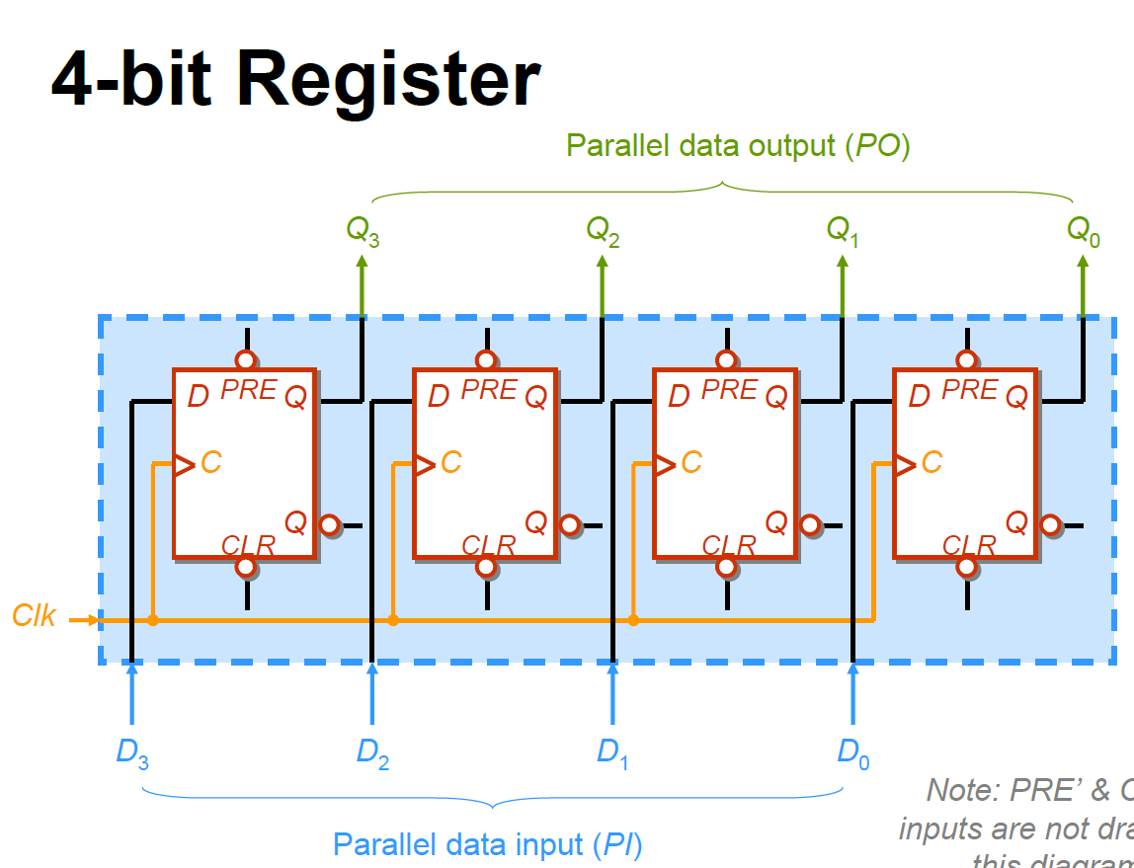
Note: PRE’ and CLR’ inputs are not shown in this diagram

Slide 8
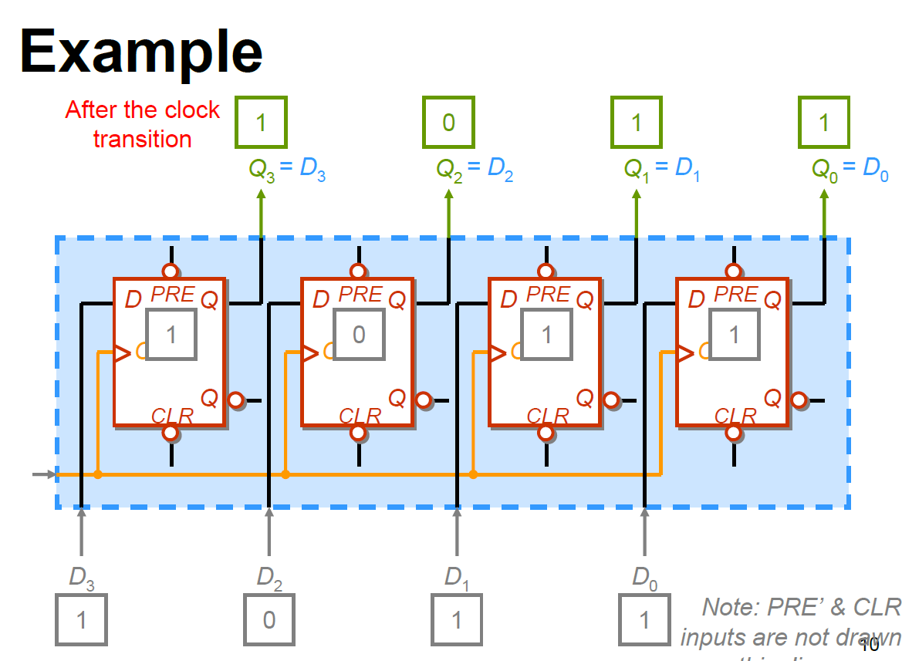
Output
t₂
Clk = ↑
t₁
Input
Note: PRE’ and CLR’ inputs are not shown in this diagram
t₀

Slide 9
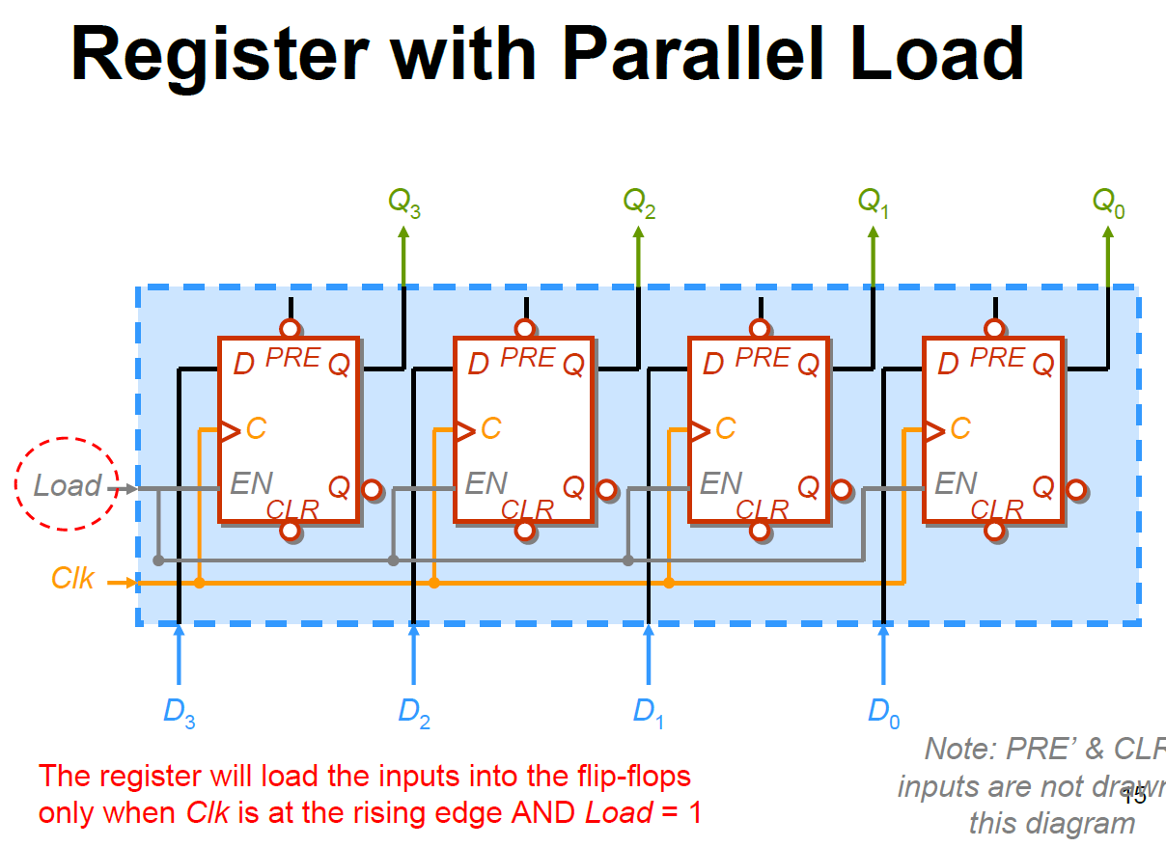

Slide 10
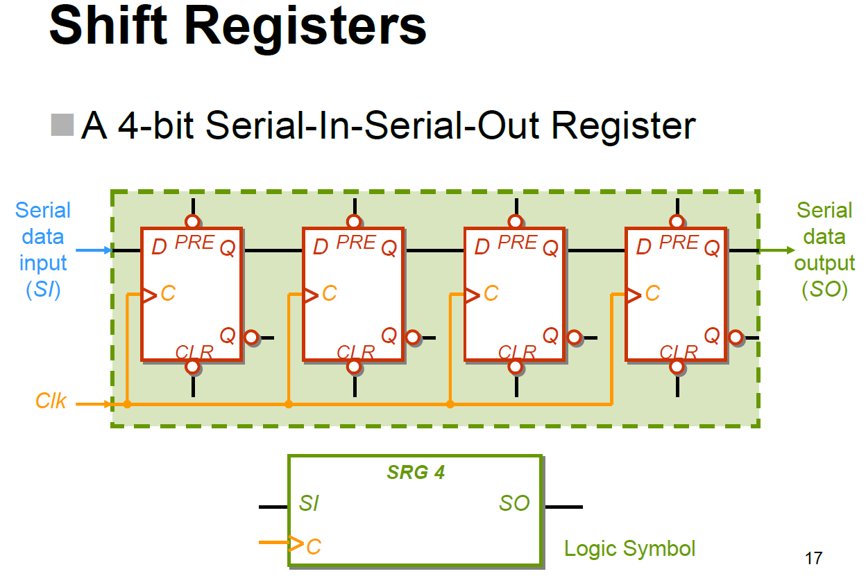

Slide 11
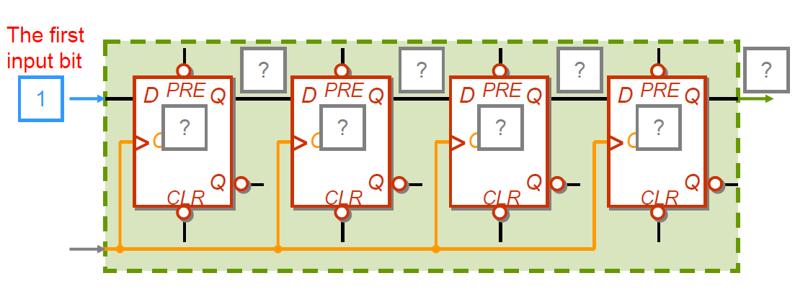
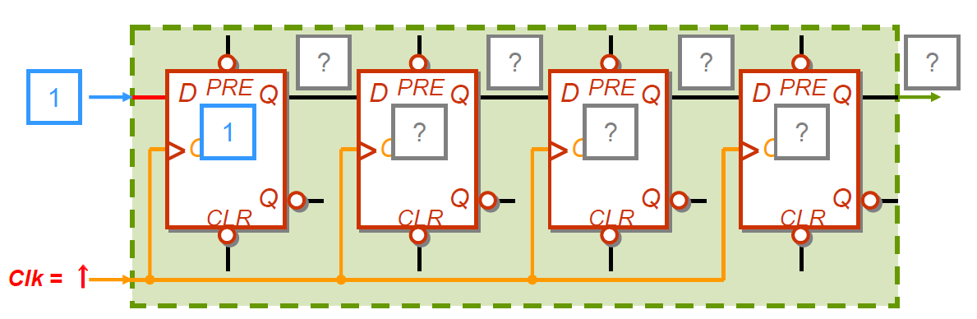
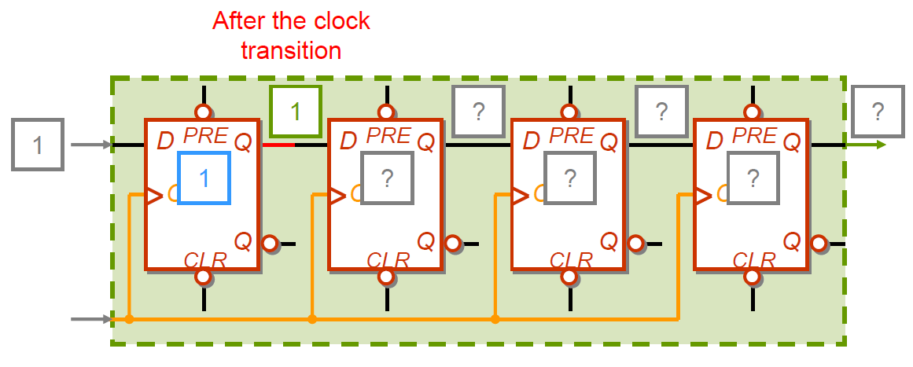

Slide 12
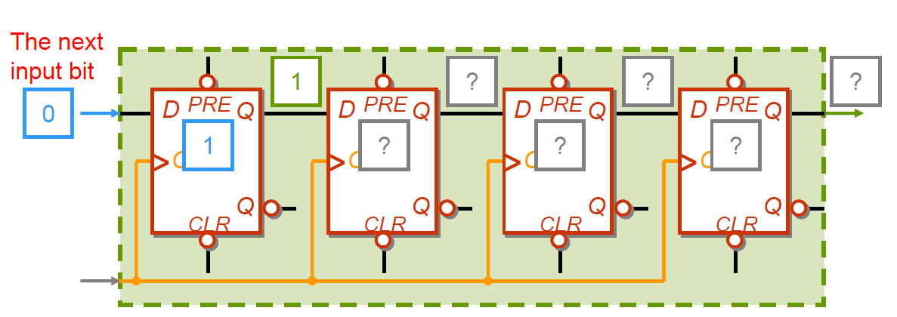
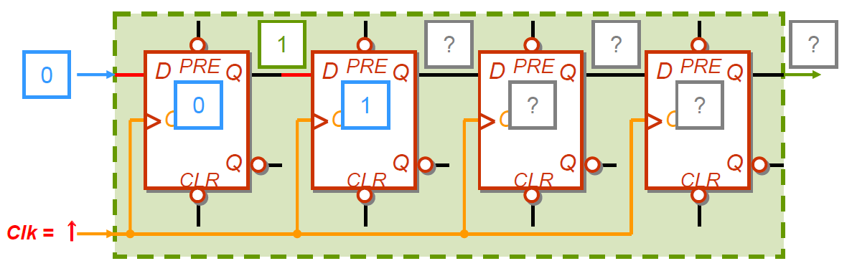
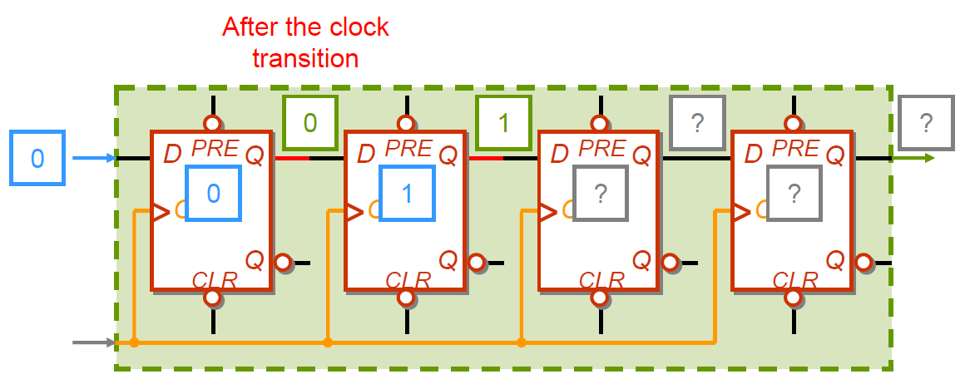

Slide 13
Counters
Many different counters can be designed based on applications.
We shall focus on ripple counters and synchronous counters

Slide 14
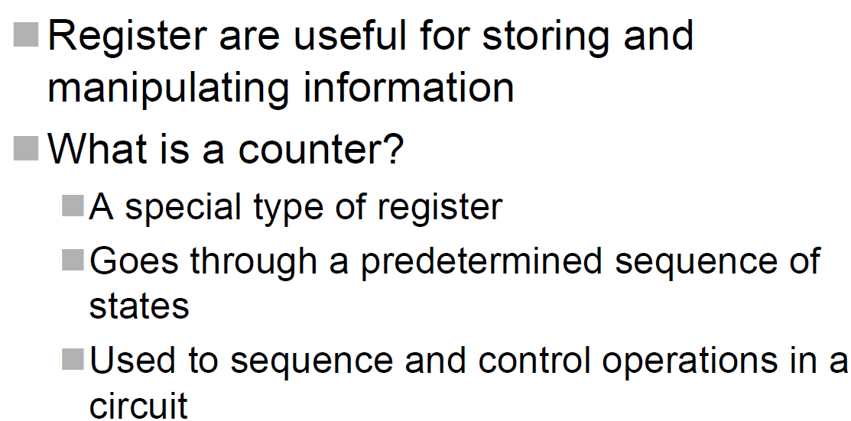
Counters

Slide 15
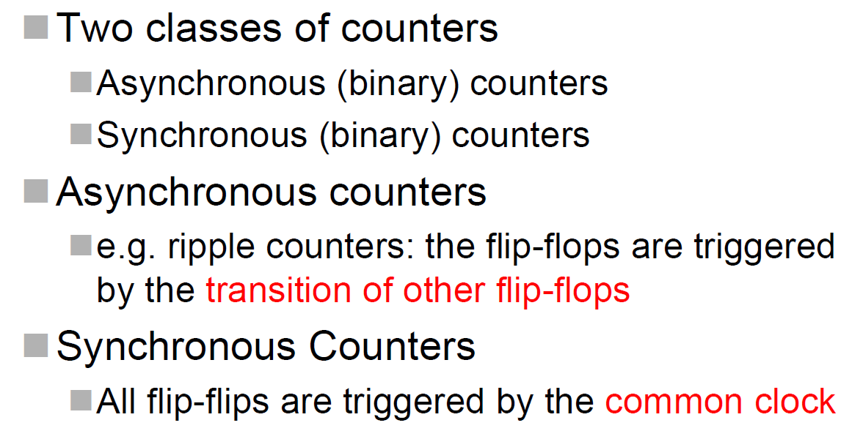
Counters

Slide 16
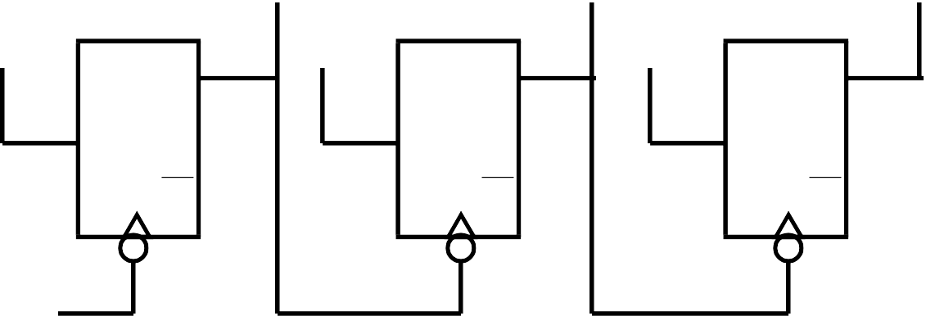
Ripple Counters
A ripple counter can be made be cascading together negative edge triggered T-type FFs operating in ‘toggle’ mode, i.e., T =1
Q₀ Q₁ Q₂
‘1’ ‘1’ ‘1’
Q Q Q
T T T
Q Q Q
CLK
Note that the FFs are not clocked using the same clock, i.e., this is not a synchronous design.
000
001
010
011
100
101
110
111

Slide 17
000
001
010
011
100
101
110
111
Ripple Counters
CLK
Q₀
Q₁ Q₂
0 1 2 3 4 5 6 7 0
Problems:
-- Outputs do not change at the same time or synchronously.
So hard to know when count output is actually valid.
-- Propagation delay builds up from stage to stage, limiting maximum clock speed before miscounting occurs.

Slide 18
Ripple Counters
If you observe the frequency of the counter output signals you will note that each has half the frequency, i.e., double the repetition period of the previous one. This is why counters are often known as dividers
Often we wish to have a count which is not a power of 2, e.g., for a BCD counter (0 to 9).To do this:
  use FFs having a Reset/Clear input
  Use an AND gate to detect the count of 10 and use its output to Reset the FFs

Slide 19
Synchronous Counters
Synchronous counter overcomes the problems identified with ripple counters.
In a synchronous design
  all the FF clock inputs are directly connected to the clock signal and so all FF outputs change at the same time, i.e., synchronously
  more complex combinational logic is now needed to generate the appropriate FF input signals (which will be different depending upon the type of FF chosen)

Slide 20
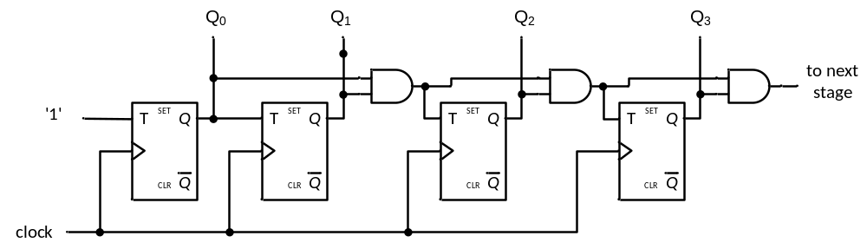
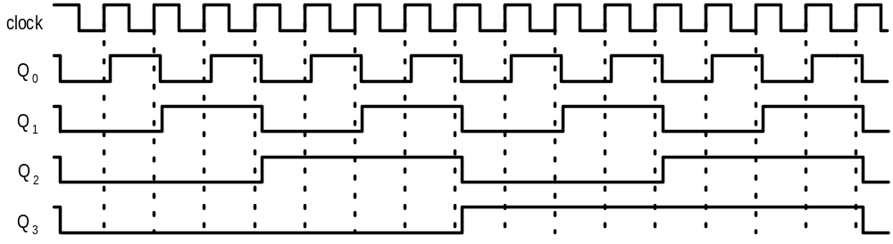
Synchronous Counter
The delays of all FFs are the propagation delays of their own.
It can be used for frequency division.

Slide 21
Synchronous Counter Design procedures
  Work out the state transition table
  Determine the FF excitation (easy for D-types)
  Determine the combinational logic for generating the required FF excitation from the current states;
    Note: remember to take into account any unused counts since these can be used as don’t care states when determining the combinational logic circuits

Slide 22
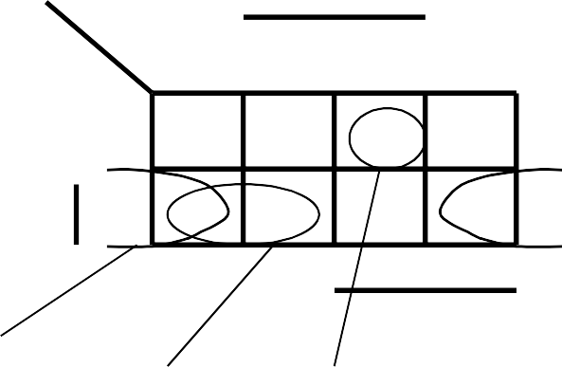
Synchronous Counter Example
Use D-type FFs to design a synchronous counter counting 0 to 7.
Current state Q₂Q₁Q₀
Next state
FF
inputs
By inspection,
D₀ = Q₀
Note: FF₀ is toggling Also, D₁ = Q₀ ⊕ Q₁
Use a K-map for D₂ ,
_{Q}' _{Q}' _{Q}'
D D D
2 1 0
2 1 0
0 | 0 | 0 | 0 | 0 | 1 | 0 | 0 | 1
0 | 0 | 1 | 0 | 1 | 0 | 0 | 1 | 0
0 | 1 | 0 | 0 | 1 | 1 | 0 | 1 | 1
0 | 1 | 1 | 1 | 0 | 0 | 1 | 0 | 0
1 | 0 | 0 | 1 | 0 | 1 | 1 | 0 | 1
1 | 0 | 1 | 1 | 1 | 0 | 1 | 1 | 0
1 | 1 | 0 | 1 | 1 | 1 | 1 | 1 | 1
1 | 1 | 1 | 0 | 0 | 0 | 0 | 0 | 0
Q₁Q₀
Q₀
Q₂
00 01 11 10
1
1
0
Q₂ 1
1 1
Q₁
Q₀.Q₂
Q₁.Q₂
Q₀.Q₁.Q₂

Slide 23
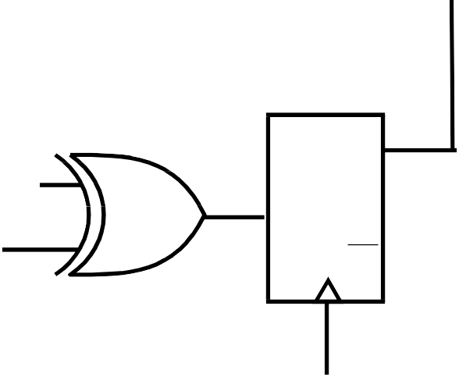
Synchronous Counter Example
Q
Q₁Q₀
0
00 01 11 10
1
Q₂
So,
0
Q₂ 1 1 1
D₂ = Q₀.Q₂ + Q₁.Q₂ + Q₀.Q₁.Q₂
1
D₂ = Q₂.(Q₀. + Q₁) + Q₀.Q₁.Q₂
Q₁
Q₀.Q₂
Q₁.Q₂ Q₀.Q₁.Q₂
Q₀
Q₁
Q₂
Q₀
Q₀
Q₁
Combinati- onal logic
Q
Q
Q
Q
D₀
D₁
1
D₂
D
D
D
Q₂
Q
Q
Q₂
Q
CLK

Slide 24
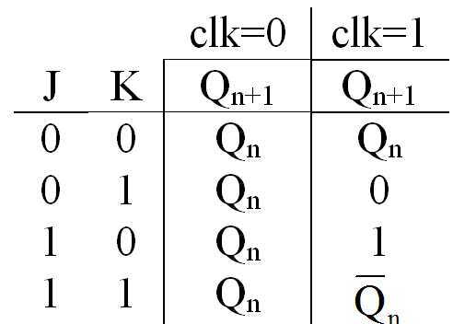
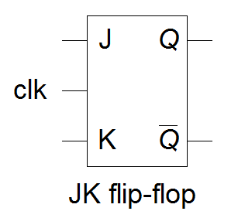
Synchronous Counter Example with JK FF
Using JK FFs and with the minimum number of states to design a counter with counting sequence: 0,4,2,1,6 and repeat.
0
6
4
1
2

Slide 25
Q(n) | Q(n+1) | J | K
0 | 0 | 0 | X
0 | 1 | 1 | X
1 | 0 | X | 1
1 | 1 | X | 0
JK Excitation Table
INPUTS |  |  | OUTPUTS
J | K | Q_{n} (Present State) | Q_{n+1} (Next State)
0 | 0 | 0 | 0
0 | 0 | 1 | 1
0 | 1 | 0 | 0
0 | 1 | 1 | 0
1 | 0 | 0 | 1
1 | 0 | 1 | 1
1 | 1 | 0 | 1
1 | 1 | 1 | 0
INPUTS |  |  | OUTPUTS | REMARKS
J | K | Q_{n} | Q_{n+1} | States and Conditions
0 | 0 | X | Q_{n} | Hold State condition J = K = 0
0 | 1 | X | 0 | Reset state condition J = 0 , K = 1
1 | 0 | X | 1 | Set state condition J = 1 , K = 0
1 | 1 | X | Q’_{n} | Toggle state condition J = K = 1

Slide 26
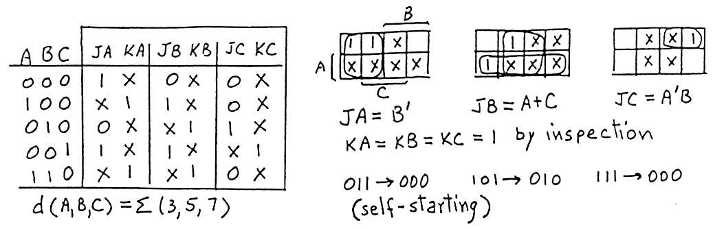
0
Present |  |  | Next |  |  | FF-A |  | FF-B |  | FF-C
A | B | C | A | B | C | JA | KA | JB | KB | JC | KC
0 | 0 | 0 | 1 | 0 | 0 | 1 | X | 0 | X | 0 | X
0 | 0 | 1 | 1 | 1 | 0 | 1 | X | 1 | X | X | 1
0 | 1 | 0 | 0 | 0 | 1 | 0 | X | X | 1 | 1 | X
0 | 1 | 1 | X | X | X | X | X | X | X | X | X
1 | 0 | 0 | 0 | 1 | 0 | X | 1 | 1 | X | 0 | X
1 | 0 | 1 | X | X | X | X | X | X | X | X | X
1 | 1 | 0 | 0 | 0 | 0 | X | 1 | X | 1 | 0 | X
1 | 1 | 1 | X | X | X | X | X | X | X | X | X
0
1
2
4
6
6
4
1
2
All the unused states are treated as don’t care condition.
Q(n) | Q(n+1) | J | K
0 | 0 | 0 | X
0 | 1 | 1 | X
1 | 0 | X | 1
1 | 1 | X | 0
JK Excitation Table

Slide 27
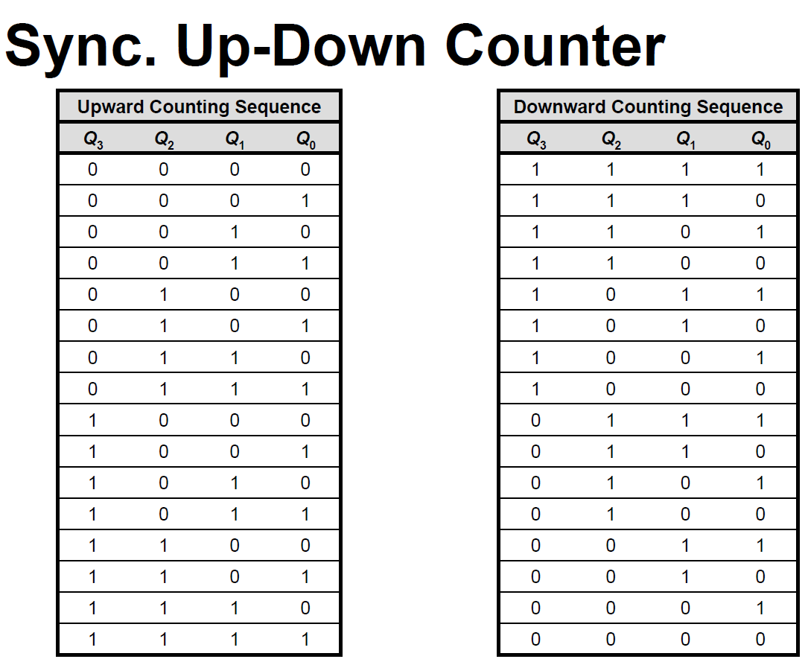

Slide 28
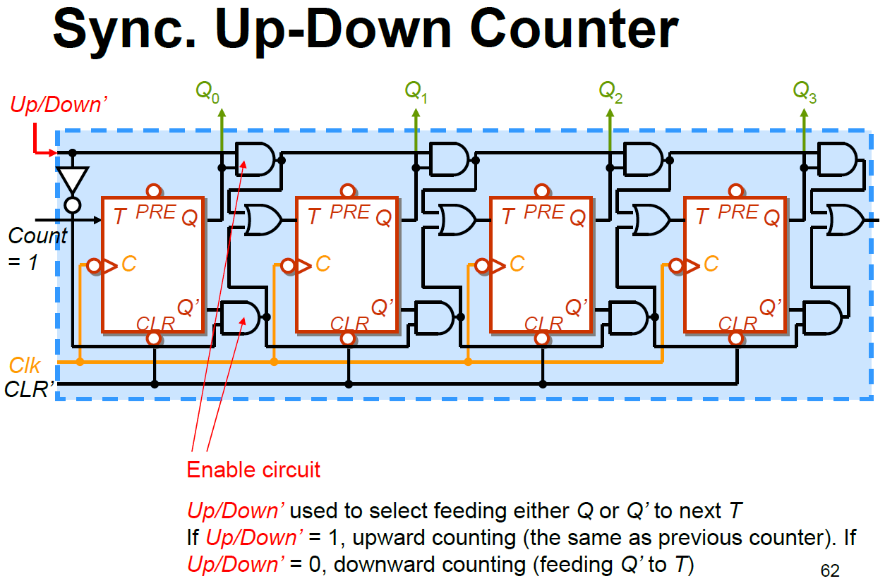

Slide 29
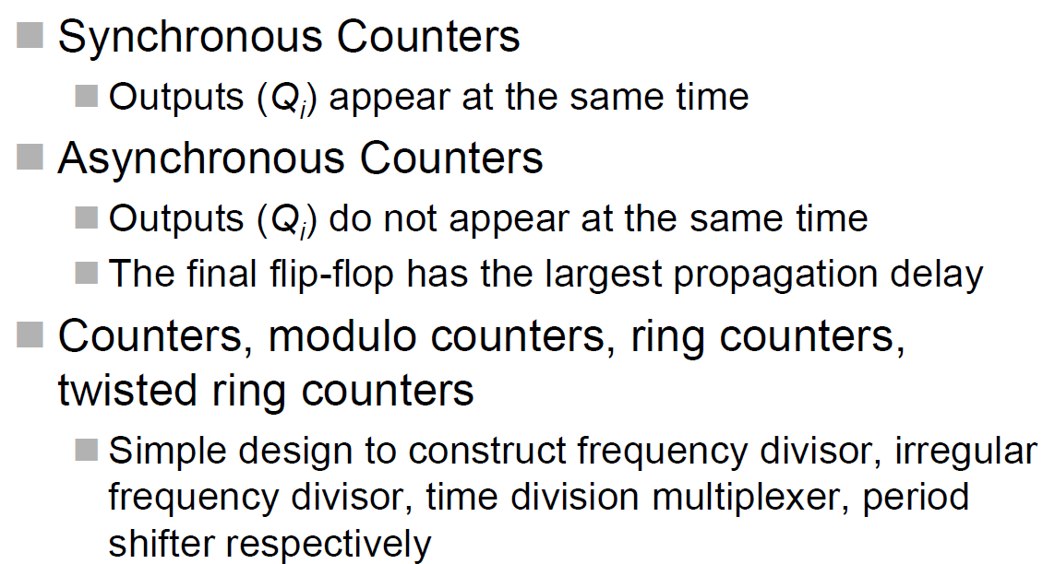
Summary

