Slide 1
EE3114 Systems and Control
Tutorial - 8
Semester B, 2018-19
2018-10-31

Slide 2
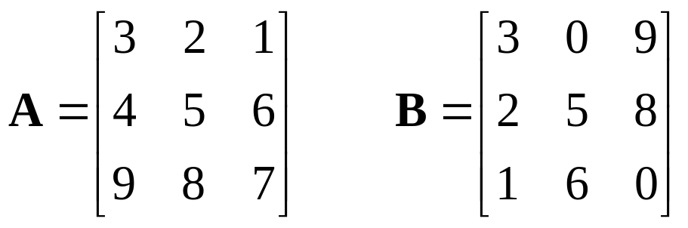

Review of Matrix-Vector Operations
(i)
%MatLab code
A = [3 2 1; 4 5 6; 9 8 7];
B = [3 0 9; 2 5 8; 1 6 0];
C = A*B
Find: (3 minutes)

Slide 3
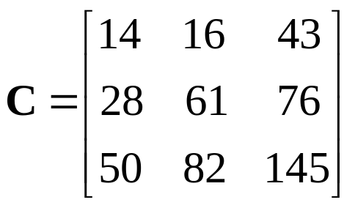

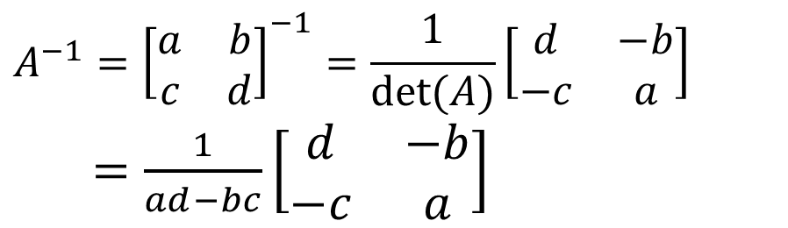
Answer:
(ii) Inverse Matrix: $A⋅A^{−1}=A^{−1}⋅A=I$
$${A^{−1}=\left[\begin{matrix}a & b \\ c & d\end{matrix}\right]}^{−1}=\frac{1}{det(A)}\left[\begin{matrix}d & −b \\ −c & a\end{matrix}\right]$$
$=\frac{1}{ad−bc}\left[\begin{matrix}d & −b \\ −c & a\end{matrix}\right]$

Slide 4

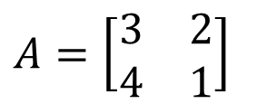
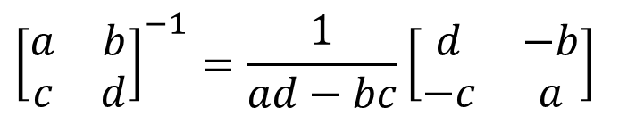
$${\left[\begin{matrix}a & b \\ c & d\end{matrix}\right]}^{−1}=\frac{1}{ad−bc}\left[\begin{matrix}d & −b \\ −c & a\end{matrix}\right]$$
$$A=\left[\begin{matrix}3 & 2 \\ 4 & 1\end{matrix}\right]$$
Find: ${ A}^{−1}$ (3 minutes)

Slide 5

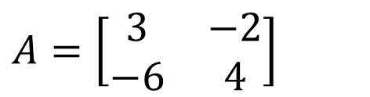

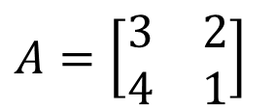
$${\left[\begin{matrix}a & b \\ c & d\end{matrix}\right]}^{−1}=\frac{1}{ad−bc}\left[\begin{matrix}d & −b \\ −c & a\end{matrix}\right]$$
$$A=\left[\begin{matrix}3 & 2 \\ 4 & 1\end{matrix}\right]$$
Answer: ${ A}^{−1}=\left[\begin{matrix}−1/5 & 2/5 \\ 4/5 & −3/5\end{matrix}\right]$
$$A=\left[\begin{matrix}3 & −2 \\ −6 & 4\end{matrix}\right]$$
Find: ${ A}^{−1}$ (3 minutes)

Slide 6
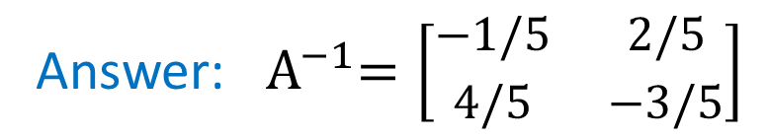
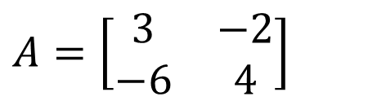
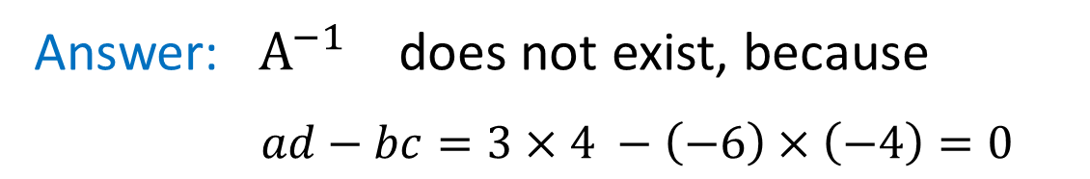
$${\left[\begin{matrix}a & b \\ c & d\end{matrix}\right]}^{−1}=\frac{1}{ad−bc}\left[\begin{matrix}d & −b \\ −c & a\end{matrix}\right]$$
$$A=\left[\begin{matrix}3 & 2 \\ 4 & 1\end{matrix}\right]$$
Answer: ${ A}^{−1}=\left[\begin{matrix}−1/5 & 2/5 \\ 4/5 & −3/5\end{matrix}\right]$
$$A=\left[\begin{matrix}3 & −2 \\ −6 & 4\end{matrix}\right]$$
Answer: ${ A}^{−1}$ does not exist, because
$ad−bc=3×4 −\left(−6\right)×\left(−4\right)=0$

Slide 7
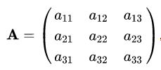
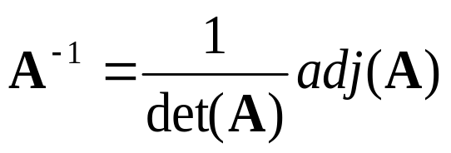
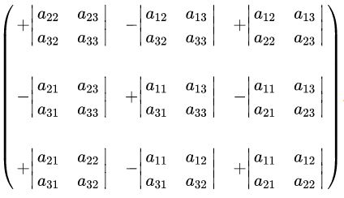
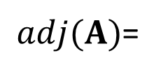

(iii) $3×3$ Matrices
Inverse Matrix:
Determinant of A:
$$\det\left(A\right)=\left|\begin{matrix}a_{11} & a_{12} & a_{13} \\ a_{21} & a_{22} & a_{23} \\ a_{31} & a_{32} & a_{33}\end{matrix}\right|={+a}_{11}\left|\begin{matrix}a_{22} & a_{23} \\ a_{32} & a_{33}\end{matrix}\right|−a_{12}\left|\begin{matrix}a_{21} & a_{23} \\ a_{31} & a_{33}\end{matrix}\right|+a_{13}\left|\begin{matrix}a_{21} & a_{22} \\ a_{31} & a_{32}\end{matrix}\right|$$
Adjugate of A:
$adj(A)$=

Slide 8
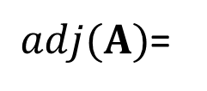
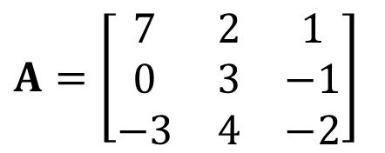
$$A=\left[\begin{matrix}7 & 2 & 1 \\ 0 & 3 & −1 \\ −3 & 4 & −2\end{matrix}\right]$$
Find: (10 minutes)
$$\det\left(A\right)=\left|\begin{matrix}a_{11} & a_{12} & a_{13} \\ a_{21} & a_{22} & a_{23} \\ a_{31} & a_{32} & a_{33}\end{matrix}\right|={+a}_{11}\left|\begin{matrix}a_{22} & a_{23} \\ a_{32} & a_{33}\end{matrix}\right|−a_{12}\left|\begin{matrix}a_{21} & a_{23} \\ a_{31} & a_{33}\end{matrix}\right|+a_{13}\left|\begin{matrix}a_{21} & a_{22} \\ a_{31} & a_{32}\end{matrix}\right|$$
$adj(A)$=

Slide 9
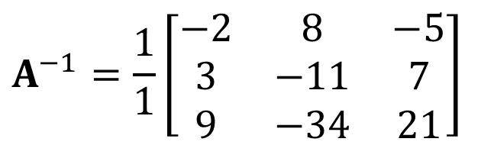
$$A=\left[\begin{matrix}7 & 2 & 1 \\ 0 & 3 & −1 \\ −3 & 4 & −2\end{matrix}\right]$$
Find: (10 minutes)
Answer:
$$A^{−1}=\frac{1}{1}\left[\begin{matrix}−2 & 8 & −5 \\ 3 & −11 & 7 \\ 9 & −34 & 21\end{matrix}\right]$$
%MatLab code
A = [7 2 1; 0 3 -1; -3 4 -2];
detA = det(A)
invA = inv(A)

Slide 10
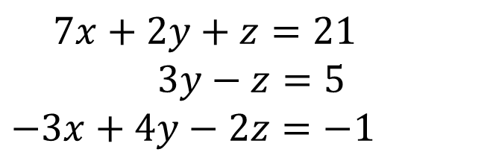
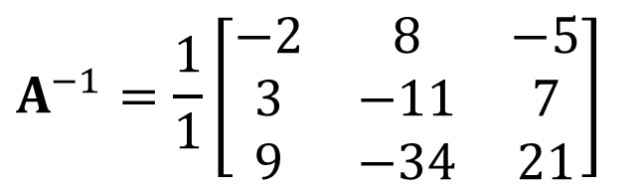


Solving a System of Equations
$7x+2y+z=21$
$3y−z=5$
$$−3x+4y−2z=−1$$
Find: $x, y,z$ (5 minutes)
Recall: $A=\left[\begin{matrix}7 & 2 & 1 \\ 0 & 3 & −1 \\ −3 & 4 & −2\end{matrix}\right]$
$$A^{−1}=\frac{1}{1}\left[\begin{matrix}−2 & 8 & −5 \\ 3 & −11 & 7 \\ 9 & −34 & 21\end{matrix}\right]$$

Slide 11
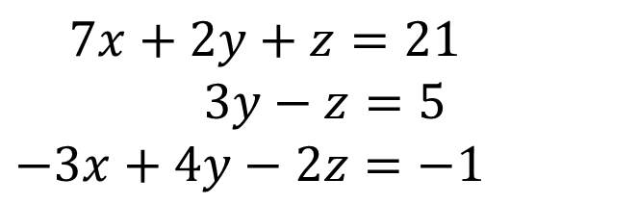
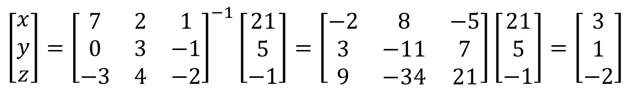

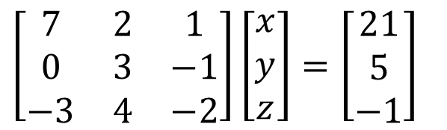
Solving a System of Equations
$7x+2y+z=21$
$3y−z=5$
$$−3x+4y−2z=−1$$
Find: $x, y,z$ (5 minutes)
Answer:
$\left[\begin{matrix}7 & 2 & 1 \\ 0 & 3 & −1 \\ −3 & 4 & −2\end{matrix}\right]\left[\begin{matrix}x \\ y \\ z\end{matrix}\right]=\left[\begin{matrix}21 \\ 5 \\ −1\end{matrix}\right]$
$$\left[\begin{matrix}x \\ y \\ z\end{matrix}\right]={\left[\begin{matrix}7 & 2 & 1 \\ 0 & 3 & −1 \\ −3 & 4 & −2\end{matrix}\right]}^{−1}\left[\begin{matrix}21 \\ 5 \\ −1\end{matrix}\right]=\left[\begin{matrix}−2 & 8 & −5 \\ 3 & −11 & 7 \\ 9 & −34 & 21\end{matrix}\right]\left[\begin{matrix}21 \\ 5 \\ −1\end{matrix}\right]=\left[\begin{matrix}3 \\ 1 \\ −2\end{matrix}\right]$$
(from above)

Slide 12
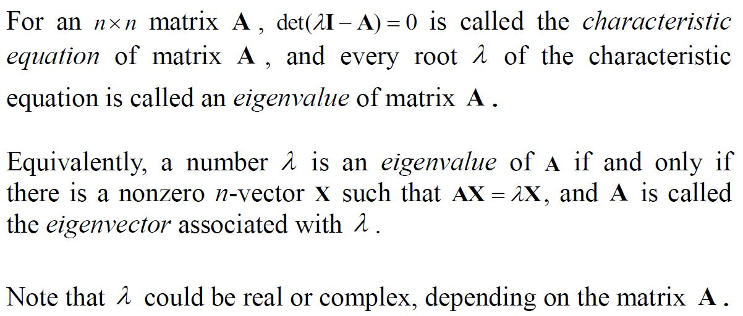
(iv)
X
%MatLab code
A = [ x x x ; x x x ; x x x ];
Lambda = eig(A)
%MatLab code
A = [ x x x ; x x x ; x x x ];
[V, D] = eig(A)
%V has eigenvectors
%D has eigenvalues in diagonal

Slide 13
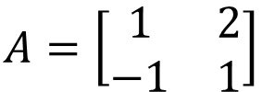
(iv)
X
Find: The characteristic equation and eigenvalues of matrix
$$A=\left[\begin{matrix}1 & 2 \\ −1 & 1\end{matrix}\right]$$
(5 minutes)

Slide 14
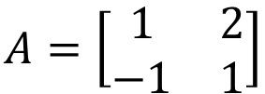

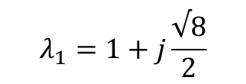

(iii)
X
Find: The characteristic equation and eigenvalues of matrix
$$A=\left[\begin{matrix}1 & 2 \\ −1 & 1\end{matrix}\right]$$
Answer:
$$λ^{2}−2λ+3=0$$
$$λ_{1}=1+j\frac{√8}{2}$$
$$λ_{2}=1−j\frac{√8}{2}$$

Slide 15
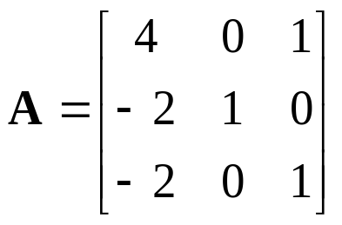
(iii)
X
Find: The characteristic equation and eigenvalues of matrix
%MatLab code
A = [4 0 1; -2 1 0; -2 0 1];
p = poly(A)
r = roots(p)
(10 minutes)

Slide 16




(iii)
X
Find: The characteristic equation and eigenvalues of matrix
Answer:
(by inspection)

Slide 17
END

