Slide 1
EE3114 Systems and Control
5. Root Locus Analysis and Design
Semester A, 2018-19
2018-10-3

Slide 2
Framework of Lectures
System
Time Domain Frequency Domain
→ Laplace Transform →
State-Space Formulation Frequency Analysis
(dynamic responses,
transients, steady-states,
root-locus, PID controllers)
← mixed →
(State-feedback,
Controllability, controller
Observability, observer
Optimal control)
Today:
Root-locus Analysis

Slide 3
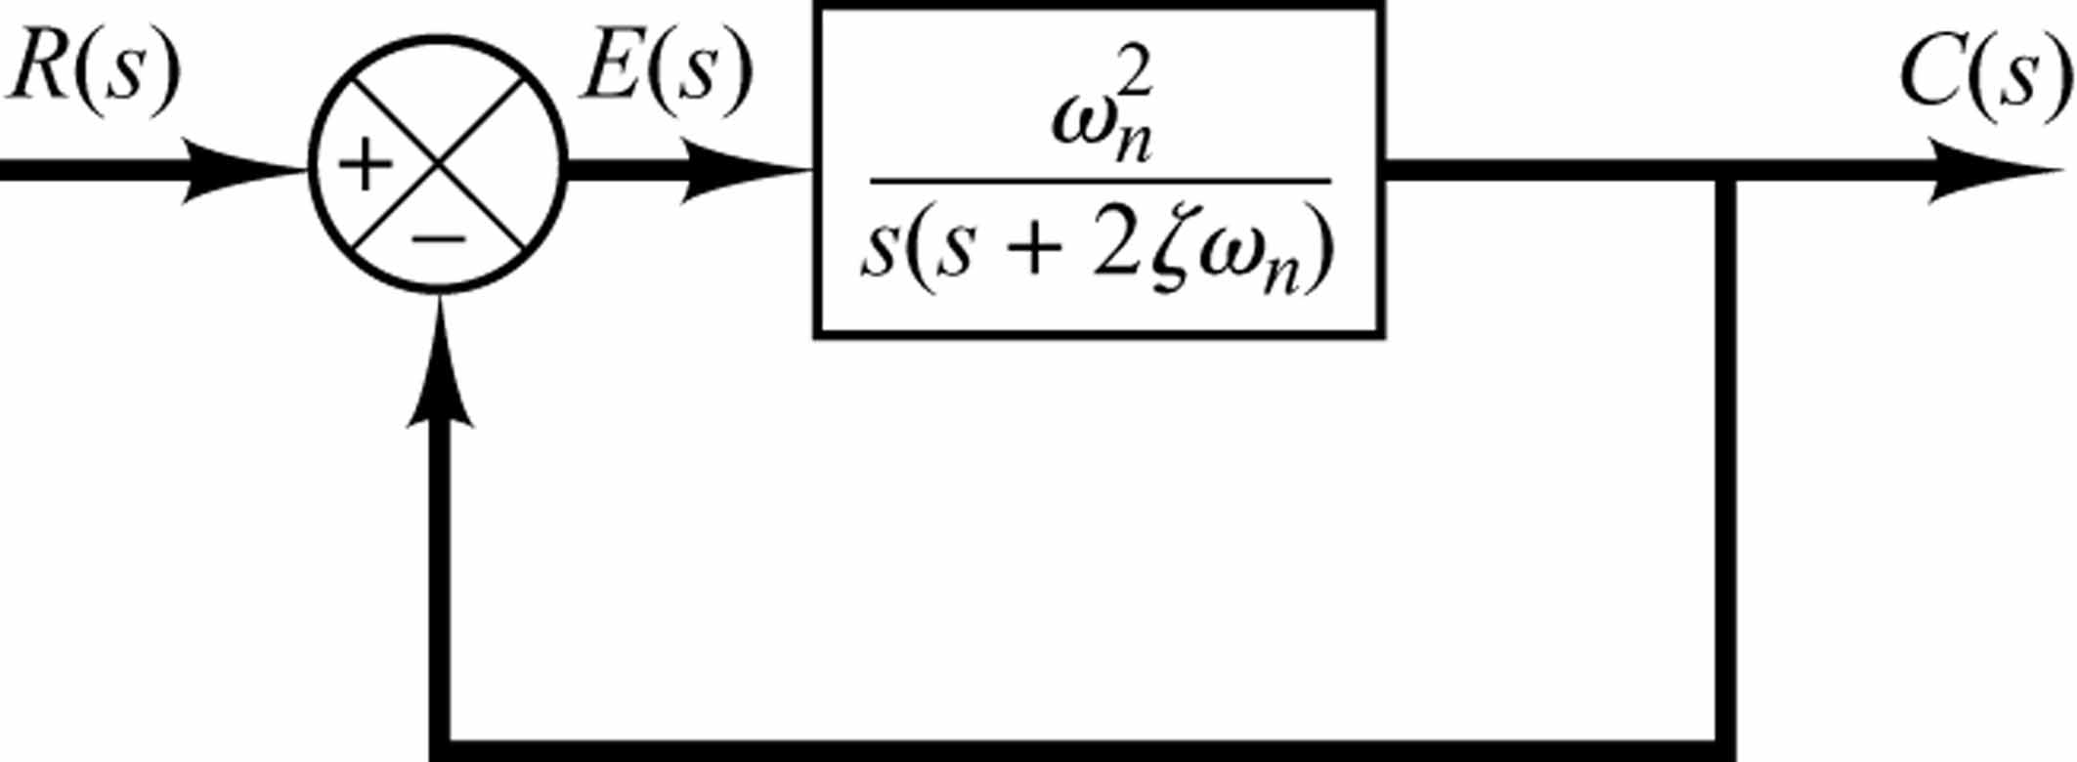
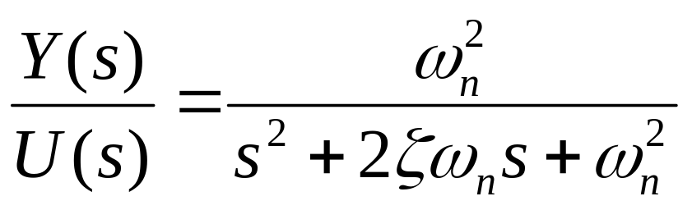
Recall: Standard form of second-order systems
U(s)
Y(s)
Damping ratio
Un-damped natural frequency

Slide 4

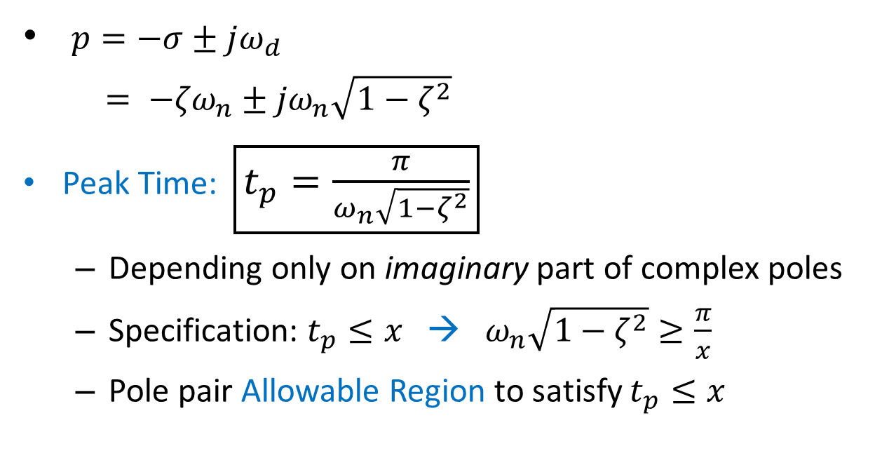

Review: Allowable Region on s-Plane
$p=−σ±jω_{d}$
$= {−{ζω}_{n}±jω}_{n}\sqrt{1−ζ^{2}}$
Peak Time: $\boxed{t_{p}=\frac{π}{ω_{n}\sqrt{1−ζ^{2}}}}$
  Depending only on imaginary part of complex poles
  Specification: $t_{p}≤x$ → $ω_{n}\sqrt{1−ζ^{2}}≥\frac{π}{x}$
  Pole pair Allowable Region to satisfy $t_{p}≤x$
Im
$$\frac{π}{x}$$
Re
$$−\frac{π}{x}$$

Slide 5
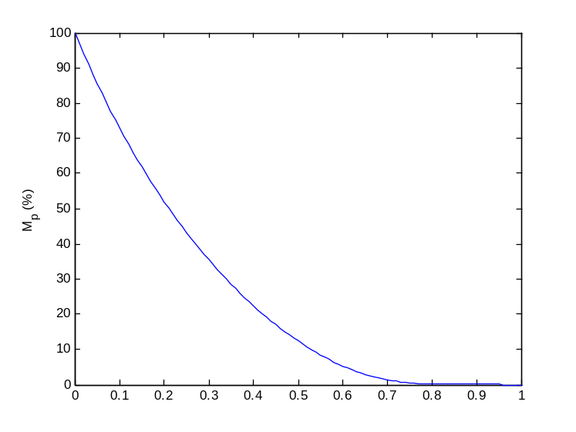

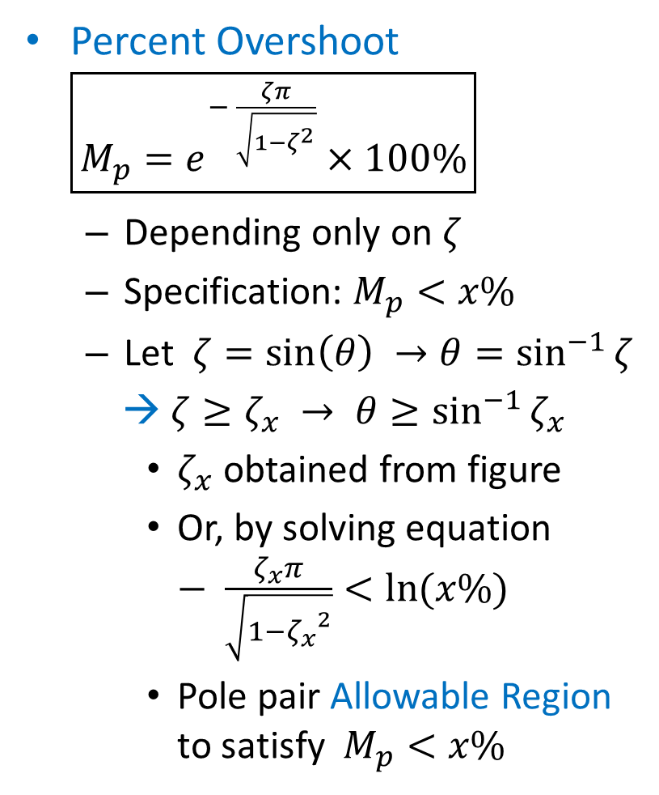


Percent Overshoot $\boxed{M_{p}=e^{− \frac{ζπ}{\sqrt{1−ζ^{2}}}}×100\%}$
  Depending only on $ζ$
  Specification: $M_{p}<x\%$
  Let $ζ=\sin\left(θ\right) →θ=\sin^{−1}{ζ}$
  → $ζ≥ζ_{x} → θ≥\sin^{−1}{ζ_{x}}$
    $ζ_{x}$ obtained from figure
    Or, by solving equation $− \frac{ζ_{x}π}{\sqrt{1−{ζ_{x}}^{2}}}<\ln{(x\%)}$
    Pole pair Allowable Region to satisfy $M_{p}<x\%$
$$ζ$$
Im
$$\sin^{−1}{ζ_{x}}$$
$$θ$$
Re
$$\sin^{−1}{ζ_{x}}$$
(Lectrure-3: Geometric Meaning of Complex Conjugate Poles)

Slide 6

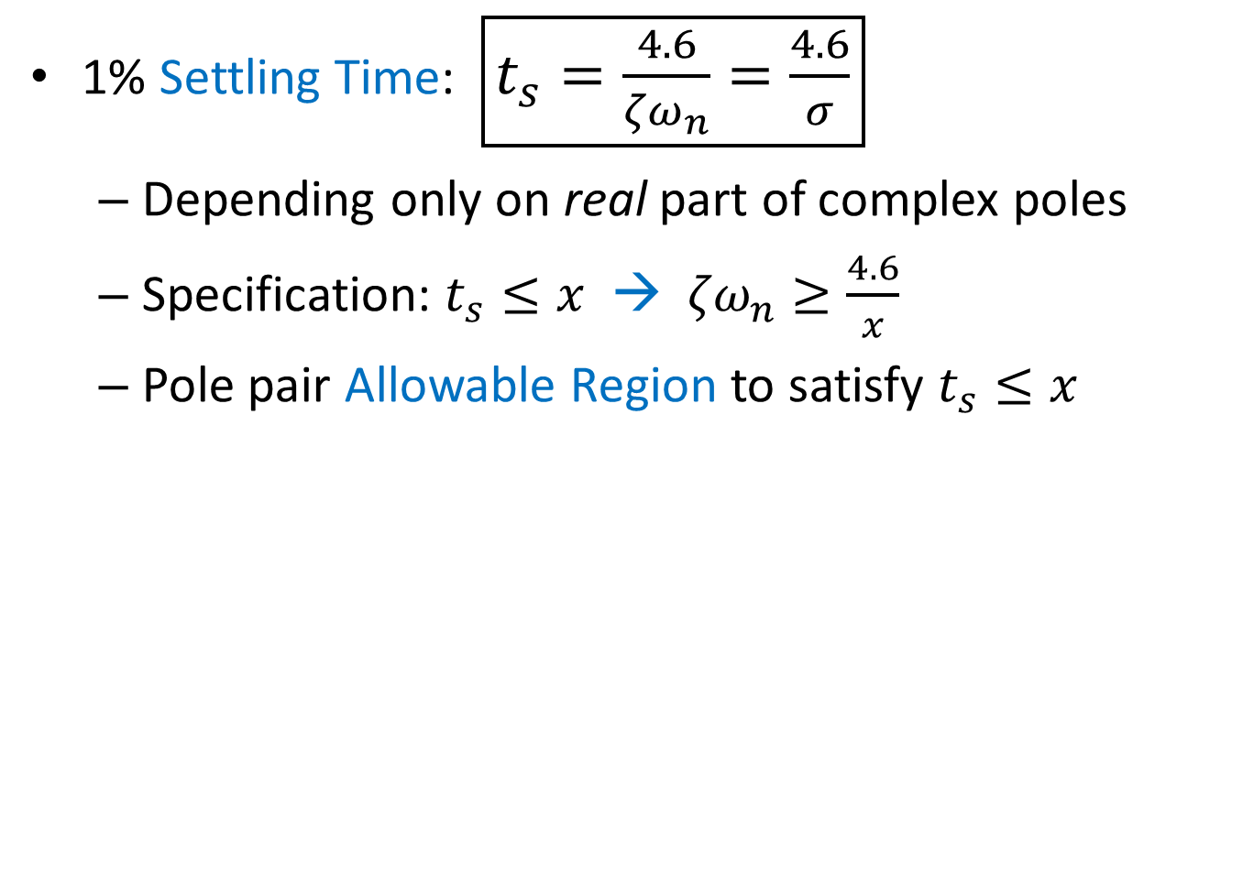
1% Settling Time: $\boxed{t_{s}=\frac{4.6}{{ζω}_{n}}=\frac{4.6}{σ}}$
  Depending only on real part of complex poles
  Specification: $t_{s}≤x$ → ${ζω}_{n}≥\frac{4.6}{x}$
  Pole pair Allowable Region to satisfy $t_{s}≤x$
Im
Re
$$\frac{4.6}{x}$$

Slide 7

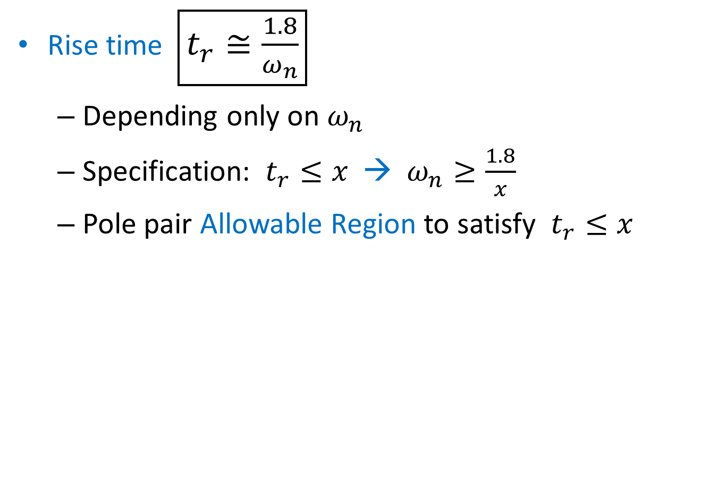
Rise time $\boxed{t_{r}≅\frac{1.8}{ω_{n}}}$
  Depending only on $ω_{n}$
  Specification: $t_{r}≤x$ → $ω_{n}≥\frac{1.8}{x}$
  Pole pair Allowable Region to satisfy $t_{r}≤x$
Im
$$\frac{1.8}{x}$$
Re

Slide 8
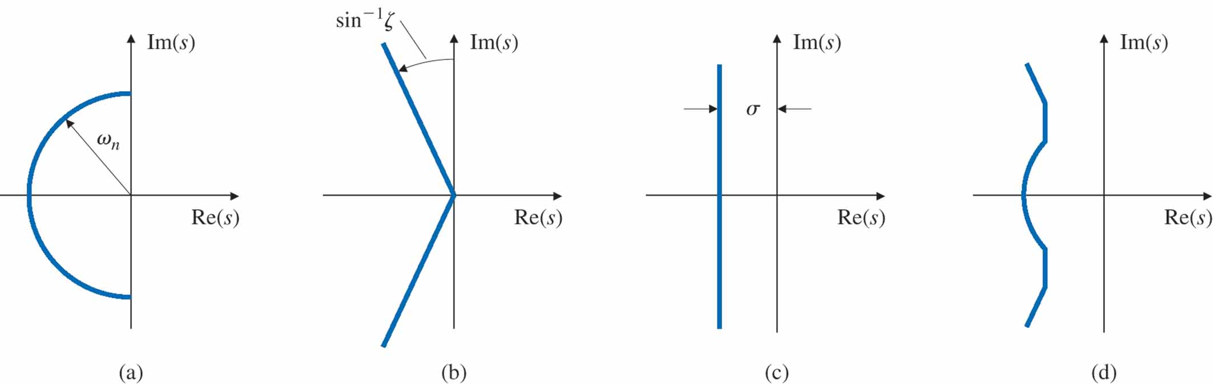
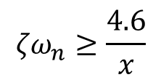
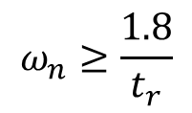
Allowable Region on s-Plane
(delineated all by transient requirements)
$$ω_{n}≥\frac{1.8}{t_{r}}$$
$${ζω}_{n}≥\frac{4.6}{x}$$
+
+
=
Rise Time
Overshoot
1% Settling Time
Composite of all 3 requirements

Slide 9
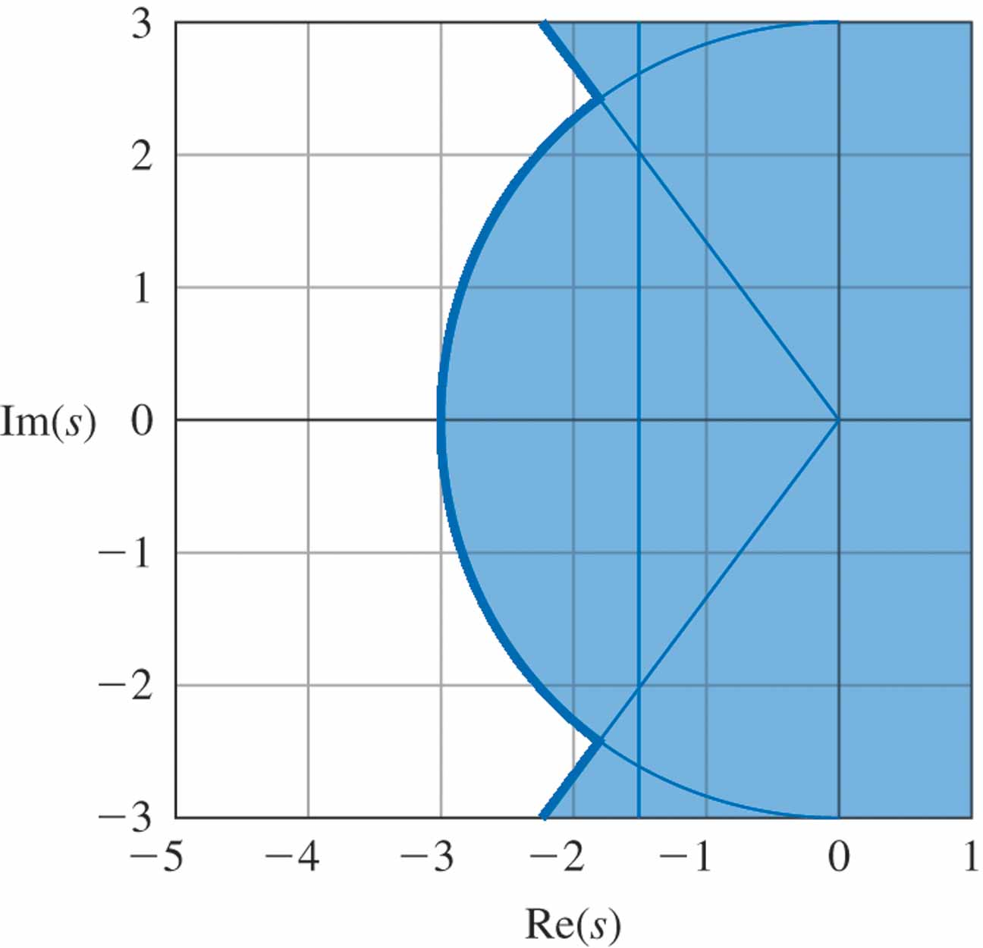

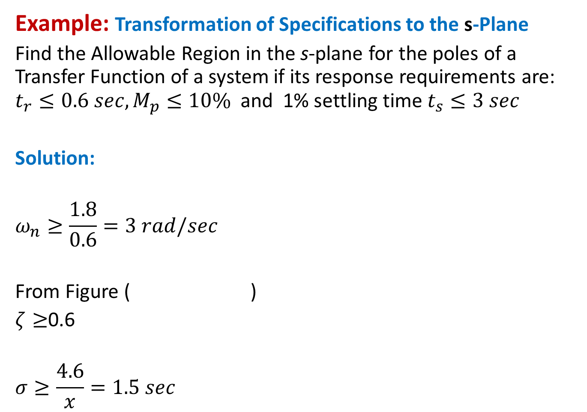
Example: Transformation of Specifications to the s-Plane
Find the Allowable Region in the s-plane for the poles of a Transfer Function of a system if its response requirements are: $t_{r}≤0.6 sec, M_{p}≤10\%$and 1% settling time $t_{s}≤3 sec$
Solution:
$$ω_{n}≥\frac{1.8}{0.6}=3 rad/sec$$
From Figure ( )
$ζ≥$0.6
$$σ≥\frac{4.6}{x}=1.5 sec$$
☹

Slide 10
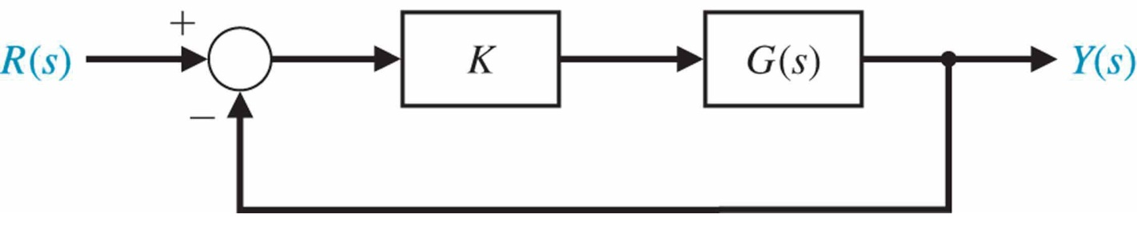
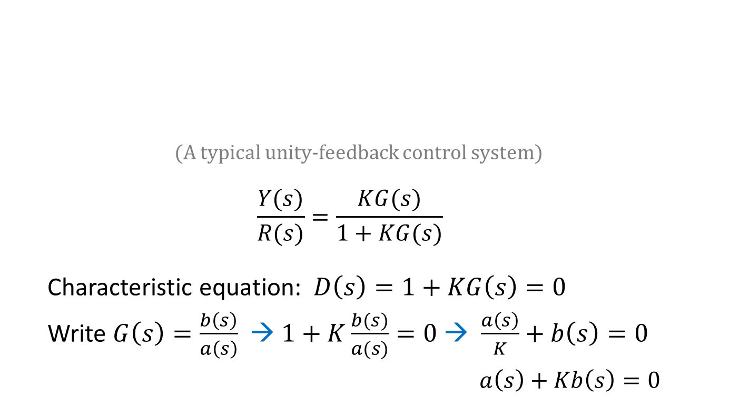

What is a Root Locus?
  Control gain
  (to be designed)
  Plant transfer function (given)
  (A typical unity-feedback control system)
  $$\frac{Y(s)}{R(s)}=\frac{KG(s)}{1+KG(s)}$$
  Characteristic equation: $D\left(s\right)=1+KG\left(s\right)=0$
  Write $G\left(s\right)=\frac{b\left(s\right)}{a\left(s\right)}$ → $1+K\frac{b(s)}{a(s)}=0$ → $\frac{a\left(s\right)}{K}+b\left(s\right)=0$
  $a\left(s\right)+Kb\left(s\right)=0$
$$(K>0)$$

Slide 11
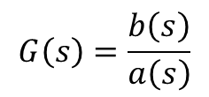
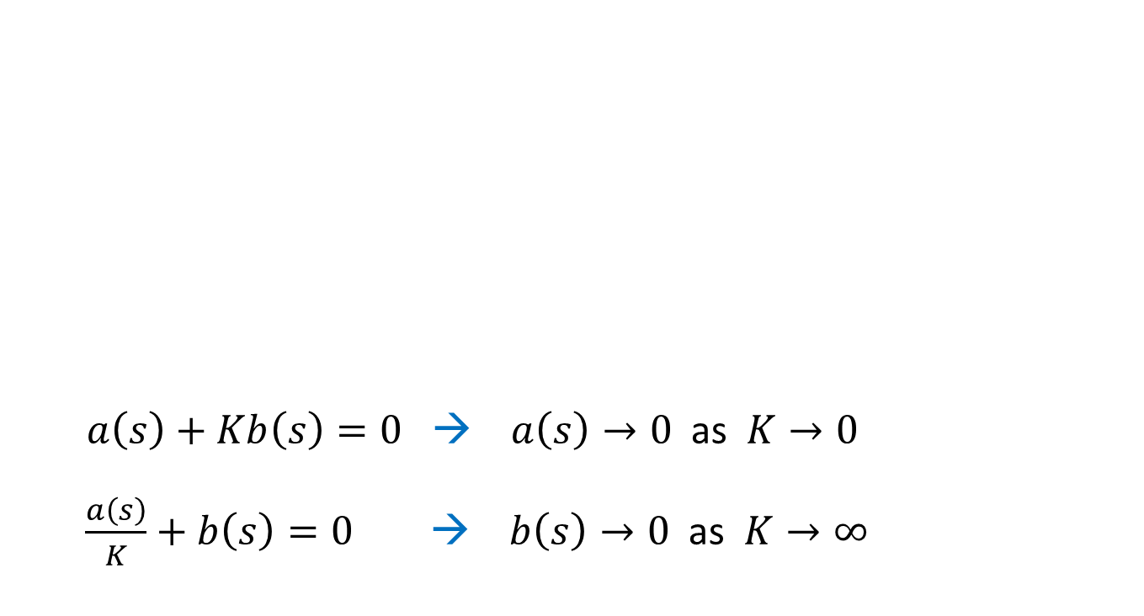
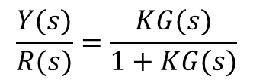

What is a Root Locus?
  $a\left(s\right)+Kb\left(s\right)=0$ → $a\left(s\right)→0$ as $K→0$
  $\frac{a\left(s\right)}{K}+b\left(s\right)=0$ → $b\left(s\right)→0$ as $K→∞$
  Control gain
  (to be designed)
  Plant transfer function (given)
$$(K>0)$$
$$G\left(s\right)=\frac{b\left(s\right)}{a\left(s\right)}$$
$$\frac{Y(s)}{R(s)}=\frac{KG(s)}{1+KG(s)}$$
Root Locus is the movement of the roots of $D\left(s\right):$
$D\left(s\right)=1+KG\left(s\right)=1+K\frac{b(s)}{a(s)}$ as K: 0 → ∞

Slide 12
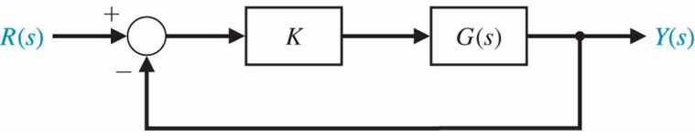
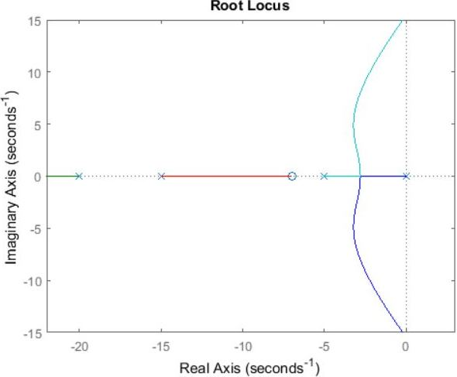


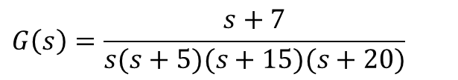



Root Locus of Transfer Function
Example:
$$G\left(s\right)=\frac{s+7}{s(s+5)(s+15)(s+20)}$$
%MatLab code
s = tf('s');
sys = (s + 7)/(s*(s + 5)*(s + 15)*(s + 20));
rlocus(sys)
axis([-22 3 -15 15])
This MatLab plot shows all possible closed-loop pole locations for the control gain K: 0 → ∞
$$p_{4}=−20$$
$$p_{3}=−15$$
$$z=−7$$
$$p_{1}=0$$
$$p_{2}=−5$$
Acceptable Region
(left-hand side of curve)

Slide 13
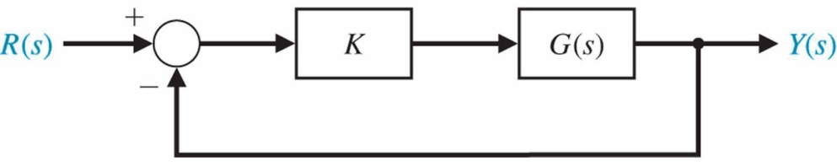
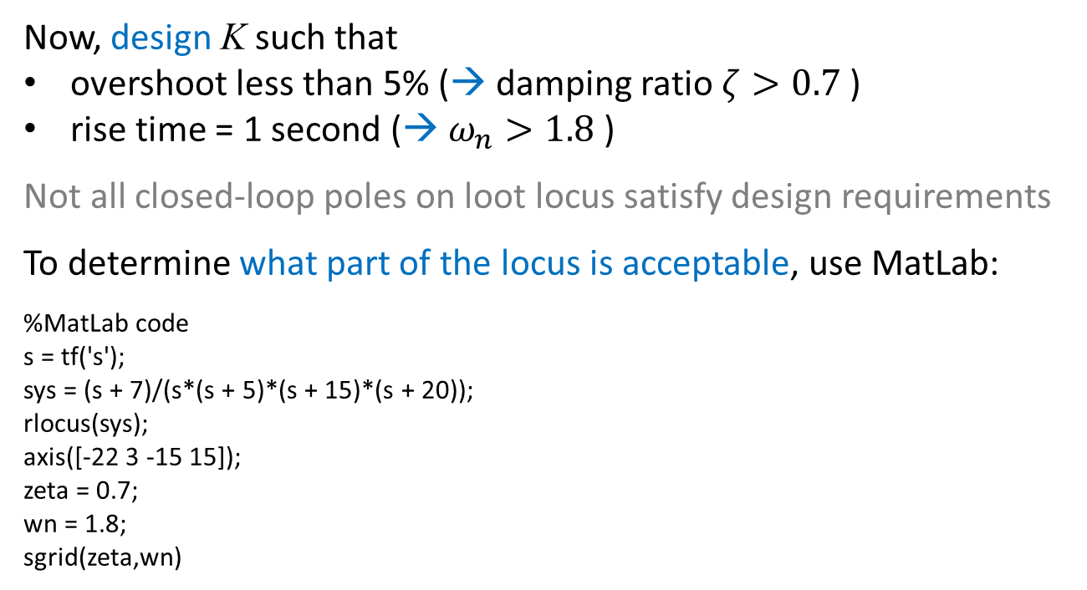
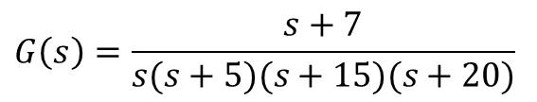
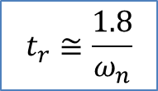
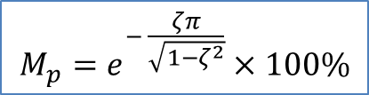
Root Locus of Transfer Function
$$G\left(s\right)=\frac{s+7}{s(s+5)(s+15)(s+20)}$$
$$M_{p}=e^{− \frac{ζπ}{\sqrt{1−ζ^{2}}}}×100\%$$
$$t_{r}≅\frac{1.8}{ω_{n}}$$
Now, design K such that
overshoot less than 5% (→ damping ratio $ζ>0.7$ )
rise time = 1 second (→ $ω_{n}>1.8$)
Not all closed-loop poles on loot locus satisfy design requirements
To determine what part of the locus is acceptable, use MatLab:
%MatLab code
s = tf('s');
sys = (s + 7)/(s*(s + 5)*(s + 15)*(s + 20));
rlocus(sys);
axis([-22 3 -15 15]);
zeta = 0.7;
wn = 1.8;
sgrid(zeta,wn)
MatLab generates a graph (next page)

Slide 14
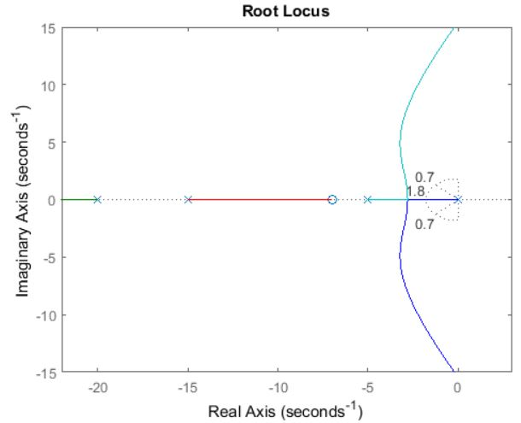
MatLab generates this plot:
(Discussions on next two pages)

Slide 15
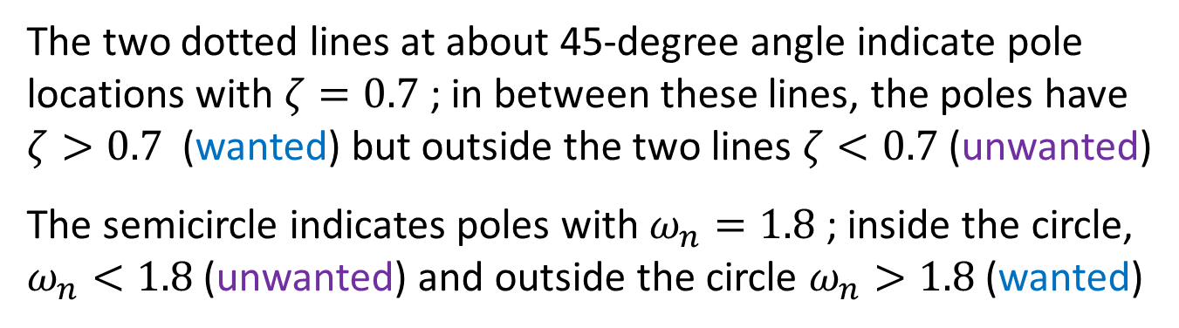
The two dotted lines at about 45-degree angle indicate pole locations with $ζ=0.7$; in between these lines, the poles have $ζ>0.7$ (wanted) but outside the two lines $ζ<0.7$ (unwanted)
The semicircle indicates poles with $ω_{n}=1.8$ ; inside the circle, $ω_{n}<1.8$ (unwanted) and outside the circle $ω_{n}>1.8$ (wanted)

Slide 16
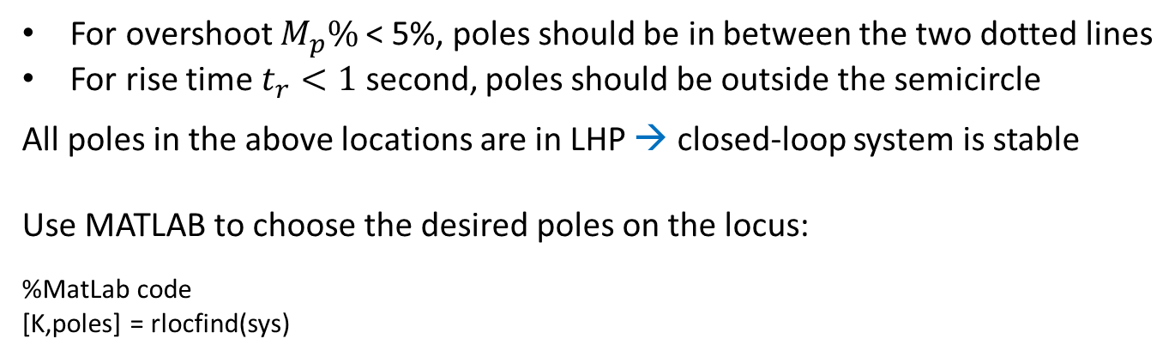
For overshoot $M_{p}\%$< 5%, poles should be in between the two dotted lines
For rise time $t_{r}<1$ second, poles should be outside the semicircle
All poles in the above locations are in LHP → closed-loop system is stable
Use MATLAB to choose the desired poles on the locus:
%MatLab code
[K,poles] = rlocfind(sys)
(See next page)

Slide 17
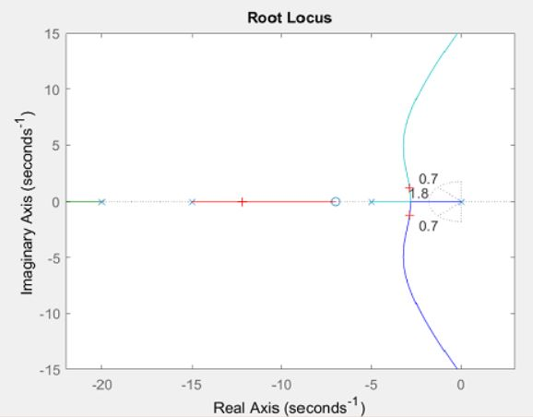
%MatLab code
s = tf('s');
sys = (s + 7)/(s*(s + 5)*(s + 15)*(s + 20));
rlocus(sys);
axis([-22 3 -15 15]);
zeta = 0.7;
wn = 1.8;
sgrid(zeta,wn);
[K,poles] = rlocfind(sys)
Click at the point where you want the closed-loop pole to be
(for example, the one marked by "+")
You may also select some point within the allowable region, which are not unique but affect response (Recall: Lecture-3)

Slide 18
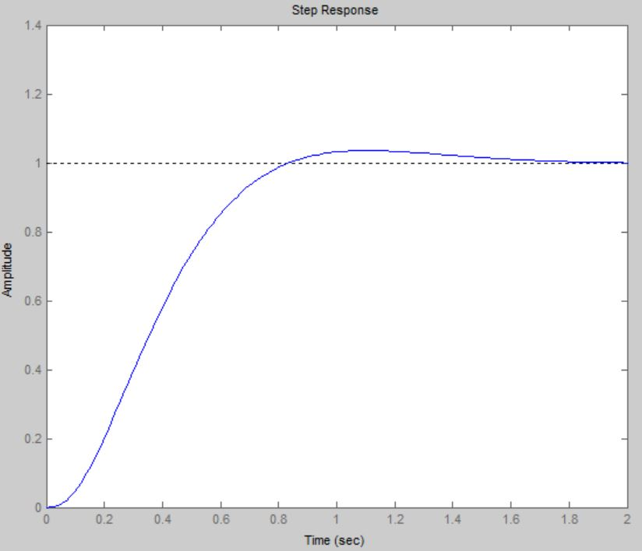
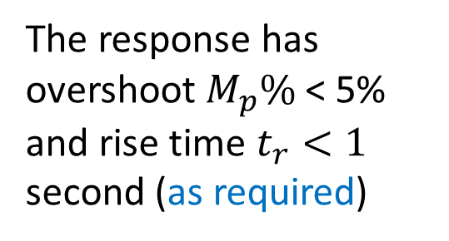
Now, verify the Step Response:
Use MatLab
%MatLab code
s = tf('s');
sys = (s + 7)/(s*(s + 5)*(s + 15)*(s + 20));
rlocus(sys);
axis([-22 3 -15 15]);
zeta = 0.7;
wn = 1.8;
sgrid(zeta,wn);
K = 600;
sys_cl = feedback(K*sys,1)
step(sys_cl)
The response has overshoot $M_{p}\%$< 5% and rise time $t_{r}<1$ second (as required)

Slide 19
Remark:
Use MatLab (no need to enter K value if using command “rlocfind”):
%MatLab code
s = tf('s');
sys = (s + 7)/(s*(s + 5)*(s + 15)*(s + 20));
rlocus(sys);
axis([-22 3 -15 15]);
zeta = 0.7;
wn = 1.8;
sgrid(zeta,wn);
[K,poles] = rlocfind(sys); %No need to enter value, e.g., K=600
sys_cl = feedback(K*sys,1)
step(sys_cl)

Slide 20
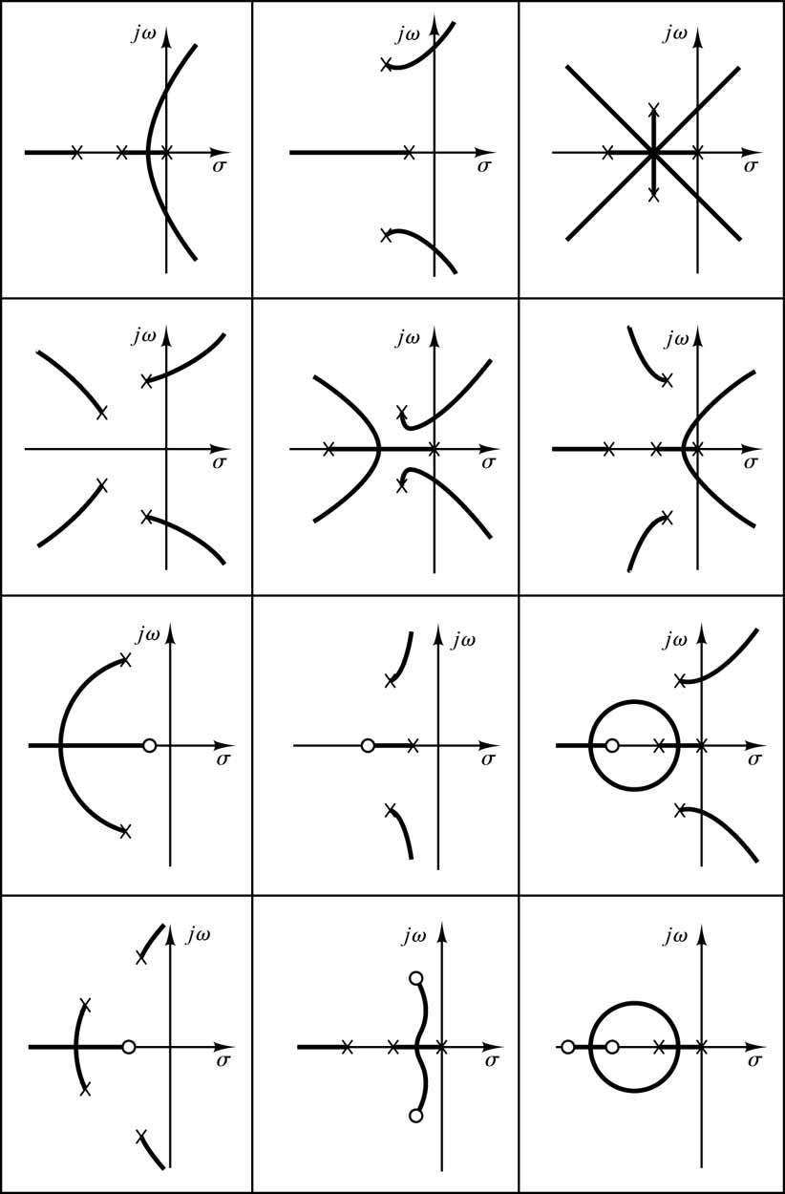
Typical Pole–Zero Locations and their Root Loci

Slide 21

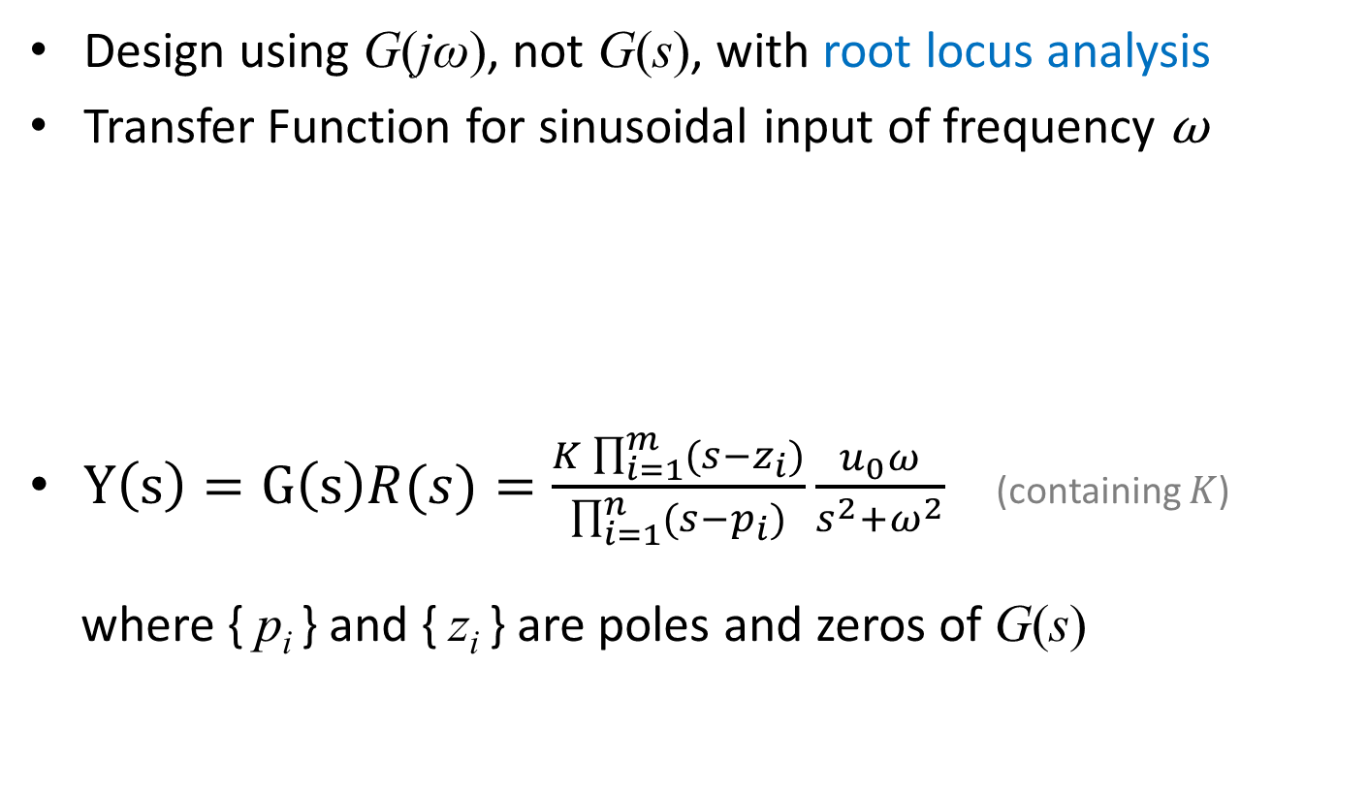
More about Root Locus
Design using G(jω), not G(s), with root locus analysis
Transfer Function for sinusoidal input of frequency ω
$Y\left(s\right)=G\left(s\right)R(s)=\frac{K\prod_{i=1}^{m}{(s−z_{i})}}{\prod_{i=1}^{n}{(s−p_{i})}}\frac{u_{0}ω}{s^{2}+ω^{2}}$ (containing $K$)
where { p_{i} } and { z_{i} } are poles and zeros of G(s)
r(t) = u₀ sin (ωt)
y(t) = ?
$$G(s)$$

Slide 22
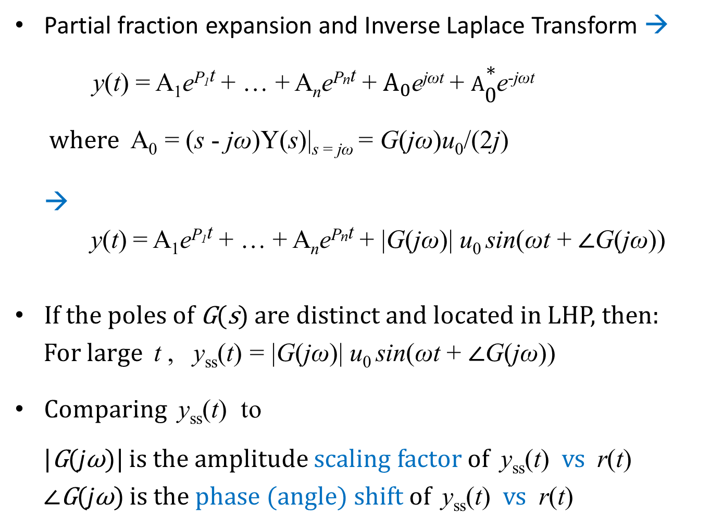
Partial fraction expansion and Inverse Laplace Transform →
y(t) = A₁e^{P1t} + … + A_{n}e^{Pnt} + $A_{0}$e^{jωt} + $A\begin{matrix}∗ \\ 0\end{matrix}$e^{-jωt}
where A₀ = (s - jω)Y(s)|_{s = jω} = G(jω)u₀/(2j)
→
y(t) = A₁e^{P1t} + … + A_{n}e^{Pnt} + |G(jω)| u₀ sin(ωt + ∠G(jω))
If the poles of G(s) are distinct and located in LHP, then:
For large t , y_{ss}(t) = |G(jω)| u₀ sin(ωt + ∠G(jω))
Comparing y_{ss}(t) to
|G(jω)| is the amplitude scaling factor of y_{ss}(t) vs r(t)
∠G(jω) is the phase (angle) shift of y_{ss}(t) vs r(t)
r(t) := u₀ sin (ωt)
Notes:
Euler

Slide 23
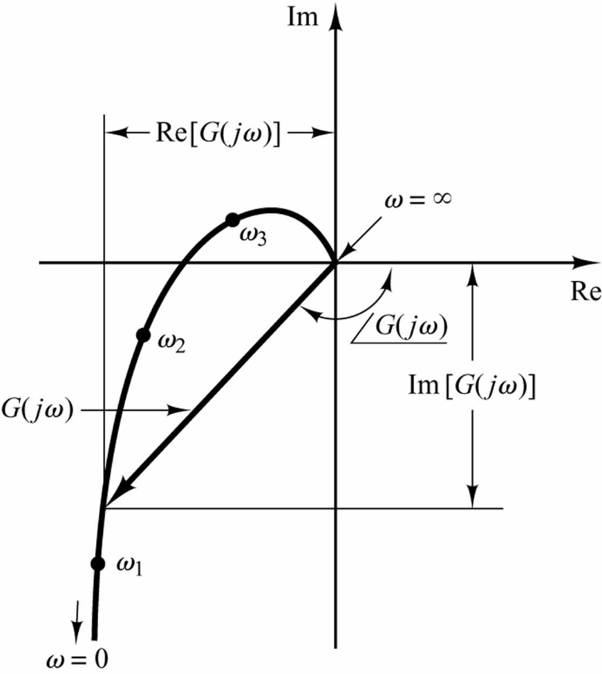

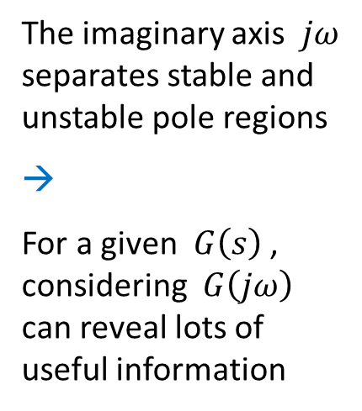
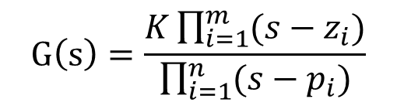
Representation of G(jω)
Polar Plot
All information (magnitude, phase, frequency) in one plot
$$G\left(s\right)=\frac{K\prod_{i=1}^{m}{(s−z_{i})}}{\prod_{i=1}^{n}{(s−p_{i})}}$$
The imaginary axis $jω$ separates stable and unstable pole regions
→
For a given $G\left(s\right)$ , considering $G\left(jω\right)$ can reveal lots of useful information

Slide 24
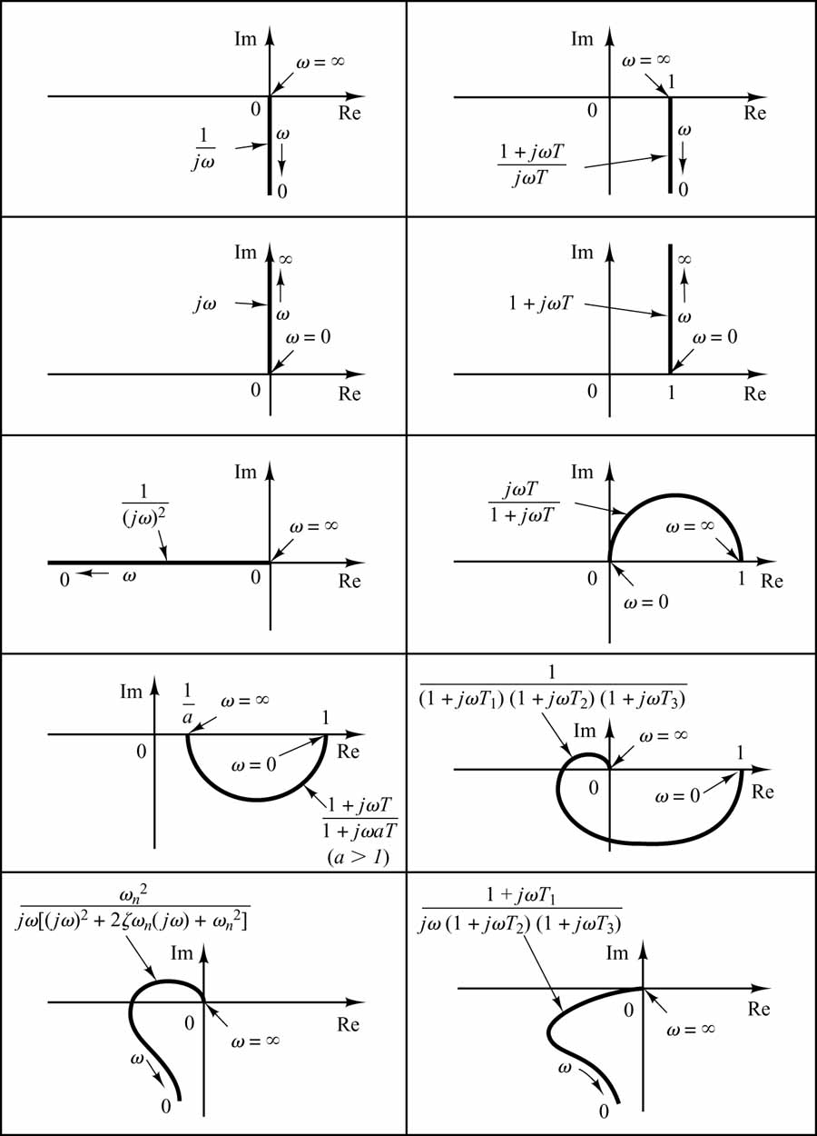
Polar Plots of some typical Transfer Functions
(for information only)

Slide 25
Bode Plots
Present the information in two plots:
  Magnitude: log₁₀|G(jω)| vs log₁₀ ω
  Phase: ∠G(jω) vs log₁₀ ω
Advantages of log-log scale:
  For ω axis to cover a wide frequency range
  For G(jω) = G₁(jω)G₂(jω)
  → log₁₀|G(jω)| = log₁₀|G₁(jω)| + log₁₀|G₂(jω)|
  ∠G(jω) = ∠ G₁(jω) + ∠ G₂(jω)
  → Bode plots of G
  = Bode plots of G₁ + Bode plots of G₂
Special dB unit for magnitude plot:
|G(jω)|_{dB} = 20 log₁₀|G(jω)|

Slide 26
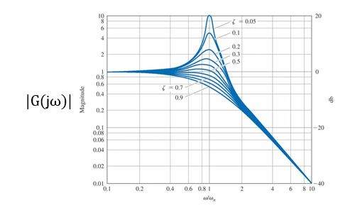

Bode Plot of Transfer Function
of Standard Second-Order System
$$G(jω)$$

Slide 27
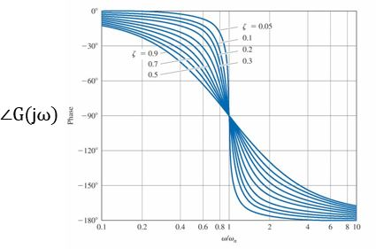

Bode Plot of Transfer Function
of Standard Second-Order System
$$G(jω)$$

Slide 28
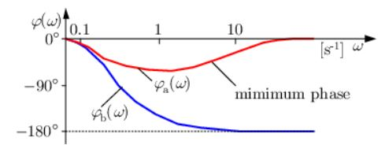
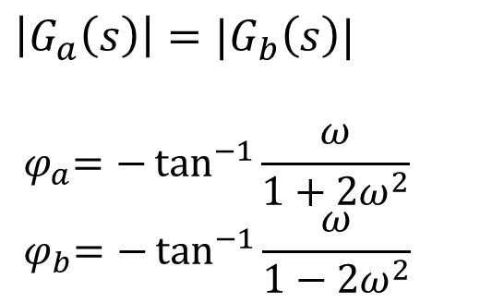
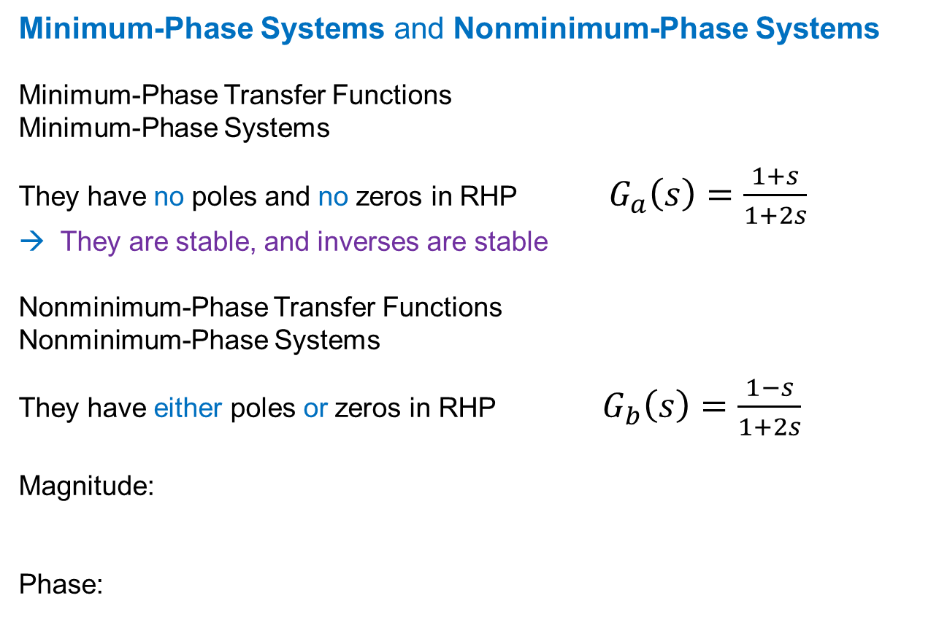
Minimum-Phase Systems and Nonminimum-Phase Systems
Minimum-Phase Transfer Functions
Minimum-Phase Systems
They have no poles and no zeros in RHP $G_{a}\left(s\right)=\frac{1+s}{1+2s}$
→ They are stable, and inverses are stable
Nonminimum-Phase Transfer Functions
Nonminimum-Phase Systems
They have either poles or zeros in RHP $G_{b}\left(s\right)=\frac{1−s}{1+2s}$
Magnitude:
Phase:
$$\left|G_{a}\left(s\right)\right|=|G_{b}\left(s\right)|$$
$${ φ}_{a}=−\tan^{−1}{\frac{ω}{1+2ω^{2}}}$$
$${ φ}_{b}=−\tan^{−1}{\frac{ω}{1−2ω^{2}}}$$

Slide 29
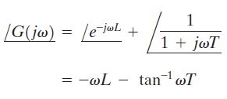
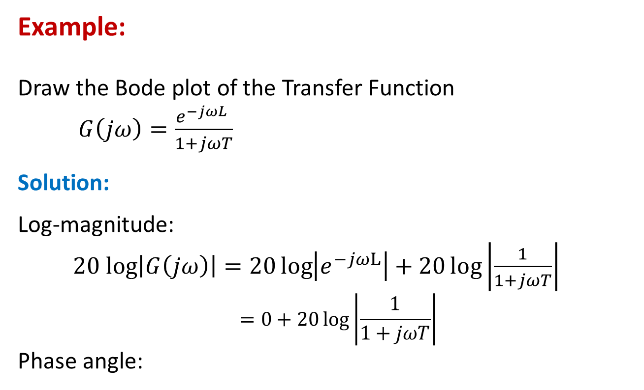
Example:
Draw the Bode plot of the Transfer Function
$G\left(jω\right)=\frac{e^{−jωL} }{1+jωT}$
Solution:
Log-magnitude:
$20 log\left|G\left(jω\right)\right|=20\log\left|e^{−jωL}\right|+20\log\left|\frac{1}{1+jωT}\right|$
$$=0+20\log\left|\frac{1}{1+jωT}\right|$$
Phase angle:

Slide 30
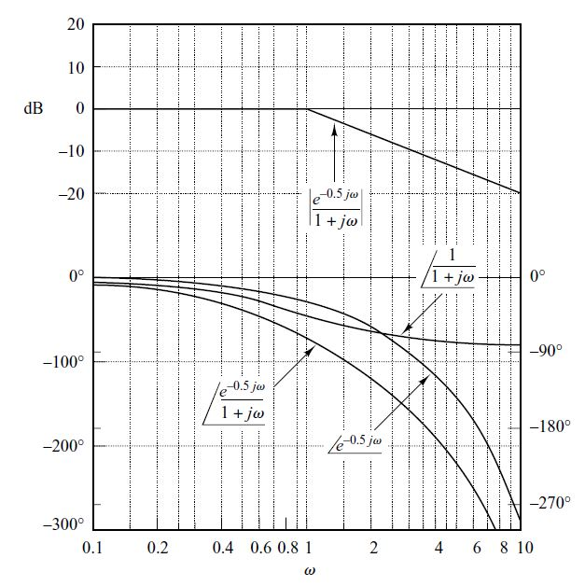
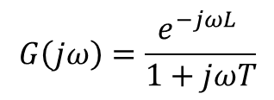
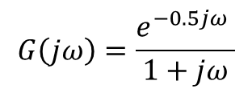
$$G\left(jω\right)=\frac{e^{−jωL} }{1+jωT}$$
L = 0.5
T = 1
Log-Magnitude
_______
Phase
$$G\left(jω\right)=\frac{e^{−0.5jω} }{1+jω}$$

Slide 31
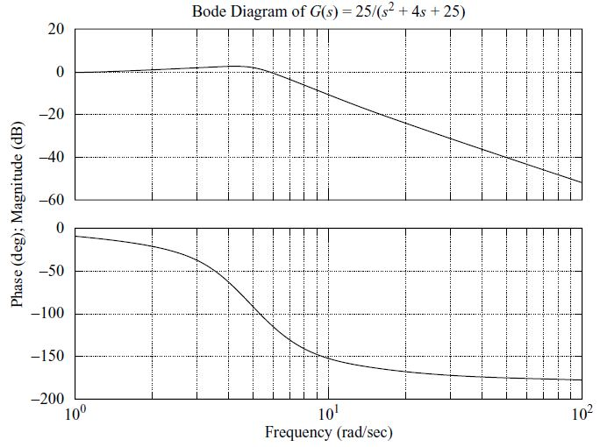
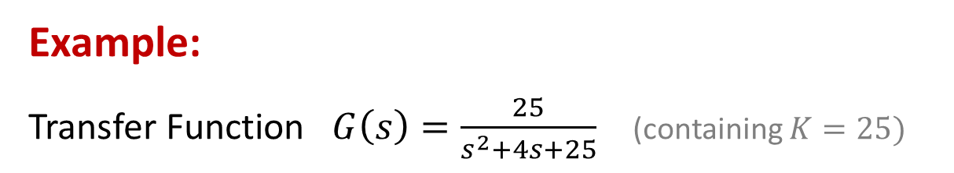
Bode Plots by MatLab
Example:
Transfer Function $G\left(s\right)=\frac{25}{s^{2}+4s+25}$ (containing $K=25)$
%MatLab code
num = [25];
den = [1 4 25];
bode(num,den);
grid

Slide 32



Example:
$$(K=9)$$
%MatLab code
num = [9 1.8 9];
den = [1 1.2 9 0];
bode(num,den);
grid

Slide 33


Stability Analysis with G(jω)
s → jω
→
G(s) → G(jω)

Slide 34



Stability Analysis with G(jω)
Y(s)
$$\frac{Y(s)}{R(s)}=\frac{G(s)}{1+G\left(s\right)H(s)}$$
Closed-loop system stability if and only if all poles are located in LHP
$1+G\left(s\right)H\left(s\right)=0$ gives all poles → $G\left(s\right)H\left(s\right)=−1$
→ the point $−1$ is important (write: $−1=−1+j0$ )
Nyquist Stability Criterion:
If (i) G(s)H(s) has P poles in RHP
(ii) $\lim_{s→∞}{G\left(s\right)H\left(s\right)=}$ constant
then, for closed-loop stability, as $ω:−∞→+∞$, $G\left(jω\right)H\left(jω\right)$ locus must encircle the point $(−1+j0)$ for P times counterclockwise

Slide 35


Nyquist Stability Criterion B:
For the closed-loop to be stable, one must have N + P = Z
$N$ = number of clockwise encirclements of the point –1+j0
($−N$ = number of counterclockwise encirclements)
$P$= number of poles of G(s)H(s) in RHP
$Z$ = number of zeros of 1+G(s)H(s) in RHP
Remark
Recall: Nyquist Condition A (i): G(s)H(s) has P poles in RHP
(1) If $P≠0$, for the closed-loop to be stable: “locus must encircle the point $(−1+j0)$ for P times counterclockwise”
→ $−N=P$ (i.e., N + P = 0) → $Z=0$
(2) If $P=0$, for the closed-loop to be stable: “locus must encircle the point $(−1+j0)$ for $P=0$ times counterclockwise”
All other cases: namely, otherwise, closed-loop is unstable

Slide 36




Example:
$G\left(s\right)H\left(s\right)=\frac{K(s+3)}{s(s−1)}$ $(K>0)$
(i) $G\left(s\right)H\left(s\right)$ has one pole $\left(s=1\right)$ in RHP $(P=1)$
(ii) $\lim_{s→∞}{G\left(s\right)H\left(s\right)=0 }$(constant)
Nyquist Plot →
Point $−1+0j$ is encircled by the curve once (P = 1) counterclockwise
→
Closed-loop system with Transfer Function
$\frac{G(s)}{1+G\left(s\right)H(s)}$ is stable

Slide 37



Example:
Transfer Function $G\left(s\right)H\left(s\right)=\frac{1}{s^{2}+0.8s+1}$
There are no poles of G(s)H(s) in the RHP, so P = 0, and the point $−1+j0$ is not being encircled counterclockwise, so N = 0,
→ Z = 0 = N + P
→ Closed-loop system is stable
%MatLab code
num = [1];
den = [1 0.8 1];
nyquist(num,den)

Slide 38




Example:
If $G\left(s\right)H\left(s\right)$ is unknown, but $P=0$ and $Z=0$, and Nyquist plots are obtained as $ω:−∞ → +∞$ for the following two cases of $K:$
Without encirclement
With encirclement(s)
N + P = Z
N + P $≠$ Z
→ $K$can change the system stability

Slide 39





Common Case:
(Consider $KG(s)$ only)
If the $KG\left(jω\right)$ locus passes through the point $−1+j0$, then closed-loop poles are located on the imaginary axis
This is marginally stable and is not desirable for practical control systems, so it should be found out, and then be avoided by appropriately designing the control gain K
→ It is very important to know the “margin” of the control gain $K$

Slide 40



Gain Margin
Definition: Gain Margin (GM) is the maximum scalar factor multiplying to KG(jω) for which polar plot is still not encircling ($−1,0$)
Let polar plot cut real axis at point A ($−d,0$), $0<d<1$
$GM= \frac{1}{d}$
A
-d

Slide 41




Phase Margin
Definition: Phase Margin (PM) is the maximum clockwise rotation of polar plot (about the origin), which is still not encircling ($−1,0$)
Draw a circle of radius 1 about the origin and mark the intersection point as point B
PM = ∠$G\left(jω_{B}\right)−(−{180}^{o})$
$(Generally, PM≅100 ζ$)
B

Slide 42



GM and PM from Bode Plot
Point A occurs at point where phase = $−{180}^{o}$
Point B occurs at point where magnitude = 1 = 0 dB
B
B
B
A
A
A

Slide 43

GM and PM from Bode Plot
Example: $50/(s^{3}+9s^{2}+30s+40)$
%MatLab code
bode(50, [1 9 30 40])
Gain Margin (GM) is the difference between the magnitude curve and 0dB at the point corresponding to the phase of -180 degree
Phase Margin (PM) is the difference between the phase curve and -180 degree at the point corresponding to the gain of 0dB
B
-180
A

Slide 44




Same Example
%MatLab code
margin(50,[1 9 30 40])
$$50/(s^{3}+9s^{2}+30s+40)$$
( W = $ω$ )
← Gm
Pm →

Slide 45




Example:
A occurs at point where phase = $−{180}^{o}$
B occurs at point where magnitude = 0 dB
GM $≈$ 32.5 dB
($0−\left(−32.5\right)=32.5$)
PM $≈$ ${33}^{o}$
(${−{147}^{o}−(−180}^{o})={33}^{o}$)

Slide 46




Special Cases:
G(s)H(s) has poles and/or zeros on the imaginary axis
Example:
$G\left(s\right)H\left(s\right)=\frac{K}{s}$
It has one pole at 0 (on the imaginary axis)
When $s=0$, let the pole be $s=εe^{jθ}$ with $0<ε≪1$and $−{90}^{o}<θ<{+90}^{o}$ Then
$G\left(εe^{jθ}\right)H\left(εe^{jθ}\right)=\frac{K}{εe^{jθ}}=\frac{K}{ε}e^{jθ}$
As $ε:0^{−}→0^{+}$, on has $\frac{K}{ε}:−∞→+∞$, so that
$G\left(j0^{−}\right)H\left(j0^{−}\right)=−∞=+∞=G\left(j0^{+}\right)H\left(j0^{+}\right)$
So, $G\left(s\right)H(s)$ locus does not encircle $−1+j0$
→ The closed-loop system is stable

Slide 47
END

