Slide 1
EE3114 Systems and Control
Tutorial - 6
Semester B, 2018-19
2018-10-10

Slide 2
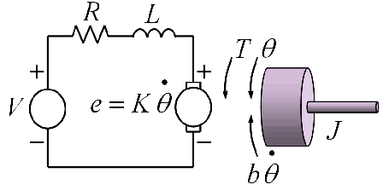
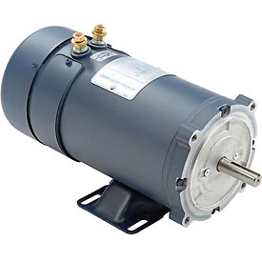

DC Motor Control
$$τ$$
B

Slide 3
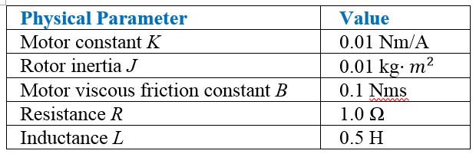
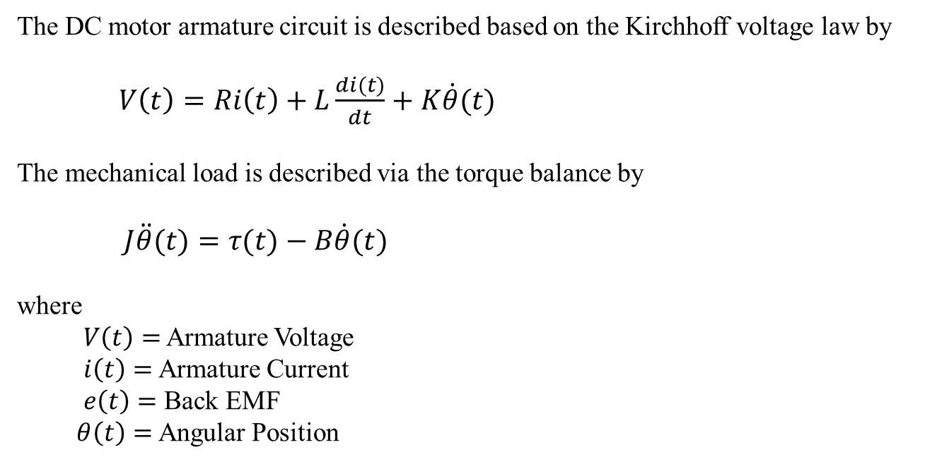

$$τ$$
B
The DC motor armature circuit is described based on the Kirchhoff voltage law by
$V\left(t\right)=Ri\left(t\right)+L\frac{di(t)}{dt}+K\dot{θ}(t)$
The mechanical load is described via the torque balance by
$J\ddot{θ}(t)=τ(t)−B\dot{θ}(t)$
where
$V\left(t\right)=$ Armature Voltage
$i\left(t\right)=$ Armature Current
$e\left(t\right)=$ Back EMF
$θ\left(t\right)=$ Angular Position

Slide 4

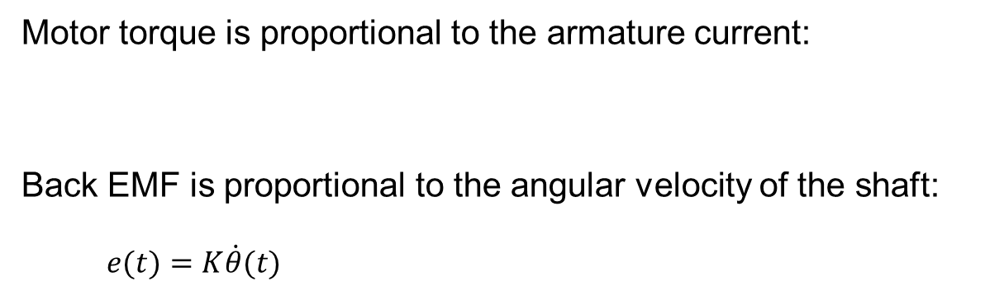
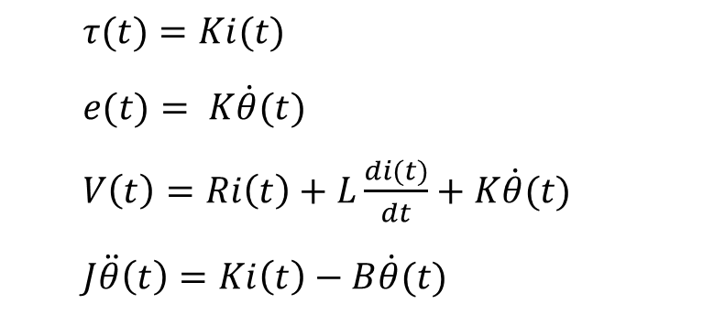
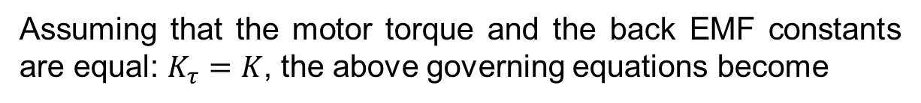
Motor torque is proportional to the armature current:
Back EMF is proportional to the angular velocity of the shaft:
$e(t)=K\dot{θ}(t)$
$τ(t)=K_{τ}i(t)$
Assuming that the motor torque and the back EMF constants are equal: $K_{τ}=K$, the above governing equations become
$τ(t)=Ki(t)$
$e(t)= K\dot{θ}(t)$
$V\left(t\right)=Ri\left(t\right)+L\frac{di(t)}{dt}+K\dot{θ}(t)$
$J\ddot{θ}\left(t\right)=Ki\left(t\right)−B\dot{θ}(t)$

Slide 5
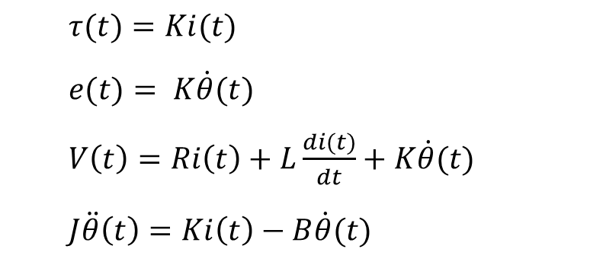
$τ(t)=Ki(t)$
$e(t)= K\dot{θ}(t)$
$V\left(t\right)=Ri\left(t\right)+L\frac{di(t)}{dt}+K\dot{θ}(t)$
$J\ddot{θ}\left(t\right)=Ki\left(t\right)−B\dot{θ}(t)$
(i) Write the Laplace Transforms of the above 4 equations:
(3 minutes)

Slide 6
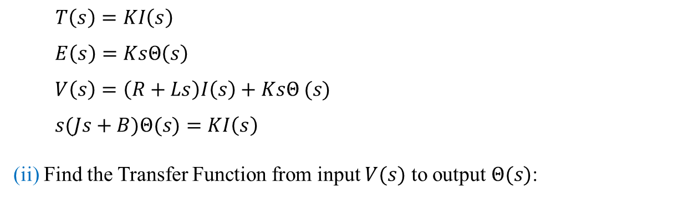
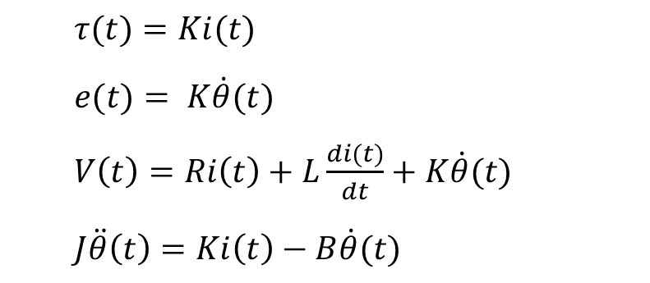
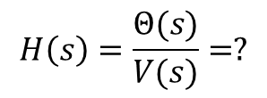
$τ(t)=Ki(t)$
$e(t)= K\dot{θ}(t)$
$V\left(t\right)=Ri\left(t\right)+L\frac{di(t)}{dt}+K\dot{θ}(t)$
$J\ddot{θ}\left(t\right)=Ki\left(t\right)−B\dot{θ}(t)$
(i) Write the Laplace Transforms of the above 4 equations:
Solution:
$T\left(s\right)=KI\left(s\right)$
$$E\left(s\right)=KsΘ\left(s\right)$$
$V\left(s\right)=\left(R+Ls\right)I\left(s\right)+KsΘ (s)$
$s(Js+B)Θ(s)=KI\left(s\right)$
(ii) Find the Transfer Function from input $V(s)$ to output $Θ(s)$:
$$H\left(s\right)=\frac{Θ(s)}{V(s)}=?$$
(5 minutes)

Slide 7
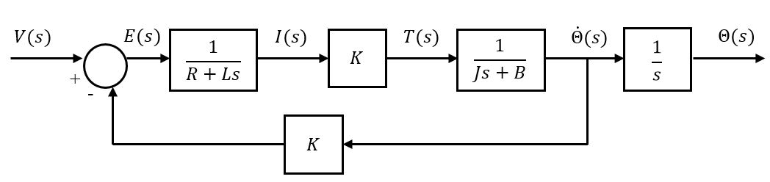
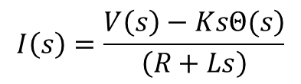
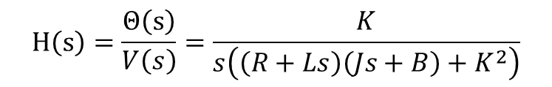
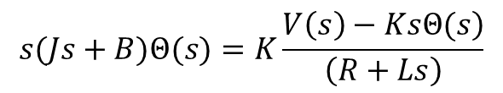
(ii) Find the Transfer Function from input $V(s)$ to output $Θ(s)$:
Solution:
$$I\left(s\right)=\frac{\left.V\left(s\right)−KsΘ(s\right)}{\left(R+Ls\right)}$$
$$s(Js+B)Θ(s)=K\frac{\left.V\left(s\right)−KsΘ(s\right)}{\left(R+Ls\right)}$$
$$H\left(s\right)=\frac{Θ\left(s\right)}{V\left(s\right)}=\frac{K}{s\left(\left(R+Ls\right)\left(Js+B\right)+K^{2}\right)}$$
A block diagram (not unique)

Slide 8
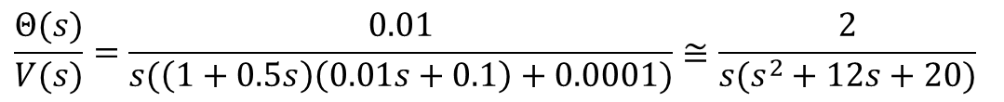
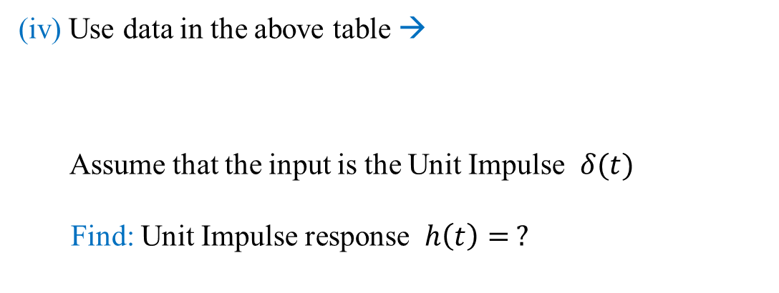
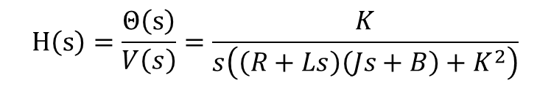
Now, continue to consider:
$$H\left(s\right)=\frac{Θ\left(s\right)}{V\left(s\right)}=\frac{K}{s\left(\left(R+Ls\right)\left(Js+B\right)+K^{2}\right)}$$
(iv) Use data in the above table →
Assume that the input is the Unit Impulse $δ(t)$
Find: Unit Impulse response $h\left(t\right)= ?$
$$\frac{Θ(s)}{V(s)}=\frac{0.01}{s(\left(1+0.5s\right)\left(0.01s+0.1\right)+0.0001)}≅\frac{2}{s(s^{2}+12s+20)}$$
(10 minutes)

Slide 9
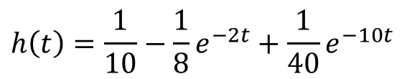
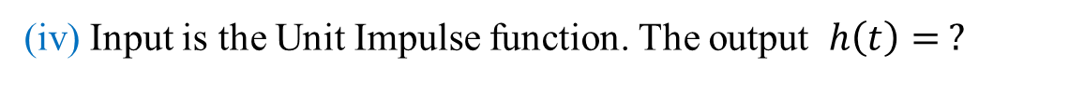
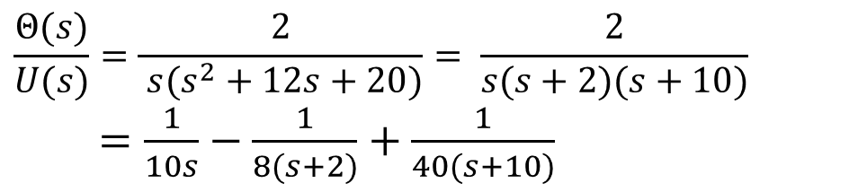
(iv) Input is the Unit Impulse function. The output $h\left(t\right)= ?$
Solution:
$$\frac{Θ(s)}{U(s)}=\frac{2}{ s(s^{2}+12s+20)}= \frac{2}{s(s+2)(s+10)}$$
$=\frac{1}{10s}−\frac{1}{8(s+2)}+\frac{1}{40(s+10)}$
$$h\left(t\right)=\frac{1}{10}−\frac{1}{8}e^{−2t}+\frac{1}{40}e^{−10t}$$
(v) Sketch the Unit Impulse response of the system:
(3 minutes)
h(t)
t

Slide 10
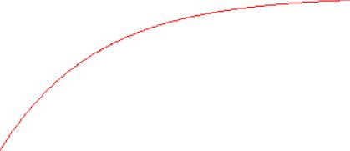
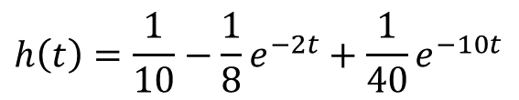

$$h\left(t\right)=\frac{1}{10}−\frac{1}{8}e^{−2t}+\frac{1}{40}e^{−10t}$$
(v) Sketch the Unit Impulse Response of the system:
Solution:
h(t)
1/10
$h\left(0\right)=\frac{1}{10}−\frac{1}{8}+\frac{1}{40}$ = 0
t
(vi) Is the system BIBO stable? Why?
(3 minutes)

Slide 11
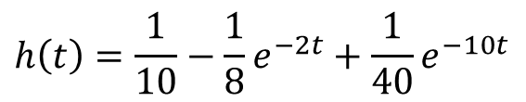
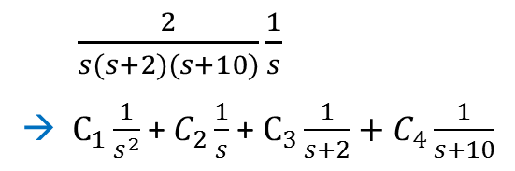

$$h\left(t\right)=\frac{1}{10}−\frac{1}{8}e^{−2t}+\frac{1}{40}e^{−10t}$$
(v) Sketch the Unit Impulse Response of the system:
Solution:
h(t)
1/10
$h\left(0\right)=\frac{1}{10}−\frac{1}{8}+\frac{1}{40}$ = 0
t
(vi) Is the system BIBO stable? Why?
Solution:
No. The transfer function has a pole on the imaginary axis, which yields a ramp output (unbounded) for step input (bounded)
$\frac{2}{s(s+2)(s+10)}\frac{1}{s}$
→ $C_{1}\frac{1}{s^{2}}$ +$C_{2}\frac{1}{s}$+ $C_{3}\frac{1}{s+2}+C_{4}\frac{1}{s+10}$

Slide 12
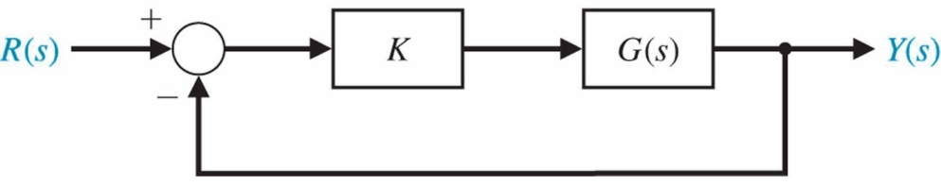
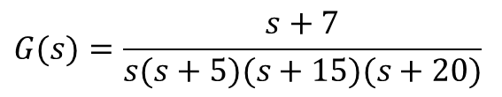
Root Locus Design
Using
MatLab: Control System Designer
Control System Toolbox™
Free 30-Day Trial
Example:
$$G(s)=\frac{s+7}{s(s+5)(s+15)(s+20)}$$
Zero: -7
Poles: 0, -5, -15, -20
%MatLab code
s = tf('s');
plant = (s + 7)/(s*(s + 5)*(s + 15)*(s + 20));
controlSystemDesigner(plant)
← Command from Toolbox

Slide 13
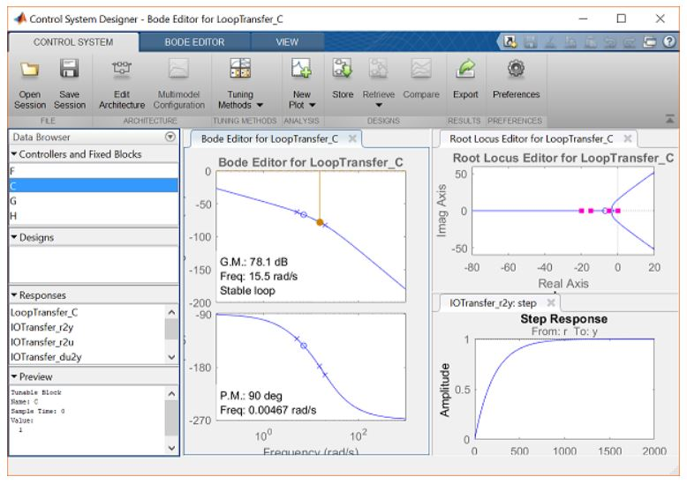
With default gain K = 1

Slide 14
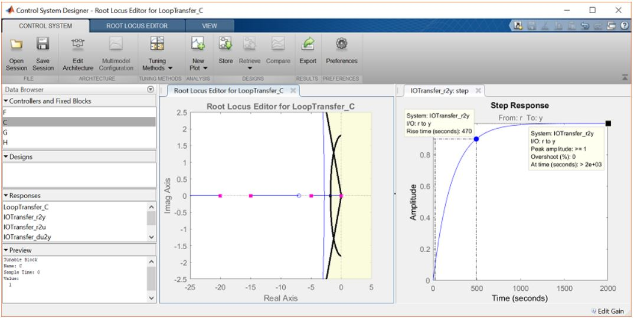
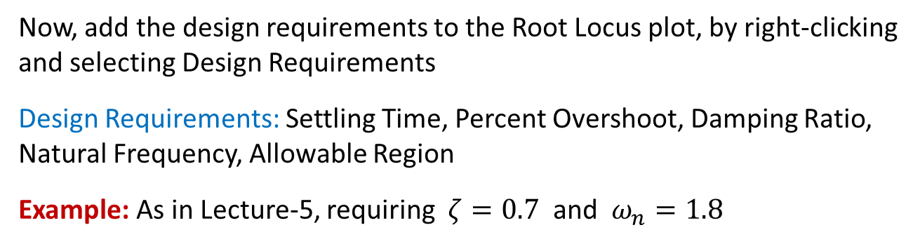
Now, add the design requirements to the Root Locus plot, by right-clicking and selecting Design Requirements
Design Requirements: Settling Time, Percent Overshoot, Damping Ratio, Natural Frequency, Allowable Region
Example: As in Lecture-5, requiring $ζ=0.7$ and $ω_{n}=1.8$

Slide 15
On the left plot, the white area is Acceptable Region for the closed-loop poles
As the characteristics show on the Step Response, the Overshoot is acceptable but the Rise Time is much too long (which needs to be tuned, see next page)

Slide 16
Zoom into the Root Locus by right-clicking on an axis and selecting Properties followed by the label Limits
Change the real-axis limits: from -25 to 5
Change the imaginary axis limits: from -2.5 to 2.5
On the Step Response plot, right-click on the plot and go to Characteristics and select Peak Response. Then, select the characteristic Rise Time.
Now, there should be two large dots on the screen indicating the values of these parameters.
Click each of these dots to bring up a tiny box with new information.
Both plots should appear as shown below, once the Bode Plot is closed: (next page)

Slide 17
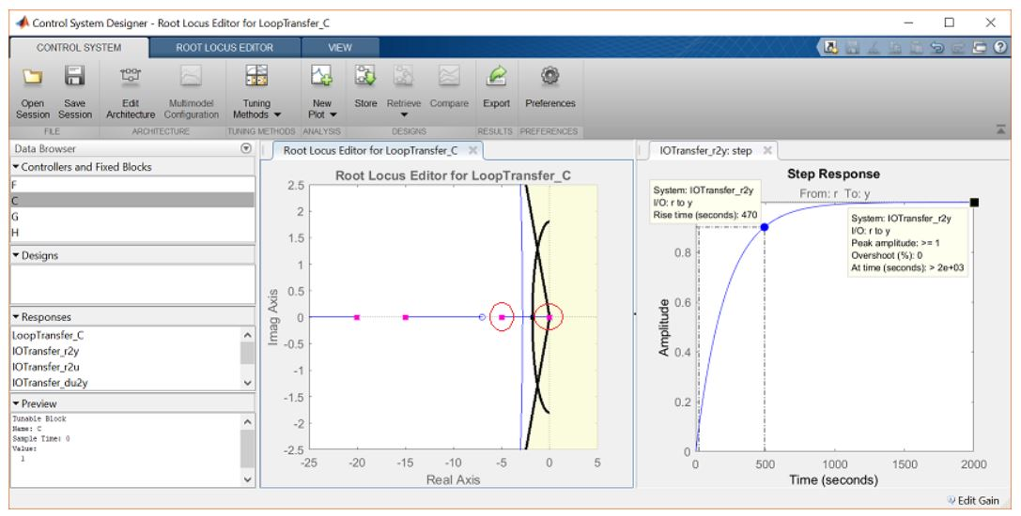
The pink tiny boxes on the root locus show the corresponding closed-loop pole locations for the currently chosen control gain K
To fix it, choose a new value for the gain K, which can be changed directly on the root locus plot -- Click and drag the pink box closest to the imaginary axis (at the origin) to the acceptable region of the root locus plot as shown below:

Slide 18
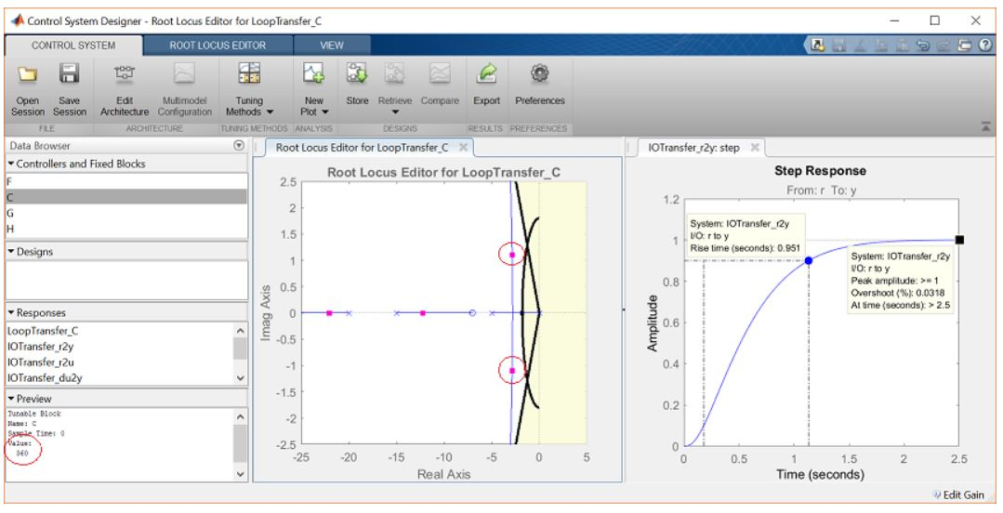
In the Preview box of the window, it can be seen that the loop gain has been changed to 360
Inspecting the Step Response plot: Now, both requirements are met

Slide 19
END

