Slide 1
Lecture 4: Relational Algebra
CS3402 Database Systems

Slide 2
What is Relational Algebra?
Relational algebra is a formal language for the relational model
The operations in relational algebra enable a user to specify basic retrieval requests (or queries)
Relational algebra consists of a set of operations on relations to generate relations
The result of an operation is a new relation that can be further manipulated using operations
A sequence of relational algebra operations forms a relational algebra expression

Slide 3
Importance of Relational Algebra
Relational algebra provides a formal foundation for relational model
It is used as a basis for implementing and optimizing queries in query processing and optimization
Its concepts are incorporated into SQL standard language for relational database management systems
The internal modules of most commercial RDBMS are based on relational algebra

Slide 4
Relational Algebra Overview (1/2)
Relational algebra consists of several groups of operations
Unary Relational Operations
  SELECT (symbol: σ (sigma))
  PROJECT (symbol: π (pi))
  RENAME (symbol: ρ (rho))
Relational algebra operations from set theory
  UNION ( ∪ ), INTERSECTION ( ∩ ), DIFFERENCE (or MINUS, – )
  CARTESIAN PRODUCT ( x )

Slide 5
Relational Algebra Overview (2/2)
Binary Relational Operations
  JOIN (several variations of JOIN exist)
  DIVISION
Additional Relational Operations
  OUTER JOINS, OUTER UNION
  AGGREGATE FUNCTIONS (These compute summary of information: for example, SUM, COUNT, AVG, MIN, and MAX)

Slide 6
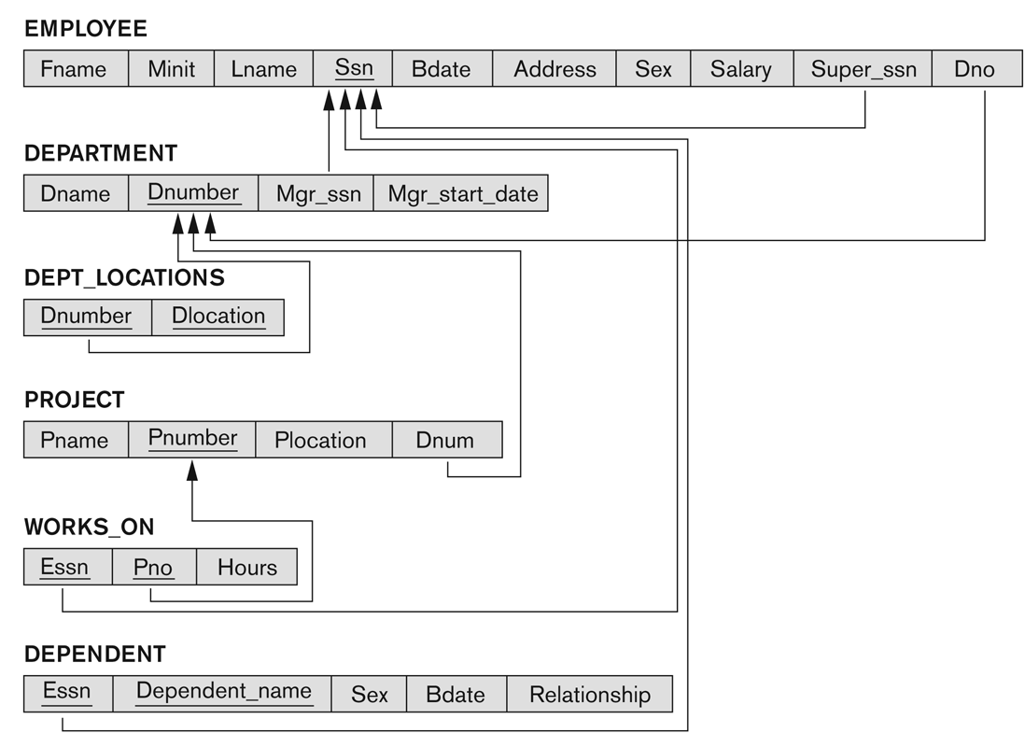
Referential Integrity Constraints for the COMPANY Relational Database Schema

Slide 7
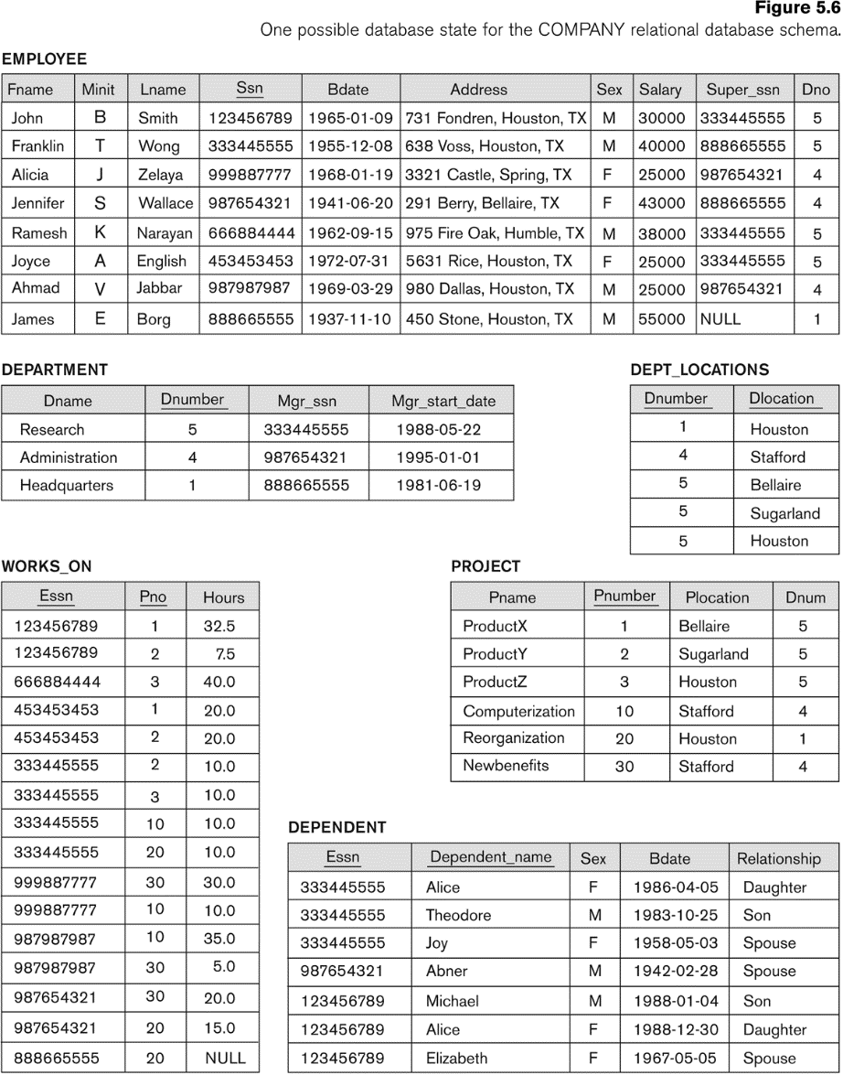
One Possible Database State for the COMPANY Relational Database Schema

Slide 8
Unary Relational Operations: SELECT
The SELECT operation (denoted by σ (sigma)) is used to select a subset of the tuples from a relation based on a selection condition
  The selection condition acts as a filter to keep only those tuples that satisfy the qualifying condition
  Horizontal partitioning: Tuples satisfying the condition are selected whereas the other tuples are discarded (filtered out)
Examples:
  Select the EMPLOYEE tuples whose department number is 4:
σ _{DNO = 4} (EMPLOYEE)
  Select the employee tuples whose salary is greater than $30,000:
σ _{SALARY > 30,000} (EMPLOYEE)
SELECT *
FROM EMPLOYEE
WHERE DNO=4
SELECT *
FROM EMPLOYEE
WHERE SALARY>30000

Slide 9
SELECT Operation Properties (1/2)
The SELECT operation σ _{<selection condition>}(R) produces a relation S that has the same schema (i.e., same attributes) as R
SELECT σ is commutative:
  σ _{<condition1>}(σ _{< condition2>} (R)) = σ _{<condition2>} (σ _{< condition1>} (R))
Because of commutativity property, a cascade (sequence) of SELECT operations may be applied in any order:
  σ_{<cond1>}(σ_{<cond2>} (σ_{<cond3>} (R)) = σ_{<cond2>} (σ_{<cond3>} (σ_{<cond1>} ( R)))

Slide 10
SELECT Operation Properties (2/2)
A cascade of SELECT operations may be replaced by a single selection with a conjunction (and) of all the conditions:
  σ_{<cond1>}(σ_{<cond2>} (σ_{<cond3>}(R)) = σ <cond1> AND <cond2> AND <cond3>(R)))
The number of tuples in the result of a SELECT operation is less than (or equal to) the number of tuples in the input relation R
The fraction of tuples selected by a selection condition is called the selectivity of the condition

Slide 11
Unary Relational Operations: PROJECT (1/2)
PROJECT Operation is denoted by π (pi)
This operation keeps certain attributes from a relation and discards the other attributes
  PROJECT creates a vertical partitioning: the list of specified attributes is kept in each tuple and the other attributes in each tuple are discarded
Example: To list each employee’s first and last name and salary, the following is used:
  π_{LNAME, FNAME,SALARY}(EMPLOYEE)
SELECT LNAME, FNAME, SALARY
FROM EMPLOYEE

Slide 12
Unary Relational Operations: PROJECT (2/2)
The general form of the project operation is:
π_{<attribute list>}(R)
  π (pi) is the symbol used to represent the project operation
  <attribute list> is the desired list of attributes from relation R
The project operation removes any duplicate tuples
  This is because the result of the project operation must be a set of tuples
  Mathematical sets do not allow duplicate elements

Slide 13
PROJECT Operation Properties
The number of tuples in the result of projection π_{<list>}(R) is always less (duplicates are removed) or equal (unique values) to the number of tuples in R
If the list of attributes includes a key of R, then the number of tuples in the result of PROJECT is equal to the number of tuples in R
PROJECT is not commutative
  π _{<list1>} (π _{<list2>} (R) ) ≠ π _{<list2>} (π _{<list1>} (R) )
  π _{<list1>} (π _{<list2>} (R) ) = π _{<list1>} (R) as long as <list2> contains the attributes in <list1>
  For example, List1 = LNAME, FNAME; List2 = LNAME, FNAME, SALARY

Slide 14
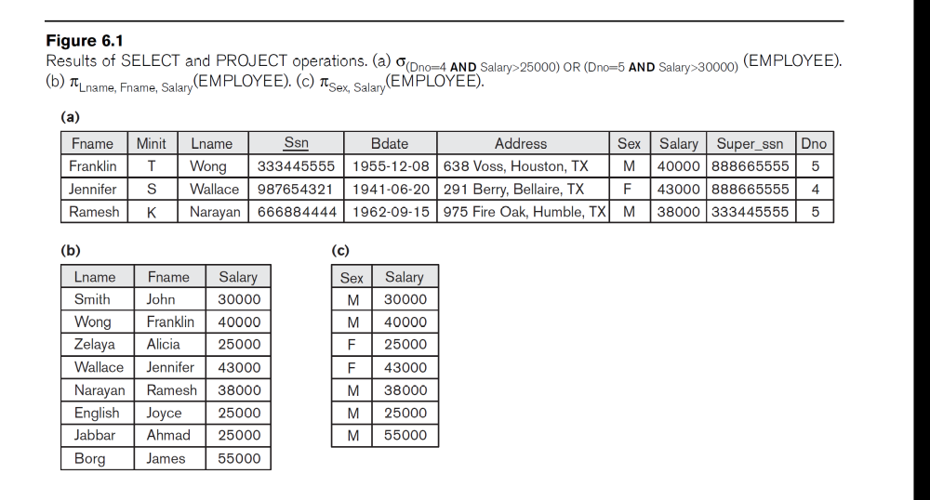
Examples of Applying SELECT and PROJECT Operations

Slide 15
Relational Algebra Expressions
We may want to apply several relational algebra operations one after the other
  Either we can write the operations as a single relational algebra expression by nesting the operations, or
  We can apply one operation at a time and create intermediate result relations
In the latter case, we must give names (rename) to the relations that hold the intermediate results

Slide 16
Single Expression versus Sequence of Relational Operations
To retrieve the first name, last name, and salary of all employees who work in department number 5, we must apply a select and a project operation
We can write a single relational algebra expression as follows:
  π_{FNAME, LNAME, SALARY}(σ _{DNO=5}(EMPLOYEE))
Or, we can explicitly show the sequence of operations, giving a name to each intermediate relation:
  DEP5_EMPS ← σ _{DNO=5}(EMPLOYEE)
  RESULT ← π _{FNAME, LNAME, SALARY}(DEP5_EMPS)

Slide 17
Unary Relational Operations: RENAME (1/2)
The RENAME operator is denoted by ρ (rho)
The general RENAME operation ρ can be expressed by any of the following forms:
  ρ_{S (B1, B2, …, Bn)}(R) changes both:
    the relation name to S, and
    the attribute names to B1, B2, …, Bn
  ρ_{S}(R) changes:
    the relation name only to S
  ρ_{(B1, B2, …, Bn)}(R) changes:
    the attribute names only to B1, B2, …, Bn
SELECT E.Fname AS F_Name,
E.Lname AS L_Name, E.Salary AS Salary
FROM EMPLOYEE AS E
WHERE E.Dno = 5

Slide 18
Unary Relational Operations: RENAME (2/2)
For convenience, we also use a shorthand for renaming attributes in an intermediate relation:
  If we write:
    RESULT ← π _{FNAME, LNAME, SALARY} (DEP5_EMPS)
    RESULT will have the same attribute names as DEP5_EMPS (same attributes as EMPLOYEE)
  If we write:
    RESULT ← ρ RESULT (F,M,L,S,B,A,SX,SAL,SU, DNO)(DEP5_EMPS)
    The 10 attributes of DEP5_EMPS are renamed to F, M, L, S, B, A, SX, SAL, SU, DNO, respectively
  Note: the ← symbol is an assignment operator

Slide 19
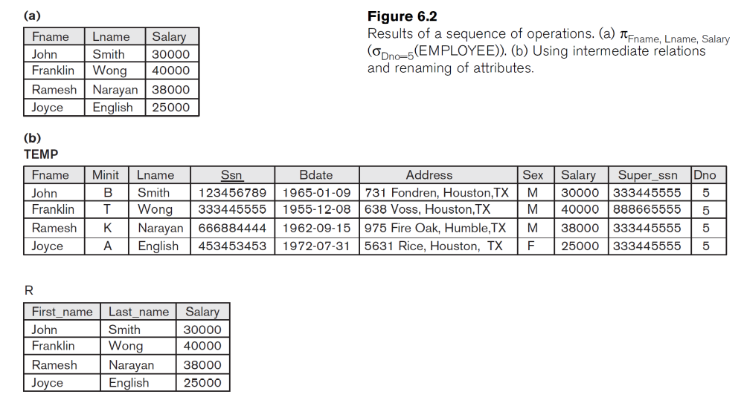
Example of Applying Multiple Operations and RENAME
  π_{FNAME, LNAME, SALARY}(σ _{DNO=5}(EMPLOYEE))
TEMP ← σ _{DNO=5}(EMPLOYEE)
R(First_name, Last_name, Salary) ← π_{FNAME, LNAME, SALARY} (TEMP)

Slide 20
Set Theory: UNION Operation
Binary operation, denoted by ∪
The result of R ∪ S, is a relation that includes all tuples that are either in R or in S or in both R and S
Duplicate tuples are eliminated
The two operand relations R and S must be “type compatible” (or UNION compatible)
  R and S must have same number of attributes
  Each pair of corresponding attributes must be type compatible (have same or compatible domains)

Slide 21
Relational Algebra Operations from
Set Theory: UNION (Examples)
To retrieve the social security numbers of all employees who either work in department 5 (RESULT1 below) or directly supervise an employee who works in department 5 (RESULT2 below)
We can use the UNION operation as follows:
DEP5_EMPS ← σ_{DNO=5} (EMPLOYEE)
RESULT1 ← π _{SSN} (DEP5_EMPS)
RESULT2(SSN) ← π_{SUPERSSN} (DEP5_EMPS)
RESULT ← RESULT1 ∪ RESULT2
The union operation produces the tuples that are in either RESULT1 or RESULT2 or both

Slide 22
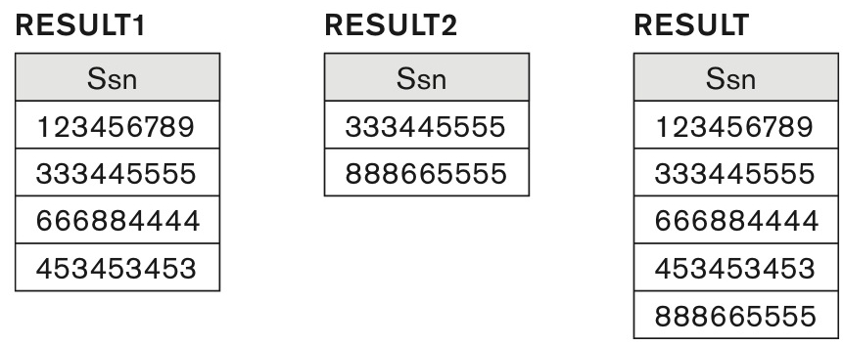
Result of the UNION Operation RESULT ← RESULT1 ∪ RESULT2

Slide 23
Relational Algebra Operations from
Set Theory
Type compatibility of operands is required for the binary set operation UNION ∪, (also for INTERSECTION ∩, and SET DIFFERENCE –)
R1(A1, A2, ..., An) and R2(B1, B2, ..., Bn) are type compatible if:
  They have the same number of attributes, and
  The domains of corresponding attributes are type compatible (i.e. dom(Ai)=dom(Bi) for i=1, 2, ..., n)
The resulting relation for R1∪R2 (also for R1∩R2, or R1–R2) has the same attribute names as the first operand relation R1

Slide 24
Relational Algebra Operations from Set Theory: INTERSECTION
INTERSECTION is denoted by ∩
The result of the operation R ∩ S, is a relation that includes all tuples that are in both R and S
  The attribute names in the result will be the same as the attribute names in R
The two operand relations R and S must be “type compatible”

Slide 25
Relational Algebra Operations from Set Theory: SET DIFFERENCE
SET DIFFERENCE (also called MINUS or EXCEPT) is denoted by –
The result of R – S, is a relation that includes all tuples that are in R but not in S
  The attribute names in the result will be the same as the attribute names in R
The two operand relations R and S must be “type compatible”
R ∩ S = (R ∪ S) – (R – S) – (S – R)
S
R-S
R∩S
S-R
R

Slide 26
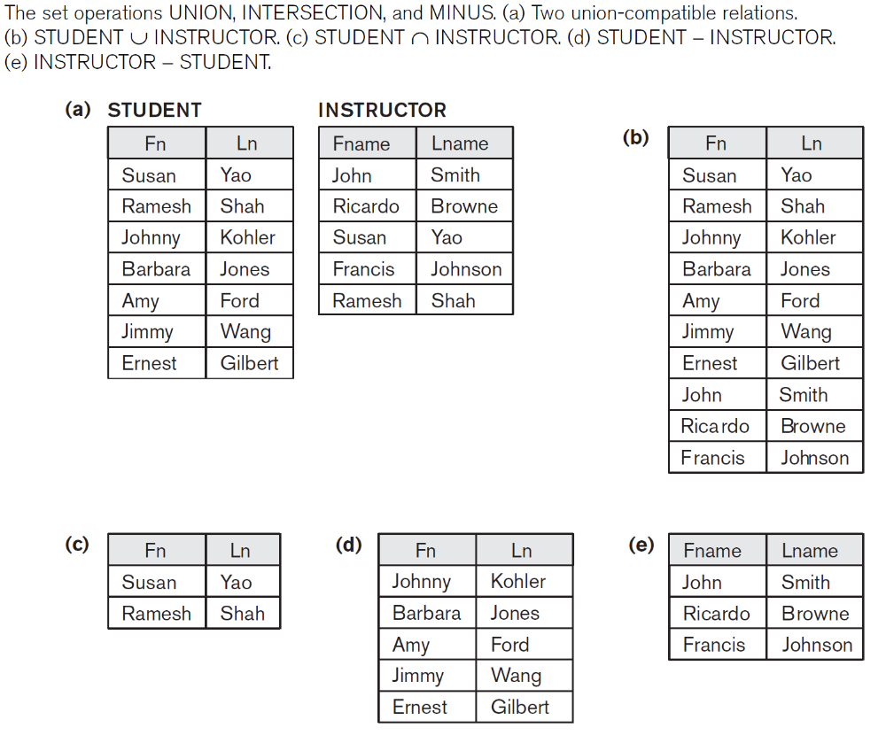
Example to illustrate the result of UNION, INTERSECT, and DIFFERENCE
(a) Two union-compatible relations
(b) STUDENT ∪ INSTRUCTOR
(c) STUDENT ∩ INSTRUCTOR
(d) STUDENT – INSTRUCTOR
(e) INSTRUCTOR – STUDENT

Slide 27
Some properties of UNION, INTERSECT, and DIFFERENCE
Notice that both union and intersection are commutative operations; that is: R ∪ S = S ∪ R, and R ∩ S = S ∩ R
Both union and intersection can be treated as n-ary operations applicable to any number of relations as both are associative operations; that is
  R ∪ (S ∪ T) = (R ∪ S) ∪ T
  (R ∩ S) ∩ T = R ∩ (S ∩ T)
The minus operation is not commutative
  R – S ≠ S – R

Slide 28
Relational Algebra Operations from Set Theory: CARTESIAN (or CROSS) PRODUCT (1/4)
This operation is used to combine tuples from two relations in a combinatorial fashion
Denoted by R(A1, A2, …, An) x S(B1, B2, …, Bm)
Result is a relation Q with degree n + m attributes:
  Q(A1, A2, …, An, B1, B2, …, Bm), in that order
The resulting relation state has one tuple for each combination of tuples - one from R and one from S
Hence, if R has n_{R} tuples (denoted as |R| = n_{R} ), and S has n_{S} tuples, then R x S will have n_{R} * n_{S} tuples
The two operands do NOT have to be “type compatible”

Slide 29
Relational Algebra Operations from Set Theory: CARTESIAN (or CROSS) PRODUCT (2/4)
Generally, CROSS PRODUCT is not a meaningful operation
  Some relations do not exist in the mini-world
  Can become meaningful when followed by other operations
Example (not meaningful):
  FEMALE_EMPS ← σ _{SEX=’F’}(EMPLOYEE)
  EMPNAMES ← π _{FNAME, LNAME, SSN} (FEMALE_EMPS)
  EMP_DEPENDENTS ← EMPNAMES x DEPENDENT
EMP_DEPENDENTS will contain every combination of EMPNAMES and DEPENDENT
  Whether or not they are actually related

Slide 30
Relational Algebra Operations from Set Theory: CARTESIAN (or CROSS) PRODUCT (3/4)
To keep only combinations where the DEPENDENT is related to the EMPLOYEE, we add a SELECT operation as follows
Example (meaningful):
  FEMALE_EMPS ← σ _{SEX=’F’}(EMPLOYEE)
  EMPNAMES ← π _{FNAME, LNAME, SSN} (FEMALE_EMPS)
  EMP_DEPENDENTS ← EMPNAMES x DEPENDENT
  ACTUAL_DEPS ← σ _{SSN=ESSN}(EMP_DEPENDENTS)
  RESULT ← π _{FNAME, LNAME, DEPENDENT_NAME} (ACTUAL_DEPS)
RESULT will now contain the name of female employees and their dependents

Slide 31
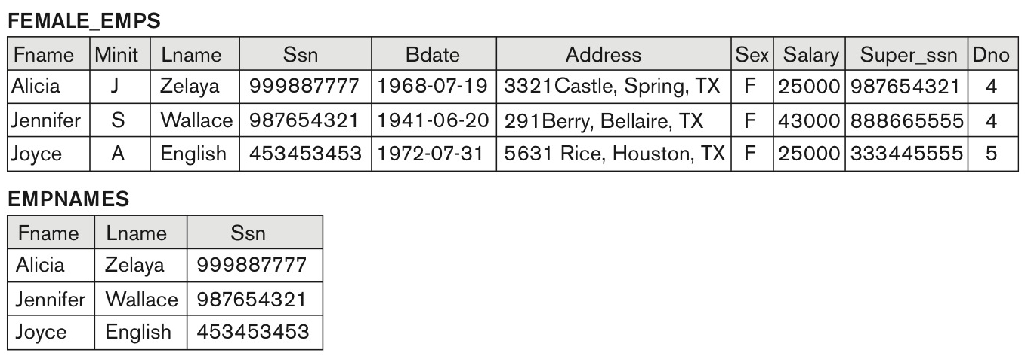
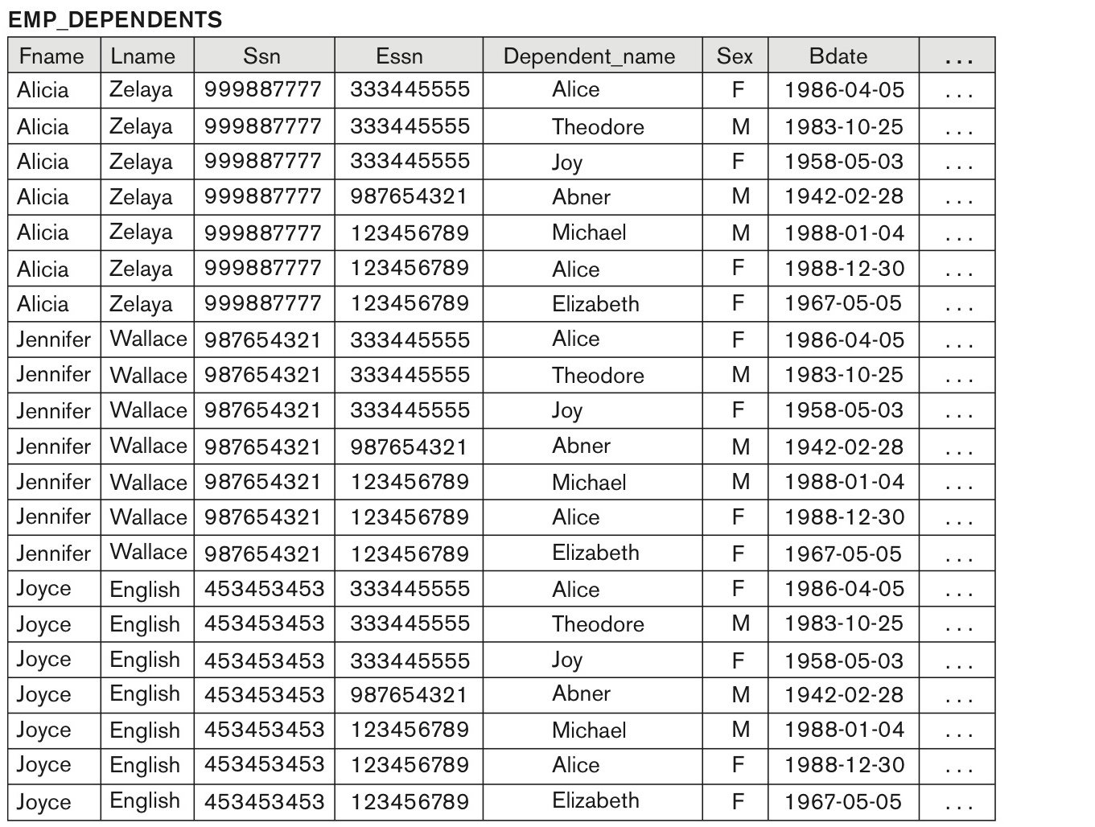
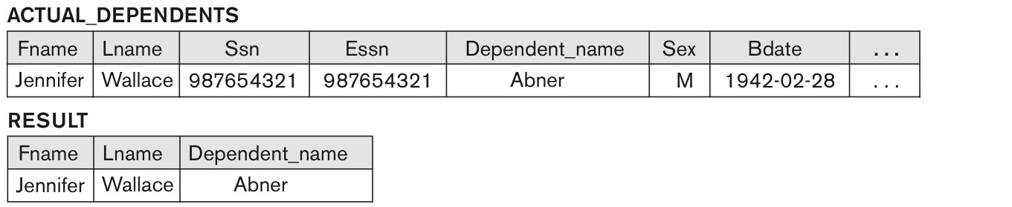
Relational Algebra Operations from Set Theory: CARTESIAN (or CROSS) PRODUCT (4/4)
1
3
2
4
5

Slide 32
Binary Relational Operations: JOIN (1/2)
JOIN Operation (denoted by )
The sequence of CARTESIAN PRODECT followed by SELECT is used quite commonly to identify and select related tuples from two relations
A special operation, called JOIN combines this sequence into a single operation
The general form of a join operation on two relations R(A1, A2, . . ., An) and S(B1, B2, . . ., Bm) is:
R _{<join condition>}S
R and S can be any relations that result from general relational algebra expressions

Slide 33
Binary Relational Operations: JOIN (2/2)
Example: Suppose that we want to retrieve the name of the manager of each department
  To get the manager’s name, we need to combine each DEPARTMENT tuple with the EMPLOYEE tuple whose Ssn value matches the Mgr_ssn value in the department tuple.
  DEPT_MGR ← DEPARTMENT _{Mgr_ssn=Ssn} EMPLOYEE
Mgr_ssn=Ssn is the join condition
  Combine each department record with the employee who manages the department

Slide 34
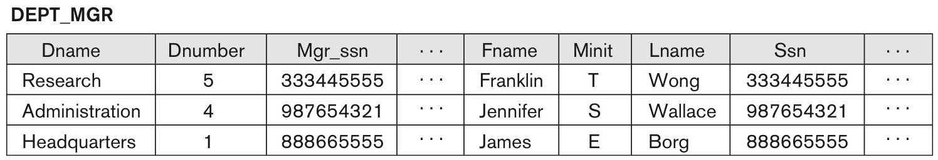
Result of the JOIN operation
DEPT_MGR ← DEPARTMENT _{Mgr_ssn=Ssn}EMPLOYEE

Slide 35
Some Properties of JOIN (1/2)
Consider the following JOIN operation:
  R(A1, A2, …, An) S(B1, B2, …, Bm)
    R.Ai=S.Bj
  Result is a relation Q with degree n + m attributes:
    Q(A1, A2, . . ., An, B1, B2, . . ., Bm) in that order
  The resulting relation state has one tuple for each combination of tuples: r from R and s from S, but only if they satisfy the join condition r[Ai]=s[Bj]
  Hence, if R has n_{R} tuples, and S has n_{S} tuples, then the join result will generally have less than n_{R} x n_{S} tuples

Slide 36
Some Properties of JOIN (2/2)
The general case of JOIN operation is called a Theta-join: R S
The join condition is called theta
Theta can be any general boolean expression on the attributes of R and S; for example:
  R.Ai < S.Bj AND (R.Ak=S.Bl OR R.Ap<S.Bq)
Most join conditions involve one or more equality conditions “AND”ed together; for example:
  R.Ai=S.Bj AND R.Ak=S.Bl AND R.Ap=S.Bq

Slide 37
Binary Relational Operations: EQUIJOIN
EQUIJOIN Operation
The most common use of join involves join conditions with equality comparisons only
Such a join, where the only comparison operator used is =, is called an EQUIJOIN
  In the result of an EQUIJOIN, we always have one or more pairs of attributes (whose names need not be identical) that have identical values in every tuple
  The JOIN seen in the previous example was an EQUIJOIN

Slide 38
Binary Relational Operations: NATURAL JOIN Operation (1/2)
NATURAL JOIN Operation
  Another variation of JOIN called NATURAL JOIN — denoted by * was created to get rid of the second (superfluous) attribute in an EQUIJOIN condition, because one of each pair of attributes with identical values is superfluous
  The standard definition of natural join requires that the two join attributes, or each pair of corresponding join attributes, have the same name in both relations
  If this is not the case, a renaming operation is applied first

Slide 39
Binary Relational Operations: NATURAL JOIN Operation (2/2)
Example: To apply a natural join on the DNUMBER attributes of DEPARTMENT and DEPT_LOCATIONS, it is sufficient to write:
  DEPT_LOCS ← DEPARTMENT * DEPT_LOCATIONS
Only attribute with the same name is DNUMBER
An implicit join condition is created based on this attribute: DEPARTMENT.DNUMBER=DEPT_LOCATIONS.DNUMBER
Another example: Q ← R(A,B,C,D) * S(C,D,E)
  The implicit join condition includes each pair of attributes with the same name, “AND”ed together: R.C=S.C AND R.D=S.D
  Result keeps only one attribute of each such pair: Q(A,B,C,D,E)

Slide 40
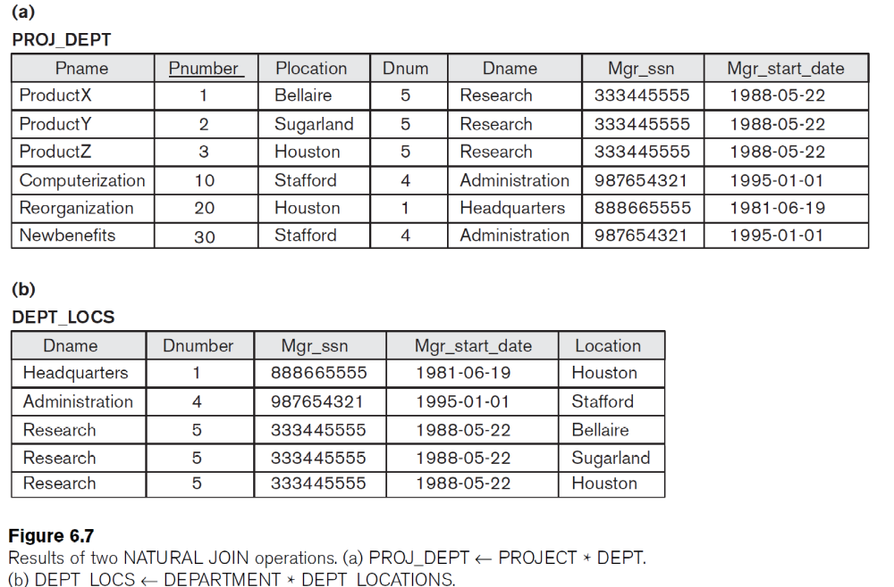
Example of NATURAL JOIN Operation

Slide 41
Complete Set of Relational Operations
The set of operations including SELECT σ, PROJECT π , UNION ∪, DIFFERENCE − , RENAME ρ, and CARTESIAN PRODUCT X is called a complete set because any other relational algebra expression can be expressed by a combination of these five operations
For example:
  R ∩ S = (R ∪ S ) – ((R − S) ∪ (S − R))
  R _{<join condition>}S = σ _{<join condition>} (R X S)

Slide 42
Binary Relational Operations: DIVISION
The division operation is applied to two relations
R(Z) ÷ S(X), where X is a subset of Z
Let Y = Z - X (and hence Z = X ∪ Y); that is, let Y be the set of attributes of R that are not attributes of S
The result of DIVISION is a relation T(Y) that includes a tuple t if tuples t_{R} appear in R with t_{R} [Y] = t, and with
  t_{R} [X] = t_{s} for every tuple t_{s} in S
For a tuple t to appear in the result T of the DIVISION, the values in t must appear in R in combination with every tuple in S

Slide 43
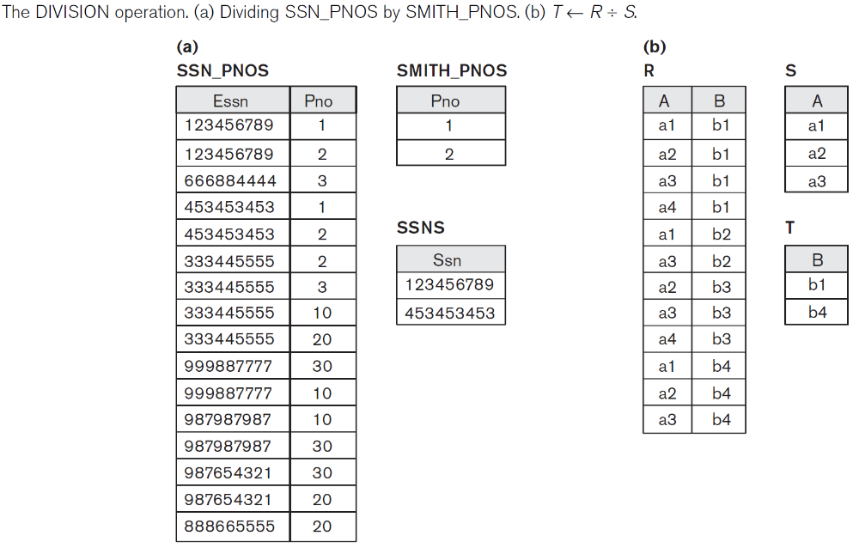
Example of DIVISION

Slide 44
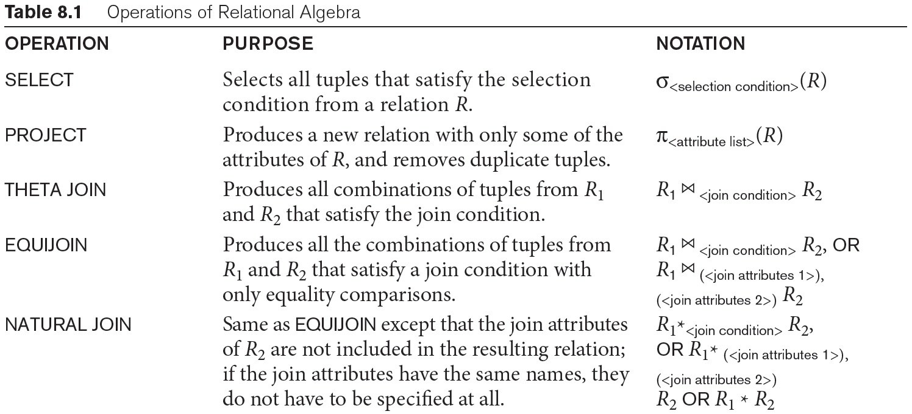
Operations of Relational Algebra (1/2)

Slide 45
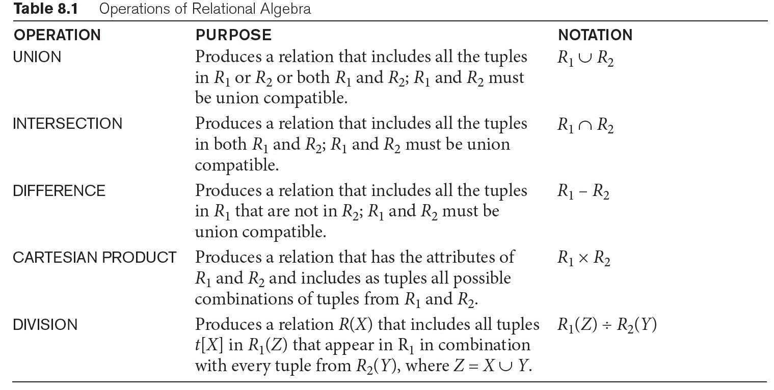
Operations of Relational Algebra (2/2)

