Slide 1
EE2203 Modelling Techniques
Week 10
Logistic Regression

Slide 2
Objectives of Logistic Regression
Classify individuals into one of two groups when:
  Some of the classifying variables are categorical
Quantify risk of outcome
Test which variables are useful

Slide 3
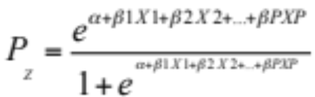
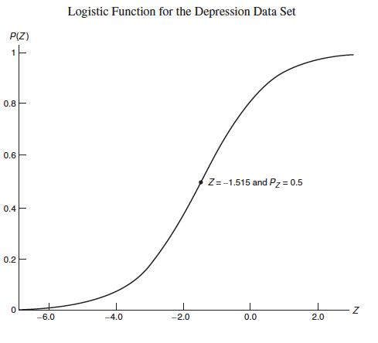
Logistic Regression Model &
Odds of an event
The probability of being to group 1 is a logistic function:
P is the probability of an event
The odds are defined as:
  Odds =P/(1-P)
* Z is a linear function of the X’s*

Slide 4
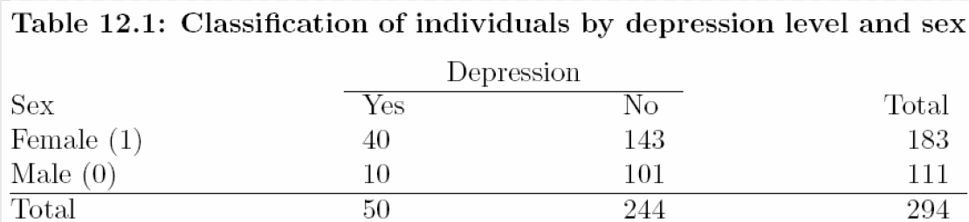
Example: Depression vs. Gender

Slide 5
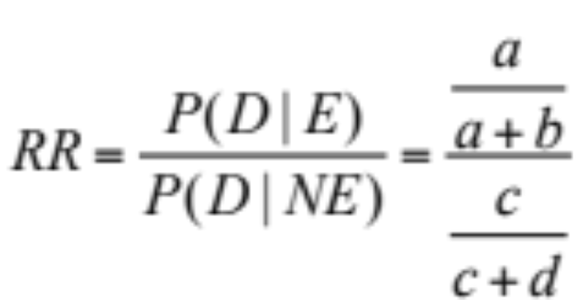
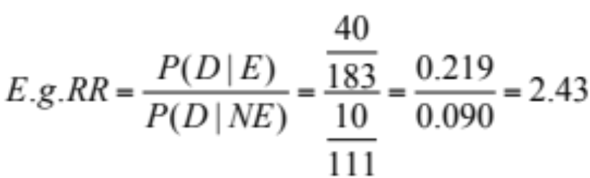
Risk Ratio
 | D | ND | Total
E (F) | a (40) | b (143) | a+b (183)
NE (M) | c (10) | d (101) | c+d (111)
Total | a+c (50) | b+d (244) | (294)

Slide 6
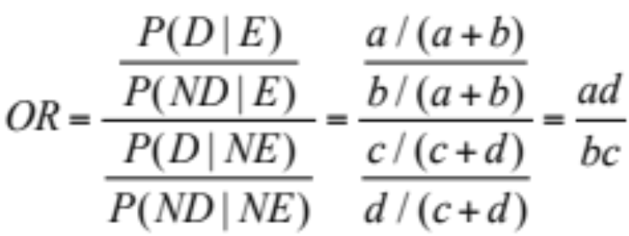
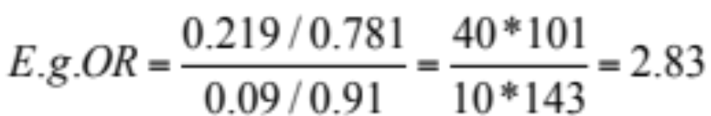
Odds Ratio - formula
 | D | ND | Total
E (F) | a (40) | b (143) | a+b (183)
NE (M) | c (10) | d (101) | c+d (111)
Total | a+c (50) | b+d (244) | (294)
Odds Ratio (OR)
=[odds (D|E)] / [odds (D|NE)]

Slide 7
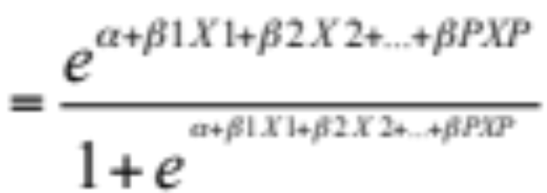
Logistic Regression Equation
Outcome Variable:
  Y = 1 (event) or
  Y = 0 (no event)
Covariates: X₁, X₂, …, X_{p}
P (Y = 1 | X₁, X₂, …, X_{p})

Slide 8
Implications: The odds are multiplicative
Ln (odds) = α + β₁X₁ + β₂X₂+…+…+β_{p}X_{p}
Odds = e ^{α + β1X1 + β2X2+…+…+βpXp}
= (e ^{α} ) (e^{β1X1}) (…) (e^{βpXp})
= constant * exp(constant*X₁)
* exp(constant*X₂)
……
* exp(constant*X_{p})

Slide 9
Implications: The log odds are additive
Ln (odds) = α + β₁X₁ + β₂X₂+…+…+β_{p}X_{p}
Ln (odds) = constant + constant*X₁
+ constant*X₂
……
+ constant*X_{p}

Slide 10
Model is flexible
X variables can be continuous or categorical
We can incorporate interactions
Coefficients are estimated by maximum likelihood
Computer programs implicitly use prior probabilities estimated from sample

Slide 11
Example: circulatory shock
Patients in shock
Outcome = survival or death
Use of logistic regression to identify risk factors for death

Slide 12
Parameter estimates
Better to use maximum likelihood
Depends on the idea of Generalized Linear Model (GLM):
  Logistic regression is an example of the GLM
  Define Y = outcome = 1 (event) or 0 (not)
  E(Y|X’s) = μ = P(1|X’s)
  Find a function g(μ), called the link function, such that:
    g(μ) = linear function of the X’s
  Here we take g(μ) = log(odds) = logit function

Slide 13
Estimation
The model is: g(μ) = α + β₁X₁ + β₂X₂+…+…+β_{p}X_{p}
Need to estimate α, β₁, β₂, …, β_{p}, we use:
  Iterative process called the iterative weighted least square
    Start with initial estimates of parameters
    Evaluate the score equations (derivative of log-likelihood =0)
    Solve the score equations and get new parameters
    Go back to step 1 and repeat till converge

Slide 14
Example: Depression data set
X’s = AGE, INCOME
Results:
  Ln(odds) = logit = 0.028 – 0.020 (age) – 0.041 (income)
  Interpretation:
    Odds of being depressed are less if the individual has a higher income and with older age
Term | Coefficient | SE
Age | -0.020 | 0.009
Income | -0.041 | 0.014
Constant | 0.028 | 0.487

Slide 15
OR interpretation – binary variable
Y = outcome is binary: 0, 1 variable
  E.g. depressed = 1
X is binary: 0, 1 variable (e.g. GENDER = 1 if F)
Odds (Y=1|X) = e (^{α + βX + other X’s)}
Odds (Y=1 | X=1) = e ^{(α + β} ^{+ other X’s)}
Odds (Y=1 | | X = 0) = e ^{(α + other X’s)}
OR = odds (Y=1 | X=1) / odds (Y=1 | X=0) = e ^{β}
Ln(OR) = β

Slide 16
Odds Ratios – binary example
Variable GENDER is categorical:
  Sample estimate of the parameter β given the other X’s = 1.039
  e ^{(0.929)} = 2.582 = adjusted odds ratio if female
  Recall: raw (unadjusted) OR = 2.83

Slide 17
Odds Ratios – continuous example
The OR interpretation for continuous variable is the same as that for binary variable
Variable AGE is continuous:
  e^{(-0.020)} = 0.98 = adjusted incremental odds ratio for increase of 1 year of age
  How about a 10 year increase in age?
  Use e^{(10* -0.021)} = 0.82

Slide 18
OR interpretation – nominal variable, more than two categories
Y = outcome is binary: 0, 1 variable
  e.g. non-depressed = 0
X nominal: e.g. religion
Dummy (indicator) variable
Coefficient of D₁ = ln(OR) for “Cath” vs. “Other”
Religion | D₁ | D₂ | D₃
Cath. | 1 | 0 | 0
Prot. | 0 | 1 | 0
Jewish | 0 | 0 | 1
Other | 0 | 0 | 0

Slide 19
Confidence Intervals for OR
CI for β = B±X*SE(B)
Exponentiate → CI for population OR
Reject H₀: β = 0 if and only if CI for β excludes 0
  If it includes 0, then result is not statistically significant
Similarly, if CI for OR includes 1 → non-significant result

Slide 20
Tests of hypotheses
Single β: estimate = B, SE (B)
Test H₀: β = 0
  Use z = B/SE(B) ~ N(0,1)
  Equivalently: Wald Test: χ² = B²/[SE(B)]², df =1

Slide 21
Diagnostics: Model Evaluation
For classification:
  Choose cutoff P_{c}
  Place individual in group 1 if P_{z} < P_{c}
  What percent correctly classified?
  Repeat for many values of P_{c}

Slide 22
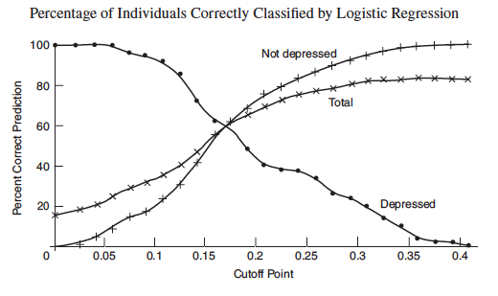
Probability of Correct Classification

Slide 23
Receiver Operating Characteristic (ROC)
Plot true positive fraction
= P (classified + | actual +)
= sensitivity
vs. false positive fraction
= P (classified + | actual -)
= 1 - specificity

Slide 24
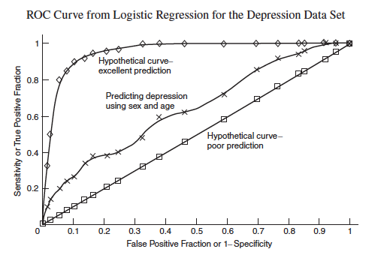
ROC curve - example

Slide 25
How good is ROC curve?
Area under the curve (AUC) = a measure of how good model is
  Values between 0.5 and 1
AUC = probability that a randomly chosen positive subject is correctly classified with greater likelihood as positive than a randomly chosen negative subject

Slide 26
What to watch out for
Training samples must be correctly classified and representative of population
Fundamental assumption of logistic model is that the log odds is linearly related to independent variables
Coefficient of any one variable can vary widely, depending on what others are included in the model

Slide 27
Acknowledgement
Textbook: Chapter 12, Abdelmonem Afifi, Susanne May, Virginia A. Clark. Practical Multivariate Analysis. Fifth Edition. CRC Press Taylor & Francis Group
Thanks Professor Afifi for his courtesy to share the materials
Thanks our teaching assistance team for preparing the tutorial materials

