Slide 1
GE2262 Business Statistics
Topic 7
Inference for the Proportion
Reference
Levine, D.M., Krehbiel, T.C. and Berenson, M.L., Business Statistics: A First Course, Pearson Education Ltd, Chapter 7 & 8 & 9

Slide 2
Outline
Sampling Distribution of the Sample Proportion
Confidence Interval Estimate for the Proportion
Sample Size Determination for the Proportion
Hypothesis Testing for the Proportion

Slide 3
Will Britain Leave EU?
Express (UK), 22 June 2016: Analysts at TNS surveyed 2,320 adults across the UK online between June 16-22. The baseline results reveal a 2% lead for the EU leave campaign, with support for Brexit at 43% compared to 41% for Remain
We do not know the true population of British intending to leave EU until the result of the referendum is announced. A common way to gain insights on election or a referendum campaign is to held a survey and based inference on the proportion of success in a sample taken from the relevant population
In practice, most of these surveys are inaccurate because
  The involved sample is biased. It does not truly represent the population
  Some voters had not honestly revealed their voting intention, or they changed their mind after the survey

Slide 4
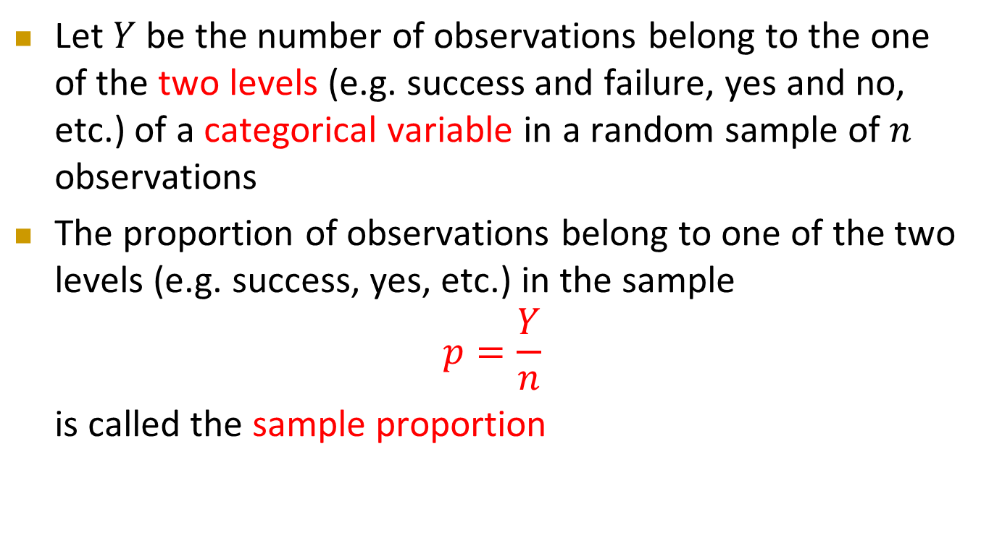
Sample Proportion
Let $Y$ be the number of observations belong to the one of the two levels (e.g. success and failure, yes and no, etc.) of a categorical variable in a random sample of $n$ observations
The proportion of observations belong to one of the two levels (e.g. success, yes, etc.) in the sample
$$p=\frac{Y}{n}$$
  is called the sample proportion

Slide 5
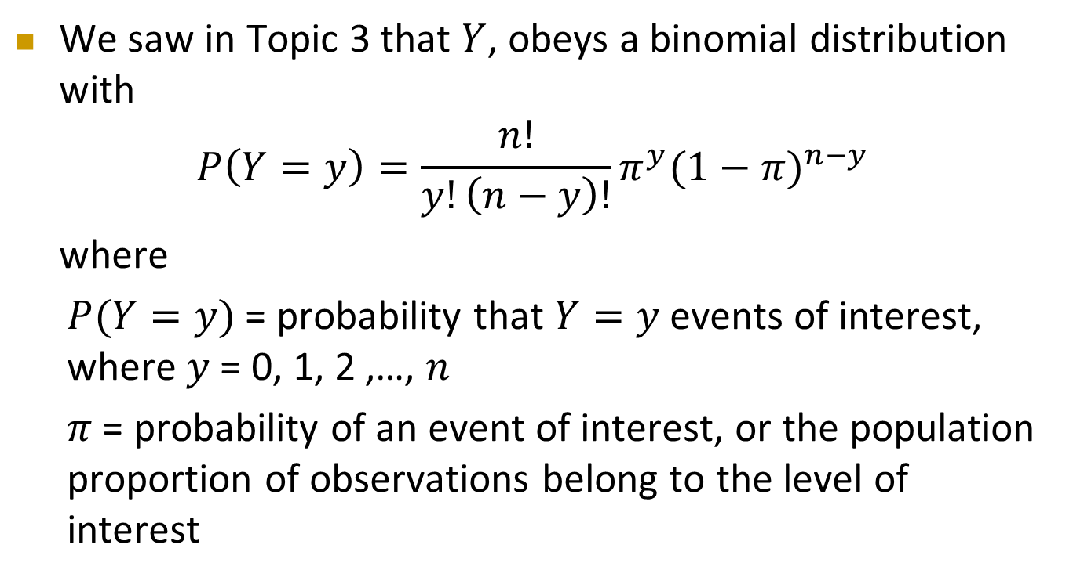
Sample Proportion
Cont’d
We saw in Topic 3 that $Y$, obeys a binomial distribution with
$$P\left(Y=y\right)=\frac{n!}{y!\left(n−y\right)!}{π^{y}(1−π)}^{n−y}$$
where
$P(Y=y)$ = probability that $Y=y$events of interest, where $y$ = 0, 1, 2 ,…, $n$
$π$ = probability of an event of interest, or the population proportion of observations belong to the level of interest

Slide 6

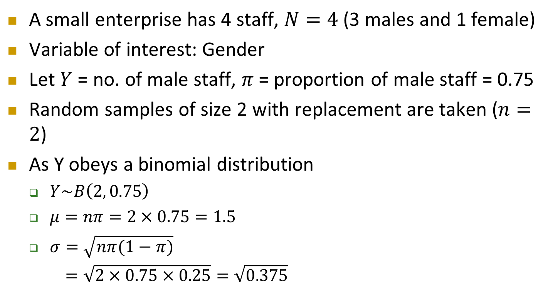
Sampling Distribution of Sample Proportion
A small enterprise has 4 staff, $N=4$ (3 males and 1 female)
Variable of interest: Gender
Let $Y$ = no. of male staff, $π$ = proportion of male staff = 0.75
Random samples of size 2 with replacement are taken ($n=2$)
As Y obeys a binomial distribution
  $Y\sim B\left(2, 0.75\right)$
  $μ=nπ=2×0.75=1.5$
  $σ=\sqrt{nπ(1−π)}$
  $=\sqrt{2×0.75×0.25}=\sqrt{0.375}$
C
A
B
D

Slide 7
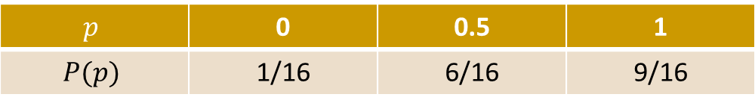
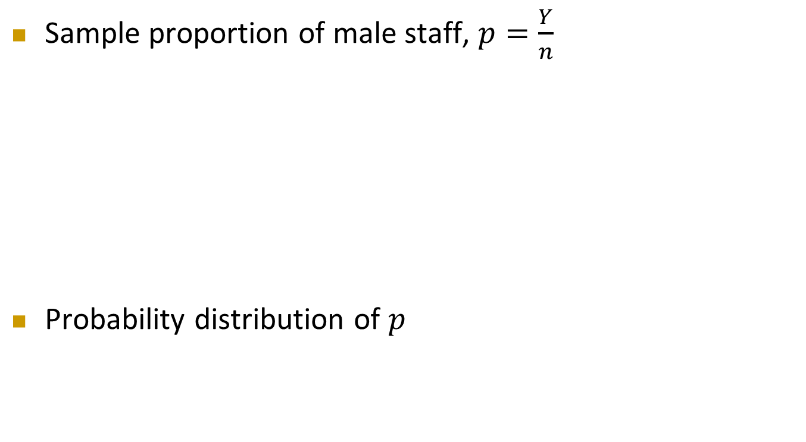
Sampling Distribution of Sample Proportion
Cont’d
Sample proportion of male staff, $p=\frac{Y}{n}$
Probability distribution of $p$
16 possible sample proportions
Respondent | A (M) | B (M) | C (F) | D (M)
A (M) | 2/2 = 1 | 2/2 = 1 | 1/2 = 0.5 | 2/2 = 1
B (M) | 2/2 = 1 | 2/2 = 1 | 1/2 = 0.5 | 2/2 = 1
C (F) | 1/2 = 0.5 | 1/2 = 0.5 | 0/2 = 0 | 1/2 = 0.5
D (M) | 2/2 = 1 | 2/2 = 1 | 1/2 = 0.5 | 2/2 = 1
$$p$$ | 0 | 0.5 | 1
$$P(p)$$ | 1/16 | 6/16 | 9/16

Slide 8
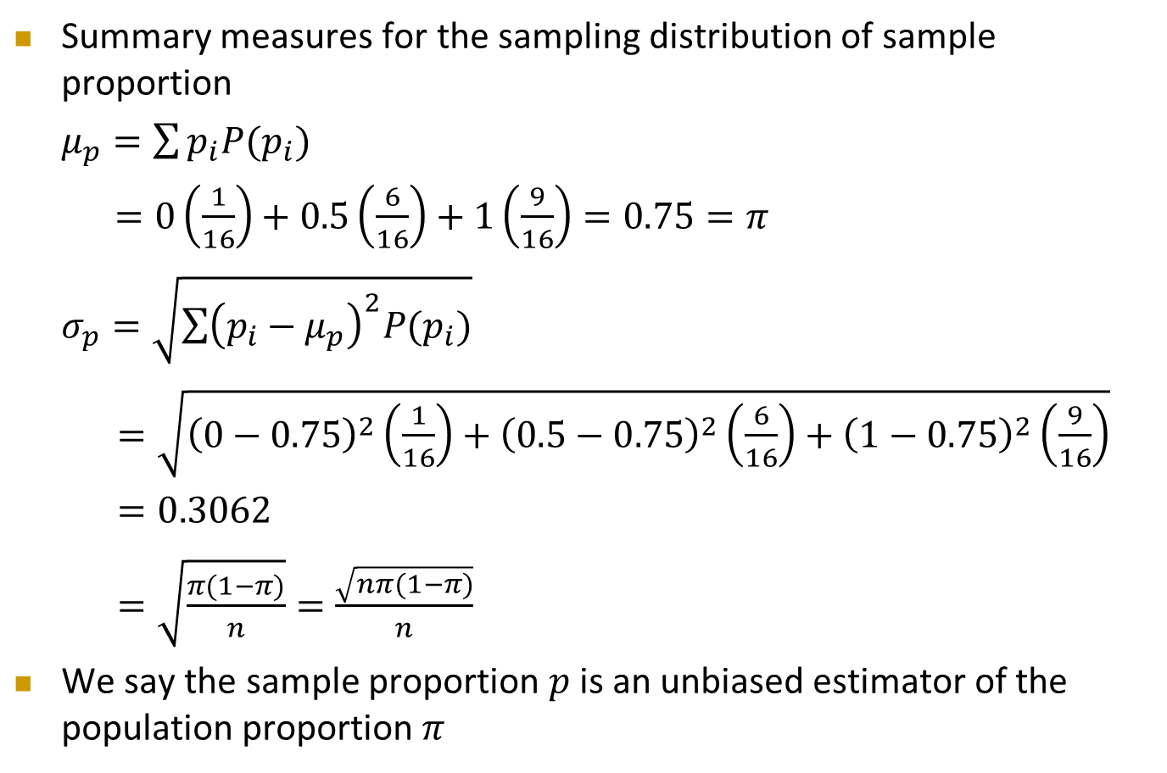
Sampling Distribution of Sample Proportion
Cont’d
Summary measures for the sampling distribution of sample proportion
$μ_{p}=\sum{p_{i}P(p_{i})}$
$=0\left(\frac{1}{16}\right)+0.5\left(\frac{6}{16}\right)+1\left(\frac{9}{16}\right)=0.75=π$
$σ_{p}=\sqrt{\sum{{\left(p_{i}−μ_{p}\right)}^{2}P(p_{i})}}$
$=\sqrt{{\left(0−0.75\right)}^{2}\left(\frac{1}{16}\right)+{\left(0.5−0.75\right)}^{2}\left(\frac{6}{16}\right)+{\left(1−0.75\right)}^{2}\left(\frac{9}{16}\right)}$
$=0.3062$
$=\sqrt{\frac{π(1−π)}{n}}=\frac{\sqrt{nπ(1−π)}}{n}$
We say the sample proportion $p$ is an unbiased estimator of the population proportion $π$

Slide 9
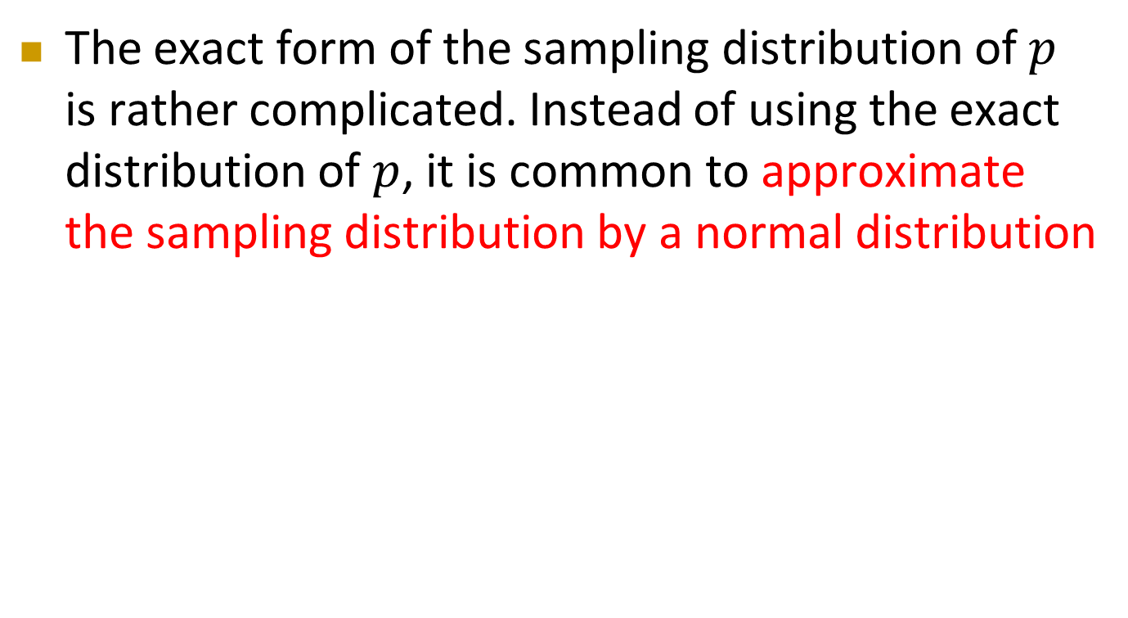
Sampling Distribution of Sample Proportion
Cont’d
The exact form of the sampling distribution of $p$ is rather complicated. Instead of using the exact distribution of $p$, it is common to approximate the sampling distribution by a normal distribution

Slide 10
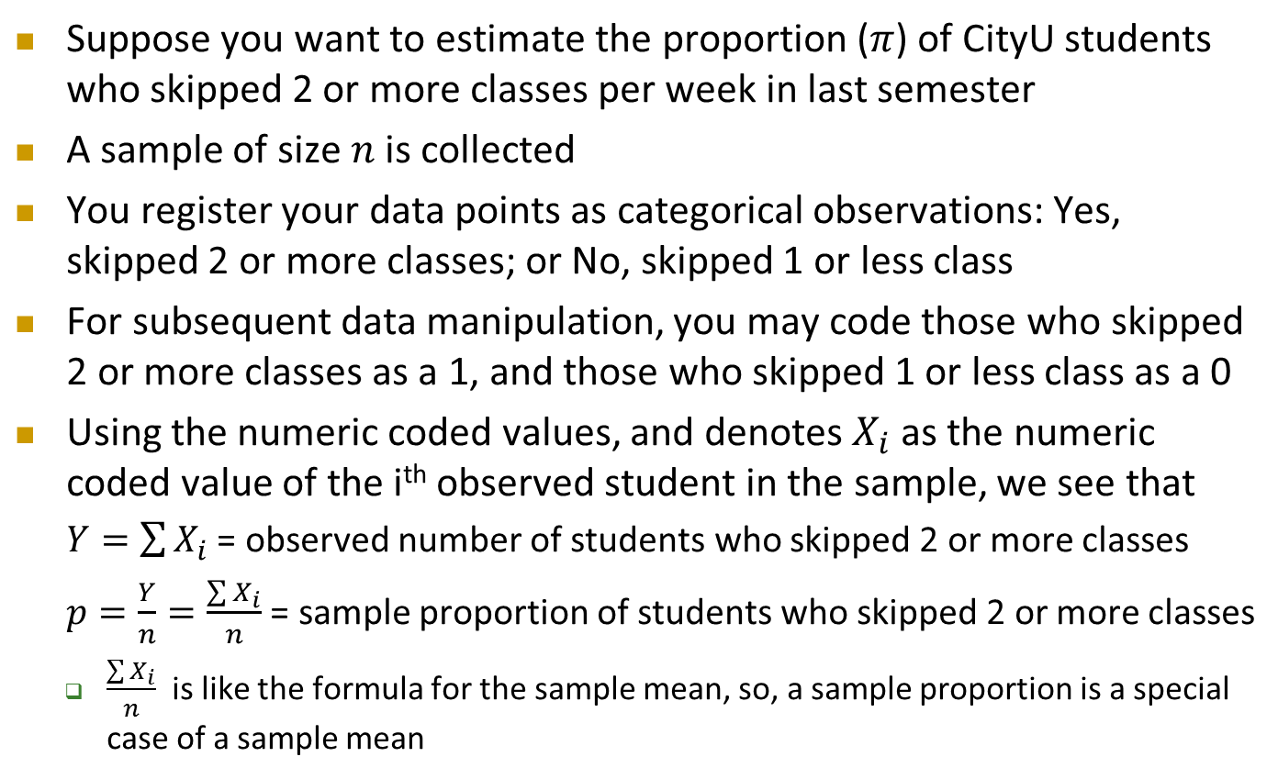
Sampling Distribution of Sample Proportion
Cont’d
Suppose you want to estimate the proportion ($π$) of CityU students who skipped 2 or more classes per week in last semester
A sample of size $n$ is collected
You register your data points as categorical observations: Yes, skipped 2 or more classes; or No, skipped 1 or less class
For subsequent data manipulation, you may code those who skipped 2 or more classes as a 1, and those who skipped 1 or less class as a 0
Using the numeric coded values, and denotes $X_{i}$ as the numeric coded value of the i^{th} observed student in the sample, we see that
$Y=\sum{X_{i}}$ = observed number of students who skipped 2 or more classes
$p=\frac{Y}{n}=\frac{\sum{X_{i}}}{n}$ = sample proportion of students who skipped 2 or more classes
  $\frac{\sum{X_{i}}}{n}$ is like the formula for the sample mean, so, a sample proportion is a special case of a sample mean

Slide 11
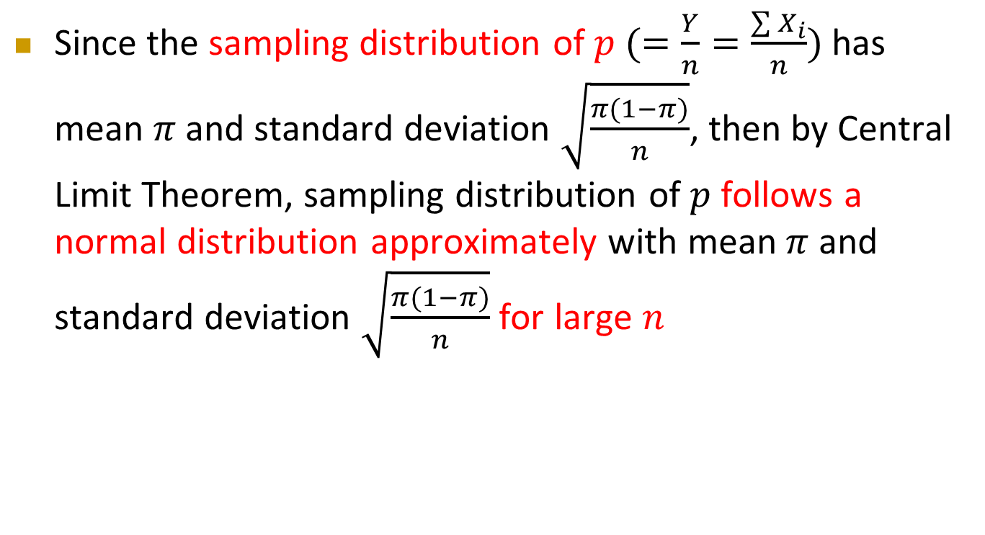
Sampling Distribution of Sample Proportion
Cont’d
Since the sampling distribution of $p (=\frac{Y}{n}=\frac{\sum{X_{i}}}{n})$ has mean $π$ and standard deviation $\sqrt{\frac{π(1−π)}{n}}$, then by Central Limit Theorem, sampling distribution of $p$follows a normal distribution approximately with mean $π$ and standard deviation $\sqrt{\frac{π(1−π)}{n}}$ for large $n$

Slide 12
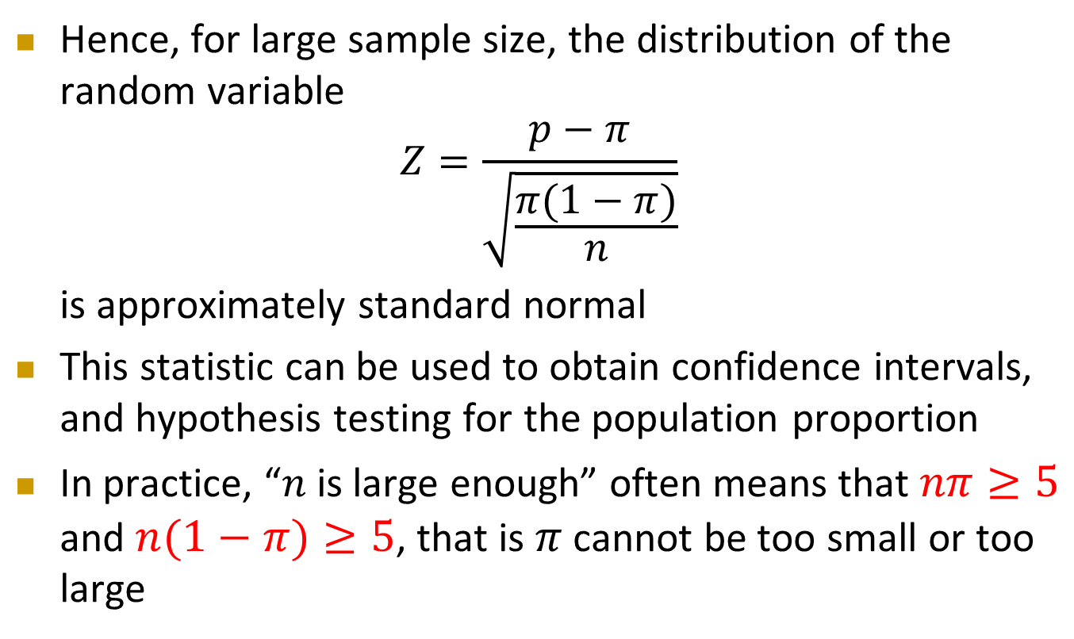
Sampling Distribution of Sample Proportion
Cont’d
Hence, for large sample size, the distribution of the random variable
$$Z=\frac{p−π}{\sqrt{\frac{π(1−π)}{n}}}$$
is approximately standard normal
This statistic can be used to obtain confidence intervals, and hypothesis testing for the population proportion
In practice, “$n$ is large enough” often means that $nπ≥5$ and $n(1−π)≥5$, that is $π$ cannot be too small or too large

Slide 13

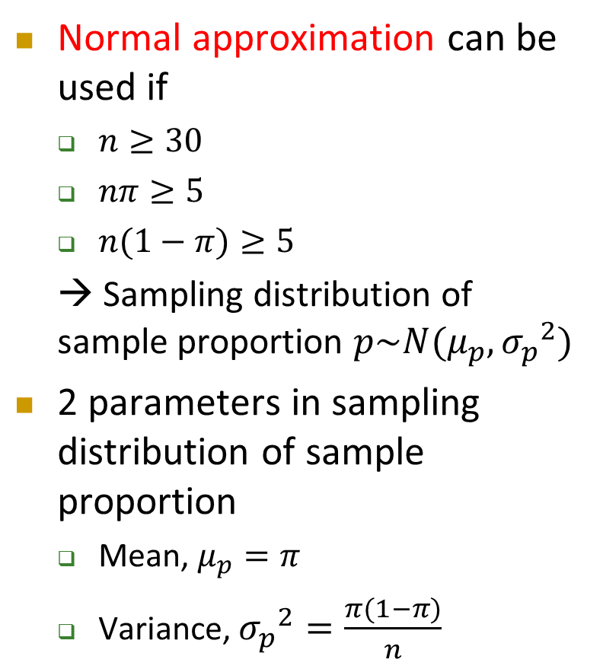



Sampling Distribution of Sample Proportion
Cont’d
Normal approximation can be used if
  $n≥30$
  $nπ≥5$
  $n(1−π)≥5$
  → Sampling distribution of sample proportion $p\sim N(μ_{p},{σ_{p}}^{2})$
2 parameters in sampling distribution of sample proportion
  Mean, $μ_{p}=π$
  Variance, ${σ_{p}}^{2}=\frac{π(1−π)}{n}$
Sampling Distribution of $p$
$$f(p)$$
.3
.2
.1
0
$$p$$
0 . 2 .4 .6 .8 1
$π$ = population proportion

Slide 14

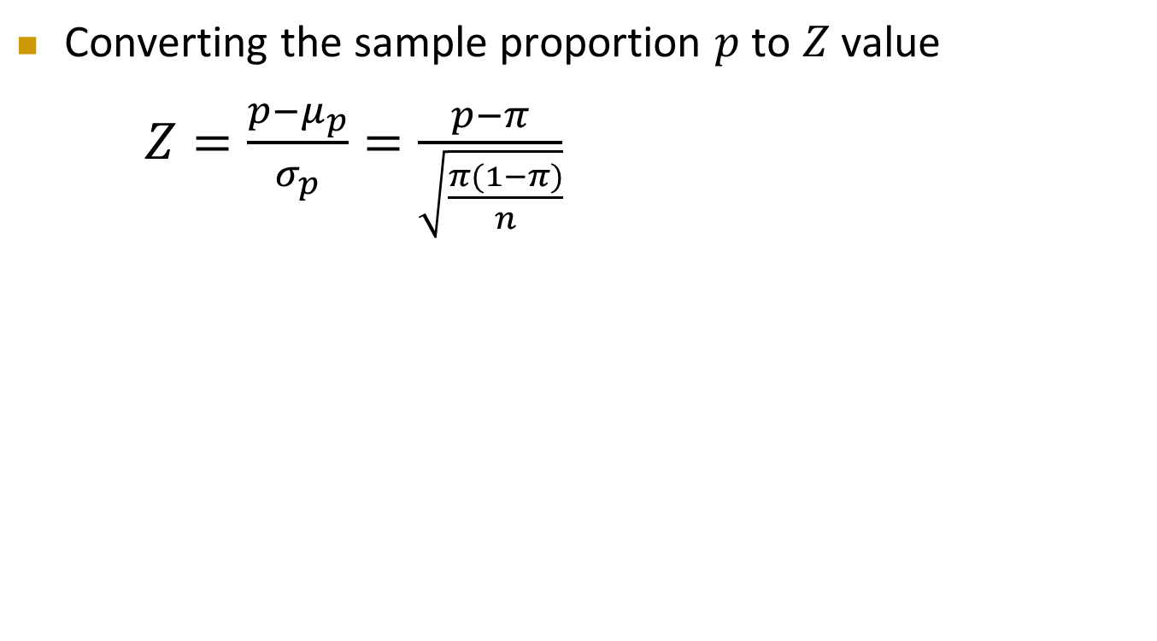




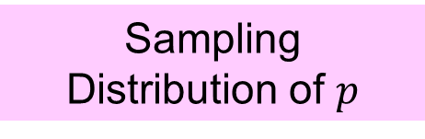

Standardizing Sampling Distribution of Proportion
Converting the sample proportion $p$ to $Z$ value
$Z=\frac{p−μ_{p}}{σ_{p}}=\frac{p−π}{\sqrt{\frac{π(1−π)}{n}}}$
Sampling Distribution of $p$
Standardized
Normal Distribution
$$σ_{Z}=1$$
$$σ_{p}$$
$$μ_{p}$$
$$p$$
$$Z$$
$$μ_{Z}=0$$

Slide 15



Standardizing Sampling Distribution of Proportion – Example
Suppose that the manager of the local bank determines that 40% of all depositors have multiple accounts at the bank
If you select a random sample of 200 depositors, what is the probability that the sample proportion of depositors with multiple accounts is less than 0.3 ?

Slide 16
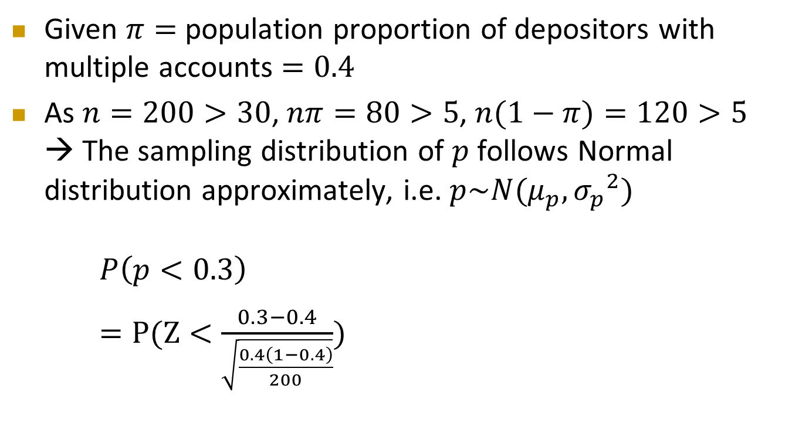
Standardizing Sampling Distribution of Proportion – Example
Cont’d
Given $π=$ population proportion of depositors with multiple accounts $=0.4$
As $n=200>30$, $nπ=80>5$, $n(1−π)=120>5$ → The sampling distribution of $p$ follows Normal distribution approximately, i.e. $p\sim N(μ_{p},{σ_{p}}^{2})$
$P\left(p<0.3\right)$
$=P(Z<\frac{0.3−0.4}{\sqrt{\frac{0.4\left(1−0.4\right)}{200}}})$

Slide 17
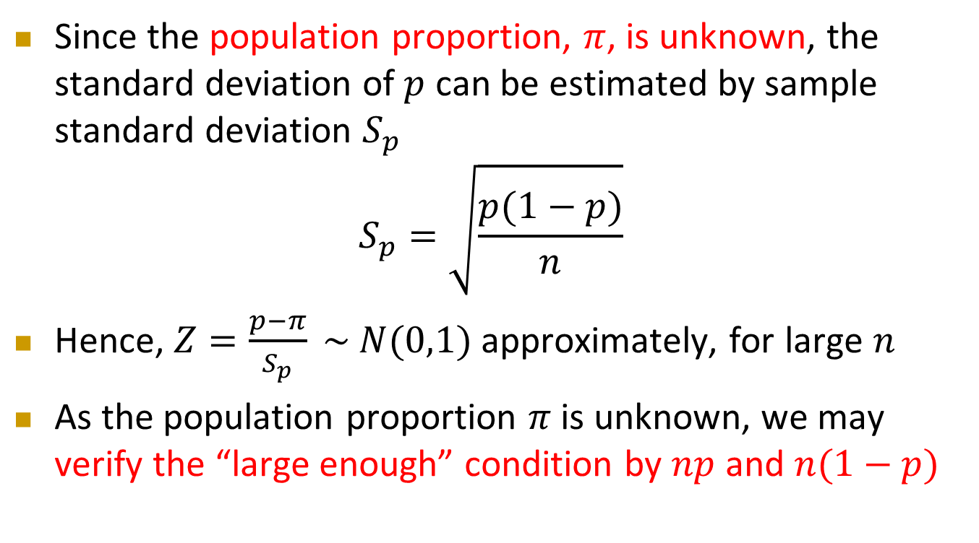
Confidence Interval Estimate for the Proportion
Since the population proportion, $π$, is unknown, the standard deviation of $p$ can be estimated by sample standard deviation $S_{p}$
$$S_{p}=\sqrt{\frac{p(1−p)}{n}}$$
Hence, $Z=\frac{p−π}{S_{p}} \sim N(0,1)$ approximately, for large $n$
As the population proportion $π$ is unknown, we may verify the “large enough” condition by $np$ and $n(1−p)$

Slide 18

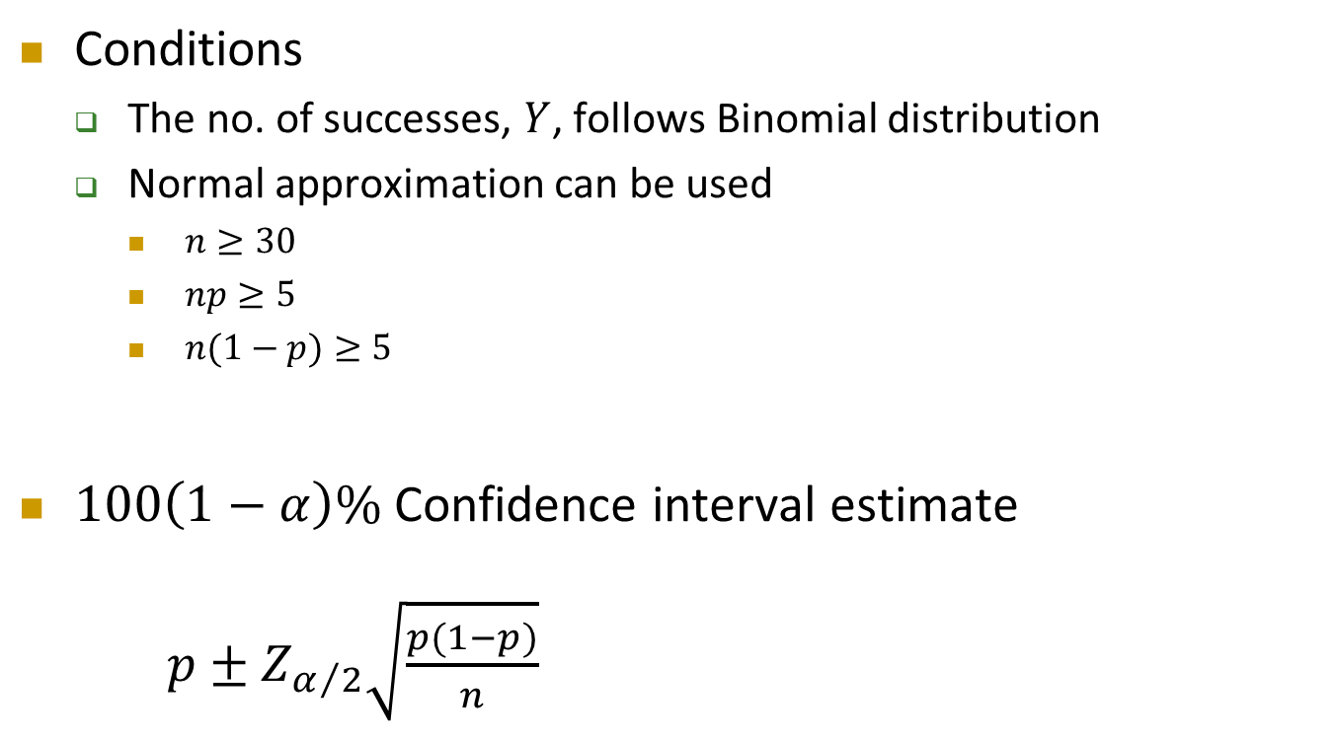

Confidence Interval Estimate for the Proportion
Cont’d
Conditions
  The no. of successes, $Y$, follows Binomial distribution
  Normal approximation can be used
    $n≥30$
    $np≥5$
    $n(1−p)≥5$
$100\left(1−α\right)\%$ Confidence interval estimate
  $p±Z_{α/2}\sqrt{\frac{p(1−p)}{n}}$
Standard Error, $σ_{p}$
Sampling Error, $E$

Slide 19

Confidence Interval Estimate for the Proportion – Example
Among the 200 depositors you randomly selected, 95 of them have RMB deposit account at the bank
Set up a 95% confidence interval estimate for the population proportion of depositors having RMB deposit account at the bank

Slide 20
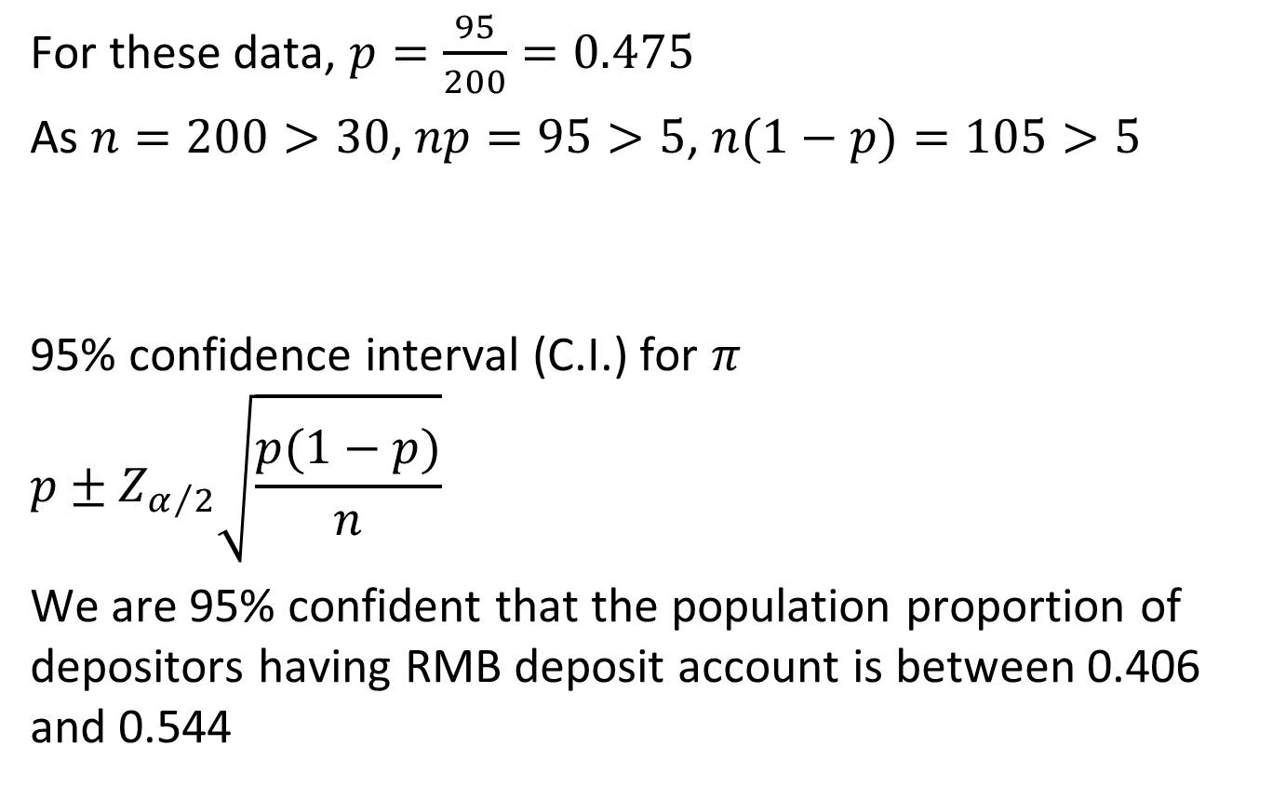
Confidence Interval Estimate for the Proportion – Example
Cont’d
For these data, $p=\frac{95}{200}=0.475$
As $n=200>30$, $np=95>5$, $n(1−p)=105>5$
95% confidence interval (C.I.) for $π$
$$p±Z_{α/2}\sqrt{\frac{p(1−p)}{n}}$$
  We are 95% confident that the population proportion of depositors having RMB deposit account is between 0.406 and 0.544

Slide 21
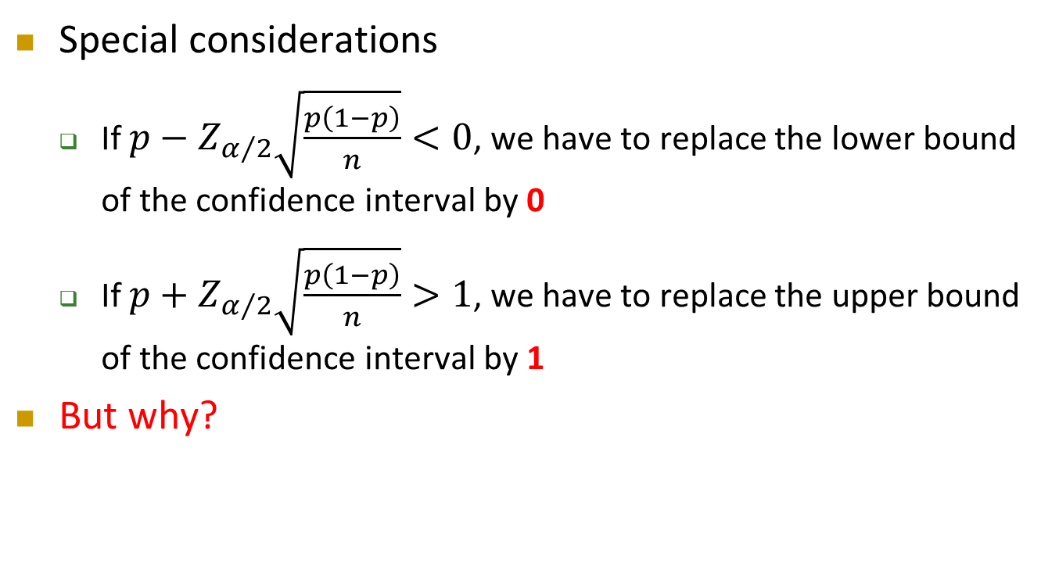
Confidence Interval Estimate for the Proportion
Cont’d
Special considerations
  If $p−Z_{α/2}\sqrt{\frac{p\left(1−p\right)}{n}}<0$, we have to replace the lower bound of the confidence interval by 0
  If $p+Z_{α/2}\sqrt{\frac{p\left(1−p\right)}{n}}>1$, we have to replace the upper bound of the confidence interval by 1
But why?

Slide 22
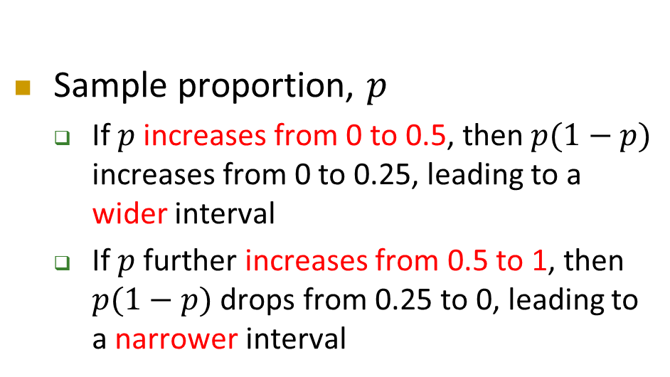
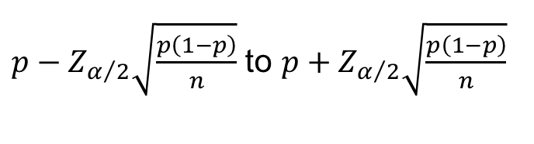
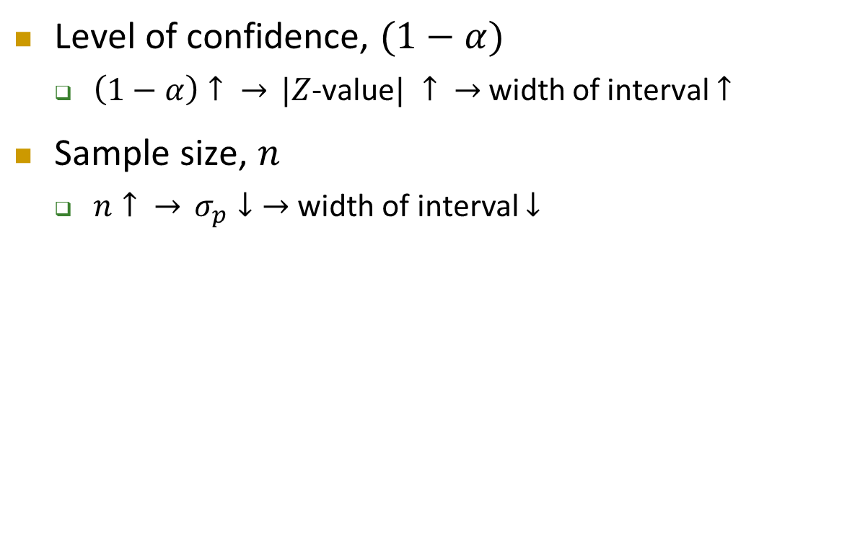
Factors Affecting Interval Width (Precision)
Level of confidence, $(1−α)$
  $\left(1−α\right)↑ \overset{→}{} |Z$-value$| ↑ \overset{→}{}$width of interval $↑$
Sample size, $n$
  $n↑ \overset{→}{} σ_{p}↓\overset{→}{}$width of interval $↓$
Intervals extend from
Sample proportion, $p$
  If $p$ increases from 0 to 0.5, then $p(1−p)$ increases from 0 to 0.25, leading to a wider interval
  If $p$ further increases from 0.5 to 1, then $p(1−p)$ drops from 0.25 to 0, leading to a narrower interval
$p−Z_{α/2}\sqrt{\frac{p\left(1−p\right)}{n}}$ to $p+Z_{α/2}\sqrt{\frac{p\left(1−p\right)}{n}}$

Slide 23
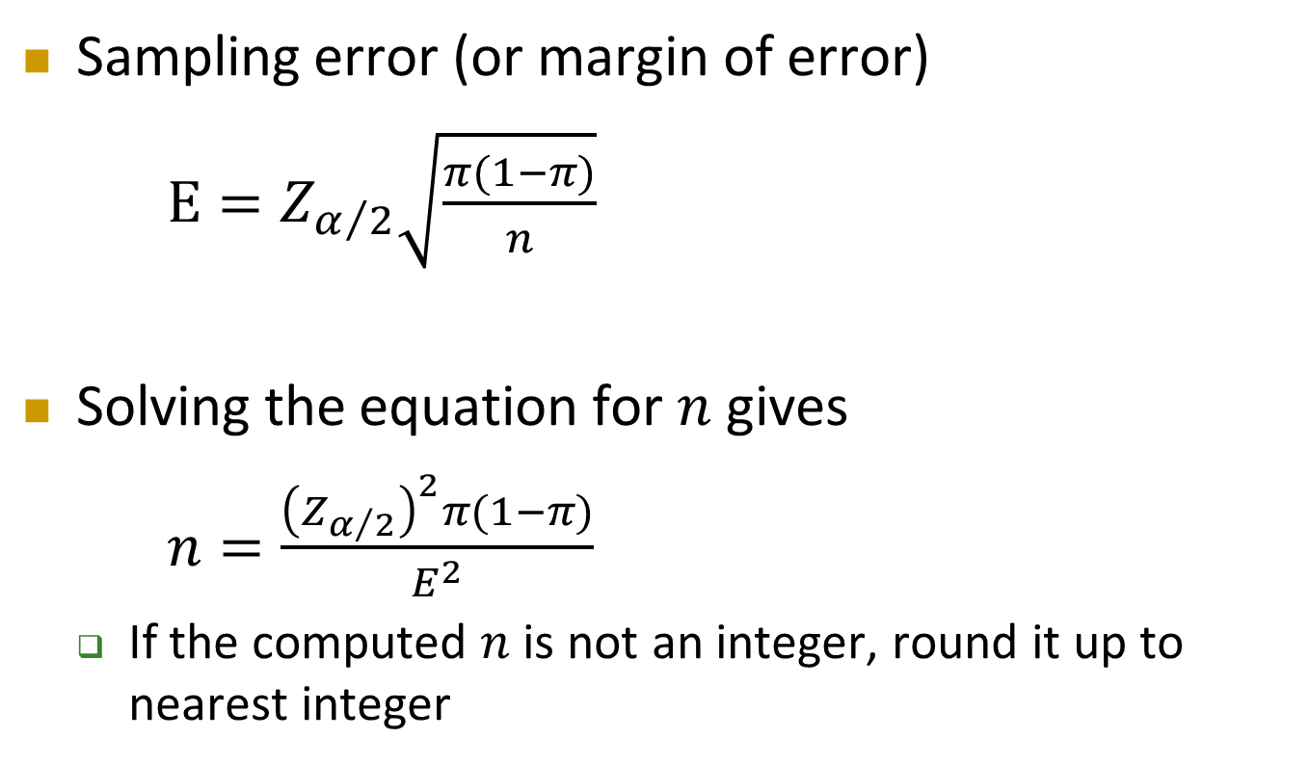
Determining Sample Size for the Proportion
Sampling error (or margin of error)
$E=Z_{α/2}\sqrt{\frac{π(1−π)}{n}}$
Solving the equation for $n$ gives
$n=\frac{{\left(Z_{α/2}\right)}^{2}π(1−π)}{E^{2}}$
  If the computed $n$ is not an integer, round it up to nearest integer

Slide 24
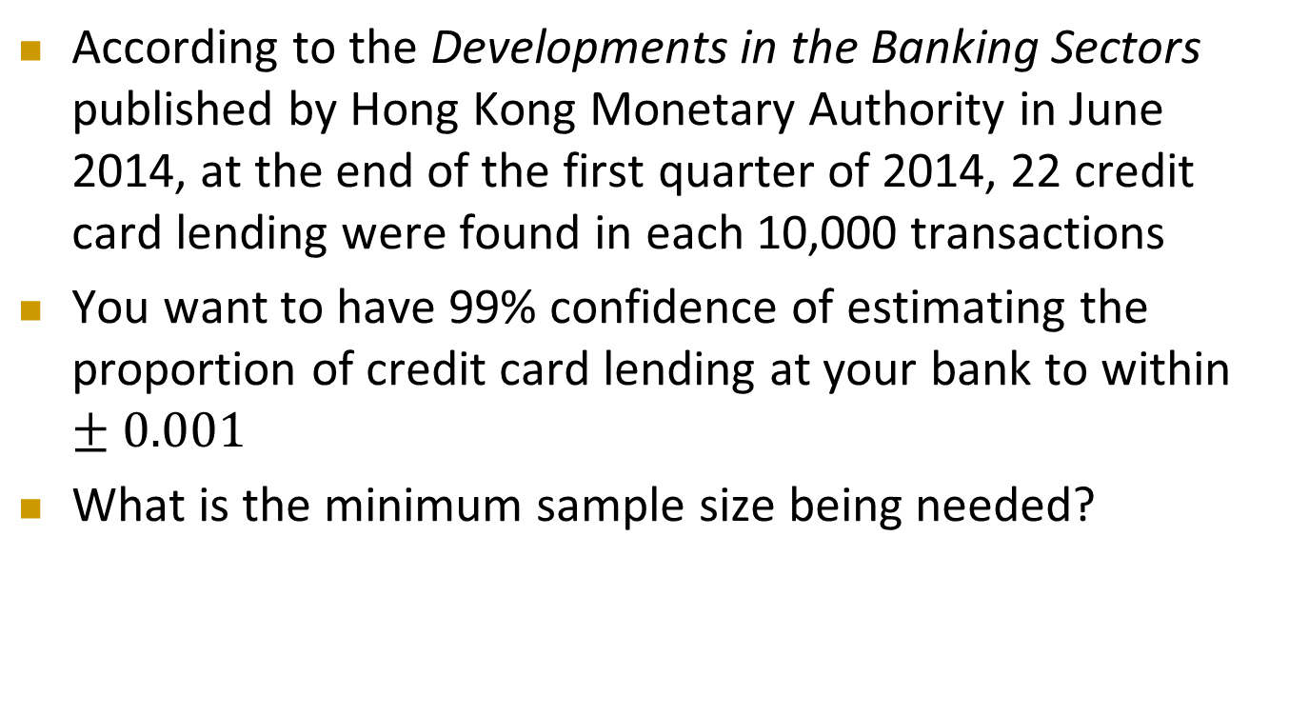
Determining Sample Size for the Proportion – Example
According to the Developments in the Banking Sectors published by Hong Kong Monetary Authority in June 2014, at the end of the first quarter of 2014, 22 credit card lending were found in each 10,000 transactions
You want to have 99% confidence of estimating the proportion of credit card lending at your bank to within $±0.001$
What is the minimum sample size being needed?

Slide 25
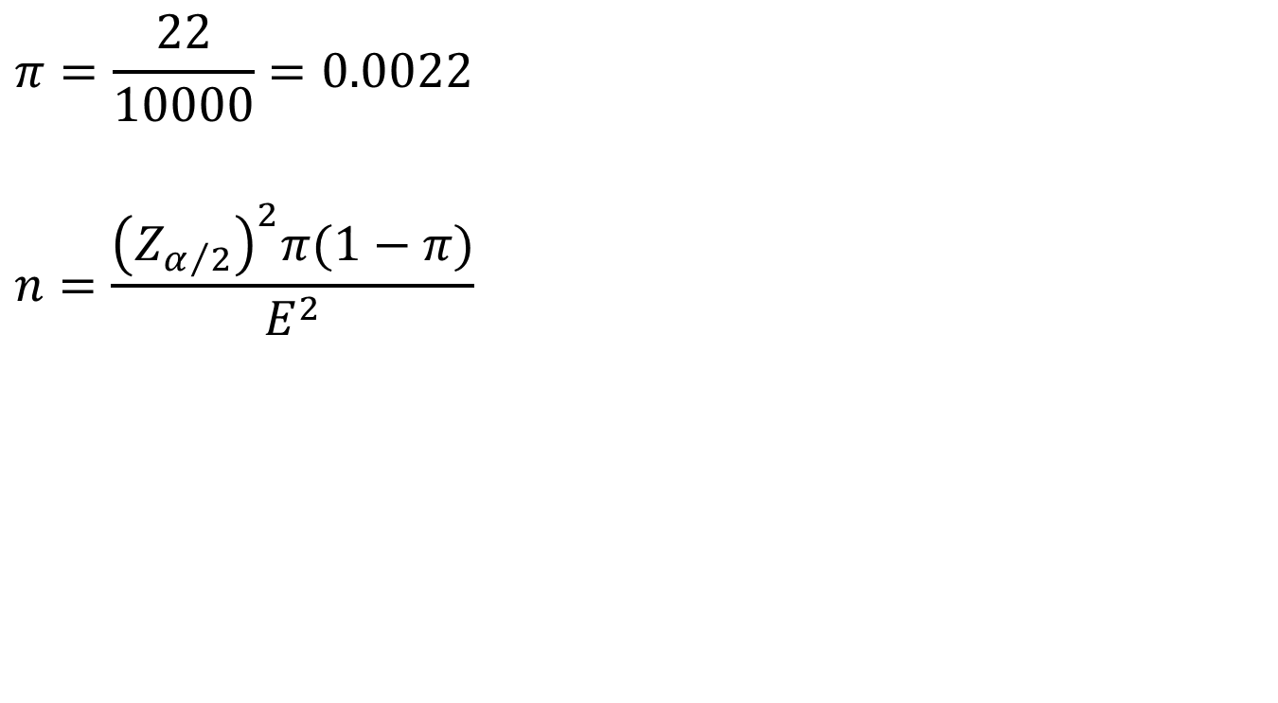
Determining Sample Size for the Proportion – Example
Cont’d
$$π=\frac{22}{10000}=0.0022$$
$$n=\frac{{\left(Z_{α/2}\right)}^{2}π(1−π)}{E^{2}}$$

Slide 26
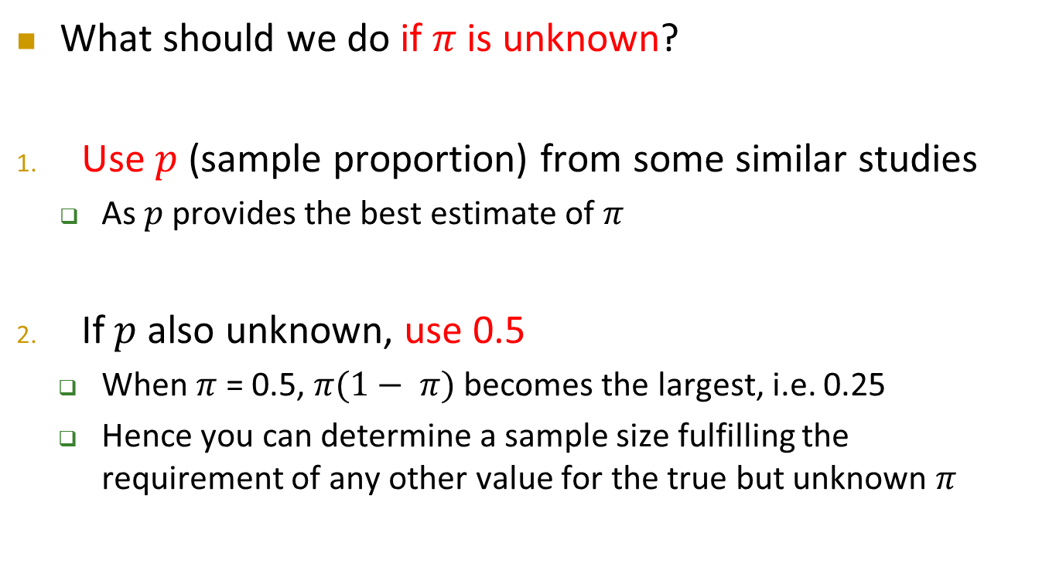
Determining Sample Size for the Proportion
Cont’d
What should we do if $π$ is unknown?
Use $p$ (sample proportion) from some similar studies
  As $p$ provides the best estimate of $π$
If $p$ also unknown, use 0.5
  When $π$ = 0.5, $π(1− π)$becomes the largest, i.e. 0.25
  Hence you can determine a sample size fulfilling the requirement of any other value for the true but unknown $π$

Slide 27
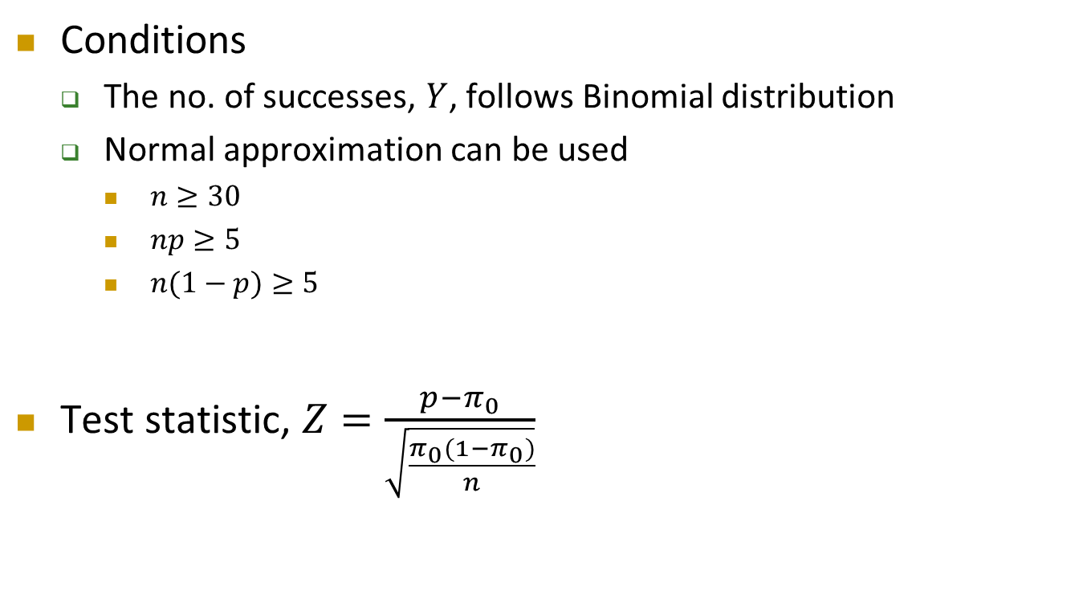
Test of Hypothesis for the Proportion
Conditions
  The no. of successes, $Y$, follows Binomial distribution
  Normal approximation can be used
    $n≥30$
    $np≥5$
    $n(1−p)≥5$
Test statistic, $Z=\frac{p−π_{0}}{\sqrt{\frac{π_{0}(1−π_{0})}{n}}}$

Slide 28

Test of Hypothesis for the Proportion – Exercise
Your bank had the business objective of serving 80% of the customers within 5 minutes upon the time the customer enters the bank
Of the 45 randomly selected customers, 39 are served within 5 minutes upon their arrival
Test the claim of the bank at 5% level of significance

Slide 29
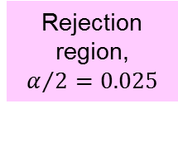



Test of Hypothesis for the Proportion – Exercise
Cont’d
Rejection region, $α/2=0.025$
Rejection region, $α/2=0.025$
$$0$$
$$Z$$
-1.96
+1.96

Slide 30



Test of Hypothesis for the Proportion – Exercise
Cont’d
p-value = $0.2628$
Rejection region, $α/2=0.025$
Rejection region, $α/2=0.025$
$$0$$
$$Z$$
-1.118
+1.118

Slide 31
Do Voters Really Vote When They Say They Do?
On November 8, 1994, a historic election took place in US, in which the Republican Party won control of both houses of Congress for the first time since 1952
But how many people actually voted?
On November 28, 1994, Time magazine reported that in a telephone poll of 800 adults taken during the two days following the election, 56% reported that they had voted
But based on information from the Committee for the Study of the American Electorate, in fact, only 39% of American adults had voted
Could it be the case that the results of the poll simply reflected a sample that, by chance, voted with greater frequency than the general population?

Slide 32
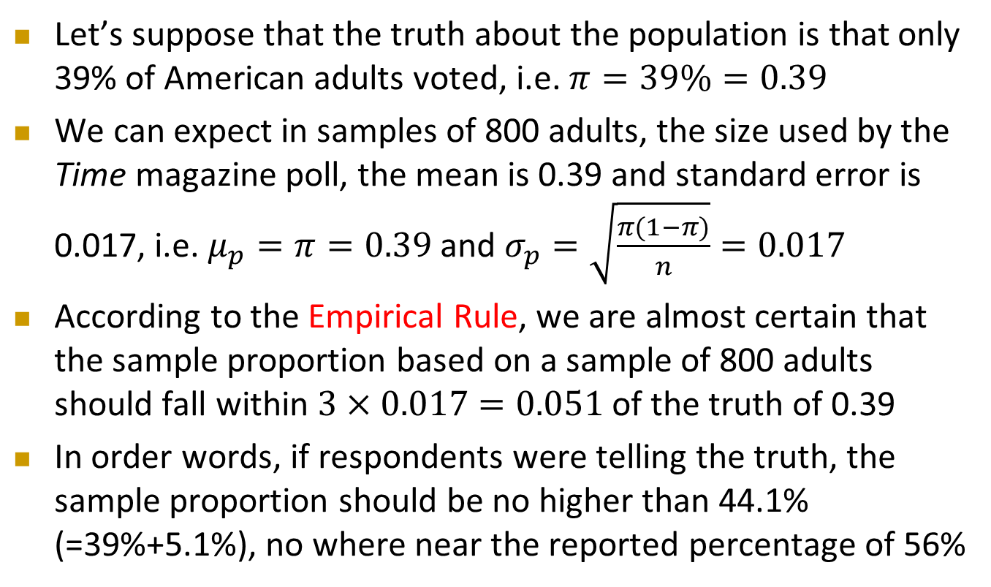
Do Voters Really Vote When They Say They Do?
Cont’d
Let’s suppose that the truth about the population is that only 39% of American adults voted, i.e. $π=39\%=0.39$
We can expect in samples of 800 adults, the size used by the Time magazine poll, the mean is 0.39 and standard error is 0.017, i.e. $μ_{p}=π=0.39$ and $σ_{p}=\sqrt{\frac{π(1−π)}{n}}=0.017$
According to the Empirical Rule, we are almost certain that the sample proportion based on a sample of 800 adults should fall within $3×0.017=0.051$ of the truth of 0.39
In order words, if respondents were telling the truth, the sample proportion should be no higher than 44.1% (=39%+5.1%), no where near the reported percentage of 56%

Slide 33
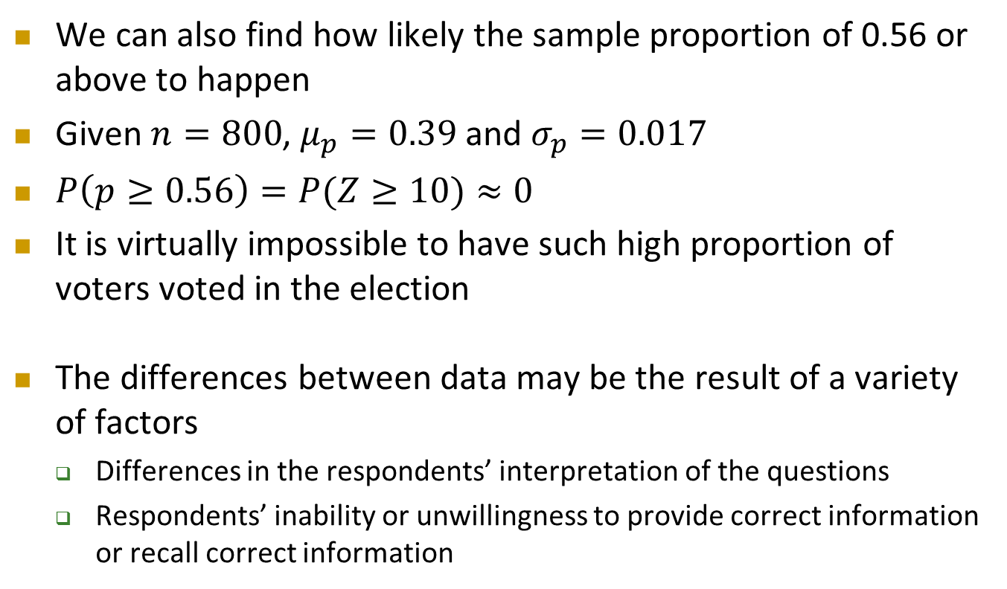
Do Voters Really Vote When They Say They Do?
Cont’d
We can also find how likely the sample proportion of 0.56 or above to happen
Given $n=800$, $μ_{p}=0.39$ and $σ_{p}=0.017$
$P\left(p≥0.56\right)=P(Z≥10)≈0$
It is virtually impossible to have such high proportion of voters voted in the election
The differences between data may be the result of a variety of factors
  Differences in the respondents’ interpretation of the questions
  Respondents’ inability or unwillingness to provide correct information or recall correct information

