Slide 1

EE4803: Analog IC Design
Noise
Department of Electrical Engineering
City University of Hong Kong
Prof. Arindam Basu

Slide 2
Outline
Noise concepts
Circuit Noise Models
Noise analysis examples
*With inputs from Phillip Allen’s course at Georgia Tech and Willy Sansen’s book

Slide 3
Outline
Noise concepts
Circuit Noise Models
Noise analysis examples
*With inputs from Phillip Allen’s course at Georgia Tech and Willy Sansen’s book

Slide 4
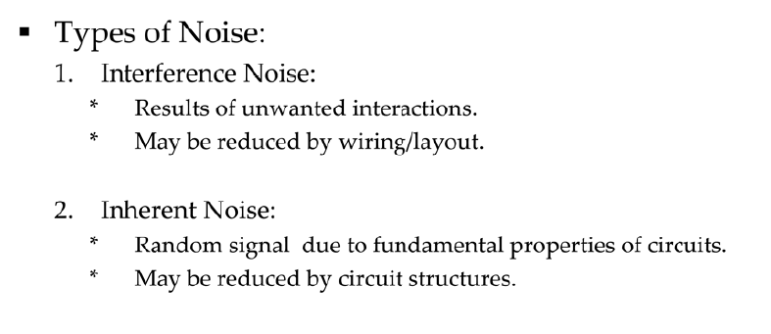
Types of Noise

Slide 5
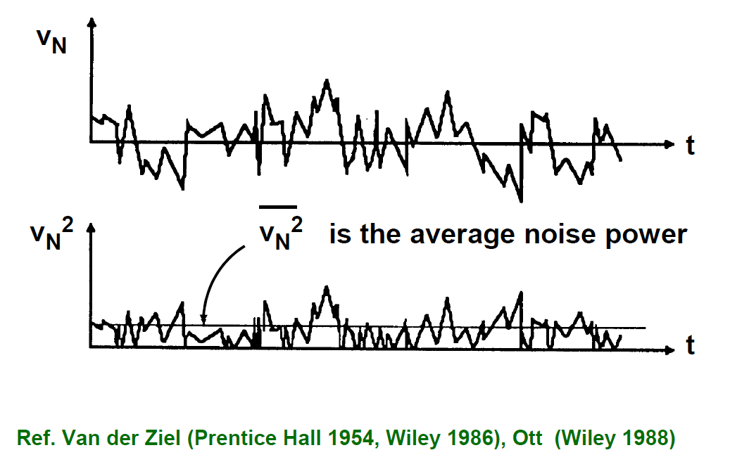
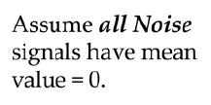
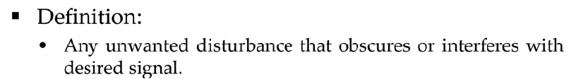
Noise vs Time

Slide 6
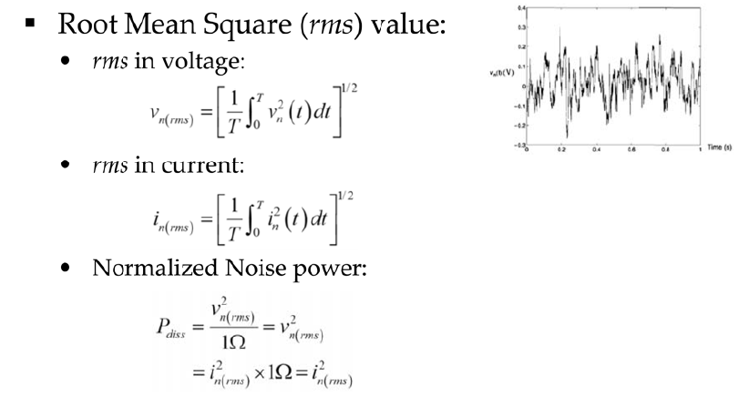
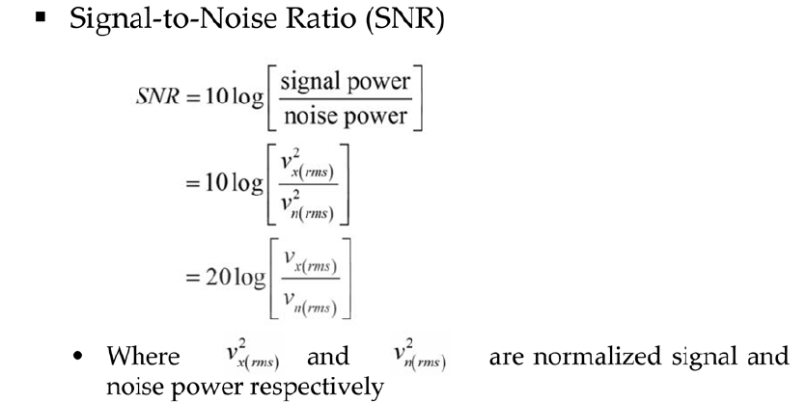
Time Domain Analysis

Slide 7
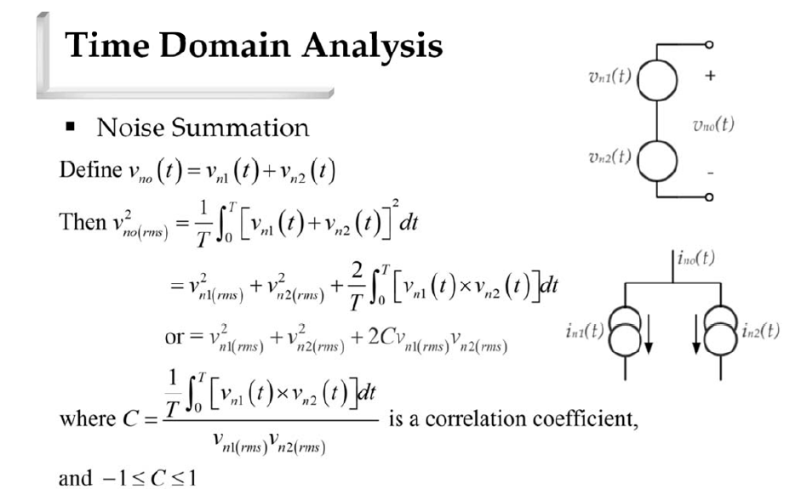
Time Domain Analysis

Slide 8
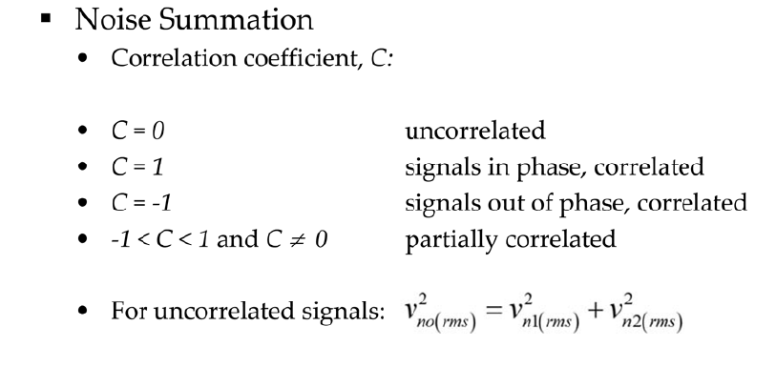
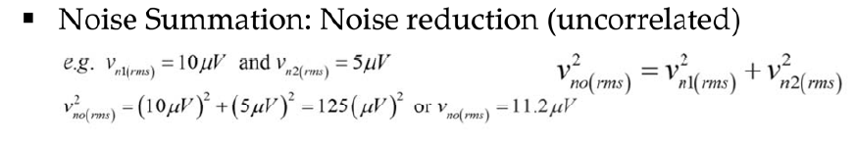
Time Domain Analysis

Slide 9
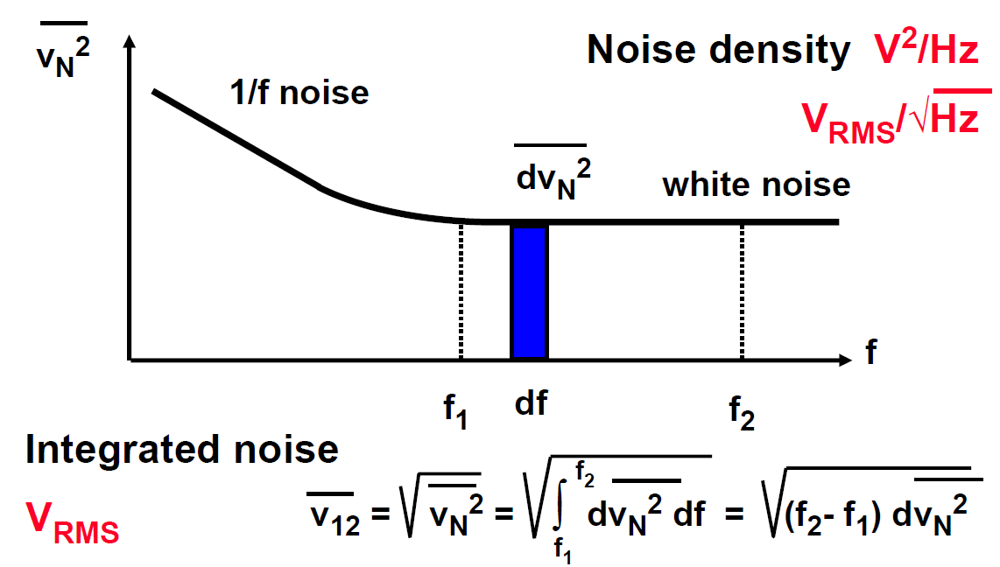
Noise vs Frequency

Slide 10
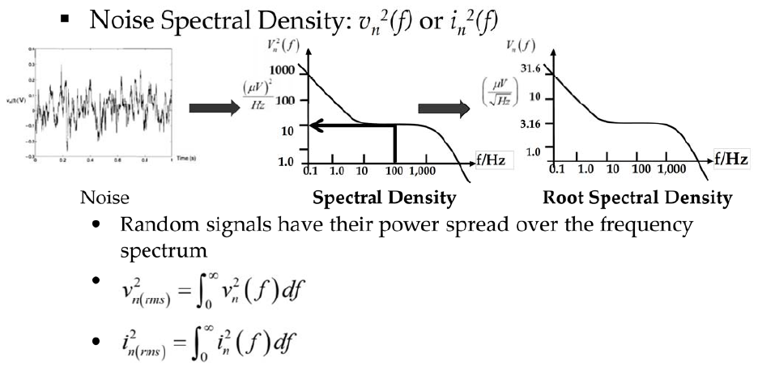
Frequency Domain Analysis

Slide 11
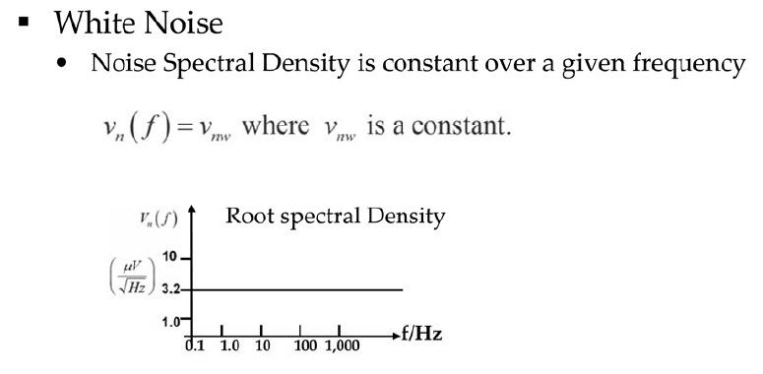
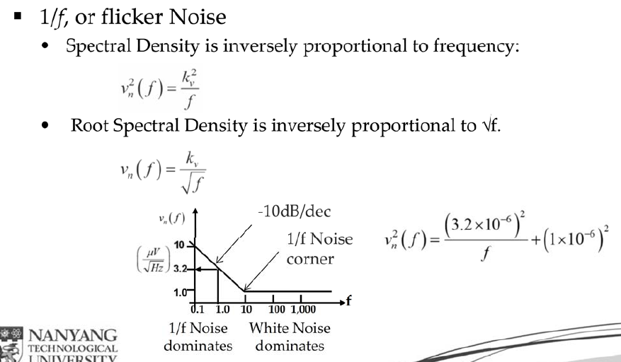
Frequency Domain Analysis

Slide 12
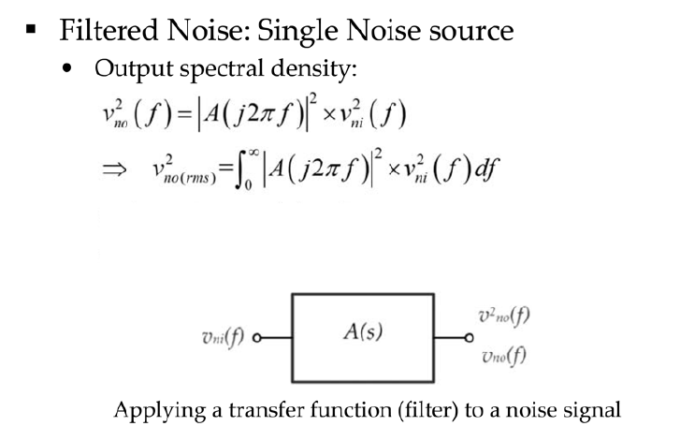
Filtered Noise

Slide 13
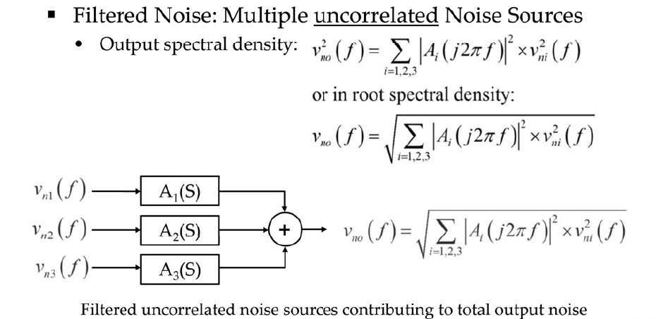
Filtered Noise

Slide 14
Outline
Noise concepts
Circuit Noise Models
Noise analysis examples
*With inputs from Phillip Allen’s course at Georgia Tech and Willy Sansen’s book

Slide 15
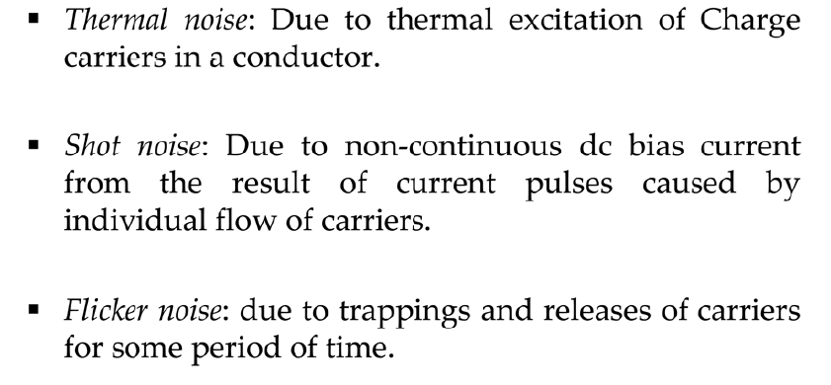
Noise Models

Slide 16
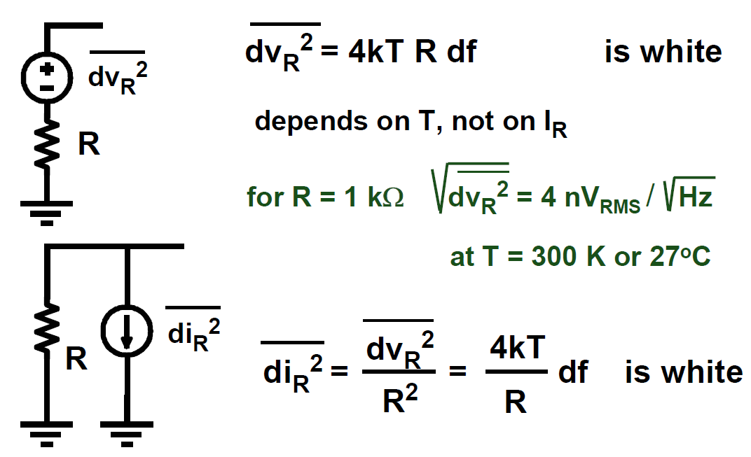
Resistor Noise Sources
Capacitors & Inductors do not generate noise, but can filter noise from other sources

Slide 17
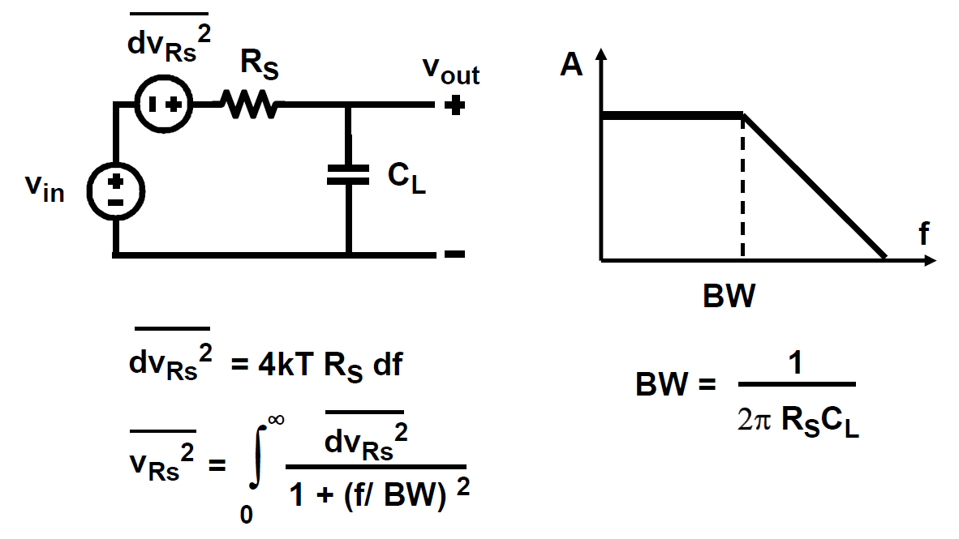
Integrated Resistor Noise

Slide 18
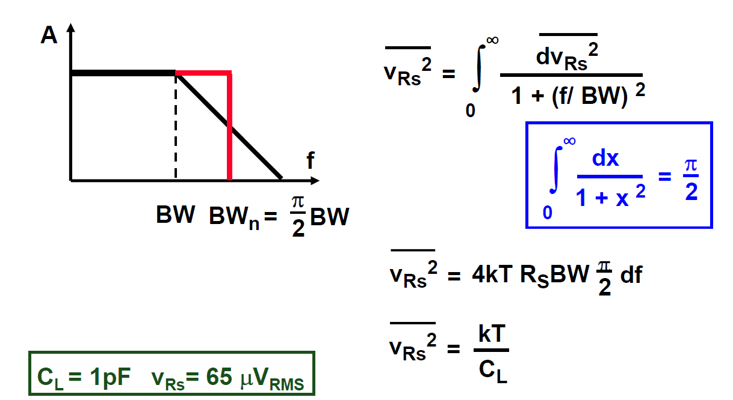
Integrated Resistor Noise

Slide 19
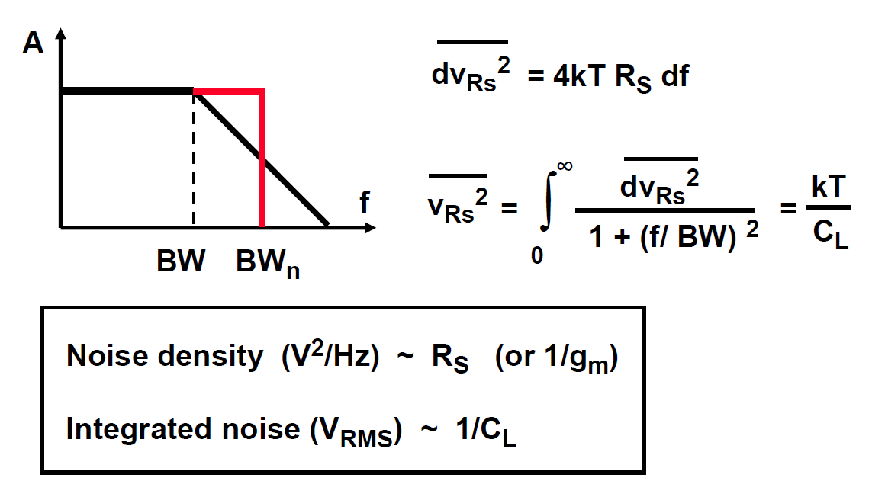
Integrated Noise vs Noise Density (R)

Slide 20
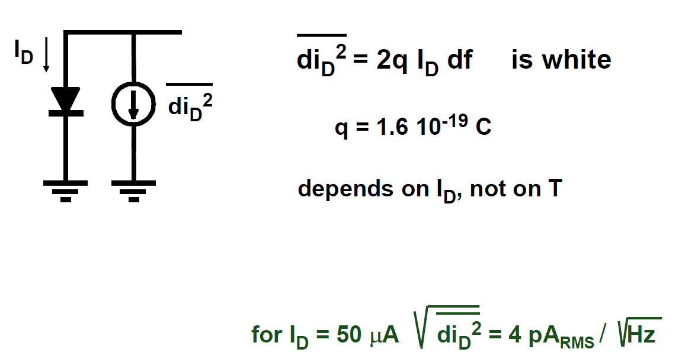
Diode Noise

Slide 21
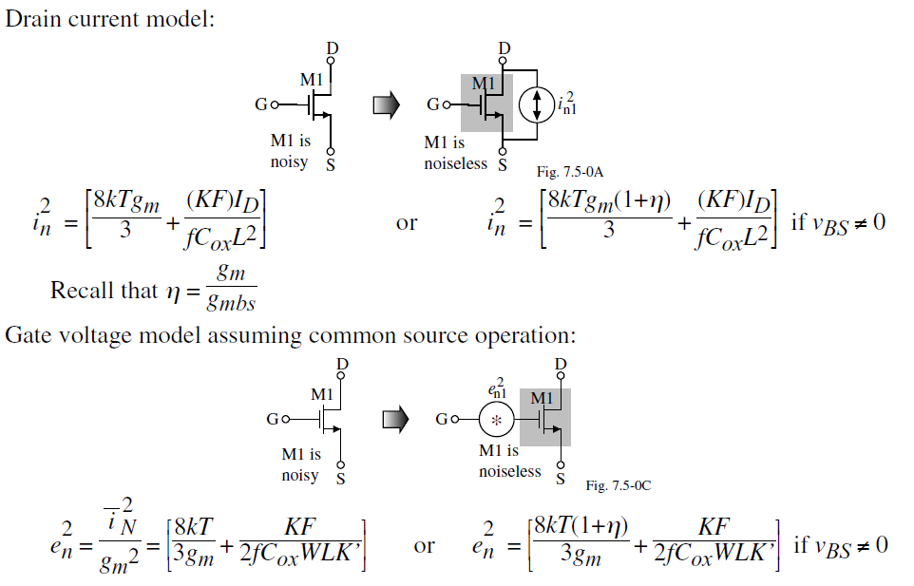
Transistor Noise Sources (Low Frequency)

Slide 22
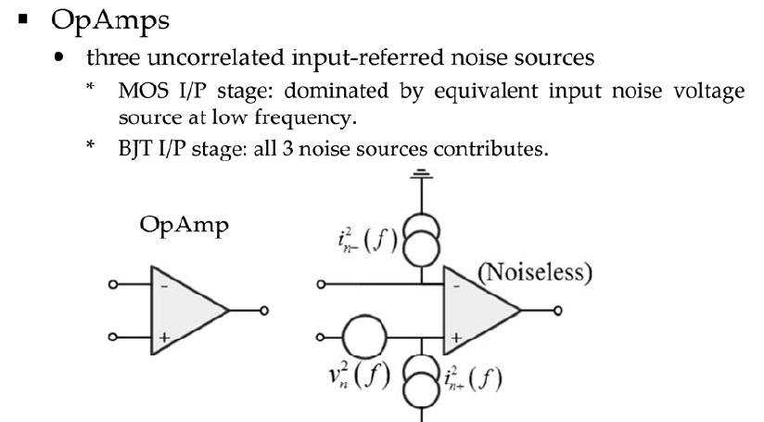
Noise models for big circuits

Slide 23
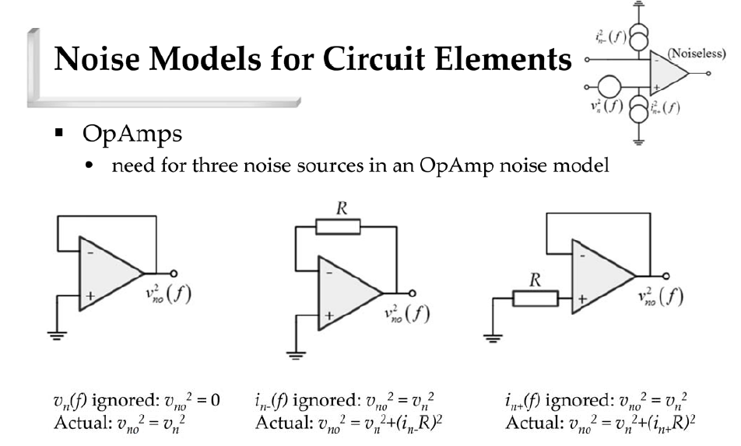
Noise models for big circuits

Slide 24
Outline
Noise concepts
Circuit Noise Models
Noise analysis examples
*With inputs from Phillip Allen’s course at Georgia Tech and Willy Sansen’s book

Slide 25
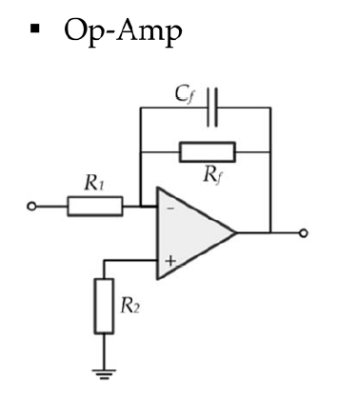
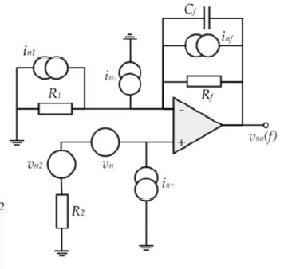
Example 1

Slide 26
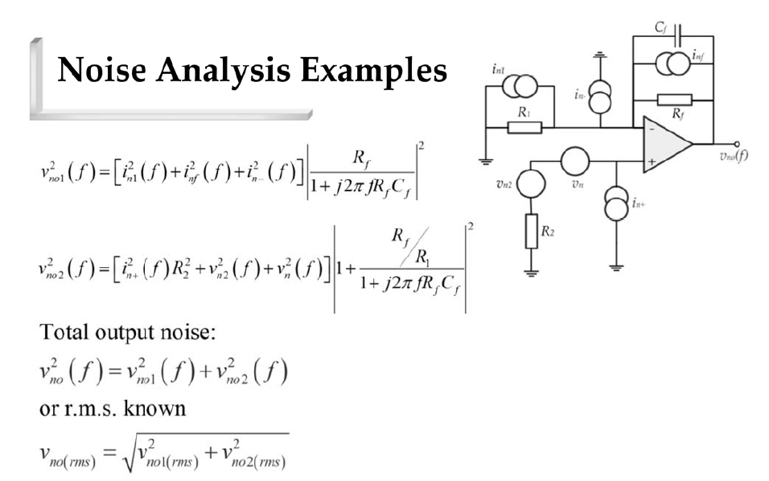
Example 1

Slide 27
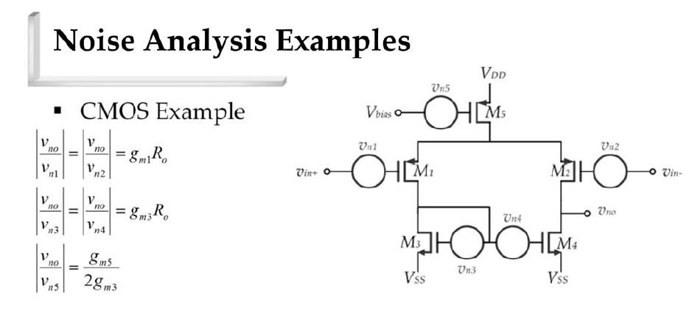
Example 2

Slide 28
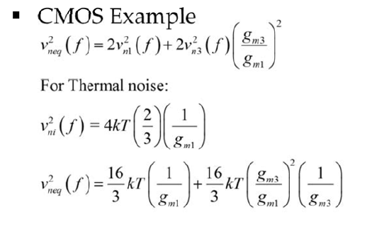

Example 2

