Slide 1
EE3122: Analogue Circuit Fundamentals
Operational Amplifier (Op-amp)
Department of Electrical Engineering
City University of Hong Kong
Prof. Arindam BASU

Slide 2
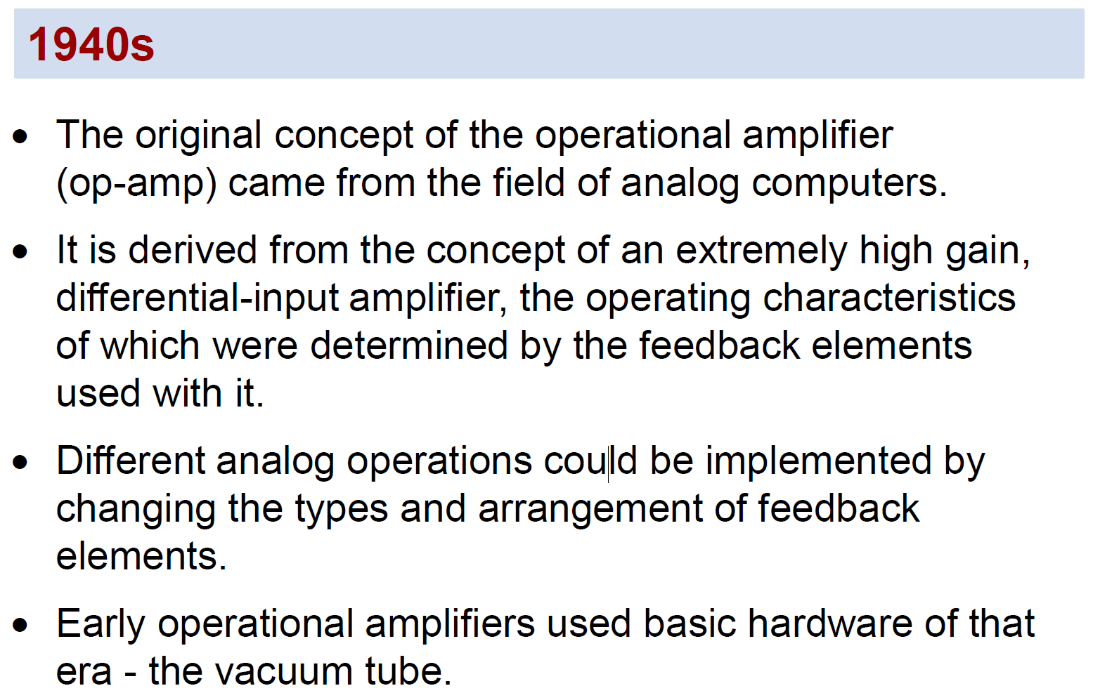
Introduction

Slide 3
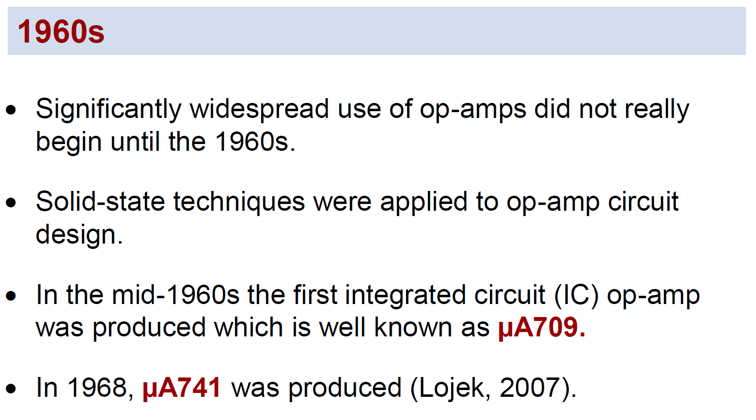
Introduction

Slide 4
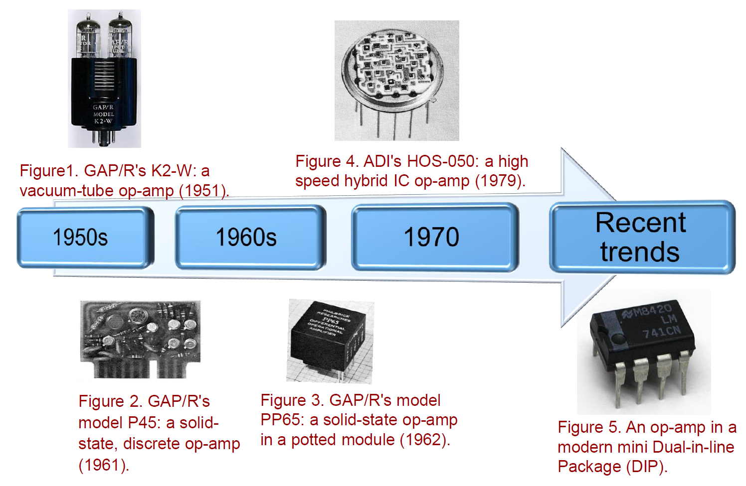
Some Op-amp models

Slide 5
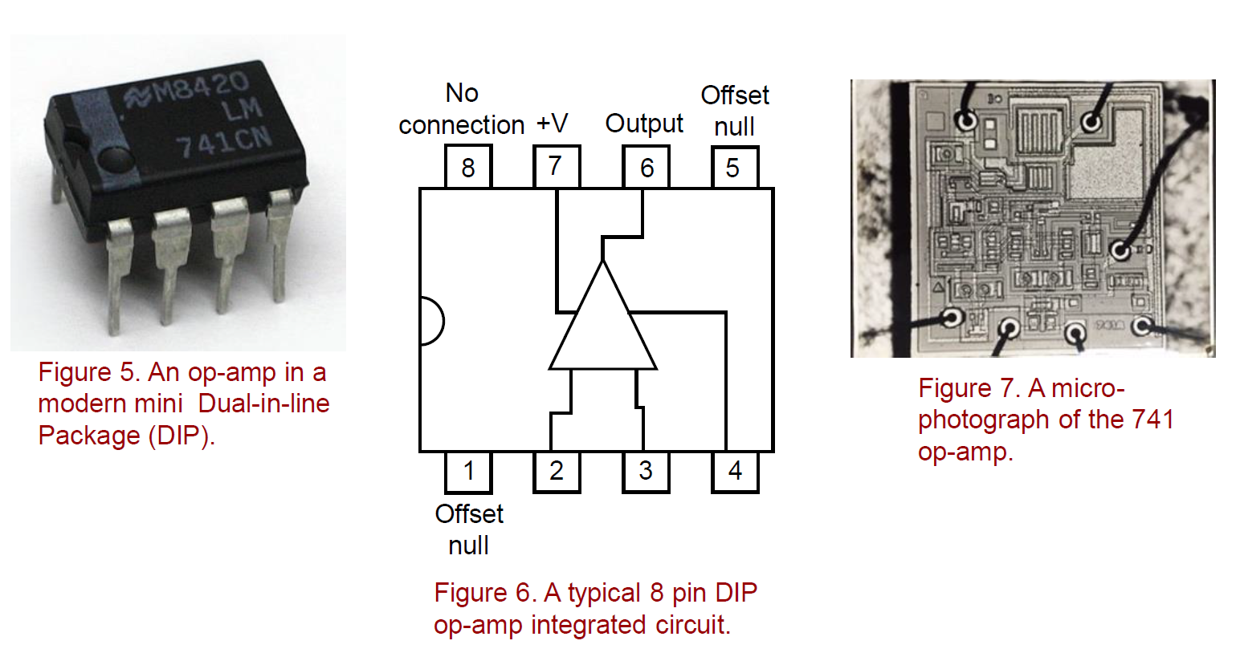
Example: 741 Opamp
+ -
How are the circuits related to what we have learnt?

Slide 6
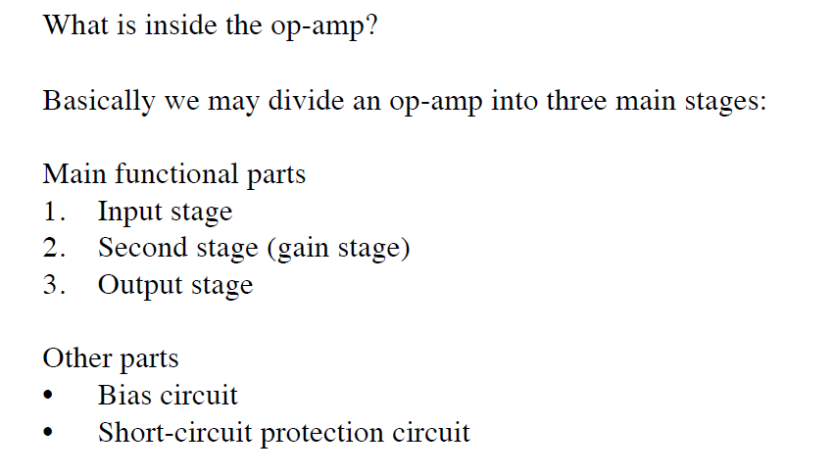
741 Opamp: What’s inside?
(Differential Amplifier (DE))
(Common Emitter (CE))
(Emitter follower (EF) based Class AB)

Slide 7
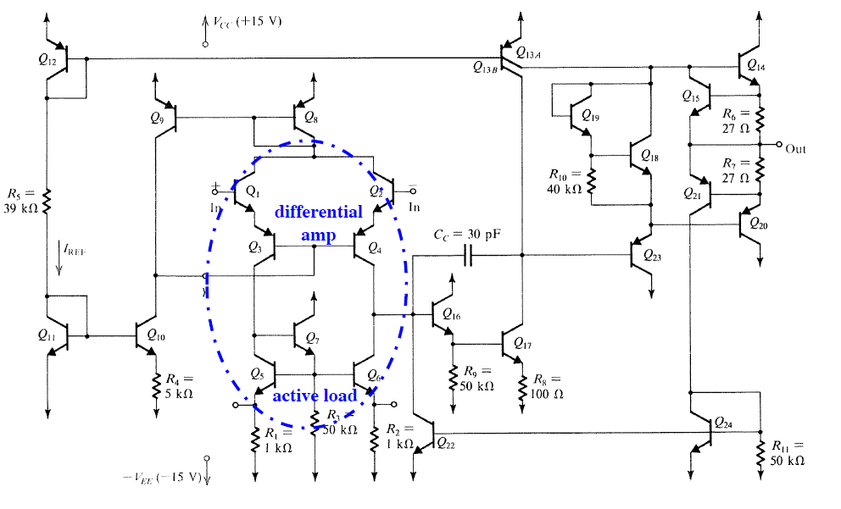
741 Opamp: Input Stage

Slide 8
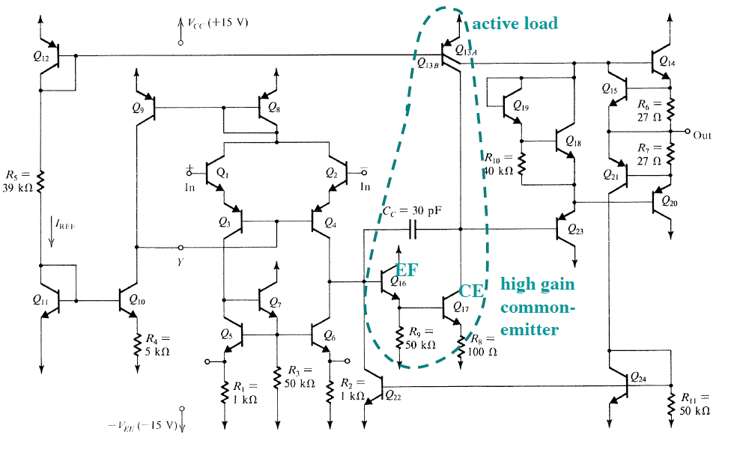
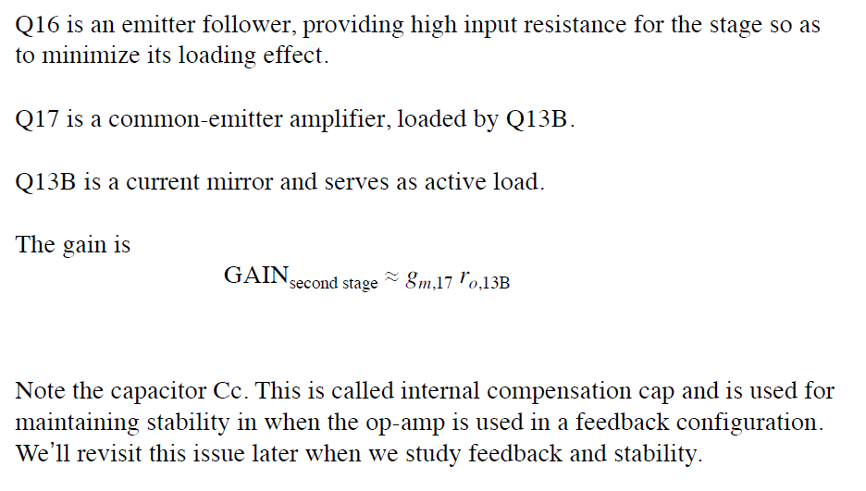
741 Opamp: Second Stage

Slide 9

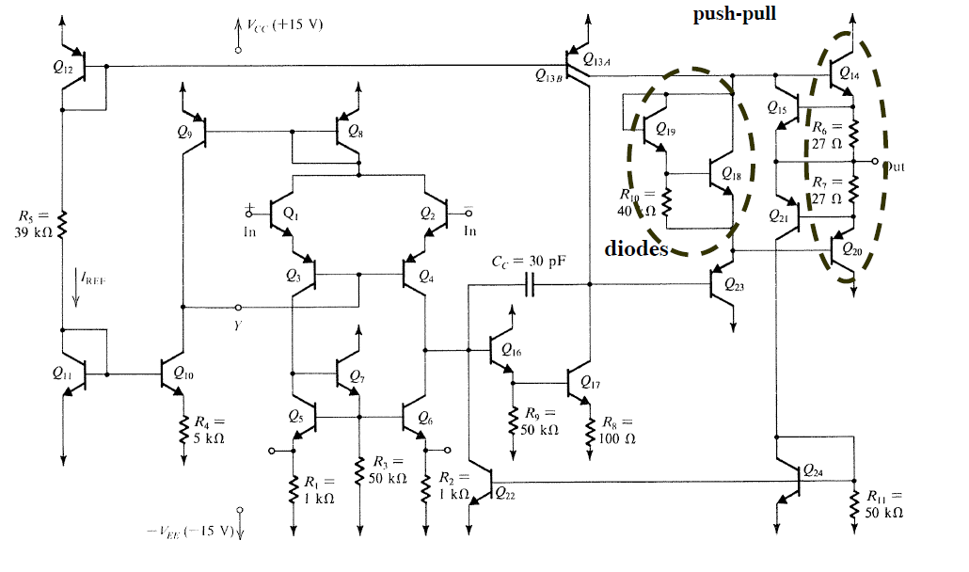
741 Opamp: Output Stage

Slide 10
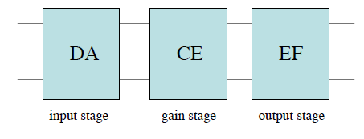
Summary: Internal circuits
Input stage: Differential amplifier (DA) of high input resistance, e.g., MOSFET/JFET pair
Second stage: Common-emitter (CE) stage with active load
Output stage: Emitter follower (EF) with low output resistance
More details in Appendix

Slide 11
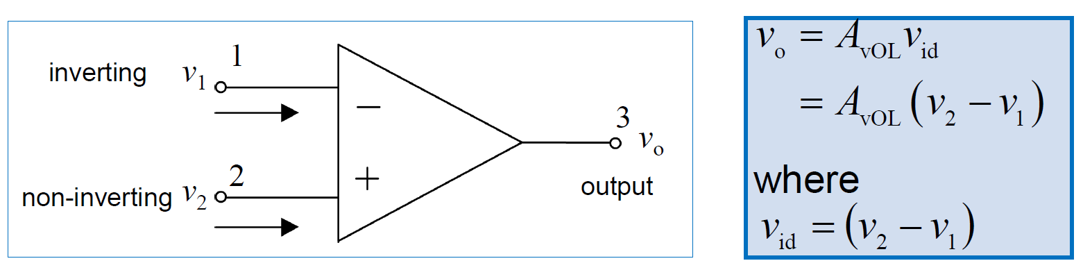
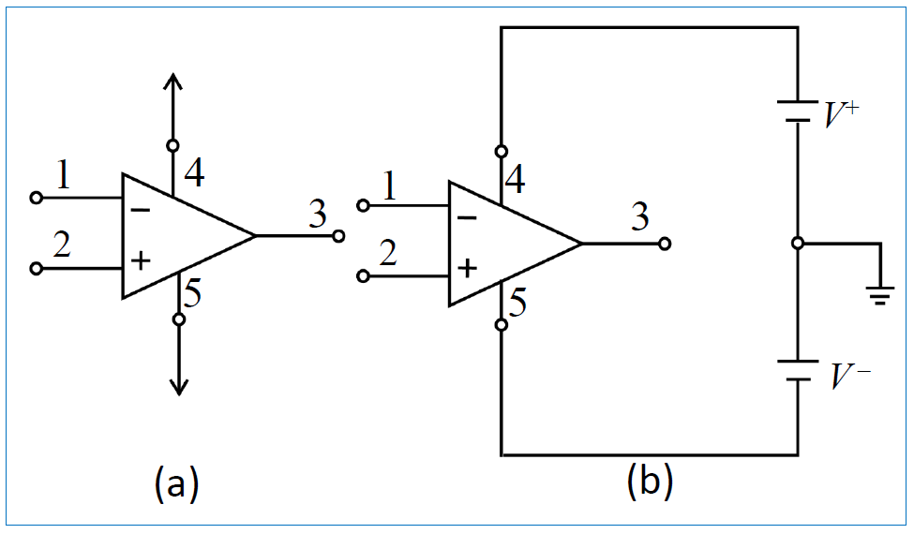
Op-amp Terminals
From a signal point of view, op-amp has three terminals: two input terminals for differential signal input and one single-ended output terminal.
Most IC op-amps require two power supplies V+and V–sometimes given as [+VCC; VCC; VDD] and [–VCC; VEE; VSS]

Slide 12
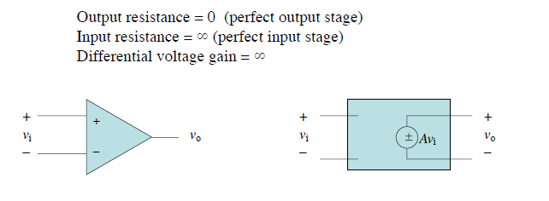
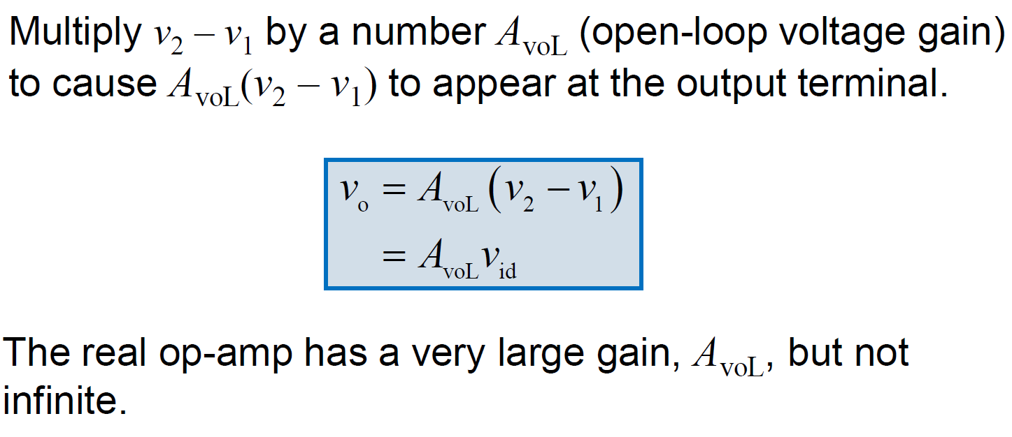
Ideal Op-amp
In EE2301/2005, you have studied the op-amps and simple op-amp circuits, assuming that the op-amp is an ideal element satisfying the following conditions:

Slide 13
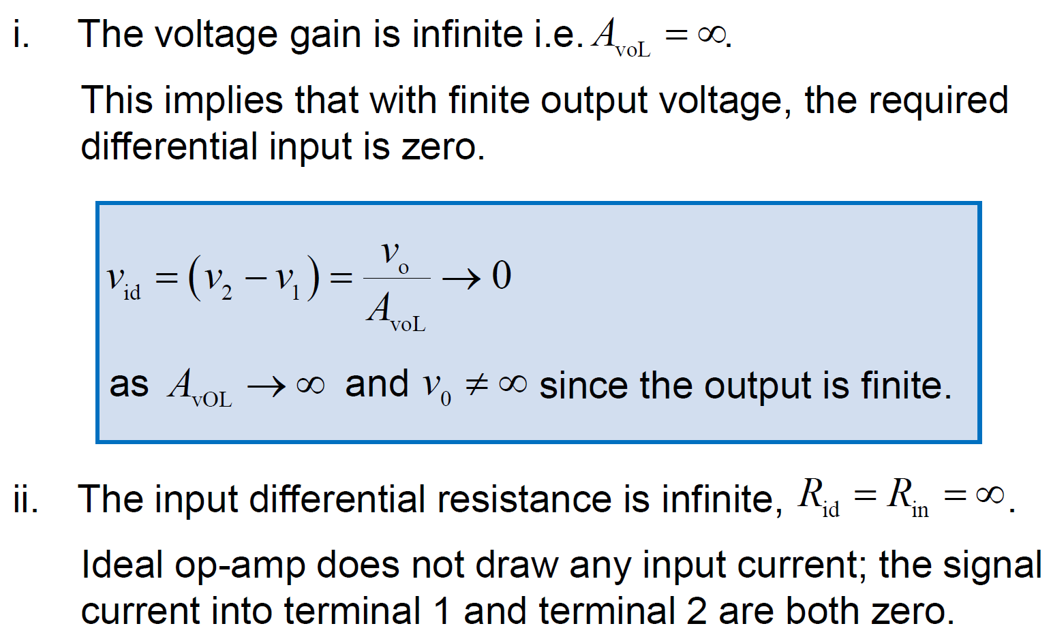
Ideal Op-amp: Properties
Negative Feedback

Slide 14
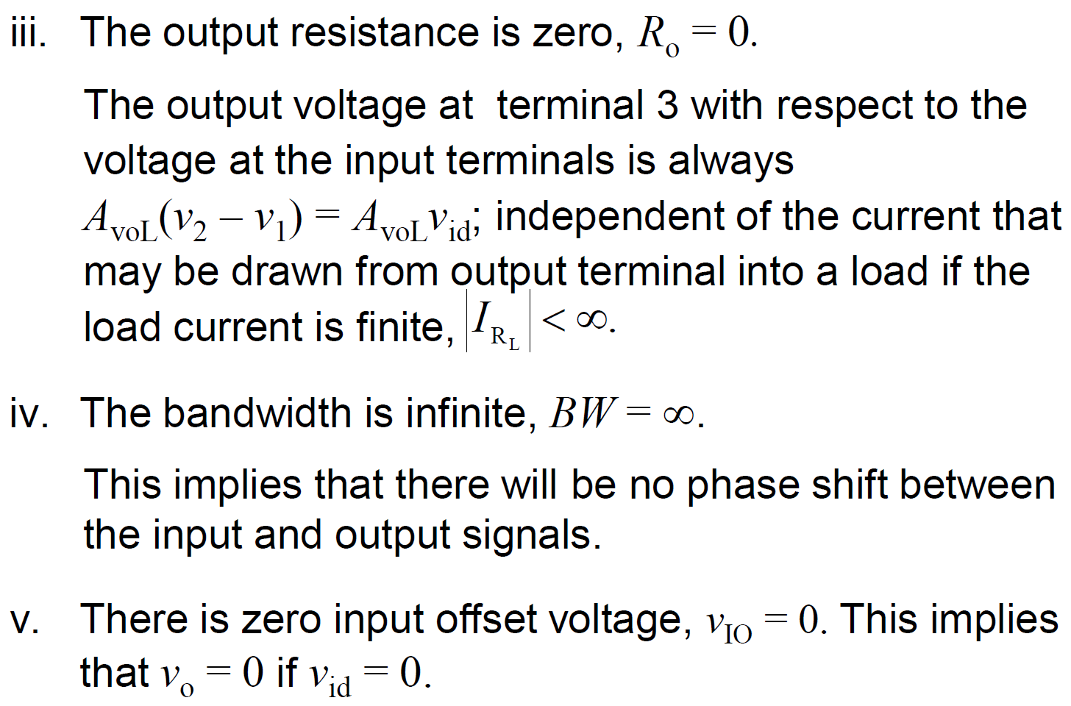
Ideal Op-amp: Properties

Slide 15
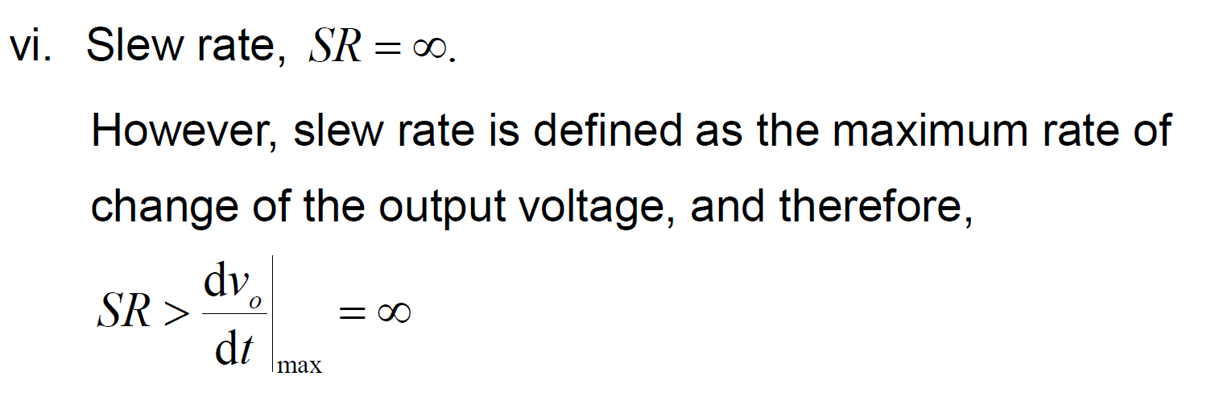
Ideal Op-amp: Properties

Slide 16
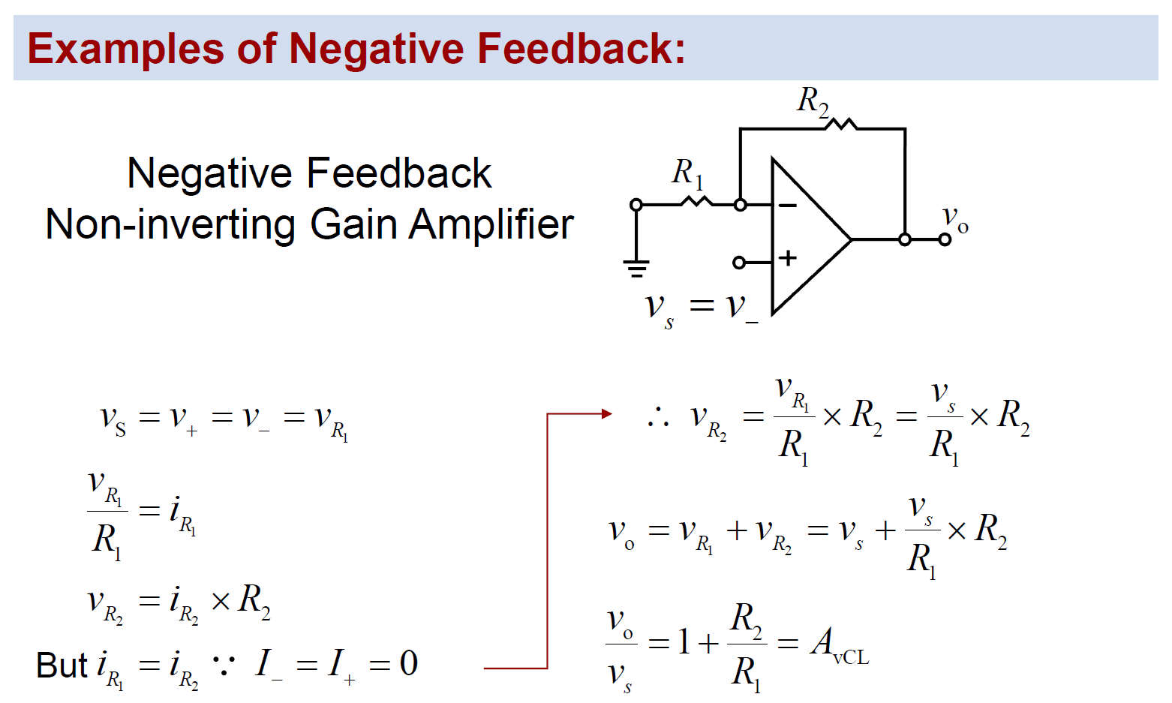
Example: Perform Mathematical Operations

Slide 17
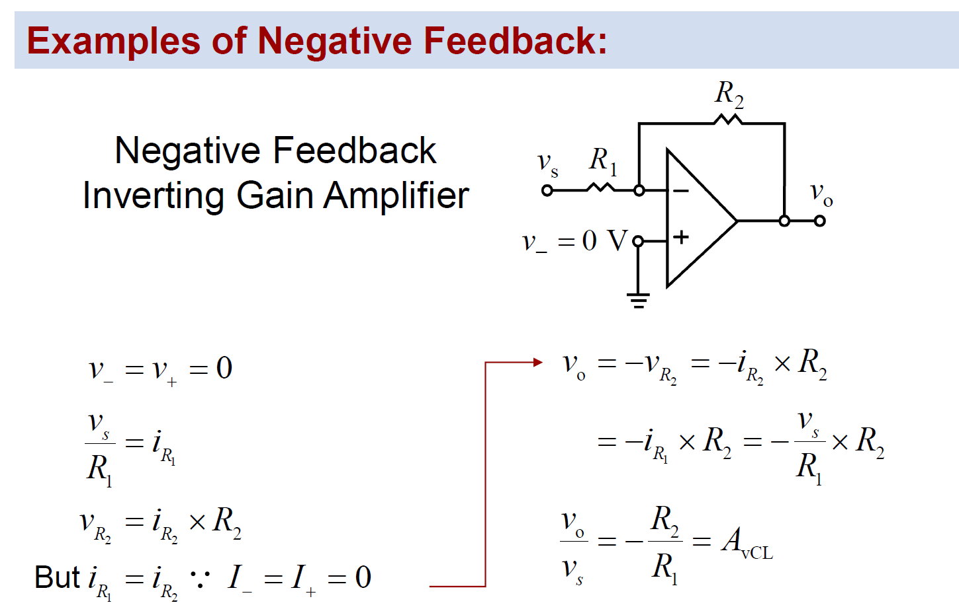
Example: Perform Mathematical Operations

Slide 18
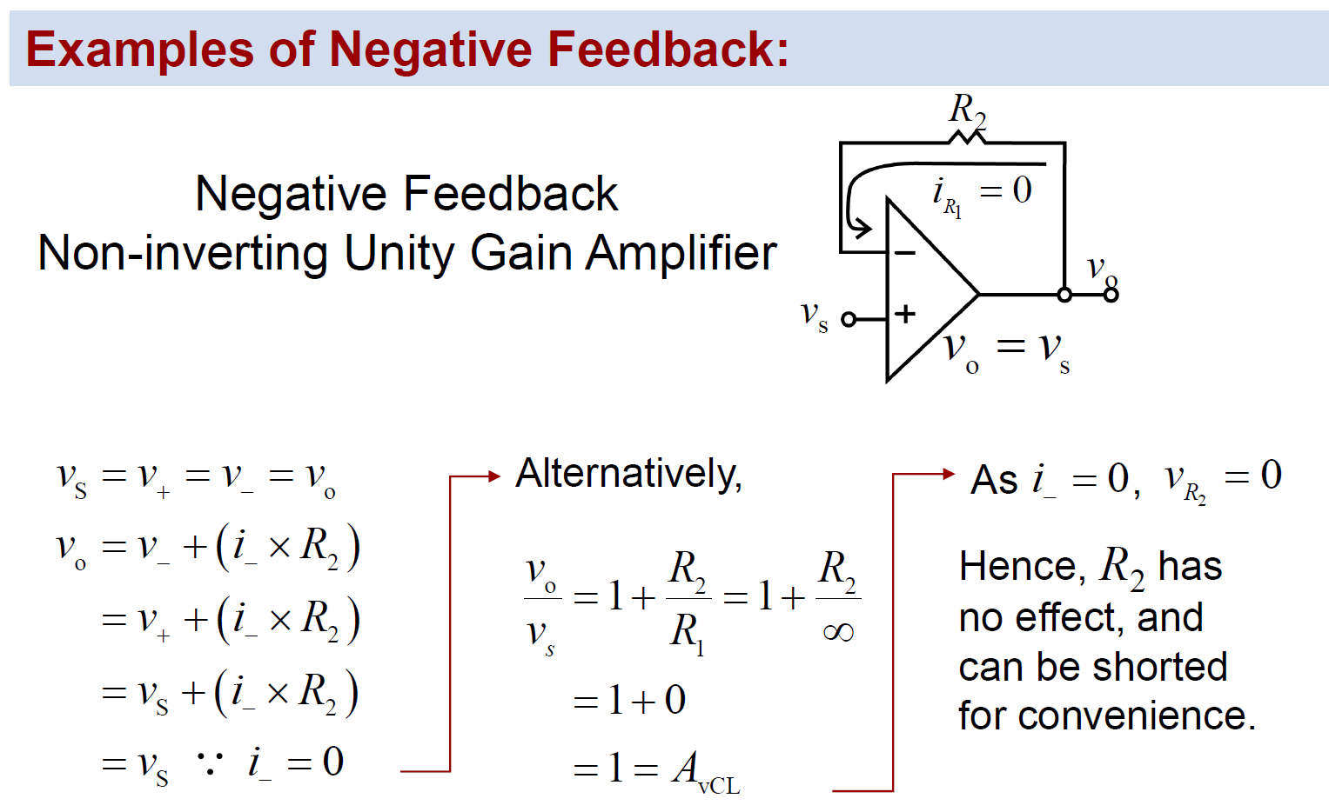
Example: Perform Mathematical Operations
Voltage
Buffer

Slide 19
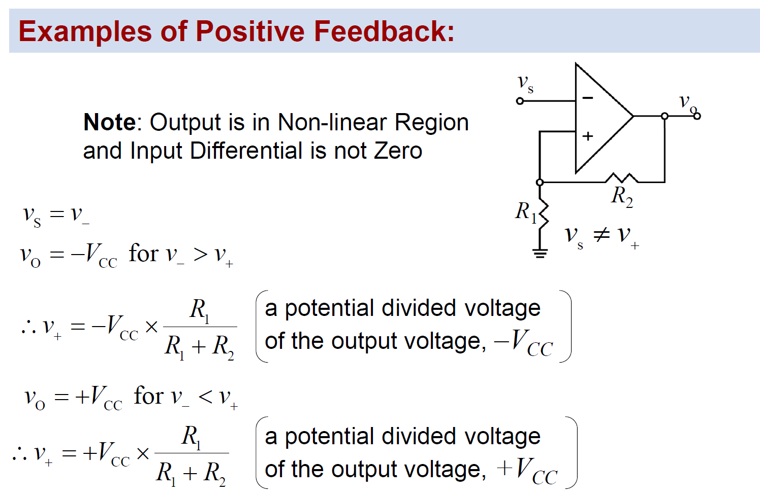
Example: Perform Mathematical Operations
Comparator

Slide 20
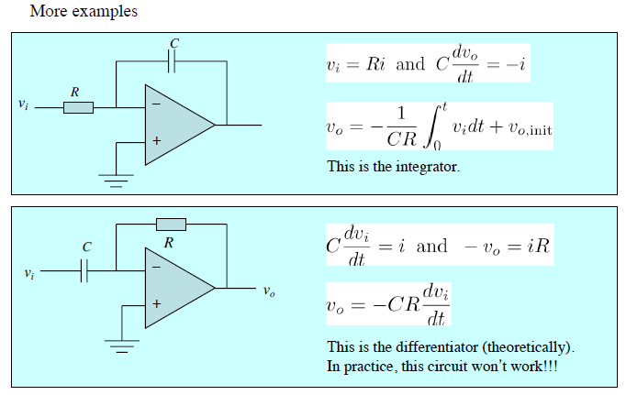
Example: Perform Mathematical Operations

Slide 21
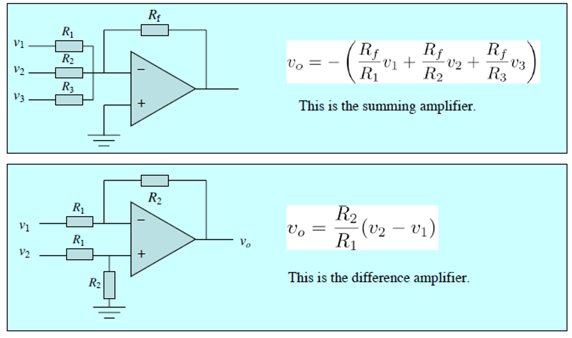
Example: Perform Mathematical Operations

Slide 22
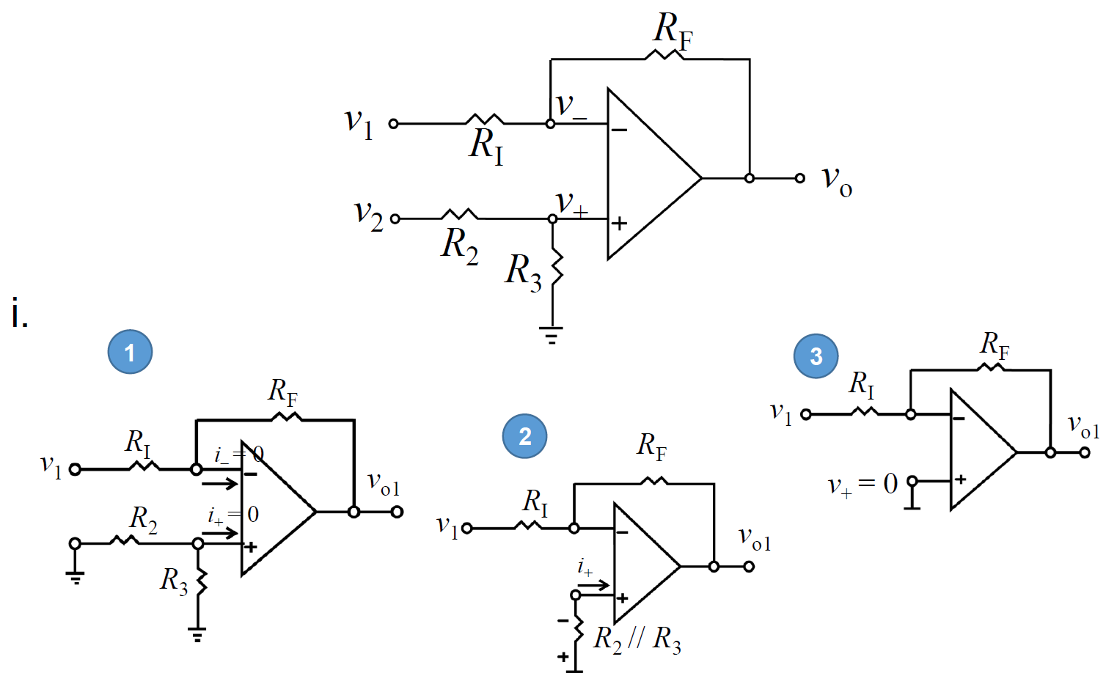
Scaling subtractor or Difference Amp

Slide 23
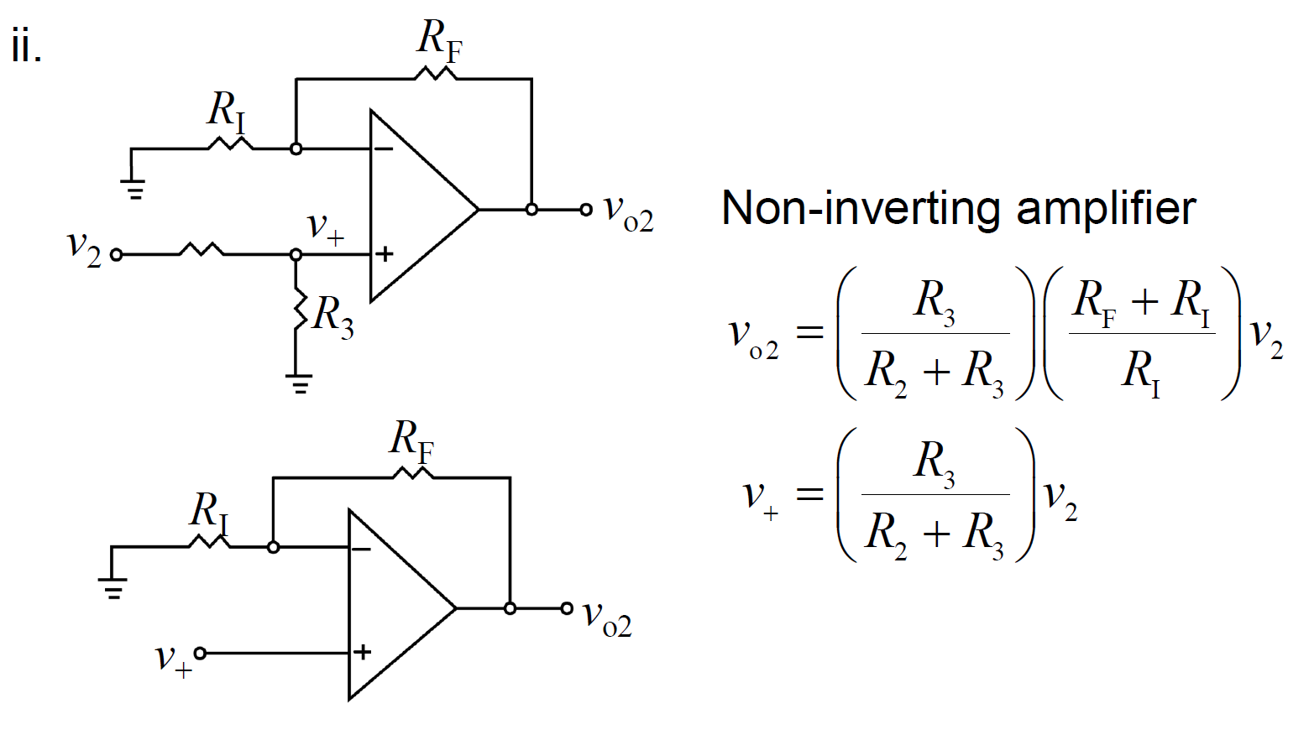
Scaling subtractor or Difference Amp

Slide 24
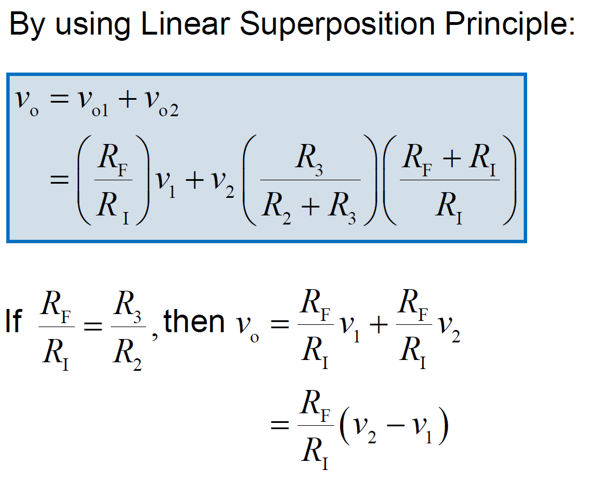
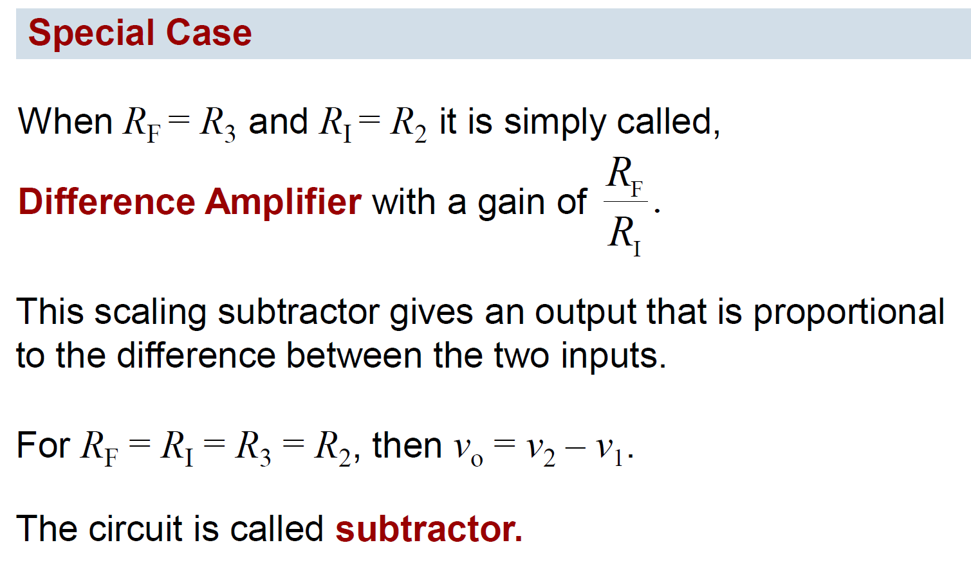
Scaling subtractor or Difference Amp
-
-

Slide 25
Op-amp nonidealities
Previous part was about Ideal op-amp → Real op-amp has several non-idealities
Offset voltage – caused by circuit mismatch between + & - terminals
Input current can be non-zero – BJT input
Actual differential gain is not infinite
Finite time taken for op-amp output to change → slew rate & bandwidth

Slide 26
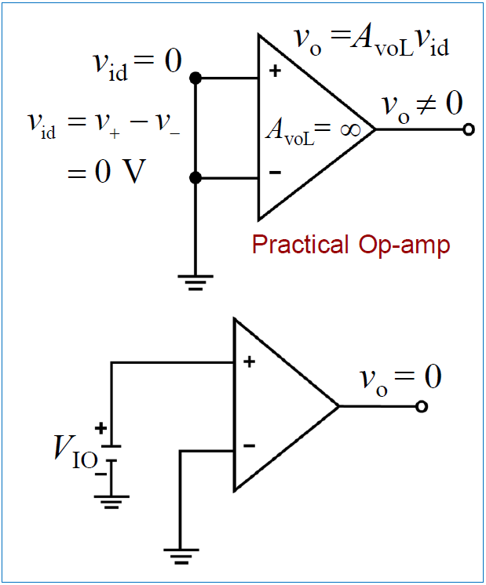
Op-amp nonidealities: Offset
V_{IO} is defined as negative of the DC voltage that must be applied between the inputs of an op-amp to force vo to zero under open-loop conditions (Figure 21).
The V_{IO} can be either positive or negative and typically has a value between 10 mV and 1 uV, depending on the type of op-amp.
It may also vary with temperature.

Slide 27
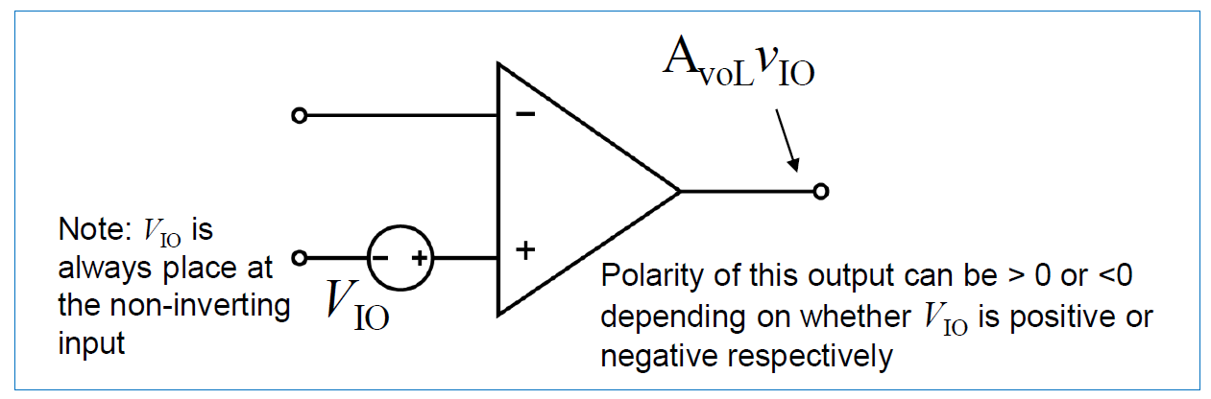
Op-amp nonidealities: Offset
The effect of V_{IO} on an op-amp circuit can be modelled by adding a DC voltage source V_{IO} in series with the non-inverting input terminal, as shown in the Figure.

Slide 28
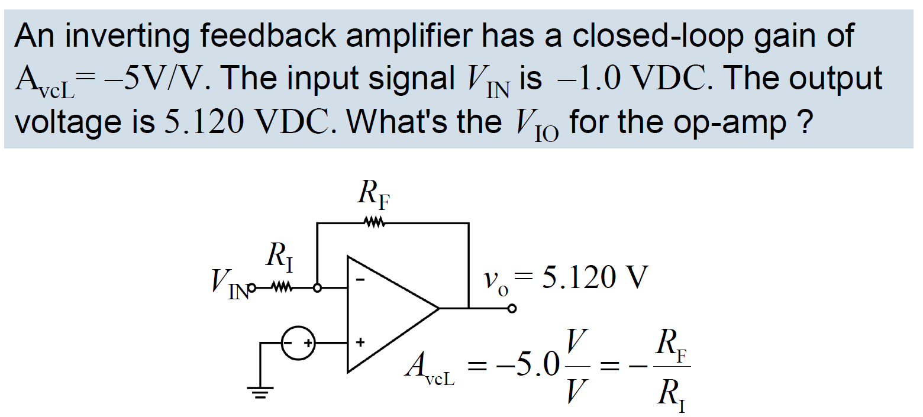
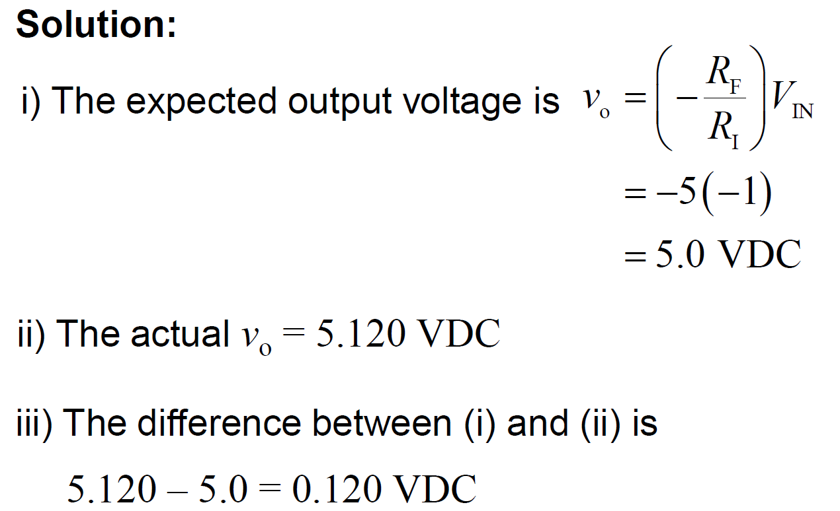
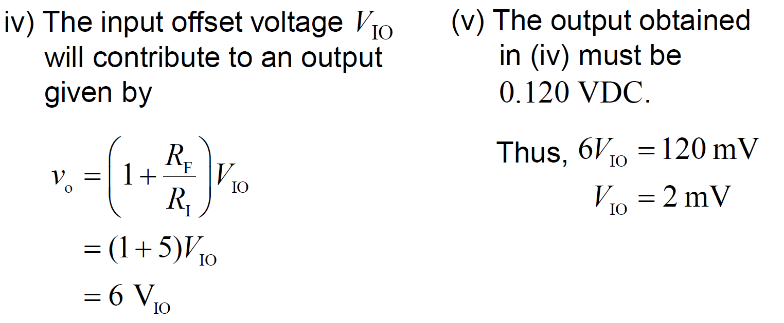
Offset: Example
20 mV

Slide 29
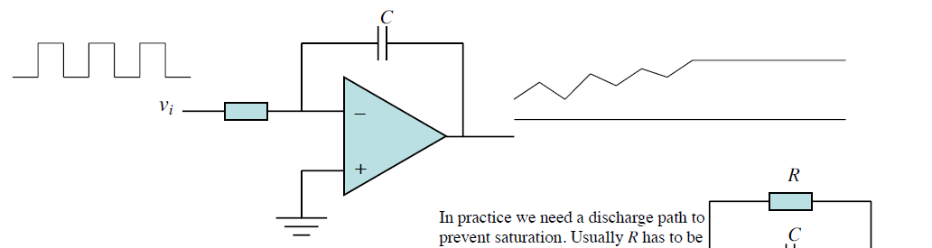
Offset: Practical problem
Offset in integrator
  The op-amp integrator is very easily saturated if there is a small lack of symmetry. This is because the error gets integrated quickly and the output will soon move towards the maximum voltage.

Slide 30
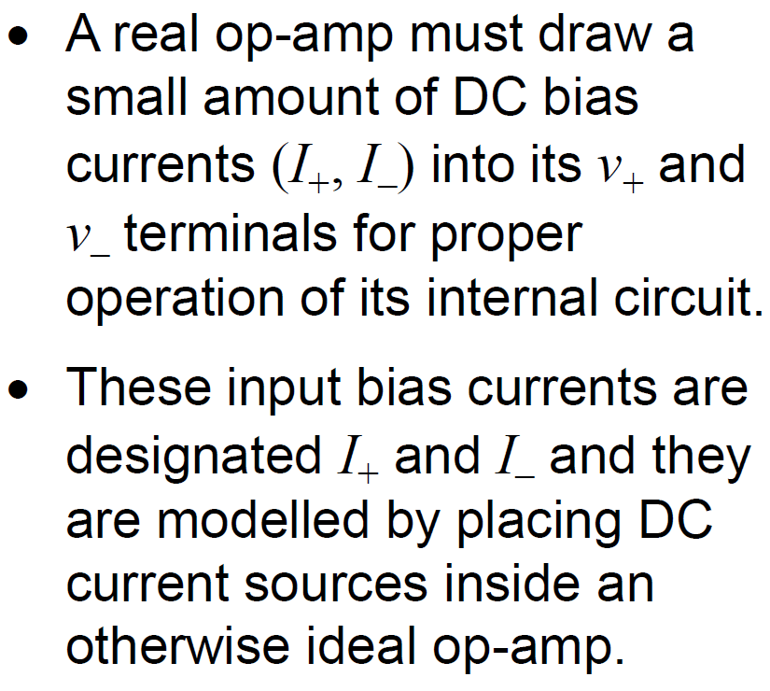
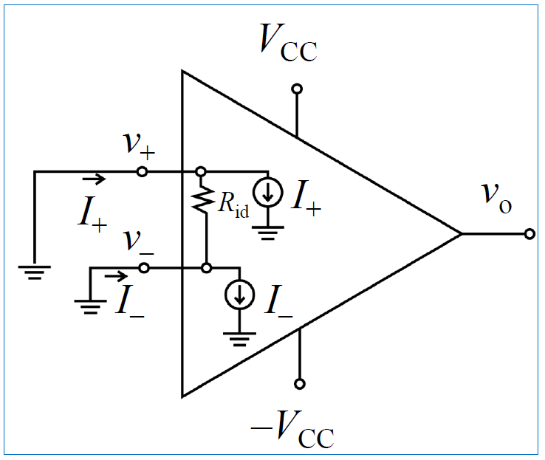
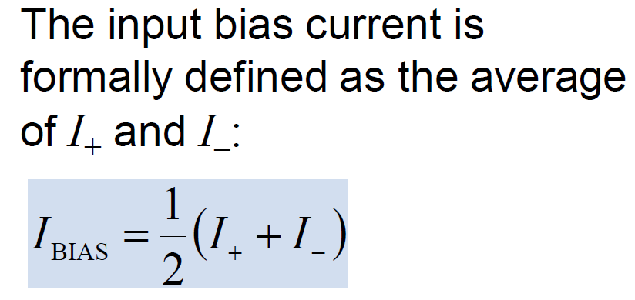
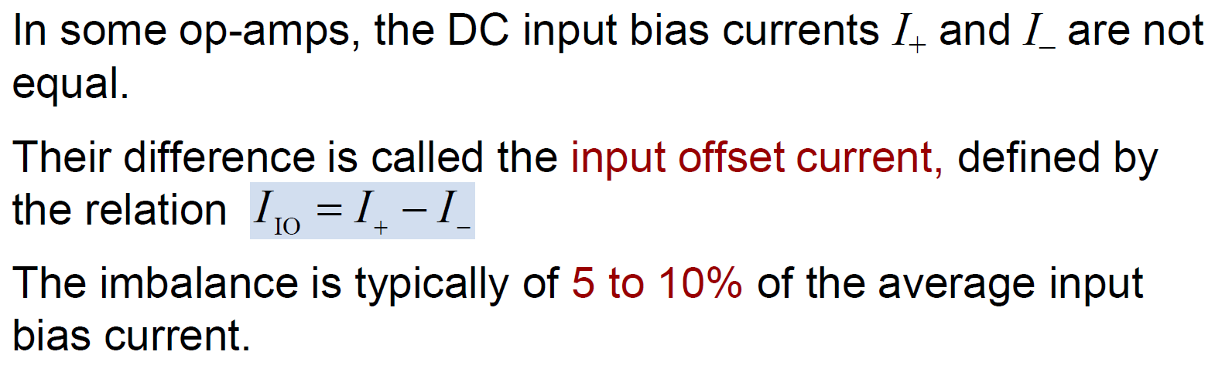
Op-amp nonidealities: Input current
Typical input bias currents range in value from 0.1 pA to 10 uA and can be positive or negative, depending on the type of op-amp.

Slide 31
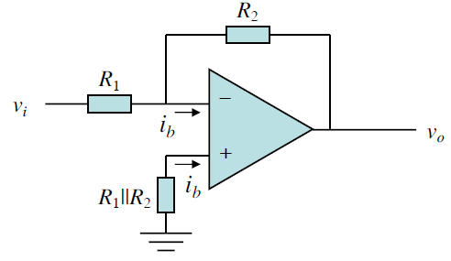
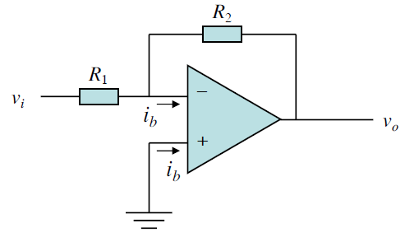
Op-amp nonidealities: Input current
Input bias current
  Unwanted offset: Since i_{b} flows into both inputs, the negative input side will have a slightly negative dc voltage even when v_{i} = 0, whereas the positive input side is still 0V because there is no resistor there!
Introduce a resistor at non-inverting terminal.

Slide 32
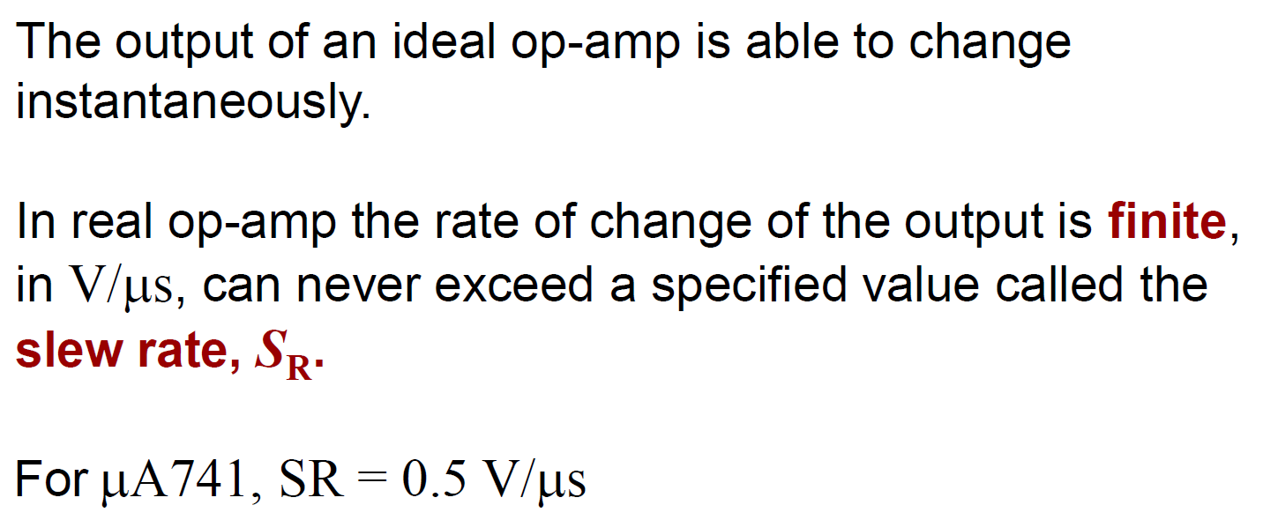
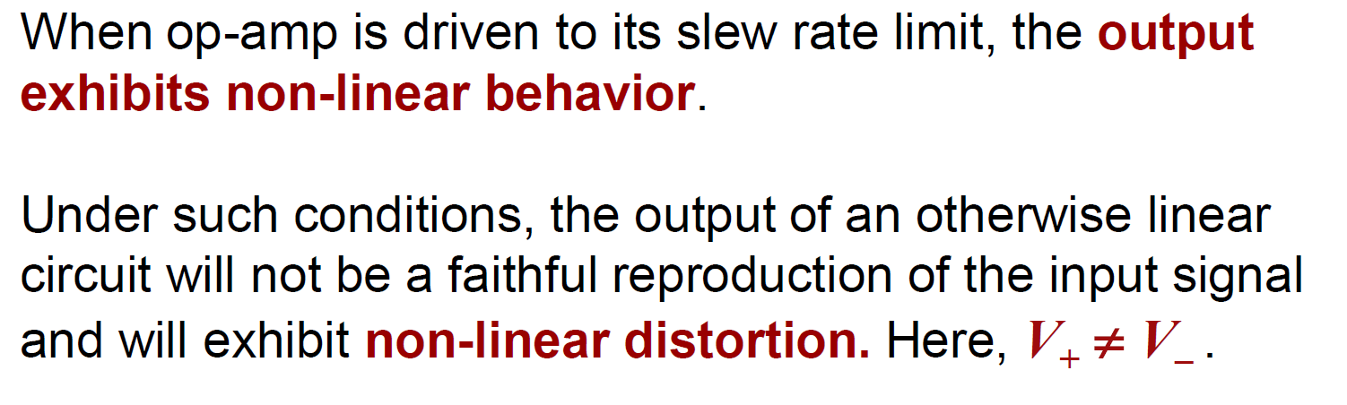
Op-amp nonidealities: Slew rate
SR = Max |dv_{o}/dt| of an opamp

Slide 33
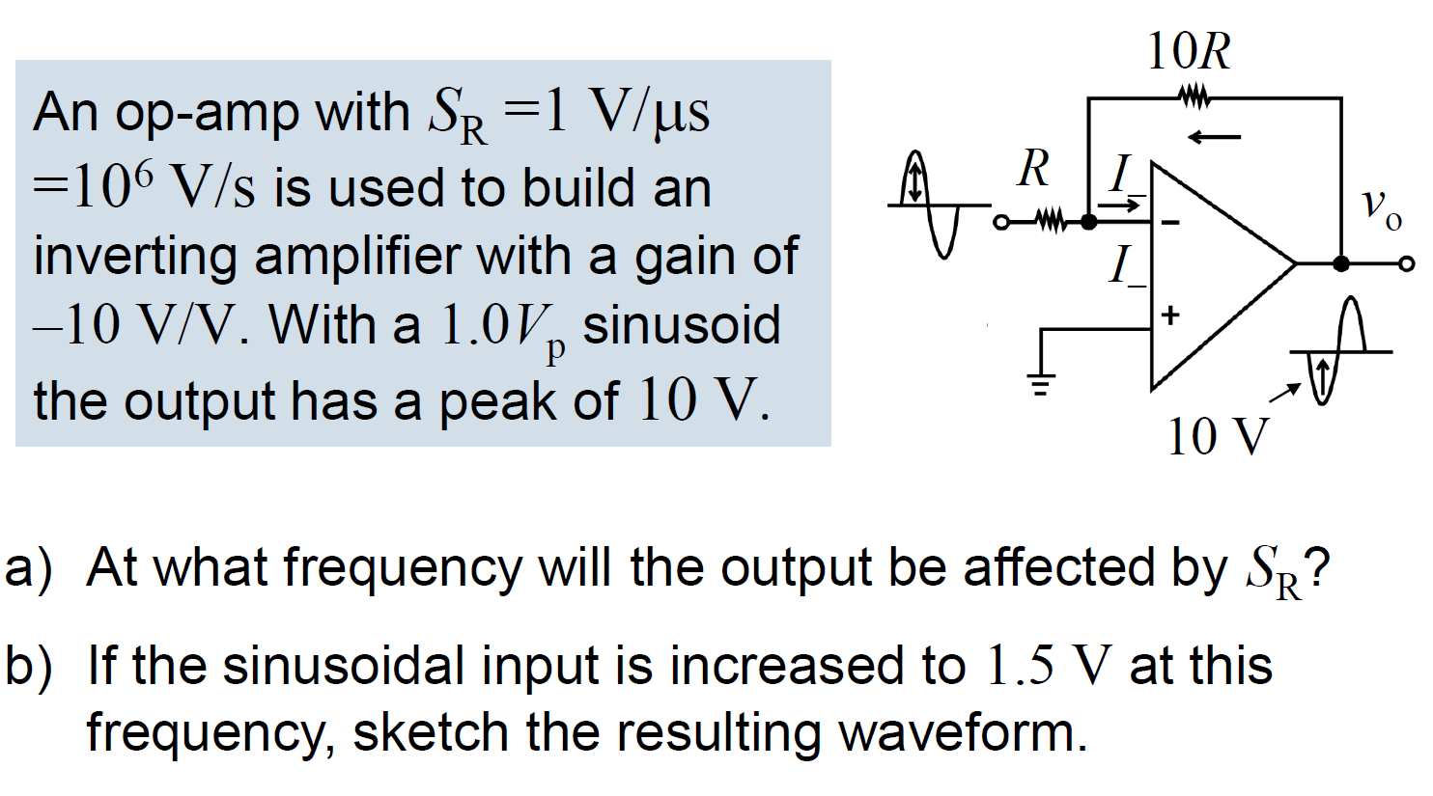
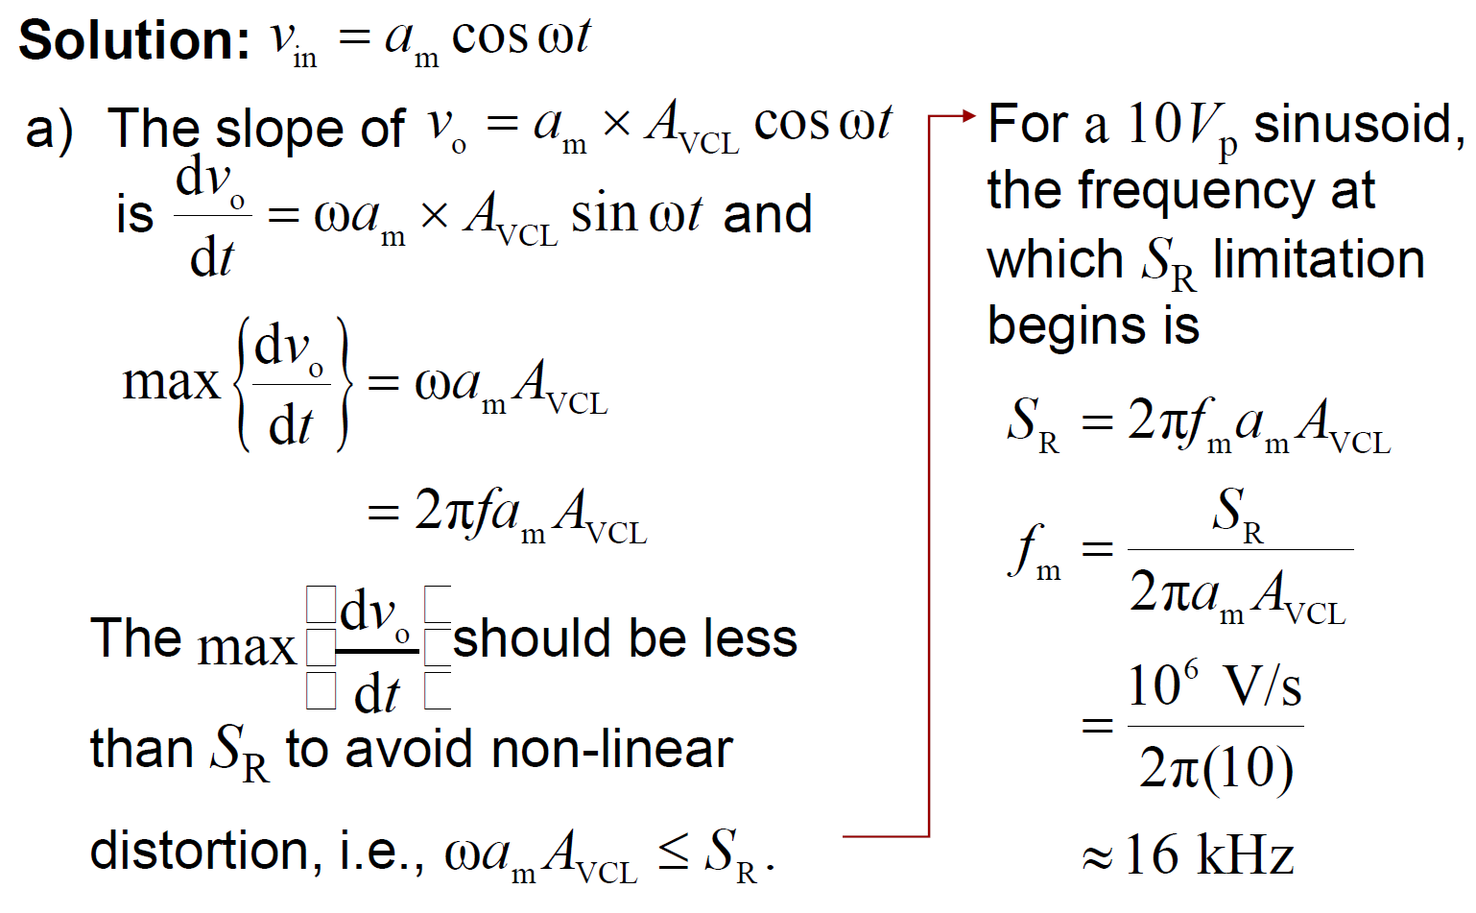
Slew rate: Example
Max|dv_{o}/dt|

Slide 34
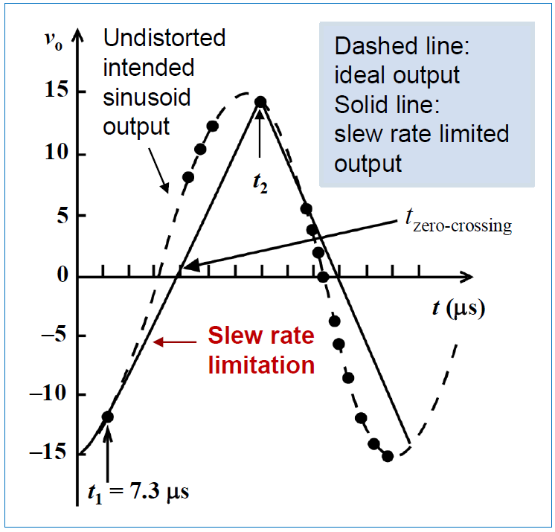
Slew rate: Example

Slide 35
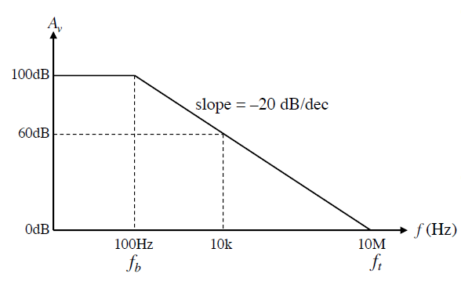
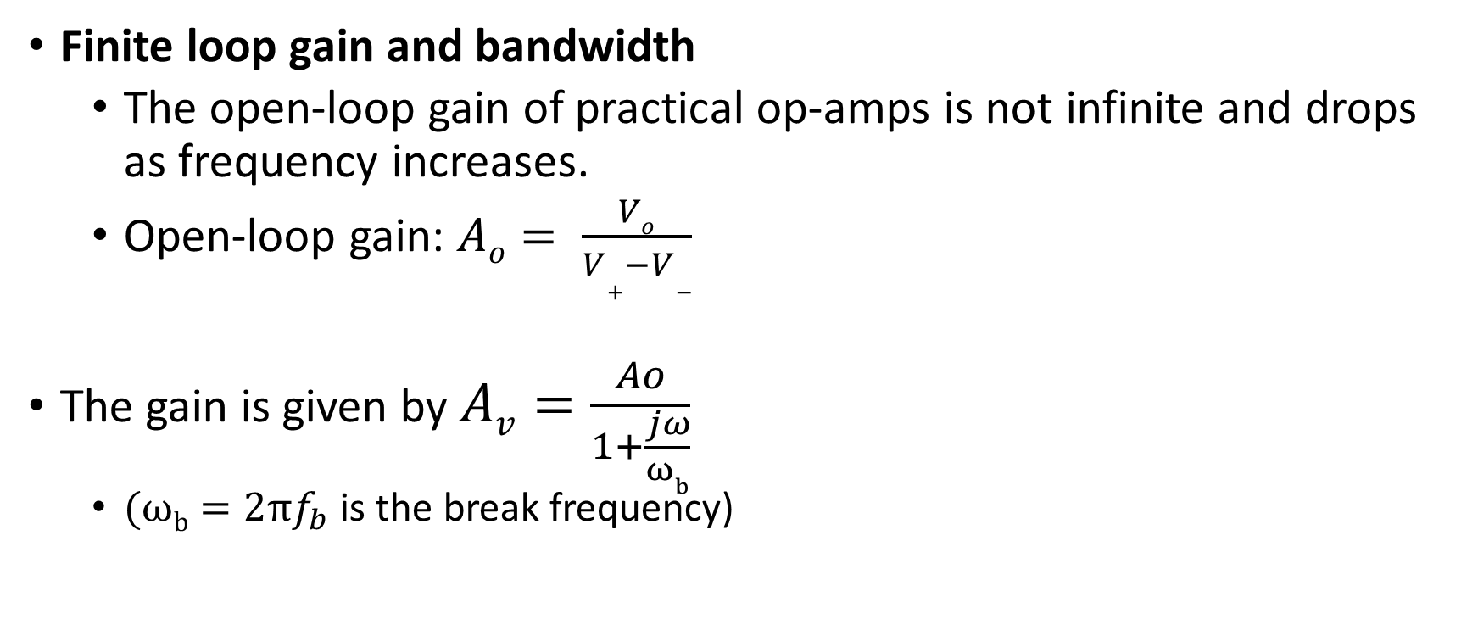
Op-amp nonidealities: Finite gain
Finite loop gain and bandwidth
  The open-loop gain of practical op-amps is not infinite and drops as frequency increases.
  Open-loop gain: $Ao= \frac{Vo}{V+−V−}$
The gain is given by $Av=\frac{Ao}{1+\frac{jω}{ωb}}$
  $(ωb=2πf_{b}$ is the break frequency)

Slide 36
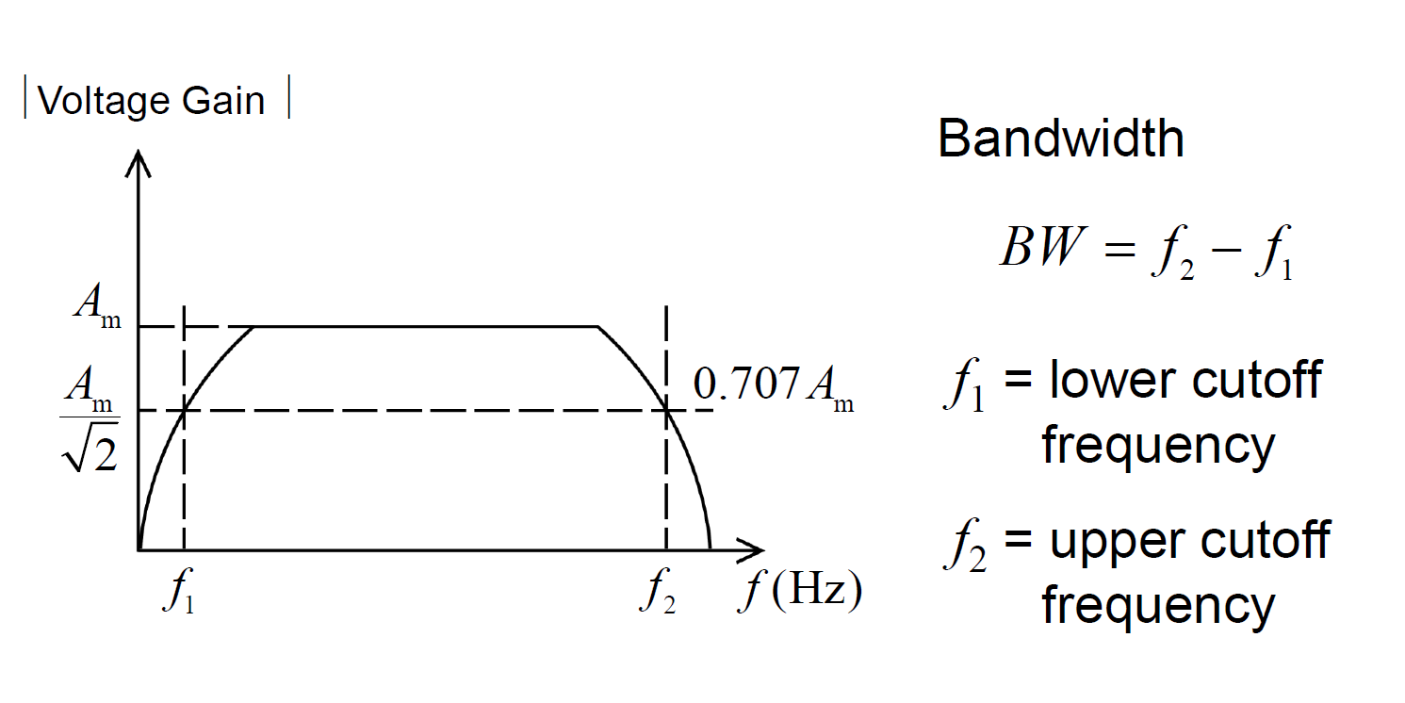
Op-amp nonidealities: Bandwidth

Slide 37
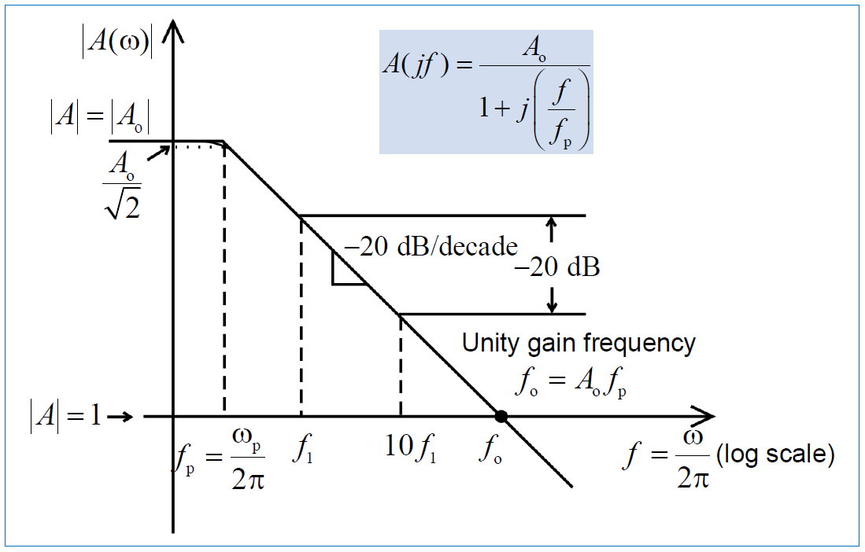
Op-amp nonidealities: Open-loop Bandwidth
The dominant pole frequency fp is often in the low frequency hertz range (normally below 1 kHz).
Above f_{p}, the gain falls at a rate of –20 dB/decade.

Slide 38
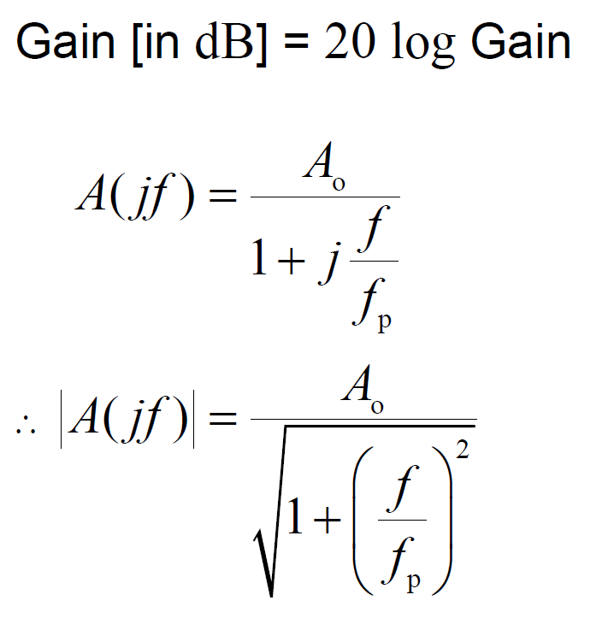
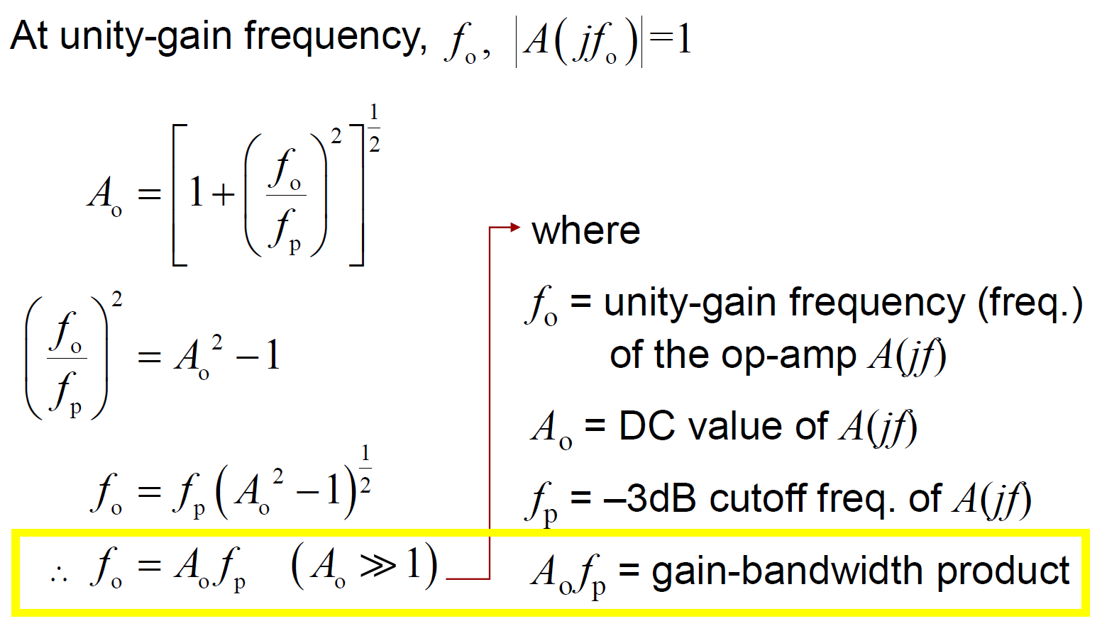
Op-amp nonidealities: Open-loop Bandwidth
UGF
UGF = Gain*BW
Gain-Bandwidth product is constant

Slide 39



Op-amp nonidealities: Closed-loop Bandwidth
Inverting amplifier: Suppose the op-amp gain is Av(w), not infinity! The inverting amplifier gain at w becomes

Slide 40

Op-amp nonidealities: Closed-loop Bandwidth

Slide 41


Op-amp : Other Applications
Current Source

Slide 42




Op-amp : Other Applications
Low-pass Filter

Slide 43


Op-amp : Other Applications
Low-pass Filter

Slide 44



Op-amp : Other Applications
High-pass Filter

Slide 45
Appendix

Slide 46

The bias circuit in 741

Slide 47

The bias circuit in 741

Slide 48

Short-circuit protection circuit in 741

Slide 49
Input stage

Slide 50


Input Stage

Slide 51
Second stage (gain stage)

Slide 52
Second stage (gain stage)

Slide 53
Output stage

Slide 54

Output stage

