Slide 1
EE2000 Logic Circuit Design
Programmable logic devices

Slide 2
Outline
6.1 Programmable logic devices
6.2 ROM and PROM
6.3 Fuse-Programmable Arrays
6.4 Programming Logic Array (PLA)
6.5 Programmable Array Logic (PAL)
6.6 Field Programmable Gate Array Logic (FPGA)

Slide 3
6.1 Programmable logic devices
Implementation technologies introduced so far are not programmable
  Fixed integrated circuits
Programmable Logic Device (PLD)
  Integrated circuit with internal logic gates connected together
  These internal connections can be reconfigured (erased / programmed) to form a specific logic circuit
Three types of basic PLDs
  ROM, PLA, PAL

Slide 4
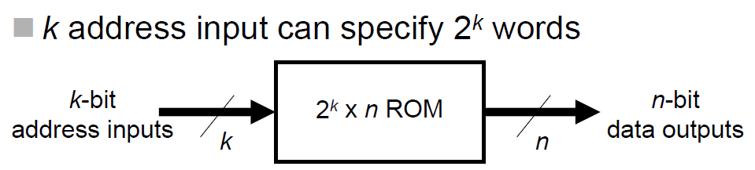
6.2.1 Read-Only Memory (ROM)
An essential memory device in which permanent binary information is stored (even when the power is turned off, the information is still there).
k-bit address inputs and n-bit data outputs
Inputs: address for the memory
Outputs: the word (n data bits) stored in ROM selected by the k-bit input address
k address input can specify 2^{k} words
Features: - advantage of simple and less connections
- disadvantage of doubling the size with an additional input
- cheap for mass production but expensive for development

Slide 5
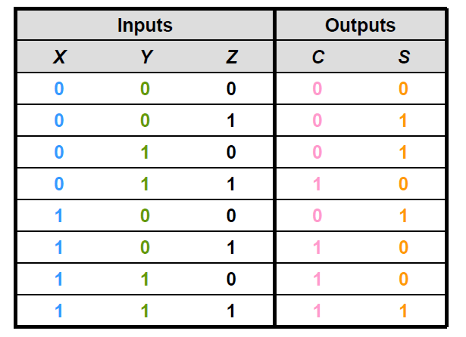
Logic Function by Lockup Table

Slide 6
Other ROMs
ROM usually works as a lookup table
No data inputs as ROM does not have a write operation (only read operation)
ROMs that can be written / rewritten:
    PROM
    EPROM (Erasable PROM)
    EEPROM (Electrically Erasable PROM)
    FEPROM (Field Erasable PROM)
    FLASH Memory

Slide 7
6.2.2 PROM
Programmable Read-Only Memory
Perform same functions as ROM
Oldest programmable logic device
Fuse or anti-fuse programmed
One-time writing process has been deferred to the end-user
Advantage: easy programming and inexpensive
Disadvantage: non-reprogrammable

Slide 8
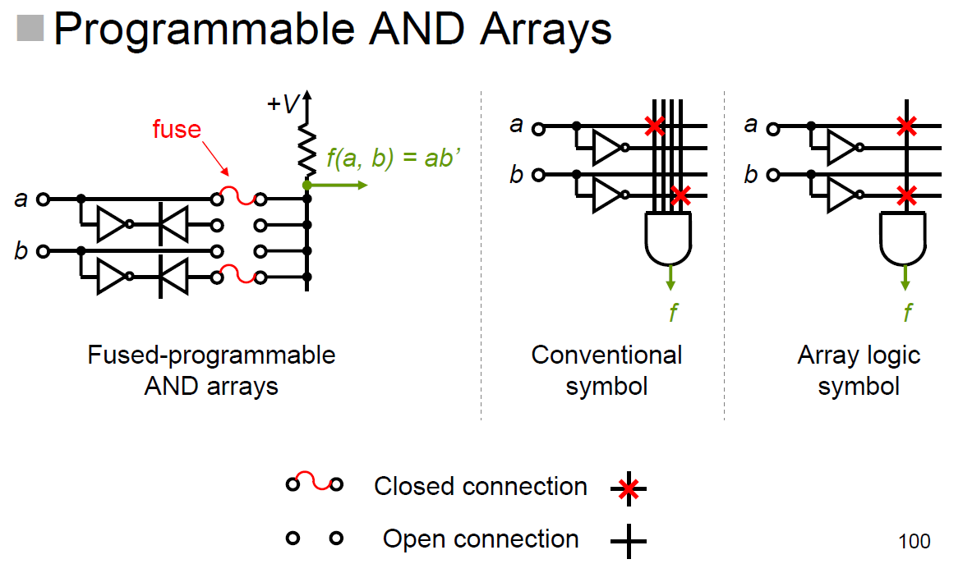
6.3 Fuse-Programmable Arrays

Slide 9
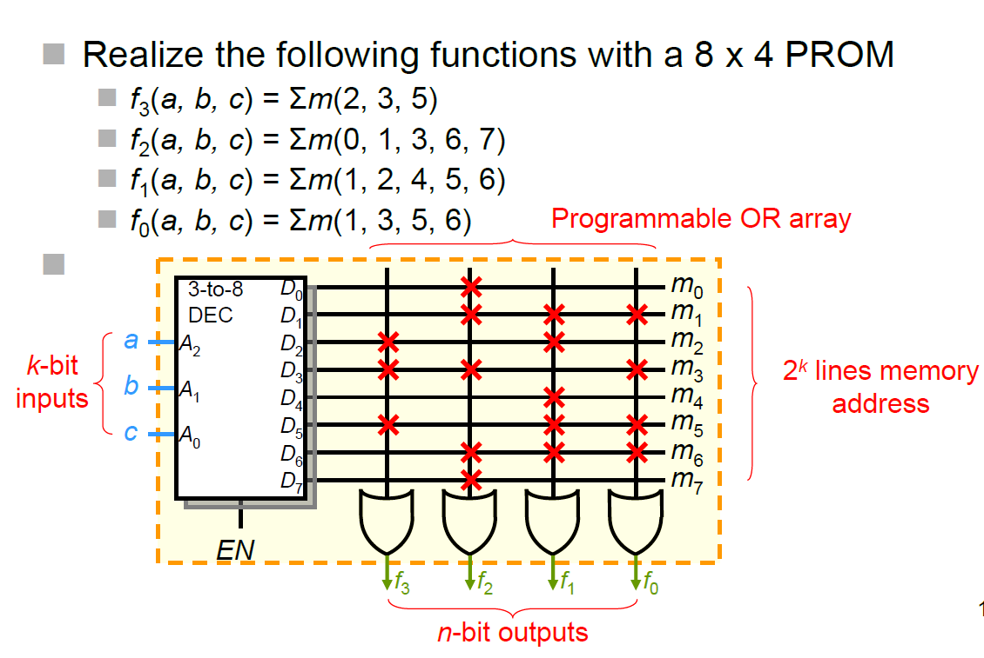
Example: 8 x 4 PROM

Slide 10
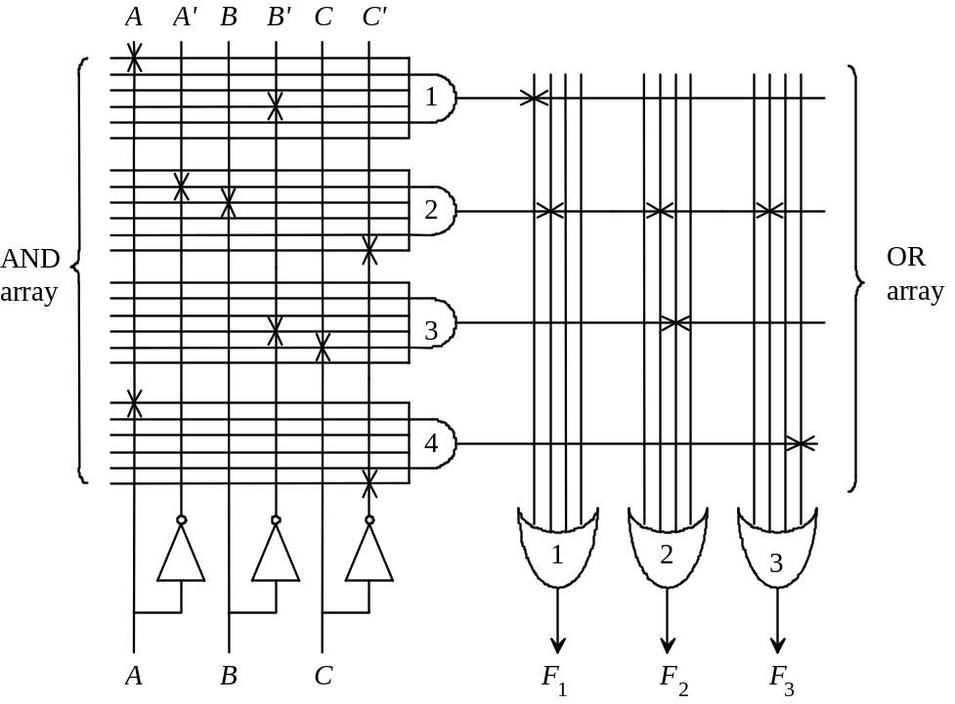
6.4 Programming Logic Array (PLA)
Programmable device similar to PROM but with different internal structure
The device is used to implement logic function in the form of sum-of- product terms

Slide 11
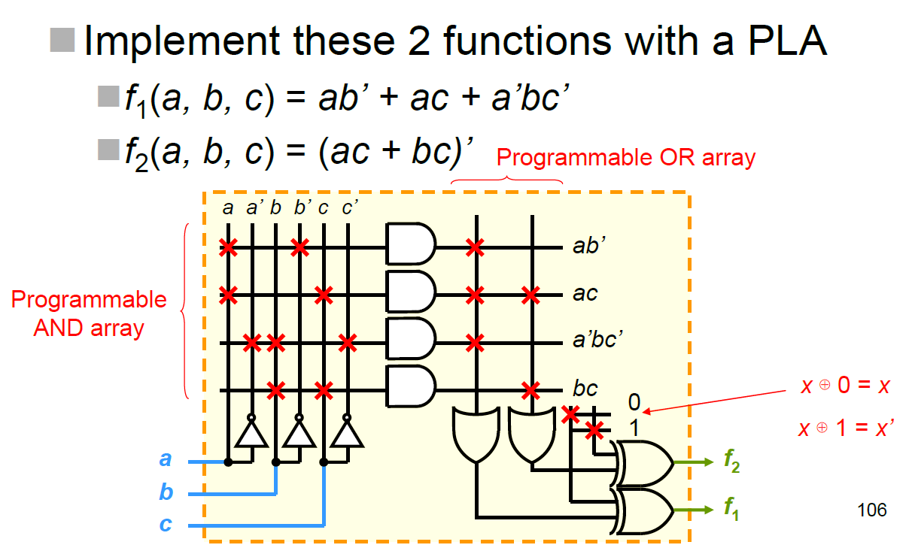
Example: PLA
How many product terms for f₁ and f₂?

Slide 12
Minimization in PLA
Reduce the number of distinct product terms, so as to
Minimize the number of AND gates
Minimize the size of PLA
Step 1) Simplify the Boolean functions, and also their complementary functions to minimum number of terms
Step 2) Find the combination to produce the minimum number of distinct product terms (or maximum common terms)

Slide 13
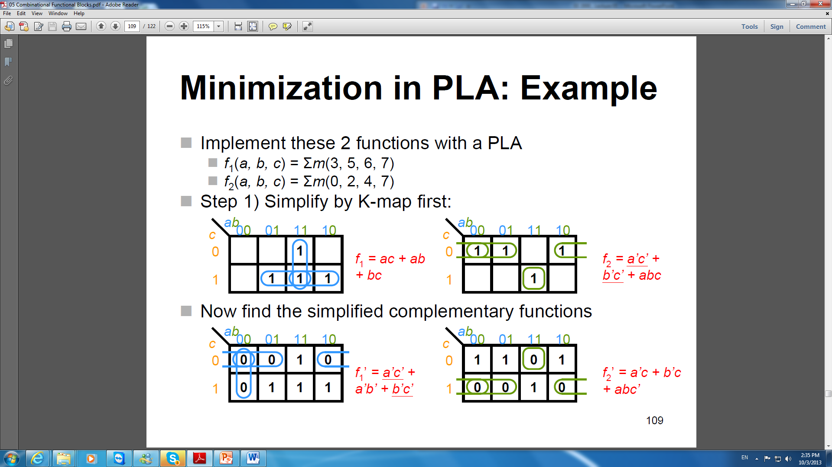

Slide 14
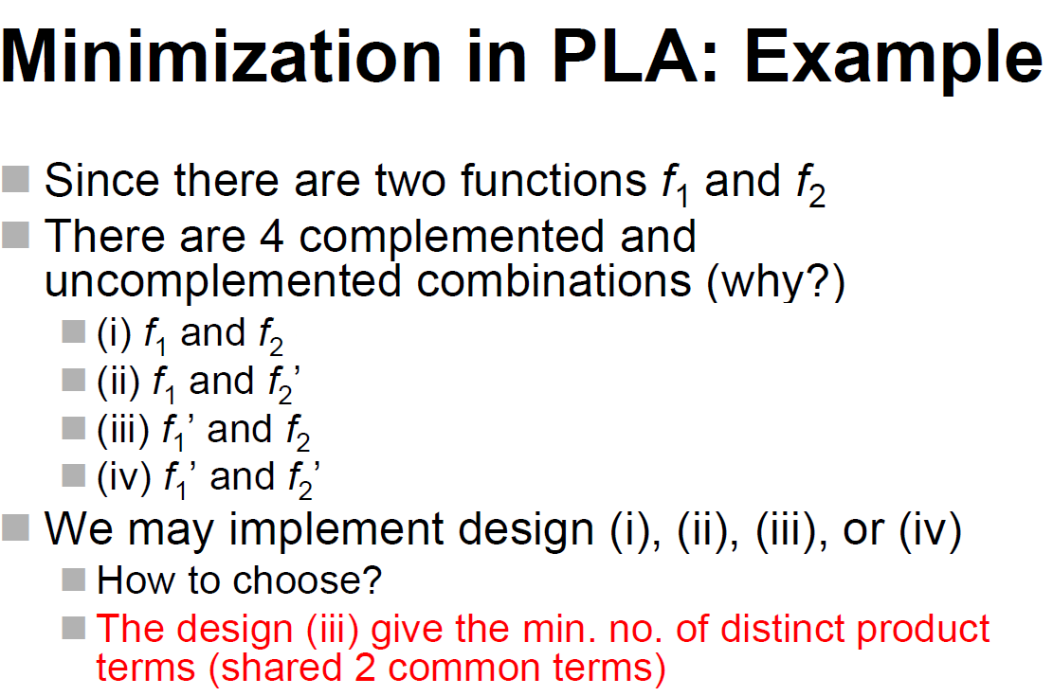

Slide 15
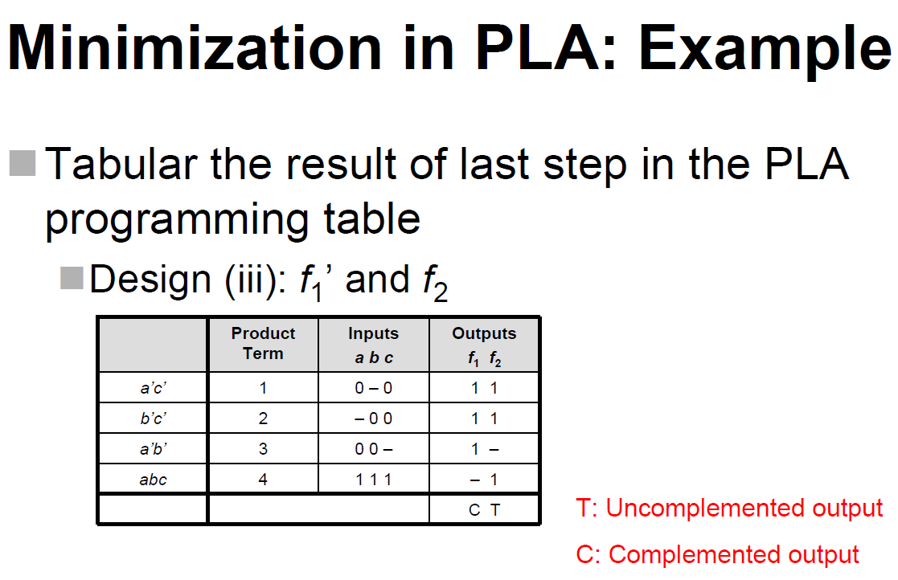

Slide 16
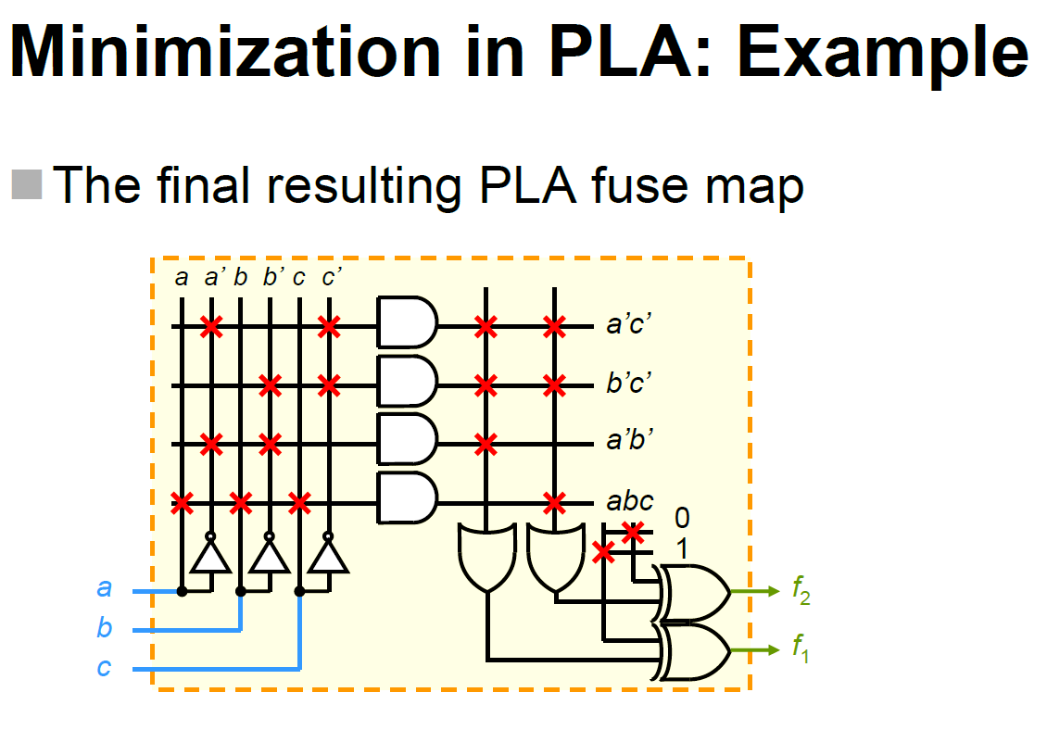

Slide 17
6.5 Programmable Array Logic (PAL)
PLA: both the AND and the OR arrays are programmable
PAL: the AND array is programmable and the OR array is fixed
PLA is a general design for implementing sum-of-product terms, whereas the PAL has fixed sum-of-product terms
Design for PAL device is easier, but not as flexible as that for PLA

Slide 18
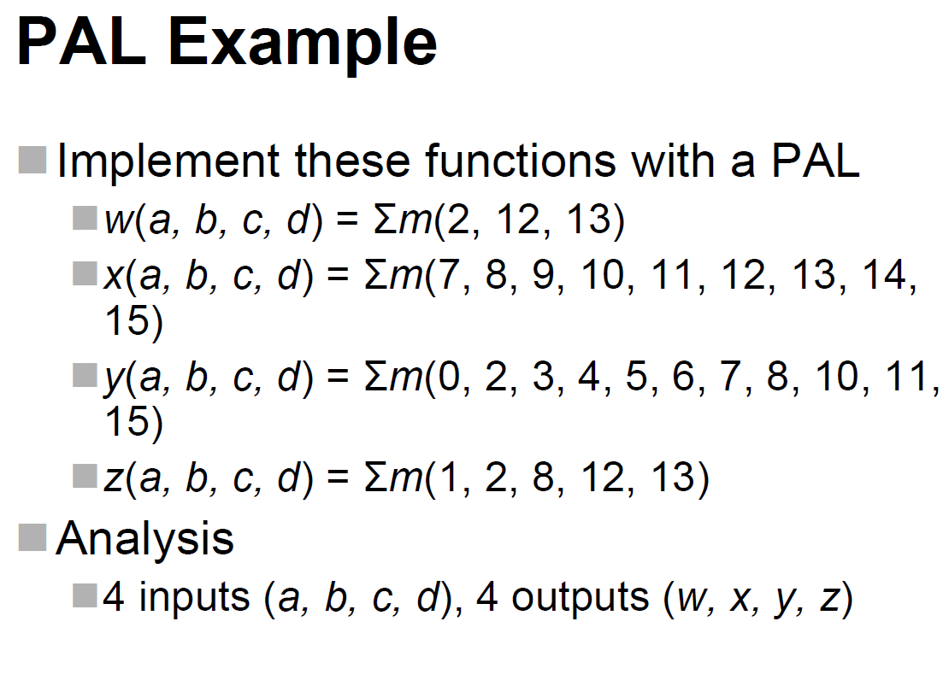

Slide 19
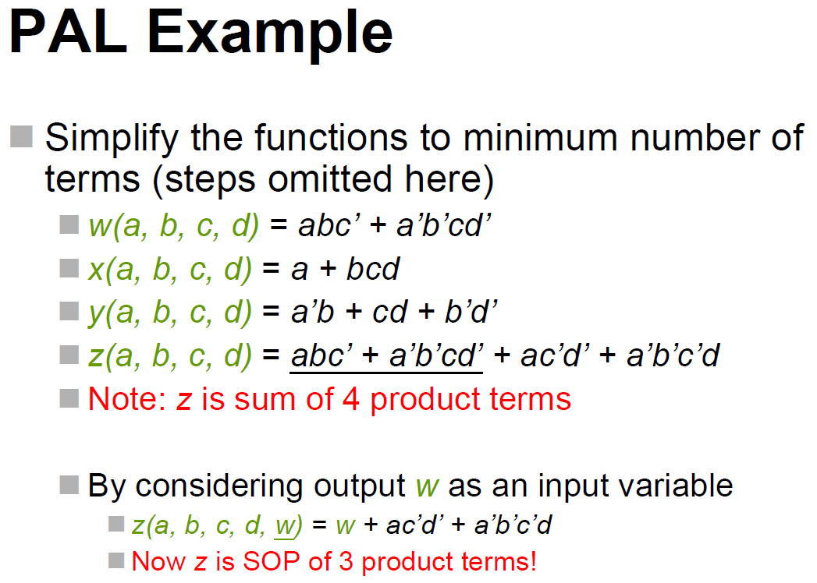

Slide 20
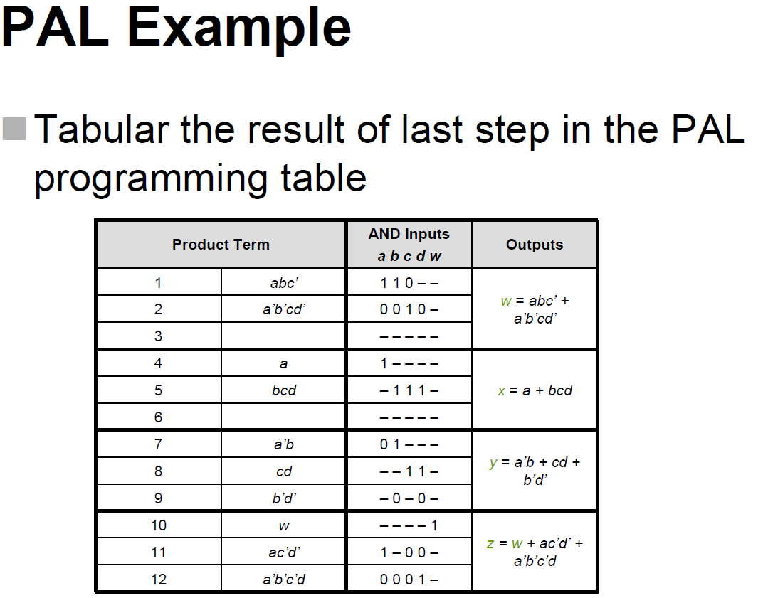

Slide 21
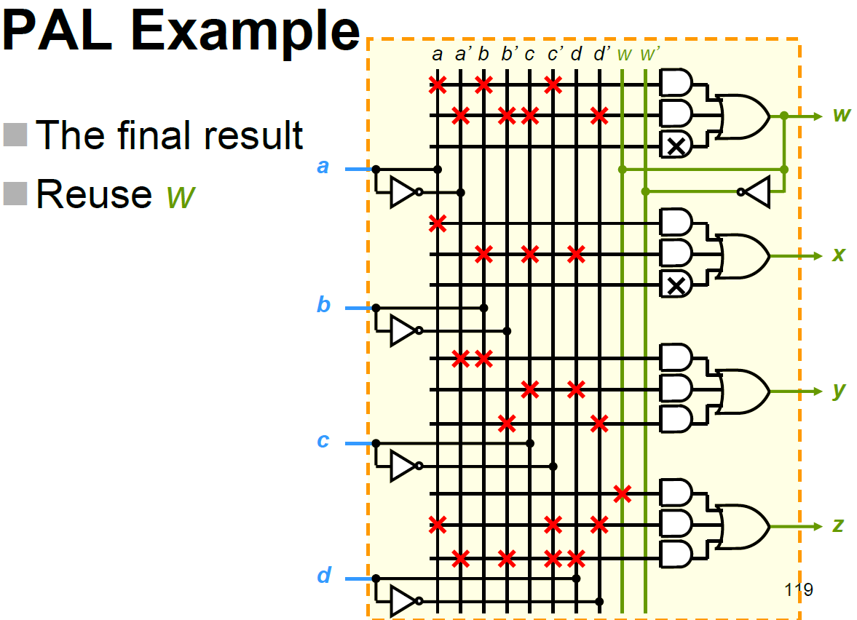

Slide 22
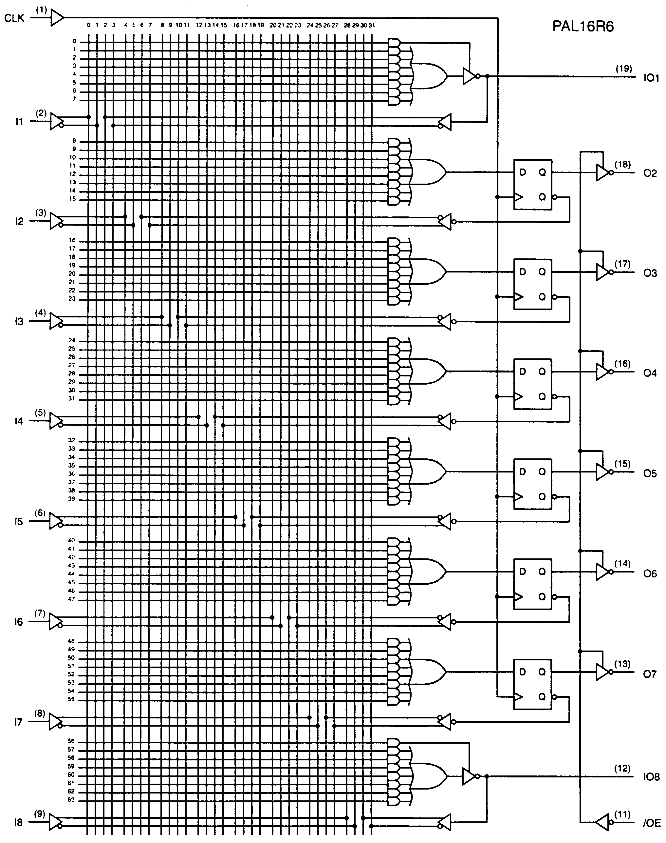
PAL 16R6
A PAL device with 16 inputs,
6 outputs with D-latch (1-bit memory device), and 2 un-buffered outputs
(8 inputs are feedback from outputs)
This device can be used for designing sequential circuit.

Slide 23
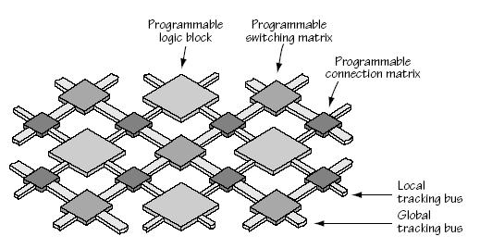
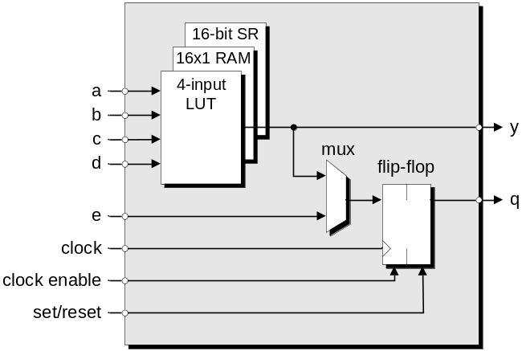
6.6 Field Programmable Gate Array Logic (FPGA)
FPGAs consist of a large number of logic blocks with programmable interconnects in matrix form.
Programmable:
The logic block can be “configured” to create the circuit.
The interconnects can also be “configured” to connect logic blocks together as well as to connect the FPGA pin through I/O blocks.
FPGA Fabric
Logic Block

Slide 24
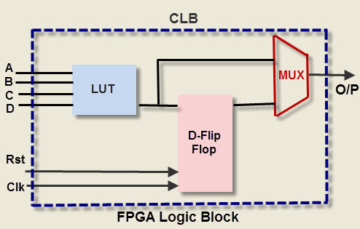
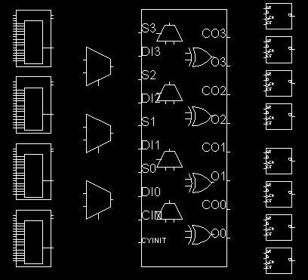
FPGA – Configurable Logic Block
A configurable logic block (CLB) consists of a look-up-table (LUT)
The LUT is for implementing the truth table of a logic function
Additional elements are for control or other functions
Simple basic logic block (in design level)
A typical logic block (in simulator)
24

Slide 25
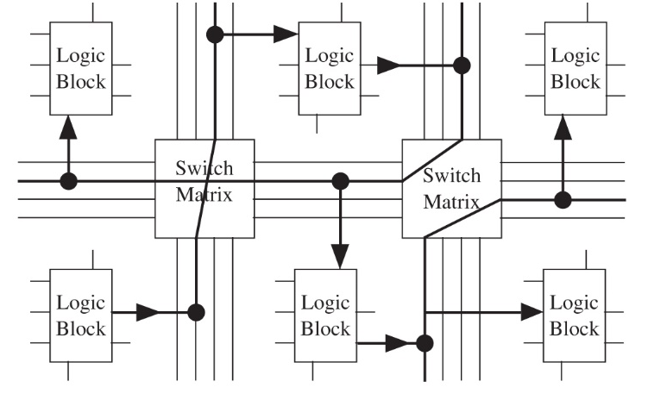
FPGA – Programmable Interconnects
FPGAs use switch matrices to provide interconnects for logic blocks
The connections between logic blocks are achieved by programming the switch matrices to form routing paths
25

Slide 26
FPGA – I/O Standard
The FPGA output may be connected to device with different electrical characteristics.
The FPGA pin I/O standard must be specified.
I/O Standards:
  LVTTL: low-voltage transistor-transistor logic; 3.3-V standard that can tolerate 5-V signals.
  PCI: peripheral component interconnect; has 5-V and 3.3-V versions.
  LVCMOS: low-voltage complementary metal-oxide semiconductor; LVCMOS2, a 2.5-V standard that can tolerate 5-V signals.
  LVPECL: low-voltage positive emitter-coupled logic
  SSTL: stub-series terminated logic
  AGP: advanced graphics port
  CTT: center tap terminated
  GTL: gunning transceiver logic
  HSTL: high-speed transceiver logic
26

Slide 27
FPGA – Design Tools (Lab Session)
FPGA is a programmable device
Use HDL (hardware description language) to describe the circuitry
Doesn’t behave like “normal” programming language ‘C/C++’
Describe Logic as collection of Processes operating in Parallel
Language Constructs for Synchronous Logic
VHDL and Verilog are common HDLs
VHDL and Xilinx Vivado are used in this course
27

Slide 28
FPGA – Design Flow
Create a behavioral, RTL, or structural model of the design in a hardware description language such as VHDL or Verilog.
Simulate and debug the design.
Synthesize the design targeting the desired device.
Run a mapping/partitioning program.
Run an automatic place and route program.
Run a program that will generate the bit pattern necessary to program the FPGA.
Download the bit pattern into the internal configuration cells in the FPGA, and test the operation of the FPGA.
28

Slide 29
FPGA – Top-Down Design
FPGA is particular suitable for digital system design.
A complex system can be made simpler by using hierarchical approach
Split the design in two or more simple design in order to easy handle the complexity
Top Level
Design1
Design2
Sub-design1
Sub-design2
Sub-design3
Sub-design4
Sub-design5
Sub-design6
29

Slide 30
FPGA – VHDL Structural Modeling
Use VHDL module to describe each simple design
Complex Design
Simple
Design 2
Simple
Design N
Simple
Design 1
Simple
Design 3
30

Slide 31
FPGA – VHDL Module
Use Entity and Architecture to describe the each module (circuit)
ENTITY
Architecture 4
Architecture 1
Architecture 3
Architecture 2
Hybrid
Data Flow
Structural
Behavioral
31

Slide 32
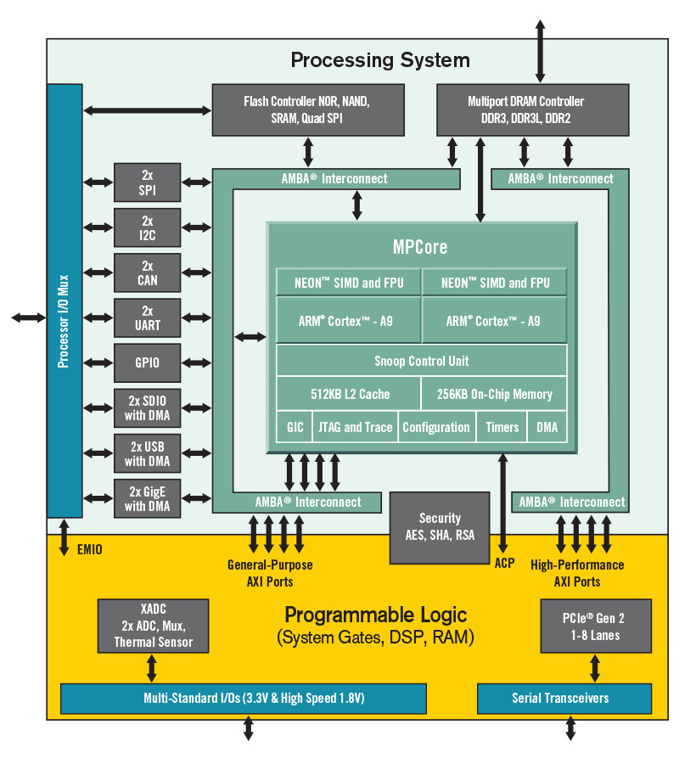
FPGA – System on chip (SoC)
Advanced FPGA chip is integrated with CPU and peripheral controllers for advanced system design.
Programmable logic is provided for customer design.
Zynq-7000 (with two ARM Cortex-A9 processors)

