Slide 1

Chapter 3
Process Description and Control
Operating Systems:
Internals and Design Principles
William Stallings

Slide 2
Roadmap
  How are processes represented and controlled by the OS?
  A flavour of creating a process in UNIX
  Process states which characterize the behaviour of processes
  Data structures used to manage processes
  Ways in which the OS uses these data structures to control process execution
  Discuss process management in UNIX

Slide 3
Applications vs. Processes
All modern OS rely on a model in which the execution of an application corresponds to the existence of one or more processes.
Example: single-user systems such as Windows and mainframe system such as IBM’s mainframe OS, z/OS, are built around the concept of process.

Slide 4
What is a “process”?
A program in execution
An instance of a program running on a computer
The entity that can be assigned to and executed on a processor
A unit of activity characterized by the execution of a sequence of instructions, a current state, and an associated set of system resources

Slide 5
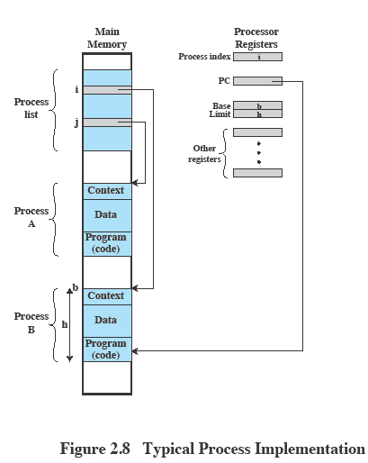
Process Elements
A process is comprised of:
  Program code
    which may be shared with other processes that are executing the same program
  A set of data associated with that code
  Execution context of the program, containing all information the OS needs to manage the process
When the processor begins to execute the program code, we refer to this executing entity as a process.

Slide 6
Requirements of an
Operating System
Fundamental Task: Process Management
The Operating System must
  Interleave the execution of multiple processes
  Allocate resources to processes and protect the resources of each process from other processes
  Enable processes to share and exchange information
  Enable synchronization among processes

Slide 7
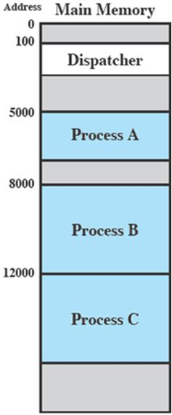
Example: Interleaved Execution of Processes
Consider three processes being executed
Plus a dispatcher - a small program which switches the processor from one process to another
All are in memory

Slide 8
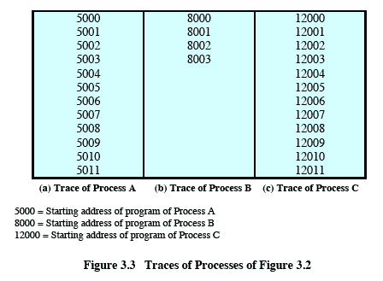
Trace from Processes’
Point of View
The behavior of an individual process can be characterized by listing the sequence of instructions that execute for that process: a trace of the process.

Slide 9
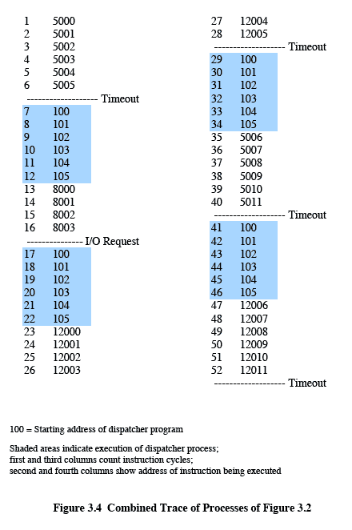
A Combined Trace from Processor’s Point of View
A
D
Timeout
Timeout
Timeout
I/O
D
A
B
D
D
The behavior of the processor can be characterized by showing how the traces of the various processes are interleaved.
C
C

Slide 10
Roadmap
  How are processes represented and controlled by the OS?
  A flavour of creating a process in UNIX
  Process states which characterize the behaviour of processes
  Data structures used to manage processes
  Ways in which the OS uses these data structures to control process execution
  Discuss process management in UNIX

Slide 11
Creating Process in UNIX
A parent process can create a child process by means of the system call, fork( ).
After creating the process, the OS can do one of the following, as part of the dispatcher routine:
  Stay in the parent process
    Control returns to the point of the fork call of the parent
  Transfer control to the child process
    The child process begins executing at the same point in the code as the parent, namely at the return from the fork call
  Transfer control to another process

Slide 12
Creating Process in UNIX
#include <iostream>
#include <unistd.h>
using namespace std;
int x = 10;
int main(void)
{ int pid;
pid = fork(); /* create a new process */
cout << "(1) x = " << x << " in " << pid << endl;
if ( pid == 0 ) {
cout << "(2) x = " << x << " in " << pid << endl;
x = x + 5;
cout << "(3) x = " << x << " in " << pid << endl;
}
cout << "(4) x = " << x << " in " << pid << endl;
}
What is possible output sequence of the program?

Slide 13
Roadmap
  How are processes represented and controlled by the OS?
  A flavour of creating a process in UNIX
  Process states which characterize the behaviour of processes
  Data structures used to manage processes.
  Ways in which the OS uses these data structures to control process execution
  Discuss process management in UNIX

Slide 14
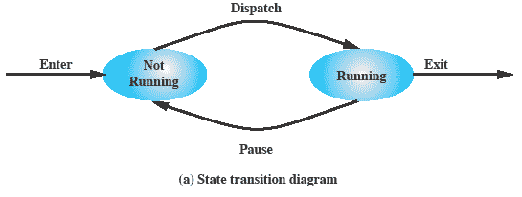
Two-State Process Model
A process is either being executed by a processor or not, so this is the simplest possible model: a process may be in one of two states
  Running
  Not-running
From time to time, the currently running process may be blocked or interrupted and the dispatcher will select some other process to run.
When the OS creates a new process, it enters the process into the system in the Not Running state.

Slide 15
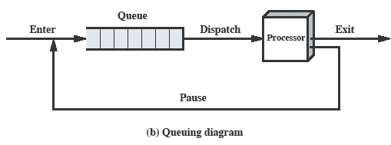
Queuing Diagram
Processes that are not running are kept in some sort of queue, waiting for their turn to execute.
Completed or aborted process
Interrupted process
Processes moved by the dispatcher to the CPU then back to the queue until the process has completed or aborted.

Slide 16
Process Birth and Death
Creation | Termination
New batch job | Normal Completion
Interactive log-on | Memory unavailable
Created by OS to provide a service | Bounds violation
Spawned by existing process | Protection error
 | Arithmetic error
 | Operator or OS Intervention
 | Parent termination
 | Parent request
See tables 3.1 and 3.2 for more

Slide 17
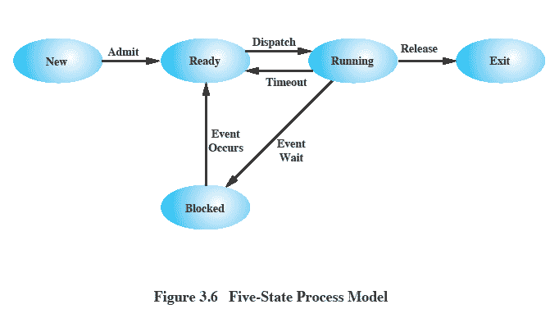
Five-State
Process Model
While some processes in the Not Running state are ready to execute, others may be blocked (e.g., waiting for an I/O operation to complete).

Slide 18
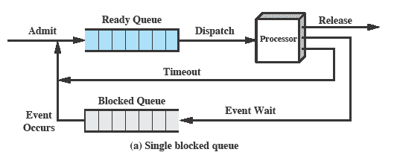
Using Two Queues

Slide 19
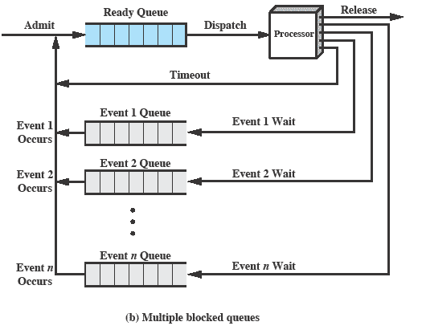
Multiple Blocked Queues

Slide 20
Suspended Processes
Processor is faster than I/O so all processes could be waiting for I/O → processor could be idle most of the time.
  OS swaps one of the blocked processes out on to disk into a suspend queue to free up more memory.
  The OS then brings in another process.
  Execution then continues with the newly arrived process.
Blocked state becomes Suspend state when swapped to disk

Slide 21
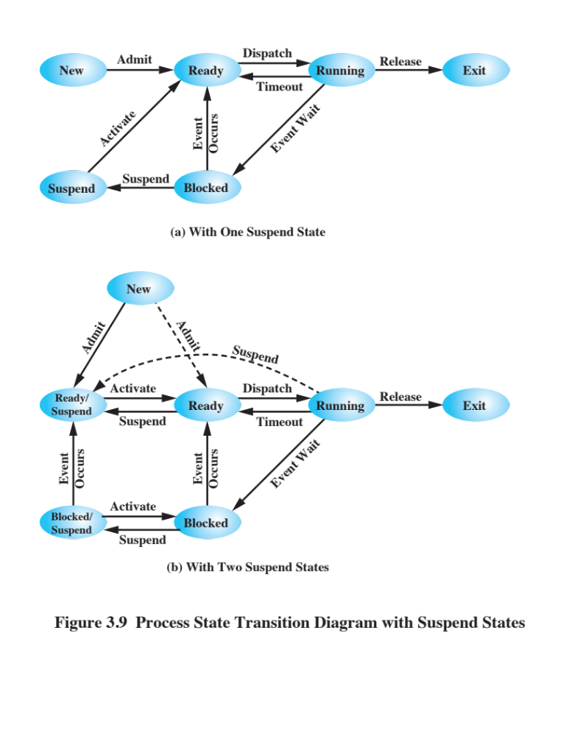
One Suspend State
Although each process in the Suspend state was originally blocked on a particular event, when that event occurs, the process is not blocked and is potentially available for execution.

Slide 22
Two Suspend States
Two new states
  Blocked/Suspend
  Ready/Suspend

Slide 23
Reason for Process Suspension
Reason | Comment
Swapping | The OS needs to release sufficient main memory to bring in a process that is ready to execute.
Other OS Reason | OS suspects process of causing a problem.
Interactive User Request | User may wish to suspend execution of a program for purpose of debugging
Timing | A process may be executed periodically (e.g., an accounting or system monitoring process) and may be suspended while waiting for the next time.
Parent Process Request | A parent process may wish to suspend execution of a descendent to examine or modify the suspended process, or to coordinate the activity of various descendants.
Table 3.3 Reasons for Process Suspension

Slide 24
Roadmap
  How are processes represented and controlled by the OS?
  A flavour of creating a process in UNIX
  Process states which characterize the behaviour of processes
  Data structures used to manage processes
  Ways in which the OS uses these data structures to control process execution
  Discuss process management in UNIX

Slide 25
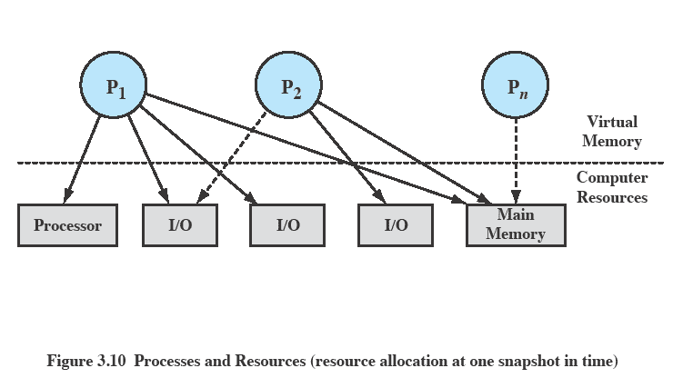
Processes and Resources
OS manages the use of system resources by processes.
P₂ is blocked waiting in memory for an I/O device allocated to P₁
P₁ is running and has 2 I/O devices
P_{n} has been swapped out and is suspended

Slide 26
Operating System
Control Structures
For the OS to manage processes and resources, it must have information about the current status of each process and resource.
Tables are constructed for each entity the OS manages.
What information does the OS need to control processes and manage resources for them?

Slide 27
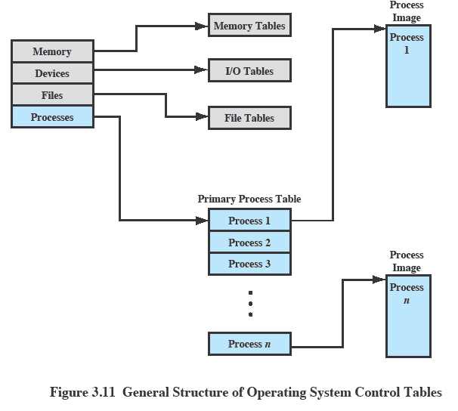
OS Control Tables

Slide 28
Memory Tables
Memory tables are used to keep track of both main (real) and secondary (virtual) memory.
Must include this information:
  Allocation of main memory to processes
  Allocation of secondary memory to processes
  Protection attributes of blocks of main or virtual memory such as which processes may access certain shared memory regions
  Information needed to manage virtual memory

Slide 29
I/O Tables
Used by the OS to manage the I/O devices and channels of the computer.
At any given time, an I/O device may be available or assigned to a particular process.
If an I/O operation is in progress, the OS needs to know:
  The status of the I/O operation
  The location in main memory being used as the source or destination of the I/O transfer

Slide 30
File Tables
These tables provide information about:
  Existence of files
  Location on secondary memory
  Current status
  other attributes.
Sometimes this information is maintained by a file management system

Slide 31
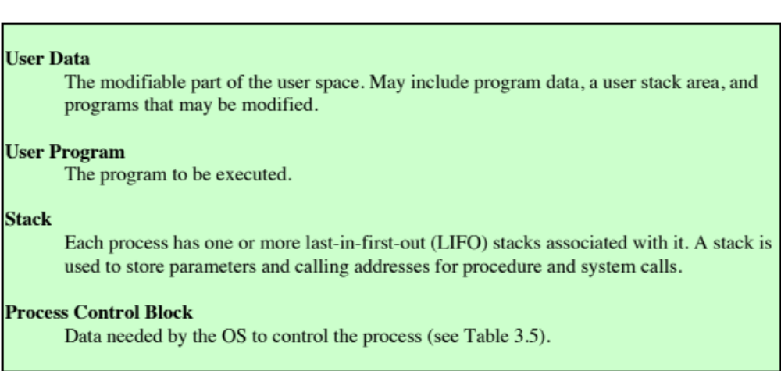
Process Table
To manage and control a process, there is one entry for each process in the process table.
Each entry points to a process image containing:

Slide 32
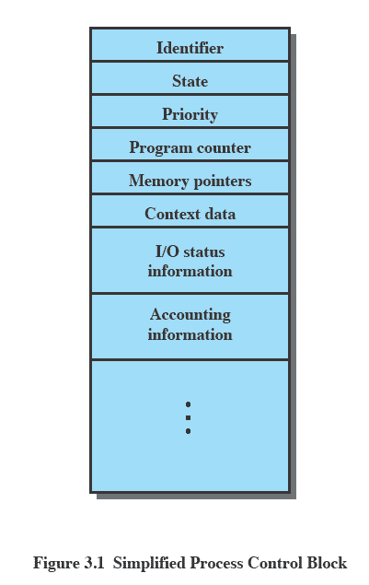
Process Control Block
Each process has associated with it a number of attributes that are used by the OS for process control.
The attributes are stored in a data structure called a process control block (PCB), created and managed by the OS.
It contains sufficient information so that it is possible to interrupt a running process and later resume its execution.

Slide 33
Process Attributes
We can group the information in a PCB into three general categories:
  Process identification
  Processor state information
  Process control information

Slide 34
Process Identification
Each process is assigned a unique numeric identifier.
  Many of the tables controlled by the OS may use process identifiers to cross-reference process tables, e.g., memory tables may be organized to provide a map of main memory with an indication of which process is assigned to each region
  When processes communicate with one another, the process identifier informs the OS of the destination of a particular communication
  When processes are allowed to create other processes, identifiers indicate the parent and descendants of each process

Slide 35
Processor State
Information
Consists of processor registers’ content
  User-visible registers
  Control and status registers
    Program counter: address of the next instruction
    Program status word (PSW)
      Condition codes: result of the most recent arithmetic or logical operation (e.g., sign, zero, carry, equal, overflow)
      Status information: e.g., interrupt enabled/disabled flags, execution mode
  Stack pointers

Slide 36
Process Control
Information
The additional information needed by the OS to control and coordinate the various active processes
  Process state
  Priority
  Scheduling-related info
  Waiting event
  Data structuring
  … (see Table 3.5 for scope of information)

Slide 37
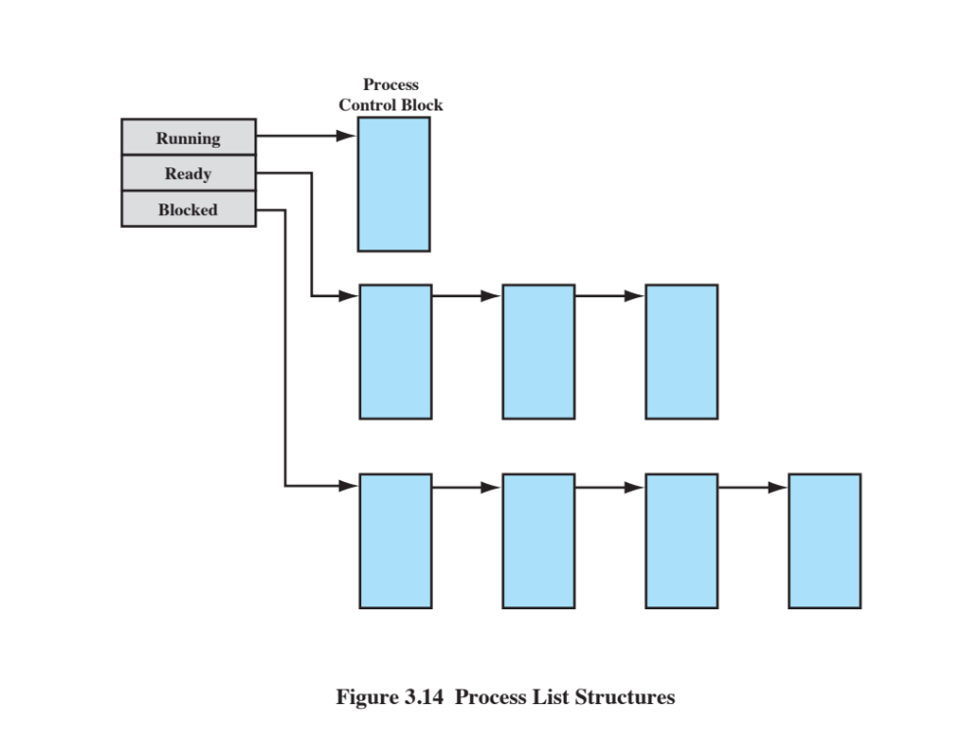
Process List Structures
The queuing structure could be implemented as linked lists of PCBs in which pointers can be stored in the PCBs (structuring information).

Slide 38
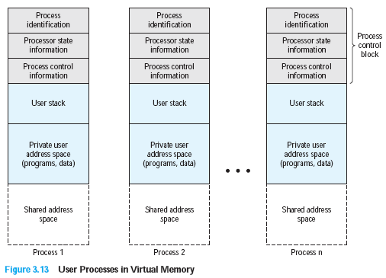
Structure of Process
Images in Virtual Memory
Figure 3.13 User Processes in Virtual Memory
(assume the whole process image in a contiguous range of addresses)

Slide 39
Role of the
Process Control Block
PCB is the most important data structure in an OS
  Contains all of the information about a process that is needed by the OS
  Read and/or modified by virtually every module in the OS such as scheduling, resource allocation, interrupt processing and performance monitoring
  Defines the state of the OS
PCB requires protection, which is difficult
  A faulty routine could damage PCBs, which could destroy the OS’s ability to manage the affected processes
  Any design change to the PCB could affect many modules of the OS

Slide 40
Roadmap
  How are processes represented and controlled by the OS
  A flavour of creating a process in UNIX
  Process states which characterize the behaviour of processes
  Data structures used to manage processes
  Ways in which the OS uses these data structures to control process execution
  Discuss process management in UNIX

Slide 41
Modes of Execution
Most processors support at least two modes of execution to protect the OS and key OS tables from interference by user programs.
User mode
  Less-privileged mode
  User programs typically execute in this mode
System mode (control mode or kernel mode)
  More-privileged mode
  Kernel of the operating system (central module of an OS)
    Loads first when the system starts
    Resides in memory (in a protected area) all the time

Slide 42
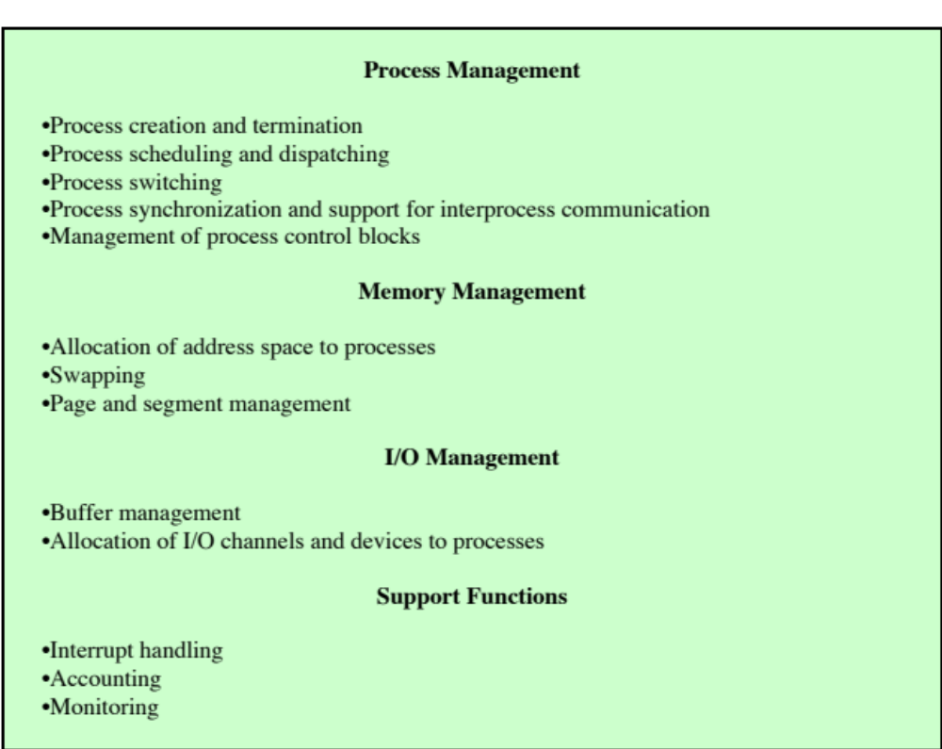
Typical Functions of an OS Kernel

Slide 43
Process Creation
Once the OS decides to create a new process, it:
  Assigns a unique process identifier and adds a new entry to the process table
  Allocates space for the process (process image)
  Initializes process control block
  Sets up appropriate linkages such as putting the new process in the Ready list
  Creates or expands other data structures such as an accounting file for performance assessment

Slide 44
Process Switching
When CPU switches to another process, the system must save the state of the old process and load the saved state for the new process (to be described).
Process-switch time is considered as overhead (the system does no useful work while switching), so several issues are important
  What events trigger a process switch?
  What must the OS do to the various data structures to achieve such a process switch?

Slide 45
When to Switch Processes
A process switch may occur any time that the OS has gained control from the currently running process. Possible events giving OS control are:
Mechanism | Cause | Use
Interrupt | External to the execution of the current instruction, e.g., clock interrupt, I/O interrupt. | Reaction to an asynchronous external event
Trap | Associated with the execution of the current instruction, e.g., illegal file access | Handling of an error or an exception condition
System call (or supervisor call) | Explicit request, e.g., file open | Call to an operating system function
Table 3.8 Mechanisms for Interrupting the Execution of a Process

Slide 46
System Calls
Mostly accessed by programs via a high-level Application Programming Interface (API).
#include <stdio.h>
#include <string.h>
#include <iostream>
using namespace std;
int main ()
{ char ch;
string s="";
ch=getchar();
while (ch!='.'){
s+=ch;
ch=getchar();
}
cout << "Your input is: " << s << endl;
}
You can use command:
pgrep –f [program name]
to find the PID of this running program in UNIX.
Then use command
strace –pPID
to find all involved system calls of this program.
You will find getchar() will make read(…) system call and cout will make write (..) system call

Slide 47
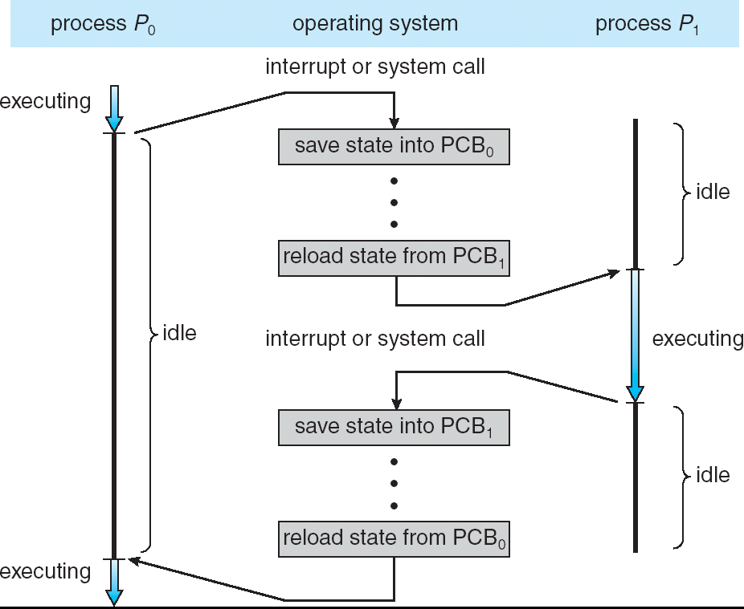
Process Switching

Slide 48
Process Switching
The steps in a process switch are:
  Save context of processor including program counter and other registers
  Update the PCB of the process currently in the Running state
  Move the PCB of this process to appropriate queue – ready; blocked; ready/suspend
  Select another process for execution
  Update the PCB of the process selected
  Update memory management data structures
  Restore context of the processor to that which existed at the time the selected process was last switched out.

Slide 49
Mode Switching
The occurrence of an interrupt does not necessarily mean a process switch.
It is possible that, after the processor switches from user mode to kernel mode in order to execute the interrupt handler (which may include privileged instructions), the currently running process will resume execution.
In such a mode switching case, only need to save / restore the processor state information.

Slide 50
Roadmap
  How are processes represented and controlled by the OS
  A flavour of creating a process in UNIX
  Process states which characterize the behaviour of processes
  Data structures used to manage processes
  Ways in which the OS uses these data structures to control process execution
  Discuss process management in UNIX

Slide 51
Unix
System processes run in kernel mode
  executes operating system code to perform administrative and housekeeping functions
User processes
  operate in user mode to execute user programs and utilities
  operate in kernel mode to execute instructions that belong to the kernel
  enter kernel mode by issuing a system call, when an exception is generated, or when an interrupt occurs

Slide 52
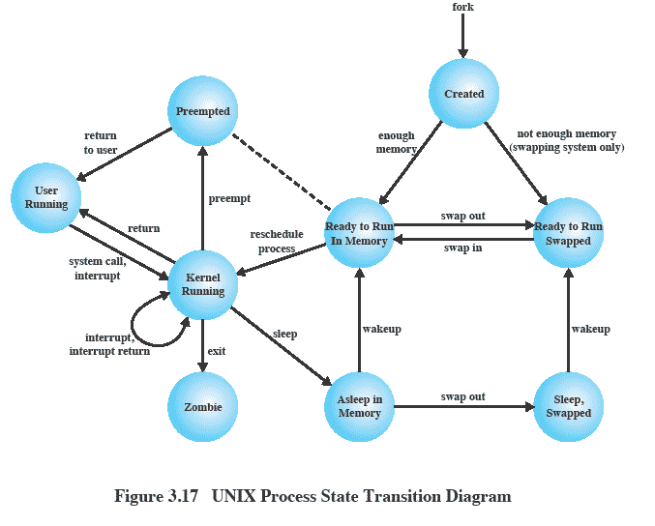
UNIX Process State Transition Diagram

Slide 53
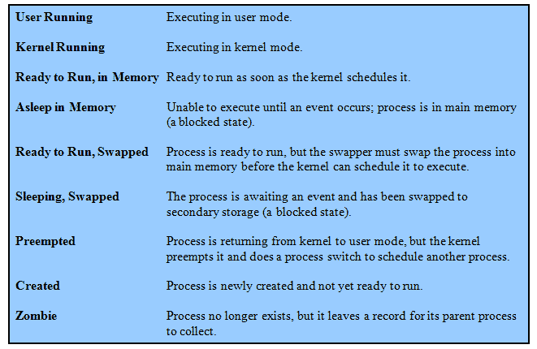
UNIX Process States

Slide 54
Deep Dive:
Process Creation in Unix
Process creation is by means of the kernel system call, fork( ).
This causes the OS, in kernel mode, to:
  Allocate a slot in the process table for the new process.
  Assign a unique process ID to the child process.
  Make a copy of the process image of the parent, with the exception of any shared memory.
  Increment counters for any files owned by the parent, to reflect that an additional process now also owns those files.
  Assign the child process to the Ready to Run state.
  Return the ID number of the child to the parent process, and a 0 value to the child process.

Slide 55
After Creation
After creating the process, the Kernel can do one of the following, as part of the dispatcher routine:
  Stay in the parent process
    Control returns to user mode at the point of the fork call of the parent
  Transfer control to the child process
    The child process begins executing at the same point in the code as the parent, namely at the return from the fork call
  Transfer control to another process
    Both parent and child are left in the Ready to Run state

Slide 56
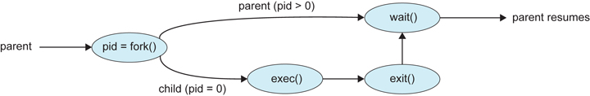
Is there any difference of the program output if the following change is made to the if statement?
#include <iostream>
#include <unistd.h>
using namespace std;
int x = 10;
int main(void)
{ int pid;
pid = fork(); /* Spawn a new process */
cout << "(1) x = " << x << " in " << pid << endl;
if ( pid == 0 ) {
cout << "(2) x = " << x << " in " << pid << endl;
x = x + 5;
cout << "(3) x = " << x << " in " << pid << endl;
}
cout << "(4) x = " << x << " in " << pid << endl;
}
if ( pid == 0 ) {
…
}
else wait (NULL);

