Slide 1
EE2203 Modelling Techniques
Week 11
Variable Selection

Slide 2
Overview
To do variables selection, need:
  A general test
  Selection criteria
  A selection process

Slide 3
General test
P variables are in equation, want to test if Q additional variables are useful
  Test H₀: Q additional variables are useless, i.e. their β’s all = 0, vs.
  H_{a}: Q additional variables are useful
Terminology:
  H_{a} is called the full model
  H₀ is called the reduced model

Slide 4
Likelihood Ratio (Deviance ) test
Use the LR (deviance) test:
  Deviance = -2 log likelihood
  Under H₀, deviance = D₀, df₀ = N-P-1
  Under H_{a}, deviance = D_{a}, df_{a} = N-P-Q-1
LR (deviance) test statistic is:
  D₀ – D_{a} is distributed approximately as χ² with Q degrees of freedom under H₀ for large N

Slide 5
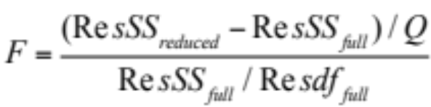

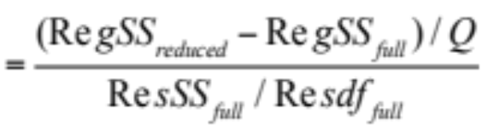
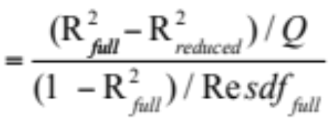
Likelihood Ratio (Deviance) test:
Exact F test
If we assume normally distributed residuals, the LR test becomes an exact F test

Slide 6
Example: Chemical Companies
Y = P/E = price to earnings ratio
X₁ = D/E = debt to equity ratio
X₂, X₃, …, X₆ = other variables
Test
  H₀: X₁ is as good as X₂, …, X₆ in predicting Y,
  i.e.,
  H_{a}: X₂, X₃, …, X₆ are useless in predicting Y when included with X₁

Slide 7
Computation
Full model has all six X variables
Reduced Model has X₁ only
  RessSS_{full} = 103.06, ResSS _{reduced} = 176.08
  Q = 6 – 1 = 5, Resdf _{full} = 30 – 6- = 23
  F = 3.26, df = 5, 23
  P-value < 0.025
Conclusion: reject H₀ and conclude that X₁, X₂, …, X₆ are better than X₁ alone

Slide 8
Variable Selection
Choose subset of X variables to best “explain” or predict the dependent variable
Criteria for selection involve balancing conciseness (no unnecessary variables) and goodness of fit, i.e. R²
Most useful in exploratory situations

Slide 9
Multiple R²
R²: including more variables gives higher (or the same) multiple correlation
R² is biased: if population R² is really zero, then E(R²) = P/(N-1)
  E.g. 1: N=100, P=1, E(R²) = 0.01
  E.g. 2: N=21, P=10, E(R²) = 0.5 !
Selection criteria
  Need ones that can weed out useless variables
  R² does not do it

Slide 10
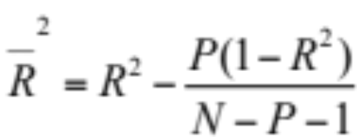
Adjusted R²
R² = ResSS/TotSS → biased
  Note: R² = 1 – ResSS/TotSS
To alleviate bias: use MS instead of SS
  Adjusted R² = 1 – ResMS/TotMS
  Adjusted R² is approximately unbiased

Slide 11
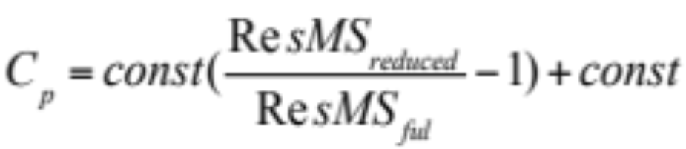
Mallows C_{p}
Compares MSE of reduced model to full model:
The smaller C_{p}, the better

Slide 12
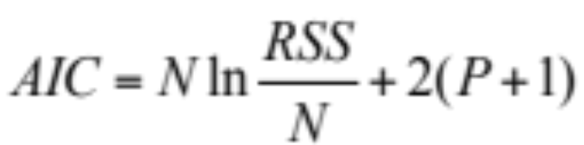
Akaike Information Criterion (AIC)
Similar to C_{p}
Tries to find a parsimonious model that is closer to the “truth”. The smaller AIC, the better
Uses an information function, e.g., the likelihood function
AIC=-2loglikelihood + 2*(# of parameters)

Slide 13
Bayesian Information Criterion (BIC)
Similar to AIC
Tries to find a parsimonious model that is more likely to be the “truth”. The smaller BIC, the better
BIC = -2loglikelihood + ln(N)*(# of parameters)
= -2loglikelihood + ln(N)*(P+1)

Slide 14
AIC versus BIC
Both are “penalized likelihood” functions
Each = -2loglikelihood + penality
AIC: penalty = 2, BIC: penalty = ln(N)
For any N>7, ln(N) > 2
  Therefore, BIC penalizes larger models more heavily
They often agree
When they disagree, AIC chooses a larger model than BIC

Slide 15
Variable selection procedures:
Stepwise Regression
Forward selection: X variables added one at a time until optimal model reached
Backward elimination: X variables removed one at a time until optimal model reached
Stepwise selection: combines the two

Slide 16
Selection process:
Forward Selection
Start with no X variables
Step 0: compute simple R’s of Y with each X_{i}, and corresponding p-values
Step 1: enter variable with highest |R| (smallest p-value)
  Compute partial R (or B) of Y with each other X, given X in, and corresponding p-values (p to enter)

Slide 17
Forward selection (cont’d)
Step 2: enter variable with smallest p to enter
  Compute partial R (or B) of Y with each other X, given X’s in, and corresponding p to enter
Steps 3, 4, ….: enter variable with smallest p to enter
  Compute partial R of Y with other X’s, given X’s in, and corresponding p to enter
Repeat till smallest p to enter > cutoff value
P-value cutoff
  Cutoff for p to enter = 0.15

Slide 18
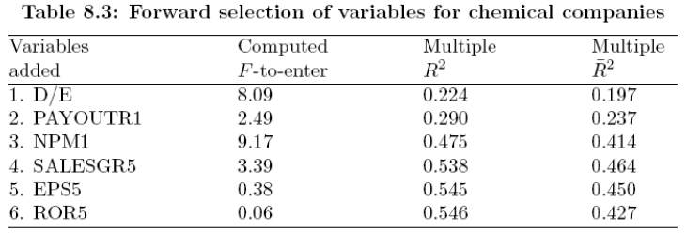
Example:
Forward Selection
P-values:
  Step 1 = 0.008, step 2 = 0.13, step 3 = 0.006,
  Step 4 = 0.08, step 5,6 > 0.50
Select the first 4 variables (D/E, PAYOUTR1, NPM1, SALESGR5)

Slide 19
Selection process:
Backward Selection (Elimination)
Start with all X variables
Step 0: compute partial R of Y with each X, given all other X’s, and corresponding p-values (p to remove)
Step 1: remove variable with lowest |partial R| (highest p to remove)
  Compute partial R of Y with each reminaing X, given other X’s in , and corresponding p to remove

Slide 20
Backward selection (cont’d)
Step 2: remove variable with highest p to remove
  Compute partial R (or B) of Y with other X’s, given other X’s in, and corresponding p to remove
Step 3, 4, …: remove variable with highest p to remove
  Compute partial R of Y (or B) with other X’s, given other X’s in, and corresponding p to remove
Repeat till highest p to remove < cutoff value
P-value cutoff
  Cutoff for p to remove = 0.30

Slide 21
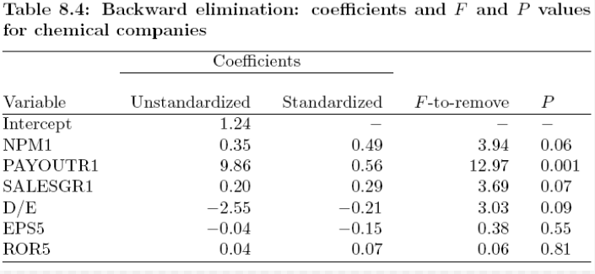
Example:
Backward Elimination
This is step 1: remove ROR5
Continue process

Slide 22
Full stepwise selection
Start with forward selection
At each step, look at variables in and check if you should remove some
Repeat till no X can be added or removed

Slide 23
Best subset selection
Select one X with highest simple R with Y
Select two X’s with highest multiple R with Y
Select three X’s with highest multiple R with Y etc.
Compute C_{p}, adjusted R², AIC or BIC each time
Compare and choose among the “best subsets” of various sizes

Slide 24
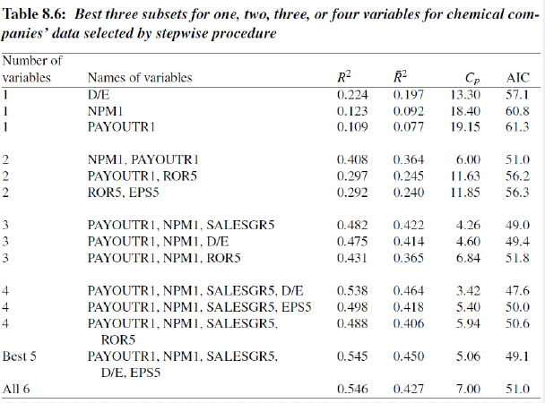
Example:
Chemical companies’ data, Y=P/E

Slide 25
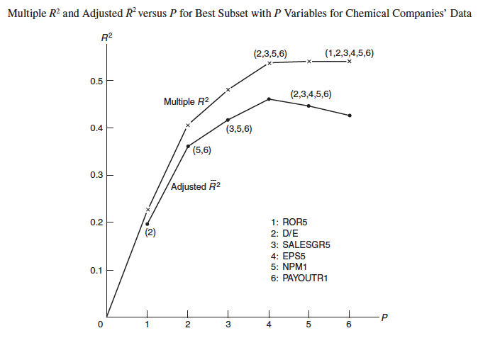
Multiple R² and Adjusted R² versus P

Slide 26
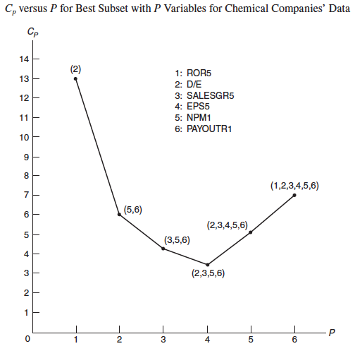
C_{p} vs. P

Slide 27
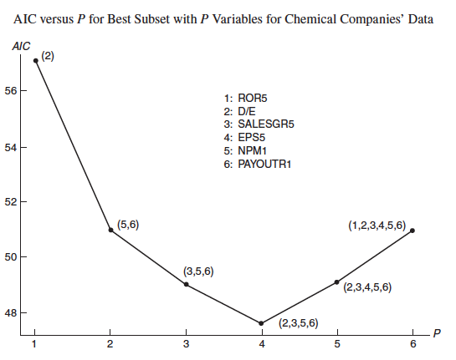
AIC vs. P

Slide 28
More on variable selection
Can also enter and remove variables in blocks
  E.g. dummy variables representing a nominal X
Can force some variables in

Slide 29
Model validation
Check selected model via cross-validation
  Randomly split the sample into training sample (3/4) and validation sample (1/4) or (2/3 vs. 1/3)
  Compute regression equation from training sample
  Use that equation to compute predicted values in validation sample
  Compute simple R of observed and predicted Y in validation sample and compare it with multiple R in training sample
  Compare residuals in two samples
Can also do this many times (1000?) and take the average R

Slide 30
What to watch out for
Use previous research as a guide
Variables included can bias the results
Significance levels are only a guide
Perform diagnostics after selection
Use common sense:
  A suboptimal subset may make more sense than optimal one

Slide 31
Acknowledgement
Textbook: Chapter 8, Abdelmonem Afifi, Susanne May, Virginia A. Clark. Practical Multivariate Analysis. Fifth Edition. CRC Press Taylor & Francis Group
Thanks Professor Afifi for his courtesy to share the materials
Thanks our teaching assistance team for preparing the tutorial materials

