Slide 1
Blueprint Assignment Example
GE 2410
English for Engineering

Slide 2

A professionally produced cover page:
It bears the title of the document which includes the client’s name
It specifies the company which prepared document.
The design is professional enough and the picture shows the nature of the context for which the solution is developed.

Slide 3
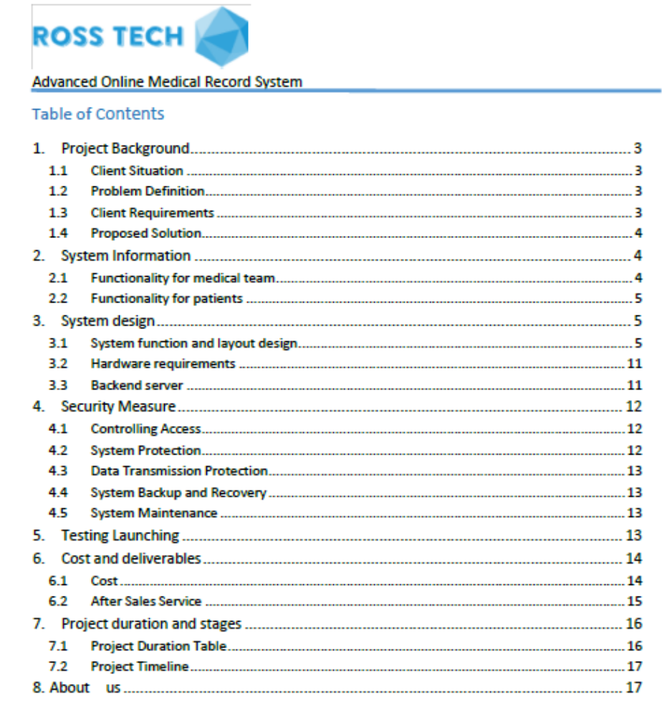
A well-formatted ToC.
The writers remembered to use the plural form of the “contents” (many students tend to skip the plural marker).
S

Slide 4
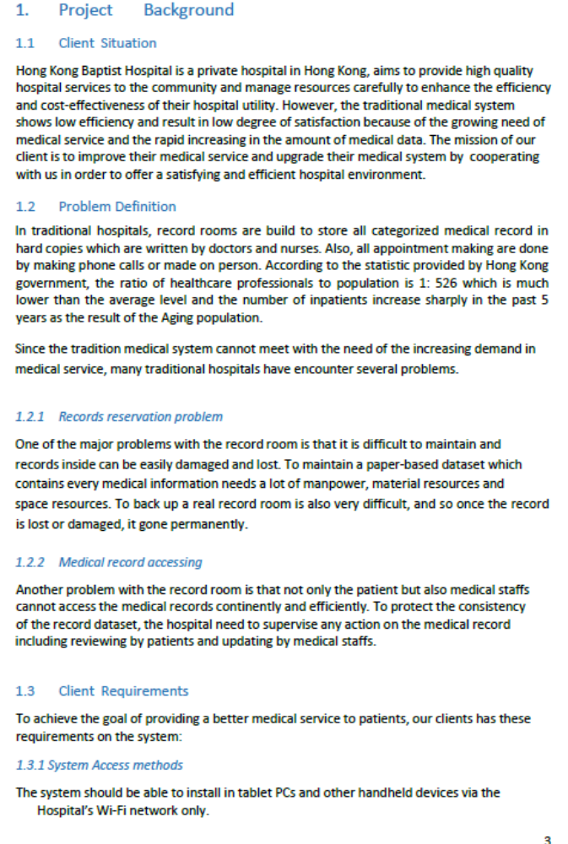
A detailed description of the client’s problem, and the specifications of the required solution (based on information collected in the Info Gap Activity in Lesson 8).
Important: The information summarized reflects the team’s effort to find out and their understanding of the client’s needs.

Slide 5
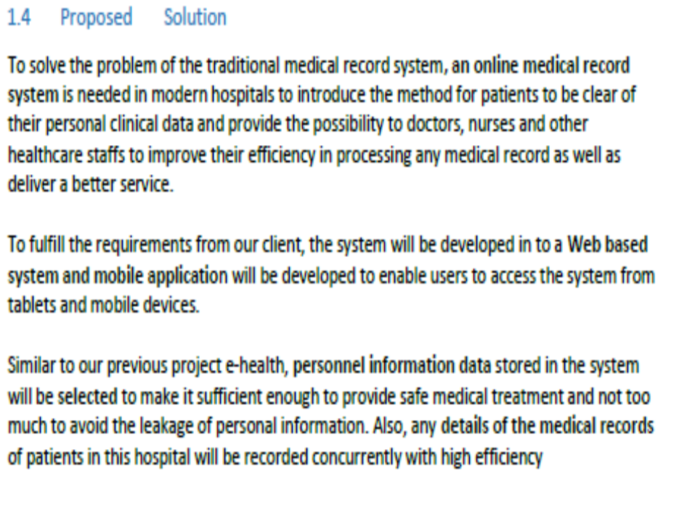
A useful overview of the solution.
Why is an overview needed here?
Important: The description indicates the team’s awareness of the purpose and the audience of the blueprint.
It’s not for a generic problem described in the seminar but a customized solution for HK Baptist Hospital

Slide 6
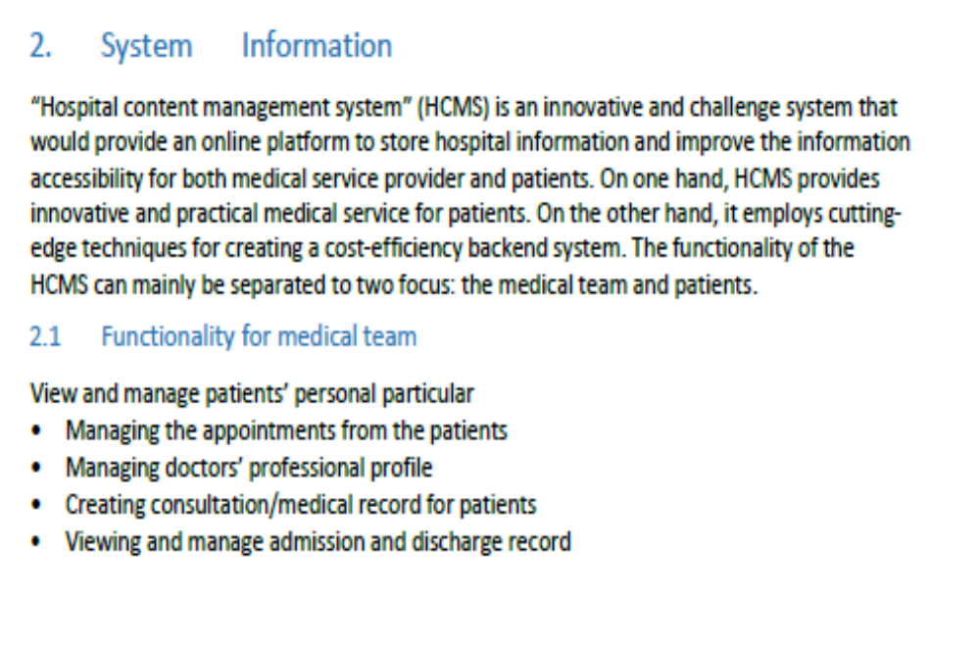
Detailed description of the solution design

Slide 7
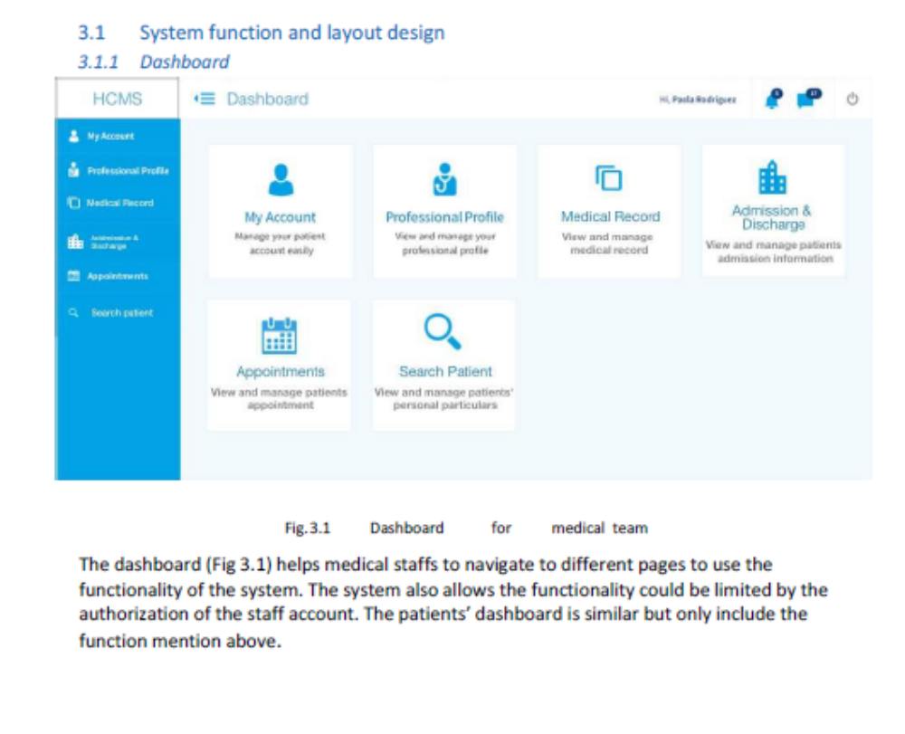
Use of graphics to illustrate the solution
Graphics are referred to so that the reader knows when to study the graphics and what they are for.

Slide 8
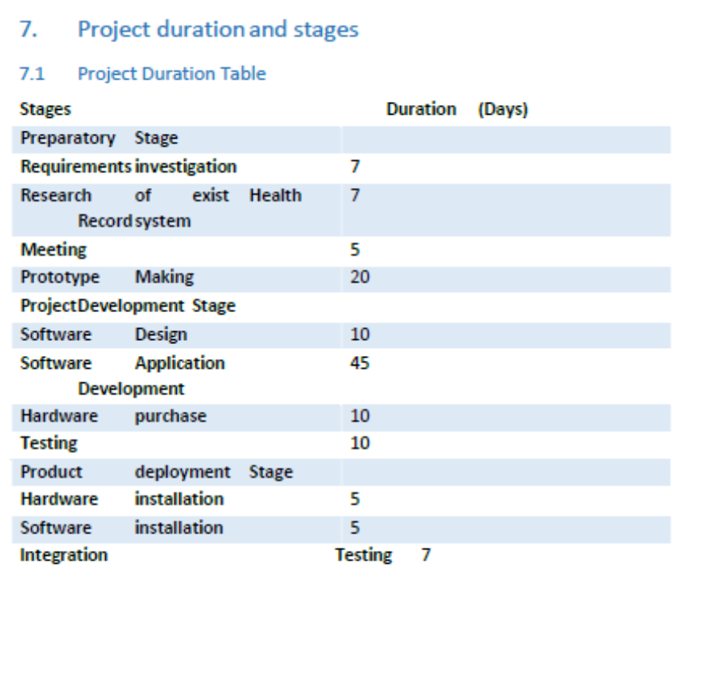
Stages of work quite realistic and succinctly presented in a table.
But the formatting (spacing/alignment) of each stage can be improved.
The table should have been provided with a number and a caption.

Slide 9
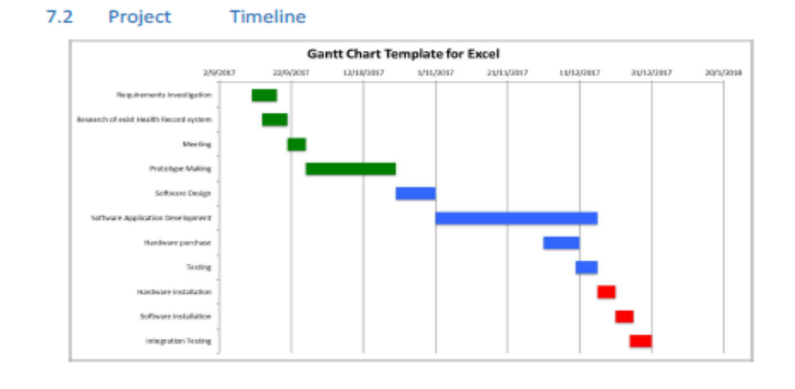
Use of a Gantt chart to to show the schedule of work

