Slide 1
EE1004
Fndt'n of IS & Data Anlys

Slide 2
Assessments:
Examination : 50%
Tests and quizzes : 30%
Assignments (Assignment and Lab EXE) : 20%
Lab: Week 6, Week 9, week 12
Reference:
Stephen Boyd and Lieven Vandenberghe, Introduction to Applied Linear Algebra Vectors, Matrices, and Least Squares
To pass the course, at least 30% in Exam and at least 30% in CourseWork.
(Note that if total is still 3x%, you may fail in the subject. Better score is 40+ )

Slide 3
Chapter One
What is data?
What is big data?
The ways to represent data in engineering
Graph

Slide 4

What are data?
Data are raw facts and figures that on their own have no meaning
Data are gathered or captured from activity of people, places and things.
These can be any alphanumeric characters i.e. text, numbers, symbols

Slide 5
What is data?
Yes, Yes, No, Yes, No, Yes, No, Yes
42, 63, 96, 74, 56, 86
111192, 111234
None of the above have any meaning until they are given a CONTEXT and PROCESSED into a usable form
What is the value of 1100 ??
The correct answer is “I do not know” because no context is given.
You want to be good in study. Please do not be loose-loose.

Slide 6
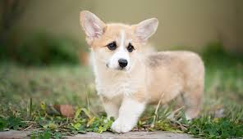
Context
Example 1: My Dog
Qualitative:
He is white and brown
He has short hair
His breed is corgi
Quantitative:
Discrete:
  Legs : 4
  Eyes : 2
  He has 2 sisters
Continuous:
  He weighs 5.2 kg
  He is 20 cm
P6

Slide 7
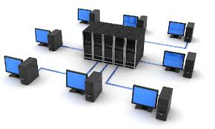
Context
Example 2: My network
Qualitative:
Color of desktop : black
Network protocol: TCP
Structure : Star
Quantitative:
Discrete:
  Number of desktop : 8
  Servers : 1
Continuous:
  Power consumption: 20.28 KW
  Total Cable length: 200.25 m
P7

Slide 8
Qualitative and Quantitative
Qualitative Data | Quantitative Data
Deals with descriptions Data can be observed Colors, texture type, smells, beauty, etc. | Result of counting or measuring attributes of a population. Deals with numbers Data which can be measured. Length, height, area, power consumption
P8

Slide 9
Qualitative and Quantitative
Qualitative is a categorical measurement (or observation) not in terms of number.
Through a natural language description.
Examples:
Hair color of my dog is brown and white
Breed of my dog is corgi
Structure of my network is star
P9

Slide 10
Qualitative and Quantitative
Quantitative data a numerical measurement not in terms of natural language description
Through numbers
Example:
My income is HKD 20,220.
Your GPA is 3.40.
I have two dogs
The power consumption of my computer is 2kW.
P10

Slide 11
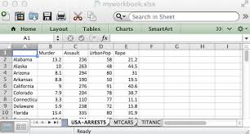
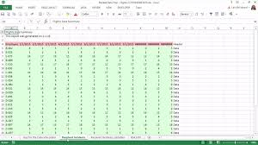




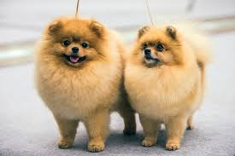
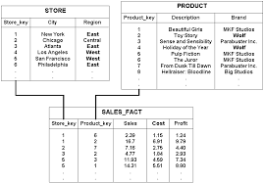
Data examples:
Excel Files:
Word Files:
Images
Tables in a database system
P11

Slide 12
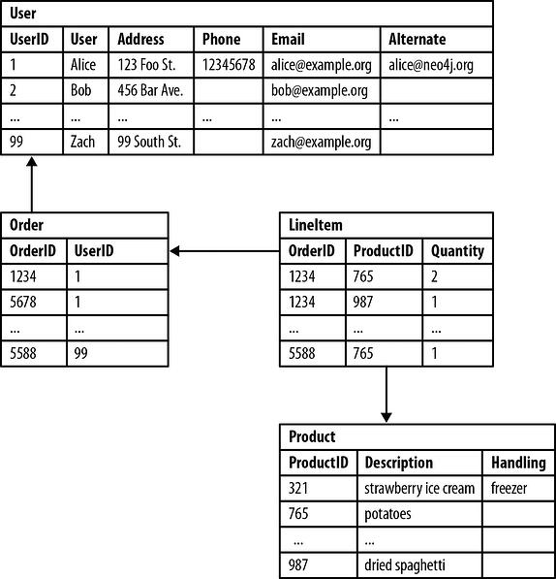
Structured Data and Unstructured Data
Structured data is the type of data most of us are used to working with. Think of data that fits neatly within fixed fields and columns in relational databases and spreadsheets. Hence structured data the patterns of structured data make them easily searchable.
Fields store length-delineated data phone numbers, Social Security numbers, or ZIP codes. Even text strings of variable length like names are contained in records, making it a simple matter to search.
Note that in a database, the format of a field is well defined.
Data may be human- or machine-generated.
Their formats allow us to search with human generated queries and via algorithms using type of data and field names, such as alphabetical or numeric, currency or date.
P12

Slide 13

Structured Data and Unstructured Data
Unstructured data is “everything else” – is comprised of data that is usually not as easily searchable, such as a collection of audio files, video files, and social media postings, formats of data should be different.
Unstructured data has internal structure but is not structured via pre-defined data models or schema. It may be textual or non-textual, and human- or machine-generated. It may also be stored within a non-relational database like NoSQL.
P13

Slide 14
Structured Data and Unstructured Data
Typical human-generated unstructured data includes:
Text files: Word processing, spreadsheets, presentations, email, logs.
Emails: Email has some internal structure thanks to its metadata, and we sometimes refer to it as semi-structured. However, its message field is unstructured and traditional analytics tools cannot parse it.
Social Media files: Data from Facebook, Twitter, LinkedIn.
Websites: YouTube, Instagram, photo sharing sites.
Typical machine-generated unstructured data includes:
Satellite imagery: Weather data, land forms, military movements.
Scientific data: Oil and gas exploration, space exploration, seismic imagery, atmospheric data.
Sensor data: Traffic, weather, oceanographic sensors.
P14

Slide 15
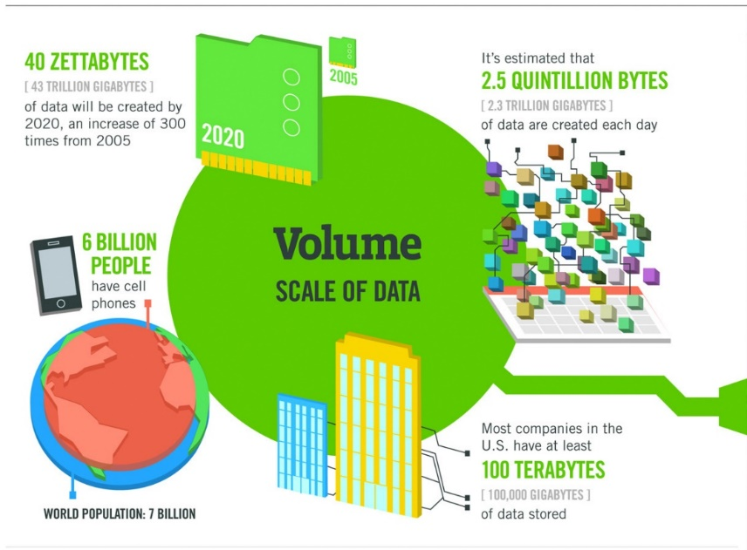
Big Data
Big Data is typically characterized by the following four V’s:
Volume:
The amount and scale of data being created every day is vast compared to traditional data sources we had in the past.
facebook posts, and Youtube
Usually greater than terabytes and petabytes
The data sets in Big Data are too large to process with a regular laptop or desktop processor.
P15

Slide 16
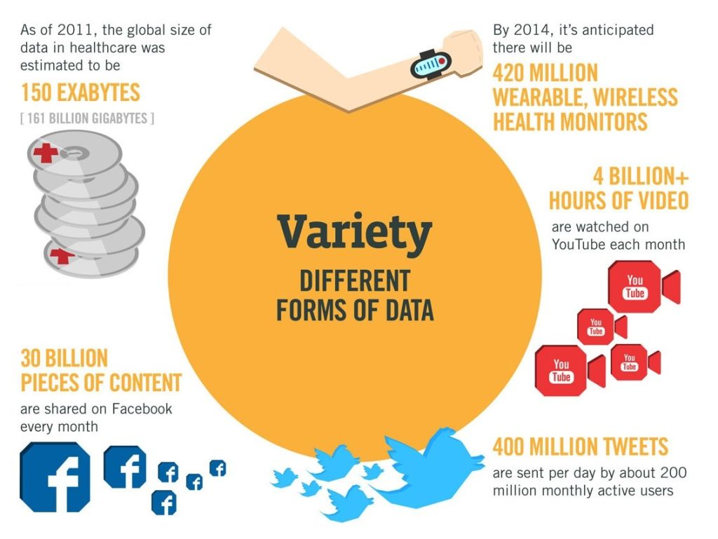
Big Data
Variety
The data comes from different sources in different structures and forms. Data are created not only by human but also by machines.
Three types: structured, semi structured and unstructured data.
The variety in data types implies that we need particular processing capabilities and specialist algorithms.
CCTV audio and video files at various locations in a city.
Facebook images and videos
P16

Slide 17
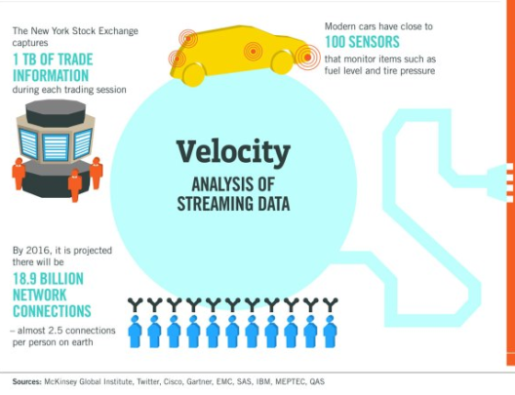
Big Data
Velocity:
Data are generated extremely fast, the process that never stops even while we sleep. Storing them never stops too.
Single instance of high-velocity data is Twitter where over 350,000 tweets are now sent worldwide per minute, equating to 500 million tweets per day.
P17

Slide 18
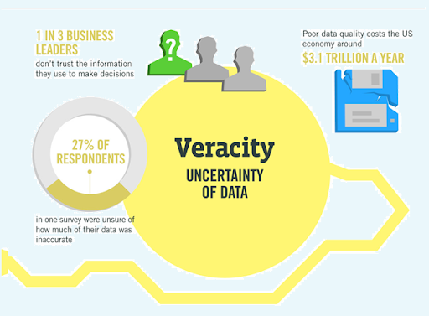
Big Data (Quality of Data)
Veracity:
Big Data is sources from many different places.
We need to test the quality of the data.
High veracity data are valuable to analyze and that contribute in a meaningful way to the overall results.
Low veracity data contains a high
percentage of meaningless data.
Also,
The bus GPS data
(about ten minutes ago )=> quality ??
The realtime bus GPS data
may not be usable in some situations??
P18

Slide 19
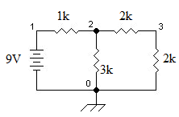
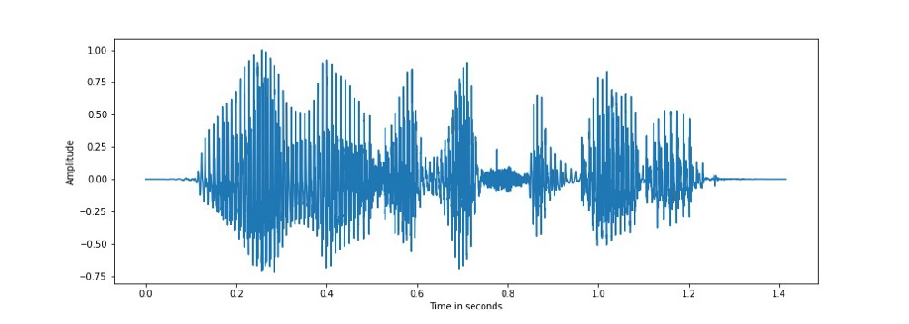
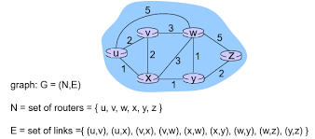
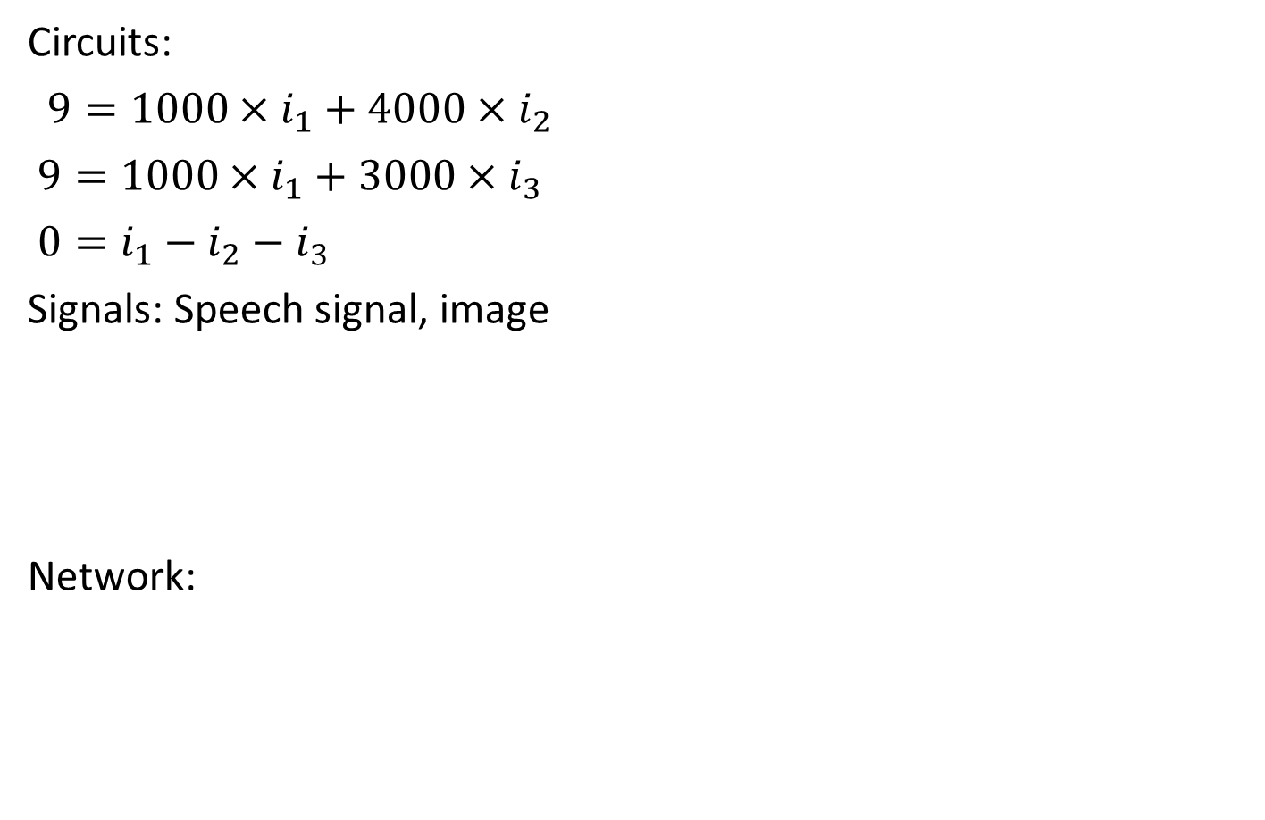
Representation of Data in EE
Circuits:
$9={1000×i}_{1}+{4000×i}_{2}$
$9={1000×i}_{1}+{3000×i}_{3}$
$0=i_{1}−i_{2}−i_{3}$
Signals: Speech signal, image
Network:
P19

Slide 20
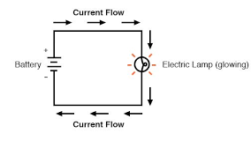
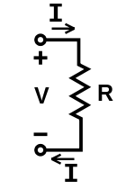
Representation of Data in EE
Circuit:
Ohm’s law :
Ohm's law states that the current through a conductor between two points is directly proportional to the voltage across the two points.
Voltage=Current × Resistance
V=IR
Voltage: electric potential difference.
Current: the rate of flow of electric charge (electrons) past a point.
Resistance: a measure of its opposition to the flow of electric current.
P20

Slide 21
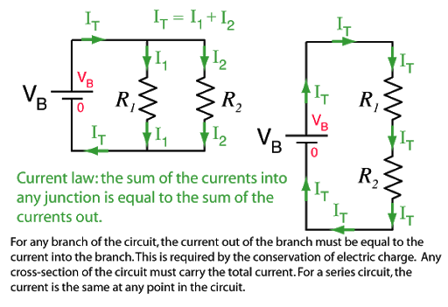
Representation of Data in EE
Circuit:
Notations: Circuit Diagrams
Node: Point of connection between elements.
Branch : Connection between two nodes.
Loop: Closed loops in circuit diagram.
P21

Slide 22
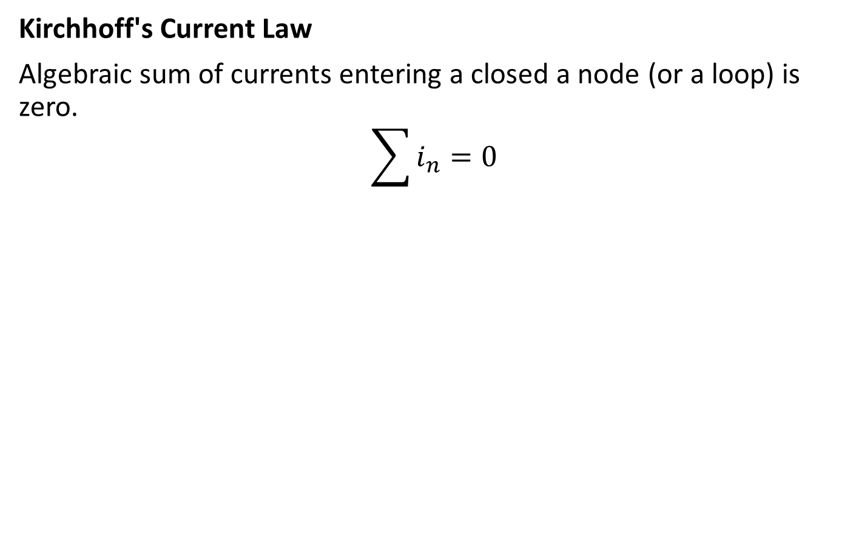
Representation of Data in EE
Kirchhoff's Current Law
Algebraic sum of currents entering a closed a node (or a loop) is zero.
$$\sum{i_{n}}=0$$
P22

Slide 23
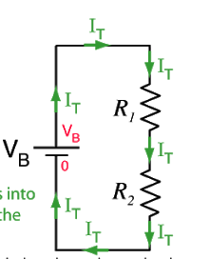
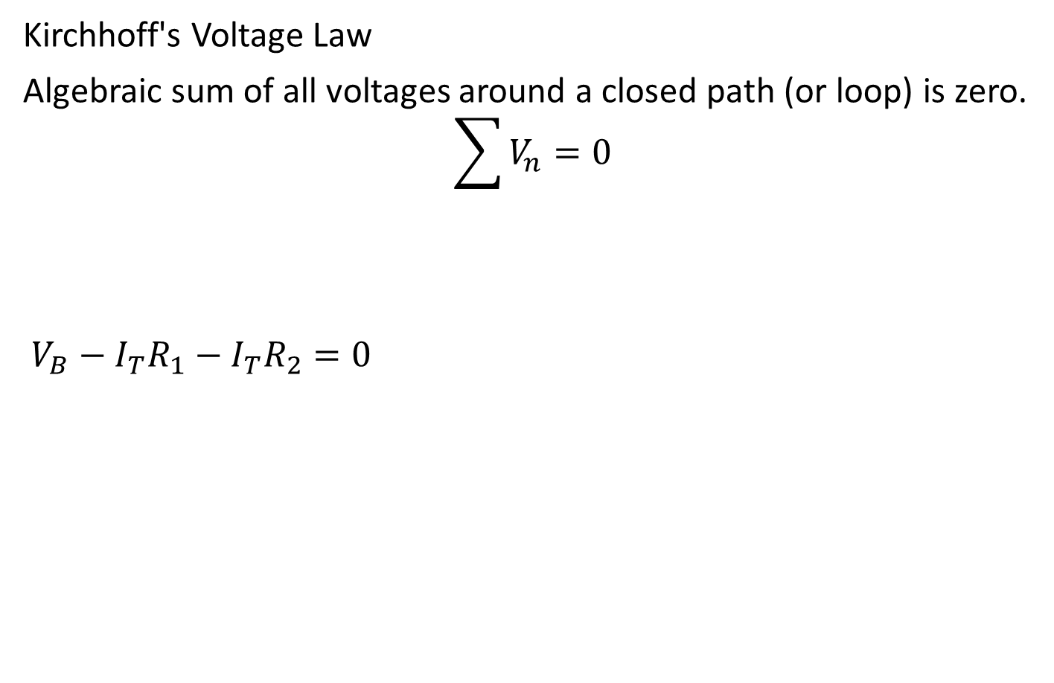
Representation of Data in EE
Kirchhoff's Voltage Law
Algebraic sum of all voltages around a closed path (or loop) is zero.
$$\sum{V_{n}}=0$$
$V_{B}−I_{T}R_{1}−I_{T}R_{2}=0$
P23

Slide 24
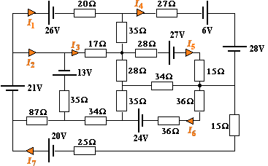
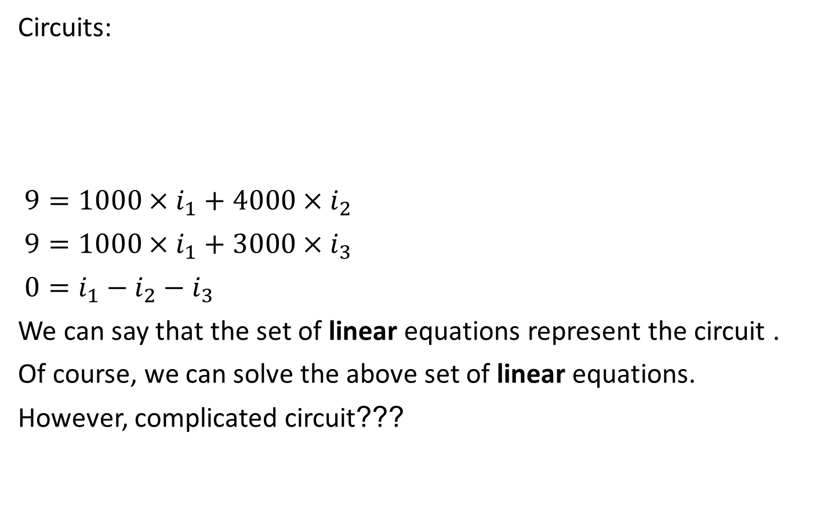
Representation of Data in EE
Circuits:
$9={1000×i}_{1}+{4000×i}_{2}$
$9={1000×i}_{1}+{3000×i}_{3}$
$0=i_{1}−i_{2}−i_{3}$
We can say that the set of linear equations represent the circuit .
Of course, we can solve the above set of linear equations.
However, complicated circuit???
Many students may set up inappropriate equations. three cases: wrong equations, not enough equations, some equations are not linear independent
P24

Slide 25
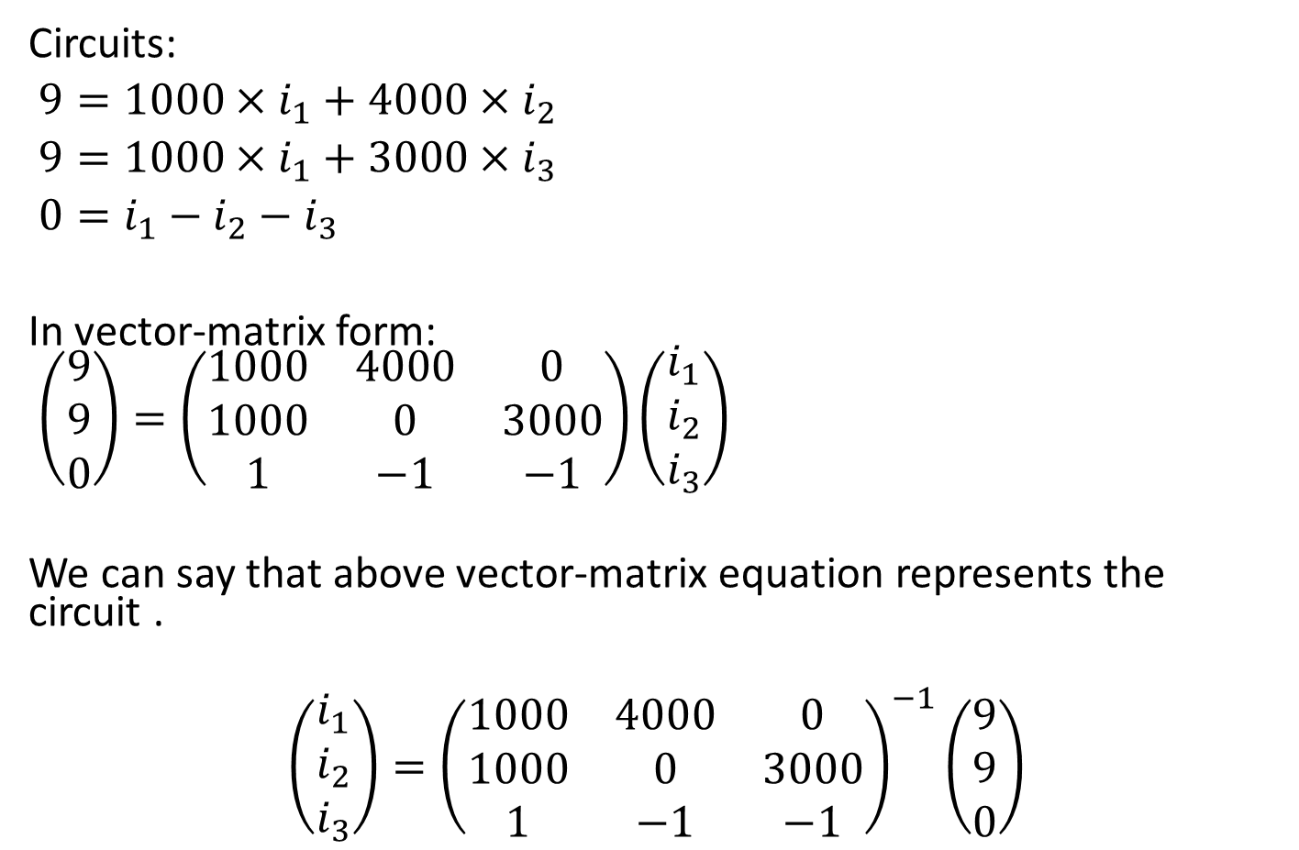
Representation of Data in EE
Circuits:
$9={1000×i}_{1}+{4000×i}_{2}$
$9={1000×i}_{1}+{3000×i}_{3}$
$0=i_{1}−i_{2}−i_{3}$
In vector-matrix form:
$\left(\begin{matrix}9 \\ 9 \\ 0\end{matrix}\right)=\left(\begin{matrix}1000 & 4000 & 0 \\ 1000 & 0 & 3000 \\ 1 & −1 & −1\end{matrix}\right)\left(\begin{matrix}i_{1} \\ i_{2} \\ i_{3}\end{matrix}\right)$
We can say that above vector-matrix equation represents the circuit .
$$\left(\begin{matrix}i_{1} \\ i_{2} \\ i_{3}\end{matrix}\right)={\left(\begin{matrix}1000 & 4000 & 0 \\ 1000 & 0 & 3000 \\ 1 & −1 & −1\end{matrix}\right)}^{−1}\left(\begin{matrix}9 \\ 9 \\ 0\end{matrix}\right)$$
P25

Slide 26
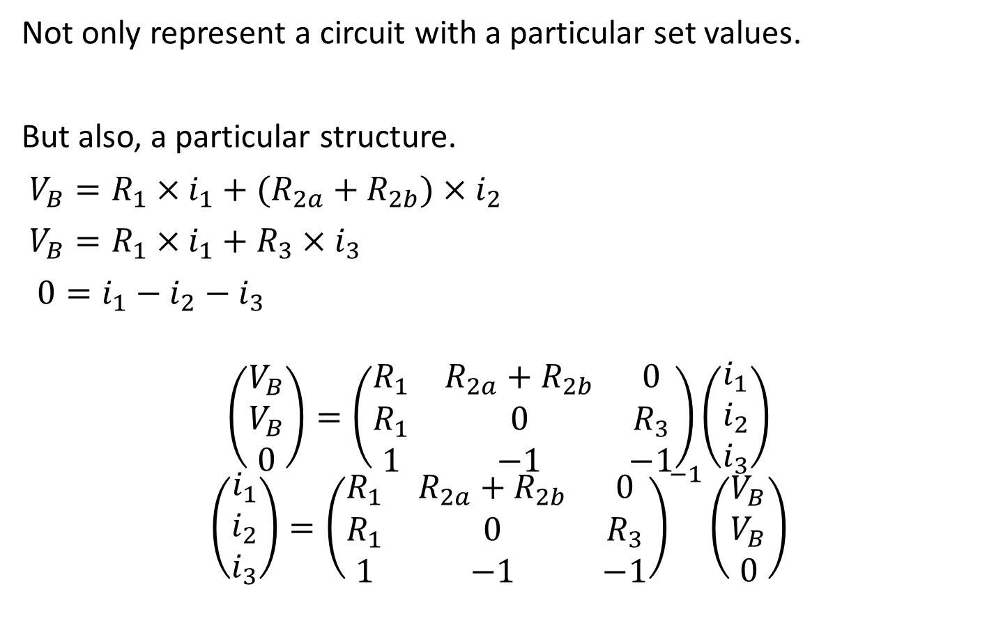
Representation of Data in EE
Not only represent a circuit with a particular set values.
But also, a particular structure.
$V_{B}={R_{1}×i}_{1}+{(R_{2a}+R_{2b})×i}_{2}$
$V_{B}={R_{1}×i}_{1}+{R_{3}×i}_{3}$
$0=i_{1}−i_{2}−i_{3}$
$$\left(\begin{matrix}V_{B} \\ V_{B} \\ 0\end{matrix}\right)=\left(\begin{matrix}R_{1} & R_{2a}+R_{2b} & 0 \\ R_{1} & 0 & R_{3} \\ 1 & −1 & −1\end{matrix}\right)\left(\begin{matrix}i_{1} \\ i_{2} \\ i_{3}\end{matrix}\right)$$
$$\left(\begin{matrix}i_{1} \\ i_{2} \\ i_{3}\end{matrix}\right)={\left(\begin{matrix}R_{1} & R_{2a}+R_{2b} & 0 \\ R_{1} & 0 & R_{3} \\ 1 & −1 & −1\end{matrix}\right)}^{−1}\left(\begin{matrix}V_{B} \\ V_{B} \\ 0\end{matrix}\right)$$
P26

Slide 27
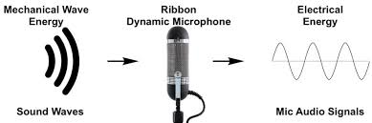
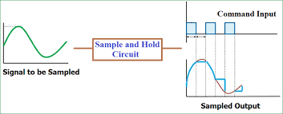
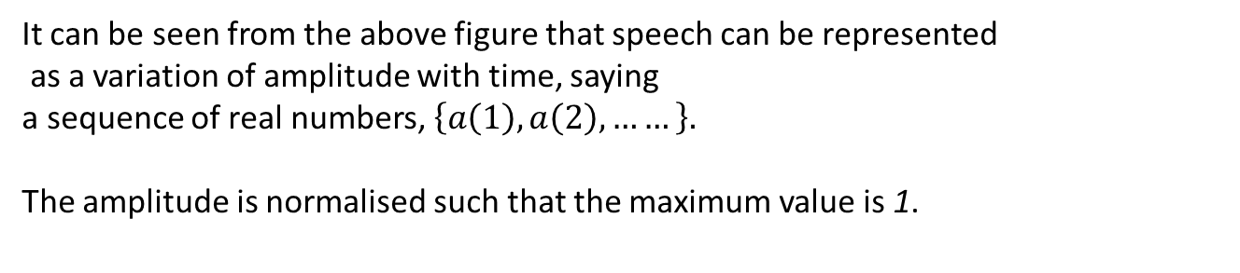
Representation of Data in EE
Speech
It can be seen from the above figure that speech can be represented
as a variation of amplitude with time, saying
a sequence of real numbers, $\left\{a\left(1\right),a\left(2\right), ……\right\}.$
The amplitude is normalised such that the maximum value is 1.
P27

Slide 28
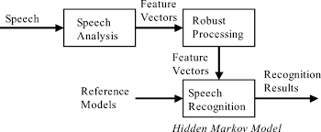
Representation of Data in EE
Speech recognition
Convert the sequence to a number of features. The collection of features from a feature vector.
In Speech Analysis, Robust Processing, Speech Recognition, a lot mathematics skills are involved, such as
linear algebra (matrix and vector), and probability.
P28

Slide 29

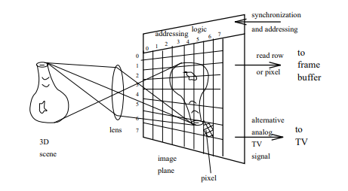
Representation of Data in EE
Image
A grey scale image is a monochrome digital image Im[indx,indy] with
one intensity value per pixel. The indices indx and indy indicate the
positions of pixels.
A color image is a 2D image M[indx,indy,c], i.e., 2D array of 3D vectors, where c=1 to 3. Or say 3D array.
In image processing and pattern recognition, we use a lot of mathematics tools in linear algebra to handle those arrays.
P29

Slide 30
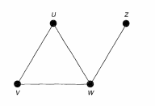
Representation of Data in EE
Graph
A simple graph G={V,E} consists of a non-empty finite set V(G) of elements called vertices (or nodes), and a finite set E(G) of distinct unordered pairs of distinct elements of V(G) called edges.
V(G): vertex set
E(G): the edge set.
An edge {v, w} is said to join the vertices v and w, and is usually abbreviated to vw.
Vertex set = {w, v, w, z},
Edge set = {uv, uw, vw, wz}
P30

Slide 31
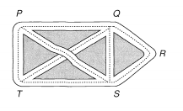
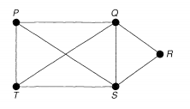
Brief Introduction of Graph
Representation example:
A road map :
The junction points P, Q, R, S and T => vertices, the roads => edges, and the whole diagram is called a graph.
Vertex set = {P, Q, R, S,T},
Edge set = { PQ, QR, RS, ST, PT, PS, QT, QS}
Note that the intersection of the lines PS and QT is not a vertex, since it does not correspond to a cross-roads
P31

Slide 32
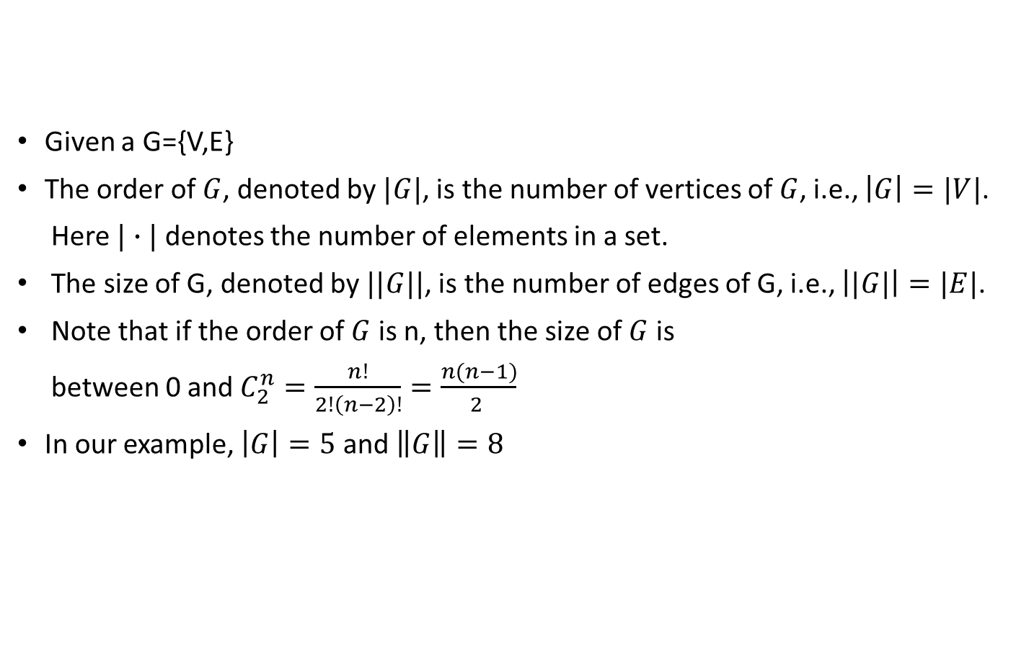
Brief Introduction of Graph (order and size)
Given a G={V,E}
The order of $G$, denoted by $|G|$, is the number of vertices of $G$, i.e., $\left|G\right|=|V|$.
Here $|∙|$ denotes the number of elements in a set.
The size of G, denoted by $||G||$, is the number of edges of G, i.e., $\left||G|\right|=|E|$.
Note that if the order of $G$ is n, then the size of $G$ is
between 0 and $C_{2}^{n}=\frac{n!}{2!\left(n−2\right)!}=\frac{n(n−1)}{2 }$
In our example, $\left|G\right|=5$ and $\left\|G\right\|=8$
P32

Slide 33
Brief Introduction of Graph (degree)
The degree of a vertex is the number of edges with that vertex as an end-point;
The degree of Q=4.
The degree of R= ?
:
P33

Slide 34
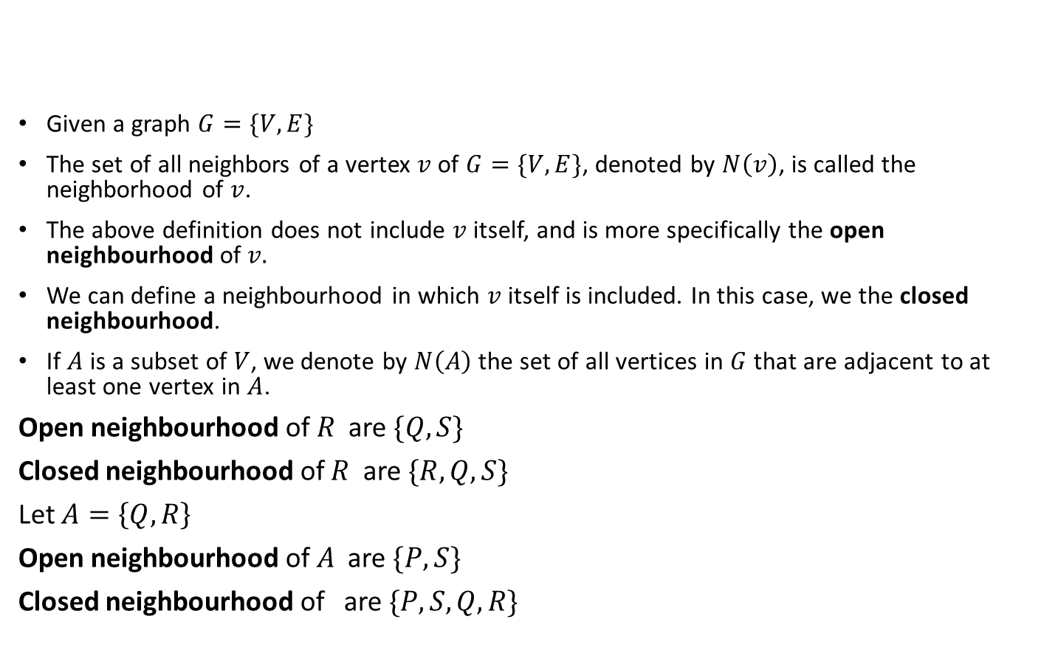
Brief Introduction of Graph (neighbourhood)
Given a graph $G=\{V,E\}$
The set of all neighbors of a vertex $v$of $G=\{V,E\}$, denoted by $N\left(v\right)$, is called the neighborhood of $v$.
The above definition does not include $v$ itself, and is more specifically the open neighbourhood of $v.$
We can define a neighbourhood in which $v$ itself is included. In this case, we the closed neighbourhood.
If $A$ is a subset of $V$, we denote by $N\left(A\right)$ the set of all vertices in $G$ that are adjacent to at least one vertex in $A$.
Open neighbourhood of $R$ are $\{Q,S\}$
Closed neighbourhood of $R$ are $\{R,Q,S\}$
Let $A=\left\{Q,R\right\}$
Open neighbourhood of $A$ are $\{P,S\}$
Closed neighbourhood of are $\{P,S,Q,R\}$
P34

Slide 35
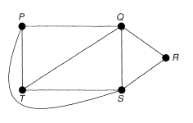
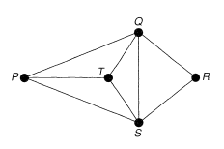
Brief Introduction of Graph (identical and isomorphic)
Remove the 'crossing' of the lines PS and QT by drawing the line PS outside the rectangle PQST.
The resulting graph still tells us whether there is a direct road from one intersection to another.
A graph is a representation of a set of points and of how they are joined up.
The way that we draw is irrelevant.
The graphs in the right hand side are the same.
P35

Slide 36
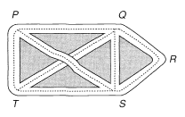
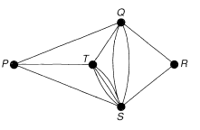
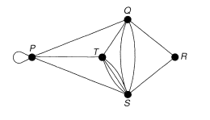
Brief Introduction of Graph (multiple edges and loop)
Suppose that the roads joining Q and S, and S and T, have too much traffic to carry.
Build extra roads joining these points.
The edges joining Q and S, or S and T, are called multiple edges.
Now we need a car park at P, then we indicate this by drawing an edge from P to itself, called a loop.
In general, a graph may contain loops and multiple edges.
Graphs with no loops or multiple edges are called simple graphs.
P36

Slide 37
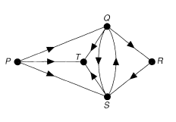
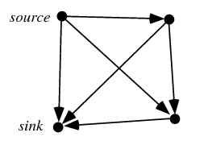
Brief Introduction of Graph (directed graphs)
The study of directed graphs (or digraphs, as we abbreviate them) arises from making the roads into one-way streets.
V is a set whose elements are called vertices, nodes, or points;
A is a set of ordered pairs of vertices, called arrows, directed edges (sometimes simply edges with the corresponding set named E instead of A), directed arcs, or directed lines.
For example, an arc (x, y) is considered to be directed from x to y.
P37

Slide 38
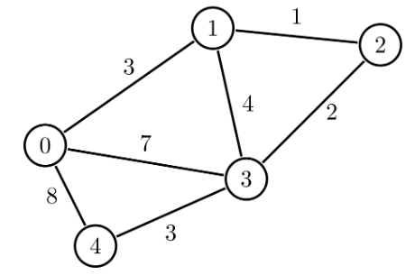
Brief Introduction of Graph (weighted graphs)
A weighted graph is a graph in which each branch is given a numerical weight.
A weighted graph is therefore a special type of labeled graph in which the labels are numbers (which are usually taken to be positive).
Weighted graphs are often used to model real objects and processes. For example, the graph above can be considered as a map, where the nodes are cities and the edges are roads. The weight of each edge is the distance between two cities.
P38

Slide 39
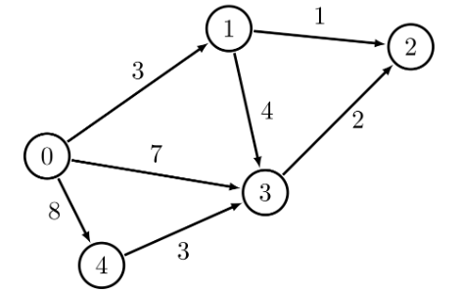
Brief Introduction of Graph (weighted graphs)
A directed weighted graph is a directed graph in which each branch is given a numerical weight.
Weighted directed graphs also can be used to model some real processes.
In our example, Node 0 can be considered as a storage place, from where we need to transfer some resources to the destination point, say to Node 2.
The remaining nodes can be considered as intermediate places.
Each edge shows a direction in which the resources can be transferred.
The weight of an edge shows the maximum amount of resources that can be sent through the edge.
P39

Slide 40
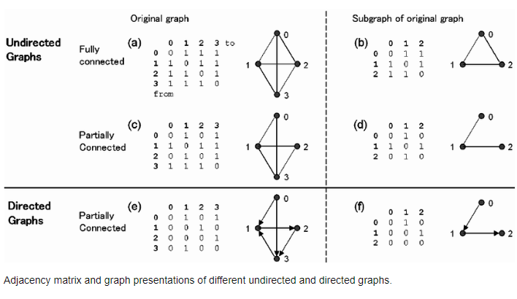
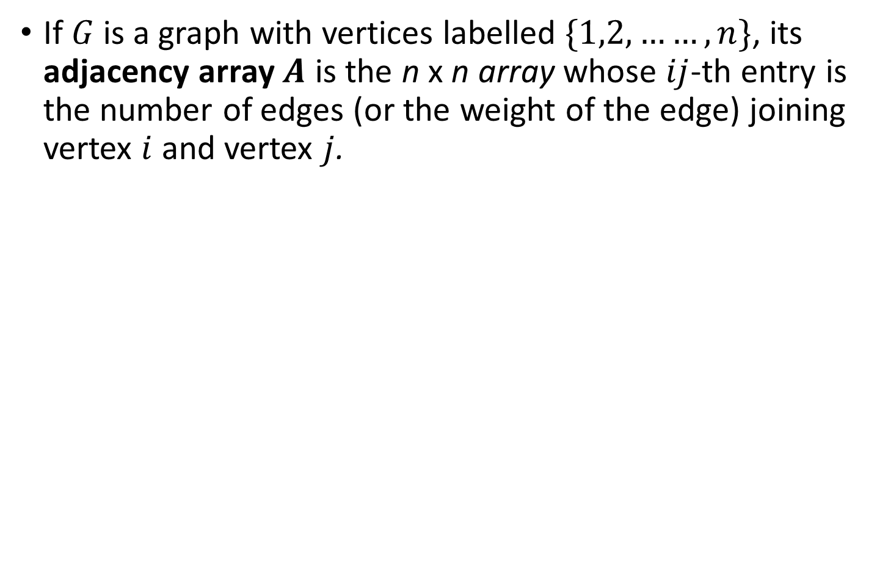
Brief Introduction of Graph
(adjacency array (matrix) and incidence array (matrix))
If $G$ is a graph with vertices labelled $\{1,2,……, n\}$, its adjacency array $A$ is the n x n array whose $ij$-th entry is the number of edges (or the weight of the edge) joining vertex $i$ and vertex $j$.
P40

Slide 41
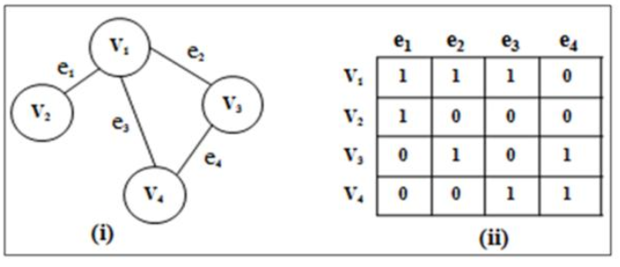
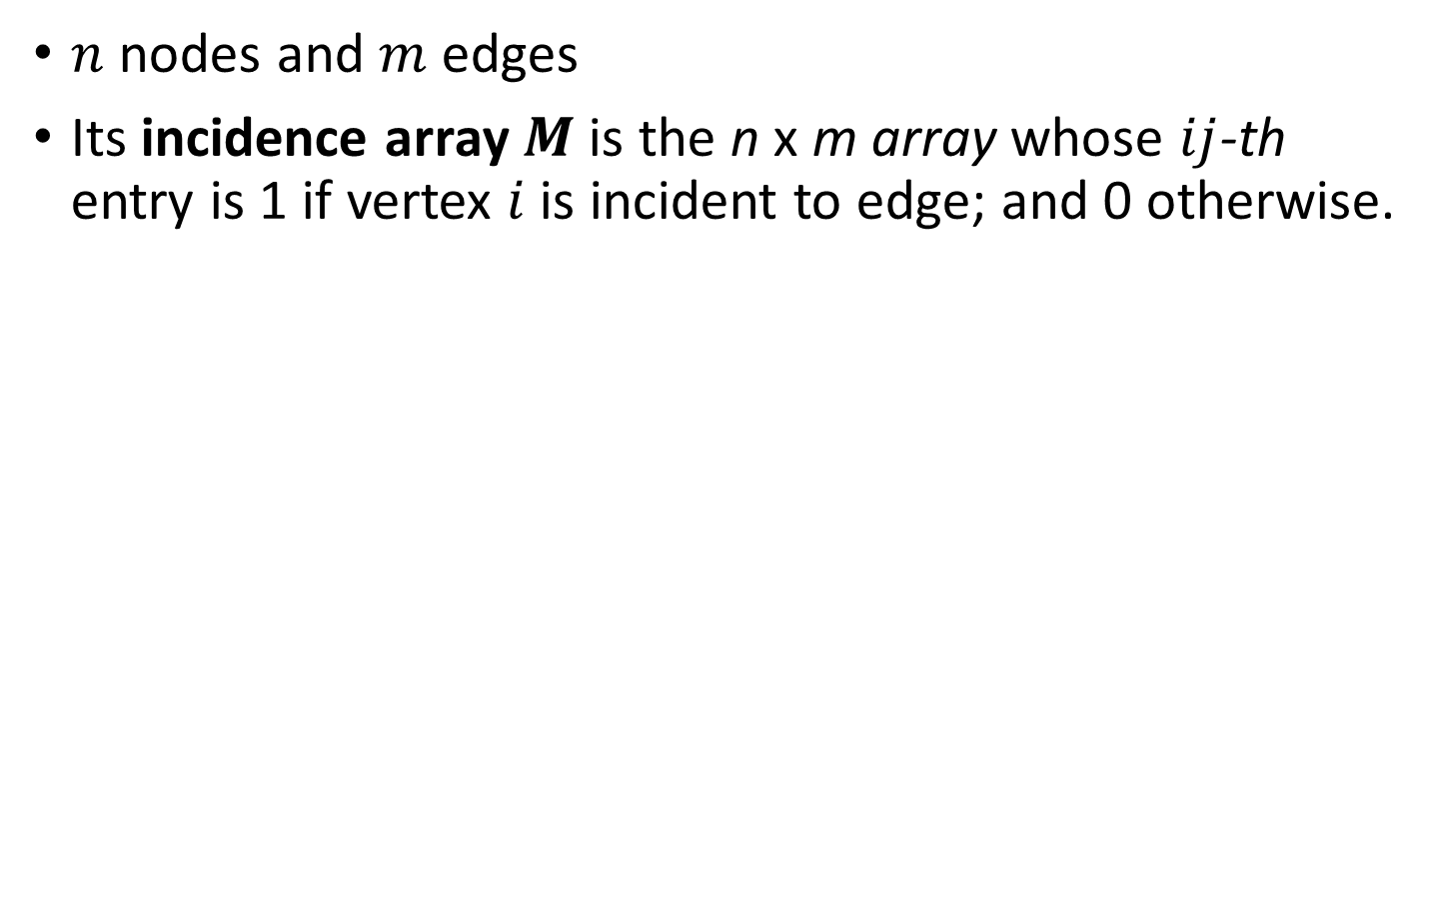
Brief Introduction of Graph
(adjacency array (matrix) and incidence array (matrix))
$n$ nodes and $m$ edges
Its incidence array $M$ is the n x m array whose $ij$-th entry is 1 if vertex $i$ is incident to edge; and 0 otherwise.
P41

Slide 42
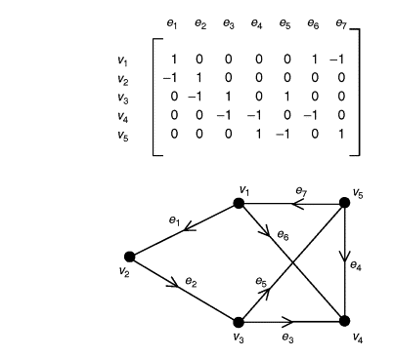
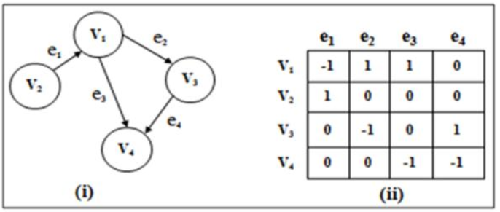

Brief Introduction of Graph
(adjacency array (matrix) and incidence array (matrix))
$n$ nodes and $m$ edges
Its incidence array $M$ is a n × m 2D array
The $ij$-th entry of $M$ is 1, the $j$-th edge leaves the $i$-th node.
The $ij$-th entry of $M$ is -1, the $j$-th edge entries the $i$-th node.
(Note that some authors use opposite sign notation)
P42

Slide 43

Brief Introduction of Graph (Some problems and Solutions)
A maze as a graph.
Each room in the maze is viewed as a vertex.
We add edges to the graph between adjacent rooms that are not blocked by a wall.
Find a shortest path from s to w. ???
It is the shortest path problem.
P43

Slide 44

Brief Introduction of Graph (shortest path)
Given a source vertex $v_{1}$ , find all the shortest paths to all other nodes.
One algorithm is Dijkstra’s Algorithm
Let $𝕊$ be the set of vertices to which we have a shortest path.
Initialize the cost of the source vertex to 0, and all the rest of the nodes to $∞$
Initialize set $𝕊$ to be empty (no element).
While $𝕊$ does not contain all vertices
a. Select the node A with the lowest cost that is not in $𝕊$
b. Put it in $𝕊$
c. For each node B adjacent to A
if cost(A)+cost(A,B) < the current cost of B’,
set cost(B) = cost(A)+cost(A,B) and record
previous(B) = A (so that we can remember the path)
P44

Slide 45


Brief Introduction of Graph (shortest path)
Example
Since ${C(v}_{1})=0,$ put $v_{1}$ to $𝕊$
$𝕊=\left\{v_{1}\right\}$, previous($v_{1}$) = Nil
P45

Slide 46


Brief Introduction of Graph (shortest path)
Example
$𝕊=\left\{v_{1}\right\}$
${C(v}_{2})=0+2=2$, previous($v_{2}$) = $v_{1}$
${C(v}_{4})=0+1=1$, previous($v_{4}$) = $v_{1}$
$C(others)=$ $∞$
P46

Slide 47


Brief Introduction of Graph (shortest path)
Example
$v_{4}$ is with min cost
put $v_{4}$ to $𝕊$
$𝕊=\left\{v_{1},v_{4}\right\}$
P47

Slide 48


Brief Introduction of Graph (shortest path)
Example
$𝕊=\left\{v_{1},v_{4}\right\}$
$v_{3},v_{5},v_{6},v_{7}$ are neighbors to $v_{4}$
update
${C(v}_{3})=1+2=3$, previous($v_{3}$) = $v_{4}$
${C(v}_{5})=1+2=3$, previous($v_{5}$) = $v_{4}$
${C(v}_{6})=1+8=9$, previous($v_{6}$) = $v_{4}$
${C(v}_{7})=1+4=5$, previous($v_{7}$) = $v_{4}$
No update
${C(v}_{4})=1$, previous($v_{4}$) = $v_{1}$
${C(v}_{2})=2$, previous($v_{2}$) = $v_{1}$ (Note $v_{2}$ is with the min cost)
P48

Slide 49


Brief Introduction of Graph (shortest path)
Example
$$v_{4}$$
put $v_{2}$ to $𝕊$
$𝕊=\left\{v_{1},v_{2},v_{4}\right\}$
$v_{5}$ is neighbor to $v_{2}$
No update why?
${Current C(v}_{5})<10+2$
${C(v}_{2})=2$, previous($v_{2}$) = $v_{1}$
${C(v}_{3})=3$, previous($v_{3}$) = $v_{4}$
${C(v}_{4})=1$, previous($v_{4}$) = $v_{1}$
${C(v}_{5})=3$, previous($v_{5}$) = $v_{4}$
${C(v}_{6})=9$, previous($v_{6}$) = $v_{4}$
${C(v}_{7})=5$, previous($v_{7}$) = $v_{4}$
P49

Slide 50


Brief Introduction of Graph (shortest path)
Example
Note $v_{5}$ is with the min cost)
put $v_{5}$ to $𝕊$
$𝕊=\left\{v_{1},v_{2},v_{4},v_{5}\right\}$
$v_{7}$ is neighbor to $v_{5}$
No update why?
${Current C(v}_{7})<3+6$
${C(v}_{2})=2$, previous($v_{2}$) = $v_{1}$
${C(v}_{3})=3$, previous($v_{3}$) = $v_{4}$
${C(v}_{4})=1$, previous($v_{4}$) = $v_{1}$
${C(v}_{5})=3$, previous($v_{5}$) = $v_{4}$
${C(v}_{6})=9$, previous($v_{6}$) = $v_{4}$
${C(v}_{7})=5$, previous($v_{7}$) = $v_{4}$
P50

Slide 51


Brief Introduction of Graph (shortest path)
Note $v_{3}$ is with the min cost
Put $v_{3}$ to $𝕊$
$𝕊=\left\{v_{1},v_{2},v_{3},v_{4},v_{5}\right\}$
$v_{6}$is neighbor to $v_{3}$
${C(v}_{2})=2$, previous($v_{2}$) = $v_{1}$
${C(v}_{3})=3$, previous($v_{3}$) = $v_{4}$
${C(v}_{4})=1$, previous($v_{4}$) = $v_{1}$
${C(v}_{5})=3$, previous($v_{5}$) = $v_{4}$
${C(v}_{6})=3+5=8<9 (current cost)$,
previous($v_{6}$) = $v_{3}$
${C(v}_{7})=5$, previous($v_{7}$) = $v_{4}$
P51

Slide 52


Brief Introduction of Graph (shortest path)
Note $v_{7}$ is with the min cost
Put $v_{7}$ to $𝕊$
$𝕊=\left\{v_{1},v_{2},v_{3},v_{4},v_{5},v_{7}\right\}$
$v_{6}$ is neighbor to $v_{7 }$
${C(v}_{2})=2$, previous($v_{2}$) = $v_{1}$
${C(v}_{3})=3$, previous($v_{3}$) = $v_{4}$
${C(v}_{4})=1$, previous($v_{4}$) = $v_{1}$
${C(v}_{5})=3$, previous($v_{5}$) = $v_{4}$
${C(v}_{6})=1+5=6<8 (current cost)$,
previous($v_{6}$) = $v_{7}$
${C(v}_{7})=5$, previous($v_{7}$) = $v_{4}$
P52

Slide 53


Brief Introduction of Graph (shortest path)
Put $v_{6}$ to $𝕊$
$𝕊=\left\{v_{1},v_{2},v_{3},v_{4},v_{5},v_{6}v_{7}\right\}$
${C(v}_{2})=2$, previous($v_{2}$) = $v_{1}$
${C(v}_{3})=3$, previous($v_{3}$) = $v_{4}$
${C(v}_{4})=1$, previous($v_{4}$) = $v_{1}$
${C(v}_{5})=3$, previous($v_{5}$) = $v_{4}$
${C(v}_{6})=6$, previous($v_{6}$) = $v_{7}$
${C(v}_{7})=5$, previous($v_{7}$) = $v_{4}$
P53

Slide 54

Brief Introduction of Graph (shortest path)
Put $v_{6}$ to $𝕊$
$𝕊=\left\{v_{1},v_{2},v_{3},v_{4},v_{5},v_{6}{,v}_{7}\right\}$
${C(v}_{2})=2$, previous($v_{2}$) = $v_{1}$
${C(v}_{3})=3$, previous($v_{3}$) = $v_{4}$
${C(v}_{4})=1$, previous($v_{4}$) = $v_{1}$
${C(v}_{5})=3$, previous($v_{5}$) = $v_{4}$
${C(v}_{6})=6$, previous($v_{6}$) = $v_{7}$
${C(v}_{7})=5$, previous($v_{7}$) = $v_{4}$
Using back track, we can find out the shortest path.
For example, what the shortest path from $v_{1}$ to $v_{7}$ ? cost of the path is 5, previous($v_{7}$) = $v_{4}$ , and
previous($v_{4}$) = $v_{1}$, so $v_{1}$->$v_{4}→v_{7}$
What the shortest path from $v_{1}$ to $v_{6}$ ? cost of the path is 6, previous($v_{6}$) = $v_{7}$, previous($v_{7}$) = $v_{4}$ , and previous($v_{4}$) = $v_{1}$, so $v_{1}$->$v_{4}→v_{7}→v_{6}$
P54

Slide 55

Brief Introduction of Graph (The minimum connector problem)
The minimum connector problem
Find a sub-graph with the minimum total length from a connected graph.
Application:
Laying cables or pipes among a number of sites.
The weights of the edges are the cost to lay cable (pipe) between two sites.
P55

Slide 56


Brief Introduction of Graph (Maximum Flow)
Maximum Flow
A flow network is defined as a directed graph involving a source(S), a sink(T) and several other nodes connected with edges.
Each edge has an individual capacity which is the maximum limit of flow that edge could allow.
For any non-source and non-sink node, the input flow is equal to output flow.
Maximum Flow : the maximum amount of flow that the network would allow to flow from source to sink.
What is the corresponding flow paths?
P56

