Slide 1

EE4803: Analog IC Design
Review: Transistors & Basics
Department of Electrical Engineering
City University of Hong Kong
Prof. Arindam Basu

Slide 2
Outline
MOS transistor
DC Analysis
AC analysis
Small-signal models
Frequency Response
*With inputs from Phillip Allen’s course at Georgia Tech and Willy Sansen’s book

Slide 3
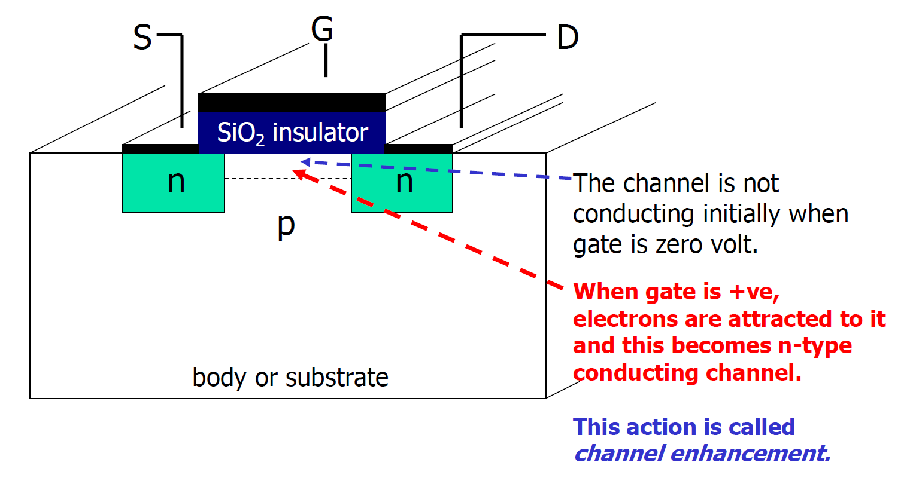
MOS Transistor
N-channel MOS (NMOS)

Slide 4
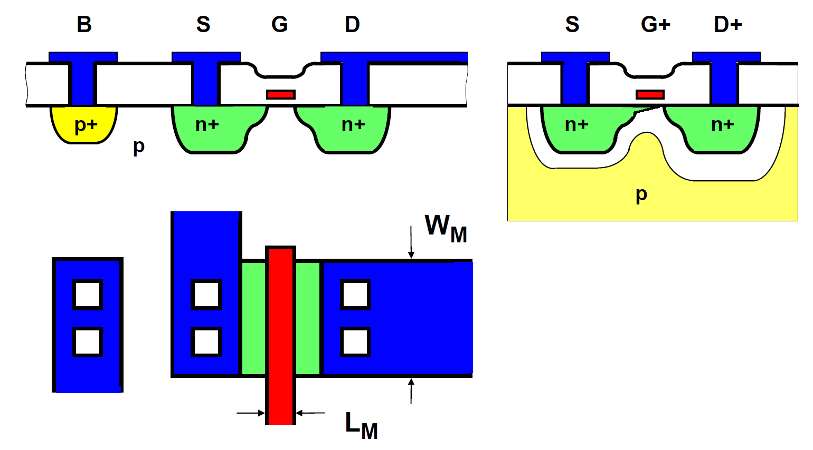
MOS Transistor

Slide 5
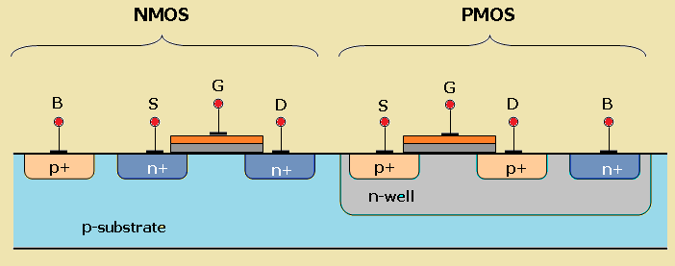
N-Well for PMOS
4th terminal
Common substrate always GND
(Why GND?)

Slide 6
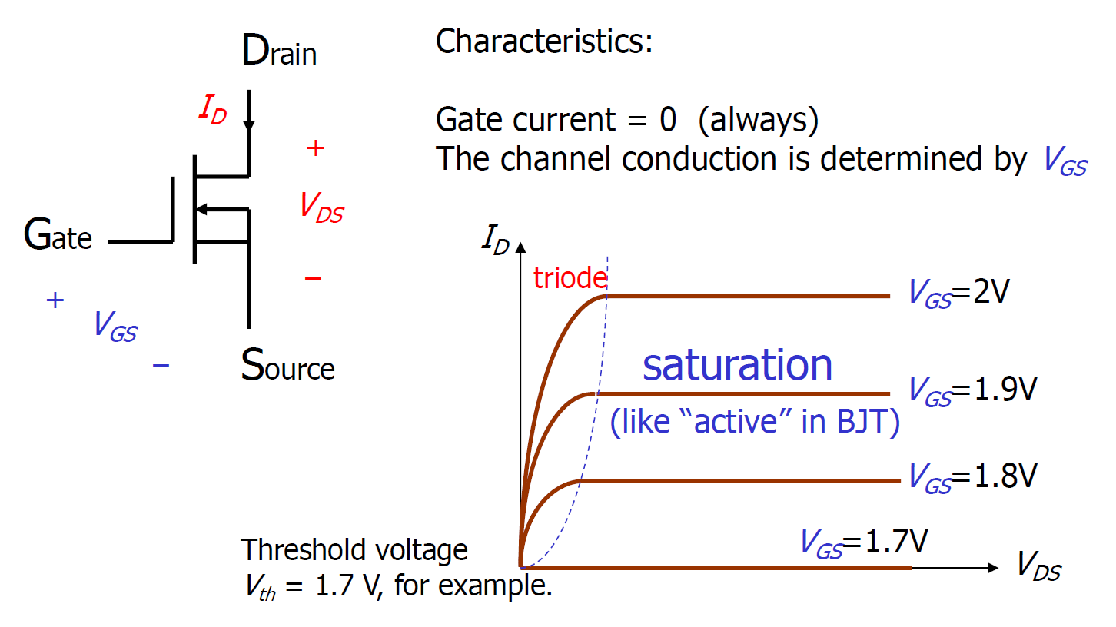
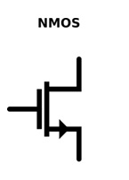
NMOS Characteristics
Other symbol:

Slide 7
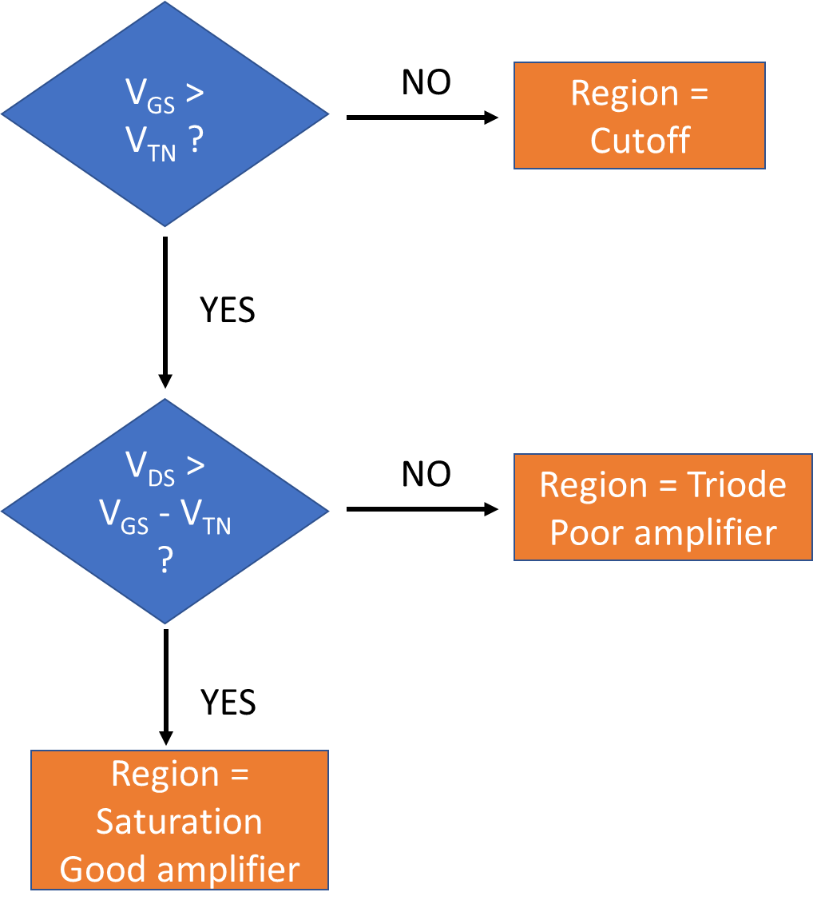
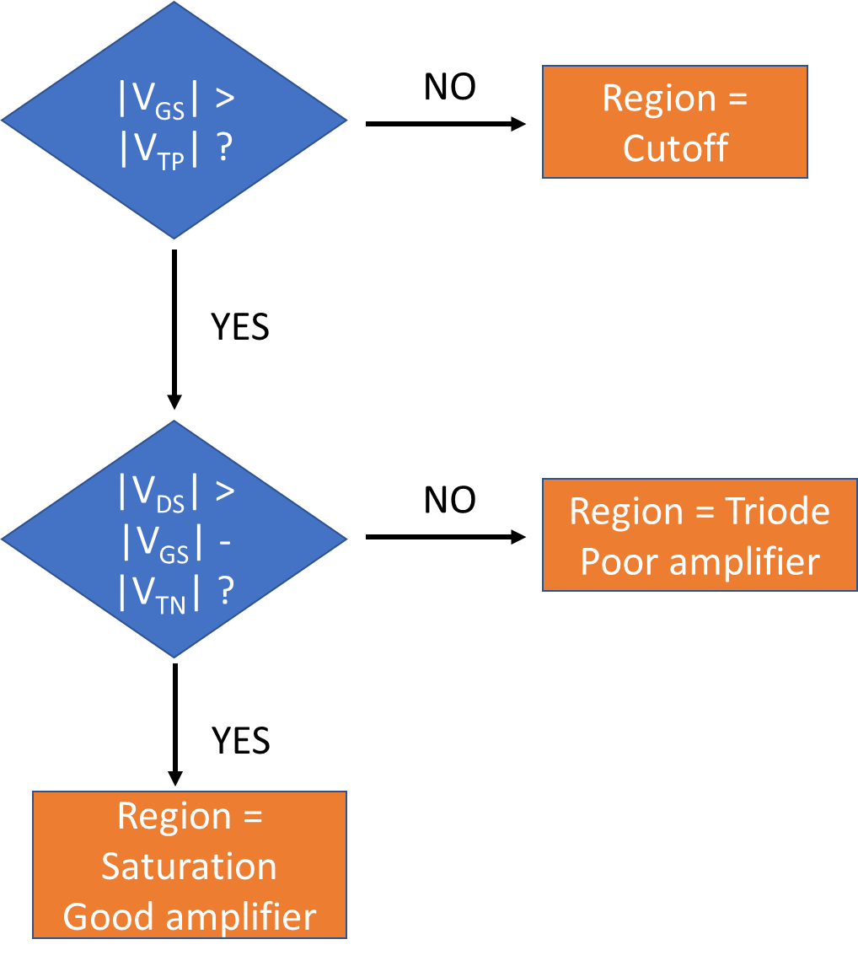
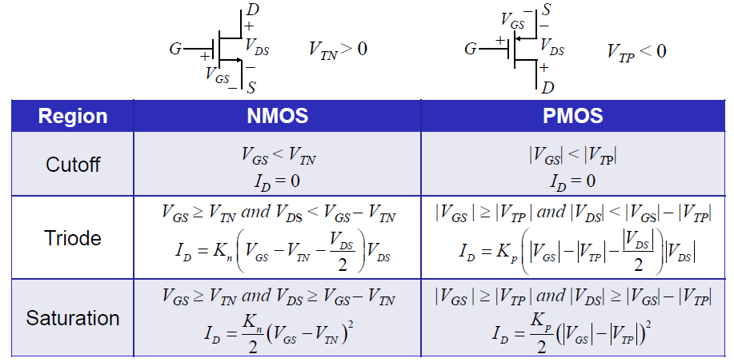
NMOS: Region of Operation
NMOS
PMOS

Slide 8
MOSFET biasing for different regions
Assuming Bulk and Source tied together, i.e. V_{BS} = 0.
PMOS: S is highest voltage
NMOS: S is lowest voltage

Slide 9
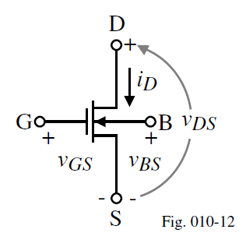
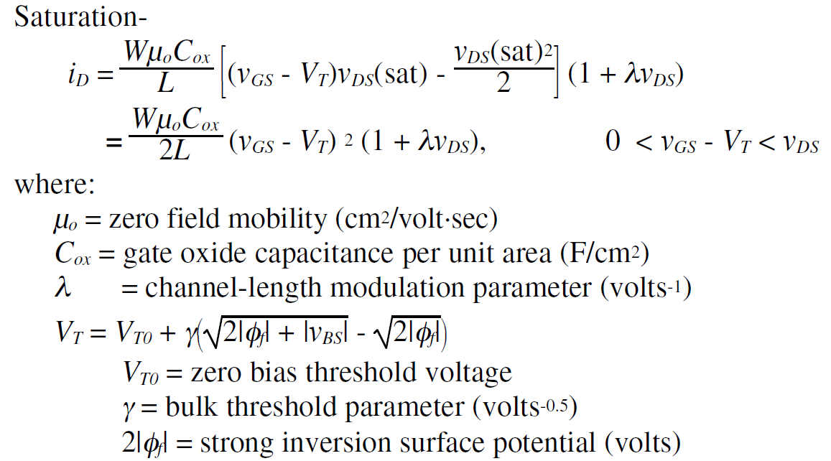
MOSFET 4th terminal: Bulk
Notation:
K’(W/L) = K or β
K’
Non-zero V_{BS} increases V_{T}! Is that bad?

Slide 10
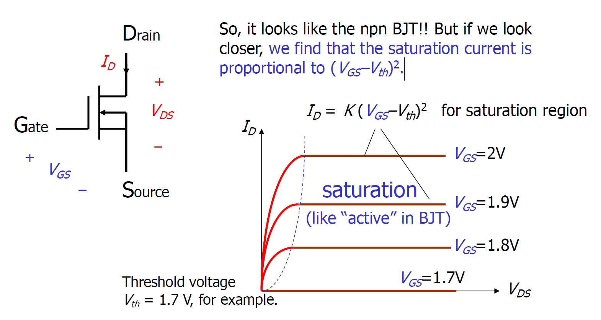
Intuition about the equations: Saturation
The saturation current is proportional to (V_{GS}–V_{th})².
K/2

Slide 11
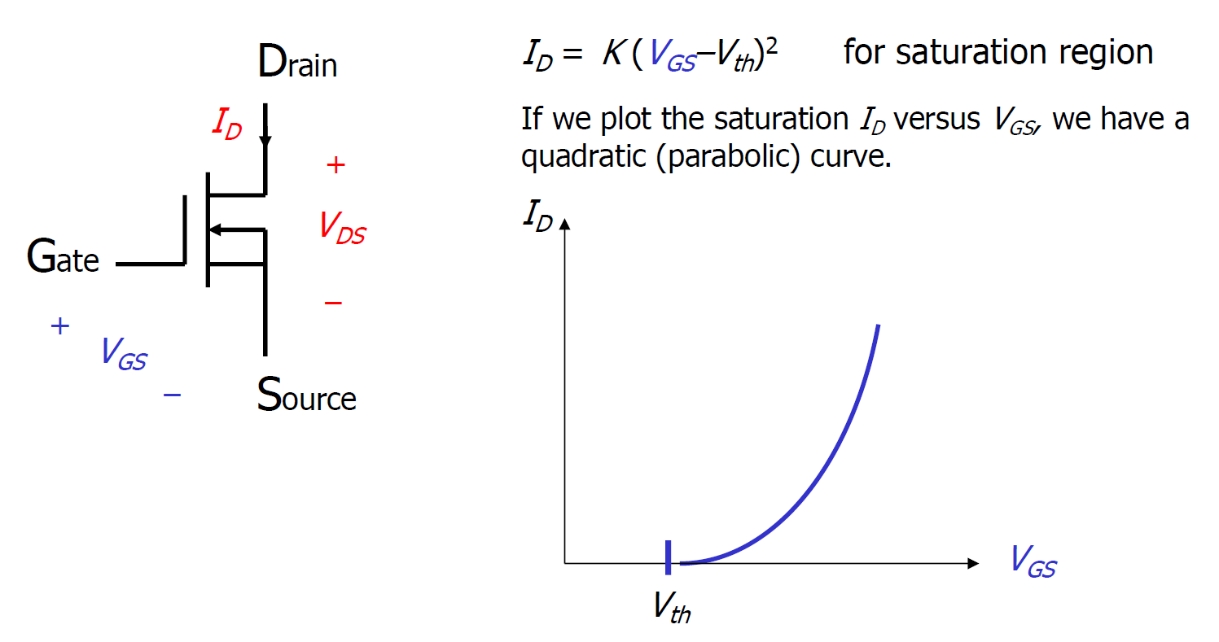
Intuition about the equations: Saturation
K/2

Slide 12
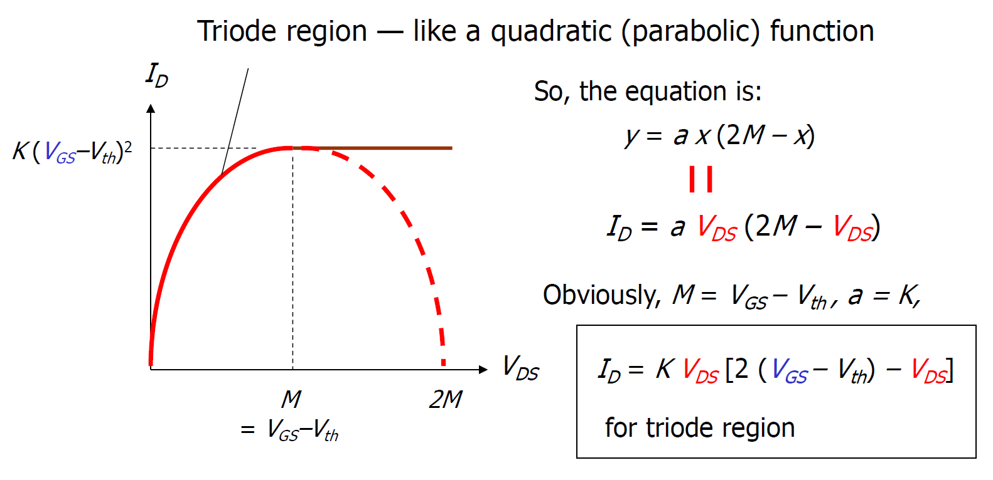
Intuition about the equations: Ohmic/Triode
K/2
K/2
K/2

Slide 13
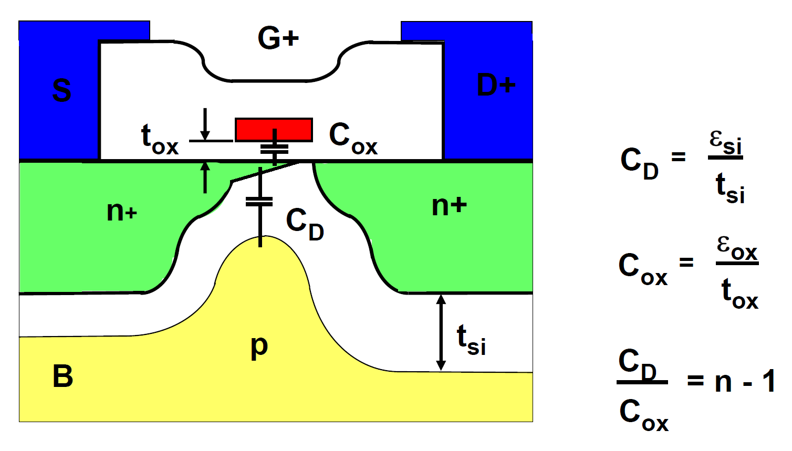


MOSFET Physics Basics
$$\frac{C_{ox}}{C_{ox}+C_{D}}=\frac{1}{n}=κ$$
Capacitive divider from Gate Voltage to Bulk creates Surface potential
of channel
$$n≈1.2/1.3 → κ≈0.8/0.7$$

Slide 14
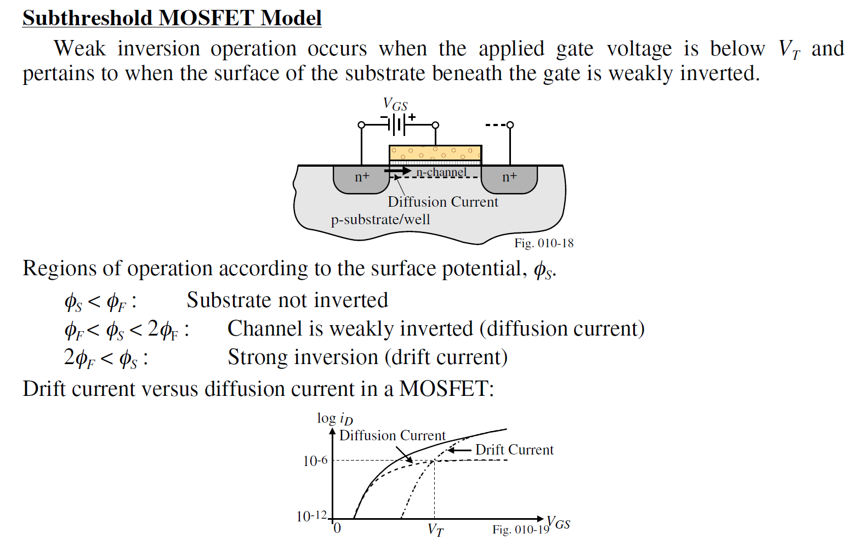
MOSFET Sub-threshold operation

Slide 15
MOSFET Sub-threshold operation
Current not 0 at V_{GS} < V_{T}!
Just exponentially smaller → Like BJT

Slide 16
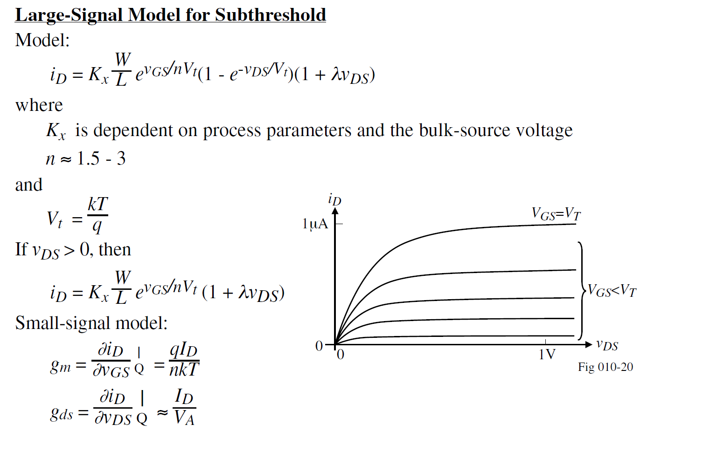



MOSFET Sub-threshold operation
$$n≈1.2/1.3$$
$$≈25 mV$$
(@ room
temperature)
V_{DS} > 4U_{T},
$$≈λI_{D}$$

Slide 17
DC Analysis
Capacitors – Open (Z_{C} = 1/jwC & DC → w=0)
Inductors – Short (Z_{L} = jwL & DC → w=0)
Disable AC sources (Voltage source → Short, Current Source → Open)
If multiple DC sources, can do superposition
  Choose one source, disable others (Voltage source → Short, Current Source → Open)
  Find output due to this one source
  Repeat above for all sources one by one
  Final output is sum off all the above

Slide 18
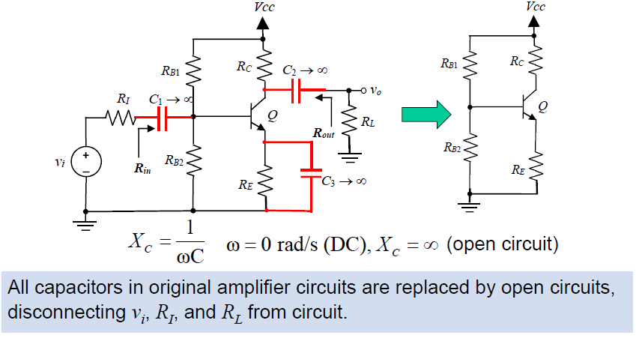
DC Equivalent Circuit: Example

Slide 19
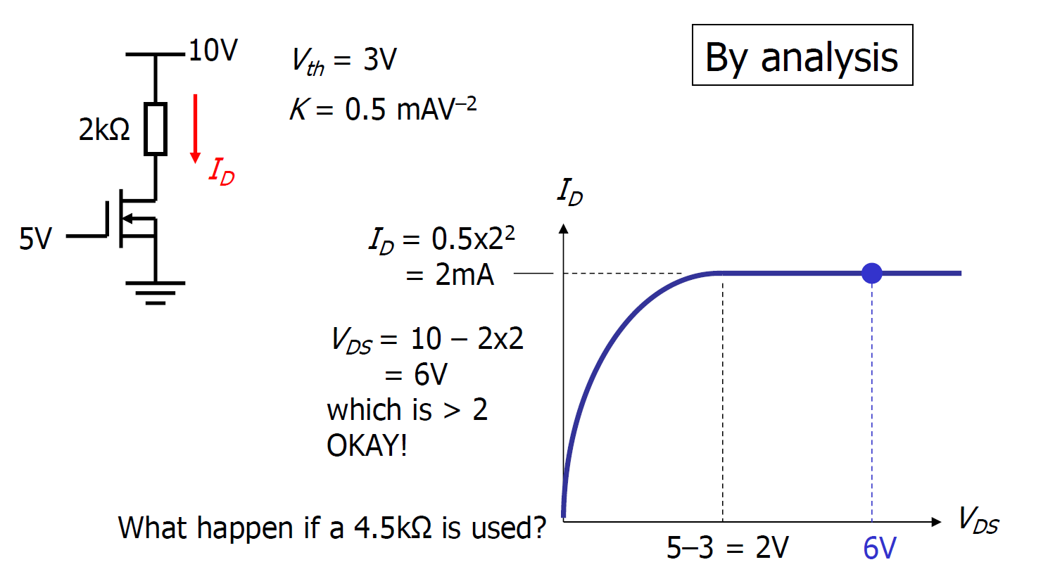
Biasing in Saturation/Triode
1

Slide 20
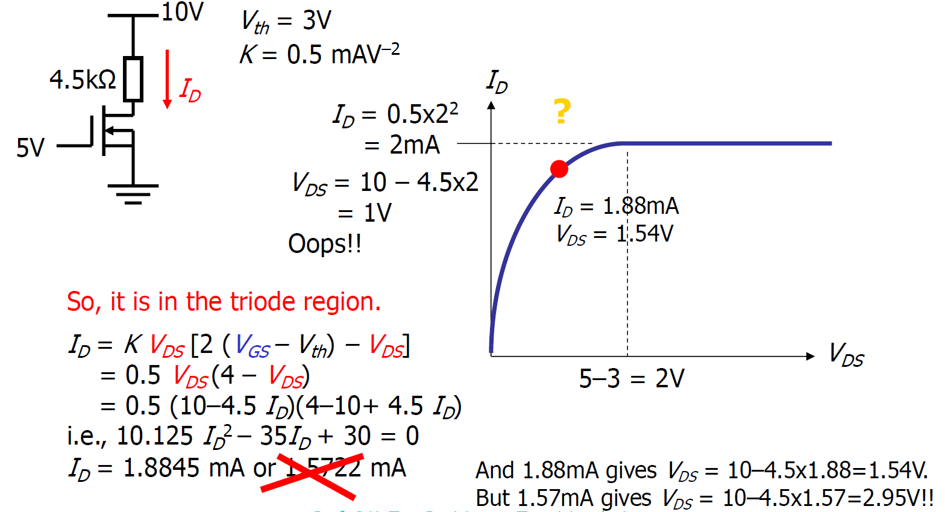
Biasing in Saturation/Triode
K/2

Slide 21
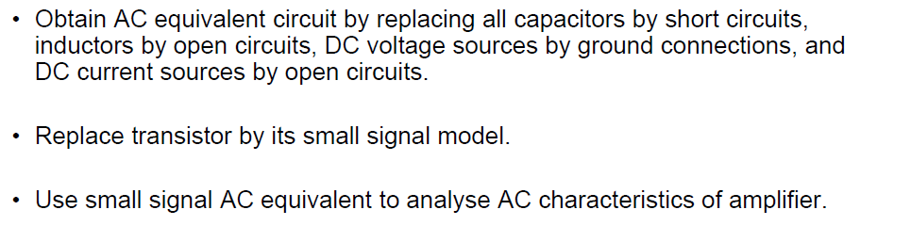
AC Analysis
If multiple AC sources, can do superposition
  Choose one source, disable others (Voltage source → Short, Current Source → Open)
  Find output due to this one source
  Repeat above for all sources one by one
  Final output is sum off all the above

Slide 22
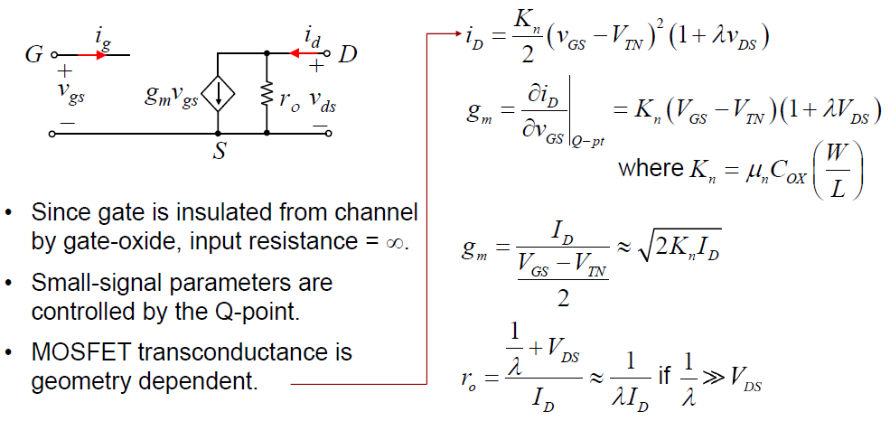
Small Signal Models

Slide 23
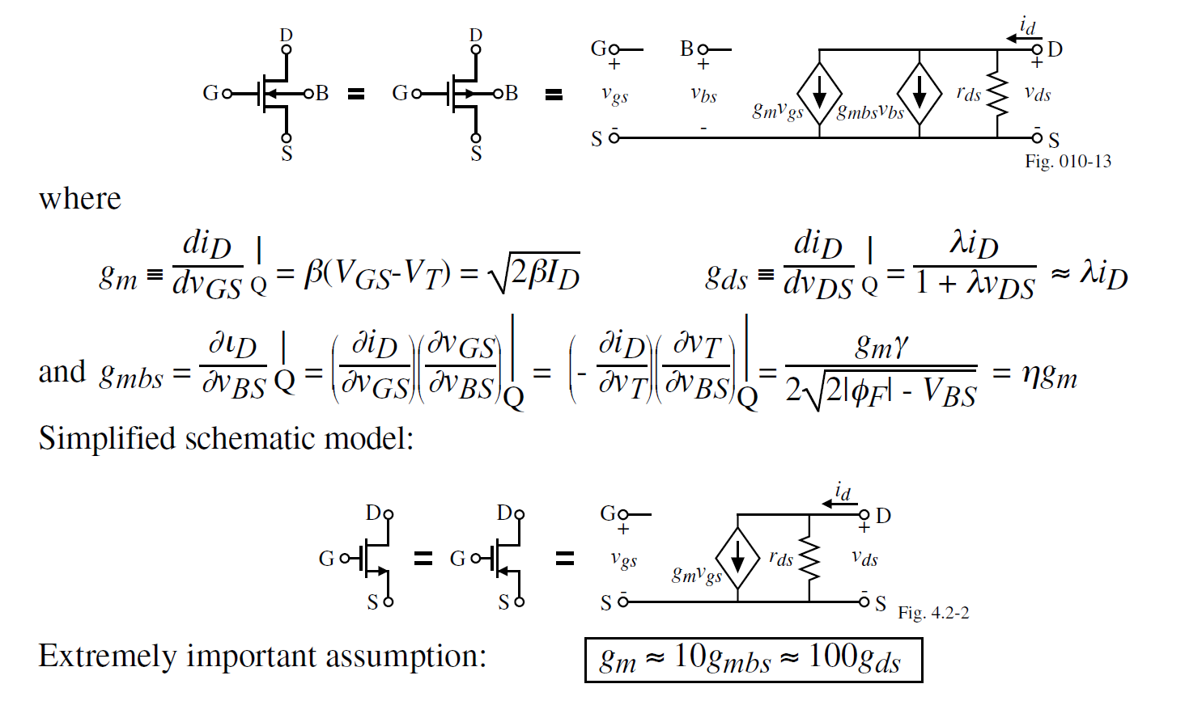


Small Signal Models with Bulk Terminal
$$r_{ds}=r_{o}$$
$$g_{m}r_{ds}≈100$$

Slide 24
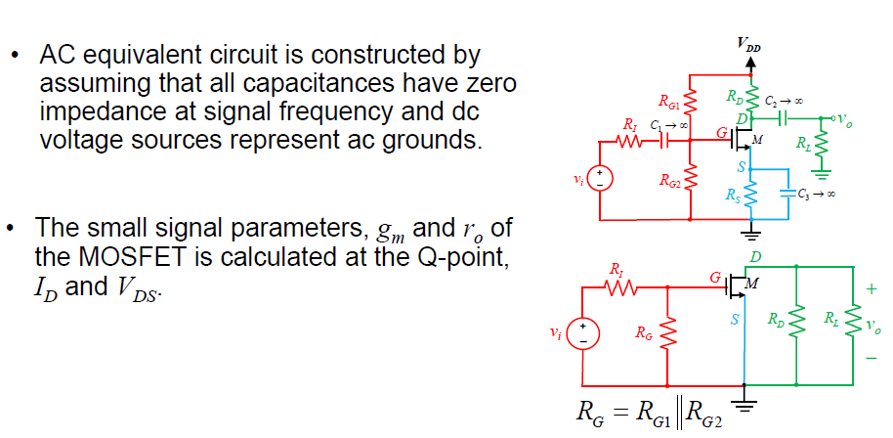
Example AC Analysis: CS amplifier

Slide 25
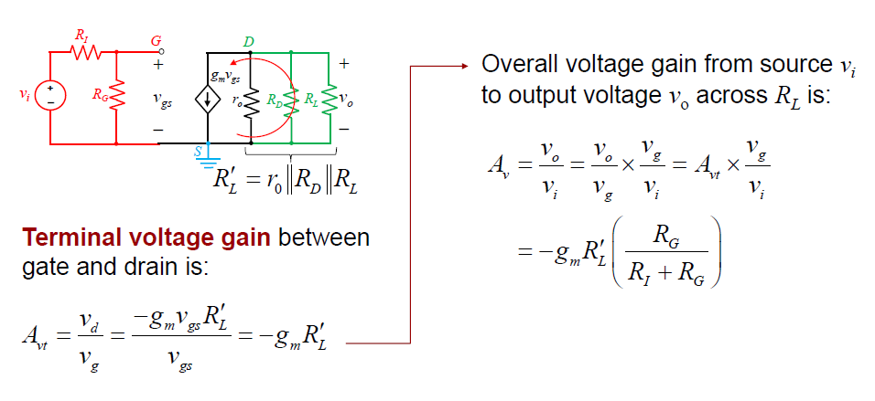
CS amplifier: Voltage Gain

Slide 26
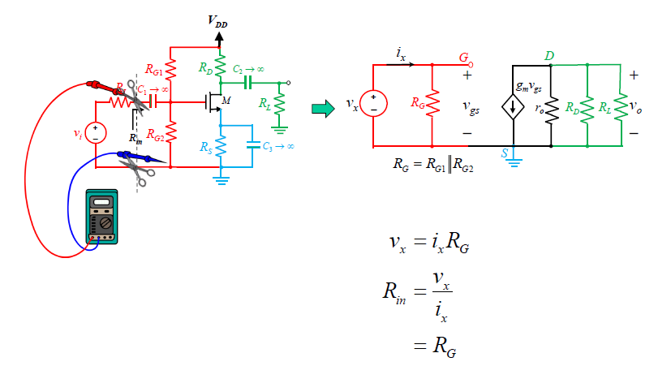
CS amplifier: Input Resistance

Slide 27
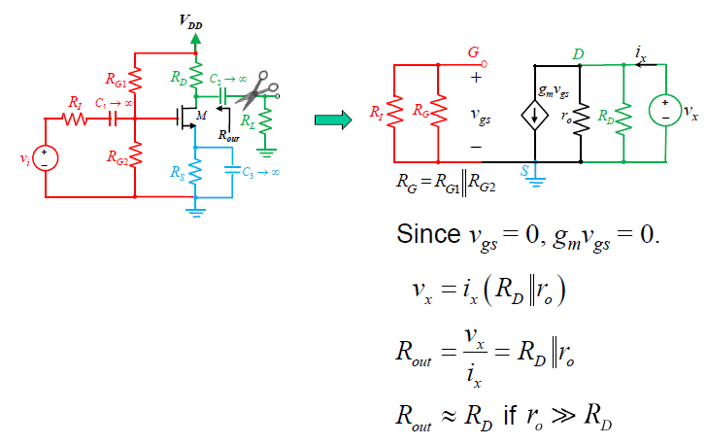
CS amplifier: Output Resistance

Slide 28
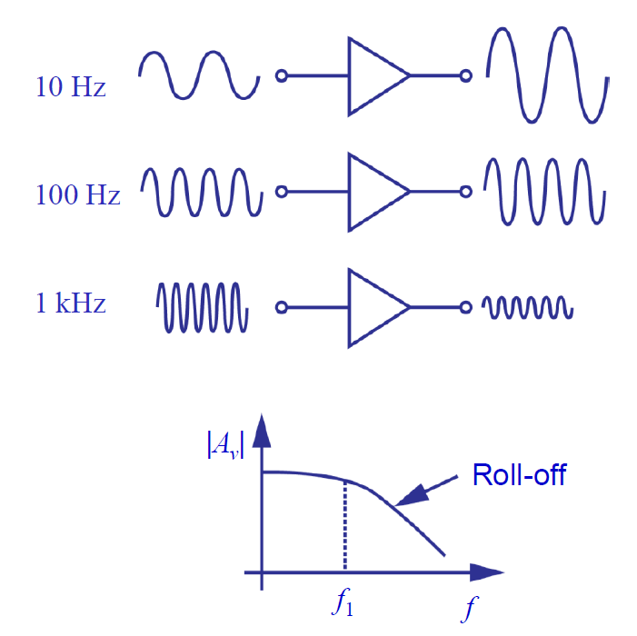
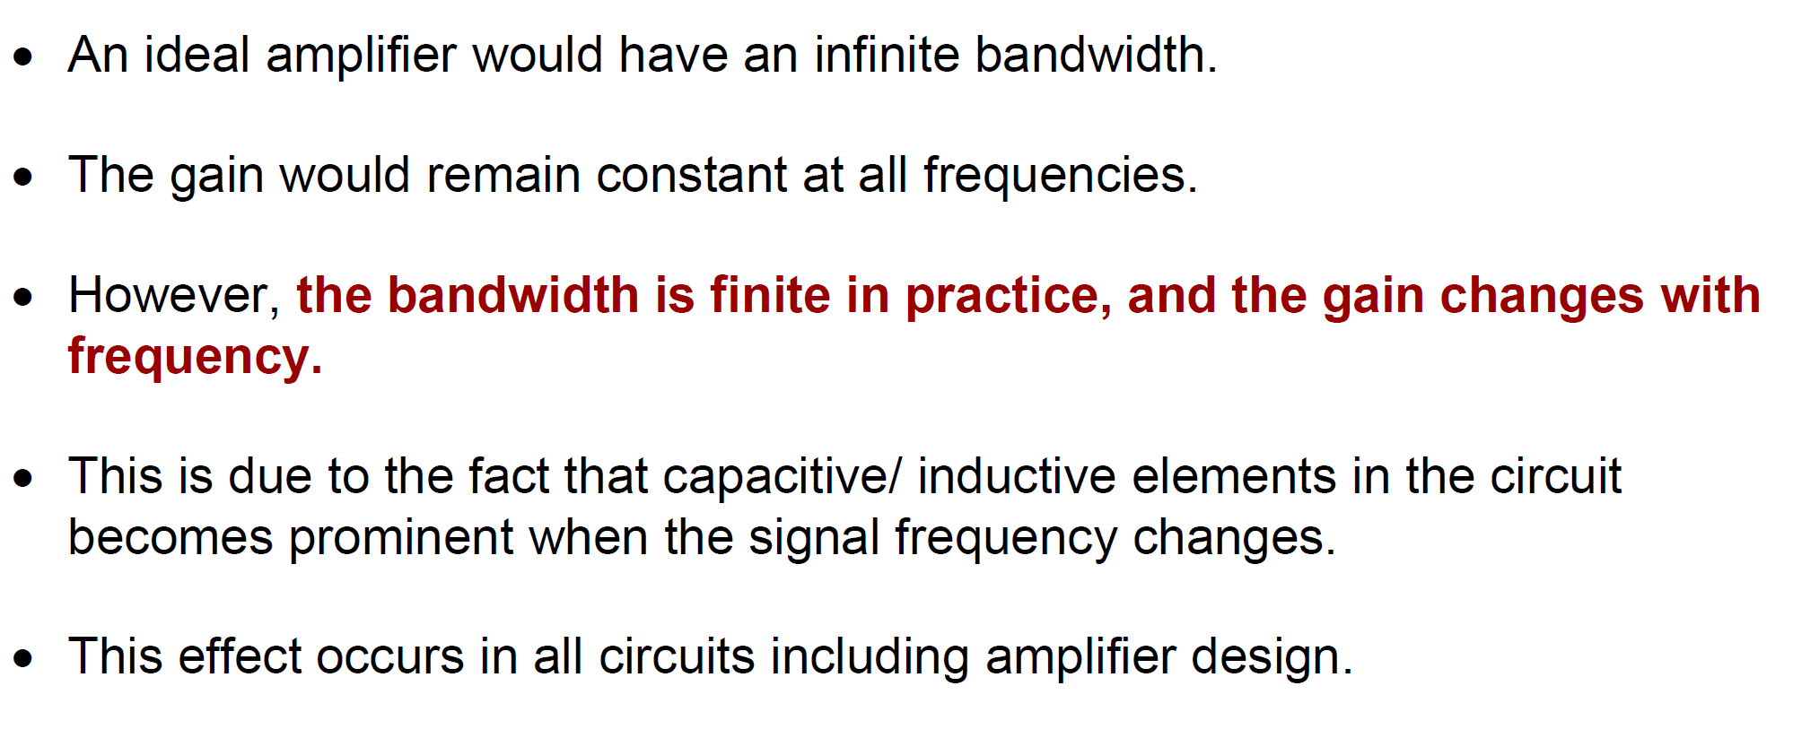
Frequency Response
Gain of amplifier reduces at high frequency! –WHY?
(Gain is a graph –not 1 number!)

Slide 29
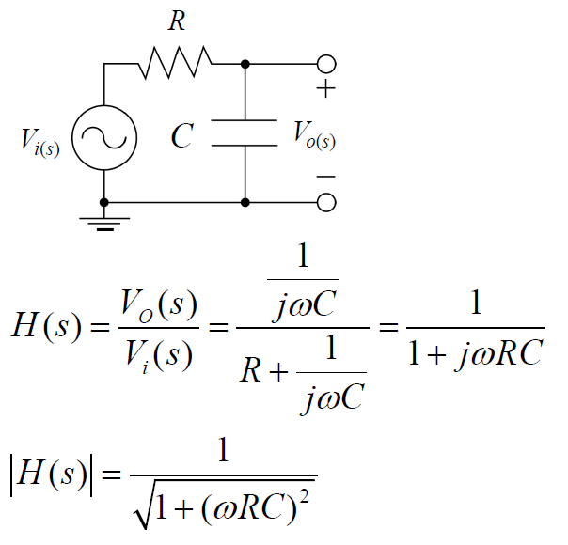
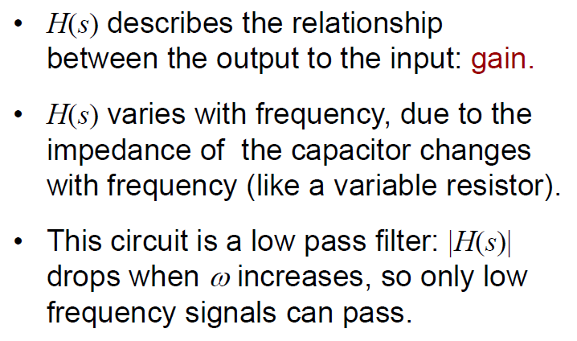
Example of RC circuit
To get intuition, always try to find the gain for small and large w

Slide 30
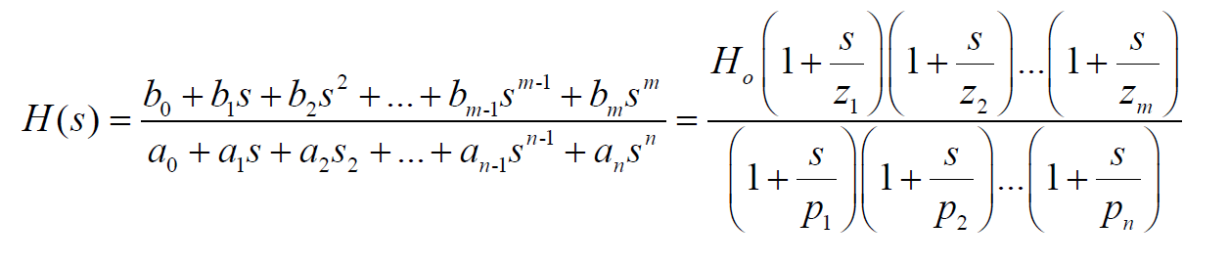
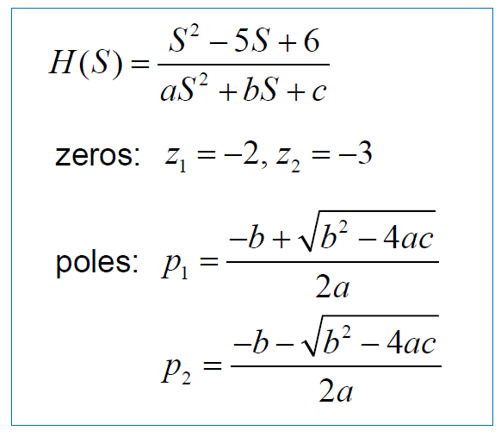
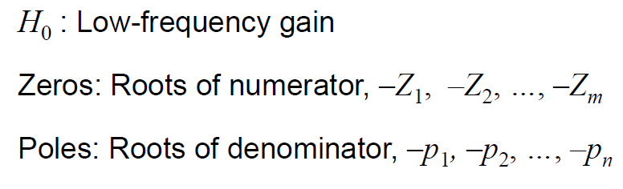
General Transfer Function

Slide 31
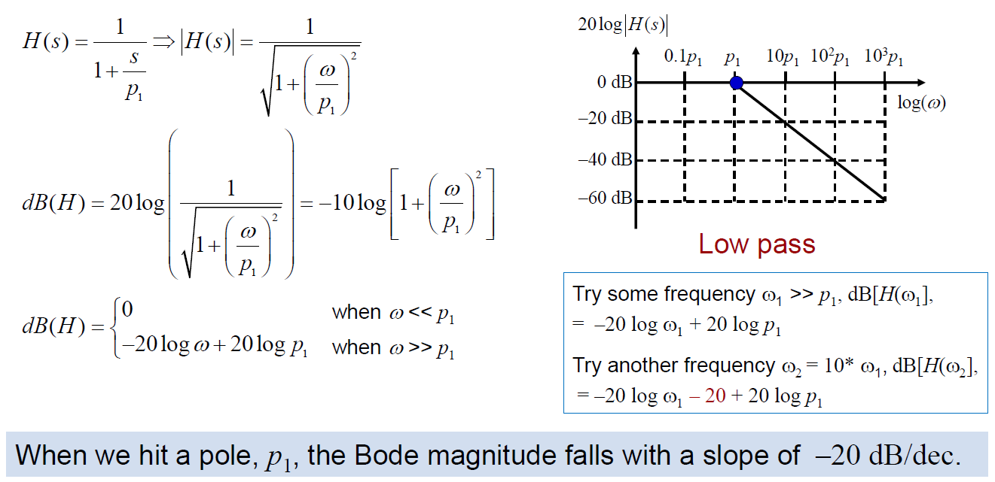
Magnitude Bode plots: Single pole system
|H(jw)|
The pole frequency is an important point on X axis-slope changes after this point

Slide 32
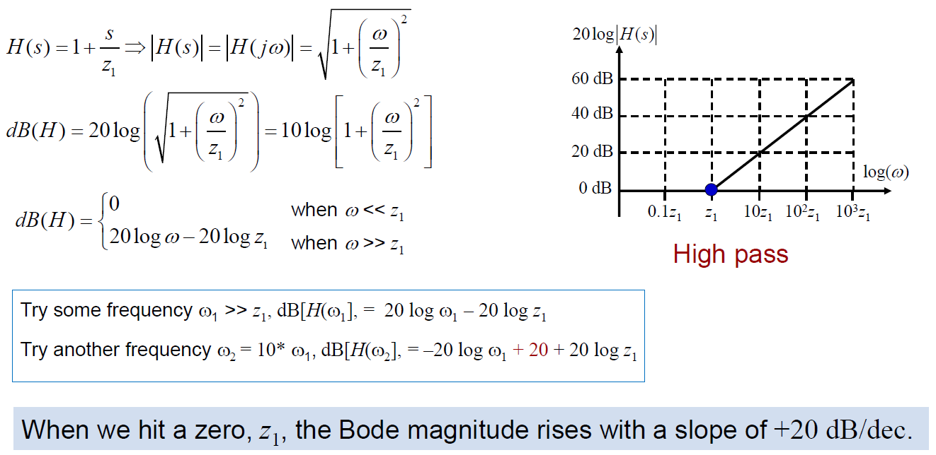
Magnitude Bode plots: Single zero system
The zero frequency is an important point on X axis-slope changes after this point

Slide 33
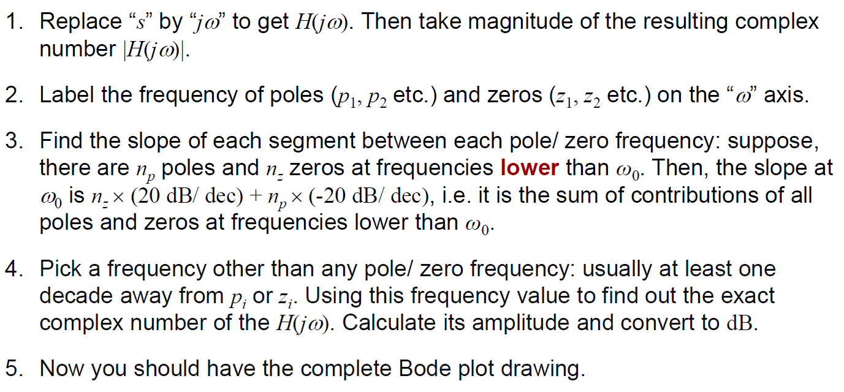
Bode plots: Many pole zero system
(only if $p_{i}≠0,z_{i}≠0$)
(this part only tells slope)
(this part adds exact magnitude information)

Slide 34
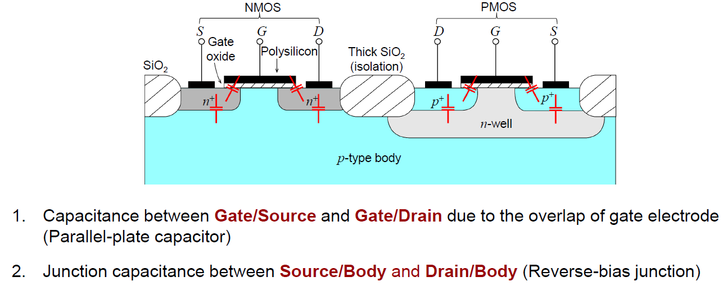

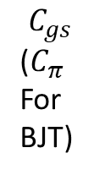
Parasitic Capacitors in Transistors
Earlier model (valid for low frequency)
$$C_{gd}(C_{μ} for BJT)$$
Typically Cgs >> Cgd (though effect of Cgd may be amplified by Miller Effect)
$$C_{gs}$$
($C_{π}$
For
BJT)
v_{gs}
v_{gs}
/r_{o}
New model (including capacitors)

Slide 35
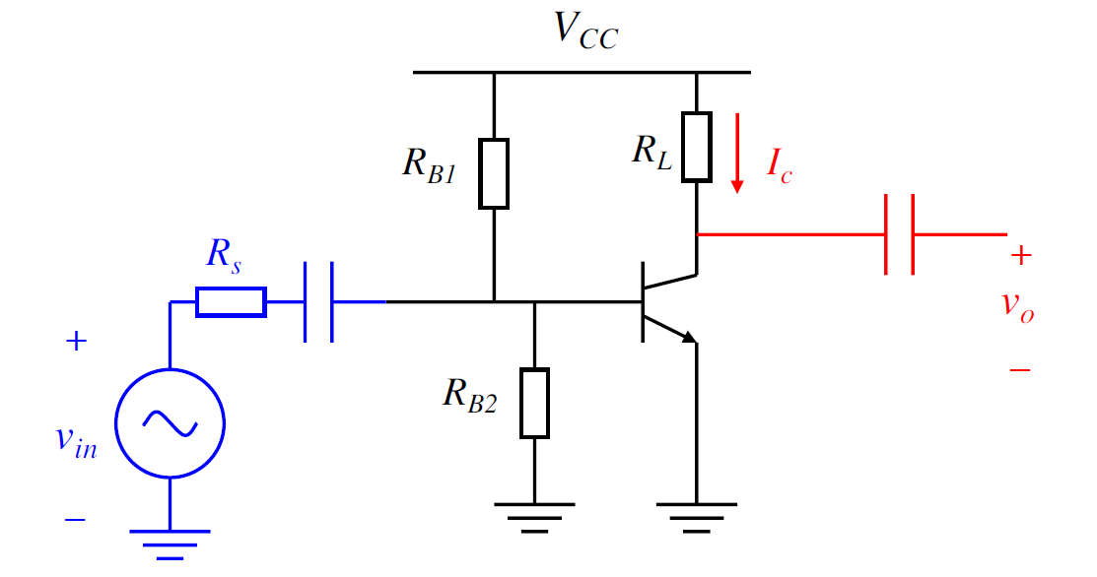
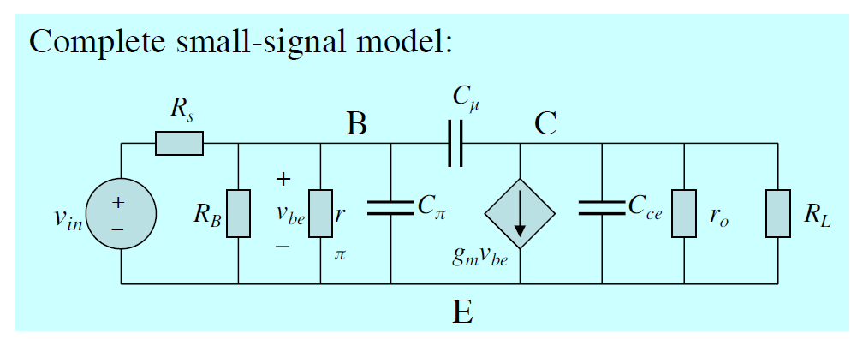


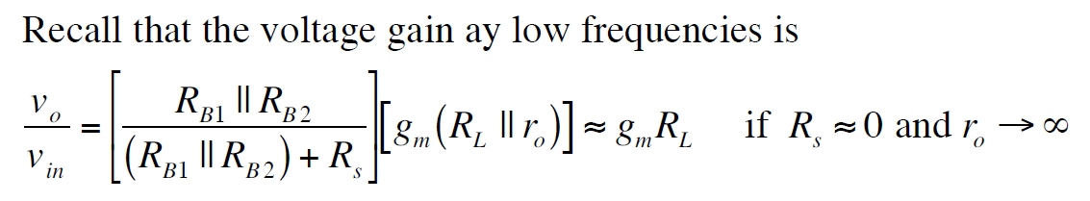
Example: CE amplifier
C_{c}
R_{B}’
Ignored since very small
Also, Cc >> C_{Π}
R_{B}’ + R_{s}
Where R_{B}’ = R_{B1}||R_{B2}||r_{π}

Slide 36
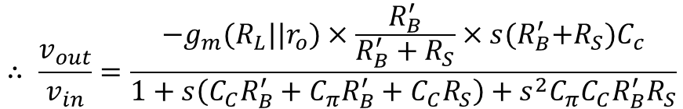
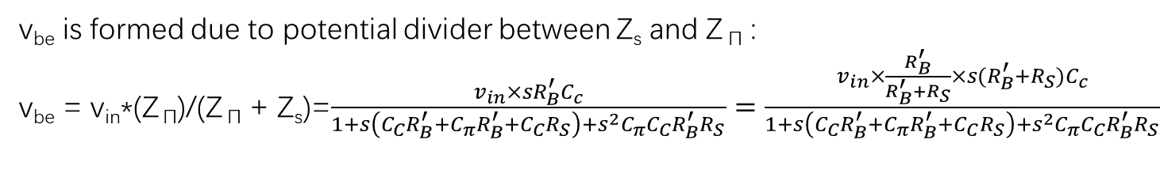
Example: CE amplifier
V_{out} = -g_{m}v_{be}*(R_{L}||r_{o})
Denote R_{B} || r_{Π} = R_{B}’
Denote Z _{Π} = R_{B}’ || (1/sC _{Π}) = R_{B}’/(1+s R_{B}’ C _{Π})
Denote Z_{s} = R_{s} + 1/sC_{c} =(1+s R_{s} C_{c})/sC_{c}
v_{be} is formed due to potential divider between Z_{s} and Z _{Π} :
v_{be} = v_{in}*(Z _{Π})/(Z _{Π} + Z_{s})=$\frac{v_{in}×sR_{B}^{′}C_{c}}{1+s\left(C_{C}R_{B}^{′}+C_{π}R_{B}^{′}+C_{C}R_{S}\right)+s^{2}C_{π}C_{C}R_{B}^{′}R_{S}}=\frac{v_{in}×\frac{R_{B}^{′}}{R_{B}^{′}+R_{S}}×s{(R}_{B}^{′}+R_{S})C_{c}}{1+s\left(C_{C}R_{B}^{′}+C_{π}R_{B}^{′}+C_{C}R_{S}\right)+s^{2}C_{π}C_{C}R_{B}^{′}R_{S}}$
$$∴ \frac{v_{out}}{v_{in}}=\frac{{−g}_{m}(R_{L}||r_{o})×\frac{R_{B}^{′}}{R_{B}^{′}+R_{S}}×s{(R}_{B}^{′}+R_{S})C_{c}}{1+s\left(C_{C}R_{B}^{′}+C_{π}R_{B}^{′}+C_{C}R_{S}\right)+s^{2}C_{π}C_{C}R_{B}^{′}R_{S}}$$

Slide 37
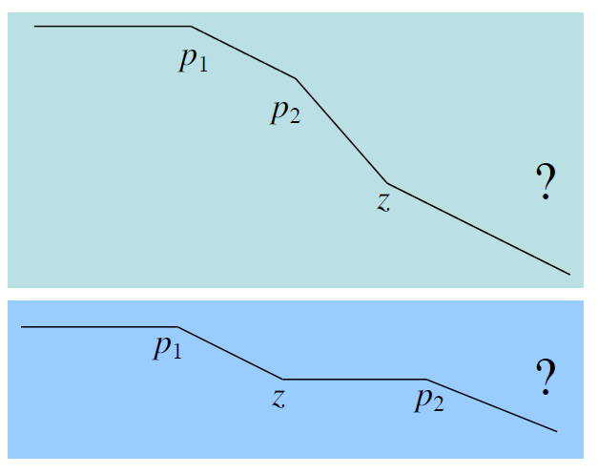
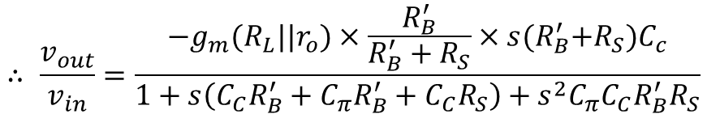
Example: CE amplifier
Highest power of s in numerator is 1 → 1 zero
Highest power of s in denominator is 2 → 2 poles
Tough to say anything else!!!
$$∴ \frac{v_{out}}{v_{in}}=\frac{{−g}_{m}(R_{L}||r_{o})×\frac{R_{B}^{′}}{R_{B}^{′}+R_{S}}×s{(R}_{B}^{′}+R_{S})C_{c}}{1+s\left(C_{C}R_{B}^{′}+C_{π}R_{B}^{′}+C_{C}R_{S}\right)+s^{2}C_{π}C_{C}R_{B}^{′}R_{S}}$$
Cc >> C_{Π}
Most important is p1 which dominates the bandwidth → Can approximate based on that!!

Slide 38
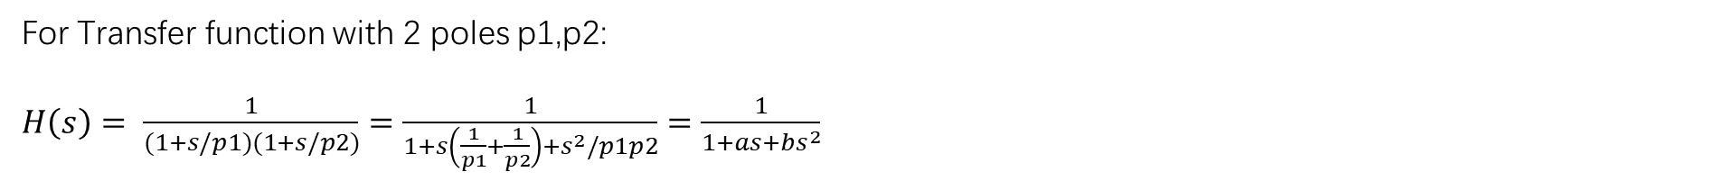
Dominant Pole Approximation
For Transfer function with 2 poles p1,p2:
$H\left(s\right)= \frac{1}{(1+s/p1)(1+s/p2)}=$ $\frac{1}{1+s\left(\frac{1}{p1}+\frac{1}{p2}\right)+s^{2}/p1p2}=\frac{1}{1+as+bs^{2}}$
Pole p1 is dominant means p1<<p2
Hence, a~1/p1 → p1 = 1/a
Also, b = 1/p1p2 ~a/p2 → p2 = a/b

Slide 39
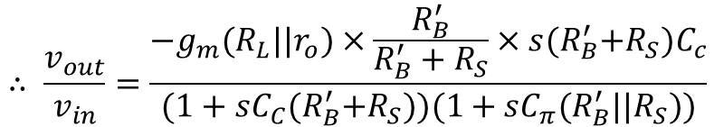
Example: CE amplifier
Applying dominant pole approximation,
p1 ~1/(C_{C}R_{B}’+C_{C}R_{S})
p2 ~C_{C}(R_{B}’+R_{S})/ C_{Π} C_{C}R_{B}’R_{S} =1/ (C_{Π}(R_{B}’||R_{S}))
$$∴ \frac{v_{out}}{v_{in}}=\frac{{−g}_{m}(R_{L}||r_{o})×\frac{R_{B}^{′}}{R_{B}^{′}+R_{S}}×s{(R}_{B}^{′}+R_{S})C_{c}}{1+s\left(C_{C}R_{B}^{′}+C_{π}R_{B}^{′}+C_{C}R_{S}\right)+s^{2}C_{π}C_{C}R_{B}^{′}R_{S}}$$
Cc >> C_{Π}
$$∴ \frac{v_{out}}{v_{in}}=\frac{{−g}_{m}(R_{L}||r_{o})×\frac{R_{B}^{′}}{R_{B}^{′}+R_{S}}×s{(R}_{B}^{′}+R_{S})C_{c}}{(1+sC_{C}{(R}_{B}^{′}+R_{S}))(1+sC_{π}(R_{B}^{′}||R_{S}))}$$

Slide 40
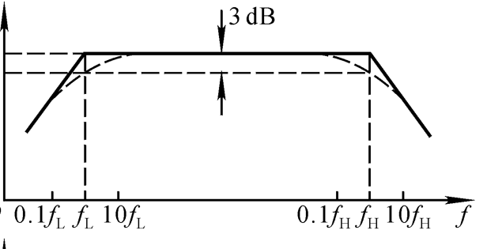
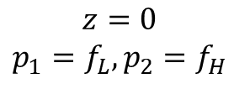
Example: CE amplifier
Applying dominant pole approximation,
p1 ~1/(C_{C}R_{B}’+C_{C}R_{S})
p2 ~C_{C}(R_{B}’+R_{S})/ C_{Π} C_{C}R_{B}’R_{S} =1/ (C_{Π}(R_{B}’||R_{S}))
(Open-circuit/Short-circuit time constant method can allow you to directly get p1,p2)
One zero, Two poles
20log|H(s)|
$$z=0$$
$$p_{1}=f_{L}, p_{2}=f_{H}$$
$$∴ \frac{v_{out}}{v_{in}}=\frac{{−g}_{m}(R_{L}||r_{o})×\frac{R_{B}^{′}}{R_{B}^{′}+R_{S}}×s{(R}_{B}^{′}+R_{S})C_{c}}{(1+sC_{C}{(R}_{B}^{′}+R_{S}))(1+sC_{π}(R_{B}^{′}||R_{S}))}$$

