Slide 1
EE3122: Analogue Circuit Fundamentals
Transistor
Department of Electrical Engineering
City University of Hong Kong
Prof. Arindam BASU

Slide 2
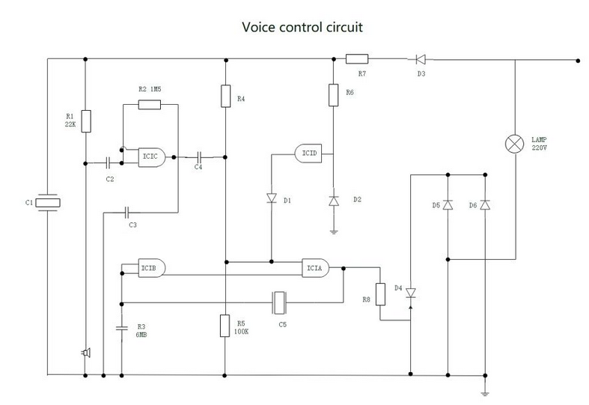
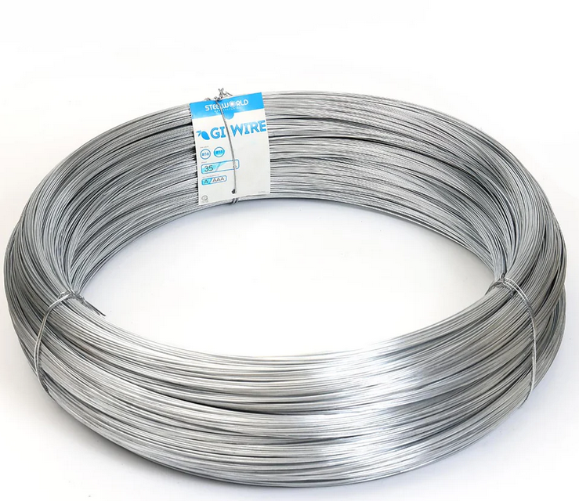
Wire (Revision)
Voltage same at both ends
All the current that comes in one end goes out the other

Slide 3
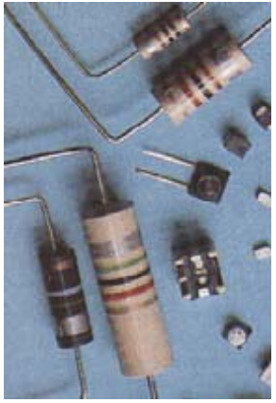
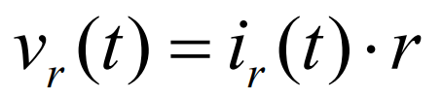
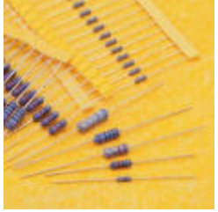
Resistors (Revision)
Voltage linearly proportional to current

Slide 4
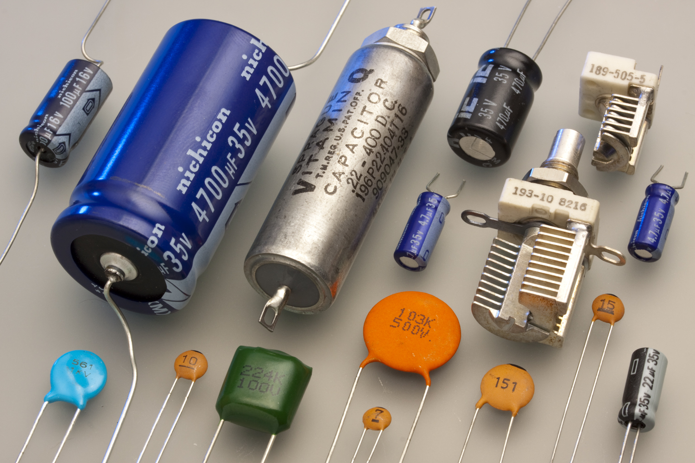
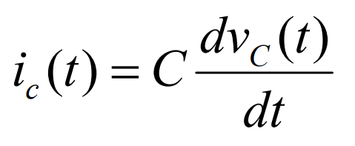
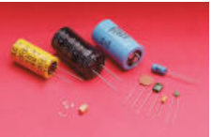
Capacitors (Revision)
Voltage proportional to charge
Current is rate of change of charge dq/dt, so current is proportional to the rate of change in the voltage.
Or, voltage is integral of current.

Slide 5
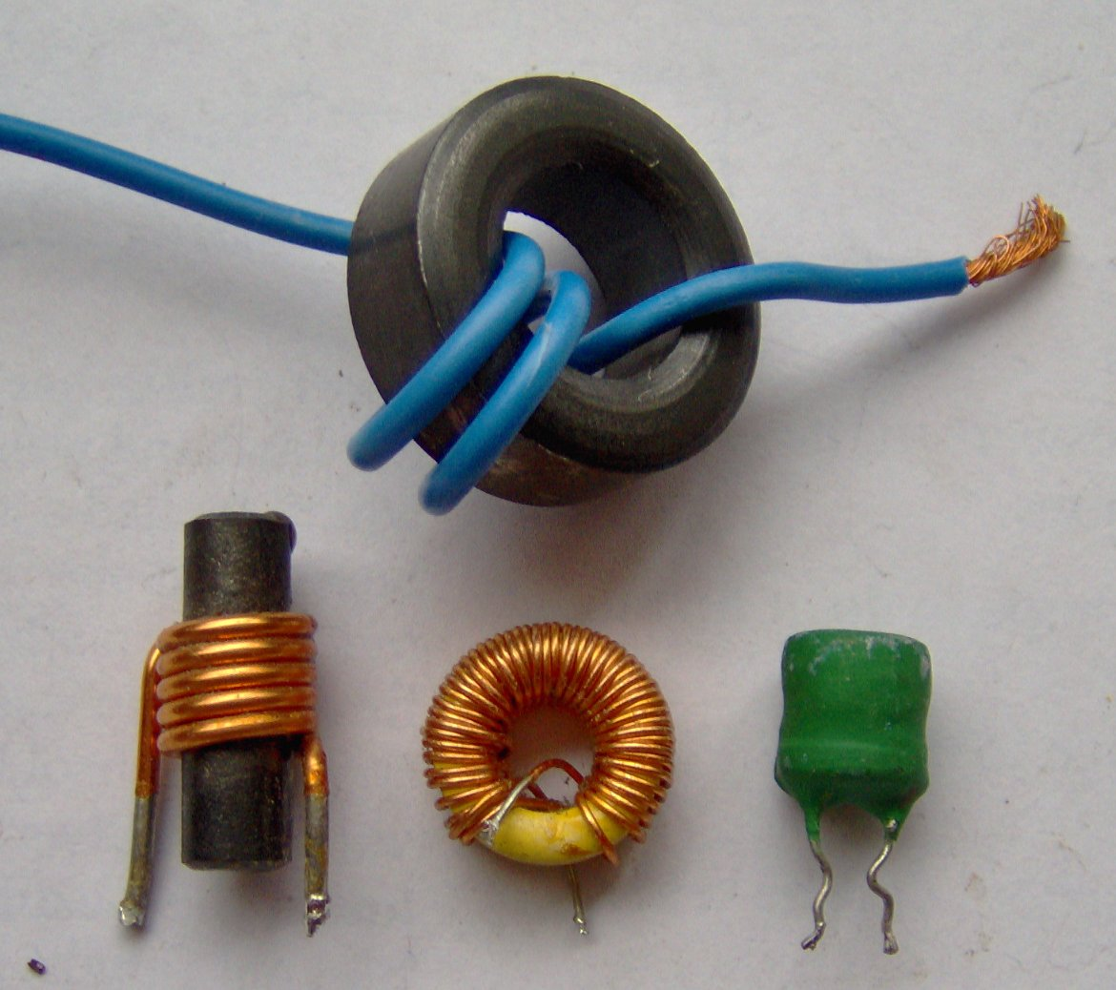
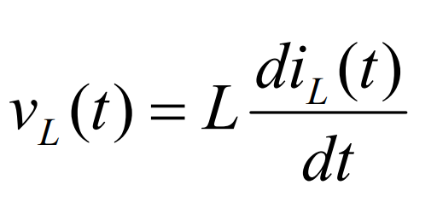
Inductors (Revision)
Voltage proportional to rate of change of current with time

Slide 6
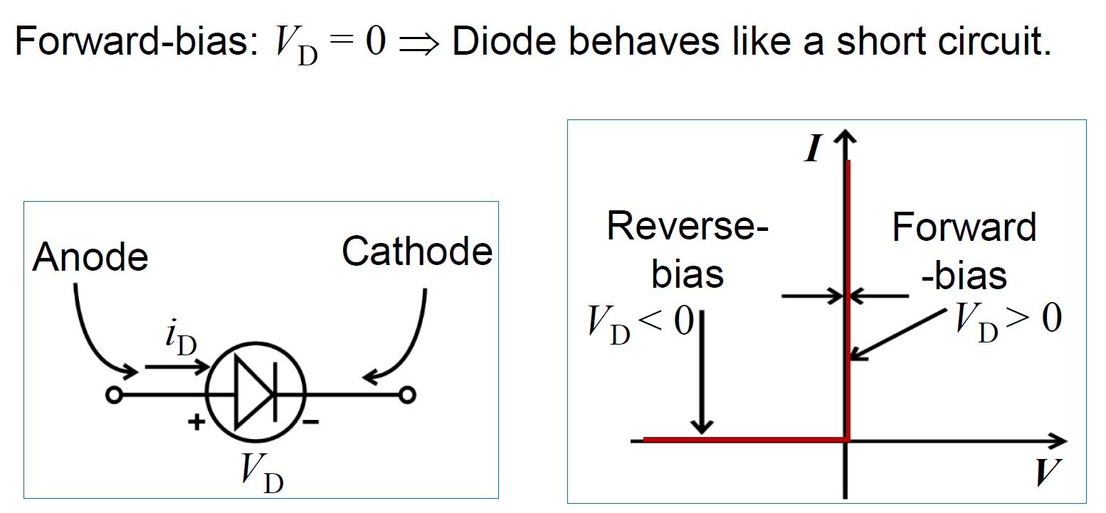
Diode (Revision)
A two-terminal device.

Slide 7
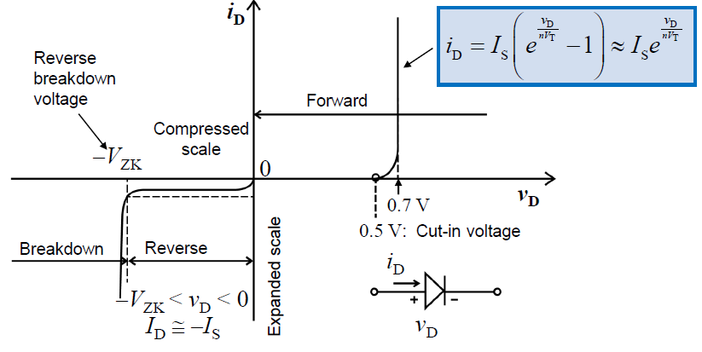

Diode (Revision)
Non-ideal case
$$i_{D}=I_{SS}(e^{\frac{v_{D}}{v_{T}}}−1)≈I_{SS}e^{\frac{v_{D}}{v_{T}}}$$

Slide 8
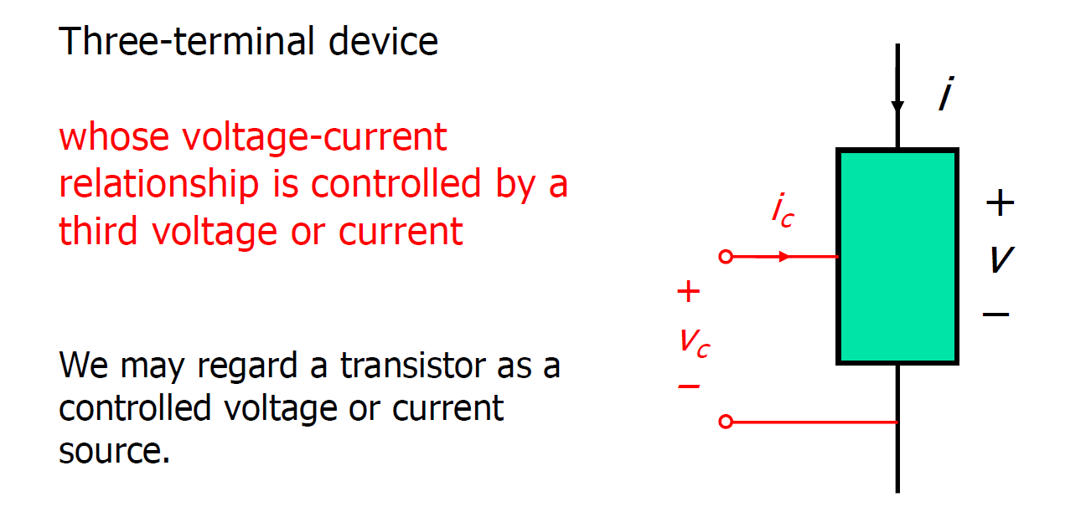
What is a transistor?
Transistor is a voltage/current controlled current source

Slide 9
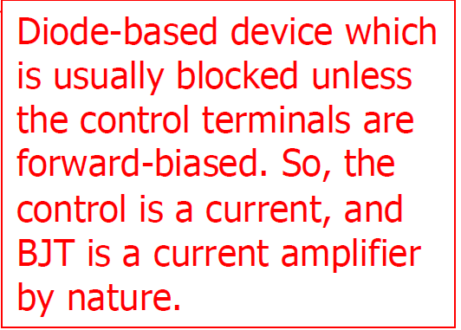
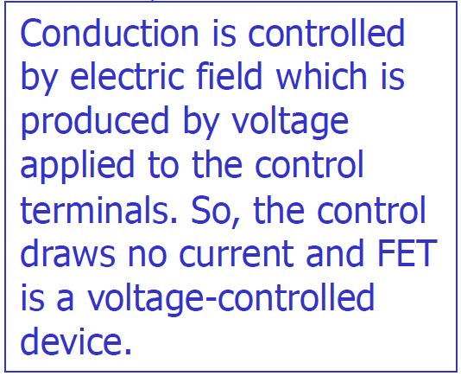
Types of transistors
According to the physics of the device, we can classify transistors into two main classes:
Bipolar junction transistors (BJT)
Field effect transistors (FET)

Slide 10
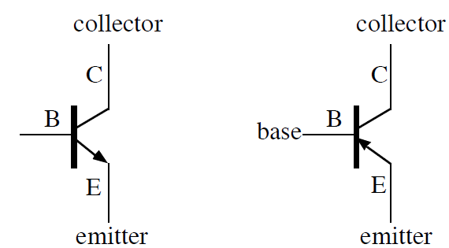
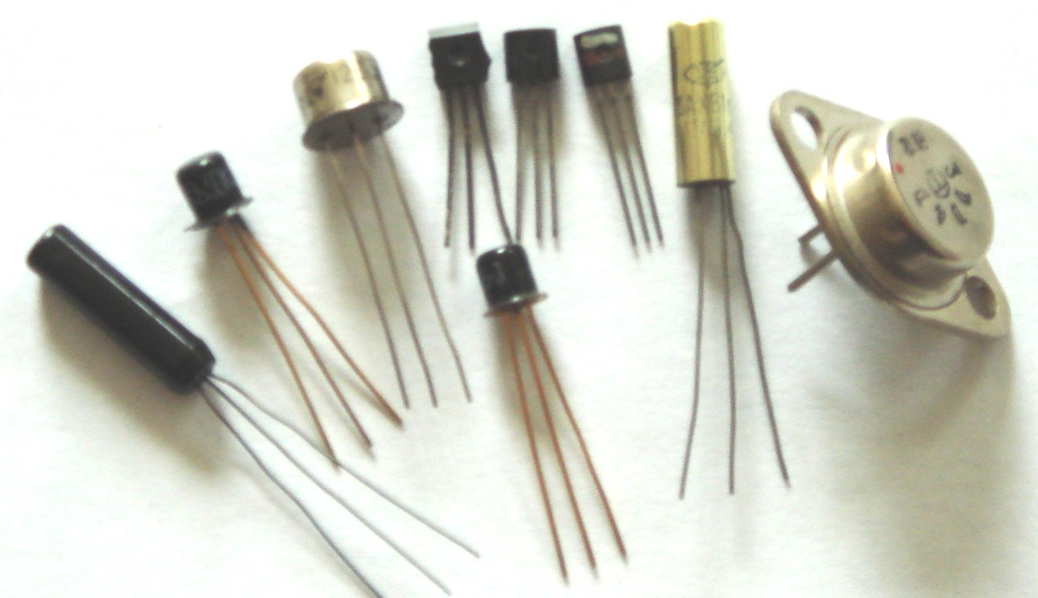
Bipolar junction transistor (BJT)
base
NPN Transistor
PNP Transistor
Schematic Symbol

Slide 11
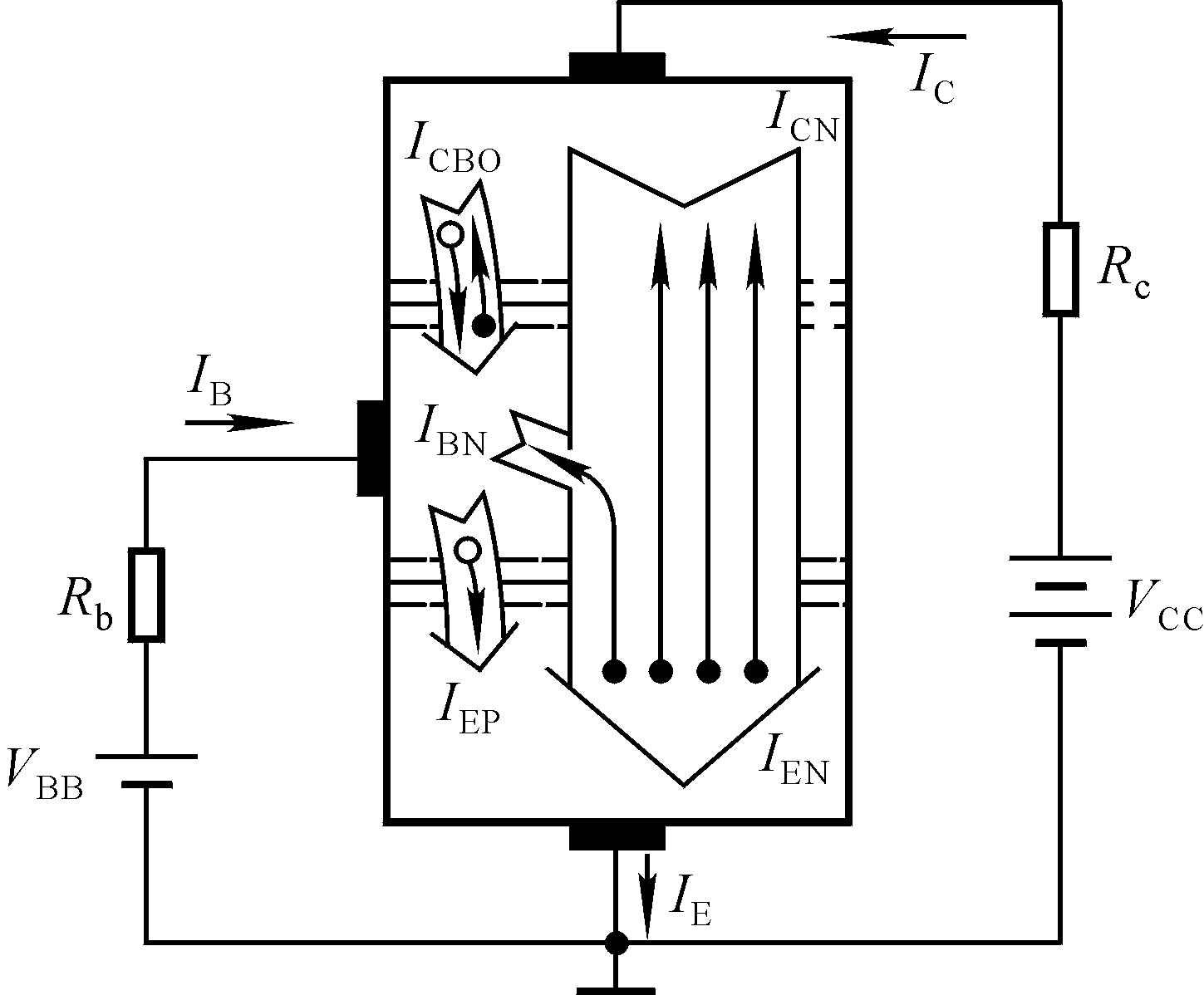
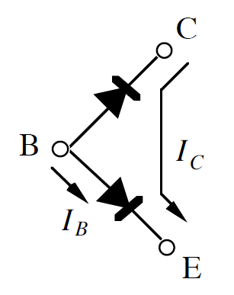
Bipolar junction transistor (BJT)
Considering NPN transistor:
The collector-base junction is reverse-biased. So, “ideally” no current can flow down.
If the base-emitter junction (BEJ) is forward biased (≈0.6/0.7V), then the diode “contact potential barrier” can be overcome. Electrons can go to base — called base injection.
These electrons are minority carriers, which are strongly attracted/captured by the collector. Hence, current flows down from collector to emitter.
THUS, we use a small base current to induce a large collector current.
N+
P
N
C
E
B
* The base region is very thin.
Simplified model
Idealized structure

Slide 12
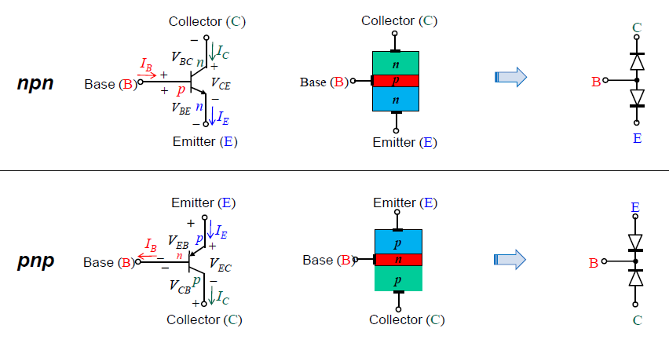
NPN and PNP BJT
NPN: E is lowest voltage
PNP: E is highest voltage

Slide 13
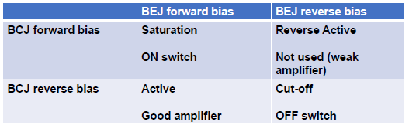
Summary: Region of Operation of BJT
Current conservation equation: I_{E} = I_{B} + I_{C}

Slide 14
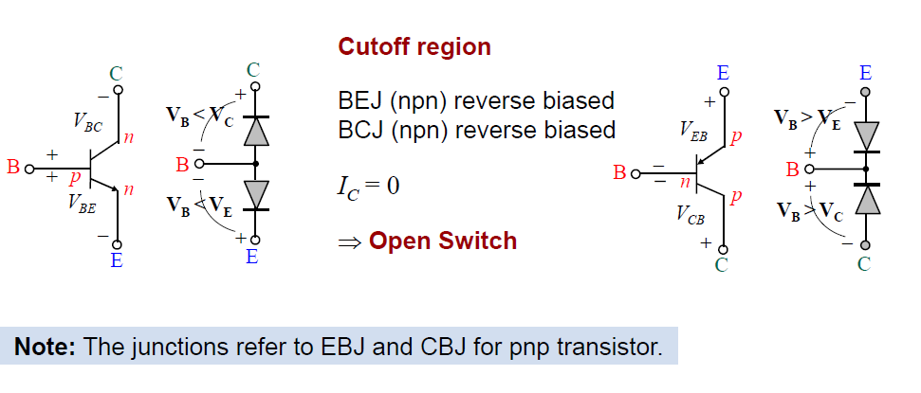
Operation Regions of BJT

Slide 15
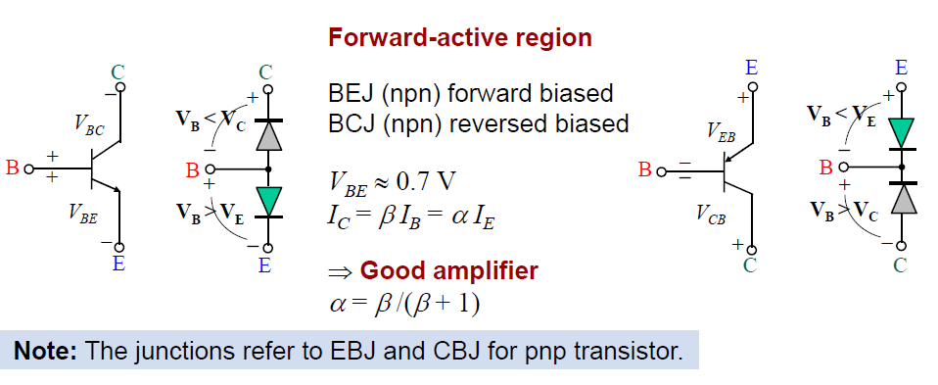
Operation Regions of BJT

Slide 16
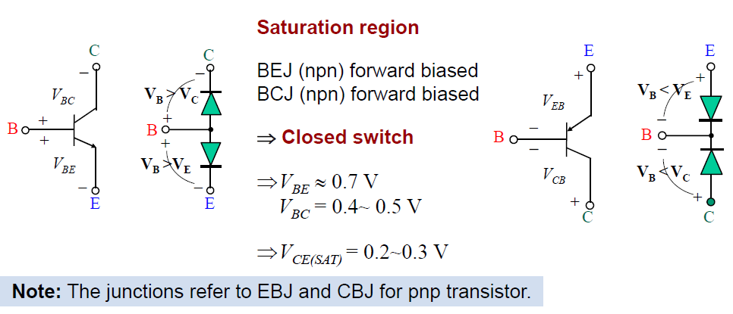
Operation Regions of BJT

Slide 17
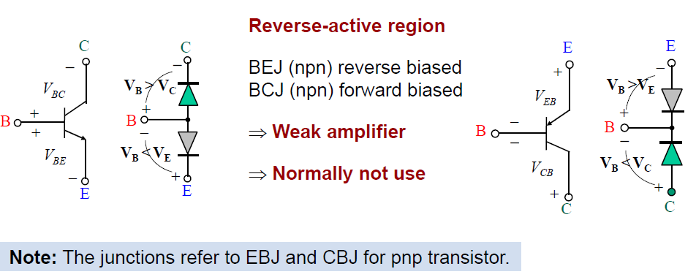
Operation Regions of BJT

Slide 18
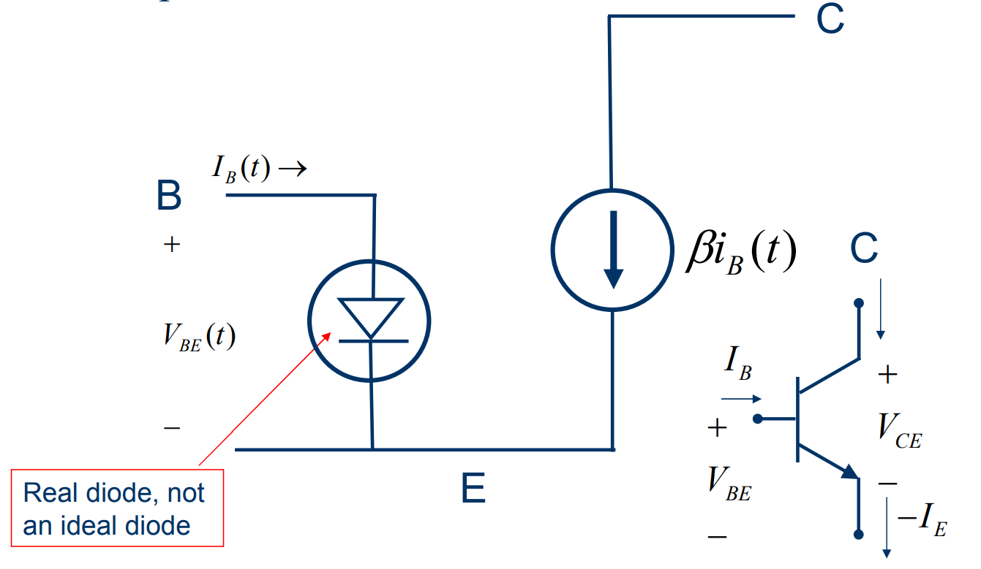
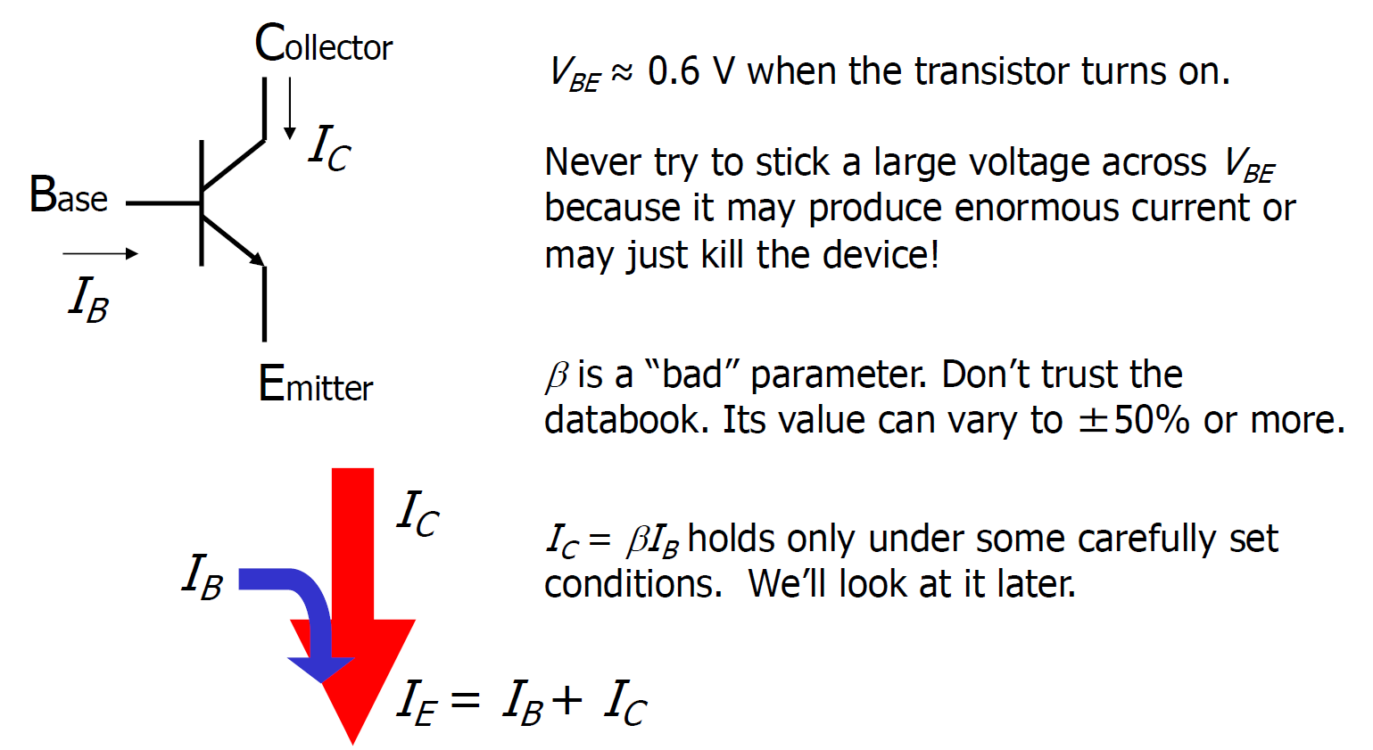

Some properties
$$VBE≈0.6/0.7V$$

Slide 19
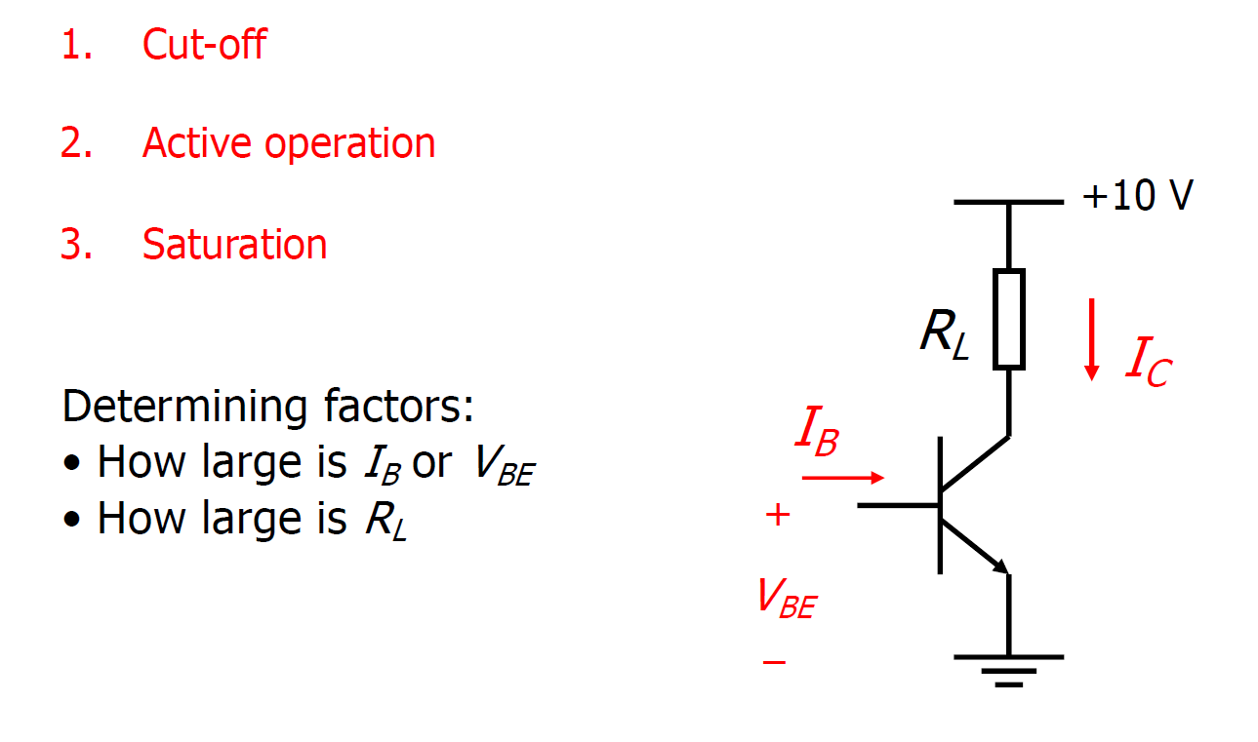
Typical operations in circuit

Slide 20
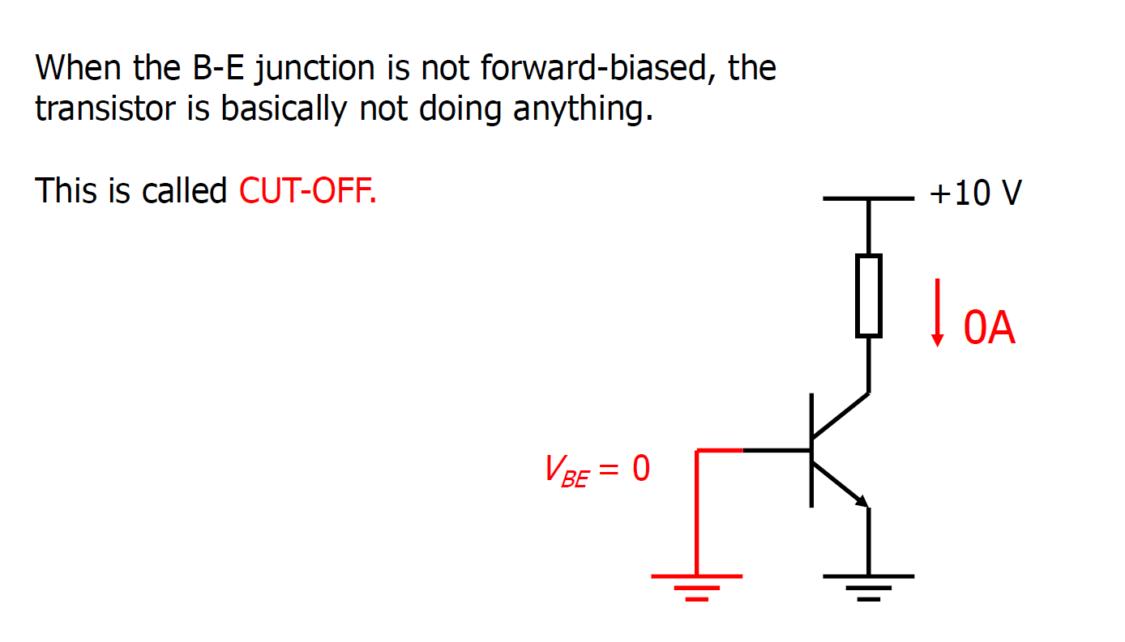
Cut-off

Slide 21
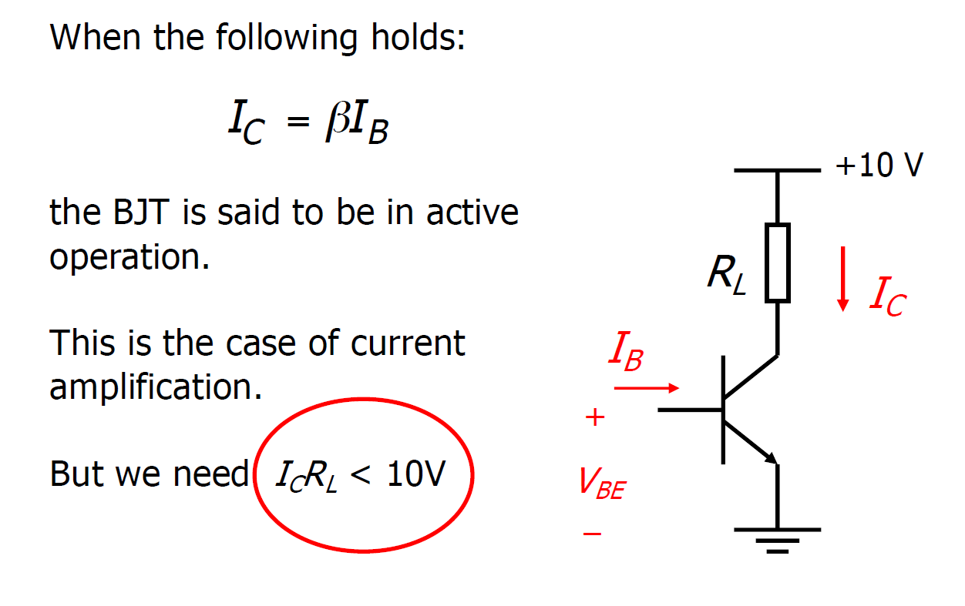
Active operation (for ideal transistor)

Slide 22
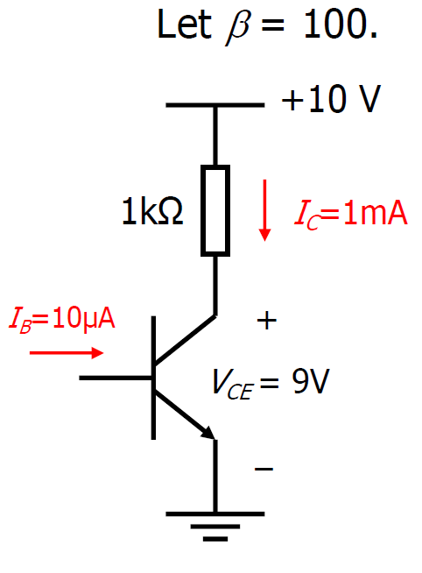
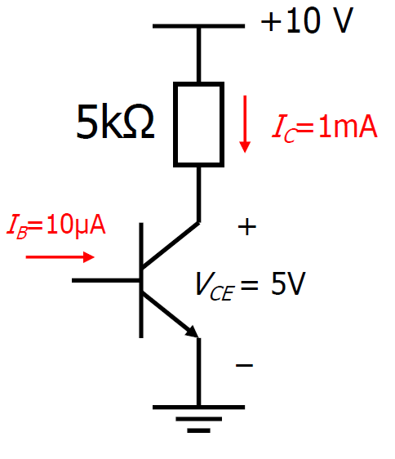
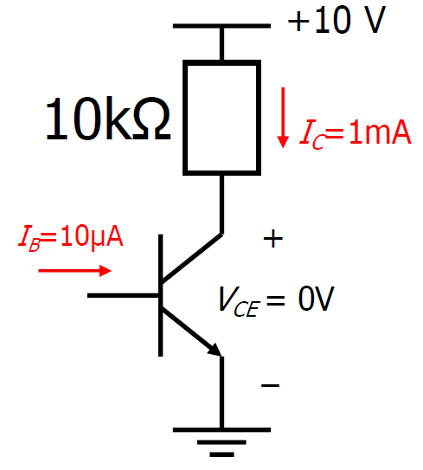
Active operation (for ideal transistor)

Slide 23
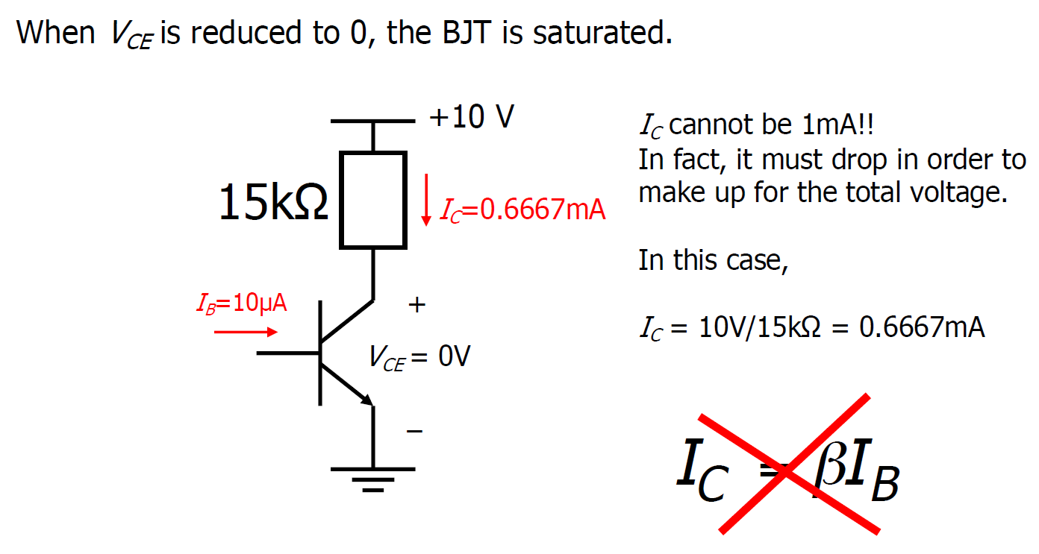
Saturation (for ideal transistor)

Slide 24
Saturation (for ideal transistor)

Slide 25
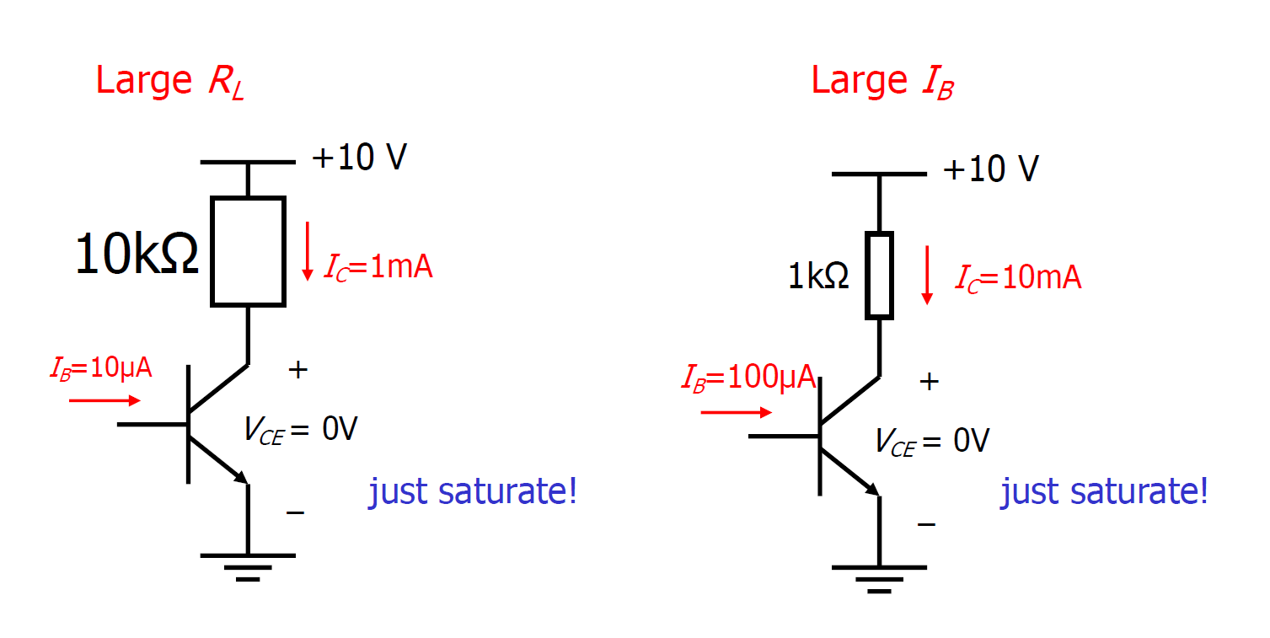
What makes it saturate?

Slide 26
What makes it saturate?

Slide 27
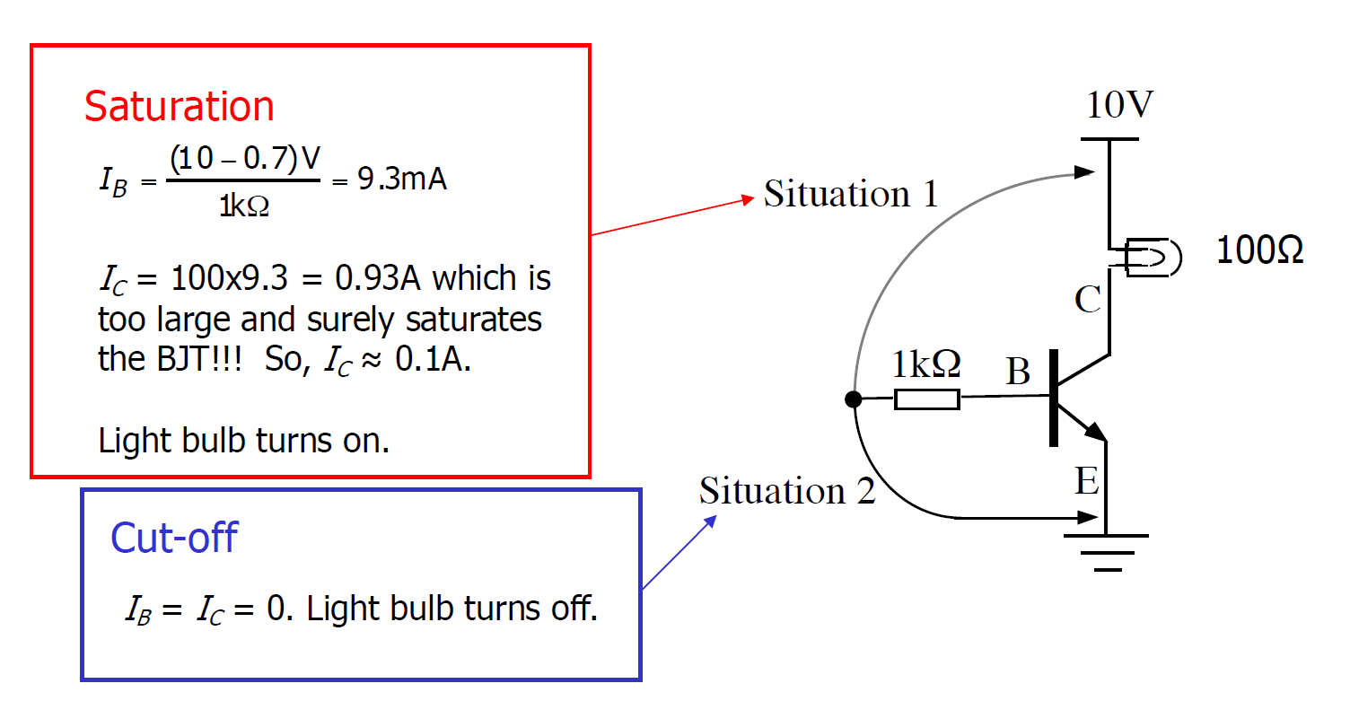
BJT as switch

Slide 28
BJT as switch

Slide 29
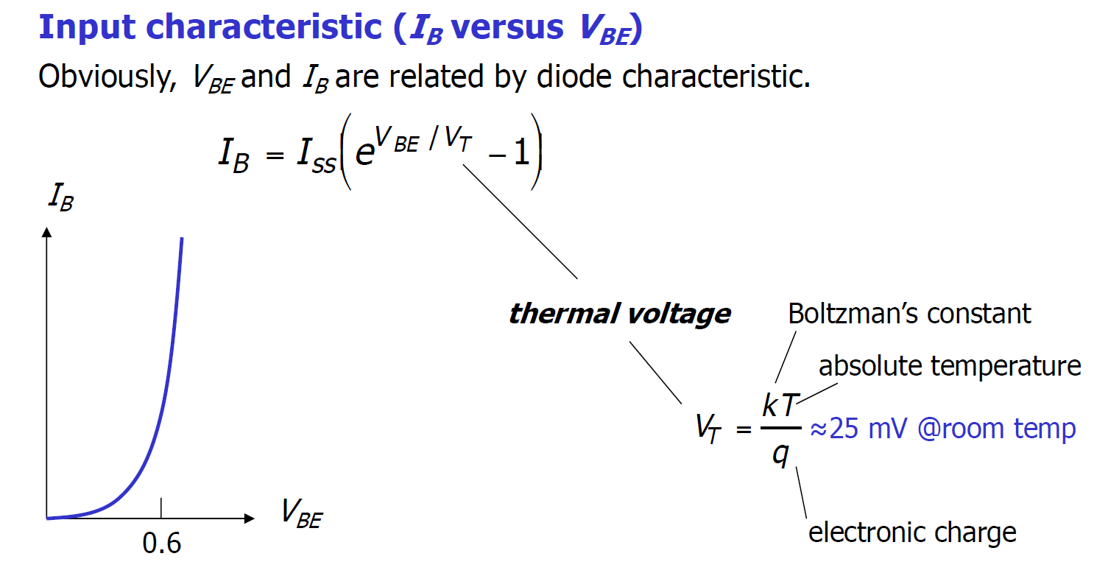
BJT characteristics
0.7

Slide 30
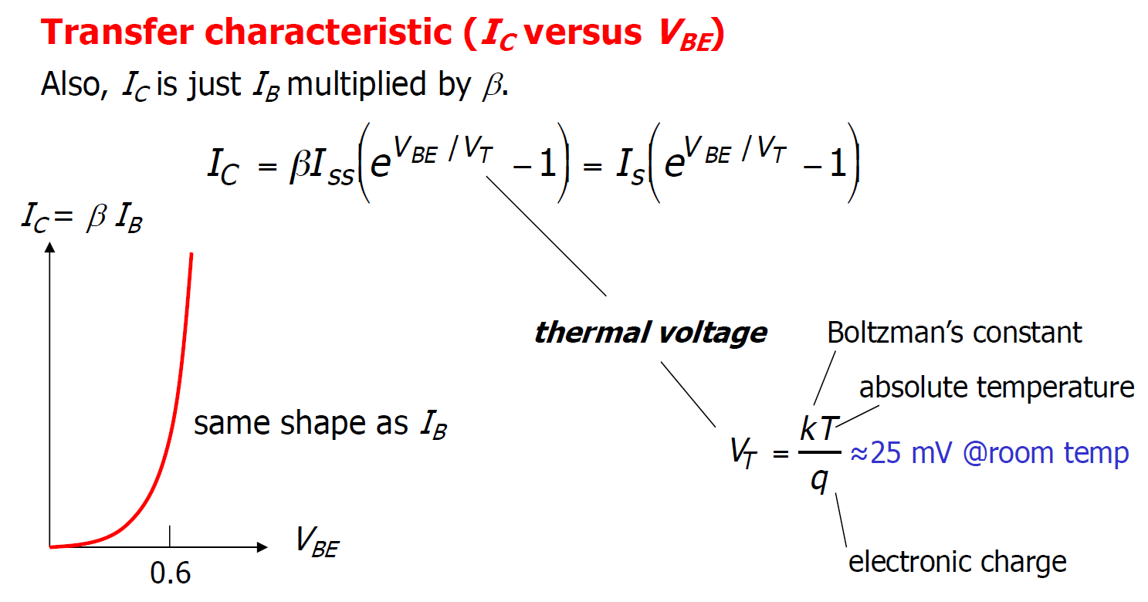
BJT characteristics
0.7

Slide 31
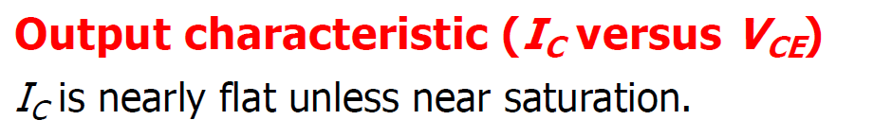
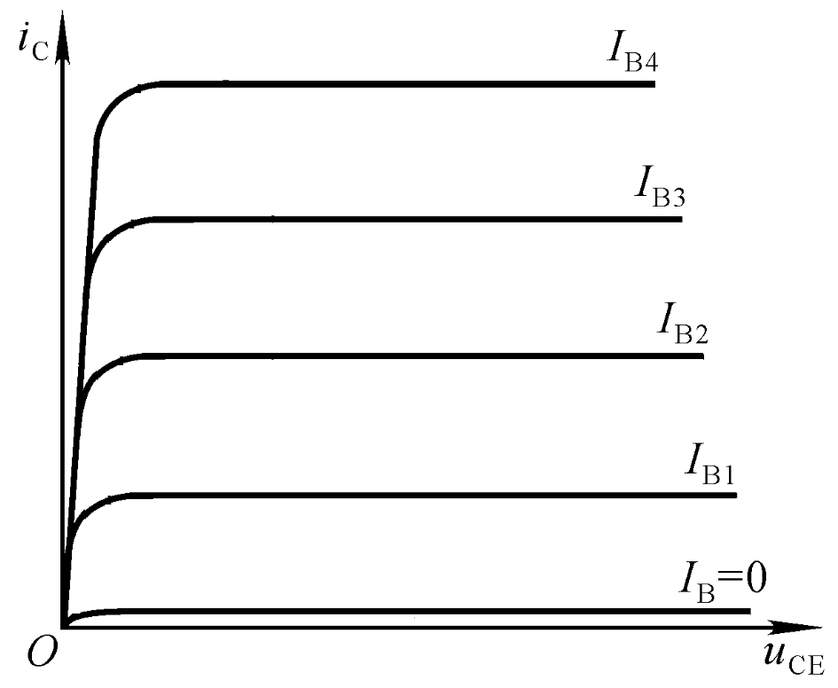
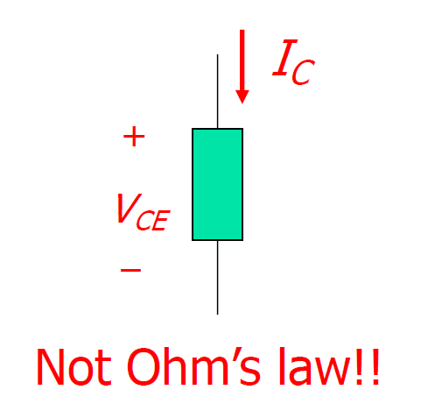
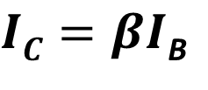
BJT characteristics
Saturation
Active Operation
$IC=βI$_{B}
Cut-off

Slide 32
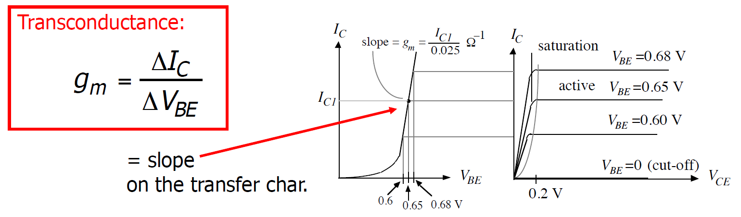
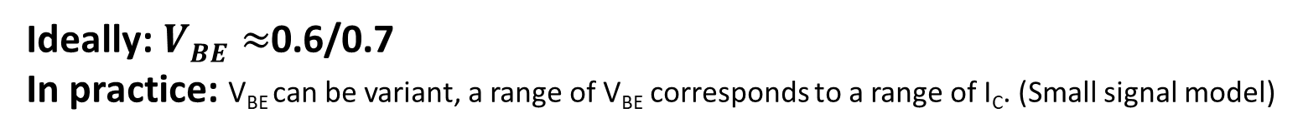
BJT characteristics
Ideally: $VBE≈$0.6/0.7
In practice: V_{BE} can be variant, a range of V_{BE} corresponds to a range of I_{C}. (Small signal model)

Slide 33
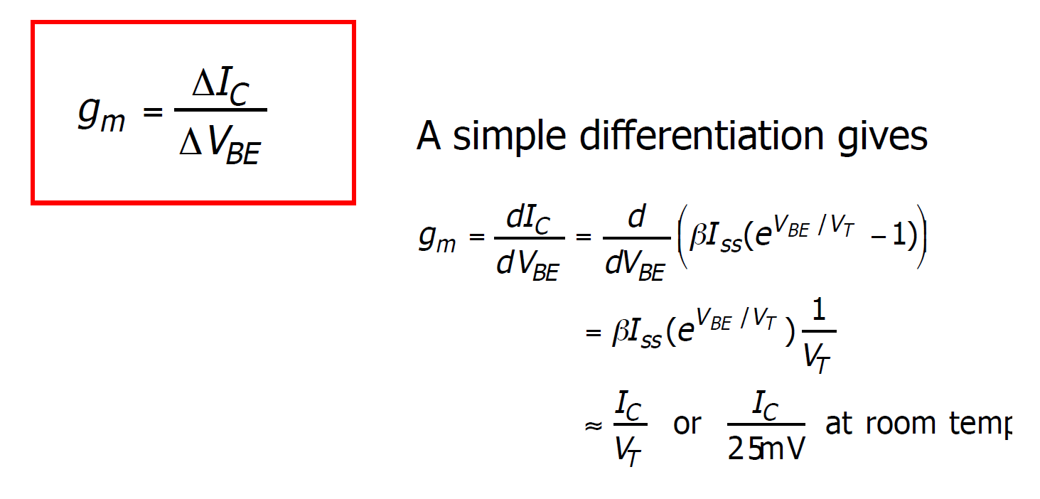
BJT characteristics
Transconductance

Slide 34
BJT characteristics
Transconductance
At room temp

Slide 35
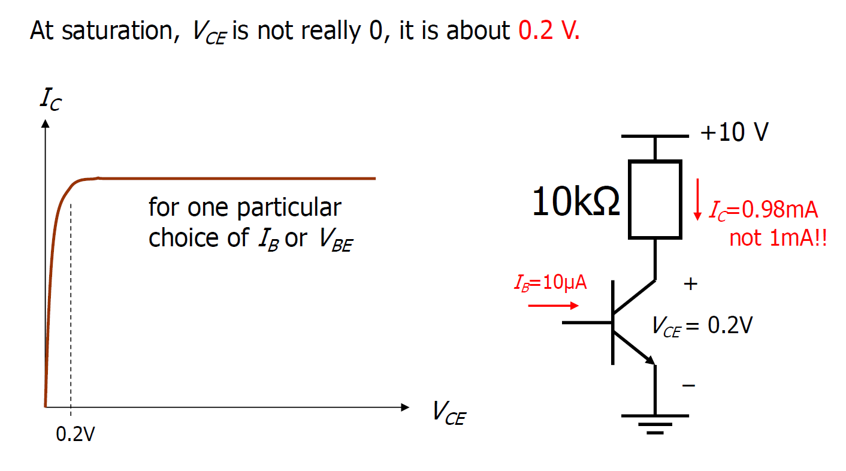
BJT characteristics

Slide 36
BJT characteristics
In our course, we treat the BJT to be ideal unless mentioned otherwise in the question.
However, in practice, we should let $V_{BE}<V_{CE}$ ($V_{CE}$ > 0.7V) to keep collector-base junction reverse-biased!!

Slide 37
BJT characteristics
For Exam/Quiz/Homework, we have $V_{CE}≥0.7V$，unless the transistor is assumed to be ideal.

Slide 38
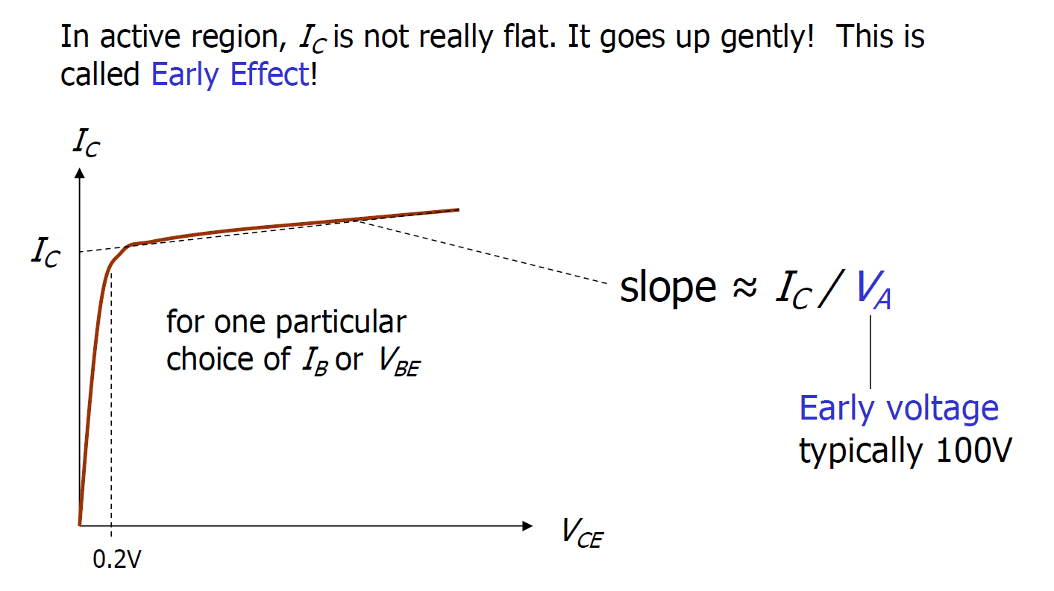
BJT characteristics

Slide 39
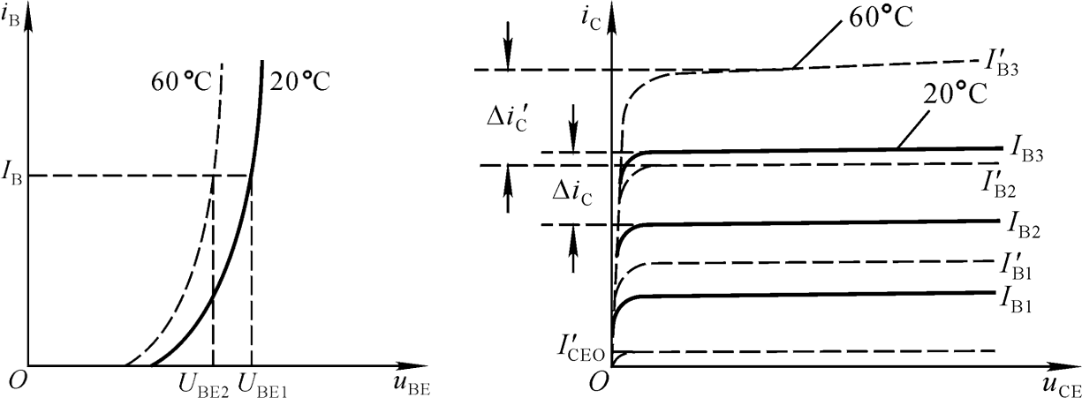
BJT characteristics
Temperature

Slide 40
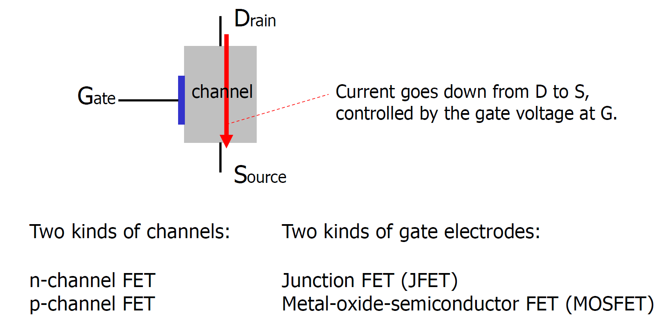
Field Effect Transistors (FET)

Slide 41
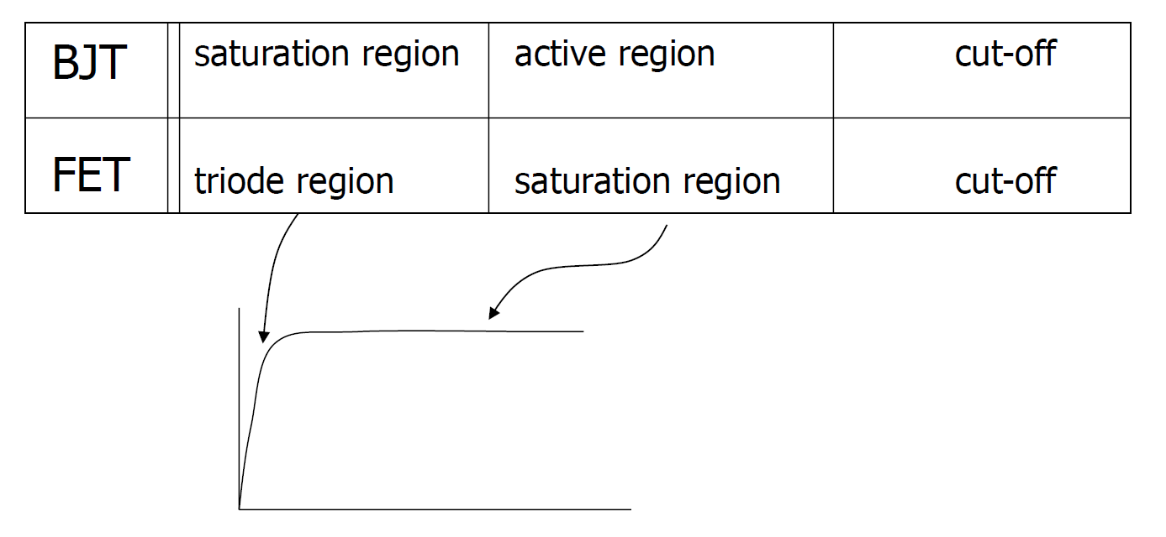
Terminology confusion
FET also has three types of operations.
I_{C}/I_{D}
V_{CE}/V_{DS}

Slide 42

n-channel MOSFET

Slide 43


n-channel MOSFET characteristic
Other symbol:

Slide 44

Summary: Region of operation of NMOS

Slide 45

MOSFET Biasing for Different Region of Operation
PMOS: S is highest voltage
NMOS: S is lowest voltage

Slide 46

Saturation region
The saturation current is proportional to (V_{GS}–V_{th})².
K/2

Slide 47

Saturation region
K/2

Slide 48

Triode region
K/2
K/2
K/2

Slide 49

n-channel MOSFET characteristic
K/2
K/2
K/2

Slide 50

Example (biasing in saturation)
1

Slide 51

Example (biasing in saturation)
1

Slide 52

Example (biasing in saturation)
1

Slide 53

Example (biasing in saturation)
1
K/2
$$ID=1.8845mA or 1.5742mA$$

Slide 54
Example (biasing in saturation)
K/2

Slide 55

Enhancement and depletion MOSFET

Slide 56
Enhancement and depletion MOSFET

Slide 57

Other FETs

Slide 58

p-channel FETs

