Slide 1
EE3114 Systems and Control
Tutorial - 2
Semester A, 2019-20

Slide 2
Review
Laplace Transform

Slide 3
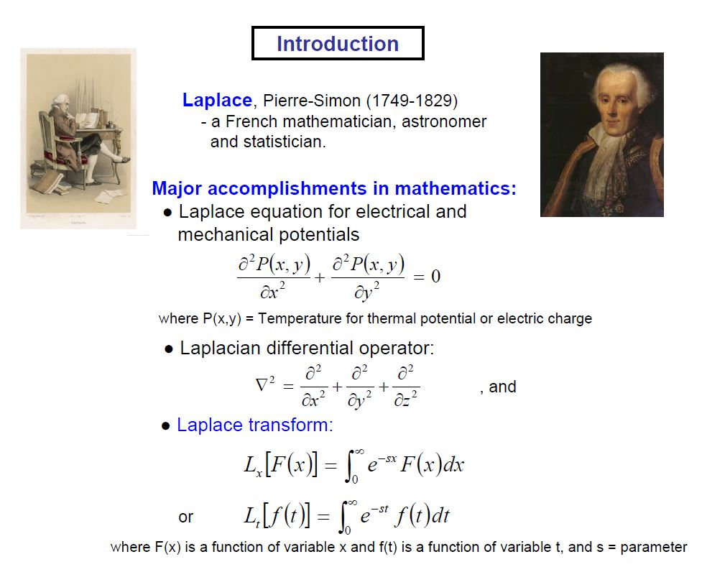

Slide 4
Review
Why Laplace Transform
Definition of Laplace Transform
Existence of Laplace Transform
Laplace Transform Properties
Laplace Transform Table
Inverse Laplace Transform

Slide 5
Why Laplace Transform
Solving linear ordinary differential equations (ODEs)
Converting functions of time t (real variable) to functions of frequency s (complex variable)
Converting ODEs to algebraic equations in s
Obtaining transfer functions
Using graphical techniques for predicting the performances of a system with out solving ODEs

Slide 6
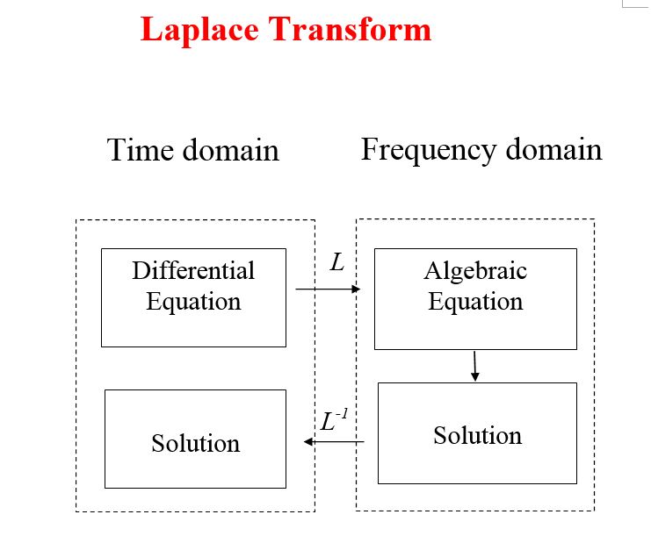

Slide 7
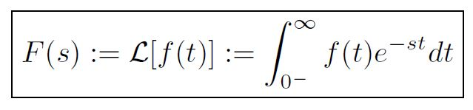
Definition of Laplace Transform
One-sided Laplace Transform

Slide 8
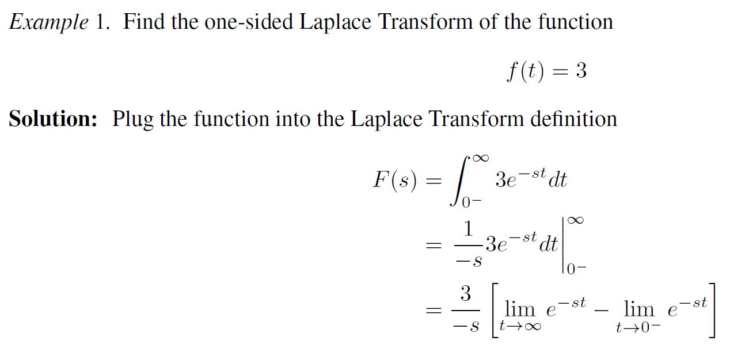
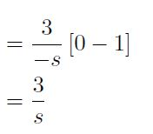
Existence of Laplace Transform
→
Existing only for Re(s) > 0 for the convergence of the “limit”

Slide 9
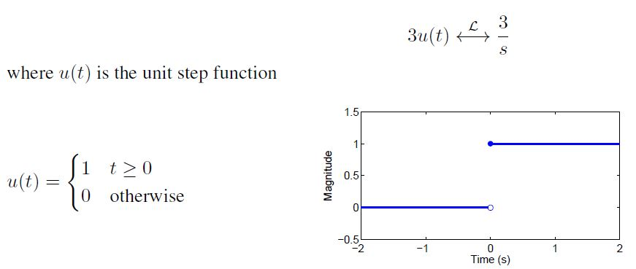
More precisely
Existing only for Re(s) > 0

Slide 10
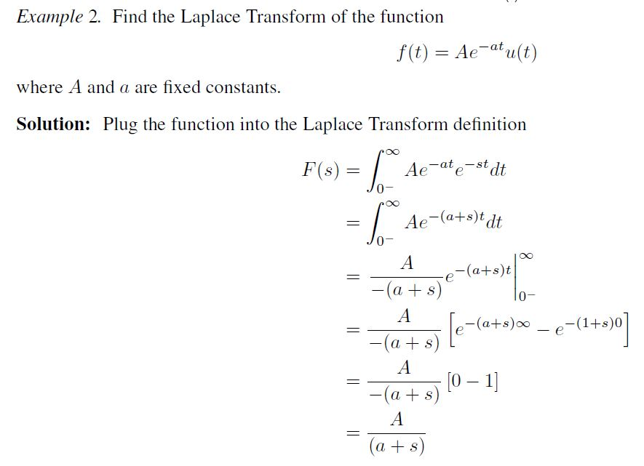
and u(t) is the unit step function.
Existing only for Re(s) > Re(-a)

Slide 11
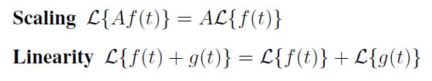
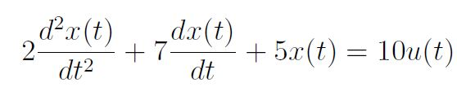
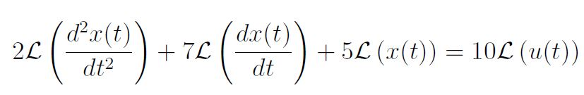
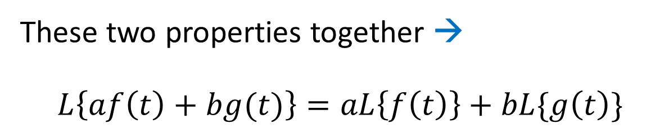
Properties of Laplace Transform
These two properties together →
$L\left\{af\left(t\right)+bg(t)\right\}=aL\left\{f\left(t\right)\right\}+bL\{g\left(t\right)\}$
Example:
(This will be solved later below)

Slide 12
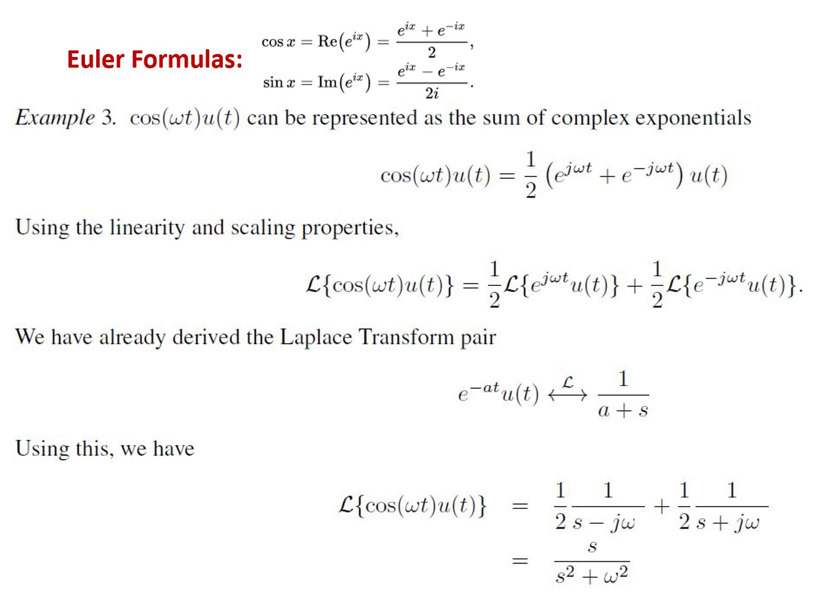

Euler Formulas:
.

Slide 13
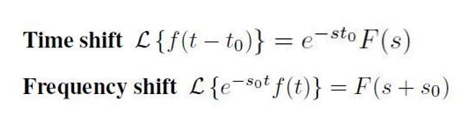
Properties of Laplace Transform

Slide 14
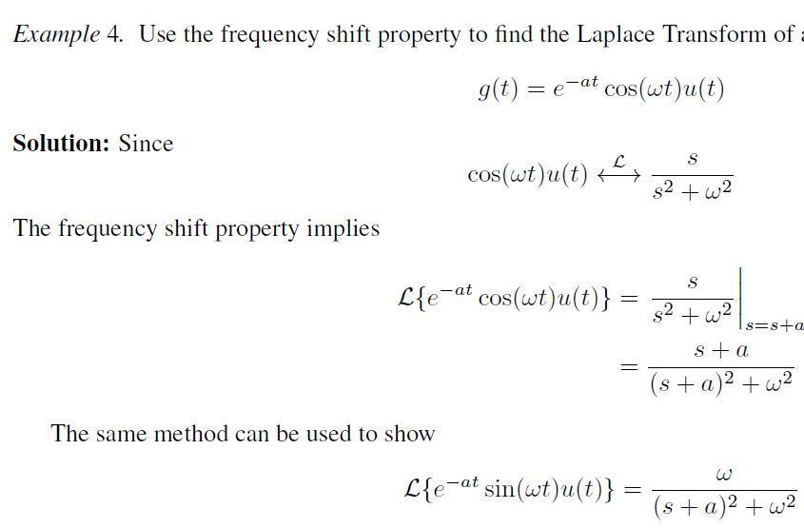

Slide 15
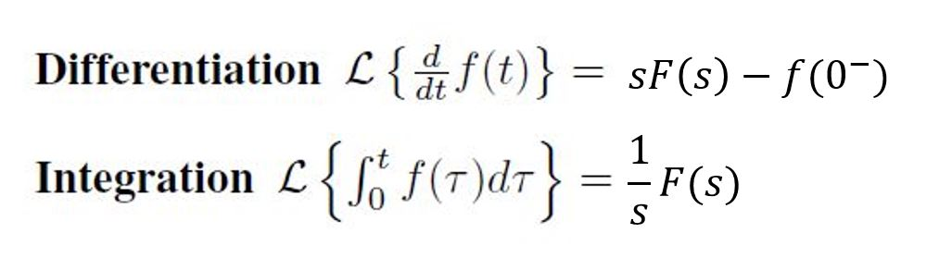
Properties of Laplace Transform

Slide 16
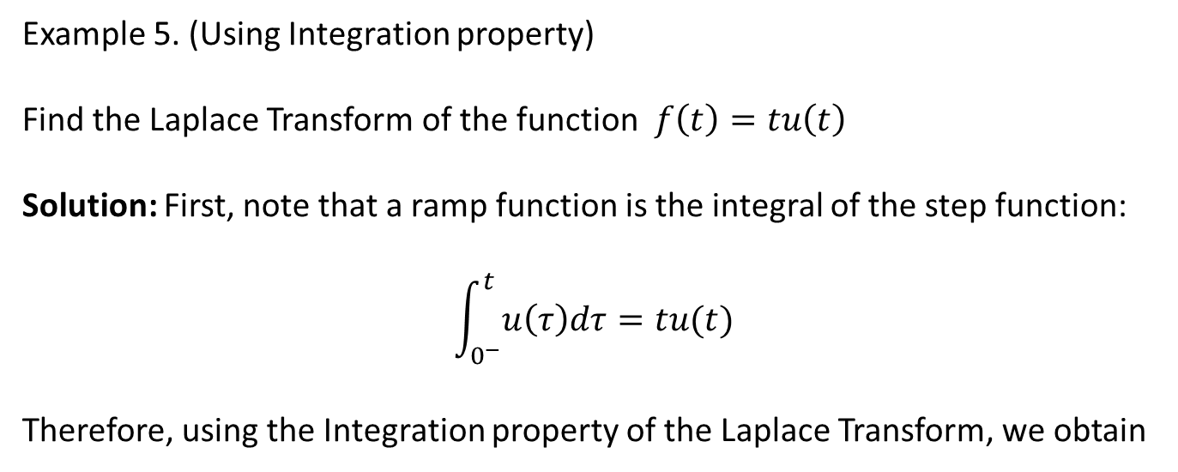
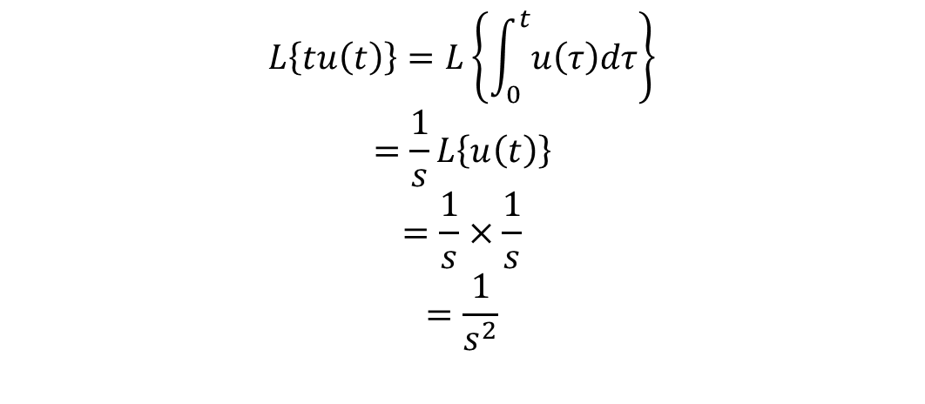
Example 5. (Using Integration property)
Find the Laplace Transform of the function $f\left(t\right)=tu\left(t\right)$
Solution: First, note that a ramp function is the integral of the step function:
$$\int_{0^{−}}^{t}{u\left(τ\right)dτ=tu(t)}$$
Therefore, using the Integration property of the Laplace Transform, we obtain
$$L\left\{tu\left(t\right)\right\}=L\left\{\int_{0}^{t}{u\left(τ\right)dτ}\right\}$$
$$=\frac{1}{s}L\left\{u\left(t\right)\right\}$$
$$=\frac{1}{s}×\frac{1}{s}$$
$$=\frac{1}{s^{2}}$$
Ramp function t u(t)

Slide 17
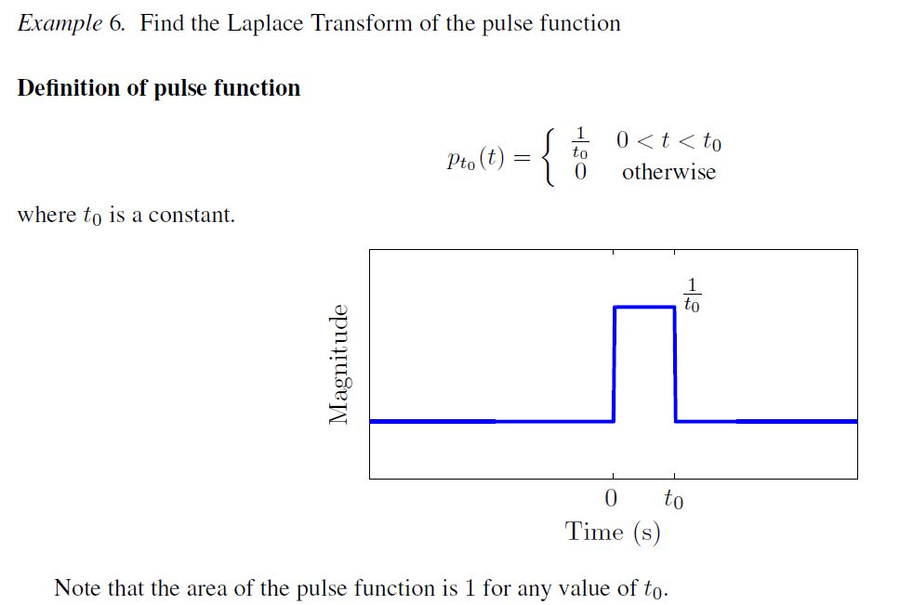

Slide 18

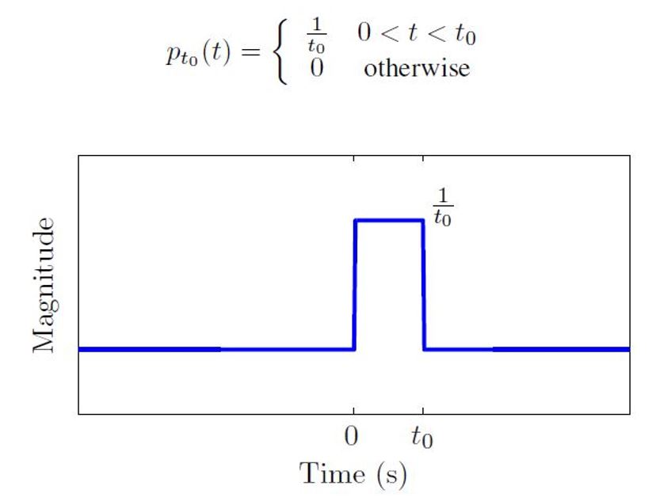
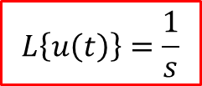
Exercise: (5 minutes)
$$L\left\{u\left(t\right)\right\}=\frac{1}{s}$$

Slide 19
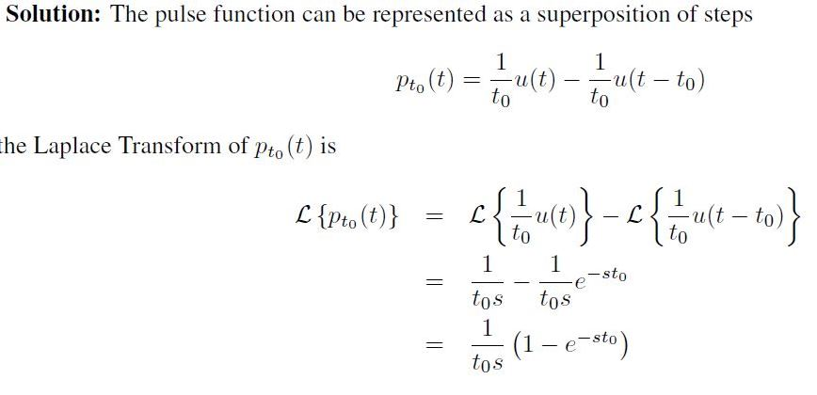
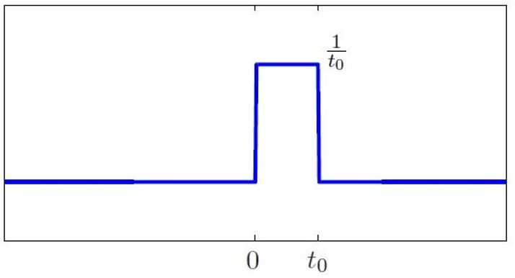
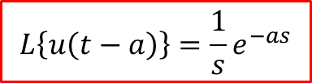
$$L\left\{u\left(t−a\right)\right\}=\frac{1}{s}e^{−as}$$

Slide 20
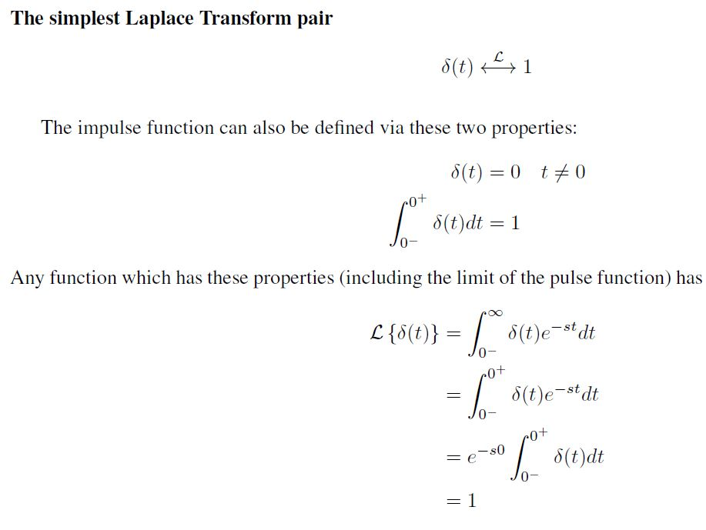
Proof:

Slide 21
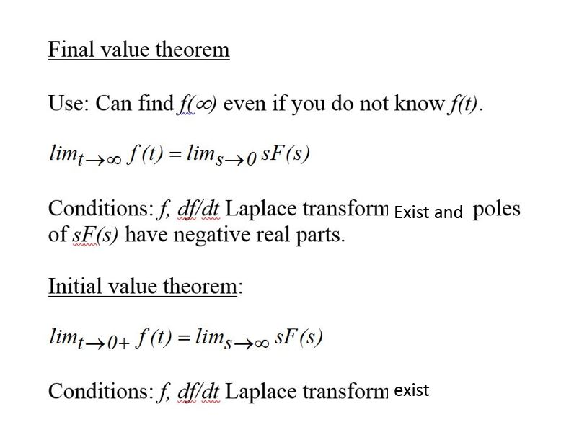

Slide 22
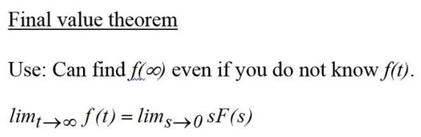
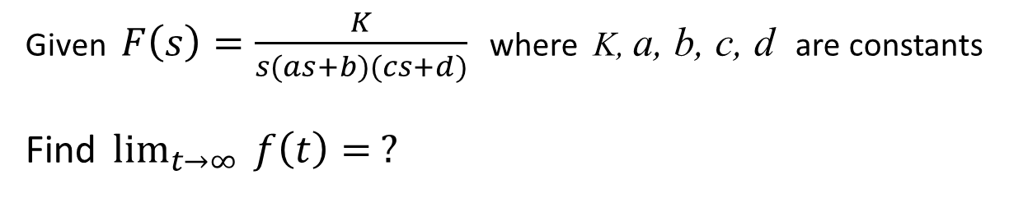
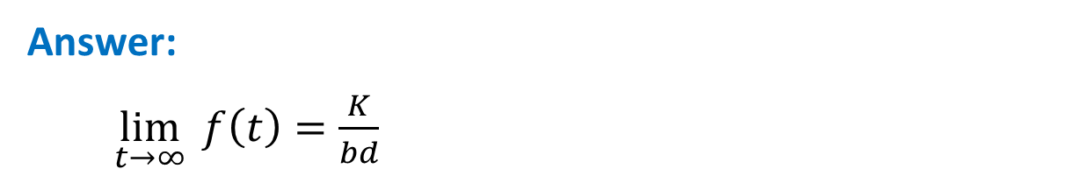
Exercise: (5 minutes)
Given $F\left(s\right)=\frac{K}{s(as+b)(cs+d)}$ where K, a, b, c, d are constants
Find $\lim_{t→∞}{ f\left(t\right)= ?}$
Answer:
$\lim_{t→∞}{ f\left(t\right)=\frac{K}{bd}}$

Slide 23
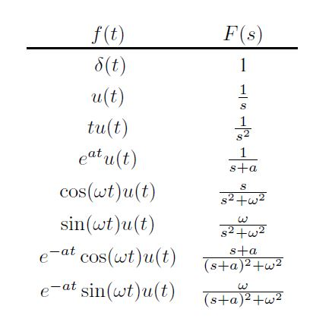

Table of Laplace Transforms
More … … (see Handout)

Slide 24
Inverse Laplace Transform
Procedure for finding Inverse Laplace Transforms:
Break down F(s) into components for each of which you know its Inverse Laplace Transform
Find the Inverse Laplace Transform of each component
Add Inverse Laplace Transforms of these components together

Slide 25
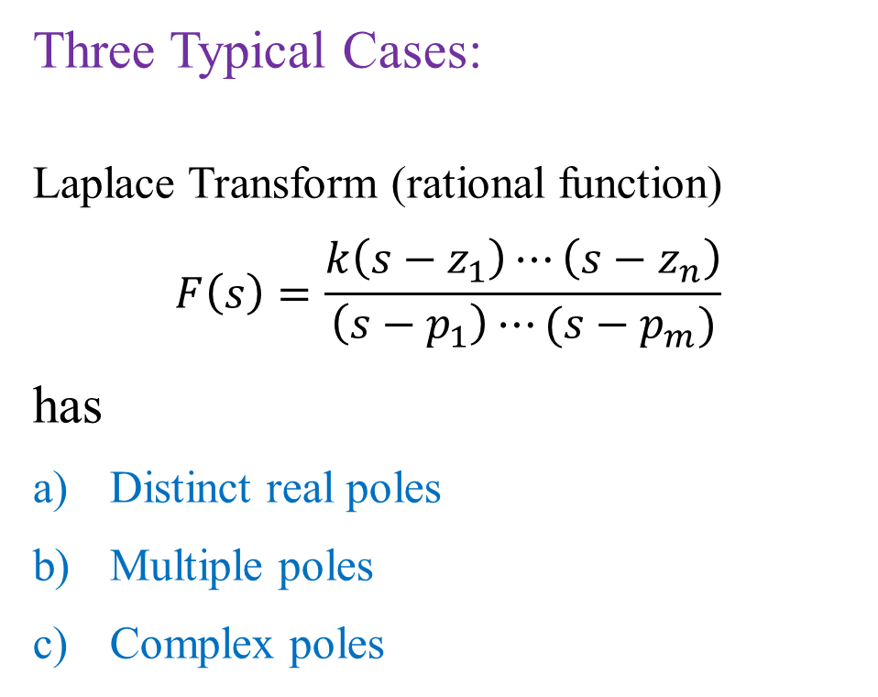
Three Typical Cases:
Laplace Transform (rational function)
$$F\left(s\right)=\frac{k\left(s−z_{1}\right)⋯\left(s−z_{n}\right)}{\left(s−p_{1}\right)⋯(s−p_{m})}$$
has
Distinct real poles
Multiple poles
Complex poles

Slide 26
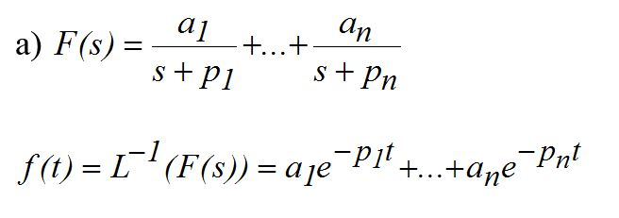
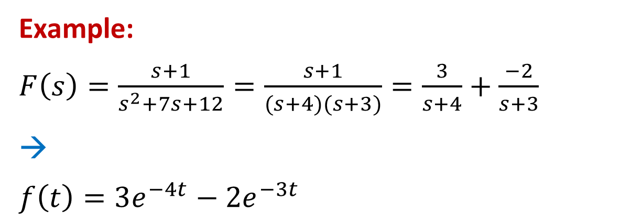
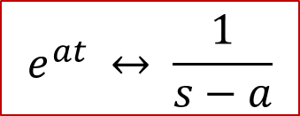
a)
Single poles
$$e^{at} ↔ \frac{1}{s−a}$$
Example:
$F\left(s\right)=\frac{s+1}{s^{2}+7s+12}=\frac{s+1}{(s+4)(s+3)}=\frac{3}{s+4}+\frac{−2}{s+3}$
→
$$f\left(t\right)=3e^{−4t}−2e^{−3t}$$

Slide 27
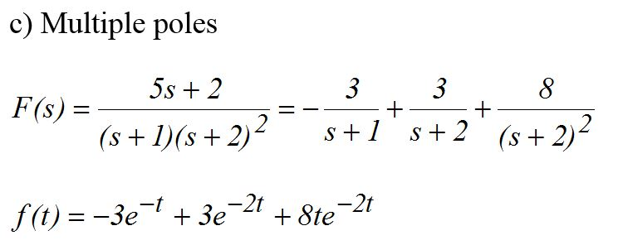
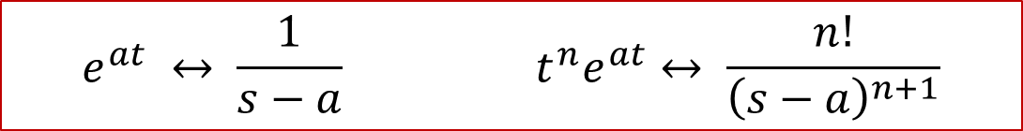
b)
$$e^{at} ↔ \frac{1}{s−a} t^{n}e^{at}↔ \frac{n!}{{\left(s−a\right)}^{n+1}}$$

Slide 28
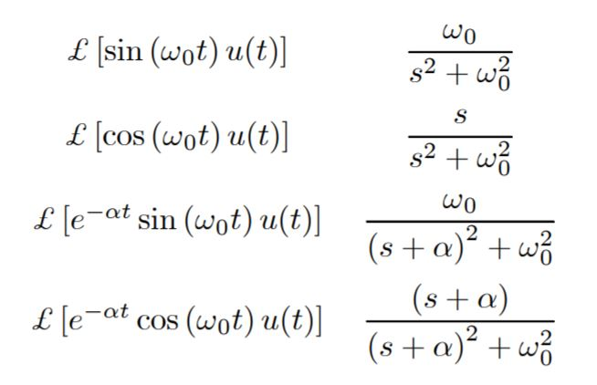
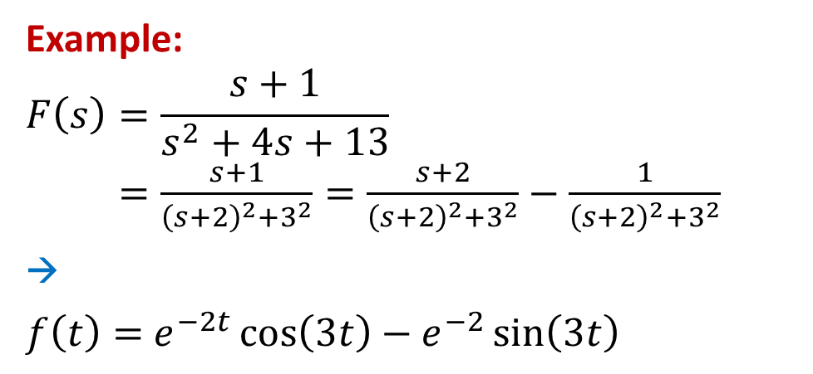
c) Complex poles
Example:
$$F\left(s\right)=\frac{s+1}{s^{2}+4s+13}$$
$=\frac{s+1}{{\left(s+2\right)}^{2}+3^{2}}=\frac{s+2}{{\left(s+2\right)}^{2}+3^{2}}−\frac{1}{{\left(s+2\right)}^{2}+3^{2}}$
→
$f\left(t\right)=$ $e^{−2t}\cos\left(3t\right)−e^{−2}\sin\left(3t\right)$

Slide 29
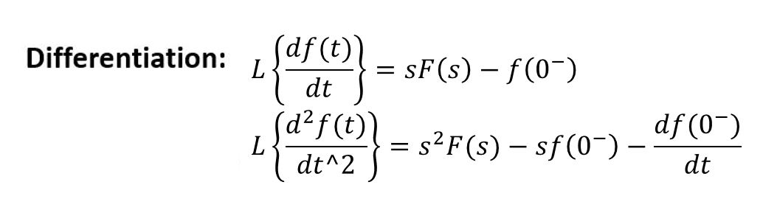
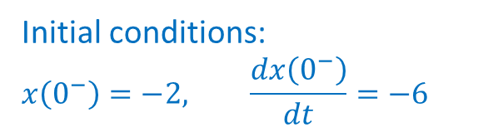
Recall Properties of Laplace Transform
Example:
Initial conditions:
$$x\left(0^{−}\right)=−2, \frac{dx\left(0^{−}\right)}{dt}=−6$$

Slide 30
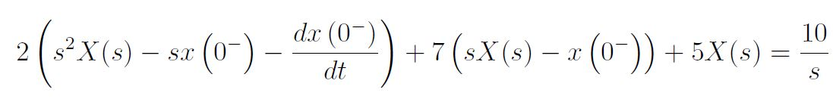
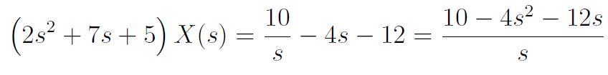
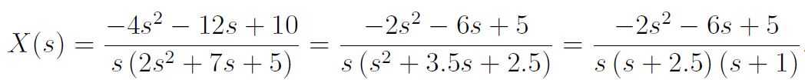
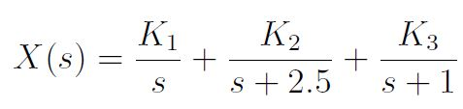
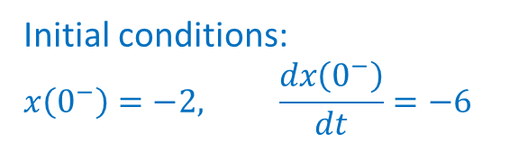
Initial conditions:
$$x\left(0^{−}\right)=−2, \frac{dx\left(0^{−}\right)}{dt}=−6$$
2
2
6

Slide 31
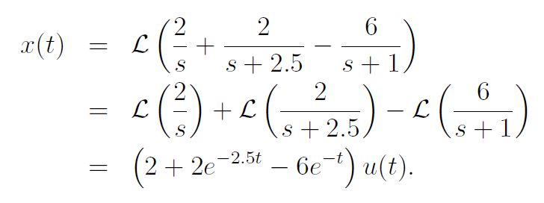

Applying Inverse Laplace Transform →
-1
-1
-1
-1
This is the solution of
Initial conditions:
$$x\left(0^{−}\right)=−2, \frac{dx\left(0^{−}\right)}{dt}=−6$$

Slide 32
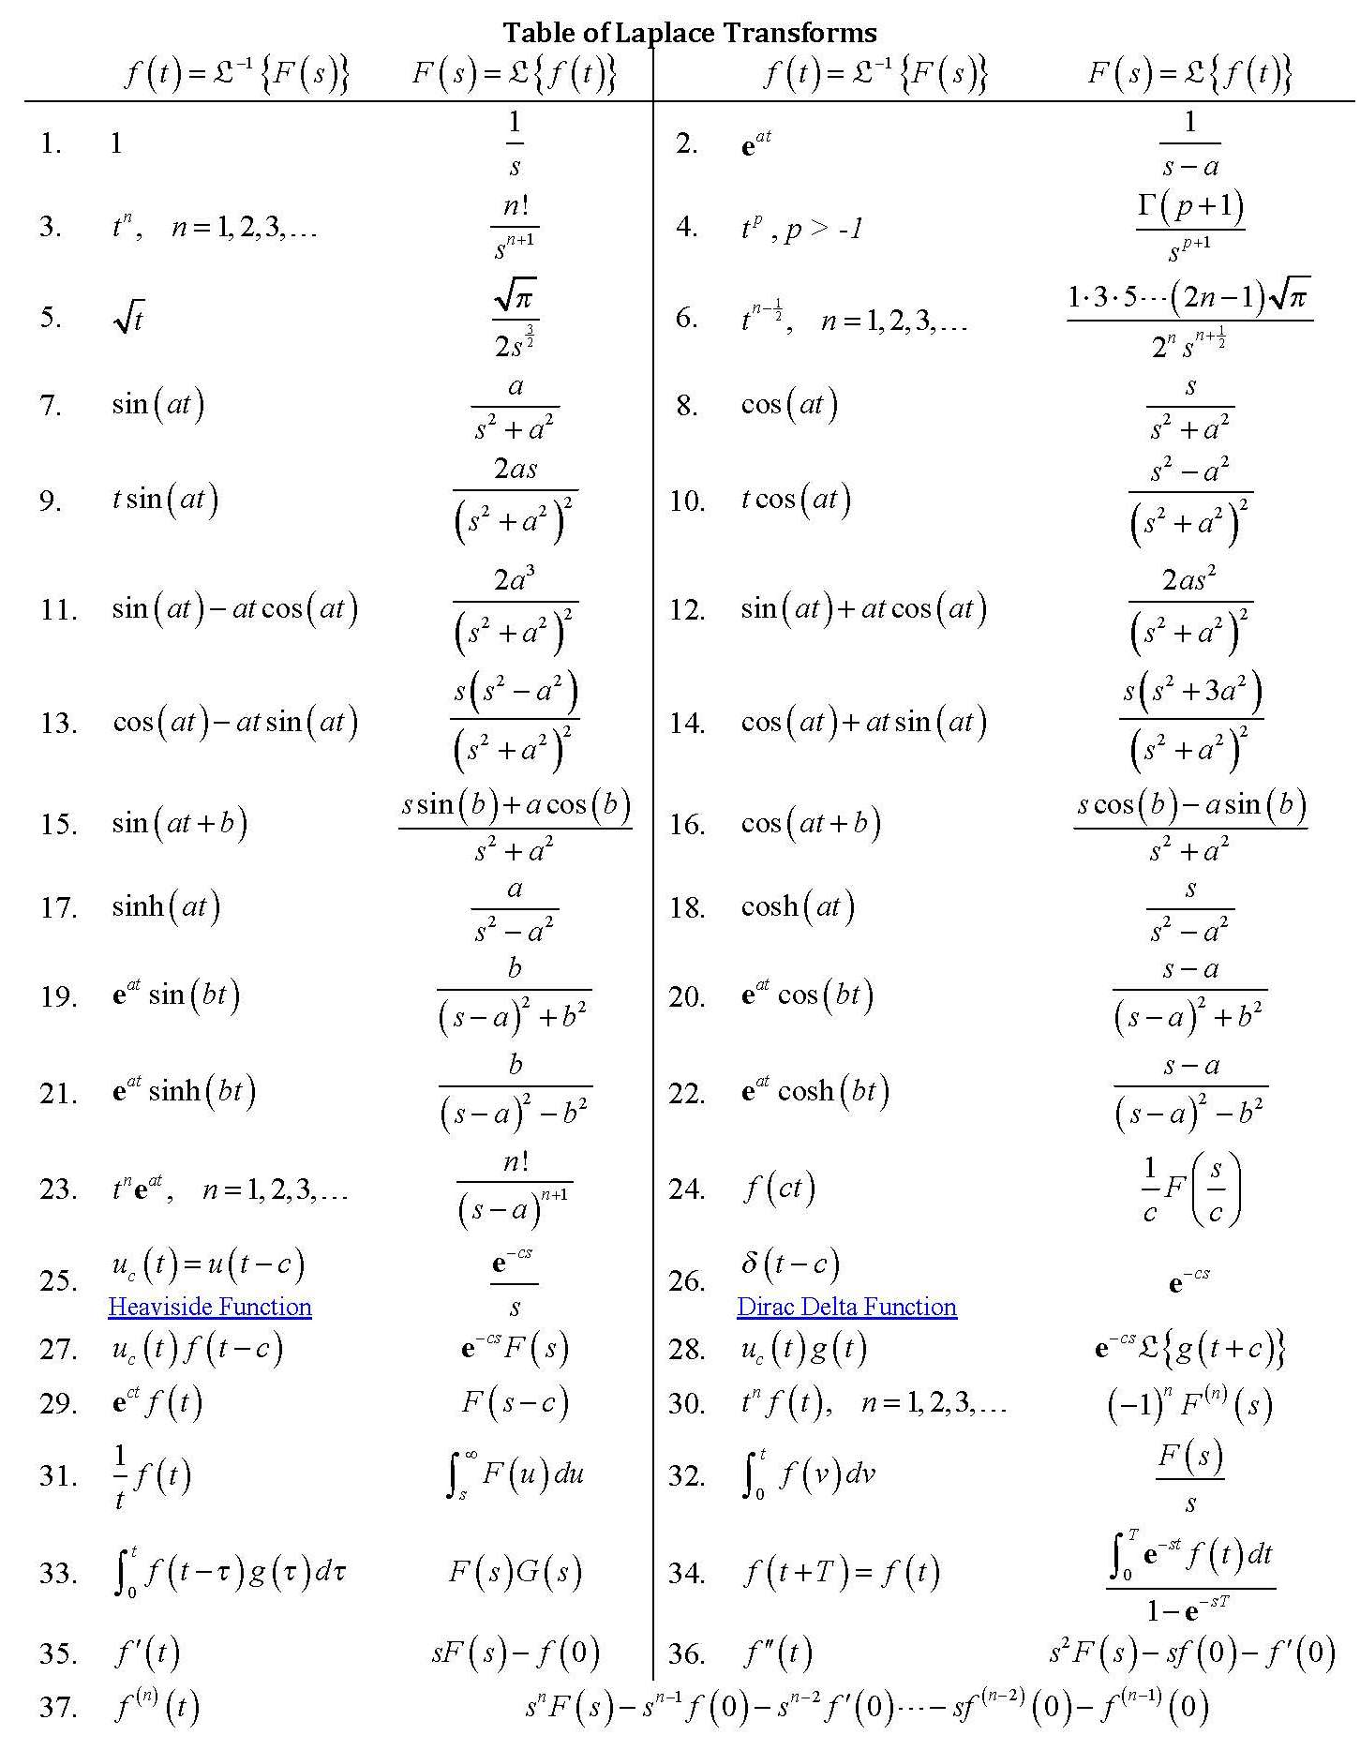
Keep it handy

Slide 33
Solving Differential Equations

Slide 34
Solution of Differential Equations
Unilateral Laplace transform can be used to solve linear constant-coefficient (LCC) differential equations with non-zero initial conditions.
Procedure:
  Apply the time-differentiation property.
  Solve for Y(s).
  Take the inverse transform of Y(s) to find y(t).

Slide 35
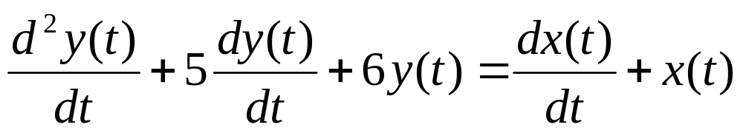
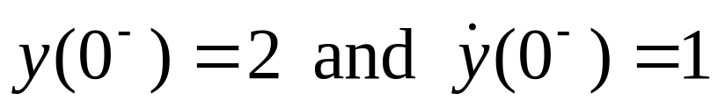
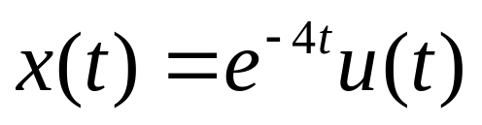
Example
Consider a causal system described by
Initial conditions:
Input:
Find y(t).

Slide 36
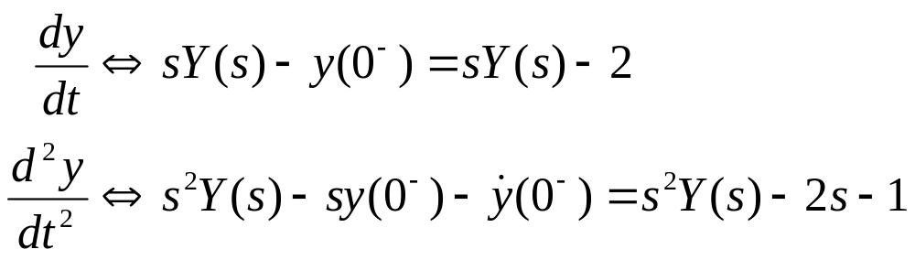

Example (cont’d)
Solution:
For the input signal, we have

Slide 37


Example (cont’d)
Taking transform for all terms in the D.E.,
Solving for Y(s),

Slide 38


Example (cont’d)
Applying partial-fraction expansion,
Taking inverse Laplace transform,

Slide 39
Zero-Input and Zero-State Components
In the previous example, the total response is obtained.
  it includes both the zero-input and zero-state components.
It is possible to separate the two components.
The initial condition terms give rise to the zero-input response.

Slide 40

Example (cont’d)
We can separate out the initial condition terms as follows:

Slide 41


Example (cont’d)
Taking the inverse transform:

Slide 42



Zero-Input and Zero-State Response

Slide 43


Zero-Input and Zero-State Response

Slide 44
END

