Slide 1

LC0200A: EAP 1 – Unit 2
English for Academic Purposes

Slide 2

Today’s Class Objectives
In this lesson you will:
Analyze and identify the genre, audience, and purpose of texts.
Evaluate and identify different types of evidence
Understand the purpose of hedging in academic writing
Identify hedging in reading
Apply the principles of hedging in academic writing

Slide 3

What is a MOOC: Task 1
Watch the following YouTube clip about Massive Open Online Course (MOOCS)
Take notes on the points you find interesting.

Slide 4
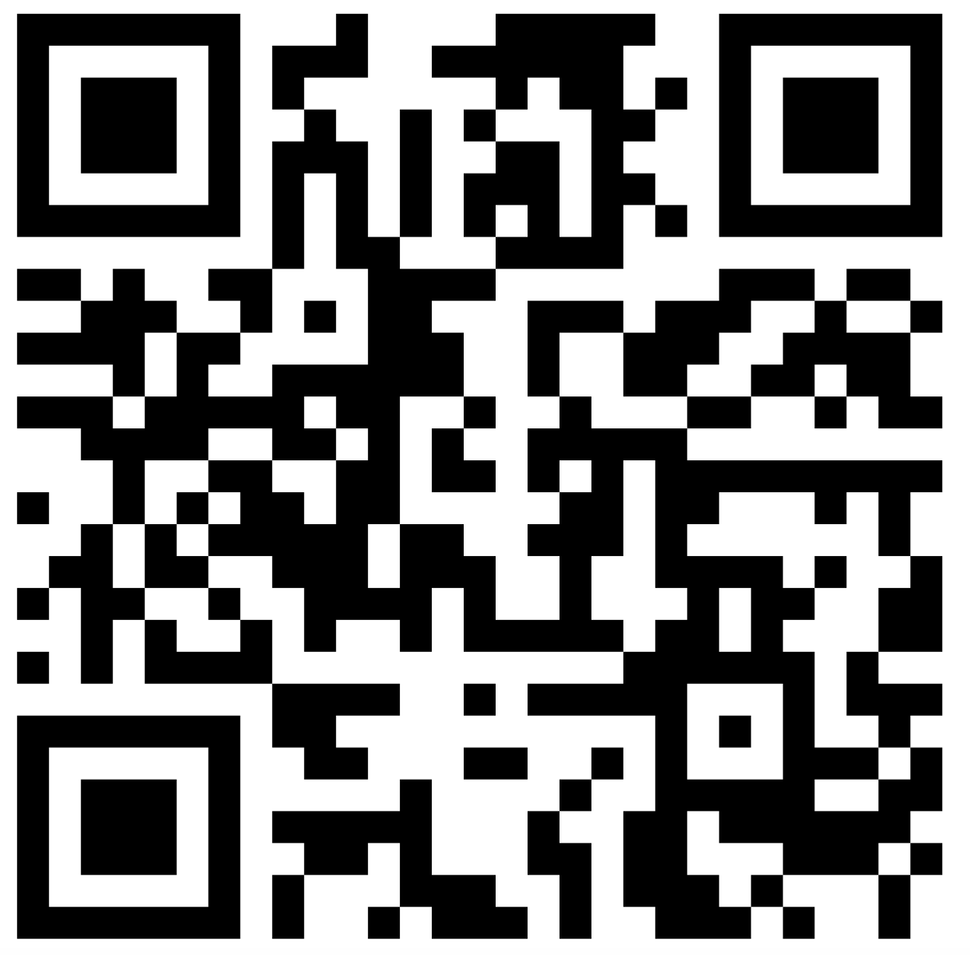
Discussion: Task 2
Discuss the following question with one or two more classmates.
  “What experience do you have with on-line learning? (What subjects have you studied on-line? What kinds of on-line resources or activities have you used?)”
Then, log in to Padlet using the QR code and answer the following question about Advantages and Disadvantages
  “Based on your experience and/or your best “educated guesses”, what are the advantages and disadvantages of:
    on-line learning?
    classroom-based learning?”
Notes:
Teachers: create your own QR code.

Slide 5
Reading: Task 3
Read the following four short texts and then discuss the following questions.
How many ideas from your previous discussion are mentioned?
What new ideas have you learned from these texts?

Slide 6
Reading: Task 3
Text 1 The OU’s range of learning techniques provides flexible learning like no other university so you can combine your work and study commitments in a way that suits you. Flexibility comes in a number of ways: Location: the OU's innovative teaching methods enable you to study across a variety of locations. Study online from your PC, or through the award winning app 'OU Anywhere.' You can take your studies to your tablet or your smartphone, and study on the move without the need for constant internet connection. Time to complete: with undergraduate degrees you can take as long as 16 years to complete. Your choice of subjects: each degree offers you a range of modules to choose a route through your degree that suits you. Online support: our range of online forums, webinars, tuition podcasts and student network support groups gives you the support whenever you need it. So now you can study for a degree without having to put your career and personal life on hold. More than 70% of OU students work and study at the same time, which demonstrates just how flexible our study methods really are. "Since I travel a lot between China and Switzerland, distance learning is the only choice for me; OU is the best and biggest university for distance learning in Europe and has very good reputation." Jun Ma, OU student.

Slide 7
Reading: Task 3
Text 2 With two small children, a long commute to work and an upcoming cross-country move, Amanda Tutlewski knew that taking on-campus classes to complete a master's degree in nursing wasn't an option. Instead, she looked for virtual programs, eventually choosing an online master's program at Simmons College. When the family moved from Indiana to Key West, Florida, for her husband's job several months later, the academic transition was seamless. Now, more than halfway through the program, Tutlewski says she'd pick an online program again in a heartbeat. "It's convenient and it's flexible," she says. In the world of online learning, female students like Tutlewski predominate. At the undergraduate level, 70 percent of online students were women in spring 2015, according to a recent survey. Among graduate students, 72 percent of students were female.

Slide 8
Reading: Task 3
Text 3 By their very design, online courses facilitate engagement through messages, discussions, group projects and assignments. Interactions between students and faculty, and among students, are part of each course module, and students are graded on the extent to which they engage with their fellow classmates and the faculty member. These engagement activities help establish a sense of community, promote learning and facilitate the development of higher-order skills, such as critical thinking, analysis, and synthesis.

Slide 9
Reading: Task 3
Text 4 When interviewed, some participants indicated that they tended to think more deeply about the subject areas when responding in writing as compared to giving verbal responses. They explained that they were able to continually reflect upon each other’s reflections because of the public and permanent display of the discussion postings on the Web. As stated by one participant: ‘‘There is something that forces you to think more deeply about subject areas when you have to respond in writing’’ (Petrides, 2002, p. 72). Another participant reiterated this sentiment, indicating that the online technology allowed more reflection than what might occur for some individuals in face-to-face classroom discussions.

Slide 10
Identifying the Genre: Task 4
Look at the four texts again and complete the chart below in as much detail as possible.
Text | Genre (e.g. blog posting, textbook….) | Intended Reader (e.g. primary school student, tourist….) | Writer’s Purpose (e.g. to provide information, to entertain…)
1
2
3
4

Slide 11
Identifying Types of Evidence: Task 5
What kinds of evidence for the benefits of online learning can you find in texts 1-4?
Text | Evidence
 | Statistics | Interview Data | Personal experience (Anecdotal evidence) | Factual support
1
2
3
4

Slide 12
Identifying Types of Evidence: Task 5
What other kinds of evidence can you think of? What kinds of evidence do you need to provide in your university course?
Academic Evidence MUST
Come from Reputable Sources
Come from Acceptable Research Methods
Be Replicable
Be Authoritative & Factual

Slide 13
Academic Writing Feature: Hedging
A very common feature of academic writing is known as hedging (and also known as cautious language).
Hedging can be used in a number of ways.
Purpose of hedging | Examples
To show uncertainty and/or openness to other viewpoints | “The results of this survey appear to indicate that…” “This may have been caused by…”
To avoid over-generalizing | “In many cases, Hong Kong students are required to take on part-time jobs while studying.” “Insomnia is often caused by stress.”
To show modesty | “One could argue that this was a major factor.” “This solution might be worth considering.”
To show politeness to other writers | “Chang (2013) has possibly overstated the importance of…” “The arguments put forward by Jones (2011) do not necessarily apply in an Asian cultural context.”

Slide 14
Identifying Hedging: Task 6
1. Look at Text 4 again. What examples of hedging can you find?
Text 4 When interviewed, some participants indicated that they tended to think more deeply about the subject areas when responding in writing as compared to giving verbal responses. They explained that they were able to continually reflect upon each other’s reflections because of the public and permanent display of the discussion postings on the Web. As stated by one participant: ‘‘There is something that forces you to think more deeply about subject areas when you have to respond in writing’’ (Petrides, 2002, p. 72). Another participant reiterated this sentiment, indicating that the online technology allowed more reflection than what might occur for some individuals in face-to-face classroom discussions.

Slide 15
Identifying Hedging: Task 6
What examples of hedging can you find in Texts 1, 2 and 3? What impact would it have if more hedging were added?
There is almost no hedging in texts 1-3.
If hedging were added, it would reduce the “selling” strength of the three texts, all of which are designed to promote on-line learning

Slide 16
Reading: Task 7
Read the conversation and then answer the questions that follow.
Jim: Hi, Sue - how are you?
Sue: Not bad, thanks. You?
Jim: Great. So, what have you been up to?
Sue: Well, I went to see the new Tom Cruise movie last night.
Jim: How was it?
Sue: Fantastic. But there were millions of people there, and it was boiling in the theatre.
Jim: How was Tom’s performance?
Sue: Excellent. But then I always go to his movies – he’s great.
Jim: Well, everyone knows that! He’ll win the Oscar® for sure this year!
Exactly how many people were at the cinema?
What was the exact temperature in the cinema?
How frequently does Sue go to Tom Cruise films?
What specific things does she like about his acting?
Who knows that Tom Cruise is a great actor?
What proof does Jim have that Cruise will win the Oscar?

Slide 17

Reading: Task 7
Were you able to answer all the questions?
If not, why not?
What does this tell you about informal conversation?
Listen to the following audio and read along in your text book p.18.

Slide 18
Hedging Practice: Task 8
Your reader may think “How can you be so sure?”
Degree of Certainty
  Suppose you write:
  “Young people who cannot pay their credit card debts will commit suicide.”
  Or
  “The Hong Kong economy will improve in the next five years.”
  Re-write the sentences so that they are less certain.

Slide 19
Hedging Practice: Task 8
Your reader may ask “All Chinese people? All the time?”
Level of Generalization
Suppose you write:
  “Chinese people are influenced by tradition”
  Or
  “Men are physically stronger than women.”
  Re-write the sentences so that they are less generalized.
Your reader might ask “All men?”

Slide 20

Hedging Practice: Task 8
Your reader may want to know “Who says so?” or “According to whom?”
Source(s) of information
Suppose you write:
  “Covid-19 is the worst problem Hong Kong has faced in the last twenty years.”
  Or
  “English is essential for career success.”
  Re-write the sentences providing a possible source for each claim.

Slide 21
Hedging Practice: Task 8
Your reader may wonder “Compared to where/what/whom/when?”
Relative versus Absolute Claims
Suppose you write:
  “Hong Kong is an expensive city.”
  Or
  “Kowloon is densely populated.”
  Re-write the sentences using comparison

Slide 22
Hedging Practice: Task 8
Your reader may ask “Is this inevitable in all circumstances?
Conditions on a Claim
Suppose you write:
  “Hong Kong will fall behind Singapore in education. ”
  Or
  “The ozone layer will be destroyed.”
  Re-write the sentences using comparison

Slide 23
Further Hedging Practice: Task 9
1. | Hong Kong students do not like the exam-based system of education.
2. | Part-time jobs are very important for university students.
3. | It is impossible for students to improve their level of English.
4. | Hong Kong students rely on a “spoon-feeding” approach to education.
5. | Western people do not value their families.
6. | Chinese students are good at sciences.
7. | Young people do not have good moral values.
8. | Football gambling is wrong.

Slide 24
Useful Resources: Hedging
Useful Resources For more on hedging, look at the following websites: http://online-resources.lc.cityu.edu.hk/WebPages/OnlineResources/- Scroll down to ‘Writing’ >>“Academic Discourse>> Hedging, Style & Tone” http://www2.elc.polyu.edu.hk/cill/eap/hedging.htm http://www.uefap.com/writing/feature/hedge.htm

Slide 25
Academic Writing Feature: Formality
Academic writing is usually very formal in structure, grammar and vocabulary.
In academic writing, the following should generally be avoided: Clichés (“Every coin has two sides.” ☒) Contractions (“is not” ☑ / “isn’t” ☒) Emotional language (“sub-standard” ☑ / “terrible” ☒) Idioms (“unexpectedly” ☑ / “out of the blue” ☒) Imperatives (“Time management is an important skill for students.” ☑ / “Manage your time better!” ☒) Informal vocabulary (“children” ☑ / “kids” ☒) Rhetorical questions (“X is inadvisable.” ☑ / “Should we really do X?” ☒)

Slide 26
Text Analysis: Task 10
Look at Texts 1 & 2 again. What examples of informal language can you find? How could these be expressed more formally?
Text 1 The OU’s range of learning techniques provides flexible learning like no other university so you can combine your work and study commitments in a way that suits you. Flexibility comes in a number of ways: Location: the OU's innovative teaching methods enable you to study across a variety of locations. Study online from your PC, or through the award winning app 'OU Anywhere.' You can take your studies to your tablet or your smartphone, and study on the move without the need for constant internet connection. Time to complete: with undergraduate degrees you can take as long as 16 years to complete. Your choice of subjects: each degree offers you a range of modules to choose a route through your degree that suits you. Online support: our range of online forums, webinars, tuition podcasts and student network support groups gives you the support whenever you need it. So now you can study for a degree without having to put your career and personal life on hold. More than 70% of OU students work and study at the same time, which demonstrates just how flexible our study methods really are. "Since I travel a lot between China and Switzerland, distance learning is the only choice for me; OU is the best and biggest university for distance learning in Europe and has very good reputation." Jun Ma, OU student.

Slide 27
Text Analysis: Task 10
Text 2 With two small children, a long commute to work and an upcoming cross-country move, Amanda Tutlewski knew that taking on-campus classes to complete a master's degree in nursing wasn't an option. Instead, she looked for virtual programs, eventually choosing an online master's program at Simmons College. When the family moved from Indiana to Key West, Florida, for her husband's job several months later, the academic transition was seamless. Now, more than halfway through the program, Tutlewski says she'd pick an online program again in a heartbeat. "It's convenient and it's flexible," she says. In the world of online learning, female students like Tutlewski predominate. At the undergraduate level, 70 percent of online students were women in spring 2015, according to a recent survey. Among graduate students, 72 percent of students were female.

Slide 28
Useful Resources: Formal Academic Language
Useful Resources For more on formality, look at the following websites: http://www.uefap.com/writing/writfram.htm http://unilearning.uow.edu.au/academic/2bi.html

