Slide 1
CS2311 Computer Programming
LT10: Pointer II
Computer Science, City University of Hong Kong
Semester A 2021-22

Slide 2
Outline
Access array elements via pointers
Manage strings via pointers
Dynamic memory allocation

Slide 3
The NULL pointer
A special value that can be assigned to any type of pointer variable (e.g., int *a=NULL; double*b=NULL;)
A symbolic constant defined in several standard library headers, e.g. <iostream>
When assigned to a pointer variable, that variable points to nothing
Example
  int *ptr1 = NULL;
  int *ptr2 = 0;

Slide 4
Operations on pointers
Copying the address
  p = q;
  p and q points to the same variable

Slide 5
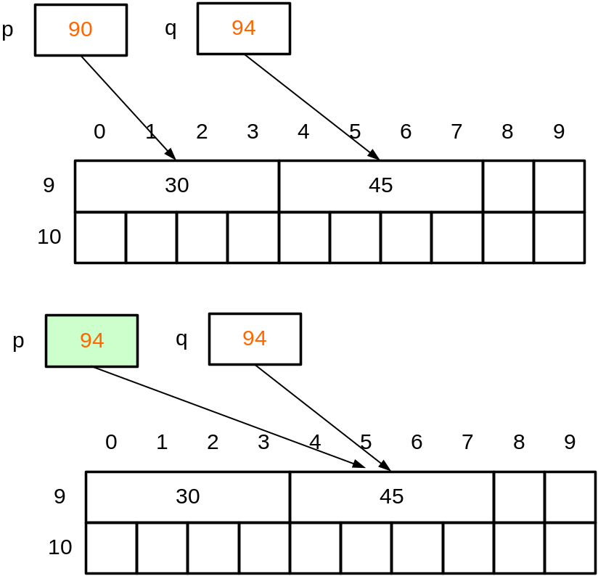
Copy the address
Assignment: p = q;
We copy the content (which is an address) of q to p.
After the assignment, p and q point to the same location in memory.
Therefore, if we change *p, *q will also be changed

Slide 6
Operations on pointers
Copying the address
  p = q;
  p and q points to the same variable
Copying the content
  Copy the value of the variable which is pointed by the p to the variable which is pointed by q
  *p = *q;
  p and q may point to different variables

Slide 7
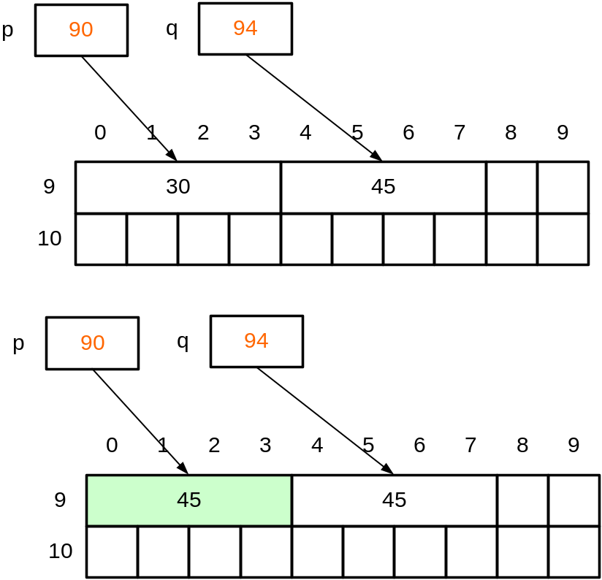
Copy the content
*p = *q;
We copy the value of the variable pointed by q to the variable pointed by p.
After the assignment, p and q still point to different locations in memory.
if we change *p, *q will not be changed as p and q points to different location in memory.

Slide 8
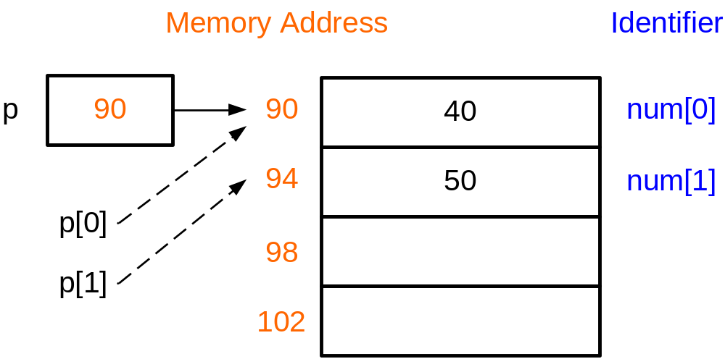
Relationship between arrays and pointers
int num[2]={40,50};
num[0]=400;
num[1]=500;
Equivalent to
int num[2]={40,50};
int *p=num;
p[0]=400;
p[1]=500;
We can use array-like notation in pointers
num is a constant pointer to the first byte of the array;
p is a pointer variable; and thus the value of p can be changed.
p=num;
However, the value of num cannot be changed.
num=p; /*illegal*/

Slide 9
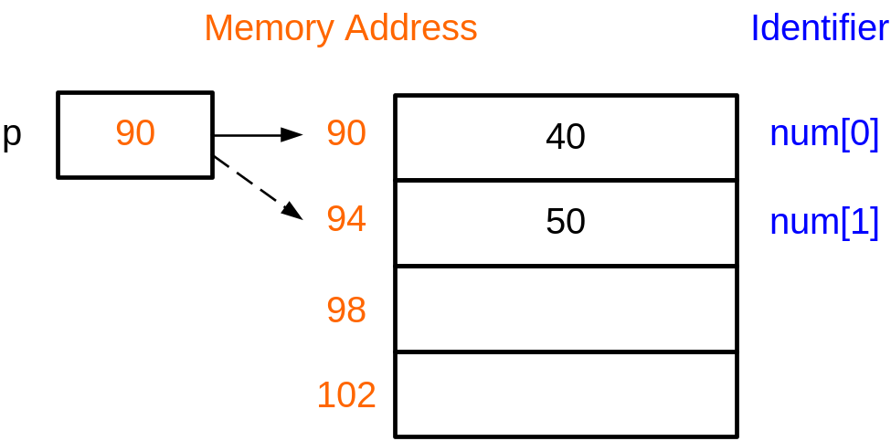
Relationship between arrays and pointers
int num[2]={40,50};
int *p;
p=num;
p[0]=400;
p[1]=500;
Equivalent to
int num[2]={40,50};
int *p;
p=num; /* p points to 90
*p=400;
++p; /*p points to 94 */
*p=500;
++p increments the content of p (an address) by sizeof(int) bytes

Slide 10
Arrays and pointers
Equivalent representation |  | Remark
num | &num[0] | num is the address of the 0th element of the array
num+i | &(num[i]) | Address of the ith element of the array
*num | num[0] | The value of the 0th element of the array
*(num+i) | num[i] | The value of the ith element of the array
(*num)+i | num[0]+i | The value of the 0th element of the array plus i

Slide 11
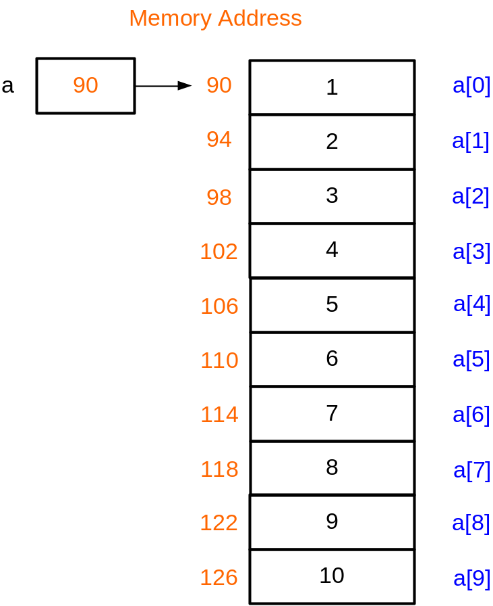
Example 2: summing an array
#define N 10
void main()
{
}
int a[N]={1,2,3,4,5,6,7,8,9,10};
int sum = 0;
for(int i = 0; i < N; ++i)
sum+=*(a+i);//sum+=a[i];
cout << sum;/*55 is printed*/
a+0 is the address of a[0]
a+1 is the address of a[1]
...
a+i is the address of a[i]
So, *(a+i) means a[i]

Slide 12
Passing arrays to functions
When an array is being passed, its base address is passed; the array elements themselves are not copied → This is call-by-pointer
As a notational convenience, the compiler allows array bracket notation to be used in declaring pointers as parameters, e.g.
double sum(int *array); is the same as
double sum(int array[]);

Slide 13
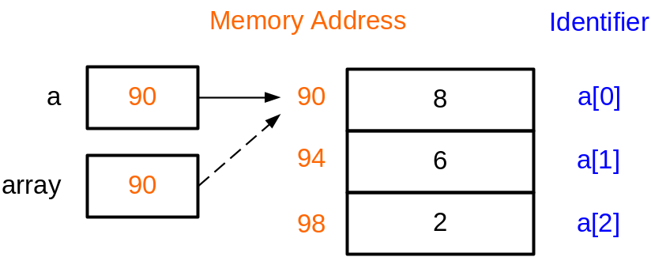
Example 3: Parameter Passing
#define N 5
double sum(int *b);
void main()//Compute the mean value
{
int a[N] = {8,6,2,7,1};
double mean;
mean = sum(a)/N;
cout << "mean = “ << mean;
}
double sum(int *b)
{
int i;
double total = 0.0;
for (i=0; i<N; i++)
total += b[i];
return total;
}
When sum(a) is called, the content of a (address of a[0]) is copied to the pointer variable b.
Therefore the pointer b points to a[0]
a
b

Slide 14
Access elements in 2D array with pointers
We can use a point to access a 2D array
For a 2D array int a[4][3], a[i] (i=0,1,2,3) is the address of the first element in the i-th. row
For each row, it is equivalent to one 1D array
We can declare a pointer int *p = a[i] to access every element on the i-th. row

Slide 15
Access elements in 2D array with pointers
Like the 1D array, we use the ‘*’ sign to access the elements in one 2D array
int a[4][3] = {1,2,3,4,5,6,7,8,9,10,11,12};
int *p = a[0];
for(int i = 0; i<12; i++){
cout << *p << endl;
p++;
}

Slide 16
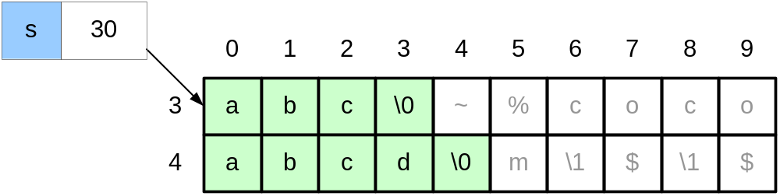
Arrays, pointers and strings
char s[]="abc";
s="abcd"; //illegal
Illegal as s is a constant pointer and cannot be modified

Slide 17
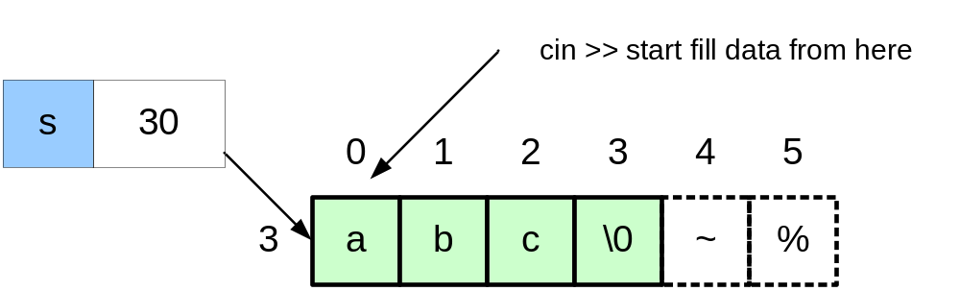
cin >> a string (I)
char s[]="abc";
cin >> s;
input: “Hello World”

Slide 18
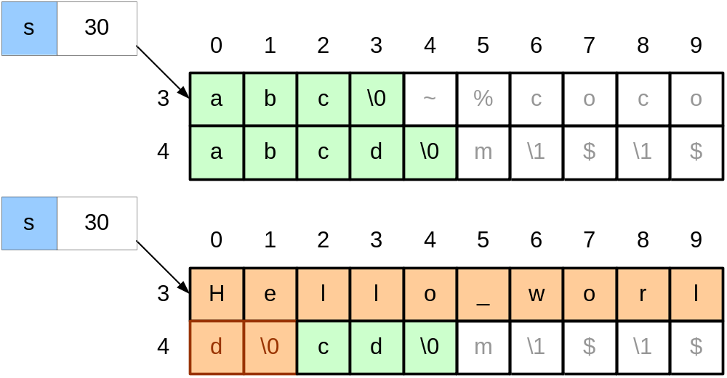
cin >> a string (I)
Size of s is 4. Array out-of-bound! cin >> does not perform bound-checking
Better to use:
cin.getline(s,4); /*read at most 3 characters*/
Leaving space for the final '\0' character

Slide 19
cin.ignore()
For std::cin statements, you use ignore() before you do a getline() call
When a user inputs something with std::cin, they hit enter and a '\n' char gets into the cin buffer. Then if you use getline(), it gets the newline char instead of the string you want
But cin itself doesn't have this issue…
More info:
  https://stackoverflow.com/questions/25475384/when-and-why-do-i-need-to-use-cin-ignore-in-c
  http://www.cplusplus.com/reference/istream/istream/ignore/

Slide 20
cin.ignore() before cin.getline()
int main() {
char *s2 = NULL;
int size;
cout << "Tell me the size of the string: ";
cin >> size;
s2 = new char[size+1];
cout << "Now enter a string with at most " << size << " characters: ";
cin.ignore(); // it absorbs the newline char
cin.getline(s2, size+1);
cout << "You entered:\n" << s2 << endl;
delete [] s2;
return 0;
}

Slide 21
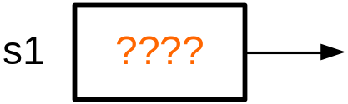
cin >> a string (II)
#include <iostream>
using namespace std;
void main () {
char *s1;
cin >> s1;
cout << s1<<endl;
}
Problem: when we declare the pointer s1, we do not know where s1 points to.
In this example, we try to read a string and store it in the location pointed by s1.
This may generate errors as we may overwrite some important locations in memory

Slide 22
Dynamic memory allocation
Keywords: new & delete
  int *p = new int;
  int *p = new int(10);
  char *p = new char(‘a’);
  delete p;
  *p = 10; // illegal
Keywords: new [] & delete []
  int *p = new int[20];
  char *p = new char[20];
  delete [] p;

Slide 23
Dynamic memory allocation
#include <iostream>
void main () {
char *s1=NULL;
s1=new char[4];
cin >> s1; /*input "abc"*/
cout << s1;
delete [] s1;
s1=new char[6];
cin >> s1;
cout << s1;
delete [] s1;
s1=NULL;
}

Slide 24
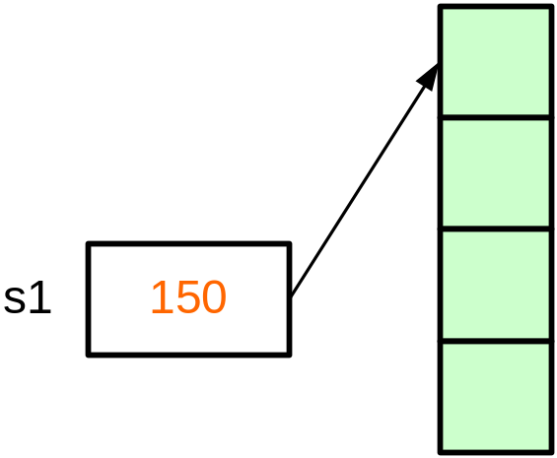
Dynamic memory allocation
#include <iostream>
void main () {
char *s1=NULL;
s1=new char[4];
cin >> s1; /*input "abc"*/
cout << s1;
delete [] s1;
s1=new char[6];
cin >> s1;
cout << s1;
delete [] s1;
s1=NULL;
}
new dynamically allocates 4 bytes of memory. new returns a pointer to the 1st byte of the chunk of memory, which is assigned to s1

Slide 25
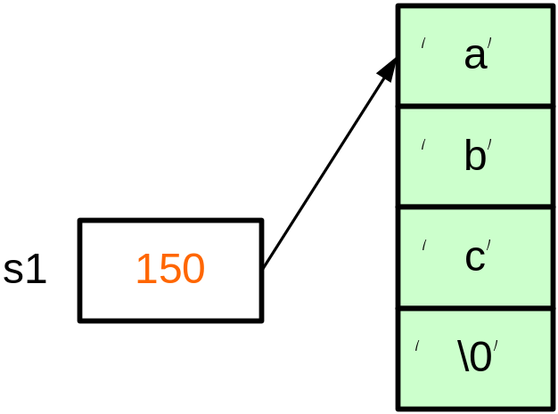
Example 4: Dynamic memory allocation
#include <iostream>
void main () {
char *s1=NULL;
s1=new char[4];
cin >> s1; /*input "abc"*/
cout << s1;
delete [] s1;
s1=new char[6];
cin >> s1;
cout << s1;
delete [] s1;
s1=NULL;
}

Slide 26
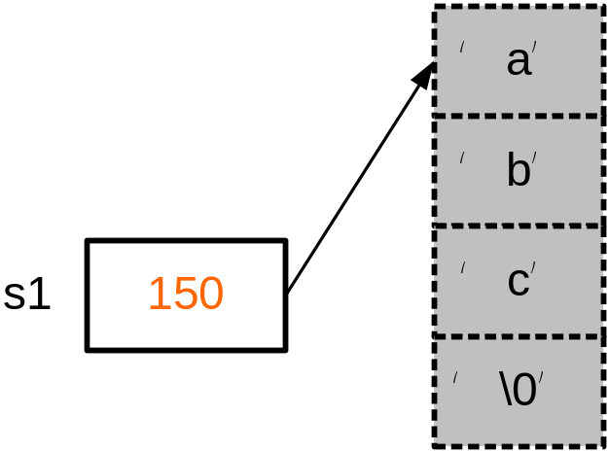
Example 4: Dynamic memory allocation
#include <iostream>
void main () {
char *s1=NULL;
s1=new char[4];
cin >> s1; /*input "abc"*/
cout << s1;
delete [] s1;
s1=new char[6];
cin >> s1;
cout << s1;
delete [] s1;
s1=NULL;
}
Memory is free and can be used to store other data

Slide 27
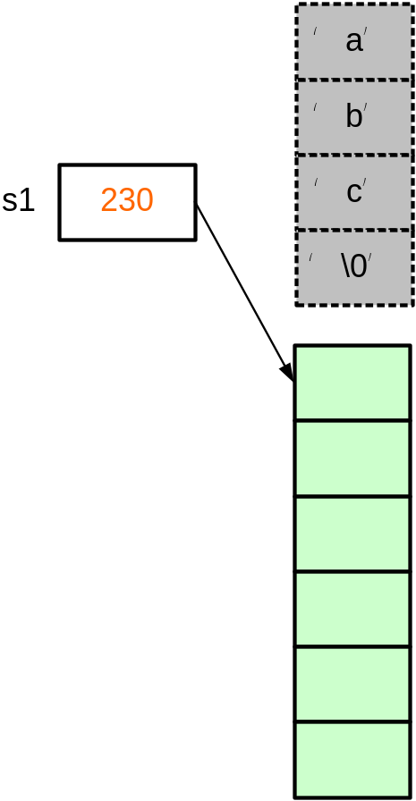
#include <iostream>
void main () {
char *s1=NULL;
s1=new char[4];
cin >> s1; /*input "abc"*/
cout << s1;
delete [] s1;
s1=new char[6];
cin >> s1;
cout << s1;
delete [] s1;
s1=NULL;
}
new dynamically allocates 6 bytes of memory. new returns a pointer to the 1st byte of the chunk of memory, which is assigned to s1

Slide 28
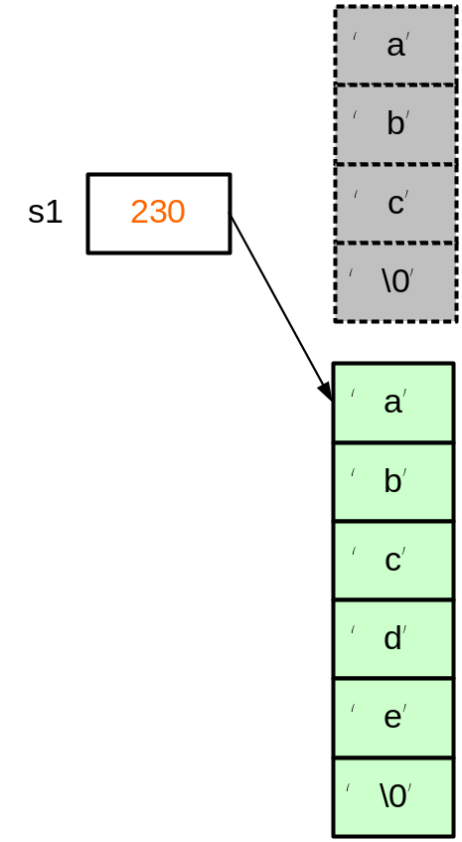
#include <iostream>
void main () {
char *s1=NULL;
s1=new char[4];
cin >> s1; /*input "abc"*/
cout << s1;
delete [] s1;
s1=new char[6];
cin >> s1;
cout << s1;
delete [] s1;
s1=NULL;
}

Slide 29
#include <iostream>
void main () {
char *s1=NULL;
s1=new char[4];
cin >> s1; /*input "abc"*/
cout << s1;
delete [] s1;
s1=new char[6];
cin >> s1;
cout << s1;
delete [] s1;
s1=NULL;
}

Slide 30
#include <iostream>
void main () {
char *s1=NULL;
s1=new char[4];
cin >> s1; /*input "abc"*/
cout << s1;
delete [] s1;
s1=new char[6];
cin >> s1;
cout << s1;
delete [] s1;
s1=NULL;
}

Slide 31
Example
The input file score.txt contains the scores of 3 different courses for n students.
  The first line of score.txt gives the value of n
  Reads all the scores, find all the students who have a failed score and output their scores for every course
As the number of the students is read from the input, we cannot define a normal 2D array (array size is not a constant). Hence, we can use dynamic memory allocation to solve the problem

Slide 32
ifstream in("score.txt");
if (in.fail()) {exit(1);}
int n;
in >> n;
int **p = new int*[n];
for (int i = 0; i < n; i++) {
p[i] = new int[3];
for (int j = 0; j < 3; j++)
in >> p[i][j];
}
in.close();
for (int i = 0; i < n; i++) {
for (int j = 0; j < 3; j++) {
if (p[i][j] < 60) {
for (int k = 0; k < 3; k++)
cout << p[i][k] << ' ‘;
cout << endl;
break;
}
}
}
for (int i=0; i<n; i++) {
delete [] p[i];
}
delete[] p;
score.txt:
4
85 89 64
93 82 94
55 92 59
59 88 70

Slide 33
Guidelines on using pointers
Initialize a pointer to NULL after declaration
  char *cPtr=NULL;
Check its value before use
  if (cptr!=NULL){
  ….
  }
Free the memory allocated by the “new” operator using delete
  cPtr = new char[6]; …
  delete [] cPtr;
Set it NULL again after free
  delete [] cPtr;
  cPtr = NULL;

