Slide 1
EE3122: Analogue Circuit Fundamentals
Single transistor Amplifiers
Department of Electrical Engineering
City University of Hong Kong
Prof. Arindam BASU

Slide 2
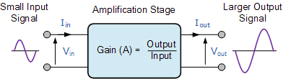
Amplifier
No distortion!
Microphone
Loudspeaker
Increase the magnitude of the signal applied to its input.
What about Conservation of Energy??

Slide 3
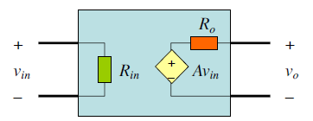
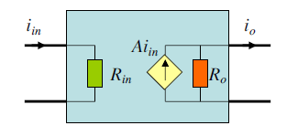
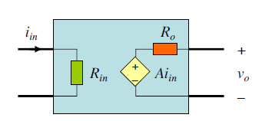
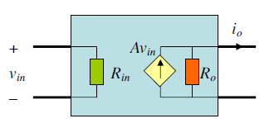
Two-port Models of amplifiers (circuit level)
Voltage amplifier
Input: voltage Output: voltage
Current amplifier
Input: current Output: current
Transresistance amplifier
Input: current Output: voltage
Transconductance amplifier
Input: voltage Output: current

Slide 4
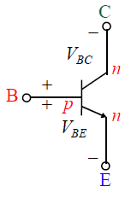
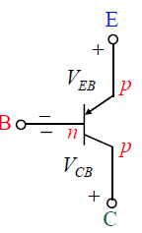
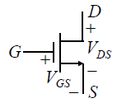
Single transistor amplifier – 3 types
BJT | Common Emitter (CE) | Common Base (CB) | Common Collector (CC)
 | Emitter connects to DC voltage (AC ground) | Base connects to DC voltage (AC ground) | Collector connects to DC voltage (AC ground)
 | Negative gain, i.e. A<-1 e.g. A = -10 | Positive gain, i.e. A>1 e.g. A = 10 | Voltage follower, i.e. A ~ 1
BJT
Emitter (E)
Base (B)
Collector (C)
MOSFET
Source (S)
Gate (G)
Drain (D)

Slide 5
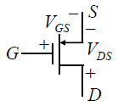
Single transistor amplifier – 3 types
MOS | Common Source (CS) | Common Gate (CG) | Common Drain (CD)
 | Source connects to DC voltage (AC ground) | Gate connects to DC voltage (AC ground) | Drain connects to DC voltage (AC ground)
 | Negative gain, i.e. A<-1 e.g. A = -10 | Positive gain, i.e. A>1 e.g. A = 10 | Voltage follower, i.e. A ~ 1
BJT
Emitter (E)
Base (B)
Collector (C)
MOSFET
Source (S)
Gate (G)
Drain (D)

Slide 6
Notation for DC & AC signals
Total voltage = DC voltage + AC voltage
v_{BE} = V_{BE} + v_{be}
Total current = DC current + AC current
i_{BE} = I_{BE} + i_{be}
Other notation
DC voltage: V_{BB} AC voltage: u_{i}

Slide 7
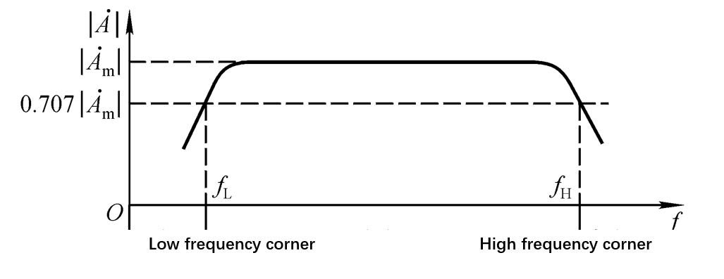
Frequency Response
Amplifiers and filters use resistors, inductors, or capacitor networks (RLC) within their design.
Internal capacitors in transistors.

Slide 8
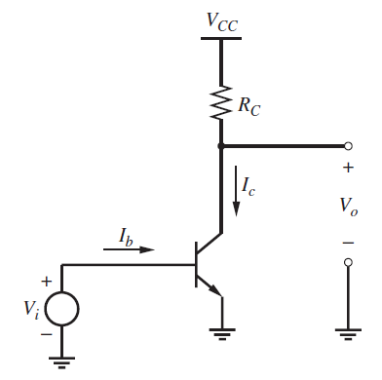
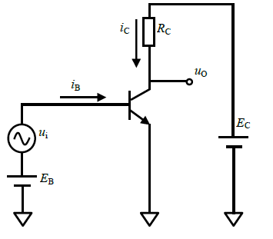

Common-Emitter Configuration of BJT
Input: Base of BJT, Output: Collector of BJT

Slide 9
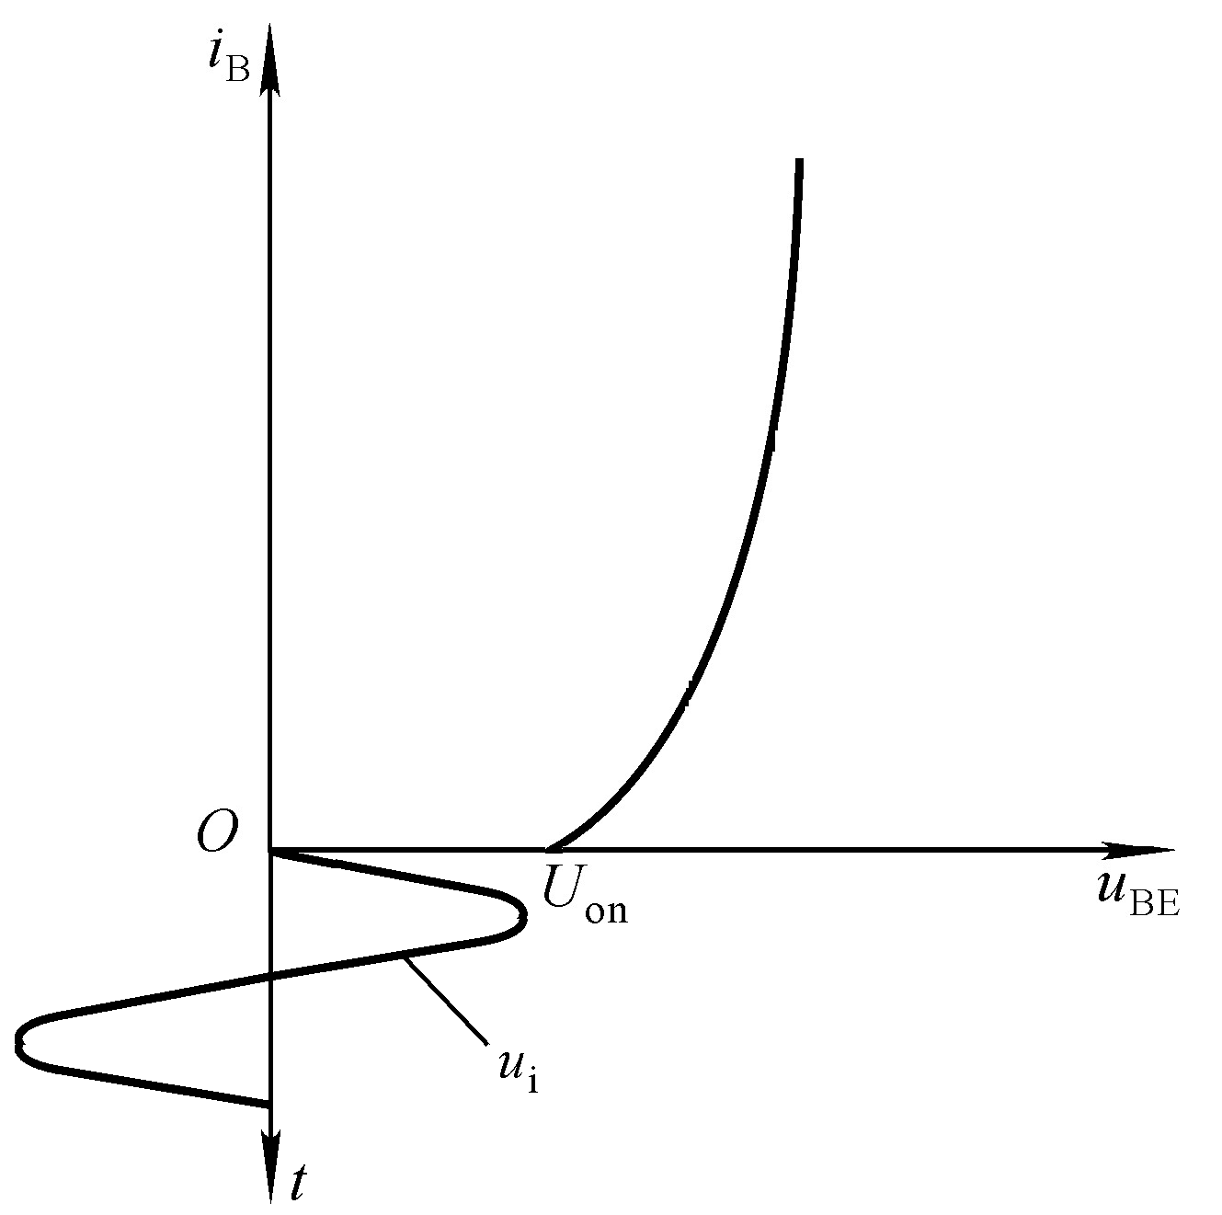
Common Emitter (C-E): Need for DC Biasing
Forward Active operation region: Add a DC component

Slide 10
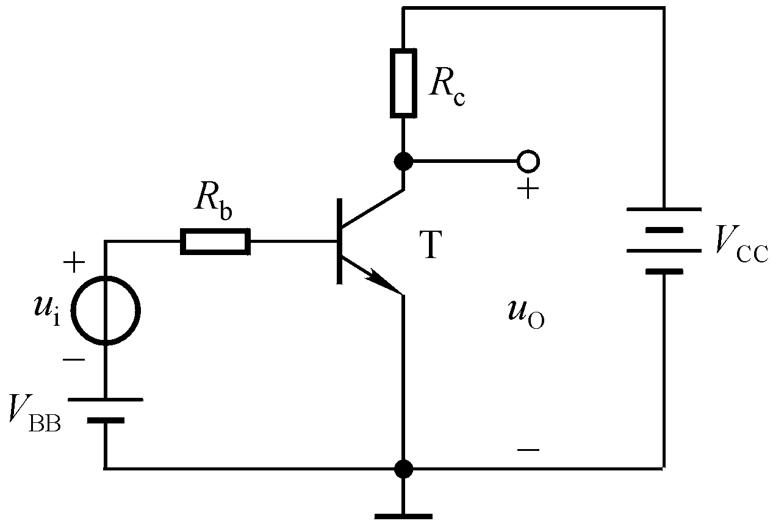
C-E configuration: DC Biasing
V_{BB} – I_{b}R_{b} =V_{BE}＞ V_{on}
R_{c}：suitable V_{CE}
Forward Bias

Slide 11
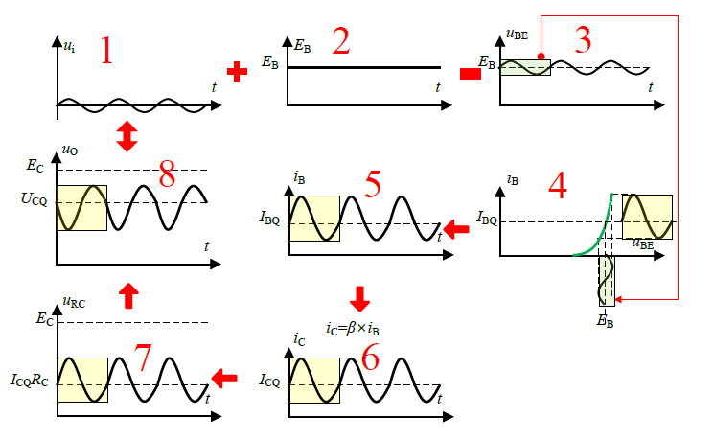
C-E configuration

Slide 12
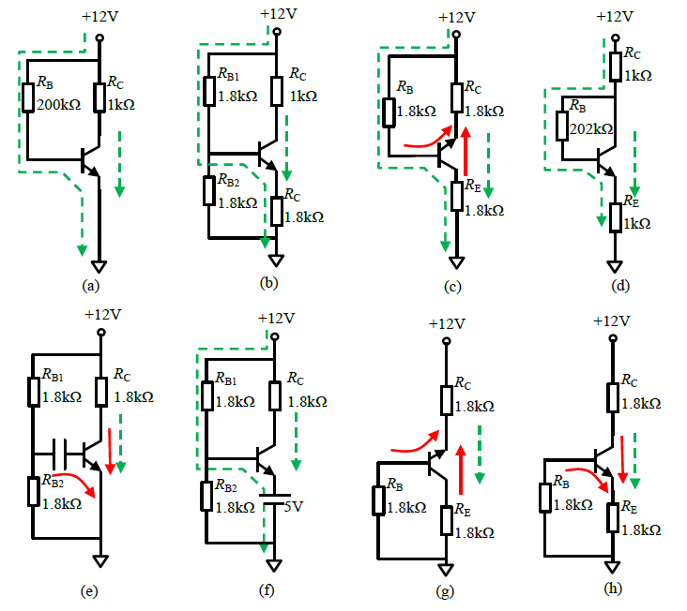
Exercise
Can these configurations work properly?
A,B,D,F: Yes!
(c) Current cannot flow from emitter to collector and emitter to base.
(e) Capacitor blocks base current.
(g) Current cannot flow from emitter to collector.
(h) No base current.

Slide 13
DC biasing: Quiescent point (Q-point)
U_{i} = 0
(Q)
Quiescent Point (Q Point)
I_{BQ,} I_{CQ}（I_{EQ} )
V_{BE,} V_{CE}

Slide 14
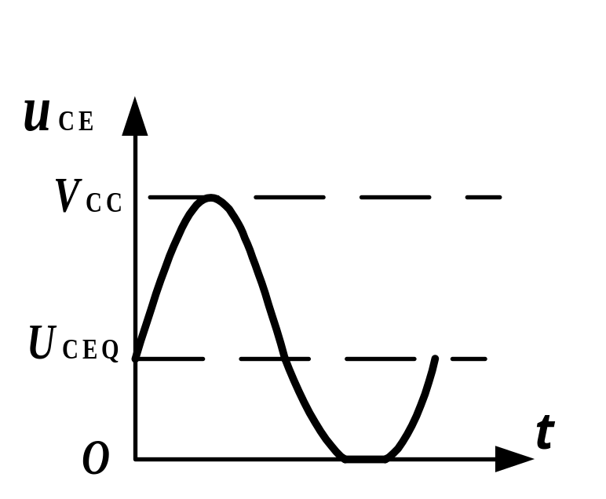
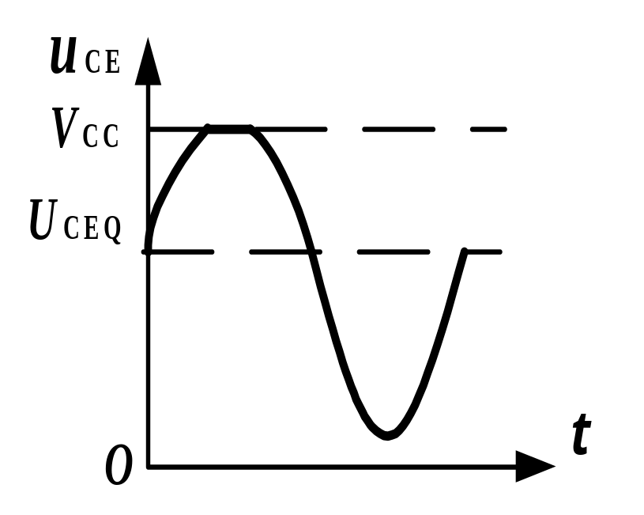


Why Q-point is important?
$$V_{CE}$$
$$V_{CE}$$
Suitable Q Point: No (Less) distortion
Suitable I_{BQ,} I_{CQ}（I_{EQ} ), V_{BE,} V_{CE}

Slide 15
Why Q-point is important?
Amplification may not be taking place over the whole signal cycle due to incorrect biasing levels.
The input signal may be too large, causing the amplifiers transistors to be limited by the supply voltage.
The amplification may not be a linear signal over the entire frequency range of inputs.
Careful choice of the transistor and biasing components (Q Point) can help minimize the effect of amplifier distortion!

Slide 16
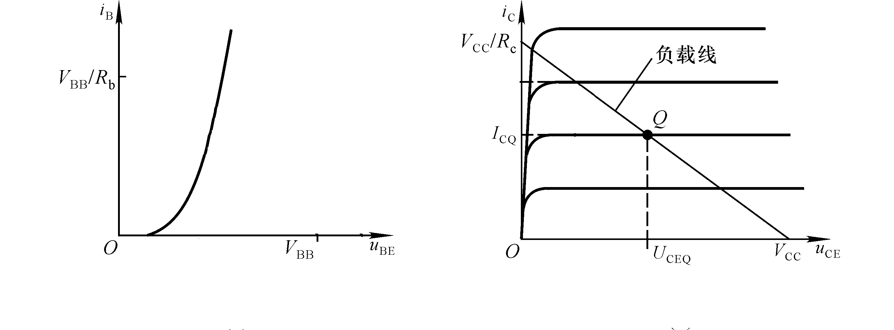
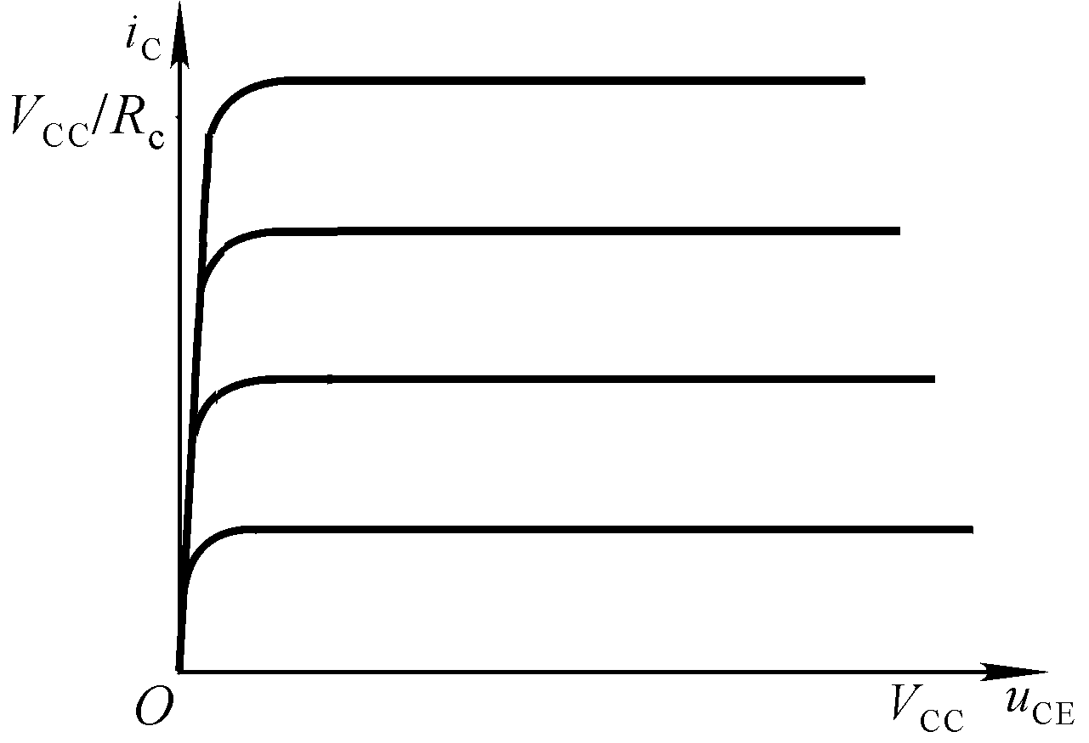




C-E configuration
Output
Input
Q
Q
I_{BQ}
I_{CQ}
I_{BQ}
$$V_{BE}$$
$$V_{CE}$$
$$V_{\text{BE}}=V_{\text{BB}}−i_{B}R_{b}$$
$$V_{\text{CE}}=V_{\text{CC}}−i_{C}R_{c}$$

Slide 17
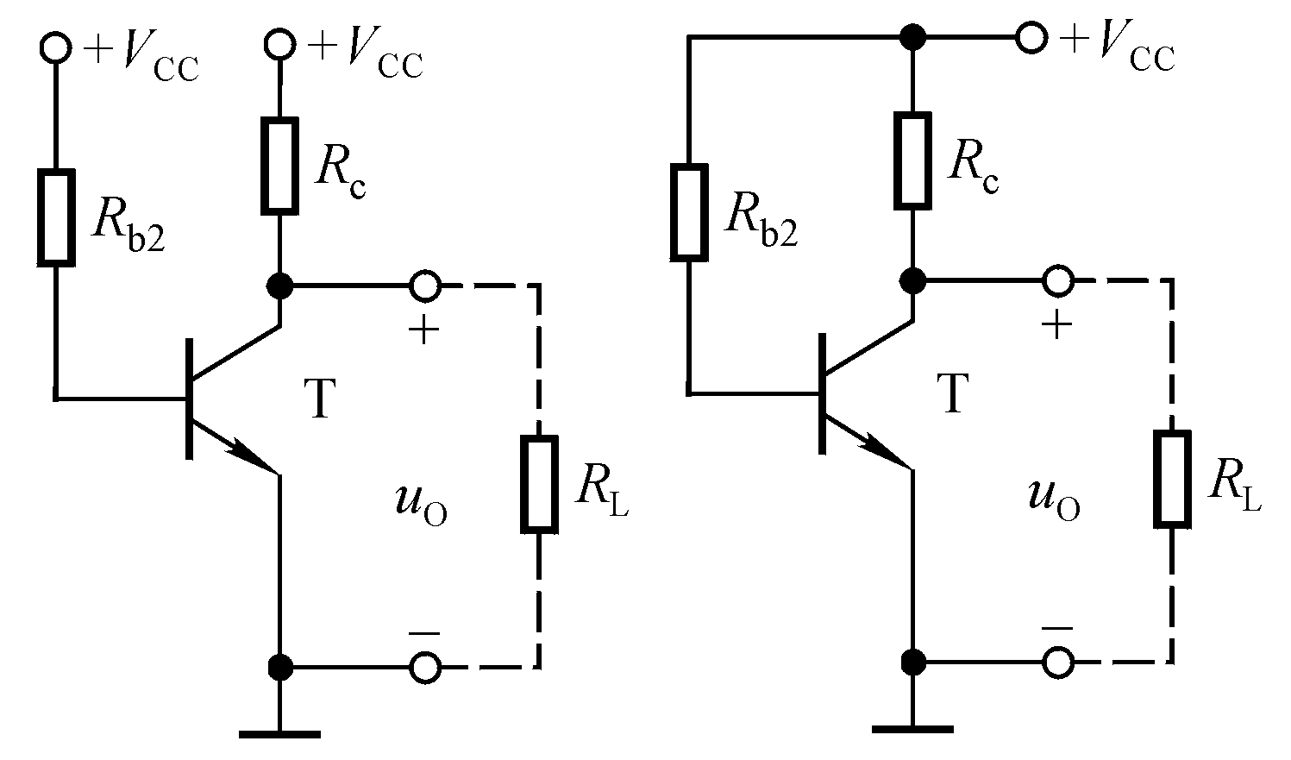
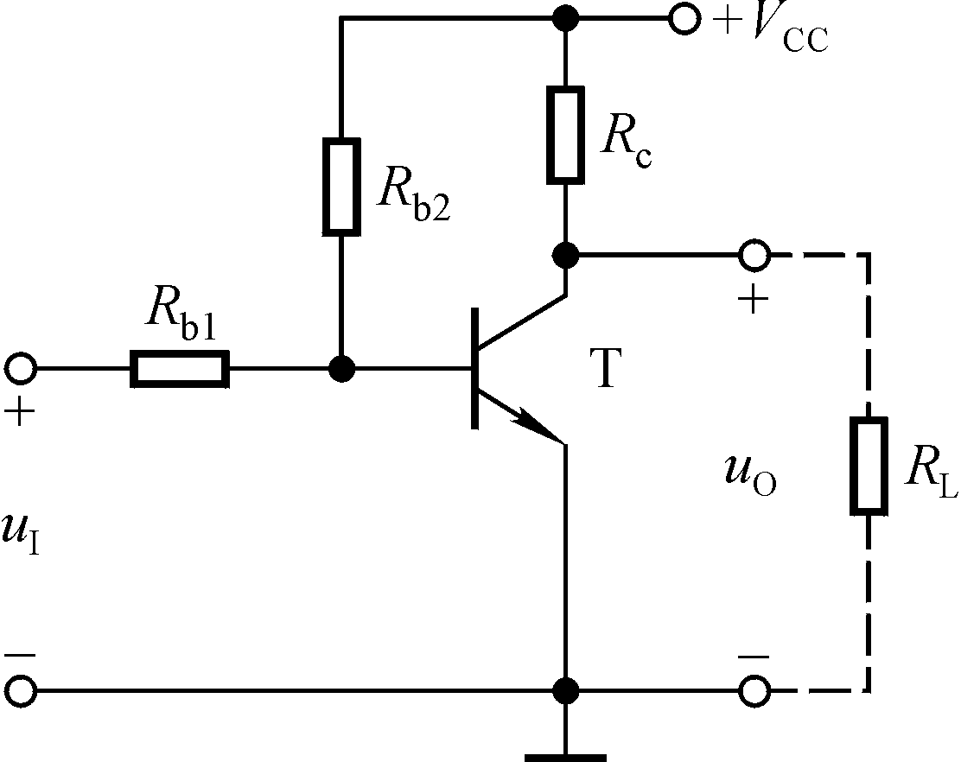
How to provide DC & AC inputs?
How to find a voltage source which is equal to the exact biasing voltage across B-E?

Slide 18
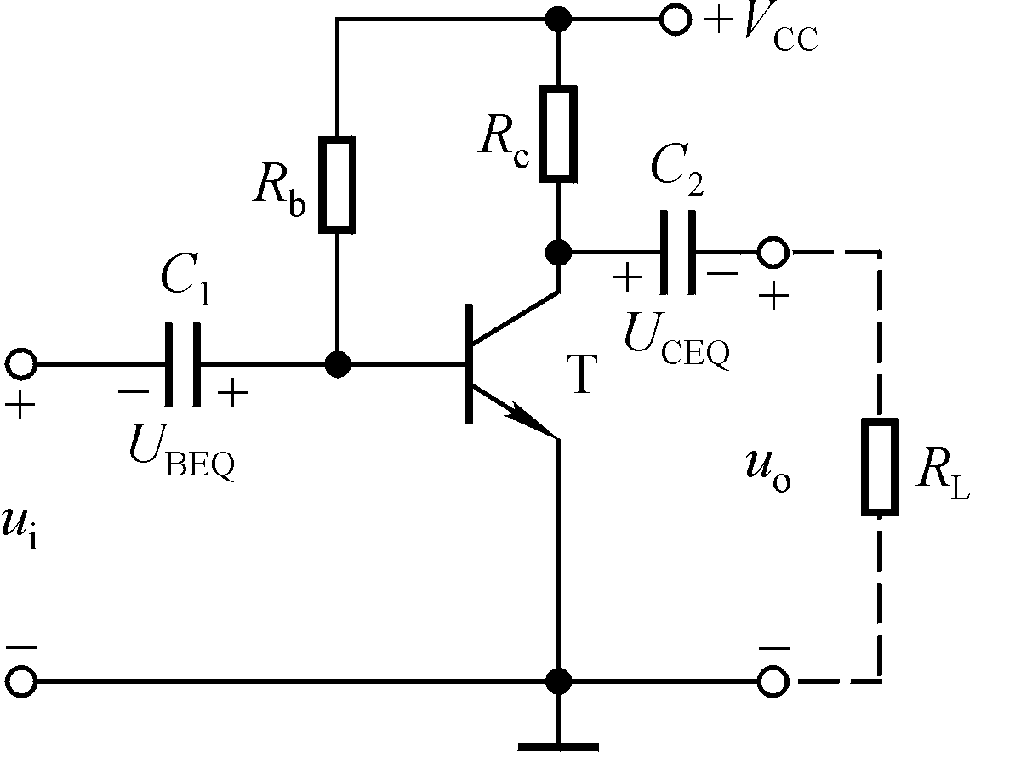


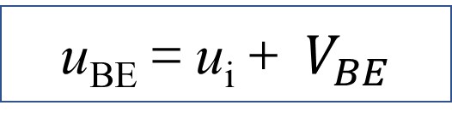

How to provide DC & AC inputs?
DC：
$$V_{\text{C}\text{1}}=V_{BE}，V_{\text{C}\text{2}}=V_{CE}$$
AC：
u_{BE}＝u_{i}
Total：
u_{BE}＝u_{i}＋ $V_{BE}$
Coupling capacitors (large enough so that they become short-circuit at signal frequencies)

Slide 19
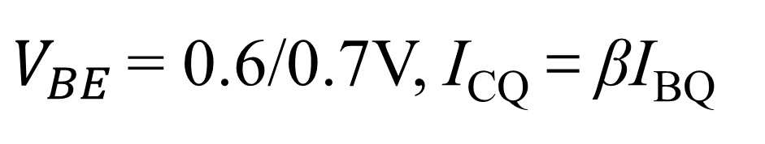
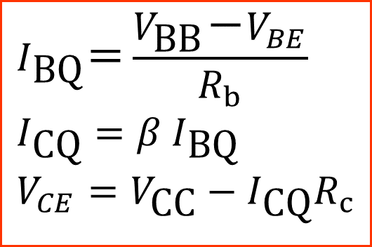
DC Analysis
$$I_{\text{BQ}}＝\frac{V_{\text{BB}}－V_{BE}}{R_{b}} \\ I_{\text{CQ}}=β I_{\text{BQ}} \\ V_{CE}=V_{\text{CC}}−I_{\text{CQ}}R_{c}$$
$V_{BE}$ = 0.6/0.7V, I_{CQ}＝βI_{BQ}

Slide 20
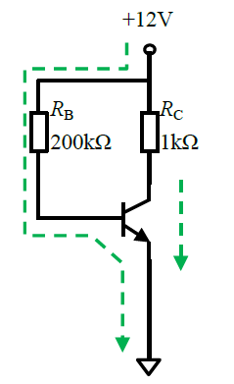






DC Analysis
Assume that the BJT works in forward active region
$$V_{CE}$$

Slide 21



DC Analysis
What if $R_{c}=5kΩ$?

Slide 22
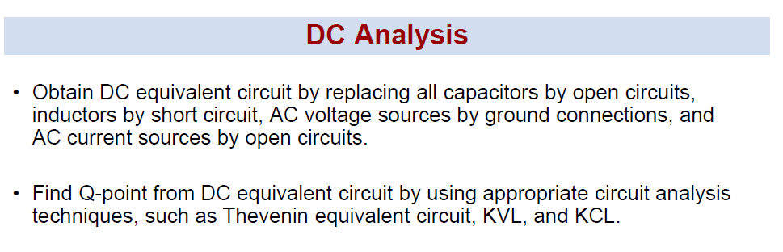
DC and AC Analysis

Slide 23
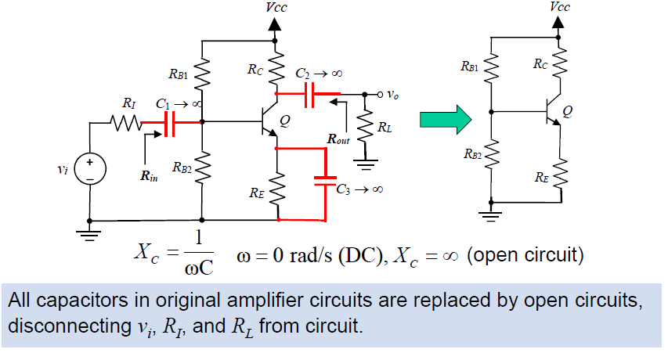
DC equivalent circuit for BJT CE Amplifier

Slide 24
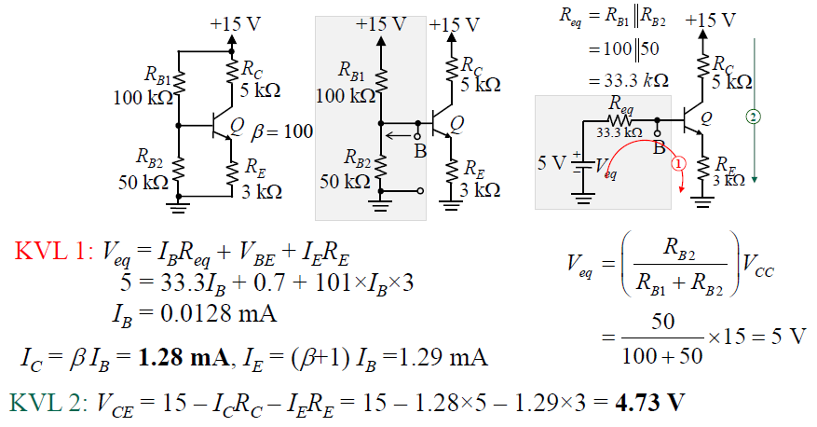
DC Analysis example: 4 resistor BJT biasing circuit

Slide 25
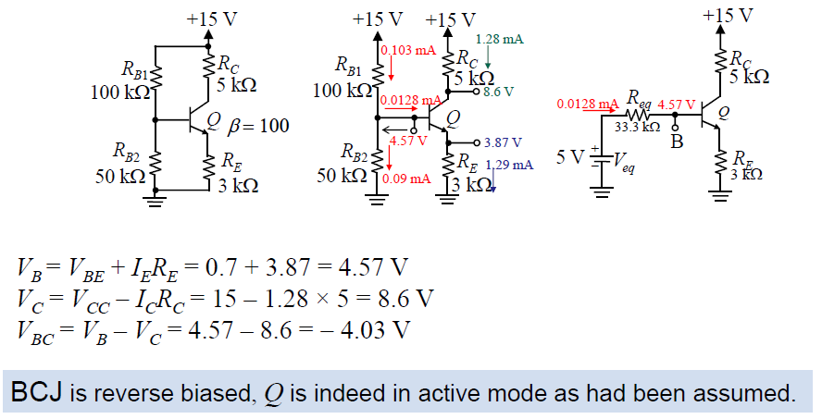
DC Analysis example: 4 resistor BJT biasing circuit

Slide 26
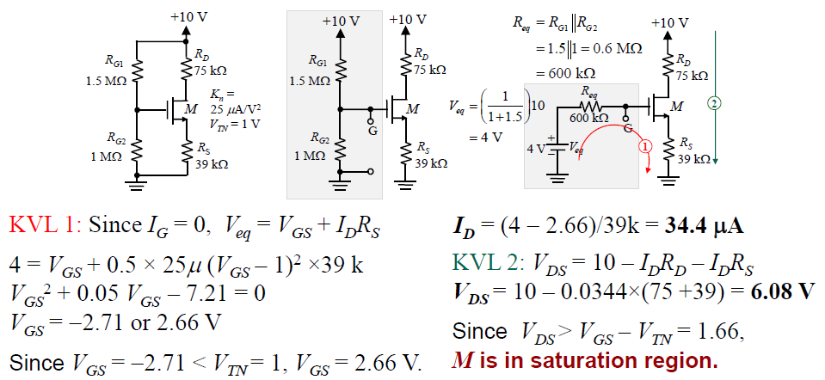
DC Analysis example: 4 resistor MOSFET biasing circuit

Slide 27
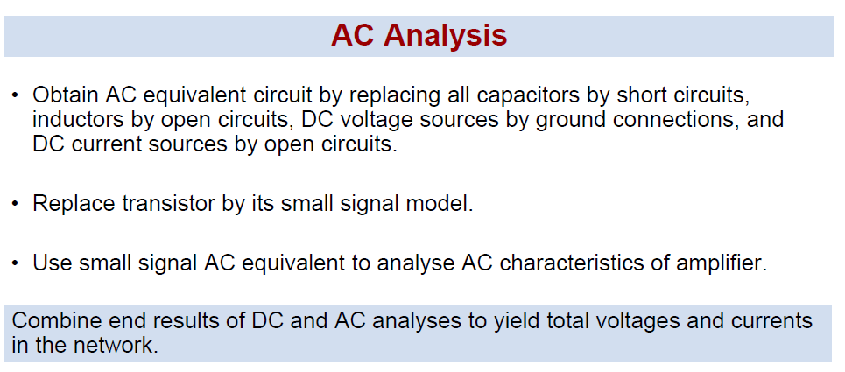
DC and AC Analysis

Slide 28
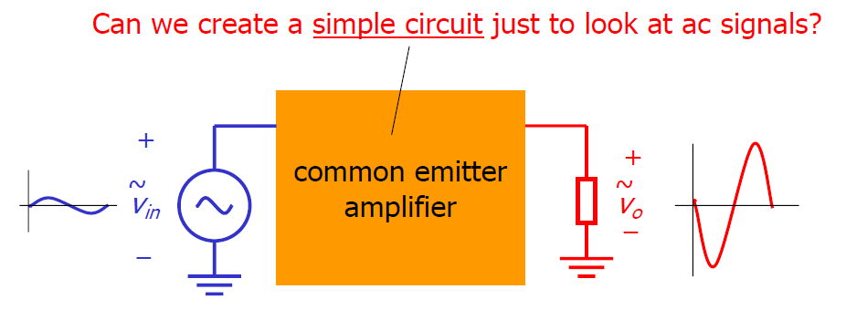
AC analysis: Small signal model
We are interested in AC signal.

Slide 29
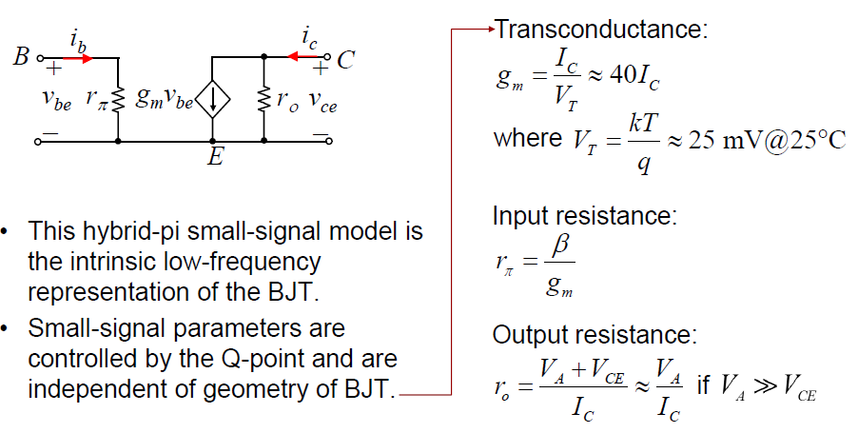
AC analysis: Small signal BJT model

Slide 30
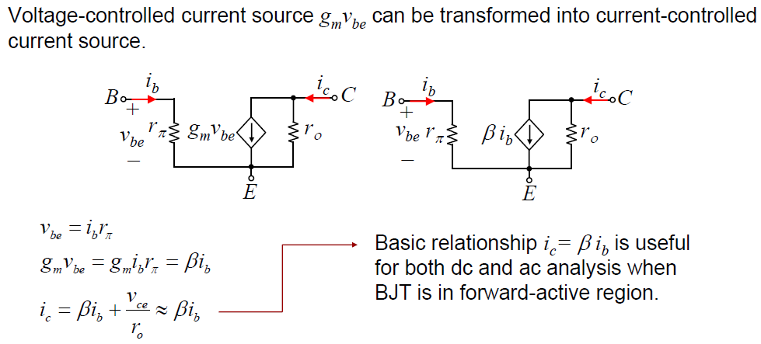
AC analysis: Small signal BJT model

Slide 31
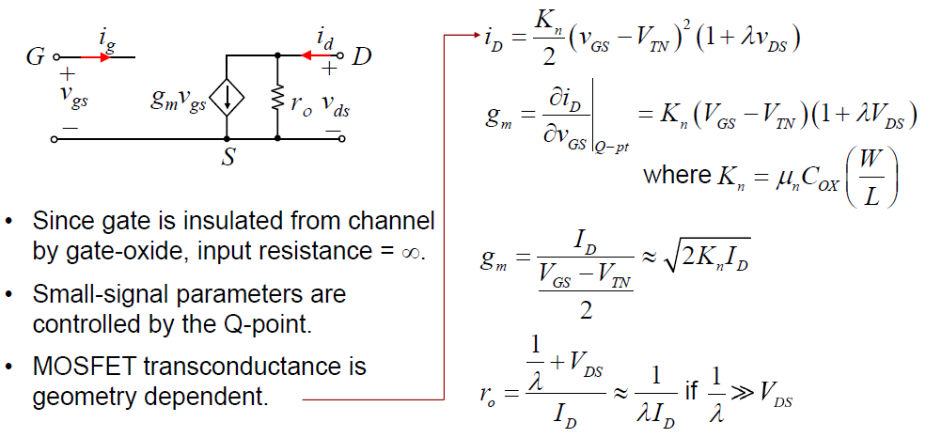
AC analysis: Small signal MOS model

Slide 32
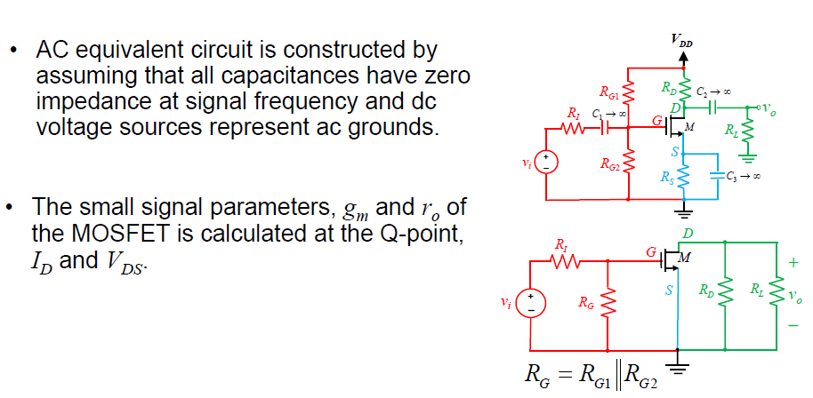
Small-signal analysis of C-S amplifier fully bypassed Rs

Slide 33
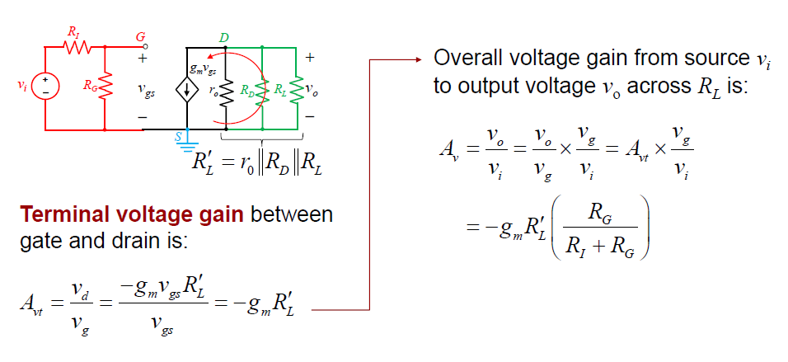
C-S amplifier fully bypassed Rs: Voltage Gain

Slide 34
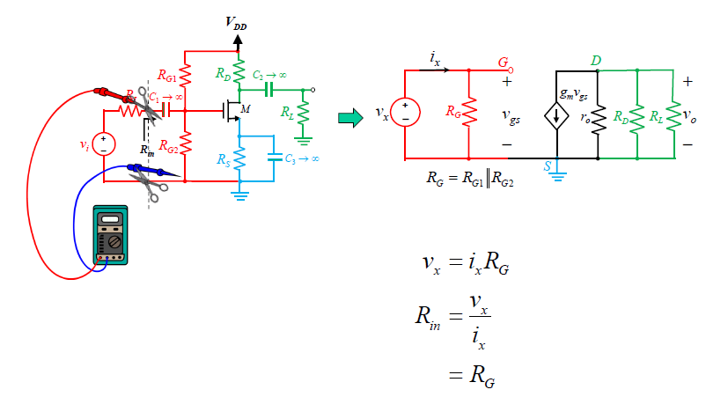
C-S amplifier fully bypassed Rs: Input Resistance

Slide 35
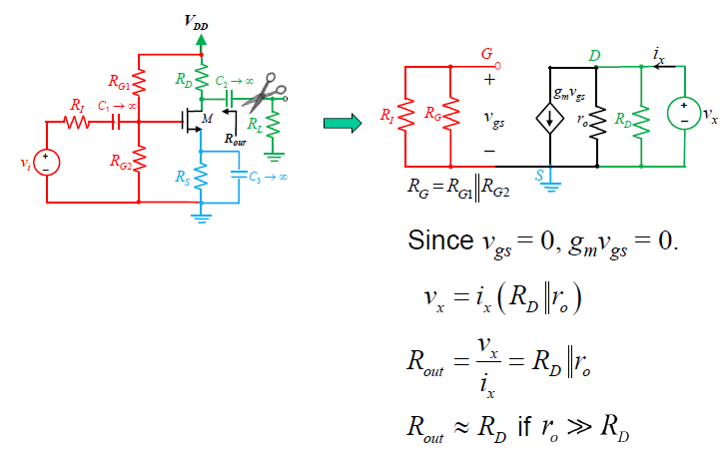
C-S amplifier fully bypassed Rs: Output Resistance

Slide 36
C-S amplifier fully bypassed Rs: Output Resistance

Slide 37
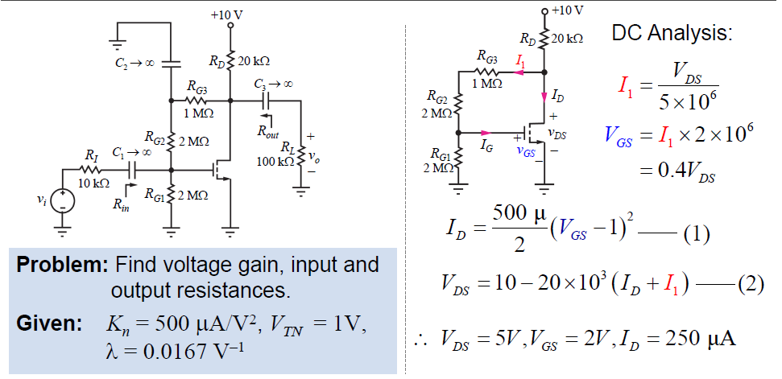
C-S amplifier fully bypassed Rs: Example

Slide 38
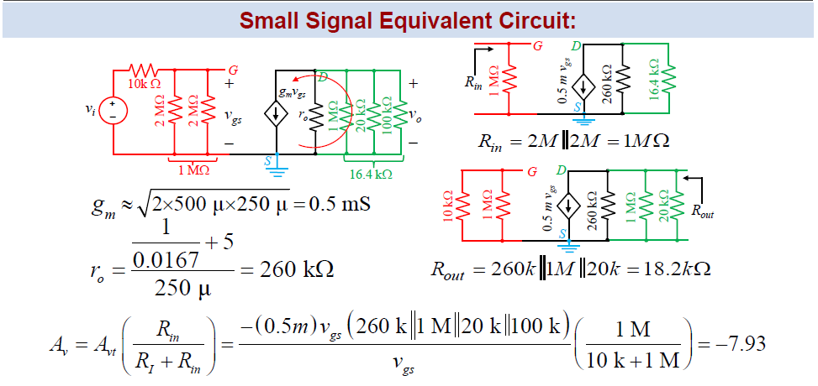
C-S amplifier fully bypassed Rs: Example

Slide 39
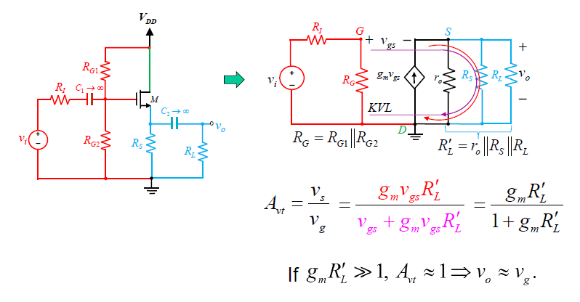
C-D Amplifier (Voltage follower): Terminal Voltage Gain

Slide 40
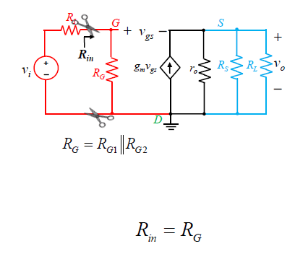
C-D Amplifier (Voltage follower): Input Resistance

Slide 41
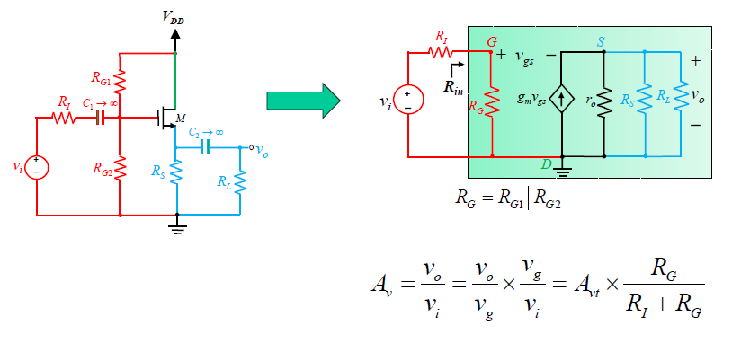
C-D Amplifier (Voltage follower): Overall Voltage Gain

Slide 42
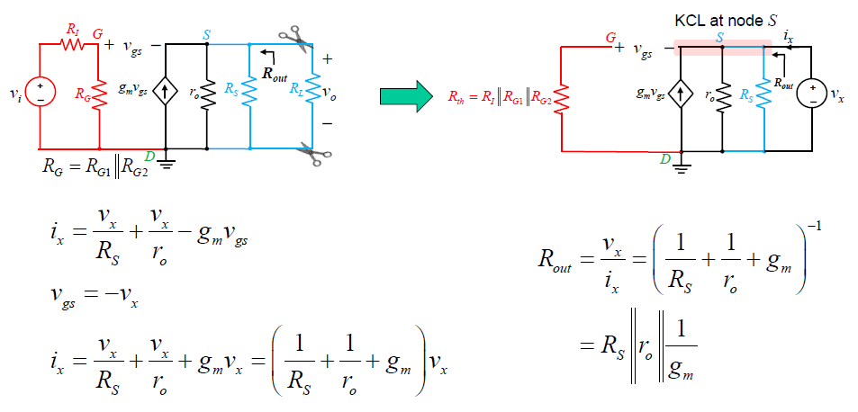
C-D Amplifier (Voltage follower): Output Resistance

Slide 43
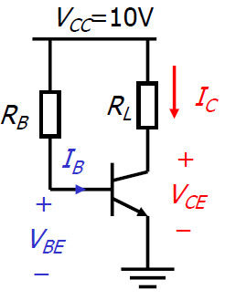
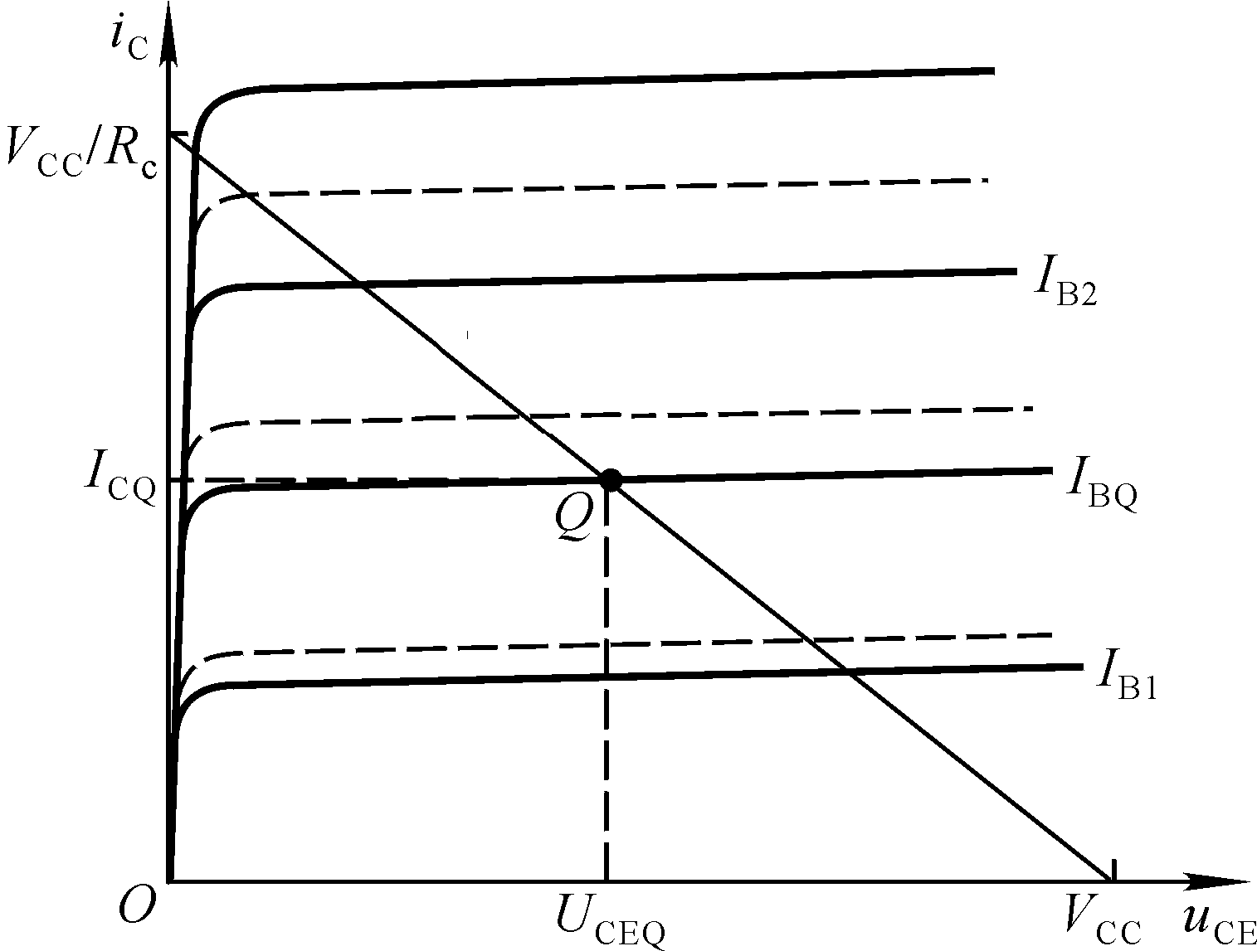


Role of feedback: Stabilizing Q point
$$V_{cc}$$
What if temperature increases?
T（ ℃ ）→ β↑→ I_{C}↑
$$R_{C}$$
Q’
Q Q’

Slide 44
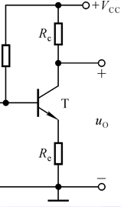

Emitter degeneration: Feedback
$$T↑ →β↑ →I_{c}↑→I_{E}↑→U_{EQ}↑→I_{B}↓$$
Feedback

Slide 45



Emitter degeneration: 4 resistor circuit
I₁>> I_{B}，I₁≈ I₂
$U_{BQ}$is a constant

Slide 46






Emitter degeneration: 4 resistor circuit
$$V_{\text{BB}}=I_{\text{BQ}}R_{b}+V_{BE}+I_{\text{EQ}}R_{e}$$
$$V_{CE}=V_{\text{CC}}−I_{\text{CQ}}R_{c}−I_{\text{EQ}}R_{e} \\ ≈V_{\text{CC}}−I_{\text{EQ}}(R_{c}+R_{e})$$

Slide 47





4 resistor circuit: AC analysis with Re bypass
$C_{e}$: bypass capacitor
Same as C-E amplifier

Slide 48

4 resistor circuit without bypass: Terminal voltage gain

Slide 49

4 resistor circuit without bypass: Input resistance

Slide 50

4 resistor circuit without bypass: Overall voltage gain

Slide 51

4 resistor circuit without bypass: Output resistance

