Slide 1
EE3122: Analogue Circuit Fundamentals
Feedback
Department of Electrical Engineering
City University of Hong Kong
Prof. Arindam BASU

Slide 2
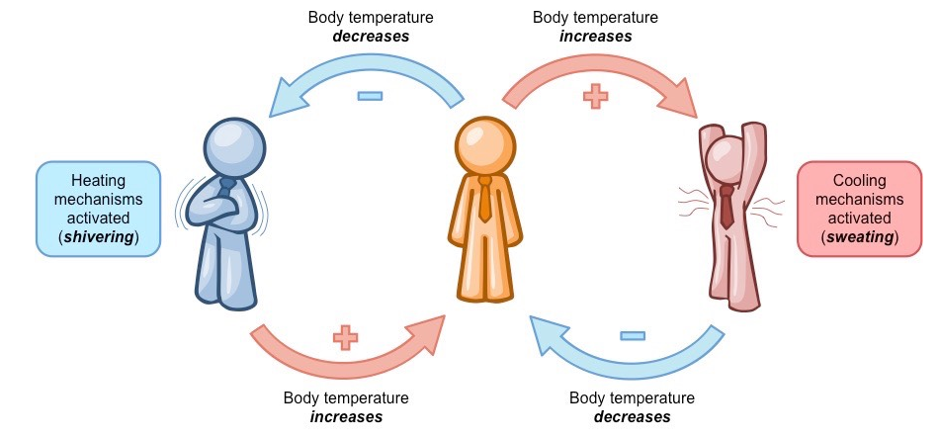
Introduction
Feedback is everywhere in real life!
Negative Feedback

Slide 3
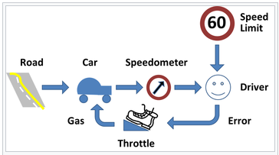
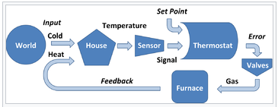
Introduction
Feedback is everywhere in real life!
Negative Feedback

Slide 4
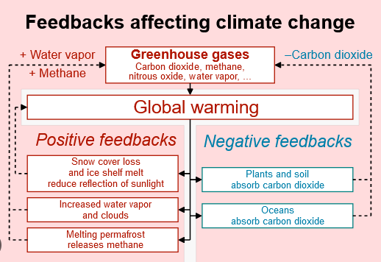
Introduction
Feedback is everywhere in real life!
Positive Feedback

Slide 5
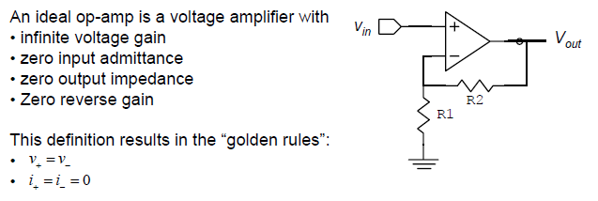
Revisiting the Op-amp
Negative feedback
Result: A_{v} = 1 + R2/R1
What if Op-amp does not have infinite voltage gain?

Slide 6
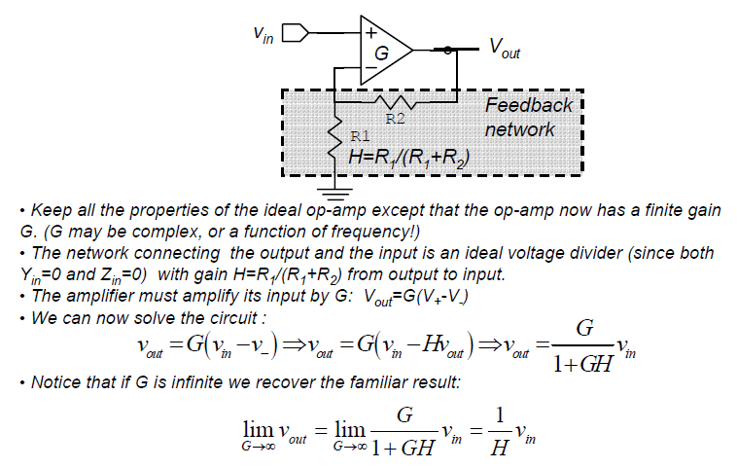
Op-amp with finite gain

Slide 7
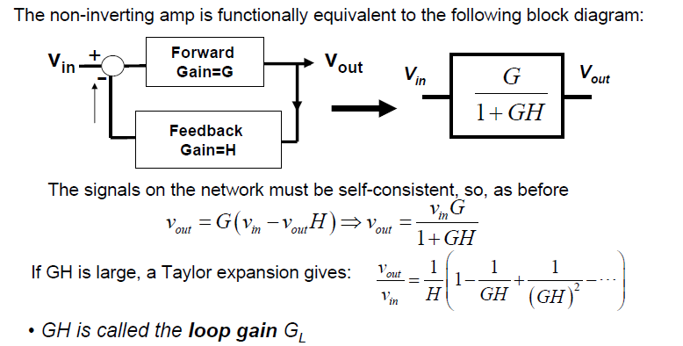
Op-amp with finite gain
(G & H could be function of frequency)

Slide 8
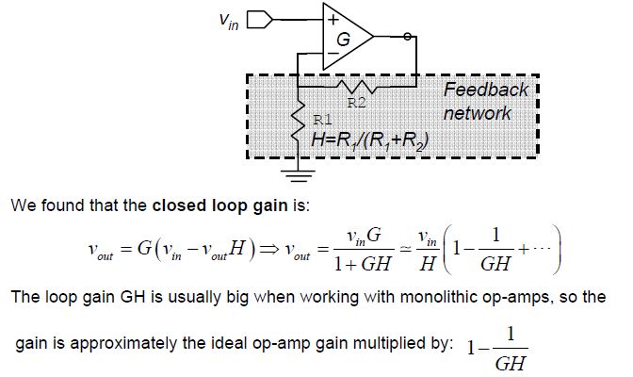
Approximating the Non-inverting gain Amp

Slide 9
Approximating the Non-inverting gain Amp
Example
Suppose you want to create a non-inverting amplifier with a gain of 10. What should be the minimum gain of the Op-amp so that the gain error is less than 1%?
1 + R2/R1 = 10 for non-inverting amplifier → 1/H = 10 or H= 0.1
Acceptable error is <1% → error/ideal value < 0.01
For feedback system with finite opamp gain G, actual gain ~1/H*(1-1/GH) → error = 1/H*1/GH
Error /ideal value = 1/GH < 0.01
Hence, G > (1/H)*100 = 1000

Slide 10
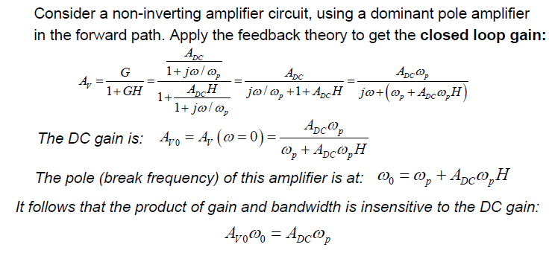
Effect of feedback on Bandwidth
Gain bandwidth product is constant!
(= Unity Gain Frequency (UGF))

Slide 11
Effect of feedback on Bandwidth
Example
Suppose you want to create a non-inverting amplifier with a gain of 10 using a non-ideal opamp with finite unity-gain frequency (UGF) = 1 MHz. What will be the closed-loop bandwidth of the non-inverting amplifier?
UGF = Gain*BW = constant
The gain for closed-loop system is 10.
Hence, 10*BW = UGF = 1 MHz → BW = 100 kHz

Slide 12
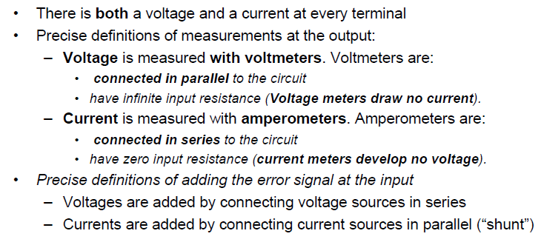
Feedback in Electronics

Slide 13
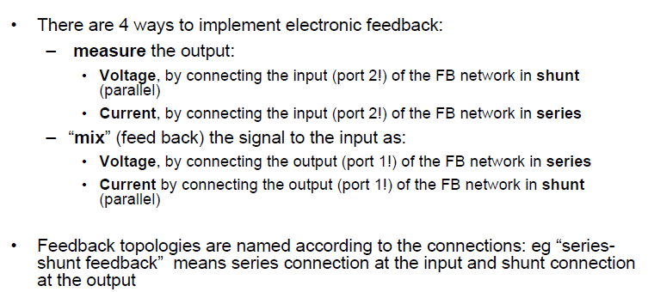
Types of Feedback
Feedback also changes impedance →
Series results in increase (Z_{F} = Z_{OL}*(1+GH))
Shunt results in decrease (Z_{F} = Z_{OL} / (1+GH))

Slide 14
Types of Feedback
IN OUT | Voltage Series | Current Shunt
Voltage Shunt | Series – Shunt Rin increase Rout decrease | Shunt-Shunt Rin decrease Rout decrease
Current Series | Series – Series Rin increase Rout increase | Shunt-Series Rin decrease Rout increase

Slide 15
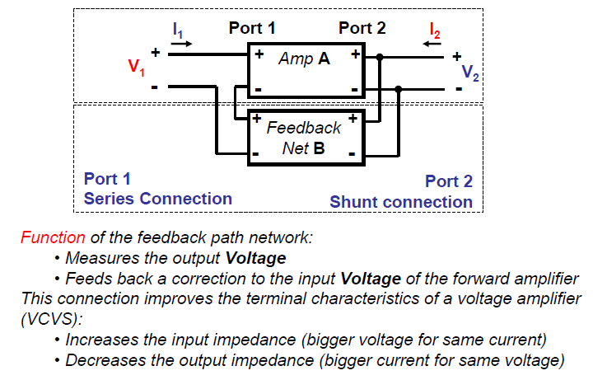
Series-Shunt Connection

Slide 16
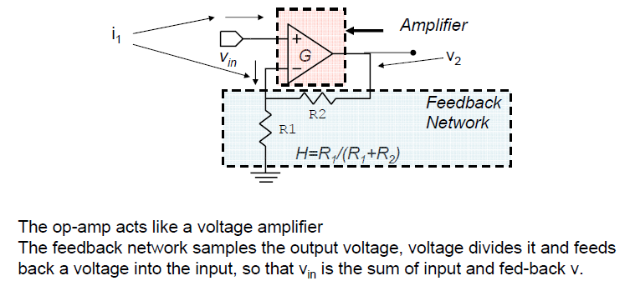
Series-Shunt Connection: Example

Slide 17
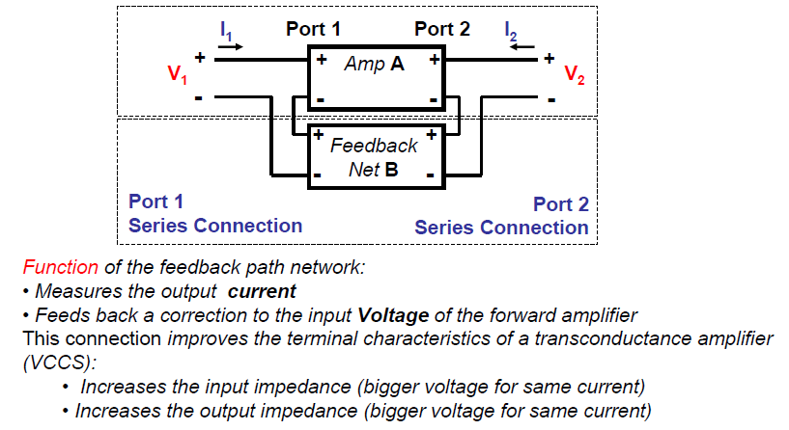
Series-Series Connection

Slide 18
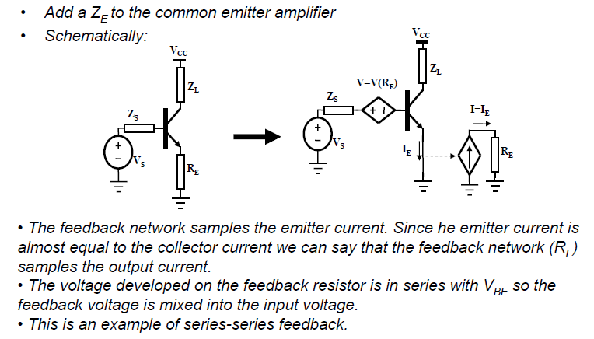
Series-Series Connection: Example

Slide 19
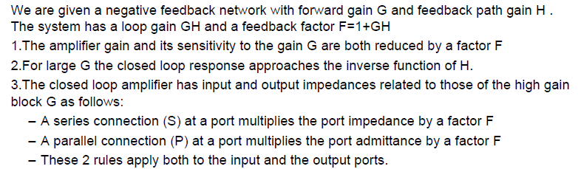
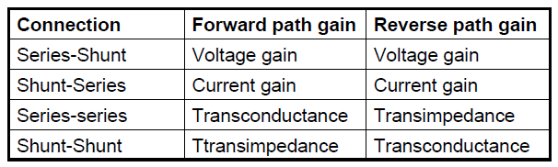
Negative feedback: Summary

Slide 20
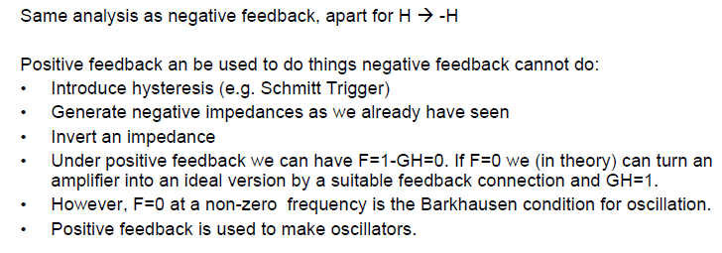
Positive Feedback
Look at oscillators next!

Slide 21
Appendix

Slide 22
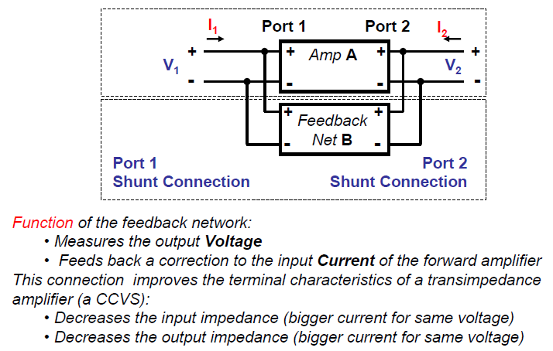
Shunt-Shunt Connection

Slide 23
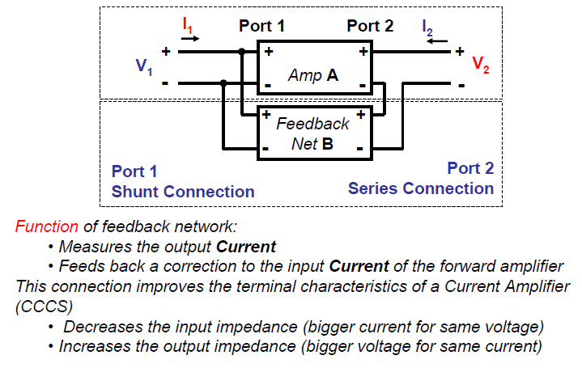
Shunt-Series Connection

