Slide 1

Chapter 11 & 12
Disk Scheduling and Secondary Storage Management
Operating Systems:
Internals and Design Principles
William Stallings

Slide 2
Roadmap
A Big Picture
Record Blocking
Disk Scheduling
File Allocation

Slide 3
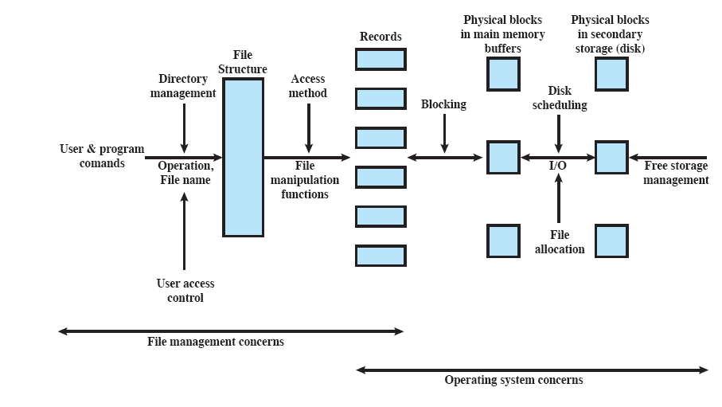
A Big Picture of
File Management
How to organize records as a sequence of blocks for I/O?
How to schedule individual block I/O requests for optimizing performance?
How to allocate files to free blocks on secondary storage?

Slide 4
Roadmap
A Big Picture
Record Blocking
Disk Scheduling
File Allocation

Slide 5
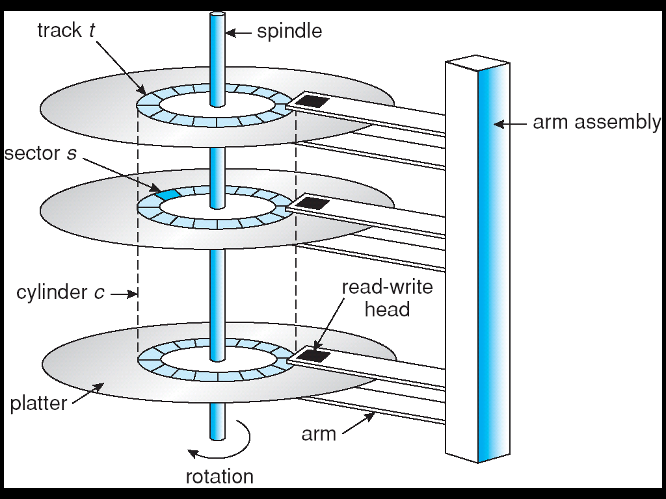
File, Record and Block
File is a collection of similar records
Record can be treated as a unit by application programs
  fixed or variable length
Blocks are the unit for I/O with secondary storage
  Blocks are mapped onto sectors of the disk sequentially
For I/O to be performed, records must be organized as blocks
Three approaches are common
  Fixed-length blocking
  Variable-length spanned blocking
  Variable-length unspanned blocking

Slide 6
Fixed-Length Blocking
Fixed-length records are used, and an integral number of records are stored in a block
 Unused space at the end of a block is internal fragmentation

Slide 7
Variable-Length
Spanned Blocking
Variable-length records are used and are packed into blocks with no unused space
Some records may span multiple blocks
  Continuation is indicated by a pointer to the successor block
 Efficient for storage
 Does not limit the size of records
 Difficult to implement
 Records that span two blocks require two I/O operations

Slide 8
Variable-Length
Unspanned Blocking
Variable length records are used but no spanning
 Wasted space in most blocks because of the remainder of a block cannot be used if the next record is larger than the remaining unused space
 Limits record size to the size of a block

Slide 9
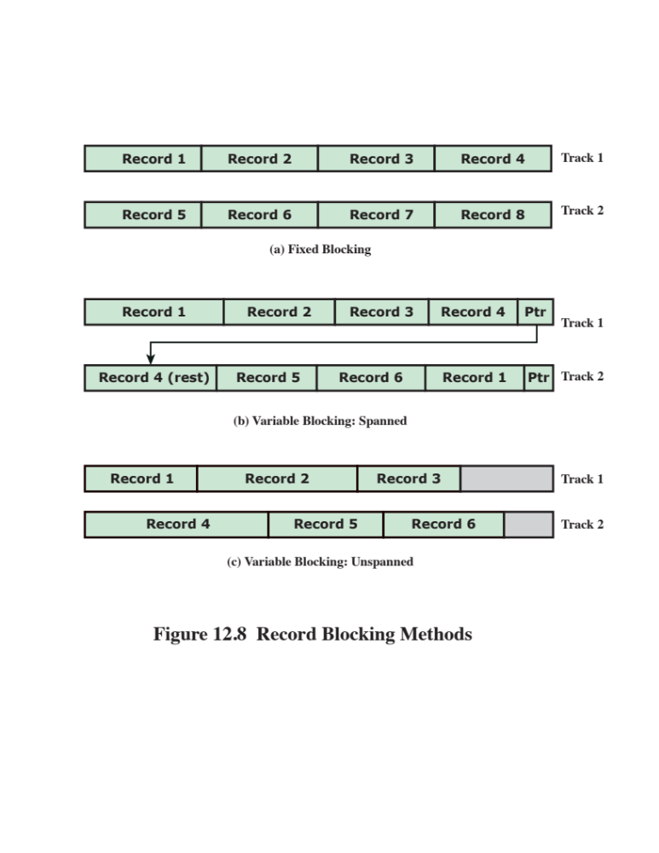
Record Blocking Methods

Slide 10
Roadmap
A Big Picture
Record Blocking
Disk Scheduling
File Allocation

Slide 11
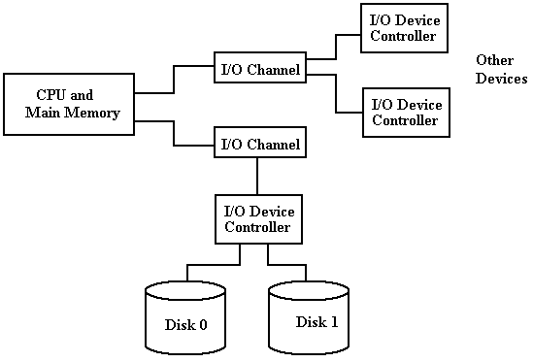
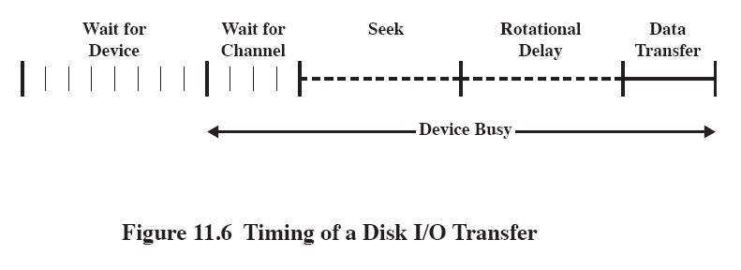
Disk Performance Parameters
Currently, disks are at least four orders of magnitude slower than main memory
  → performance of disk storage subsystem is of vital concern
A general timing diagram of disk I/O transfer is shown here.

Slide 12
Positioning the
Read/Write Heads
When the disk drive is operating, the disk is rotating at constant speed
To read or write, the head must be positioned at the desired track and at the beginning of the desired sector on that track

Slide 13
Disk Performance Parameters
Seek time: the time it takes to position the head at (move the disk arm to) the desired track
Rotational delay or rotational latency: the time it takes for the beginning of the desired sector to reach the head
Transfer Time is the time taken to transfer the data (as the sector moves under the head)

Slide 14
Disk Performance Parameters
Total average access time T_{a}
  T_{a} = T_{s} + 1 / (2r) + b / (rN)
  where T_{s} = average seek time
  b = no. of bytes to be transferred
  N = no. of bytes on a track
  r = rotation speed, in revolutions / sec.
Due to the seek time, the order in which sectors are read from disk has a tremendous effect on I/O performance

Slide 15
Disk Performance
Example
Given:
  Average seek time = 5ms
  Rotation speed = 7500rpm
    Time for one rotation = 1/(7500/60) = 8 ms
  500 sectors / track
  Read a file consisting of 2,500 sectors
Total time for sequential access (the file occupies all the sectors on 5 adjacent tracks)
= time to read 1st track + time to read successive tracks
= 5 + 4 + 8 + 4 * (4 + 8) = 65 ms

Slide 16
Disk Performance
Example (cont.)
Given:
  Average seek time = 5ms
  Rotation speed = 7500rpm
    Time for one rotation = 1/(7500/60) = 8 ms
  500 sectors / track
  Read a file consisting of 2,500 sectors
Total time for random access (sectors of the file are distributed randomly over the disk)
= 2500 * time to read a sector
= 2500 * (5 + 4 + 0.016) = 22,540 ms

Slide 17
Disk Performance
Observations:
  The reason for the difference in performance can be traced to seek time.
  In a multiprogramming environment, the OS maintains a queue of requests for each disk from various processes.
  If requests (tracks) are selected (visited) at random, the performance will be very poor.
So, there is a need to schedule access requests smartly in order to reduce the average time spent on seeks.

Slide 18
Disk Scheduling
Policies
To compare various schemes, consider a disk head initially located at track 100
  assume a disk with 200 tracks and that the disk request queue has random requests from various processes in it
The requested tracks, in the order received by the disk scheduler, are
  55, 58, 39, 18, 90, 160, 150, 38, 184

Slide 19
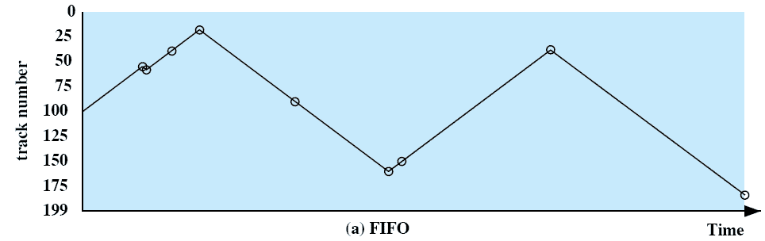
First-in, first-out (FIFO)
Process requests sequentially
 Fair to all processes
 May have good performance if most requests are to clustered file sectors
 Approximate random scheduling in performance if there are many processes
disk arm movement

Slide 20
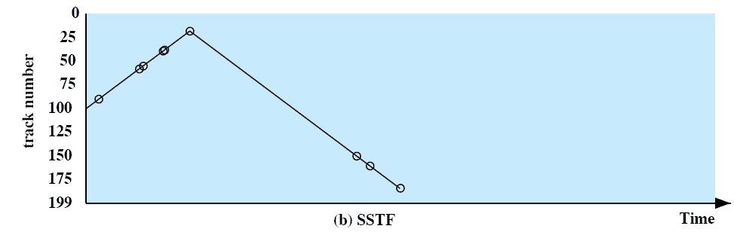
Shortest Service
Time First (SSTF)
Select the disk I/O request that requires the least movement of the disk arm from its current position
 Always choose the minimum seek time → better performance
 Does not ensure fairness
 Starvation may occur when new requests are always chosen before an existing request

Slide 21
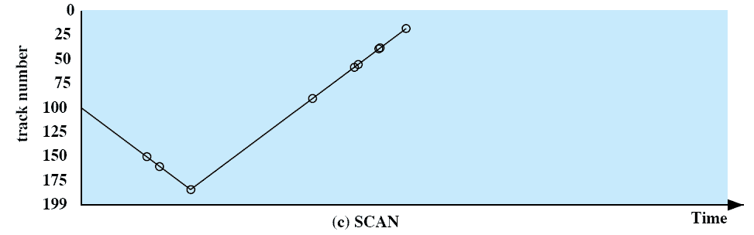
SCAN
Also known as the elevator algorithm
Arm moves in one direction, satisfying all outstanding requests until there are no more requests in that direction, then the service direction is reversed.

Slide 22
SCAN
 Reduces unfairness of SSTF
  SCAN ensures that all requests in a given direction will be serviced before the requests in the opposite direction.
 SCAN is biased against the area most recently traversed
  → does not exploit locality as well as SSTF
 SCAN may still service arriving requests before waiting requests.
  A request arriving just behind the head will have to wait until the arm completes one direction, reverses direction and comes back while a request arrives just in front of the head, it will be serviced almost immediately.
At the point when the head reverses direction, relatively few requests are immediately in front of the head, since these tracks have recently been serviced.

Slide 23
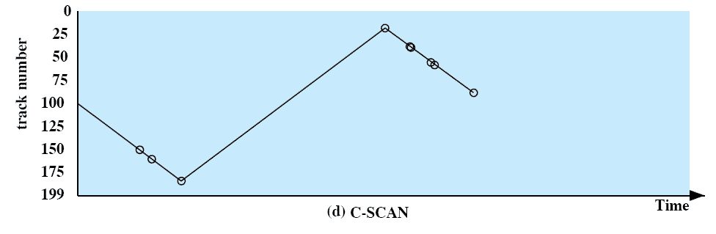
C-SCAN (Circular SCAN)
Restricts scanning to one service direction only.
When the last request in the service direction is satisfied, the arm reverses its direction without servicing any requests on the return trip and the scan begins again at the first request in the service direction.
 Reduces the maximum delay experienced by new requests.

Slide 24
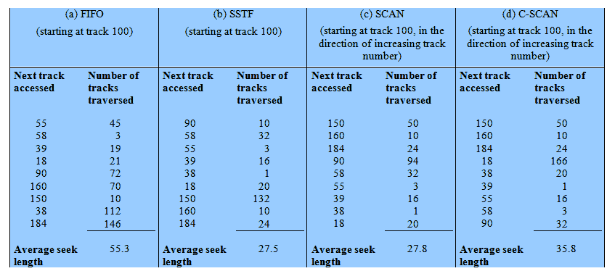
Performance Compared
Comparison of Disk Scheduling Algorithms
Notes:
T

Slide 25
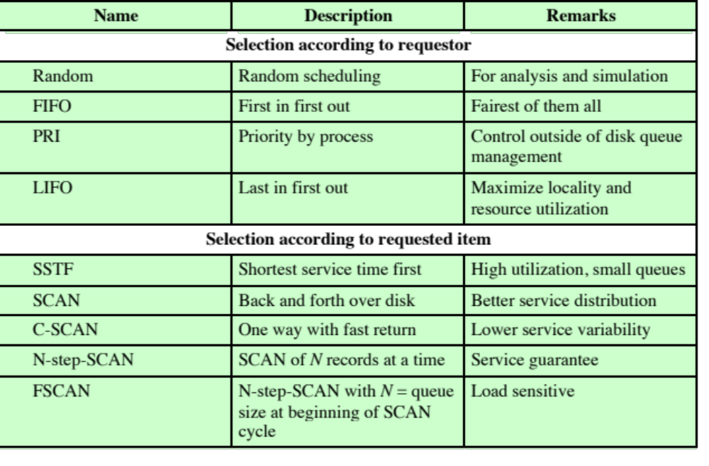
Disk Scheduling
Policies

Slide 26
Roadmap
A Big Picture
Record Blocking
Disk Scheduling
File Allocation

Slide 27
Secondary Storage Management
Reminder: on secondary storage, a file consists of a collection of blocks.
OS is responsible for allocating blocks to files BUT when: at creation time or as needed?
Space is allocated to a file as one or more portions (contiguous set of allocated blocks) BUT what size of portion should be?
File allocation table (FAT) is a data structure used to keep track of the portions assigned to a file.

Slide 28
Pre-allocation vs
Dynamic Allocation
A preallocation policy requires that the maximum size of a file be declared at the time of the file creation request
For many applications, it is difficult to estimate reliably the maximum potential size of the file
  tends to be wasteful because users and application programmers tend to overestimate size
Dynamic allocation allocates space to a file in portions as needed

Slide 29
Portion Size
In choosing a portion size, there is a trade-off between efficiency from the point of view of a single file vs. the overall system efficiency
Issues to be considered:
      Large portions: contiguity of space increases performance
      Small portions: a large number of small portions increases the size of tables needed to manage the allocation information
      Fixed-size portions: simplifies the reallocation of space
      Variable-size or small fixed-size portions: minimizes waste of unused storage due to overallocation

Slide 30
Two Major Alternatives
Variable, large contiguous portions
   provides better performance
   the variable size avoids waste
   the file allocation tables are small
   space is hard to reuse
Blocks: small fixed-sized portions
   small fixed portions provide greater flexibility
   they may require large tables or complex structures for their allocation
   contiguity has been abandoned as a primary goal; blocks are allocated as needed

Slide 31
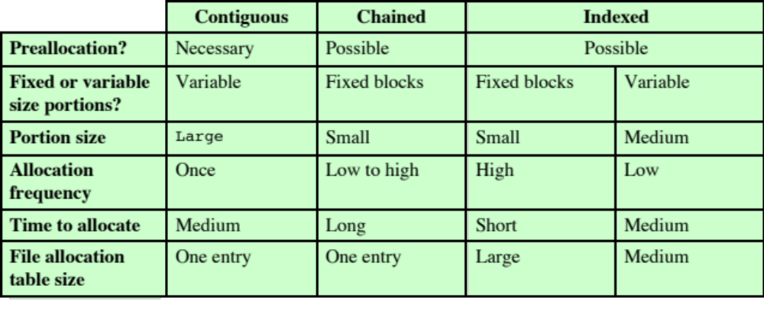
File Allocation Methods

Slide 32
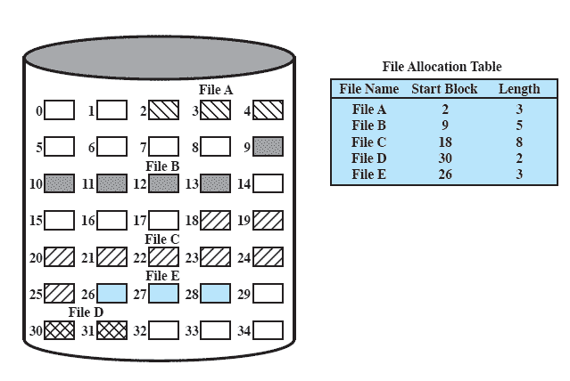
Contiguous File Allocation
A single contiguous set of blocks is allocated to a file at the time of creation
A preallocation with variable-size portions
 FAT needs a single entry for each file

Slide 33
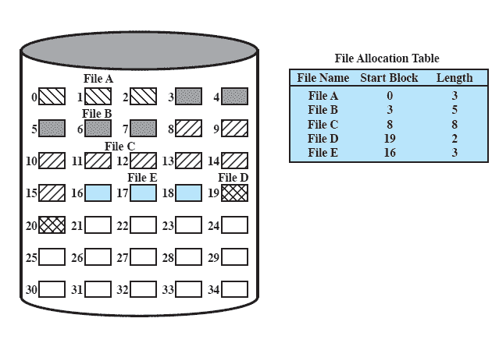
Contiguous File Allocation
 Best for individual sequential file
  multiple blocks can be read in at a time to improve I/O performance
  Also easy to retrieve a single block
    if a file starts at block b, and the i th block of the file is wanted, its location on secondary storage is simply b + i – 1.
 External fragmentation will occur
  Need to perform compaction (a.k.a. disk defragmentation )
  Before compaction
  After compaction

Slide 34
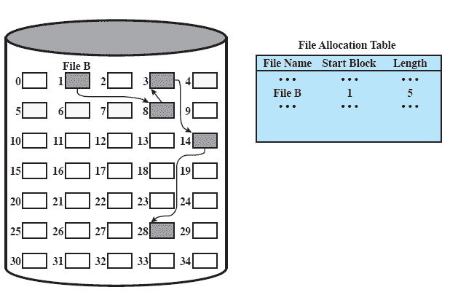
Chained Allocation
Allocation is on basis of individual block
Each block contains a pointer to the next block in the chain
Allows both preallocation and dynamic allocation
 FAT needs a single entry for each file
 Selection of blocks is simple
  any free block can be added to a chain
 No external fragmentation
 Best for sequential files that are to be processed sequentially

Slide 35
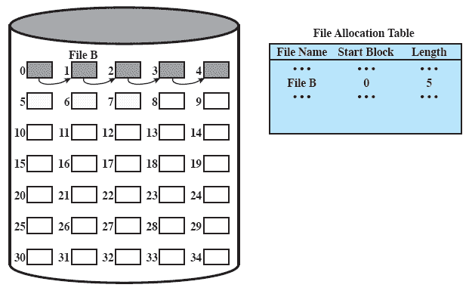
Chained Allocation
 To select an individual block of a file requires tracing through the chain to the desired block
 No accommodation of the principle of locality
  a series of accesses to different parts of the disk are required for sequential processing
  has to consolidate files periodically
  Before consolidation
  After consolidation

Slide 36
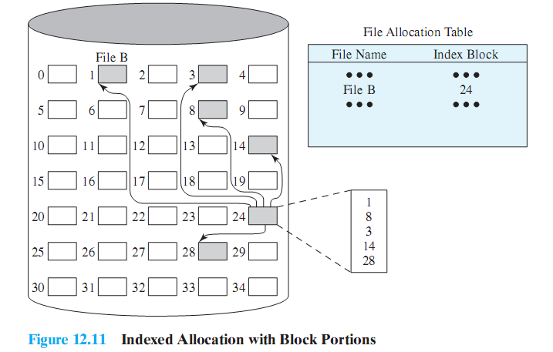
Indexed Allocation with Block Portions
FAT contains an entry for a file that points to the file index block
  The file index block has one entry for each portion allocated to the file
Allocation may be either
  Fixed-size blocks
  Variable-size portions

Slide 37
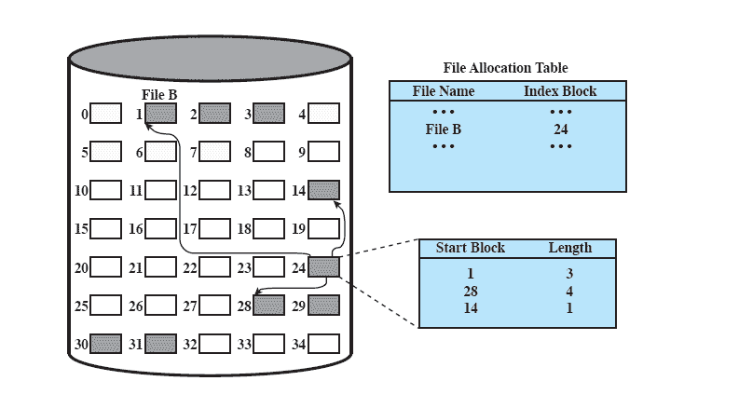
Indexed Allocation with
Variable Length Portions
variable-length portions

Slide 38
Indexed Allocation
 Allocation by blocks eliminates external fragmentation
 Allocation by variable-size portions improves locality
 Supports both sequential and direct access to the file and thus is the most popular
 File consolidation may be done
  reduces the size of the index in the case of variable-size portions

Slide 39

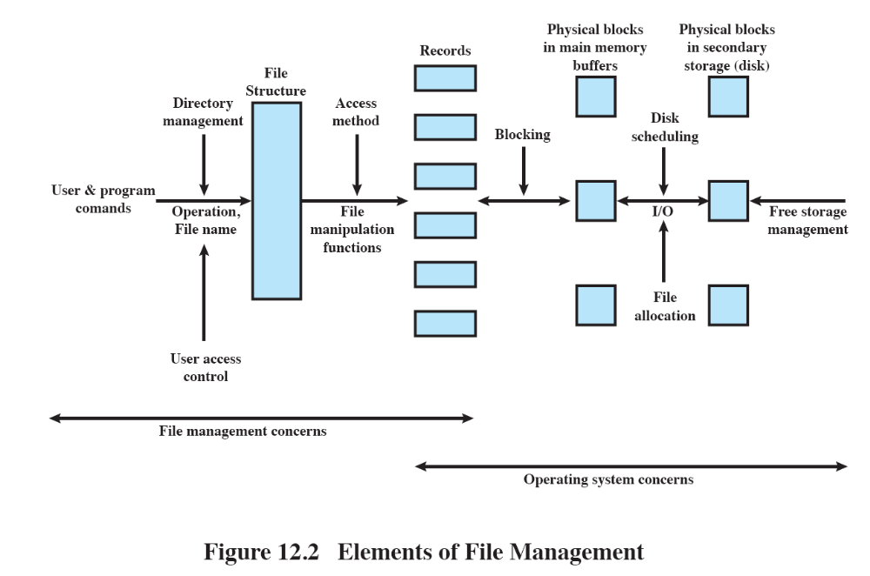
Revisit the Big Picture
Individual block I/O requests must be scheduled for optimizing performance
Records must be organized as a sequence of blocks for output and unblocked after input
File allocation is also concerned for optimizing performance.

