Slide 1
Normal Approximation
CS 2402 Lecture 8

Slide 2
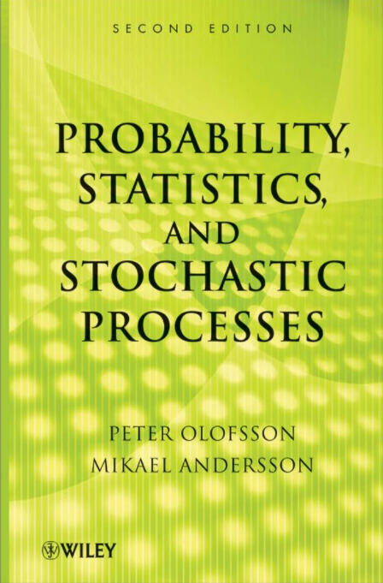
Want to Practice More?
http://ramanujan.math.trinity.edu/polofsson/teach/Book.pdf

Slide 3
Can GPT-4 Pass the Midterm Exam?

Slide 4


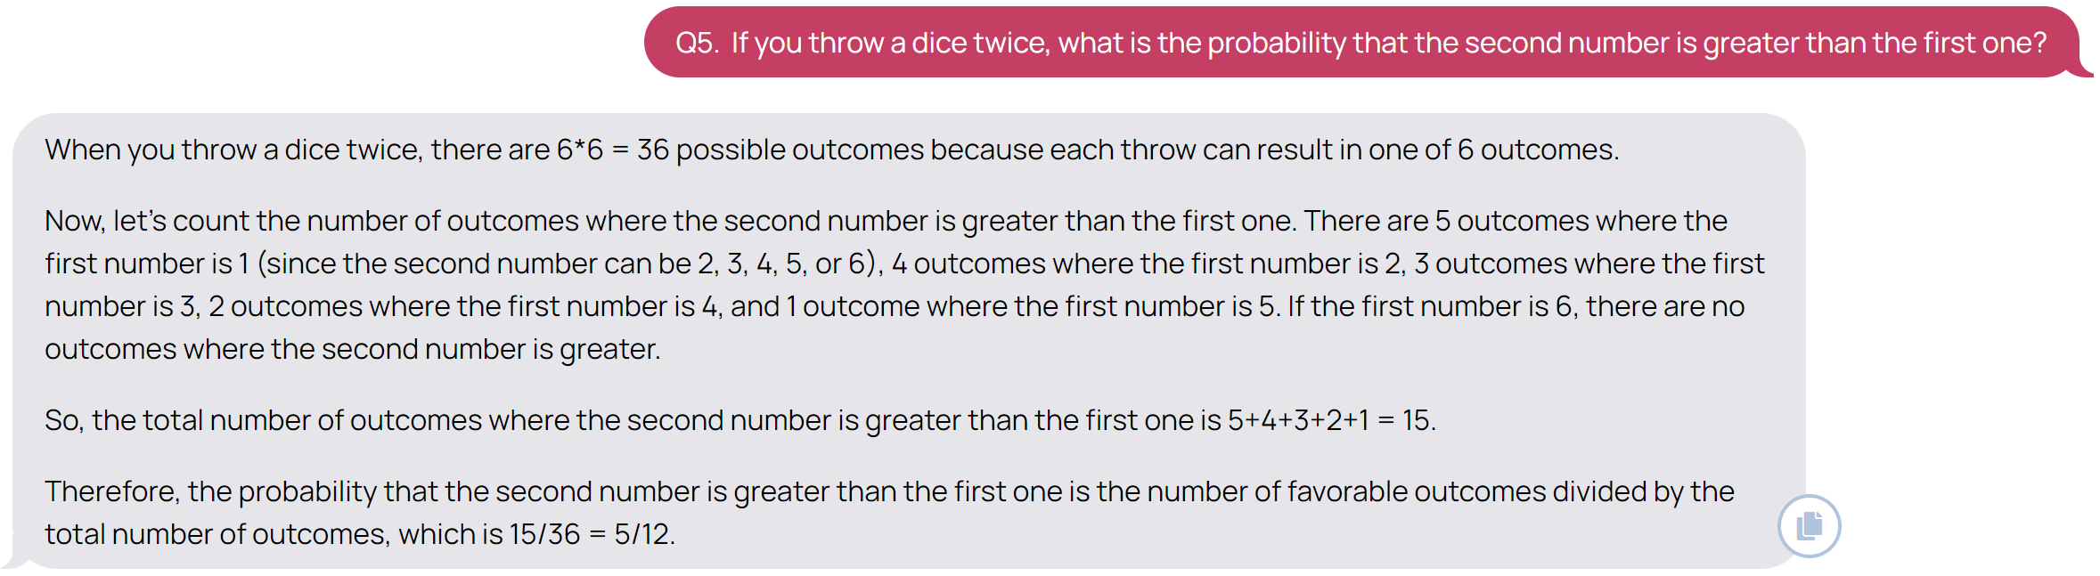
How to use
Step 1: Provide a sentence (prompt) to GPT-4 which describes the context about what you need. For example: “Suppose that you are a college student, please take an exam on probability theory and answer all of the following questions.”
Step 2: Provide the questions.

Slide 5
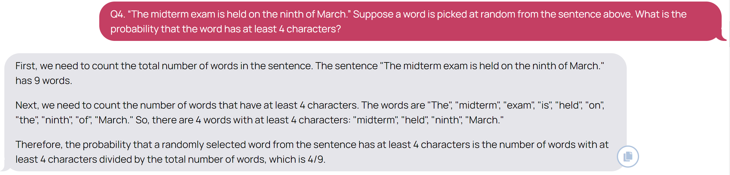
Results
Main Result: When we use the prompt “Suppose that you are a college student, please take an exam on probability theory and answer all of the following questions.”, GPT-4 achieves a score of 87/100.
Bad Examples:
1 | 2 | 3 | 4 | 5 | 6 | 7 | 8 | 9 | 10 | 11 | 12 | 13 | 14 | 15 | 16 | 17 | 18 | Total
4 | 4 | 4 | 0 | 4 | 4 | 4 | 4 | 4 | 0 | 7 | 7 | 7 | 7 | 5 | 7 | 6 | 9 | 87
The correct answer is 0.5=1/2.

Slide 6
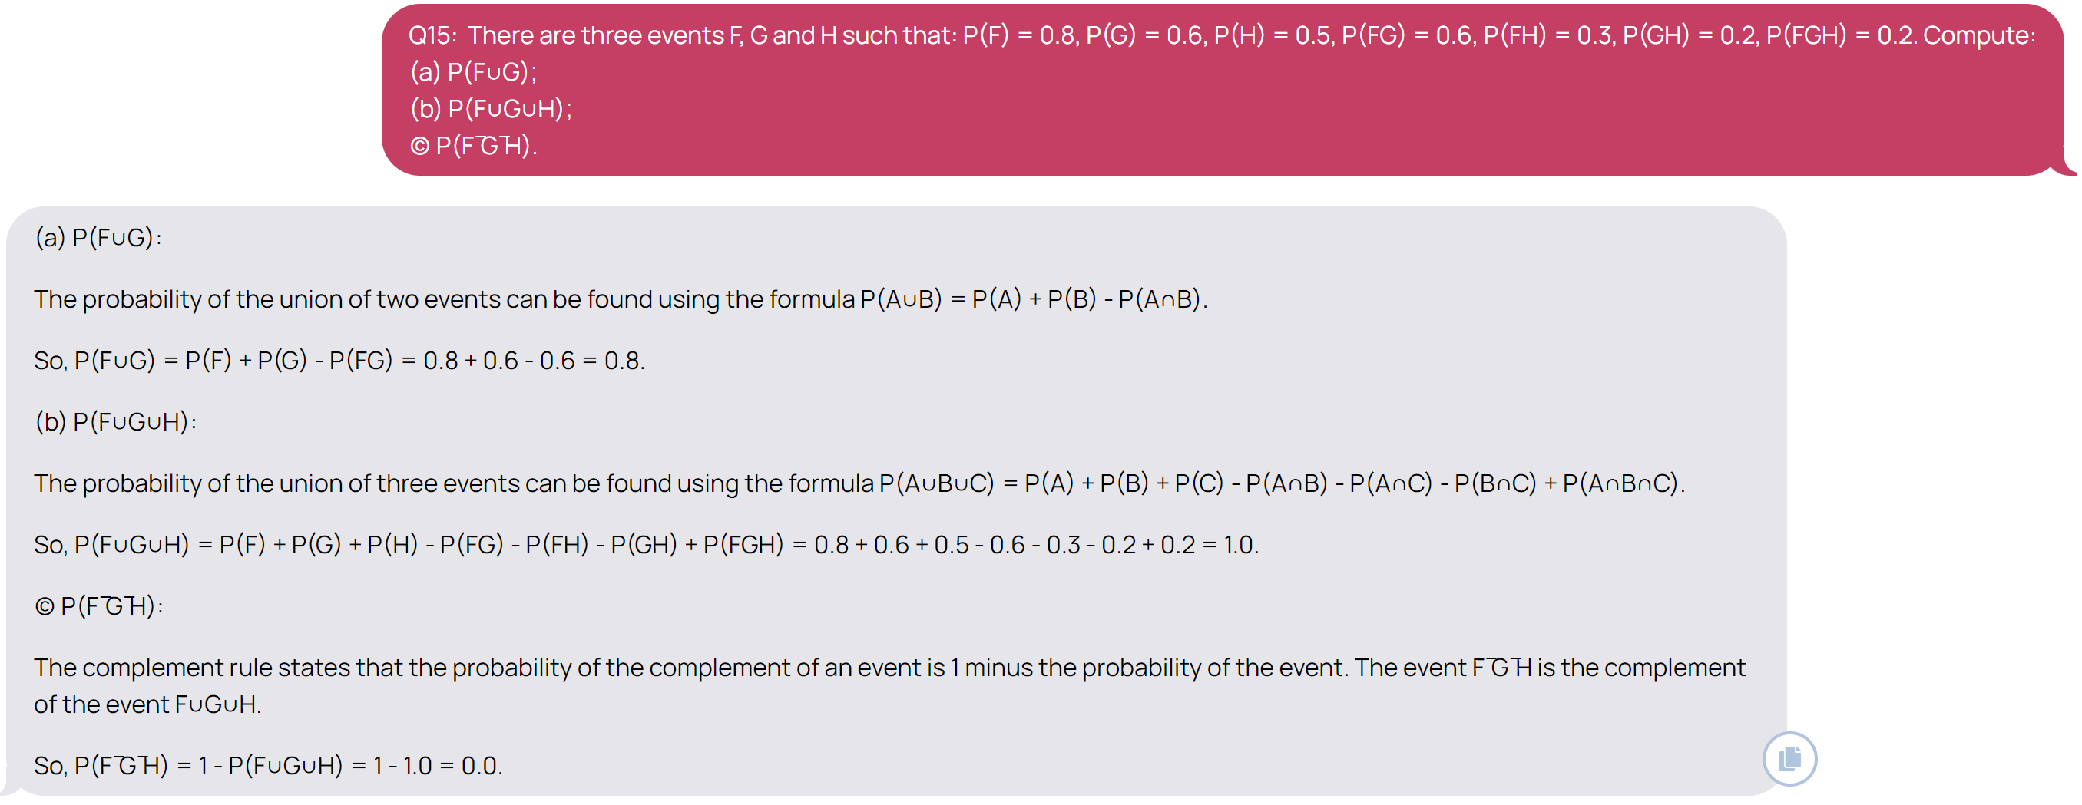
Results
Bad Examples:
The correct answer: (a) 0.8 (b) 1.0 (c) 0.2.

Slide 7
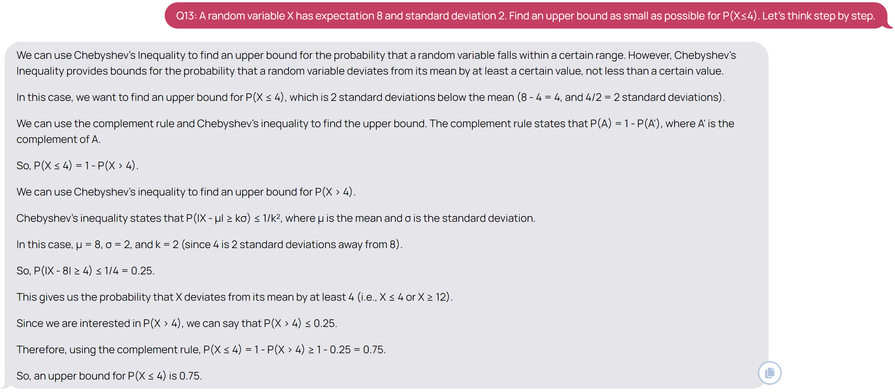
Results
Other Prompt: We can add another prompt “Let’s think step by step.”. Generally speaking, this prompt can make GPT-4 give detailed steps of the solution and result in a more accurate answer.
However, we only achieve 76/100 in my trial.
A bad example:
The correct answer is 0.25=1/4.

Slide 8
Revision

Slide 9
Basic Concepts
An outcome (sample) is a possible result of a random experiment
  Outcomes are unique (i.e., mutually exclusive and not overlapping)
Sample (Outcome) Space = the set of all the possible outcomes
An event A = a set of outcomes
Random variable X: its value depends on outcomes of a random experiment
  For example, X = the number of a rolling dice
  (X = 1) is an event; (X > 2) is an event

Slide 10
Probability
The probability of an event is the relative frequency of occurrence in the experiment
Probability of event E is
  P(E) =
  The value of P is between 0 and 1, inclusive
  Assume that each outcome has the same relative frequency
The sample space
number of outcomes in E
total number of possible outcomes
event E

Slide 11

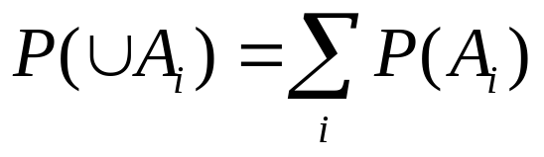

Math Definition of Probability
Probability is a way to assign numbers to events, which satisfies:
For any event A
If S is the sample space, P(S) = 1
For a finite or infinite sequences of disjoint events
$$P\left(A_{1}UA_{2}…UA_{n}\right)=P\left(A_{1}\right)+P\left(A_{2}\right)+…P\left(A_{n}\right)$$
$P\left(A_{1}UA_{2}…\right)=P\left(A_{1}\right)+P\left(A_{2}\right)+…$

Slide 12
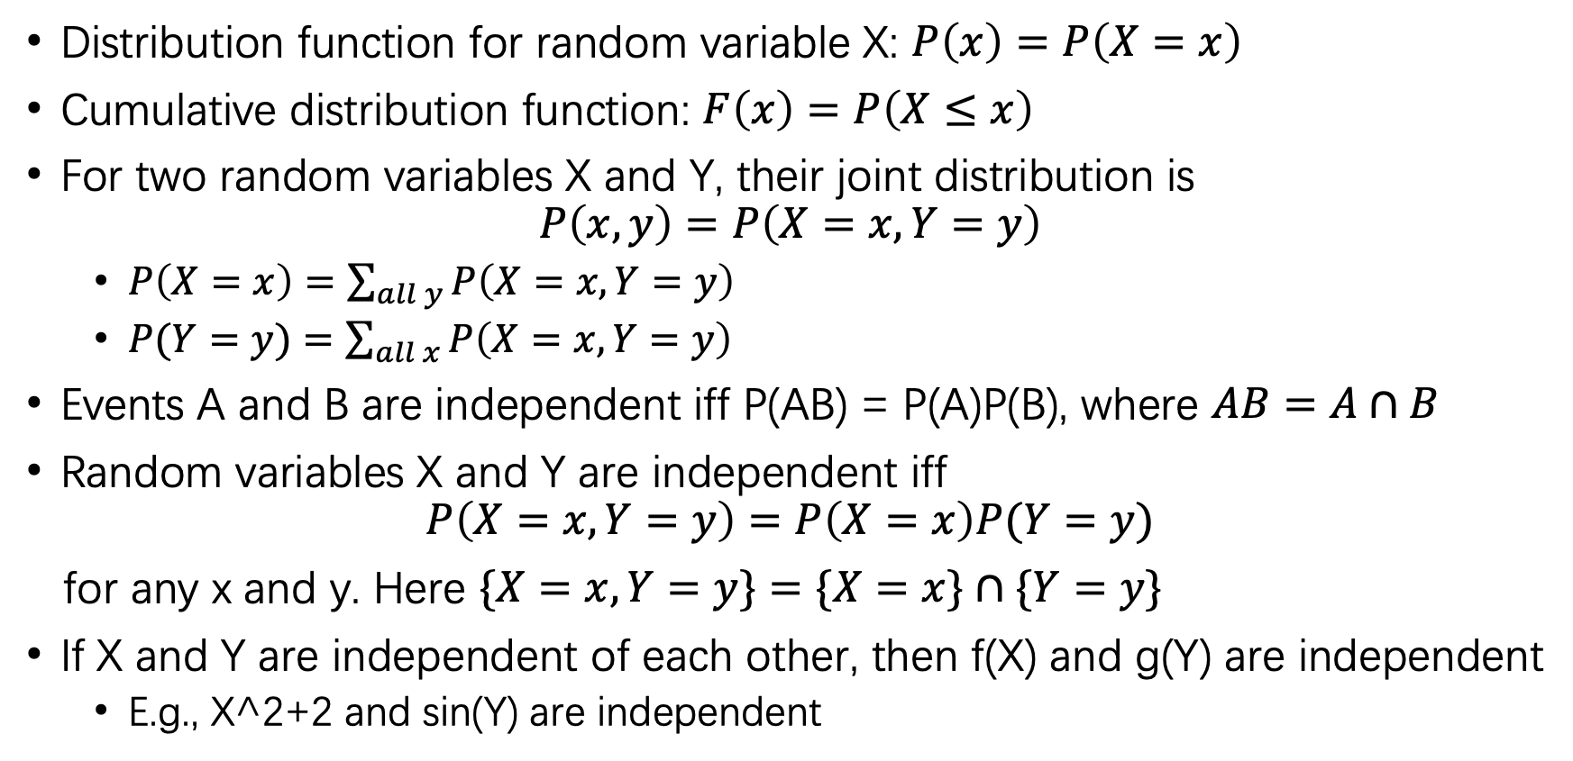
Probability Distributions
Distribution function for random variable X: $P\left(x\right)=P\left(X=x\right)$
Cumulative distribution function: $F\left(x\right)=P\left(X≤x\right)$
For two random variables X and Y, their joint distribution is
$$P\left(x,y\right)=P\left(X=x, Y=y\right)$$
  $P\left(X=x\right)=\sum_{all y}{P\left(X=x, Y=y\right) }$
  $P(Y=y)=\sum_{all x}{P\left(X=x, Y=y\right) }$
Events A and B are independent iff P(AB) = P(A)P(B), where $AB=A∩B$
Random variables X and Y are independent iff
$$P\left(X=x, Y=y\right)=P\left(X=x\right)P(Y=y)$$
for any x and y. Here $\{X=x, Y=y\}=\{X=x\}∩\{Y=y\}$
If X and Y are independent of each other, then f(X) and g(Y) are independent
  E.g., X^2+2 and sin(Y) are independent

Slide 13
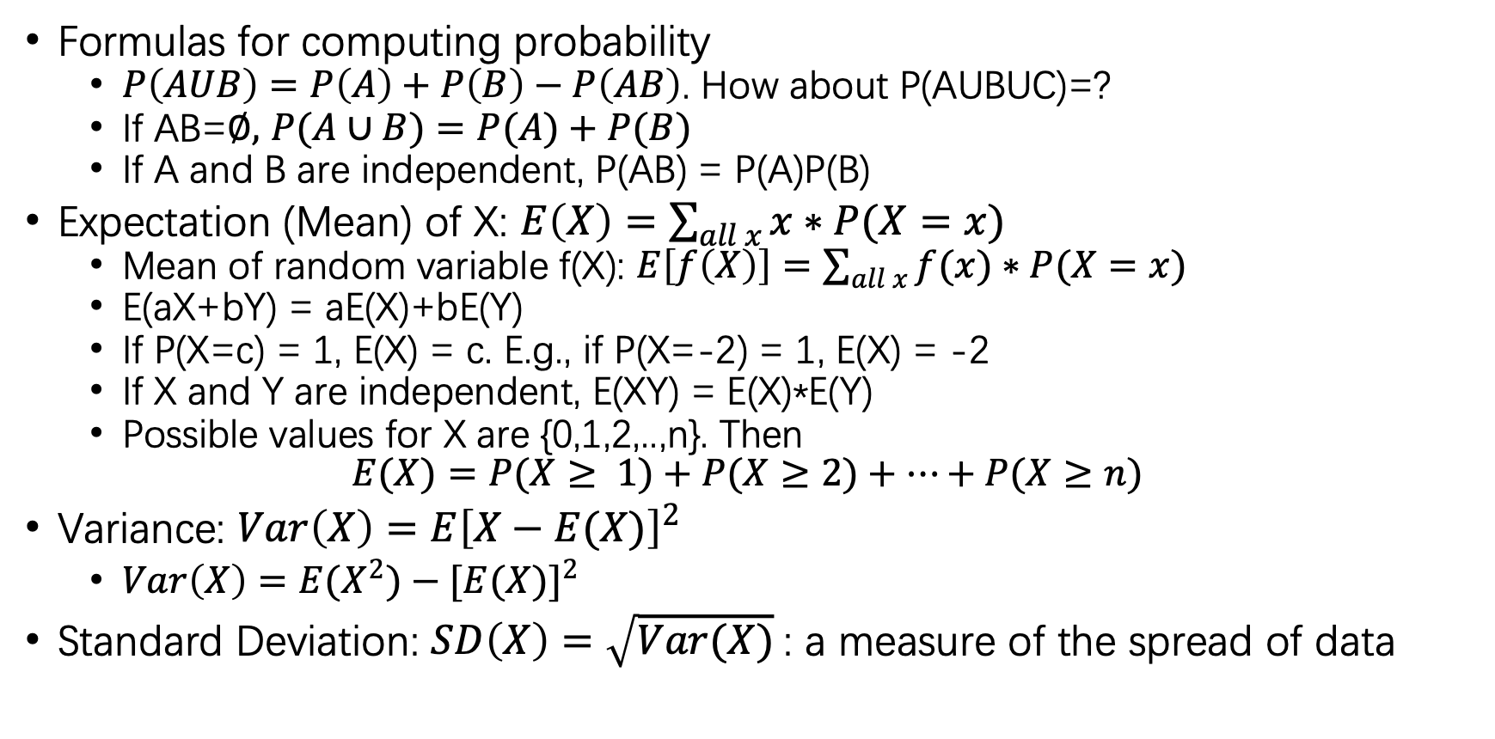
More on Probability
Formulas for computing probability
  $P\left(AUB\right)=P\left(A\right)+P\left(B\right)−P\left(AB\right)$. How about P(AUBUC)=?
  If AB=$∅,$ $P(A∪B)=P(A)+P(B)$
  If A and B are independent, P(AB) = P(A)P(B)
Expectation (Mean) of X: $E\left(X\right)=\sum_{all x}{x∗P(X=x)}$
  Mean of random variable f(X): $E\left[f\left(X\right)\right]=\sum_{all x}{f(x)∗P(X=x)}$
  E(aX+bY) = aE(X)+bE(Y)
  If P(X=c) = 1, E(X) = c. E.g., if P(X=-2) = 1, E(X) = -2
  If X and Y are independent, E(XY) = E(X)*E(Y)
  Possible values for X are {0,1,2,..,n}. Then
  $$E(X)=P(X≥ 1)+P(X≥2)+…+P(X≥n)$$
Variance: $Var\left(X\right)=E{\left[X−E(X)\right]}^{2}$
  $Var\left(X\right)=E{(X}^{2})−{[E(X)]}^{2}$
Standard Deviation: $SD\left(X\right)=\sqrt{Var(X)}$: a measure of the spread of data

Slide 14
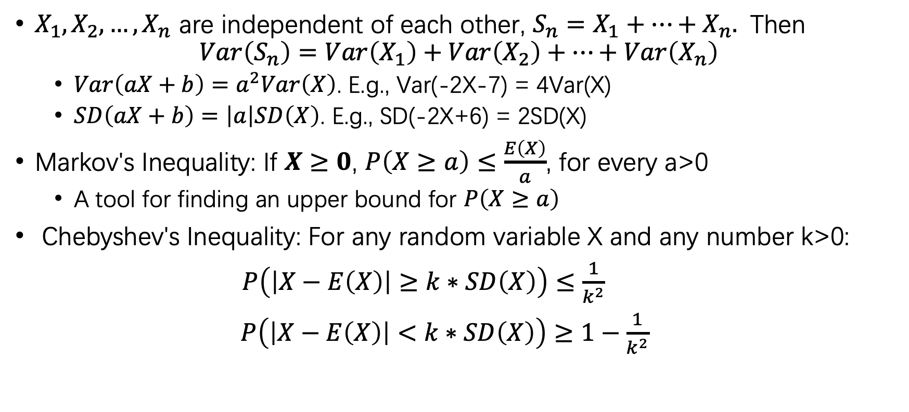
More on Probability
$X_{1}, X_{2},…, X_{n}$ are independent of each other, $S_{n}=X_{1}+…+X_{n}.$ Then
$$Var\left(S_{n}\right)=Var\left(X_{1}\right)+Var\left(X_{2}\right)+…+Var\left(X_{n}\right)$$
  $Var\left(aX+b\right)=a^{2}Var\left(X\right)$. E.g., Var(-2X-7) = 4Var(X)
  $SD\left(aX+b\right)=\left|a\right|SD\left(X\right)$. E.g., SD(-2X+6) = 2SD(X)
Markov's Inequality: If $X≥0$, $P\left(X≥a\right)≤\frac{E\left(X\right)}{a}$, for every a>0
  A tool for finding an upper bound for $P\left(X≥a\right)$
Chebyshev's Inequality: For any random variable X and any number k>0:
$P\left(\left|X−E\left(X\right)\right|≥k∗SD\left(X\right)\right)≤\frac{1}{k^{2}}$
$P\left(\left|X−E\left(X\right)\right|<k∗SD\left(X\right)\right)≥1−\frac{1}{k^{2}}$

Slide 15
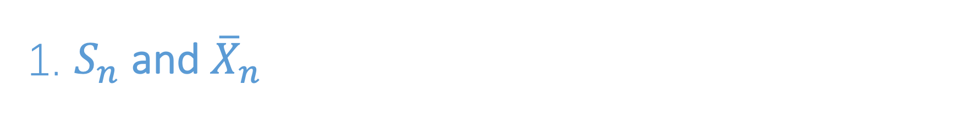
1. $S_{n}$ and ${\overline{X}}_{n}$

Slide 16
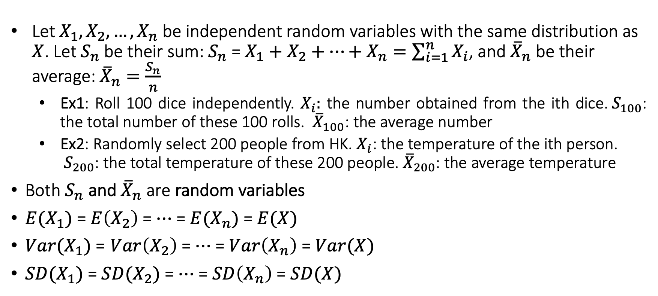
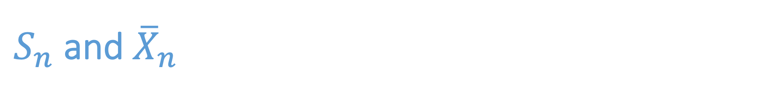
$S_{n}$ and ${\overline{X}}_{n}$
Let $X_{1},X_{2},…,X_{n}$ be independent random variables with the same distribution as $X$. Let $S_{n}$ be their sum: $S_{n}$ = $X_{1}+X_{2}+…+X_{n}=\sum_{i=1}^{n}{X_{i}}$, and ${\overline{X}}_{n}$ be their average: ${\overline{X}}_{n}=\frac{S_{n}}{n}$
  Ex1: Roll 100 dice independently. $X_{i}:$ the number obtained from the ith dice.${ S}_{100}$: the total number of these 100 rolls. ${\overline{X}}_{100}$: the average number
  Ex2: Randomly select 200 people from HK. $X_{i}$: the temperature of the ith person. ${ S}_{200}$: the total temperature of these 200 people. ${\overline{X}}_{200}$: the average temperature
Both $S_{n}$ and ${\overline{X}}_{n}$ are random variables
$E(X_{1})$ = $E\left(X_{2}\right)$ = $⋯$ = $E(X_{n})$ = $E(X)$
$Var(X_{1})$ = $Var\left(X_{2}\right)$ = $⋯$ = $Var\left(X_{n}\right)$ = $Var(X)$
$SD(X_{1})$ = $SD(X_{2})$ = $⋯$ = $SD\left(X_{n}\right)$ = $SD(X)$

Slide 17
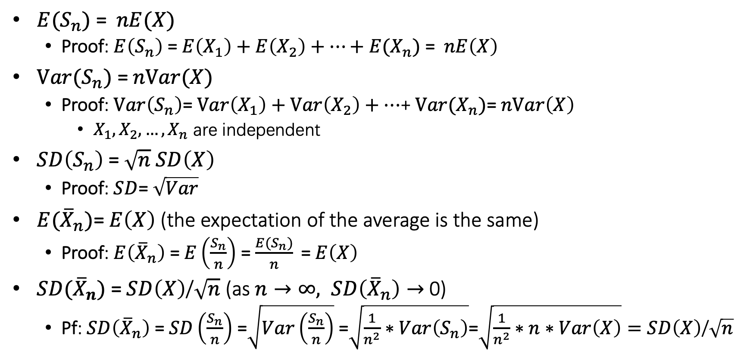
$S_{n}$ and ${\overline{X}}_{n}$
$E(S_{n})$ = $nE(X)$
  Proof: $E\left(S_{n}\right) \text{=} E\left(X_{1}\right)+E\left(X_{2}\right)+⋯+E(X_{n})$ = $nE\left(X\right)$
$Var(S_{n})$ =$nVar(X)$
  Proof:$Var\left(S_{n}\right)\text{=} Var\left(X_{1}\right)+Var\left(X_{2}\right)+⋯$+ $Var(X_{n})$= $nVar\left(X\right)$
    $X_{1},X_{2},…,X_{n}$ are independent
$SD\left(S_{n}\right)$= $\sqrt{n} SD\left(X\right)$
  Proof: $SD$= $\sqrt{Var}$
$E({\overline{X}}_{n})$=$E\left(X\right)$ (the expectation of the average is the same)
  Proof: $E\left({\overline{X}}_{n}\right) \text{= }E\left(\frac{S_{n}}{n}\right)$ = $\frac{{E(S}_{n})}{n} \text{=} E\left(X\right)$
$SD({\overline{X}}_{n})$ = $SD\left(X\right)$/$\sqrt{n}$ (as$n→∞, SD\left({\overline{X}}_{n}\right)→$ 0)
  Pf: $SD\left({\overline{X}}_{n}\right) \text{=} SD\left(\frac{S_{n}}{n}\right)$ =$\sqrt{Var\left(\frac{S_{n}}{n}\right)}$ =$\sqrt{\frac{1}{n^{2}}∗Var\left(S_{n}\right)}$=$\sqrt{\frac{1}{n^{2}}∗n∗Var\left(X\right)}=SD\left(X\right)\text{/}\sqrt{n}$

Slide 18
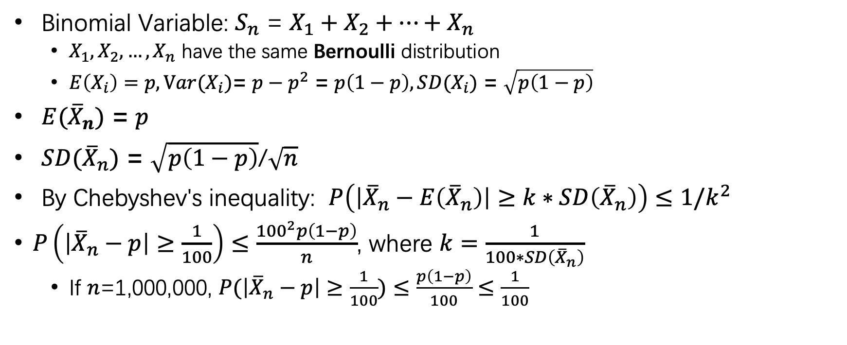
Example
Binomial Variable: $S_{n}$ = $X_{1}+X_{2}+…+X_{n}$
  $X_{1}, X_{2},…, X_{n}$ have the same Bernoulli distribution
  $E\left(X_{i}\right)=p, Var(X_{i})$= $p−p^{2}$ = $p\left(1−p\right), SD(X_{i})$ = $\sqrt{p\left(1−p\right)}$
$E({\overline{X}}_{n})$ = $p$
$SD({\overline{X}}_{n})$ = $\sqrt{p\left(1−p\right)}$/$\sqrt{n}$
By Chebyshev's inequality: $P\left(\left|{\overline{X}}_{n}−E\left({\overline{X}}_{n}\right)\right|≥k∗SD\left({\overline{X}}_{n}\right)\right)≤1/k^{2}$
$P\left(\left|{\overline{X}}_{n}−p\right|≥\frac{1}{100}\right)≤\frac{{100}^{2}p\left(1−p\right)}{n}$, where $k=\frac{1}{100∗SD\left({\overline{X}}_{n}\right)}$
  If $n$=1,000,000, $P(\left|{\overline{X}}_{n}−p\right|≥\frac{1}{100})≤\frac{p\left(1−p\right)}{100}≤\frac{1}{100}$

Slide 19
2. Standard Normal Distribution

Slide 20
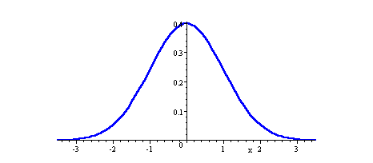
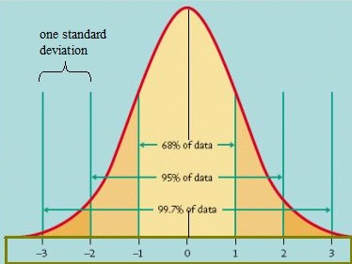
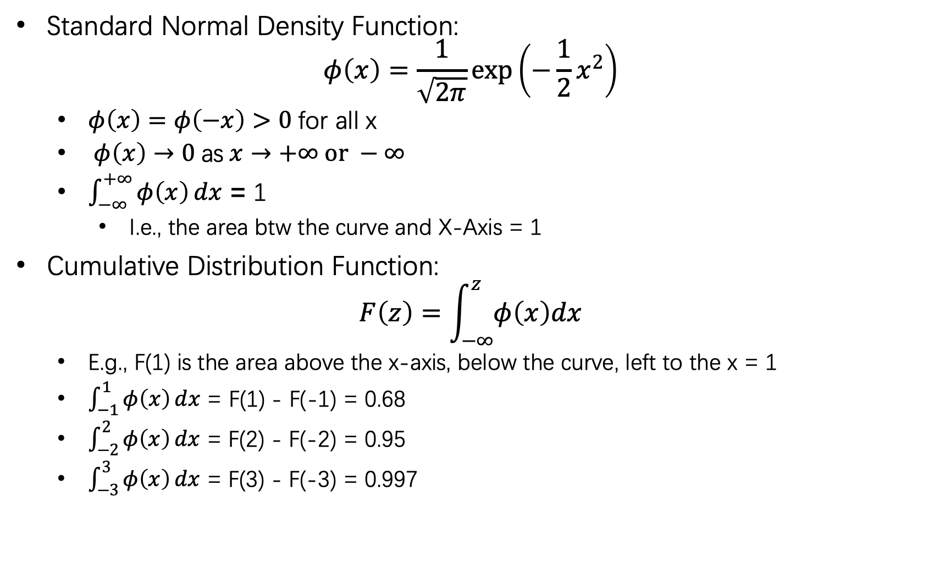
Standard Normal Distribution
Standard Normal Density Function:
$$φ\left(x\right)=\frac{1}{\sqrt{2π}}\exp\left(−\frac{1}{2}x^{2}\right)$$
  $φ\left(x\right)=φ\left(−x\right)>0$for all x
  $φ\left(x\right)$ $→0 \text{as} x→+∞ or −∞$
  $\int_{−∞}^{+∞}{φ\left(x\right)}dx$ = 1
    I.e., the area btw the curve and X-Axis = 1
Cumulative Distribution Function:
$$F\left(z\right)=\int_{−∞}^{z}{φ\left(x\right)dx}$$
  E.g., F(1) is the area above the x-axis, below the curve, left to the x = 1
  $\int_{−1}^{1}{φ\left(x\right)}dx$ = F(1) - F(-1) = 0.68
  $\int_{−2}^{2}{φ\left(x\right)}dx$ = F(2) - F(-2) = 0.95
  $\int_{−3}^{3}{φ\left(x\right)}dx$ = F(3) - F(-3) = 0.997

Slide 21
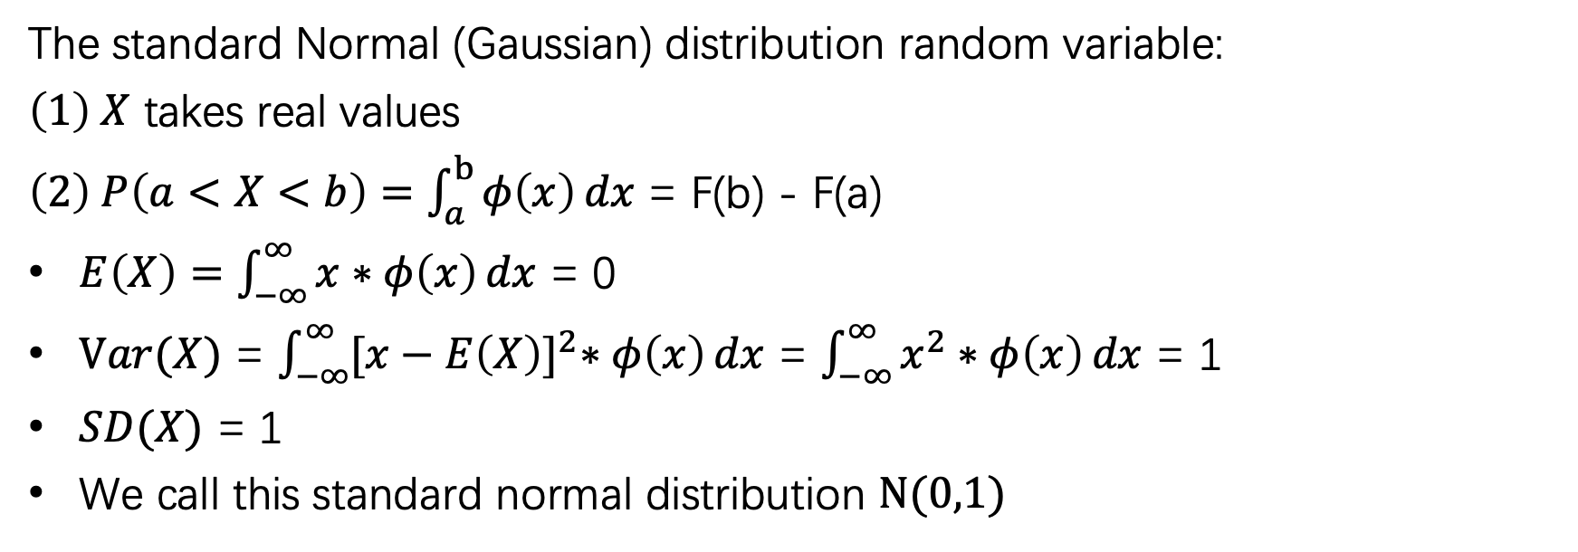
Standard Normal Distribution
The standard Normal (Gaussian) distribution random variable:
$\left(1\right) X$ takes real values
$\left(2\right) P\left(a<X<b\right)=\int_{a}^{b}{φ\left(x\right)}dx$ = F(b) - F(a)
$E\left(X\right)=\int_{−∞}^{∞}{x∗φ\left(x\right)}dx$ = 0
$Var(X)$ = $\int_{−∞}^{∞}{{[x−E\left(X\right)]}^{2}∗φ\left(x\right)}dx$ = $\int_{−∞}^{∞}{x^{2}∗φ\left(x\right)}dx$ = 1
$SD(X)$ = 1
We call this standard normal distribution $N(0,1)$

Slide 22
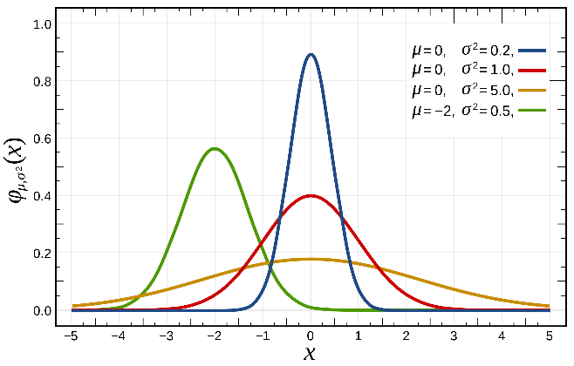
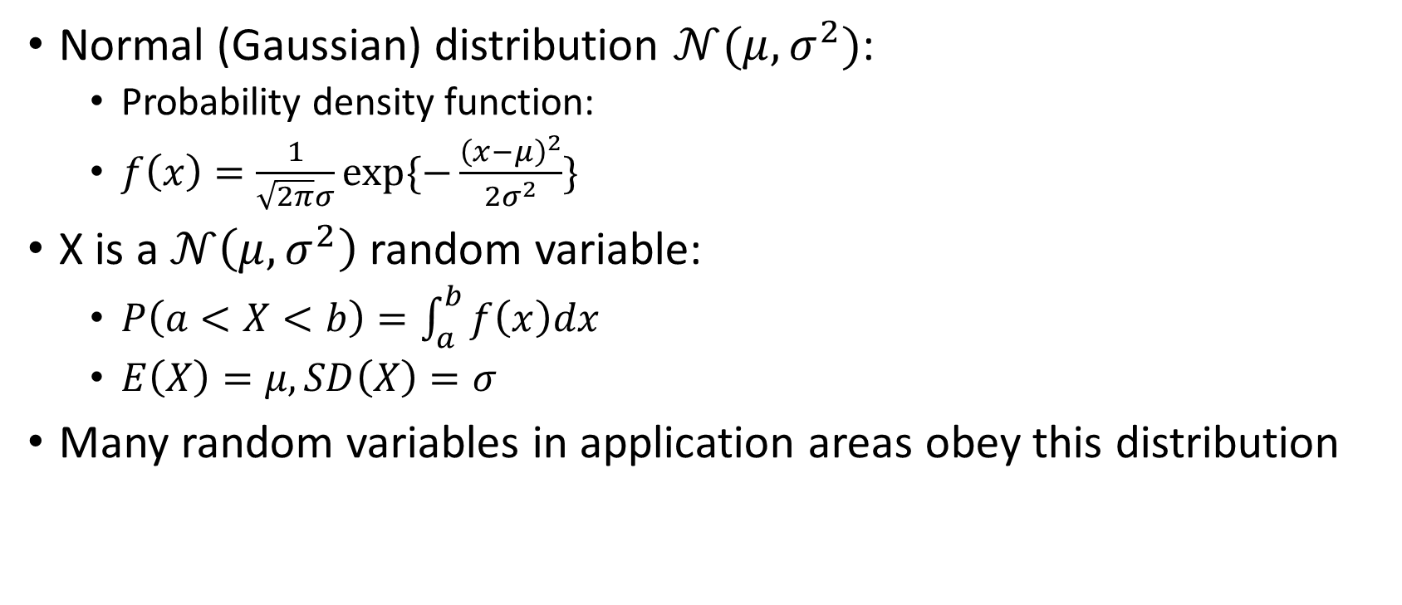
Normal Distribution
Normal (Gaussian) distribution $𝒩(μ, σ^{2})$:
  Probability density function:
  $f\left(x\right)=\frac{1}{\sqrt{2π}σ}exp⁡\{−\frac{{\left(x−μ\right)}^{2}}{2σ^{2}}\}$
X is a $𝒩\left(μ, σ^{2}\right)$random variable:
  $P\left(a<X<b\right)=\int_{a}^{b}{f\left(x\right)dx}$
  $E\left(X\right)=μ, SD\left(X\right)=σ$
Many random variables in application areas obey this distribution

Slide 23
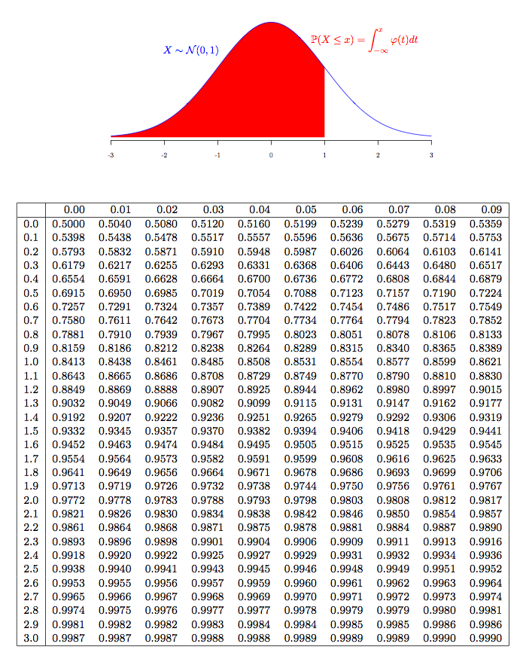
Standard Normal Cumulative Probability Table

Slide 24
3. Normal Approximation (Central Limit Theorem)

Slide 25
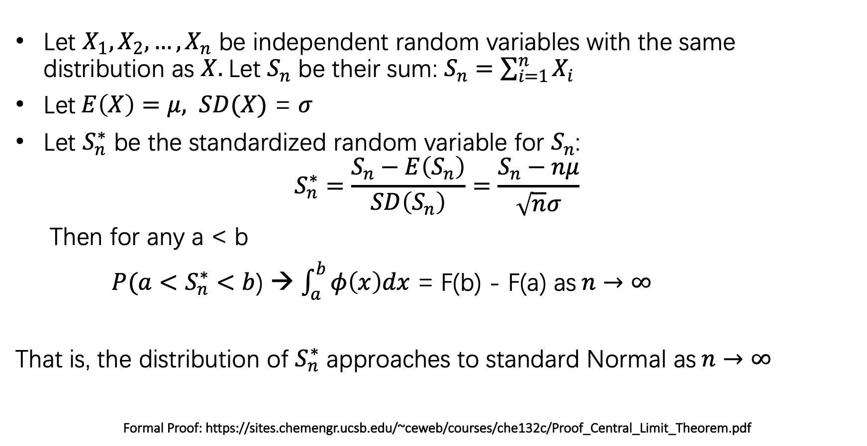
Central Limit Theorem
Let $X_{1},X_{2},…,X_{n}$ be independent random variables with the same distribution as $X.$Let $S_{n}$ be their sum: $S_{n}=\sum_{i=1}^{n}{X_{i}}$
Let$E\left(X\right)=μ, SD(X) \text{=} σ$
Let $S_{n}^{∗}$ be the standardized random variable for $S_{n}$:
$$S_{n}^{∗}=\frac{S_{n}−E\left(S_{n}\right)}{SD\left(S_{n}\right)}=\frac{S_{n}−nμ}{\sqrt{n}σ}$$
Then for any a < b
$P({a<S}_{n}^{∗}<b$) → $\int_{a}^{b}{φ\left(x\right)dx}$ = F(b) - F(a) as$n→∞$
That is, the distribution of $S_{n}^{∗}$ approaches to standard Normal as$n→∞$
Formal Proof: https://sites.chemengr.ucsb.edu/~ceweb/courses/che132c/Proof_Central_Limit_Theorem.pdf

Slide 26
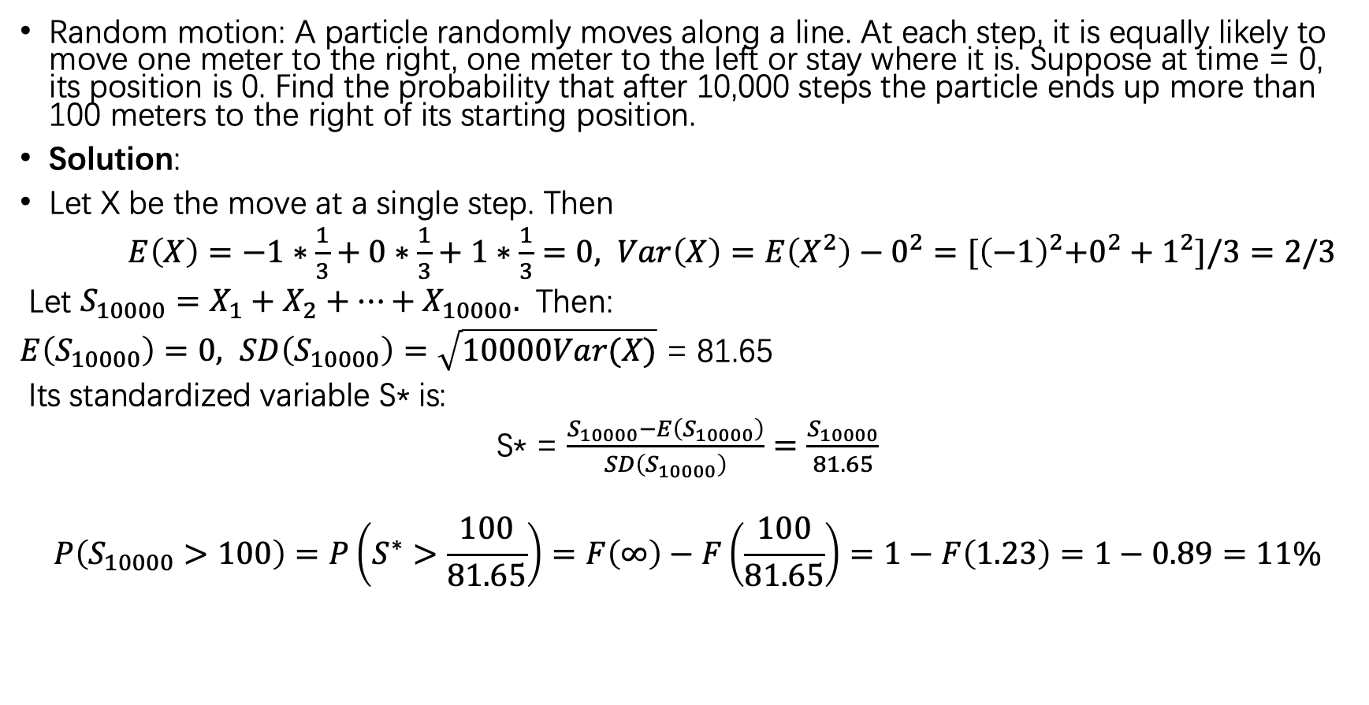
Example
Random motion: A particle randomly moves along a line. At each step, it is equally likely to move one meter to the right, one meter to the left or stay where it is. Suppose at time = 0, its position is 0. Find the probability that after 10,000 steps the particle ends up more than 100 meters to the right of its starting position.
Solution:
Let X be the move at a single step. Then
$E\left(X\right)=−1∗\frac{1}{3}+0∗\frac{1}{3}+1∗\frac{1}{3}=0, Var\left(X\right)=E\left(X^{2}\right)−0^{2}={[\left(−1\right)}^{2}+0^{2}+1^{2}]/3=2/3$
Let $S_{10000}=X_{1}+X_{2}+…+X_{10000}.$ Then:
$E\left(S_{10000}\right)=0, SD\left(S_{10000}\right)=\sqrt{10000Var(X)}$ = 81.65
Its standardized variable S* is:
S* = $\frac{S_{10000}−E\left(S_{10000}\right)}{SD\left(S_{10000}\right)}=\frac{S_{10000}}{81.65}$
$$P\left(S_{10000}>100\right)=P\left(S^{∗}>\frac{100}{81.65}\right)=F\left(∞\right)−F\left(\frac{100}{81.65}\right)=1−F\left(1.23\right)=1−0.89=11\%$$

Slide 27
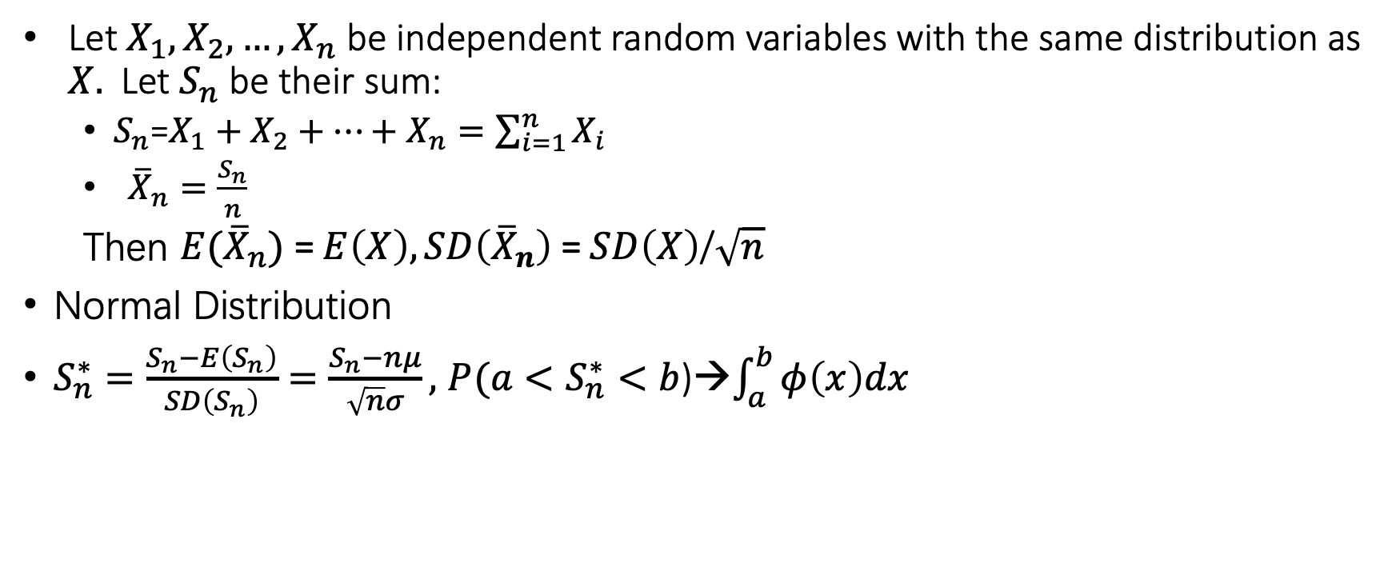
Summary
Let $X_{1},X_{2},…,X_{n}$ be independent random variables with the same distribution as $X.$ Let $S_{n}$ be their sum:
  $S_{n}$=$X_{1}+X_{2}+…+X_{n}=\sum_{i=1}^{n}{X_{i}}$
  ${\overline{X}}_{n}=\frac{S_{n}}{n}$
  Then $E({\overline{X}}_{n})$ =$E\left(X\right), SD\left({\overline{X}}_{n}\right) \text{=} SD\left(X\right)\text{/}\sqrt{n}$
Normal Distribution
$S_{n}^{∗}=\frac{S_{n}−E\left(S_{n}\right)}{SD\left(S_{n}\right)}=\frac{S_{n}−nμ}{\sqrt{n}σ},$ $P({a<S}_{n}^{∗}<b$)→$\int_{a}^{b}{φ\left(x\right)dx}$

