Slide 1
EE3114 Systems and Control
Lab - 4
Semester A, 2020-21
NAME: _ ID: _
2020-10-9

Slide 2
Task 1.1 State-Space Representation
(Hint is given on the next page)
Find the state-space representation of the DC motor
Find the order of the system
Construct the controllability and observability matrices of the system
Determine if the system is controllable?
Determine if the system is observable?
/0.5

Slide 3
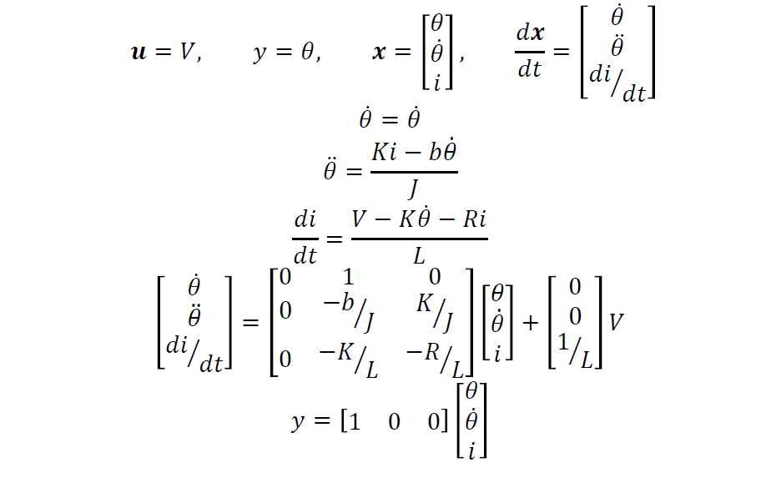
Hint:
DC Motor model
… … next page

Slide 4
%MatLab code
% Set the motor parameters K = 45E-3;
J = 3.5E-5; b = 2E-3; R = 1;
L = 0.5;
% Define the state space variables
A = [0 1 0;
0 -b/J K/J;
0 -K/L -R/L];
B = [0; 0; 1/L];
C = [1 0 0];
D = 0;
% Create the system Motor_SS = ?
… … next page

Slide 5
% Create controlability and observability matrices controllability = ?
observability = ?
% Check the system order, rank; determinants of the controllability and
% observability matrices sys_order = ? det_control = ? rank_control = ? det_observ = ? rank_observ = ?
… … next page

Slide 6
Task 1.2: Pole Placement
(Hint is given on the next page)
The poles of a standard second-order system are located at
−𝜁 ± 𝜁² − 1 𝜔_{𝑛}
where ζ is the damping ratio and ω_{n} is the natural frequency.
To determine the desired pole positions:
−
𝜁𝜋
− ln(𝑜𝑠)
Overshoot 𝑜𝑠 = 𝑒
1−𝜁² _{⟹ 𝜁 =}
𝜋² + ln(𝑜𝑠)²
2% Settling Time (𝑇𝑠) = ^{−ln 2%}
𝜁𝜔_{𝑛}
Calculate a damping ratio and natural frequency that would ensure the poles
of the system are in appropriate positions to meet the design criteria.
/0.5

Slide 7

Hint:
−
𝜁$π$
Overshoot < 0.1 = 𝑒
1−𝜁²
𝜁 >
− ln 0.1
= 0.5912
𝜋²+ln 0.1 ²
2% Settling Time < 0.5 = ^{− ln 0.02}
𝜁𝜔_{𝑛}
= 13.2352
𝜔_{𝑛} >
− ln 0.02
0.5𝜁
Poles should be placed further to the left of:
−𝜁 ± 𝜁² − 1 𝜔_{𝑛} = −7.8240 ± 𝑗10.6749
depending on the selection of 𝜁 and 𝜔_{𝑛}
… … next page

Slide 8
Hint:
Desired overshoot 10%: os = 0.1
Poles: p1,p2: p3:
Desired 2% settling time: ts = 0.5
− ln(𝑜𝑠) − ln(0.02)
−𝜁 ± 𝜁² − 1 𝜔_{𝑛}
−20
So, 𝜁 =
𝜋²+ln(𝑜𝑠)^{2 , 𝜔𝑛 ≅}
𝜁∗𝑡𝑠
% MatLab code
% Calculate the damping ratio and natural frequency
zeta = ?
wn = ?
% Round these up to ensure greater than the desired criteria zeta = ceil(zeta*100)/100
wn = ceil(wn)
% Set the desired poles of the system using the round-up numbers p1 = ?
p2 = ?
p3 = ?

Slide 9
Task 1.3: State-Feedback Control
(Hint is given on the next page)
Assuming the whole state vector x is available for feedback.
Design a controller to satisfy the design criteria using a state feedback law
𝑢 = 𝑟 − 𝐾_{𝑐}x
where 𝑟 is the reference input and the state-space system becomes
𝑑𝒙 ₌
𝐴 − 𝐵𝐾 𝒙 + 𝐵𝑟
𝑑𝑡
𝑐
𝑦 = 𝐶𝒙
By using pole-placement technique, determine the feedback gain matrix 𝐾_{𝑐} Hint: Use two dominant poles to control the system so as to ensure that
the third pole is real and faster than the other poles.
Check the response of the system to a step input, to see whether it meets all
of the design criteria or not?
/0.5

Slide 10
Hint:
% Determine the feedback matrix Kc = ?
% Create a closed-loop state-space system
Motor_SS_CL = ?
% Implement a step response figure(1),step(Motor_SS_CL) stepinfo(Motor_SS_CL)
% Calculate the input scale factor (this is only for rescaling) len = size(A,1);
Nxu = [A B;C D]\[zeros(len,1);1];
N = Nxu(len+1) + Kc*Nxu(1:len);
% Create an updated system Motor_SS_CL1 = ss(A-B*Kc,N*B,C,D) figure(2),step(Motor_SS_CL1) stepinfo(Motor_SS_CL1)

Slide 11
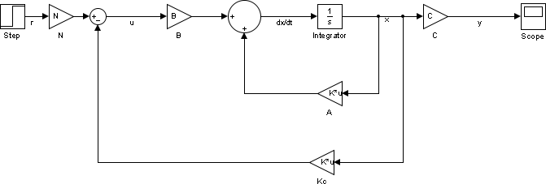
Task 2.1: State Controller
Use Simulink to create a model for your state-space controller
Using a step input to validate your model
/0.25

Slide 12
Task 2.2 State Estimator
In reality, one cannot always measure the whole state vector 𝒙
So, it is needed to build an Observer to estimate them.
Now, add an observer to your control model:
Calculate the observer gain matrix (MatLab may be used)
Hint: Poles of the observer should be about 4*|poles of controller| (Note: MatLab will not place 2 poles to be in the same position)
On Simulink, add the state estimator to your state space controller and
validate the output
(See: next page)
/0.25

Slide 13
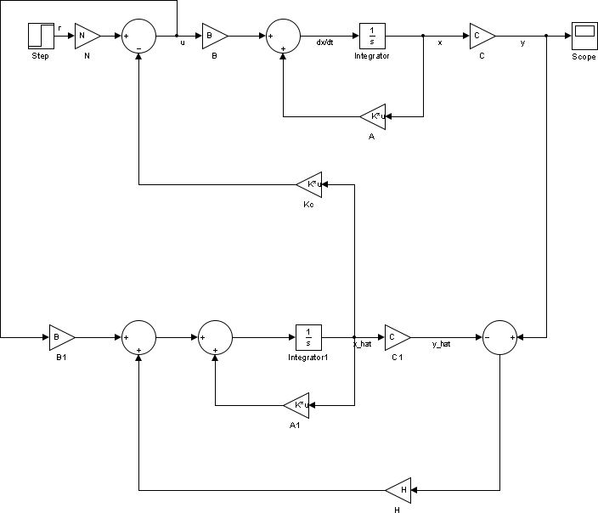
% Calculate the observer roots o1 = 4*abs(p1)
o2 = 4*abs(p2)+1
o3 = 4*abs(p3)
H = place(A',C',[o1 o2 o3])'
A1 = A B1 = B C1 = C

