Slide 1
EE3114 Systems and Control
Tutorial - 9
Semester B, 2018-19
2018-11-14

Slide 2
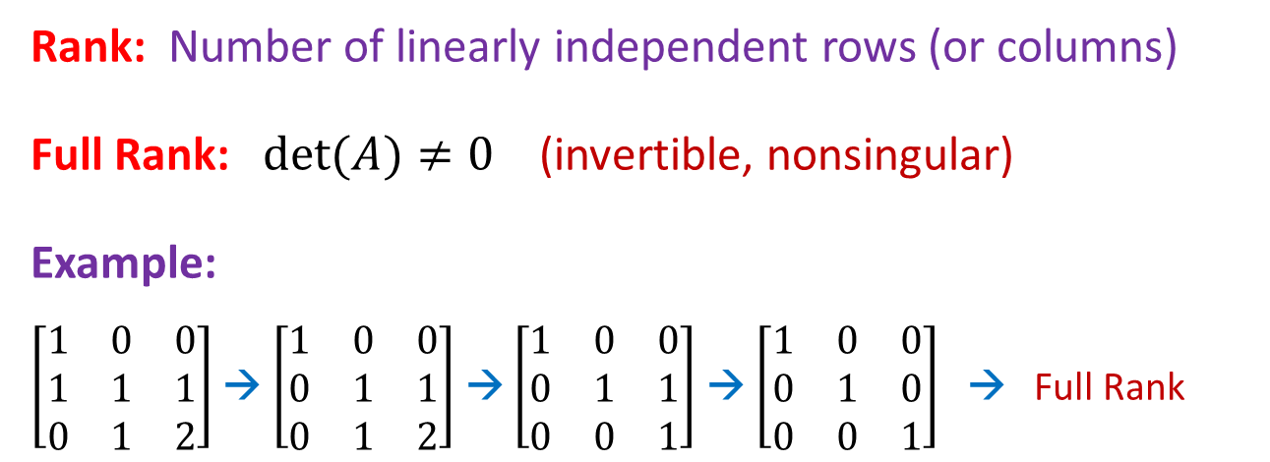
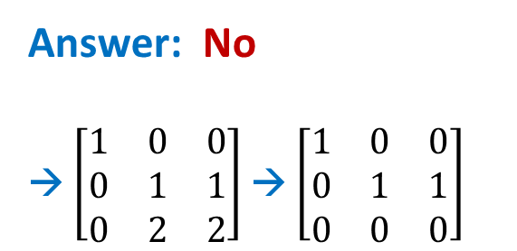
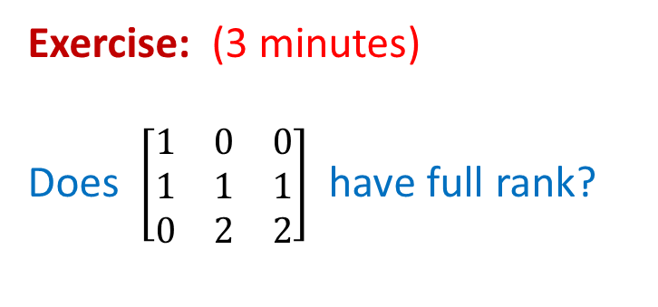
Matrix Theory
Rank: Number of linearly independent rows (or columns)
Full Rank: $det(A)≠0$ (invertible, nonsingular)
Example:
$\left[\begin{matrix}1 & 0 & 0 \\ 1 & 1 & 1 \\ 0 & 1 & 2\end{matrix}\right]$ → $\left[\begin{matrix}1 & 0 & 0 \\ 0 & 1 & 1 \\ 0 & 1 & 2\end{matrix}\right]$ → $\left[\begin{matrix}1 & 0 & 0 \\ 0 & 1 & 1 \\ 0 & 0 & 1\end{matrix}\right]$ → $\left[\begin{matrix}1 & 0 & 0 \\ 0 & 1 & 0 \\ 0 & 0 & 1\end{matrix}\right]$ → Full Rank
Exercise: (3 minutes)
Does $\left[\begin{matrix}1 & 0 & 0 \\ 1 & 1 & 1 \\ 0 & 2 & 2\end{matrix}\right]$ have full rank?
Answer: No
→ $\left[\begin{matrix}1 & 0 & 0 \\ 0 & 1 & 1 \\ 0 & 2 & 2\end{matrix}\right]$ → $\left[\begin{matrix}1 & 0 & 0 \\ 0 & 1 & 1 \\ 0 & 0 & 0\end{matrix}\right]$

Slide 3
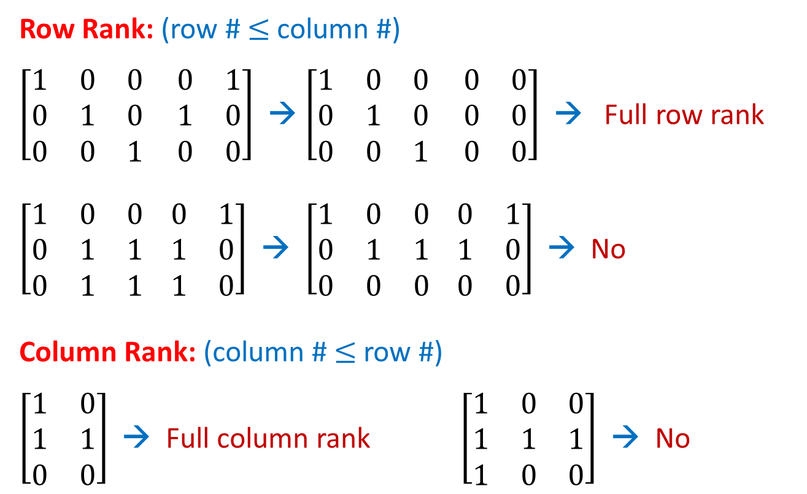
Matrix Theory
Row Rank: (row # $≤$column #)
$\left[\begin{matrix}1 & 0 & 0 \\ 0 & 1 & 0 \\ 0 & 0 & 1\end{matrix} \begin{matrix}0 & 1 \\ 1 & 0 \\ 0 & 0\end{matrix}\right]$ → $\left[\begin{matrix}1 & 0 & 0 \\ 0 & 1 & 0 \\ 0 & 0 & 1\end{matrix} \begin{matrix}0 & 0 \\ 0 & 0 \\ 0 & 0\end{matrix}\right]$ → Full row rank
$\left[\begin{matrix}1 & 0 & 0 \\ 0 & 1 & 1 \\ 0 & 1 & 1\end{matrix} \begin{matrix}0 & 1 \\ 1 & 0 \\ 1 & 0\end{matrix}\right]$ → $\left[\begin{matrix}1 & 0 & 0 \\ 0 & 1 & 1 \\ 0 & 0 & 0\end{matrix} \begin{matrix}0 & 1 \\ 1 & 0 \\ 0 & 0\end{matrix}\right]$ → No
Column Rank: (column # $≤$row #)
$\left[\begin{matrix}1 & 0 \\ 1 & 1 \\ 0 & 0\end{matrix}\right]$ → Full column rank $\left[\begin{matrix}1 & 0 & 0 \\ 1 & 1 & 1 \\ 1 & 0 & 0\end{matrix}\right]$ → No

Slide 4
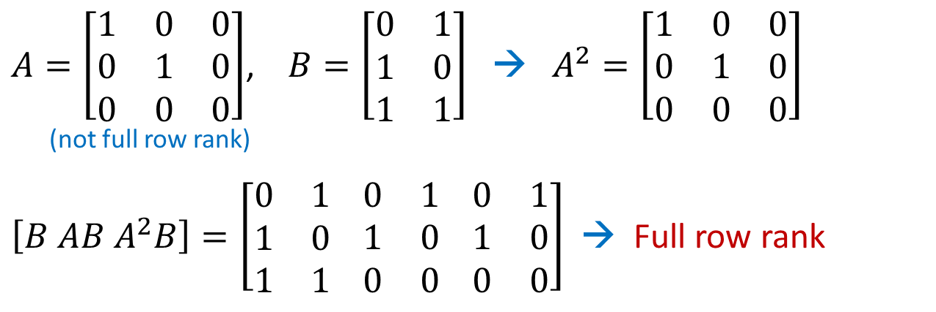
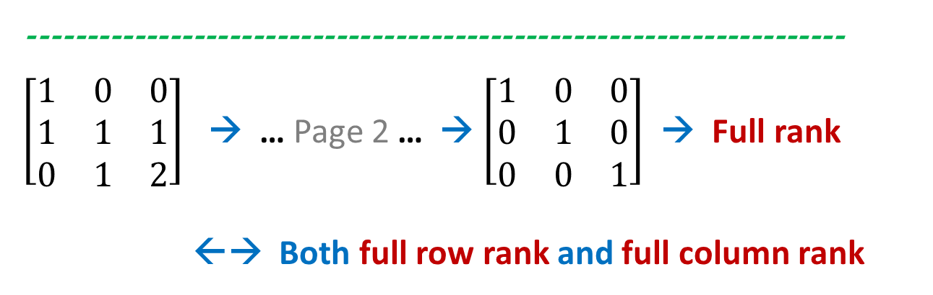
Matrix Theory
$A=\left[\begin{matrix}1 & 0 & 0 \\ 0 & 1 & 0 \\ 0 & 0 & 0\end{matrix}\right]$, $B=\left[\begin{matrix}0 & 1 \\ 1 & 0 \\ 1 & 1\end{matrix}\right]$ → $A^{2}=\left[\begin{matrix}1 & 0 & 0 \\ 0 & 1 & 0 \\ 0 & 0 & 0\end{matrix}\right]$
(not full row rank)
$\left[B AB A^{2}B\right]=\left[\begin{matrix}0 & 1 \\ 1 & 0 \\ 1 & 1\end{matrix} \begin{matrix}0 & 1 \\ 1 & 0 \\ 0 & 0\end{matrix} \begin{matrix}0 & 1 \\ 1 & 0 \\ 0 & 0\end{matrix}\right]$ → Full row rank
---------------------------------------------------------------------
$\left[\begin{matrix}1 & 0 & 0 \\ 1 & 1 & 1 \\ 0 & 1 & 2\end{matrix}\right]$ → … Page 2 … → $\left[\begin{matrix}1 & 0 & 0 \\ 0 & 1 & 0 \\ 0 & 0 & 1\end{matrix}\right]$ → Full rank
←→ Both full row rank and full column rank

Slide 5
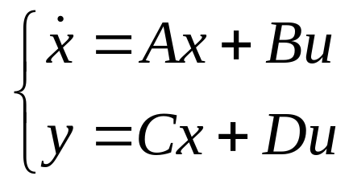

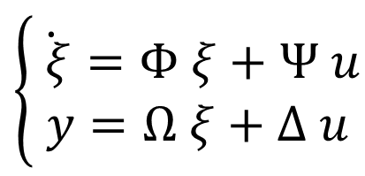
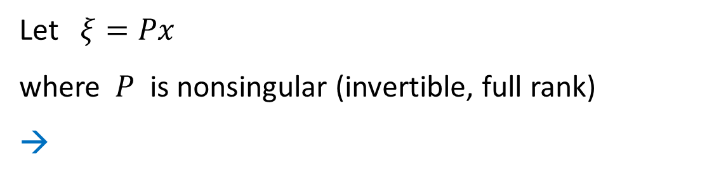
LTI Systems
Let $ξ=Px$
where $P$ is nonsingular (invertible, full rank)
→
$$\left\{\begin{matrix}\dot{ ξ}=Φ ξ+Ψ u \\ y=Ω ξ+Δ u\end{matrix}\right.$$
Find: $Φ=PAP^{−1} , Ψ= ?$ $, Ω= ?$, $Δ= ?$
(5 minutes)

Slide 6

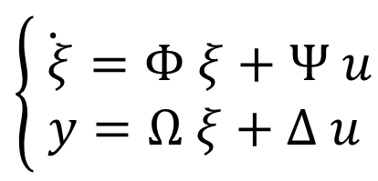

Let $ξ=Px$
where $P$ is nonsingular (invertible, full rank)
→
$$\left\{\begin{matrix}\dot{ ξ}=Φ ξ+Ψ u \\ y=Ω ξ+Δ u\end{matrix}\right.$$
Find: $Φ=PAP^{−1} , Ψ= ?$ $, Ω= ?$, $Δ= ?$
Solution: $Φ=PAP^{−1} , Ψ=PB$ $, Ω=CP^{−1}$, $Δ=D$

Slide 7
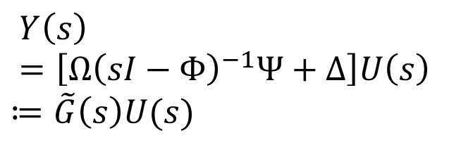
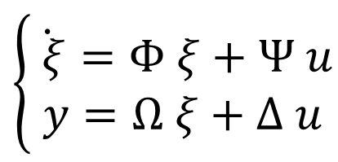
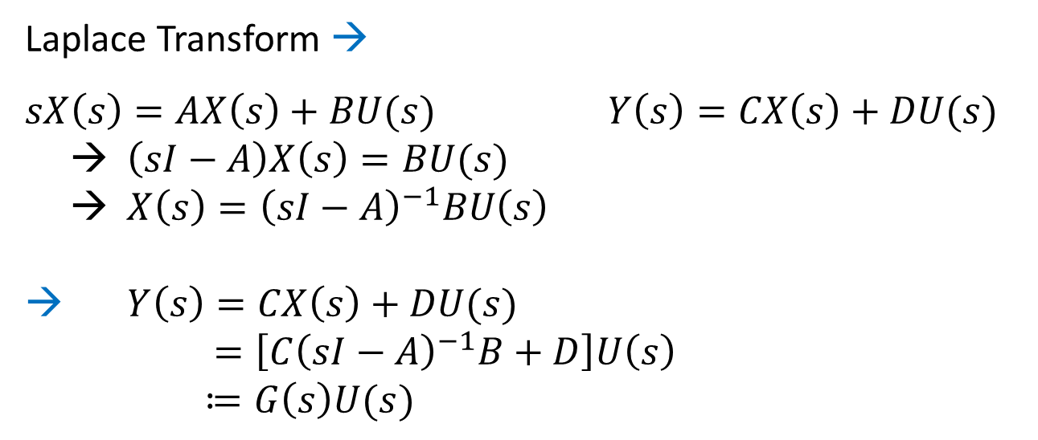
Laplace Transform →
$sX\left(s\right)=AX\left(s\right)+BU(s)$ $Y\left(s\right)=CX\left(s\right)+DU(s)$
→ $\left(sI−A\right)X\left(s\right)=BU(s)$
→ $X\left(s\right)={\left(sI−A\right)}^{−1}BU\left(s\right)$
→ $Y\left(s\right)=CX\left(s\right)+DU(s)$
$=\left[C{\left(sI−A\right)}^{−1}B+D\right]U\left(s\right)$
$≔G\left(s\right)U(s)$
Similarly,
$$\left\{\begin{matrix}\dot{ ξ}=Φ ξ+Ψ u \\ y=Ω ξ+Δ u\end{matrix}\right.$$
$$Y\left(s\right)=\left[Ω{\left(sI−Φ\right)}^{−1}Ψ+Δ\right]U\left(s\right)$$
$$≔\tilde{G}\left(s\right)U(s)$$

Slide 8
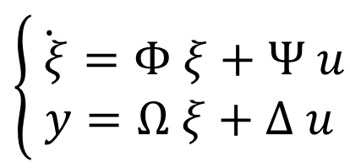

$Y\left(s\right)=\left[C{\left(sI−A\right)}^{−1}B+D\right]U\left(s\right)$ $≔G\left(s\right)U(s)$
$$\left\{\begin{matrix}\dot{ ξ}=Φ ξ+Ψ u \\ y=Ω ξ+Δ u\end{matrix}\right.$$
$$Y\left(s\right)=\left[Ω{\left(sI−Φ\right)}^{−1}Ψ+Δ\right]U\left(s\right)≔\tilde{G}\left(s\right)U(s)$$
Find: Relationship between $G(s)$ and $\tilde{G}(s)$
(10 minutes)
Recall: $Φ=PAP^{−1} , Ψ=PB$ $, Ω=CP^{−1}$, $Δ=D$

Slide 9

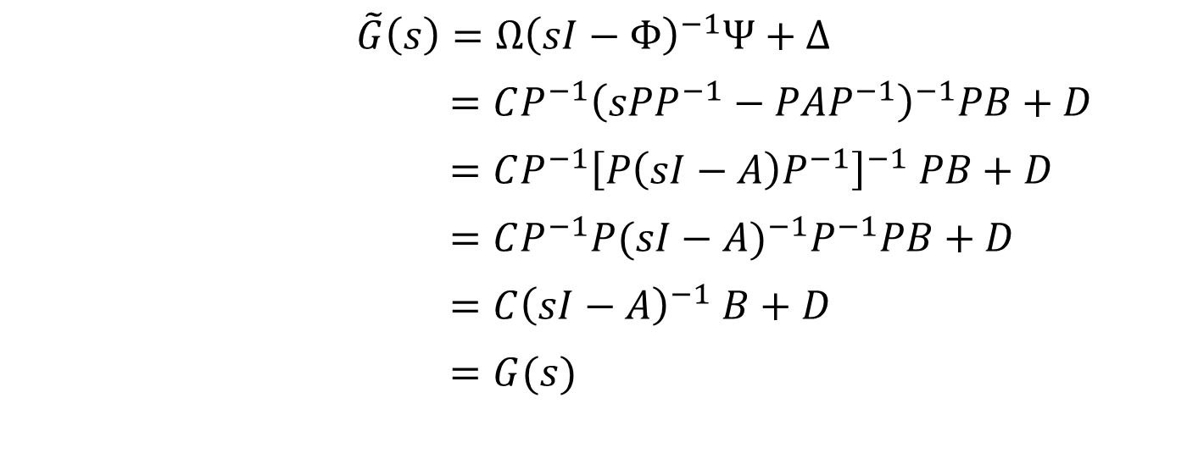
$Y\left(s\right)=\left[C{\left(sI−A\right)}^{−1}B+D\right]U\left(s\right)$ $≔G\left(s\right)U(s)$
$$Y\left(s\right)=\left[Ω{\left(sI−Φ\right)}^{−1}Ψ+Δ\right]U\left(s\right)≔\tilde{G}\left(s\right)U(s)$$
Recall: $Φ=PAP^{−1} , Ψ=PB$ $, Ω=CP^{−1}$, $Δ=D$
Solution: $G\left(s\right)=\tilde{G}(s)$
Proof:
$$\tilde{G}\left(s\right)=Ω{\left(sI−Φ\right)}^{−1}Ψ+Δ$$
$=CP^{−1}{\left(sPP^{−1}−PAP^{−1}\right)}^{−1}PB+D$
$=CP^{−1}{\left[P\left(sI−A\right)P^{−1}\right]}^{−1} PB+D$
$=CP^{−1}P{(sI−A)}^{−1}P^{−1}PB+D$
$=C{\left(sI−A\right)}^{−1} B+D$
$=G(s)$

Slide 10
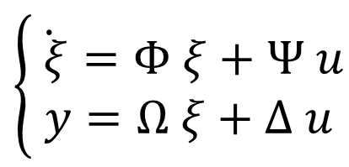
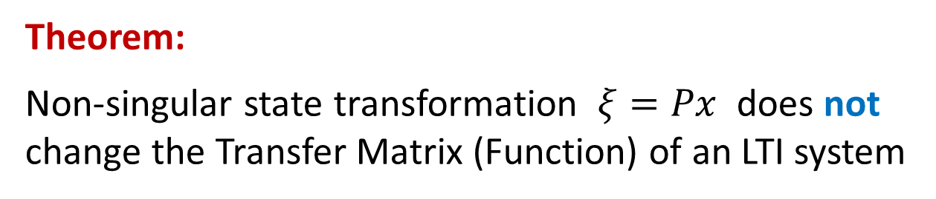

$Y\left(s\right)=\left[C{\left(sI−A\right)}^{−1}B+D\right]U\left(s\right)$ $≔G\left(s\right)U(s)$
$$\left\{\begin{matrix}\dot{ ξ}=Φ ξ+Ψ u \\ y=Ω ξ+Δ u\end{matrix}\right.$$
$$Y\left(s\right)=\left[Ω{\left(sI−Φ\right)}^{−1}Ψ+Δ\right]U\left(s\right)≔\tilde{G}\left(s\right)U(s)$$
→ $G\left(s\right)=\tilde{G}(s)$
Theorem:
Non-singular state transformation $ξ=Px$ does not change the Transfer Matrix (Function) of an LTI system

Slide 11
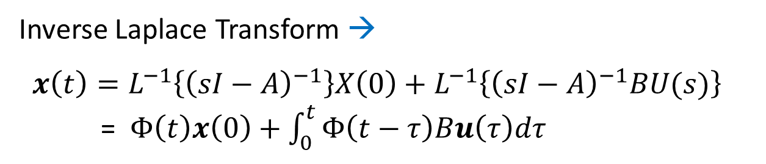
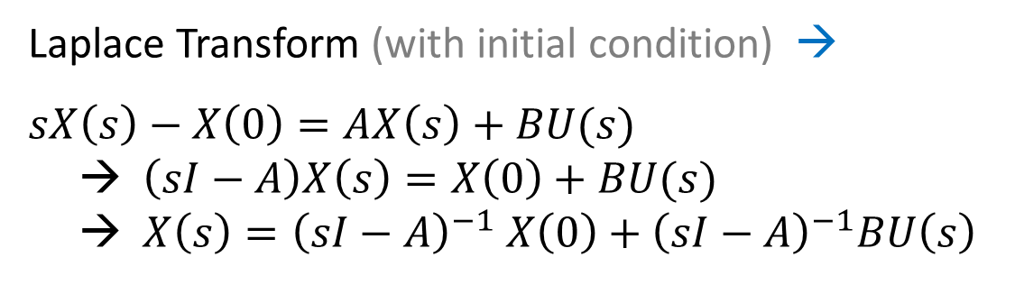
Next, consider:
Laplace Transform (with initial condition) →
$sX\left(s\right)−X\left(0\right)=AX\left(s\right)+BU(s)$
→ $\left(sI−A\right)X\left(s\right)=X\left(0\right)+BU(s)$
→ $X\left(s\right)={\left(sI−A\right)}^{−1} X\left(0\right)+{\left(sI−A\right)}^{−1}BU\left(s\right)$
Inverse Laplace Transform →
$x\left(t\right)=L^{−1}\left\{{\left(sI−A\right)}^{−1}\right\}X\left(0\right)+L^{−1}\left\{{\left(sI−A\right)}^{−1}BU(s)\right\}$
= $Φ\left(t\right)x\left(0\right)+\int_{0}^{t}{Φ\left(t−τ\right)Bu\left(τ\right)dτ}$
Convolution

Slide 12
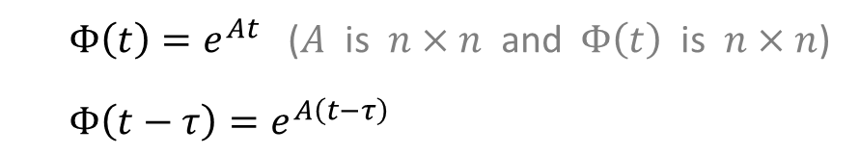
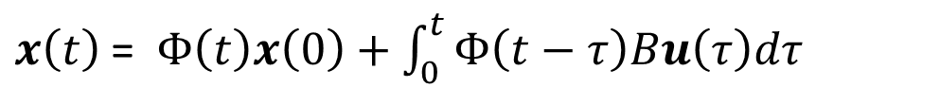
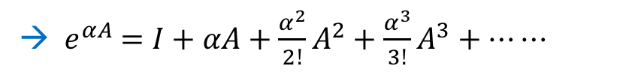
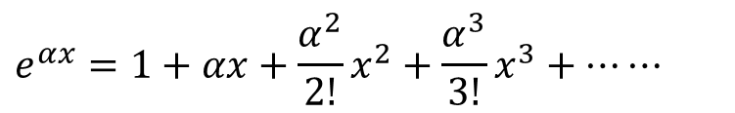
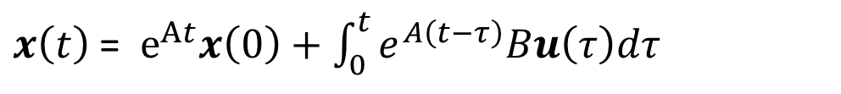
$x\left(t\right)$ = $Φ\left(t\right)x\left(0\right)+\int_{0}^{t}{Φ\left(t−τ\right)Bu\left(τ\right)dτ}$
$Φ\left(t\right)=e^{At}$ ($A$ is $n×n$ and $Φ\left(t\right)$ is $n×n$)
$Φ\left(t−τ\right)=e^{A\left(t−τ\right)}$
$x\left(t\right)$ = $e^{At}x\left(0\right)+\int_{0}^{t}{e^{A\left(t−τ\right)}Bu\left(τ\right)dτ}$
$$e^{αx}=1+αx+{\frac{α^{2}}{2!}x}^{2}+{\frac{α^{3}}{3!}x}^{3}+⋯⋯$$
→ ${ e}^{αA} =I+αA+{\frac{α^{2}}{2!}A}^{2}+{\frac{α^{3}}{3!}A}^{3}+⋯⋯$
(matrix exponential)
Cayley-Hamilton Theorem →
${ e}^{αA} =I+β_{1}A+{\frac{β_{2}}{2!}A}^{2}+{\frac{β_{3}}{3!}A}^{3}+ ⋯⋯ +{\frac{β_{n−1}}{\left(n−1\right)!}A}^{n−1}$
$β_{i}$ are some functions of $α$

Slide 13
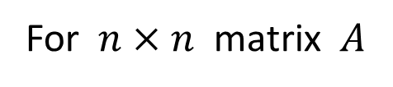

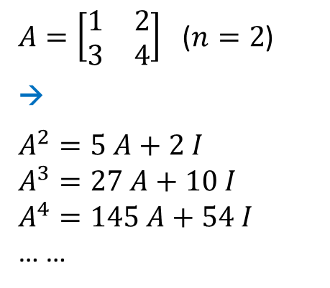
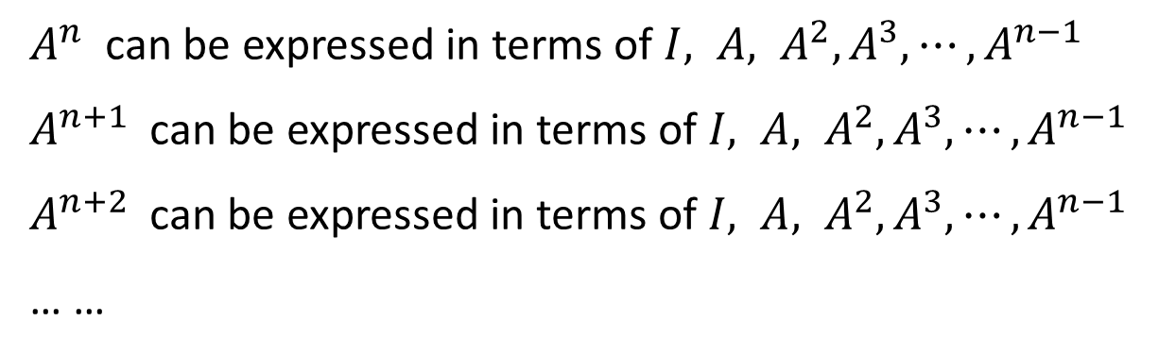
Cayley-Hamilton Theorem
For $n×n$ matrix $A$
$A^{n}$ can be expressed in terms of $I, A, A^{2}, A^{3}, ⋯, A^{n−1}$
$A^{n+1}$ can be expressed in terms of $I, A, A^{2}, A^{3}, ⋯, A^{n−1}$
$A^{n+2}$ can be expressed in terms of $I, A, A^{2}, A^{3}, ⋯, A^{n−1}$
… …
Example:
$A=\left[\begin{matrix}1 & 2 \\ 3 & 4\end{matrix}\right]$ ($n=2$)
→
$$A^{2}=5 A+2 I$$
$$A^{3}=27 A+10 I$$
$$A^{4}=145 A+54 I$$
… …
Solutions:
$$I=\left\lceil \begin{matrix}1 & 0 \\ 0 & 1\end{matrix}\right\rceil$$

Slide 14
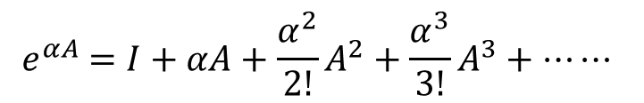
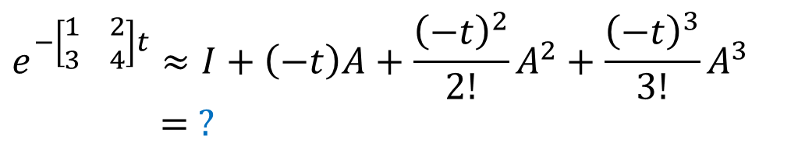

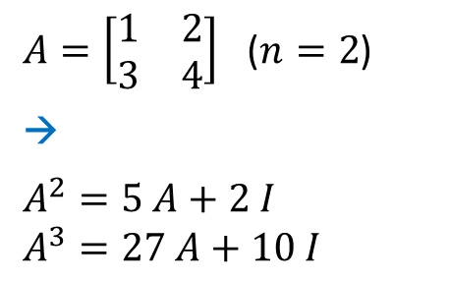
Recall:
$${ e}^{αA} =I+αA+{\frac{α^{2}}{2!}A}^{2}+{\frac{α^{3}}{3!}A}^{3}+⋯⋯$$
$A=\left[\begin{matrix}1 & 2 \\ 3 & 4\end{matrix}\right]$ ($n=2$)
→
$$A^{2}=5 A+2 I$$
$$A^{3}=27 A+10 I$$
$$I=\left\lceil \begin{matrix}1 & 0 \\ 0 & 1\end{matrix}\right\rceil$$
Exercise:
$$e^{−\left[\begin{matrix}1 & 2 \\ 3 & 4\end{matrix}\right]t}≈I+\left(−t\right)A+\frac{{\left(−t\right)}^{2}}{2!}A^{2}+\frac{{\left(−t\right)}^{3}}{3!}A^{3}$$
$= ?$
(5 minutes)

Slide 15
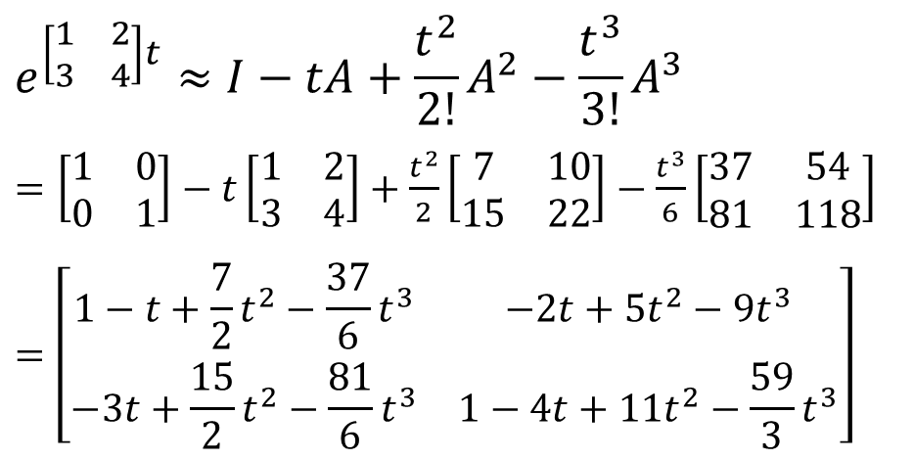
Recall:
$${ e}^{αA} =I+αA+{\frac{α^{2}}{2!}A}^{2}+{\frac{α^{3}}{3!}A}^{3}+⋯⋯$$
$A=\left[\begin{matrix}1 & 2 \\ 3 & 4\end{matrix}\right]$ ($n=2$)
→
$$A^{2}=5 A+2 I$$
$$A^{3}=27 A+10 I$$
$$I=\left\lceil \begin{matrix}1 & 0 \\ 0 & 1\end{matrix}\right\rceil$$
Solution:
$$e^{\left[\begin{matrix}1 & 2 \\ 3 & 4\end{matrix}\right]t}≈I−tA+\frac{t^{2}}{2!}A^{2}−\frac{t^{3}}{3!}A^{3}$$
$=\left[\begin{matrix}1 & 0 \\ 0 & 1\end{matrix}\right]−t\left[\begin{matrix}1 & 2 \\ 3 & 4\end{matrix}\right]+$ $\frac{t^{2}}{2}\left[\begin{matrix}7 & 10 \\ 15 & 22\end{matrix}\right]−\frac{t^{3}}{6}\left[\begin{matrix}37 & 54 \\ 81 & 118\end{matrix}\right]$
$$=\left[\begin{matrix}1−t+\frac{7}{2}t^{2}−\frac{37}{6}t^{3} & −2t+5t^{2}−9t^{3} \\ −3t+\frac{15}{2}t^{2}−\frac{81}{6}t^{3} & 1−4t+11t^{2}−\frac{59}{3}t^{3}\end{matrix}\right]$$

Slide 16
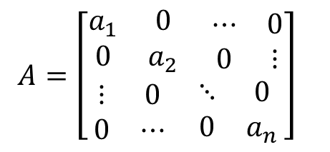
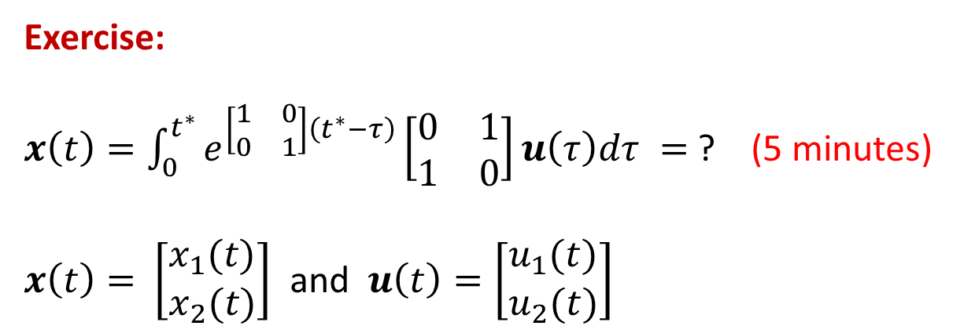
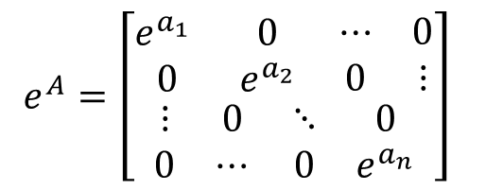
More about Matrix Exponential
(for diagonal matrices)
$A=\left[\begin{aligned}\begin{matrix}a_{1} & 0 \\ 0 & a_{2}\end{matrix} \begin{matrix}⋯ & 0 \\ 0 & ⋮\end{matrix} \\ \begin{matrix}⋮ & 0 \\ 0 & ⋯\end{matrix} \begin{matrix}⋱ & 0 \\ 0 & a_{n}\end{matrix}\end{aligned}\right]$
$e^{A}=\left[\begin{aligned}\begin{matrix}e^{a_{1}} & 0 \\ 0 & e^{a_{2}}\end{matrix} \begin{matrix}⋯ & 0 \\ 0 & ⋮\end{matrix} \\ \begin{matrix}⋮ & 0 \\ 0 & ⋯\end{matrix} \begin{matrix}⋱ & 0 \\ 0 & e^{a_{n}}\end{matrix}\end{aligned}\right]$
Exercise:
$x\left(t\right)=\int_{0}^{t^{∗}}{e^{\left[\begin{matrix}1 & 0 \\ 0 & 1\end{matrix}\right]\left(t^{∗}−τ\right)}\left[\begin{matrix}0 & 1 \\ 1 & 0\end{matrix}\right]}u\left(τ\right)dτ =$ ? (5 minutes)
$x\left(t\right)=$ $\left[\begin{matrix}x_{1}(t) \\ x_{2}(t)\end{matrix}\right]$ and $u\left(t\right)=\left[\begin{matrix}u_{1}(t) \\ u_{2}(t)\end{matrix}\right]$

Slide 17
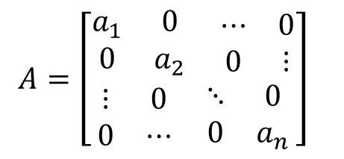
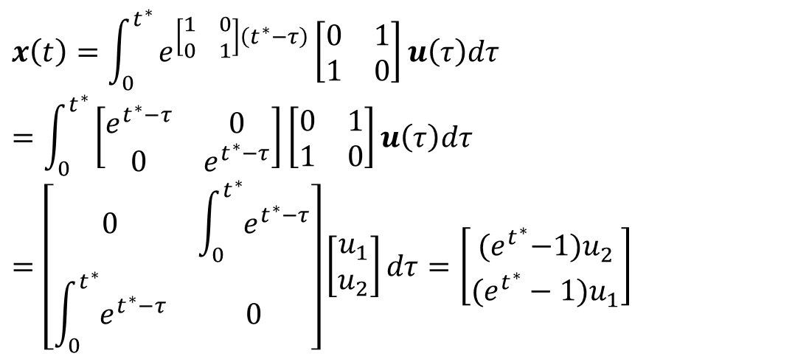
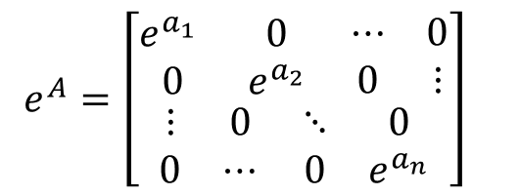
More about Matrix Exponential
(for diagonal matrices)
$A=\left[\begin{aligned}\begin{matrix}a_{1} & 0 \\ 0 & a_{2}\end{matrix} \begin{matrix}⋯ & 0 \\ 0 & ⋮\end{matrix} \\ \begin{matrix}⋮ & 0 \\ 0 & ⋯\end{matrix} \begin{matrix}⋱ & 0 \\ 0 & a_{n}\end{matrix}\end{aligned}\right]$
$e^{A}=\left[\begin{aligned}\begin{matrix}e^{a_{1}} & 0 \\ 0 & e^{a_{2}}\end{matrix} \begin{matrix}⋯ & 0 \\ 0 & ⋮\end{matrix} \\ \begin{matrix}⋮ & 0 \\ 0 & ⋯\end{matrix} \begin{matrix}⋱ & 0 \\ 0 & e^{a_{n}}\end{matrix}\end{aligned}\right]$
Solution:
$$x\left(t\right)=\int_{0}^{t^{∗}}{e^{\left[\begin{matrix}1 & 0 \\ 0 & 1\end{matrix}\right]\left(t^{∗}−τ\right)}\left[\begin{matrix}0 & 1 \\ 1 & 0\end{matrix}\right]}u\left(τ\right)dτ$$
$$=\int_{0}^{t^{∗}}{\left[\begin{matrix}e^{t^{∗}−τ} & 0 \\ 0 & e^{t^{∗}−τ}\end{matrix}\right]\left[\begin{matrix}0 & 1 \\ 1 & 0\end{matrix}\right]u\left(τ\right)dτ}$$
$$=\left[\begin{matrix}0 & \int_{0}^{t^{∗}}{e^{t^{∗}−τ}} \\ \int_{0}^{t^{∗}}{e^{t^{∗}−τ}} & 0\end{matrix}\right]\left[\begin{matrix}u_{1} \\ u_{2}\end{matrix}\right]dτ=\left[\begin{matrix}{(e}^{t^{∗}}−1)u_{2} \\ (e^{t^{∗}}−1)u_{1}\end{matrix}\right]$$

Slide 18
END

