Slide 1
CS2311 Computer Programming
LT5: Control Flow – Loop Statements
Computer Science, City University of Hong Kong
Semester A 2021-22

Slide 2
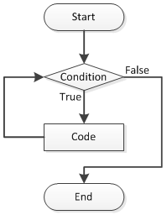
Loop
When the execution enters a loop, it executes a block of code repeatedly until the condition is NOT met
Beside sequential and branch execution, loop is another common control flow
while loop
while(condition){
doAction;
}

Slide 3
Loop
In general , a program loop consists four parts:
  Initialization statements
  Body
  Exit condition
  Post loop statements (stepping forward to exit loop condition)

Slide 4
Another example to use while
Ensure a positive number input?
#include <iostream>
using namespace std;
void main() {
int cnt = 0, n;
float max, x;
cout << "The maximum value will be computed.\n";
cout << "How many numbers do you wish to enter? ";
cin >> n;
while (n <= 0) /* ensure a positive number is entered */
{
cout << "\nERROR: Positive integer required.\n\n";
cout << "How many numbers do you wish to enter? ";
cin >> n;
}
/* To be continued in next page */

Slide 5
Another example to use while
Repetitive execution based on user’s input
cout << "\nEnter “ << n << “ real numbers: ";
cin >> x; /* read 1st number */
max = x;
/* pick the largest number in while-loop */
while (++cnt < n) {
cin >> x; /* read another number */
cout << “The ” << cnt << “-th num is: ” << x << endl;
if (max < x)
max = x;
}
cout << "\nMaximum value: " << max << endl;
}

Slide 6
do statement
General form of do statement (repetition statement)
    do
    {
    statement(s);
    }
    while (expression);
Semantics:
  statement is executed first; thus the loop body is run at least once
  If the value of expression is non-zero (true), the loop repeats; otherwise, the loop terminates

Slide 7
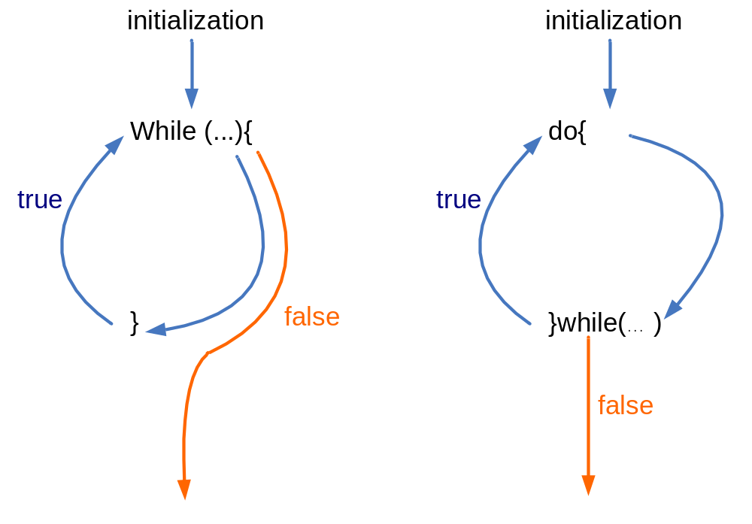
While vs Do while

Slide 8
Example of do statement
int error; /* no Boolean type support */
int n;
do {
cout << “Input a positive integer: “;
cin >> n;
if (error = (n <= 0))
cout << “\nError: negative input!\n”;
} while (error);
...

Slide 9
For-loop statement
expr1;
while(expr2)
{
loop statements;
expr3;
}
for(expr1; expr2; expr3)
{
loop statements;
}
The loop statements is executed as long as expr2 is true. When
expr2 becomes false, the loop ends (e.g., i<10).
expr1: Executed before entering the loop. Often used for variable initialization (e.g., int i=0).
expr3: For each iteration, expr3 is executed after executing the loop body. Often used to update the counter variables (e.g., i++).

Slide 10
Examples of for
#include <iostream>
using namespace std;
void main()
{
int i;
for(i=0;i<10;i++)
cout << i << endl;
}
#include <iostream>
using namespace std;
void main()
{
for(int i=0;i<10;i++)
{
if(i%2==0)
cout << i << endl;
}
}

Slide 11
for Loop: Syntax Error
for (int k = 1; k <= 8; k++)
{
cout << "log(" << k << ") = "
<< log(double(k)) << endl;
}
cout << k << endl; // SYNTAX ERROR
// Variable k can be declared before the for-loop
int k=0;
for (k = 1; k <= 8; k++)
{
cout << "sqrt(" << k << ") = "
<< sqrt(k) << endl;
}
cout << k << endl;
The variable k is declared within the for-loop statement. It is not visible/accessible outside the for-loop.
✗
✓

Slide 12
Console
#include <iostream>
using namespace std;
int main(){
int x;
cout << "Enter a number: ";
// for-loop;
for (cin >> x; x <= 0; cin >> x)
{
cout << "Input must be positive." << endl;
cout << "Enter number: ";
}
// the while-loop equivalent to the above for-loop:
cout << "Enter a number: ";
cin >> x;
while (x <= 0)
{
cout << "Input must be positive." << endl;
cout << "Enter number: ";
cin >> x;
}
cout << "The squre of " << x << " is " << x*x << endl;
}
Enter a number: -3
Input must be positive.
Enter number: 2
Enter a number: -3
Input must be positive.
Enter number: 2
The squre of 2 is 4

Slide 13
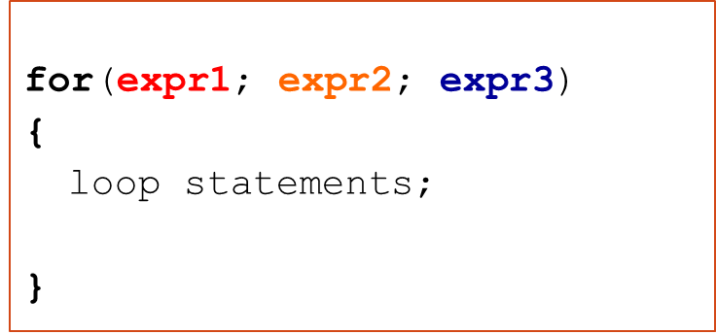
For-loop statement
expr1 and expr3 can contain multiple statements. Each statement is separated by a comma ','
Example
for(i=0, j=0; i<10; i++, j++)
……
expr1: i=0, j=0
expr2: i<10
expr3: i++, j++

Slide 14
Comma operator (,)
It has the lowest precedence of all operators in C++ and is evaluated from left to right
General form is
expra, exprb
The comma expression as a whole has the value and type of its right operand
Sometimes used in for statements to allow multiple initializations and multiple processing of indices
The comma operator is rarely used
Not all commas in a C++ program are comma operators

Slide 15
Common errors
Mix up assignment = with equality operator ==
Mix up the comma operator with the semi-colon
Unaware of extra semi-colons, e.g.,
    sum=0;
    for (j=1; j<=10; j++)
    sum += j;
  is not the same as
    sum=0;
    for (j=1; j<=10; j++);
    sum += j;

Slide 16
Common errors (cont’d)
Fail to ensure that the termination condition of a loop is reachable → infinite loop
Misuse of relational operators
int k=8;
  if (2 < k < 7)
  cout >> “true”;
  else
  cout >> “false”;
Use (2 < k && k < 7) for the correct answer

Slide 17
Nested for-loop
#include<iostream>
using namespace std;
void main(){
int i,j;
for (i=0;i<3; i++){
cout << "Outer for:\n";
for (j=0;j<2; j++){
cout << "Inner for:";
cout << "i=“ << i << ", j=" << j << endl;
}
cout << endl;
}
}
Outer for:
Inner for:i=0, j=0
Inner for:i=0, j=1
Outer for:
Inner for:i=1, j=0
Inner for:i=1, j=1
Outer for:
Inner for:i=2, j=0
Inner for:i=2, j=1
The outer loop is executed 3 times.
For each iteration of the outer loop, the inner loop is executed 2 times

Slide 18
Exercise
Write a program to generate a multiplication of n rows and m column (where n and m is input by the user). Assume n>1 and m<=9
E.g. when n=4, m=3, the following table is generated
  1 2 3
  2 4 6
  3 6 9
  4 8 12

Slide 19
Answer
void main(){
int n, m; // n: rows, m: columns
cin >> n >> m;
for (int i = 1;i <= n; i++){
for (int j = 1;j <= m; j++){
cout << i*j << “\t”;
}
cout << endl;
}
}

Slide 20
Use the Loop Counters in Nested Loop Cleverly
for (int row = 1; row <= length; row++)
{
// print (row-1) spaces
for (int col = 1; col <= row - 1; col++)
{
cout << " ";
}
cout << "x" << endl; // print x on diagonal
}
...
Enter diagonal length: 5
x
x
x
x
x
Console

Slide 21
break statement
the break statement causes an exit from the innermost enclosing loop or switch statement (discussed already)
while (1) {
cin >> n;
if (n < 0)
break;
cout << n << endl;
}
/* If break is run, jumps to here */

Slide 22
continue statement
continue statement causes the current iteration of a loop to stop and the next iteration to begin immediately
It can be applied in a while, do-while or for statement

Slide 23
Example of continue statement
cnt = 0;
while (cnt < 10) {
cin >> x;
if (x > -0.01 && x < 0.01)
continue; /* discard small values */
++cnt;
sum += x;
}

Slide 24
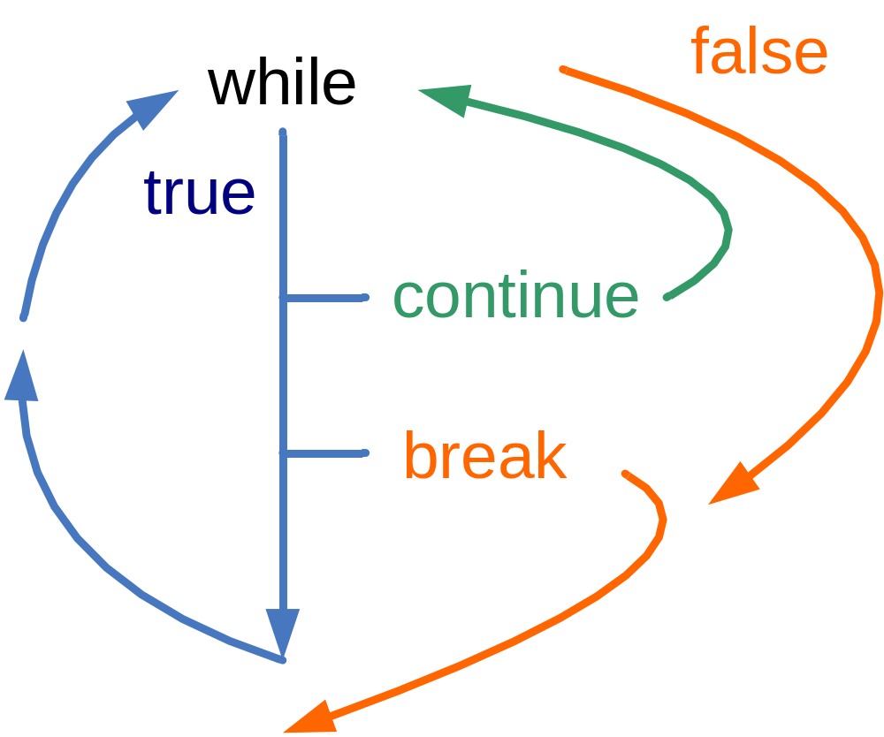
Continue, break

Slide 25
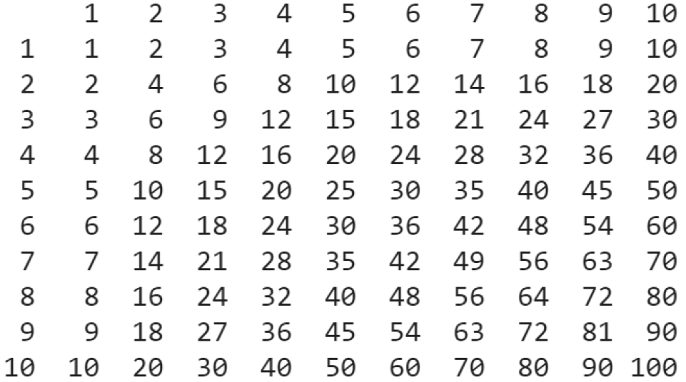
Example: output the following matrix

Slide 26
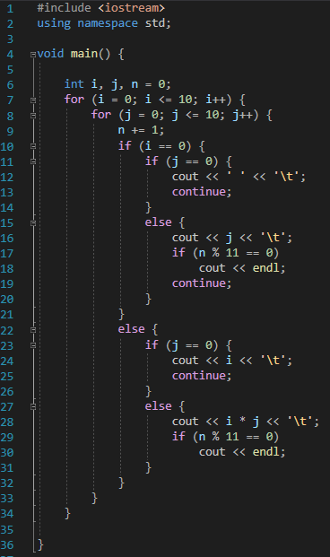
Example: output the following matrix
first element
first row
first column

Slide 27
Further remarks
Use a relational expression, if possible, rather than an equality expression to control a loop or a selection statement, e.g.,
Don’t use while (j!=4) {
...
j++;
}
Use while (j<4) {
...
j++;
}
variable j, increasing from 0 to 3

Slide 28
Further remarks
Don’t use a variable of any floating point data type to control a loop because real numbers are represented in their approximate values internally
Infinite loop can be made

Slide 29
Programming style
Indent code in a consistent fashion to indicate the flow of control (use the tab key)
  Note the multiple levels of indentation

Slide 30
Indentation
void main()
{
  int i;
  for(i = 0; i < 100; i++)
  {
      if(i>3)
      cout << i;
  }
}
1st level (1 tab)
2nd level (2 tabs)
3rd level (3 tabs)

Slide 31
Formatting programs
Indent the code properly as you write the program to reflect the structure of the program.
  Improve readability and increase the ease for debugging the program
  In assignment, marks will be allocated for indentation.
To indent in visual studio, you may press the tab button
You may select multiple lines of statements and press tab to indent all of them
To move back one level to the left, press shift+tab

Slide 32
Summary
In C++, repeating task could be expressed with
  while(…){…}
  do {…}while(…);
  for (…;…;…){…}
A complete looping structure may consist of
  Loop initialization statements
  Loop Body
  Exit condition
  Post Loop statements

