Slide 1
EE2004
Timer ConT

Slide 2
Timer Interrupt
Interrupt | Flag Bit | Register | Enable Bit | Register
Timer0 | TMR0IF | INTCON | TMR0IE | INTCON
Timer1 | TMR1IF | PIR1 | TMR1IE | PIE1
Timer2 | TMR2IF | PIR1 | TMR3IE | PIE1
Timer3 | TMR3IF | PIR3 | TMR3IE | PIE2
Timer Interrupt Flag Bits and Associated Registers
INTCON Register with Timer0 Interrupt Enable and Interrupt Flag

Slide 3
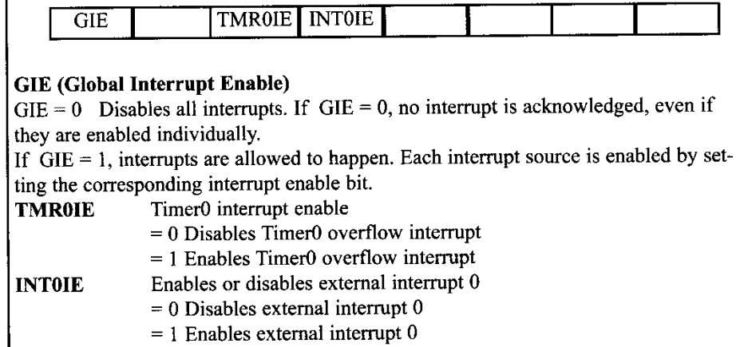
INTCON

Slide 4

TIMER0 Interrupt
Enable Timer0 interrupt
TIMER0 roll over flag

Slide 5
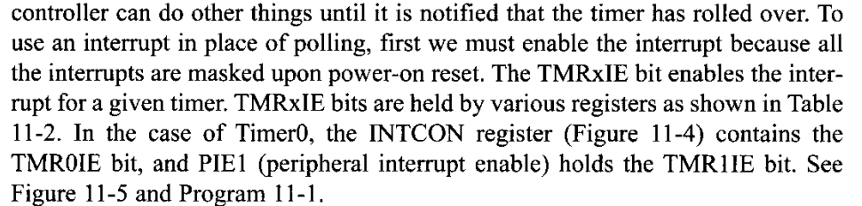
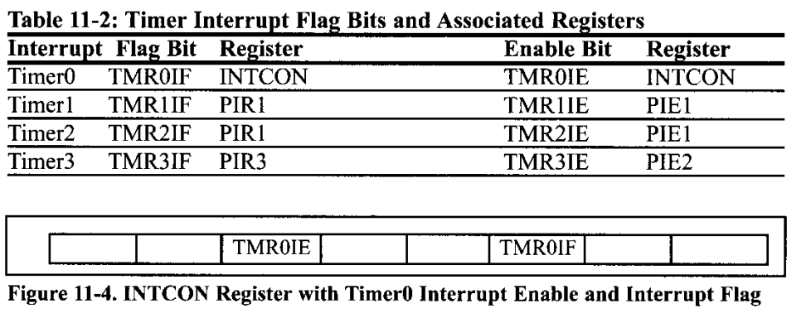
Timer Interrupt

Slide 6
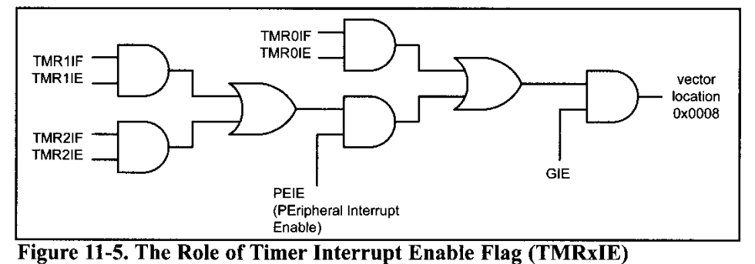
Timer Interrupt

Slide 7
Programming Example
PORTC is connected to 8 switches
PORTD to 8 LEDs
Write a program uses Timer0 to generate a square ware on pin PORTB.5, while at the same time, data is transferred from PORTC to PORTD.

Slide 8
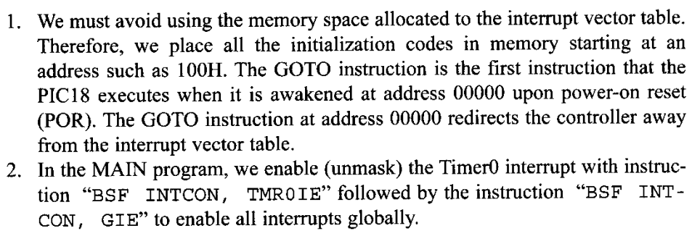
Programming

Slide 9
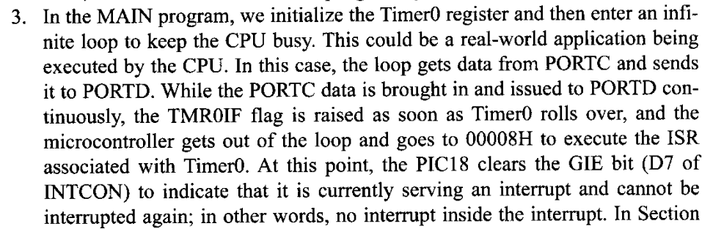
Programming

Slide 10
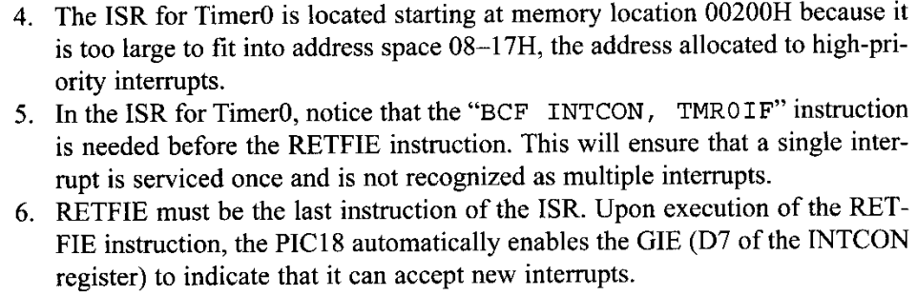
Programming

Slide 11
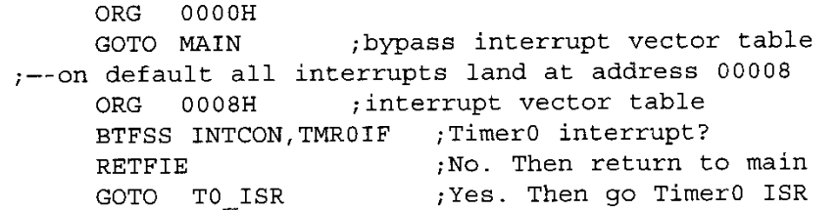
Source Code
Interrupt set up

Slide 12
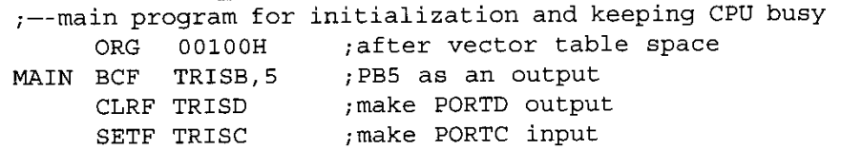
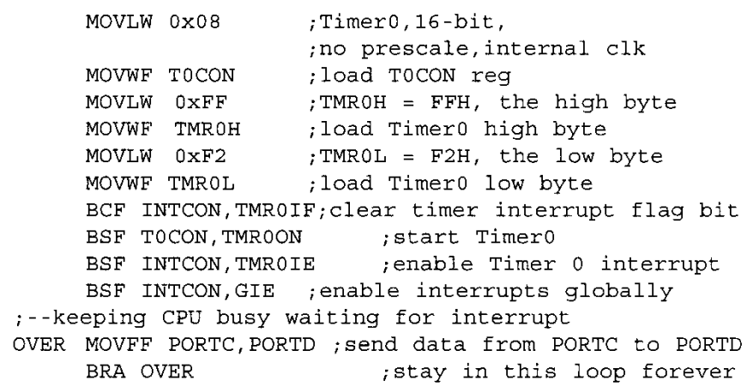
Source Code
Main program

Slide 13
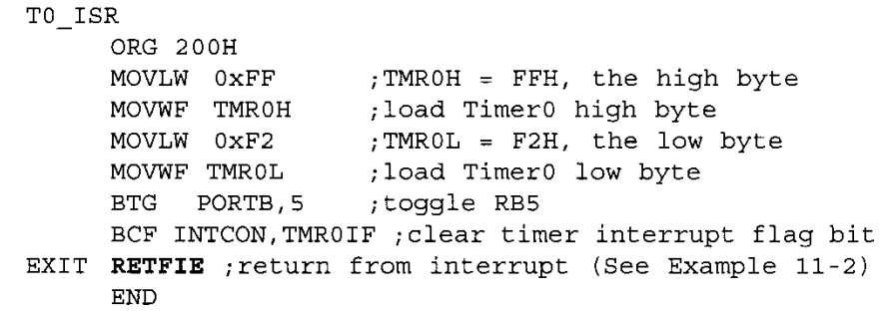
Interrupt Routine

