Slide 1
EE2000 Logic Circuit Design
Sequential Logic Circuit Design

Slide 2
Outline
7.1 Finite State Machines
  Concepts of States
  Mealy machines
  Moore machines
  Excitation table
  Design example
7.2 Sequential Circuit Analysis

Slide 3
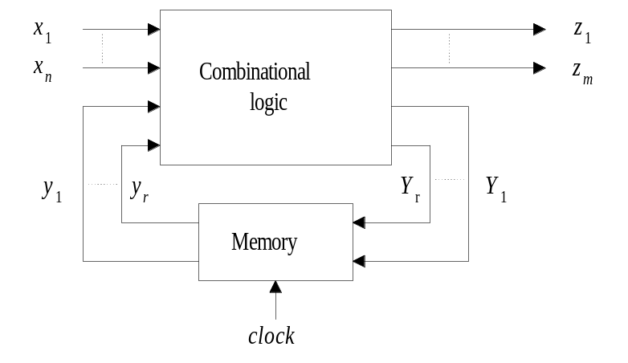
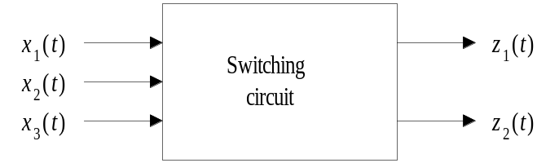
Sequential and combinational circuits
Switching system: a combinational circuit which transforms the input excitation to its corresponding output, the input and output are all function of time. The output is dependent only on the present input conditions.
Sequential circuit: the system outputs are dependent not only on the present input conditions but also on the past history of the system. The past history is usually regarded states which obviously require memory devices to remember their states.
combinational circuit
sequential circuit
z_{i}(t) = f (x_{i}(t))
z_{i}(t) = f (x_{i}(-∞, t))

Slide 4
Synchronous and asynchronous systems
Synchronous sequential systems in which the change of state takes place at discrete instants of time defined by a synchronizing input called the clock.
Asynchronous sequential systems, the states can change at any time as a function of input changes, there is no external synchronization.

Slide 5
States
With continuous inputs, the input time functions can be group into classes.
All time functions have the same effect on the output at time t.
Practically, the number of classes is finite.
These classes are represented by the auxiliary variables s_{i} called states.
States summarize the effect of past inputs.
Make decision for present and future outputs.

Slide 6
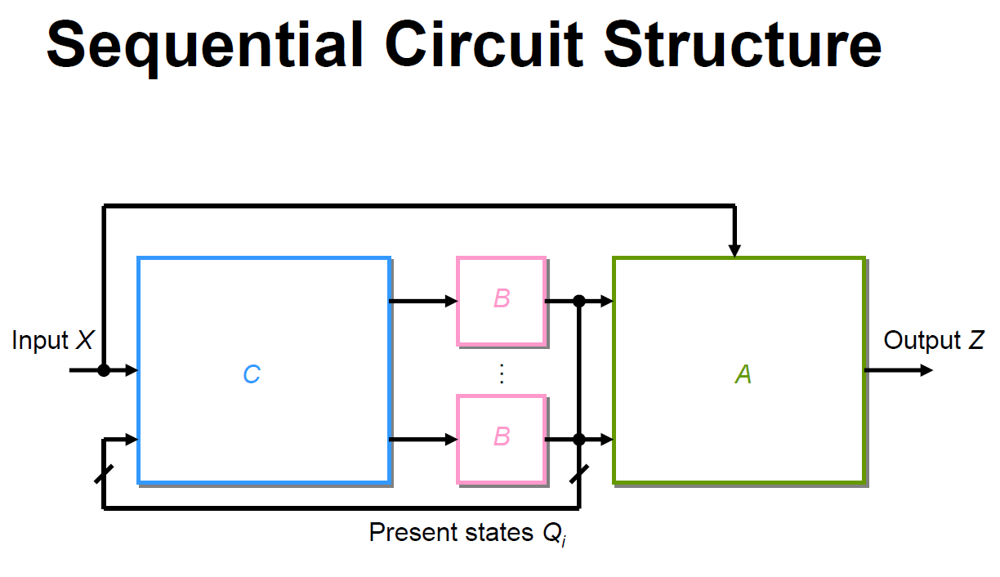

Slide 7
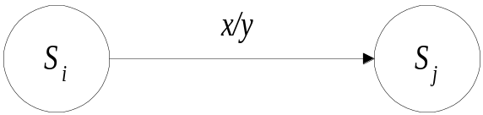
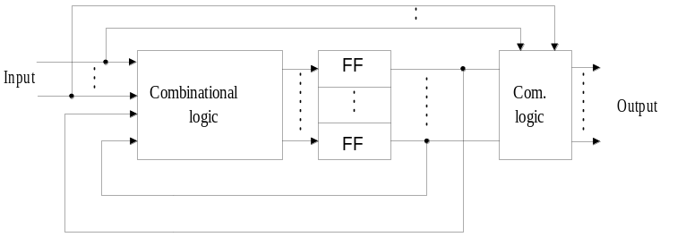
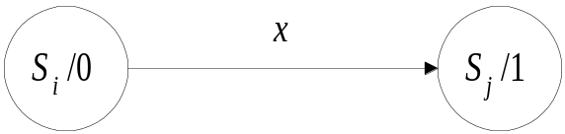
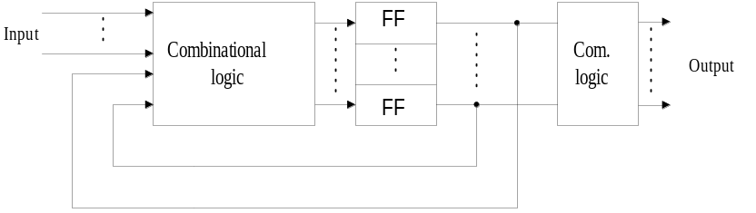
States machine
The state machine is illustrated using state diagram. A state diagram consists of circles which present the states; and lines connecting the circles that represent the transition of states.
Mealy machine
Moore machine
S = state
x = input
y = output

Slide 8
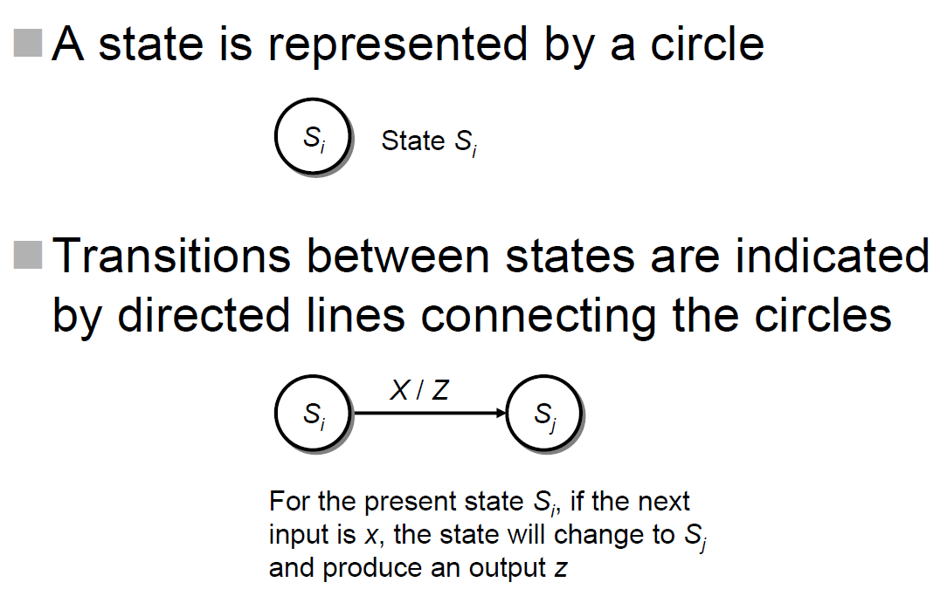
Mealy Machine

Slide 9
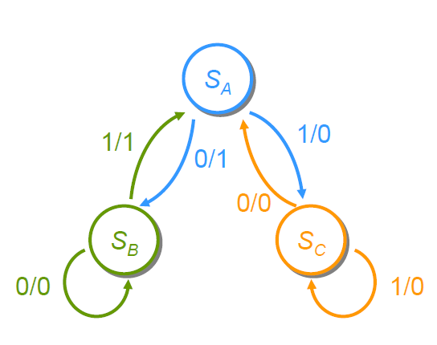
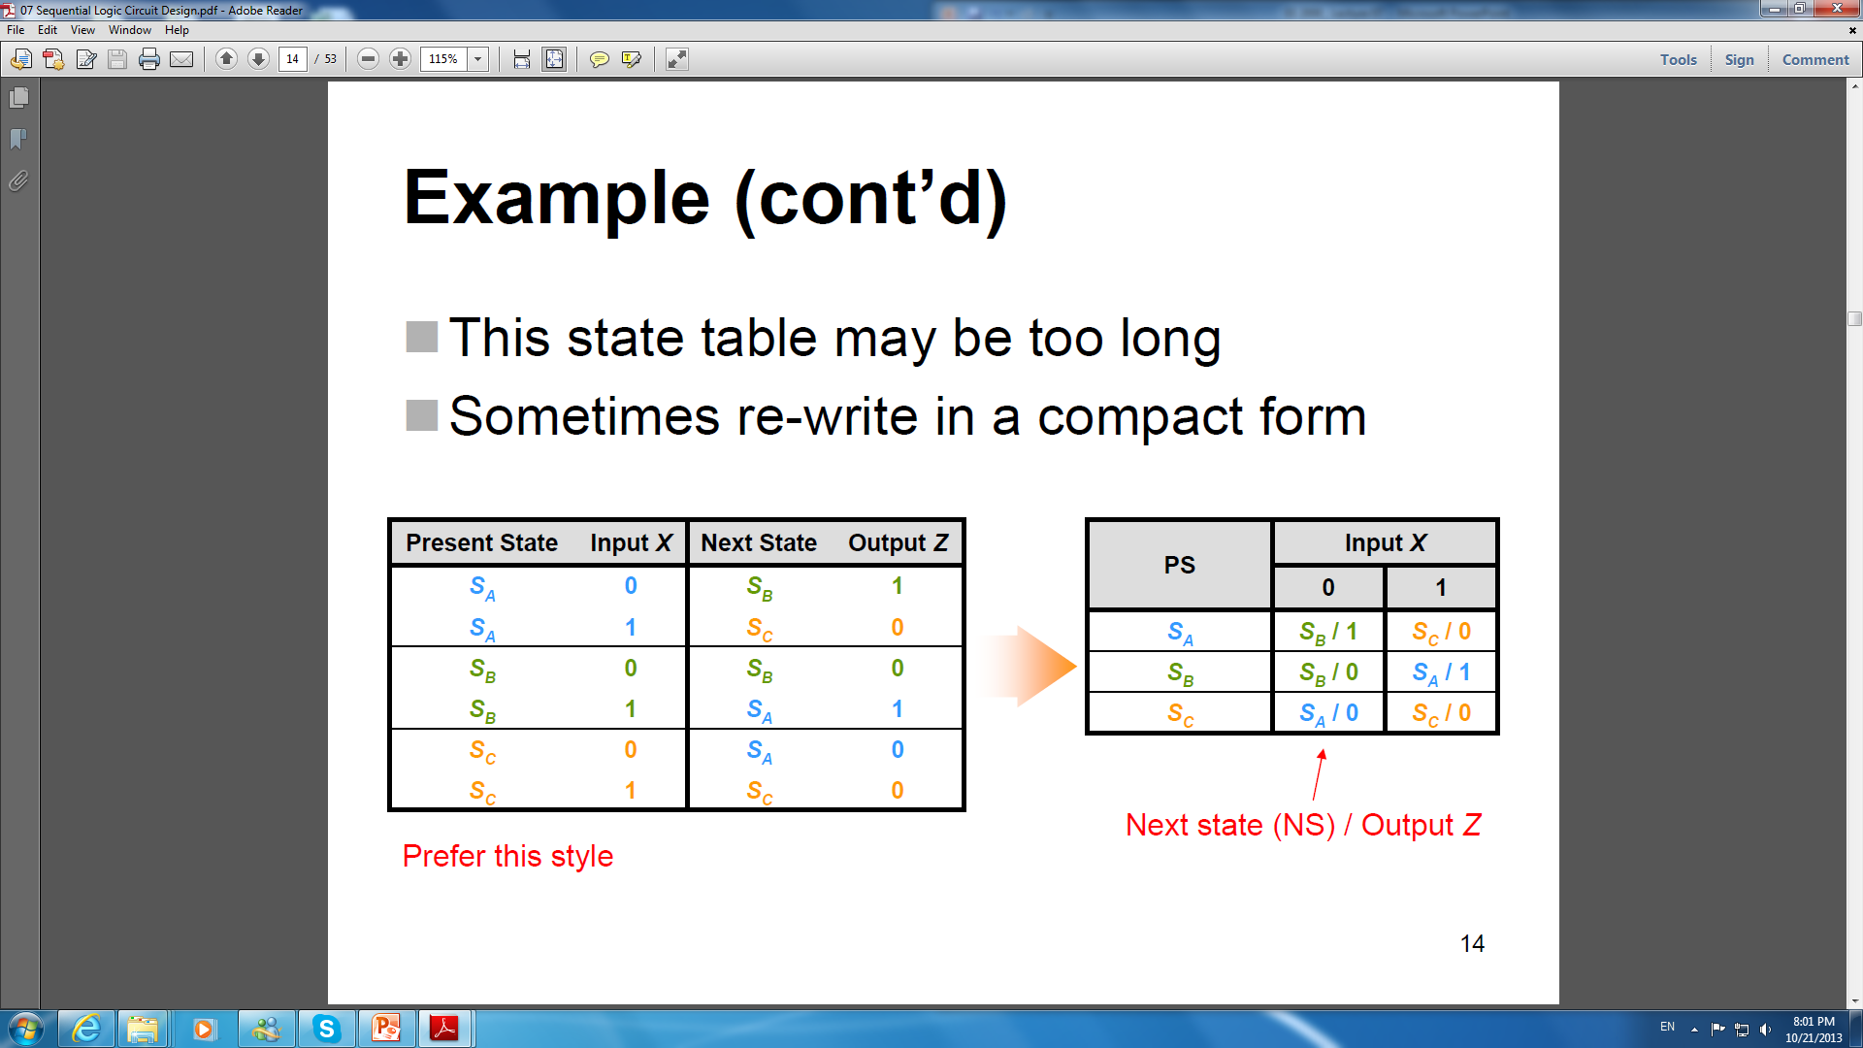
Mealy Machine

Slide 10

Mealy Machine

Slide 11
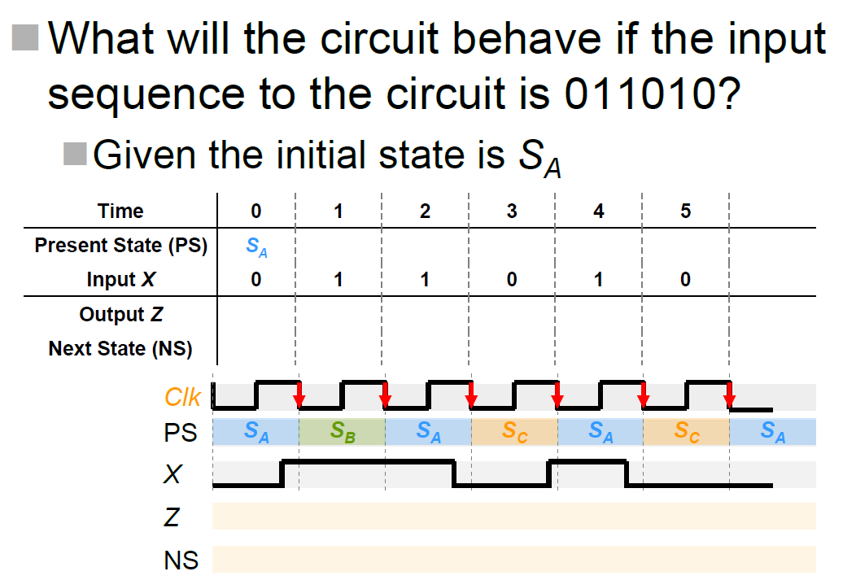
Mealy Machine

Slide 12
Mealy Machine

Slide 13
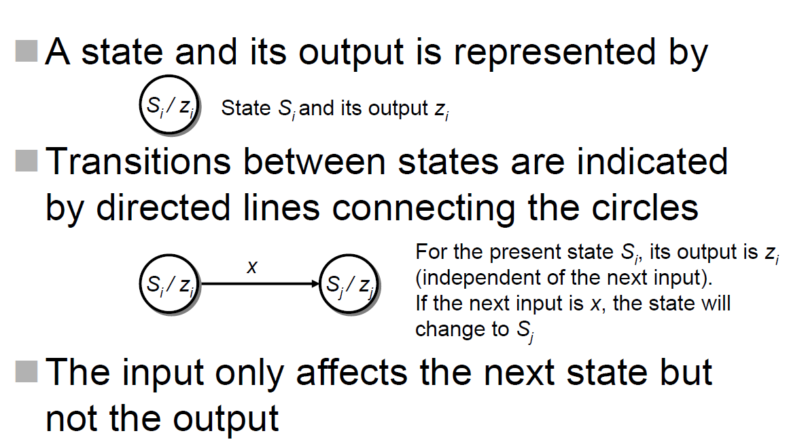
Moore Machine

Slide 14
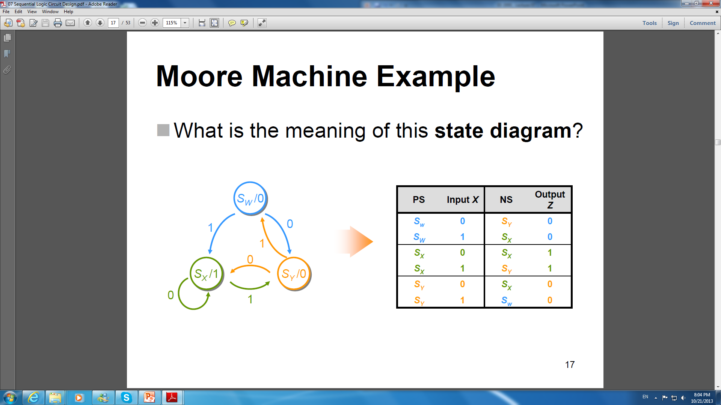
Moore Machine

Slide 15
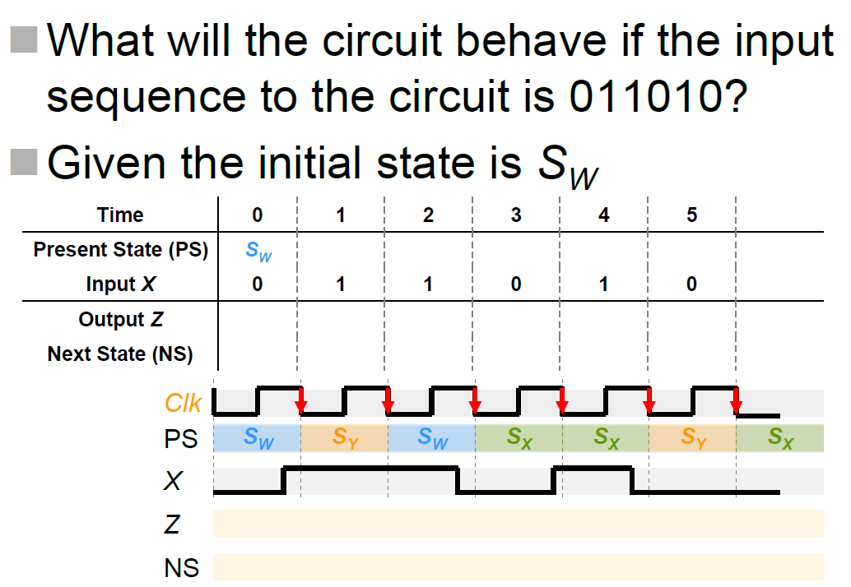
Moore Machine

Slide 16
Differences
Mealy machine
Moore machine
The output of Moore machine is related to the current state only
- The output will not change despite of the changes appears at the input
- The output is stable, because it depends solely on the state which is the group of storage elements

Slide 17
Differences
Mealy machine
Moore machine
The output of Moore machine is related to the current state only
- The output will not change despite of the changes appears at the input
- The output is stable, because it depends solely on the state which is the group of storage elements

Slide 18
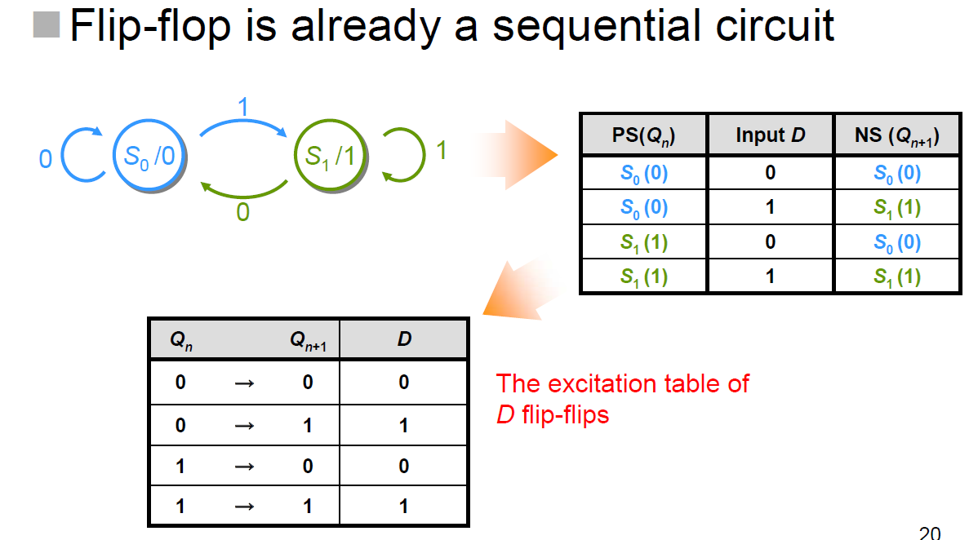
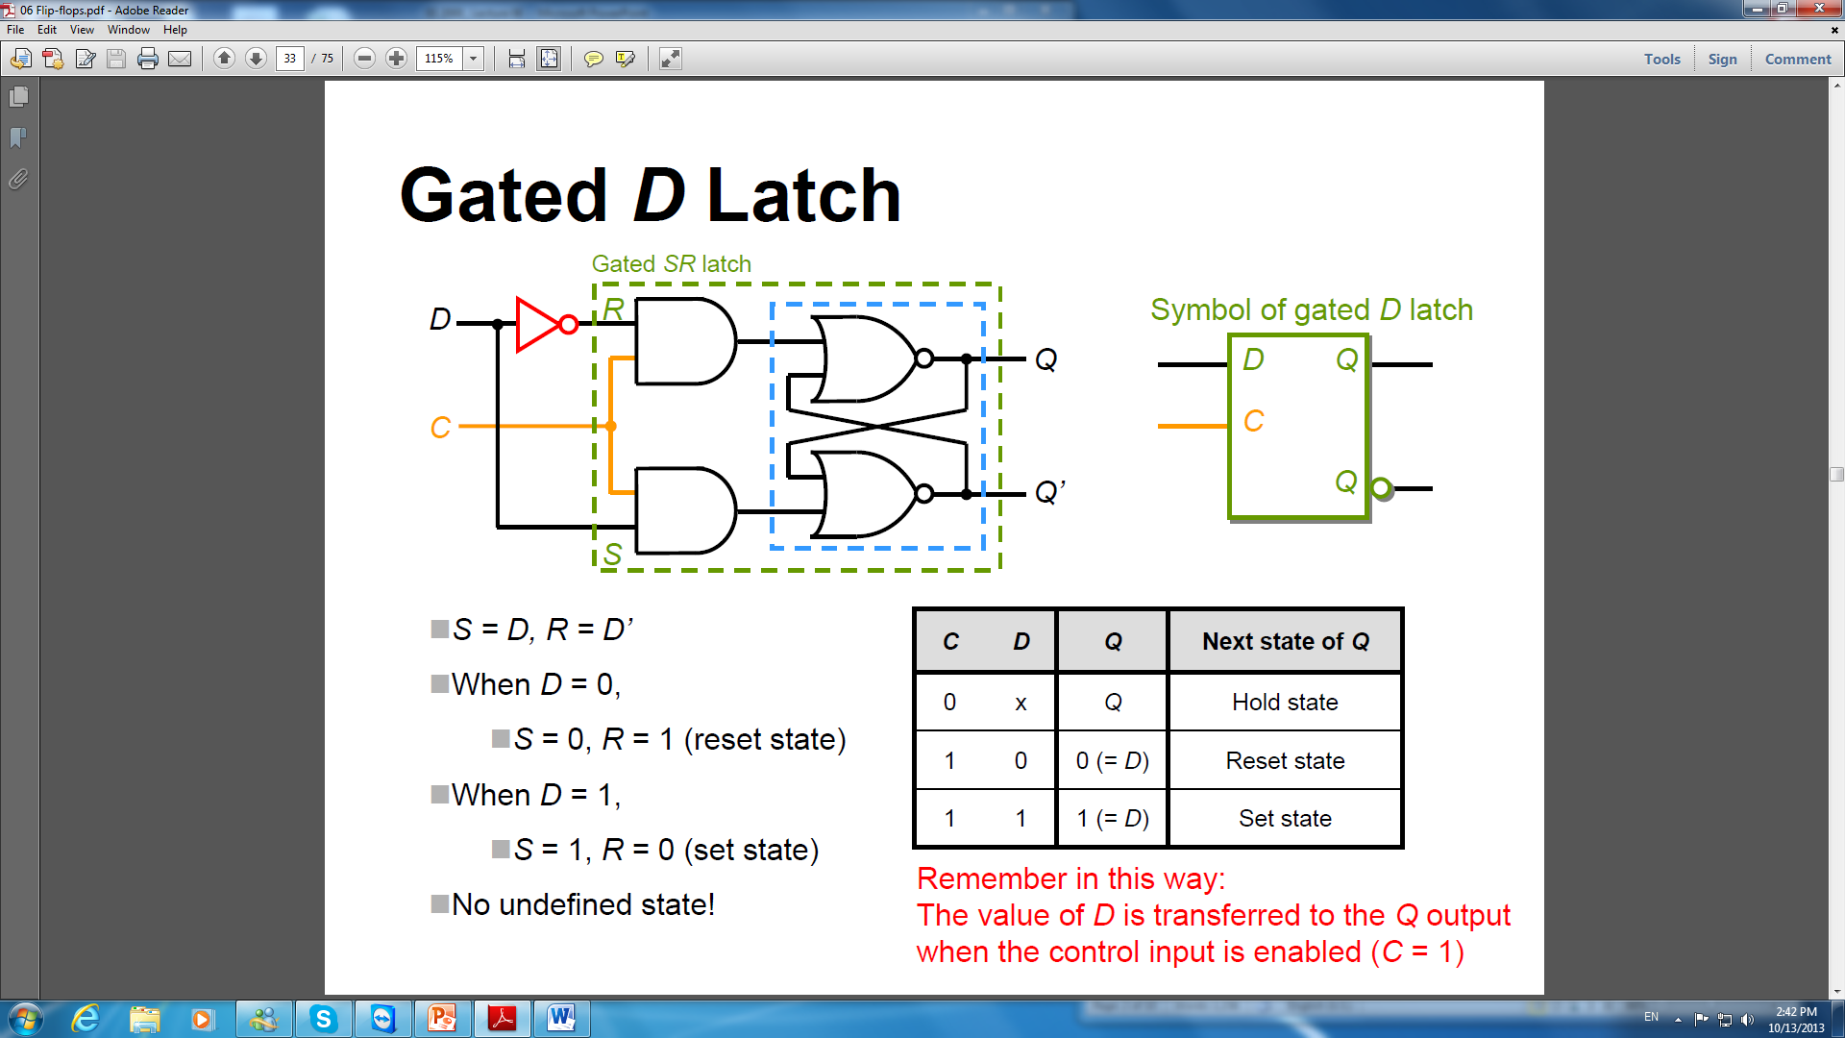
Excitation Table of D-FFs

Slide 19
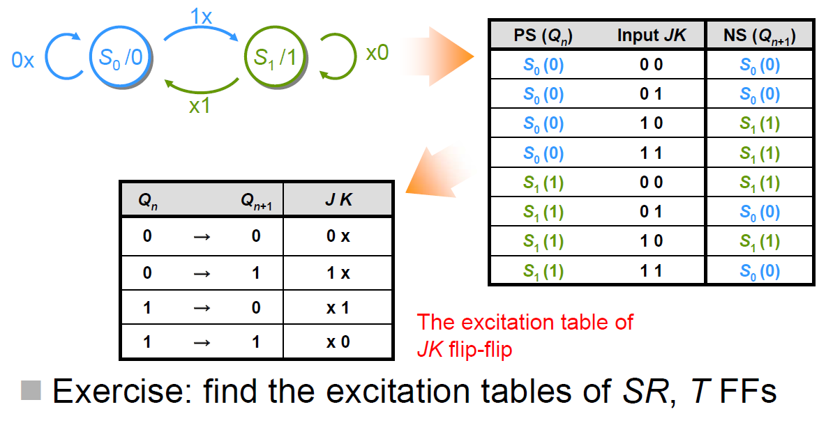
Excitation Table of JK-FFs

Slide 20
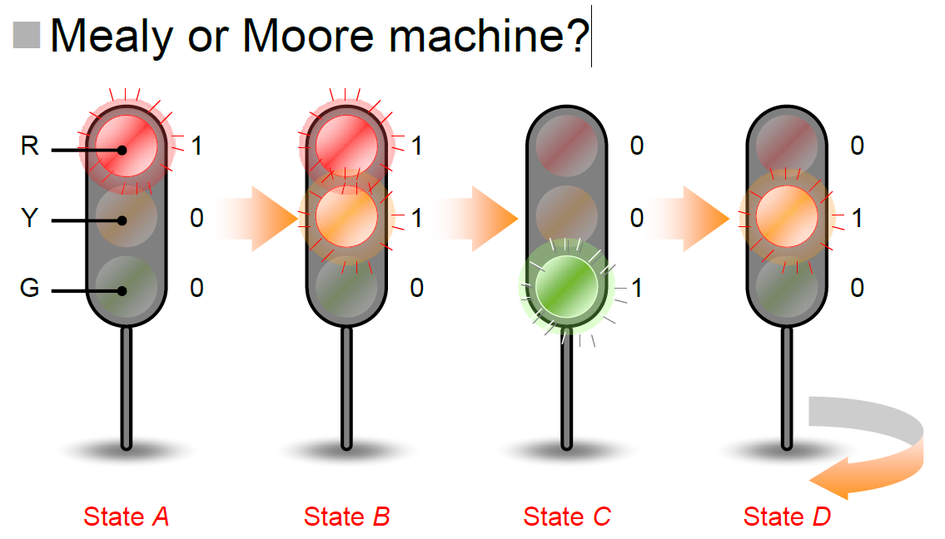
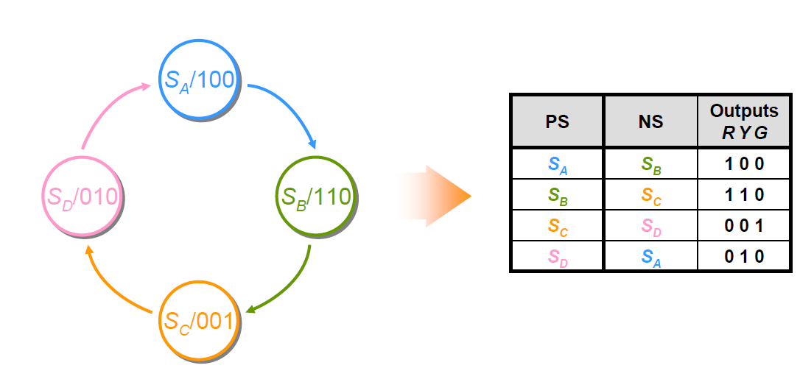
Traffic Light Circuit

Slide 21
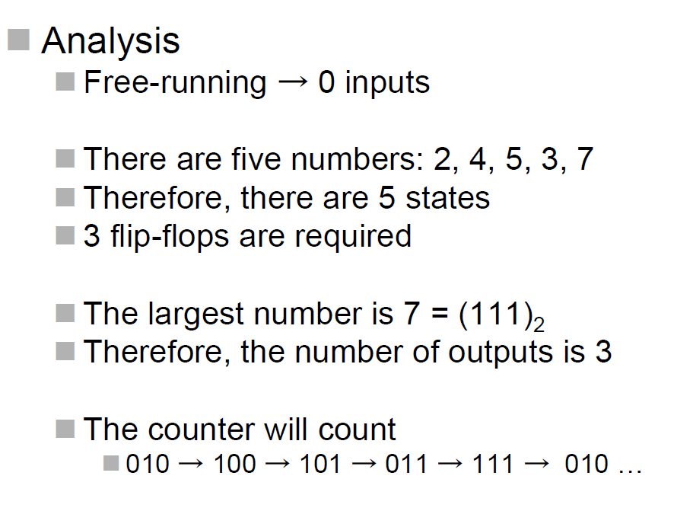
Design Example
Free-running Counter
Design a free-running counter with counting sequence 2, 4, 5, 3, 7, 2, …(and repeat) using D flip-flops

Slide 22
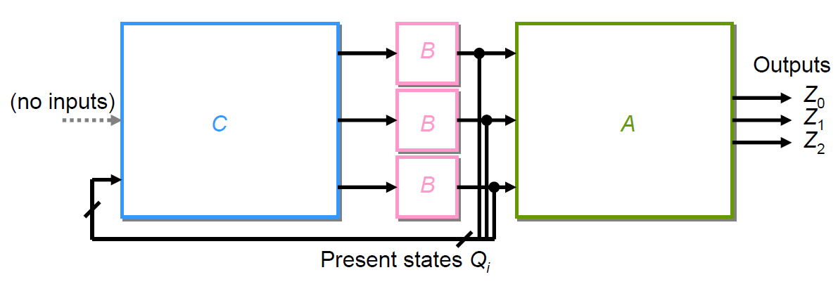
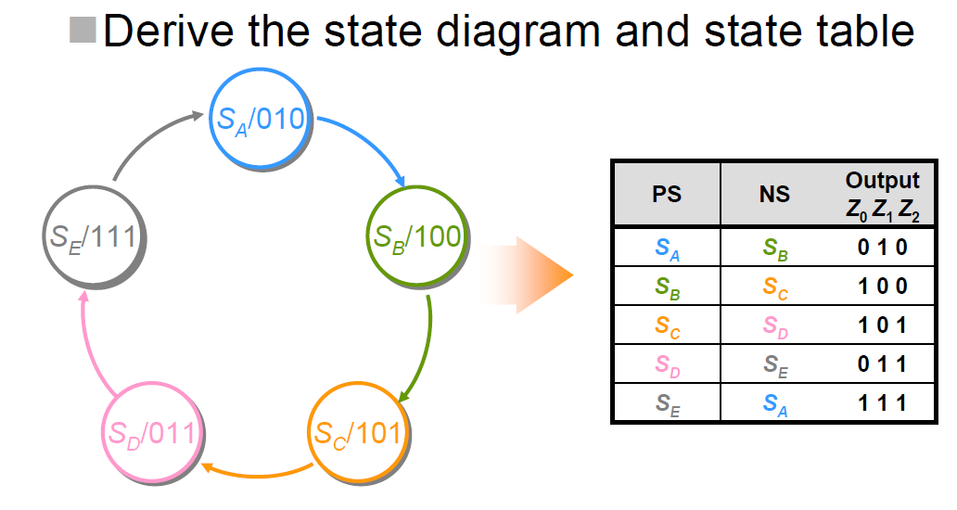
Free-running Counter
Moore Machine Structure
2, 4, 5, 3, 7, 2,

Slide 23
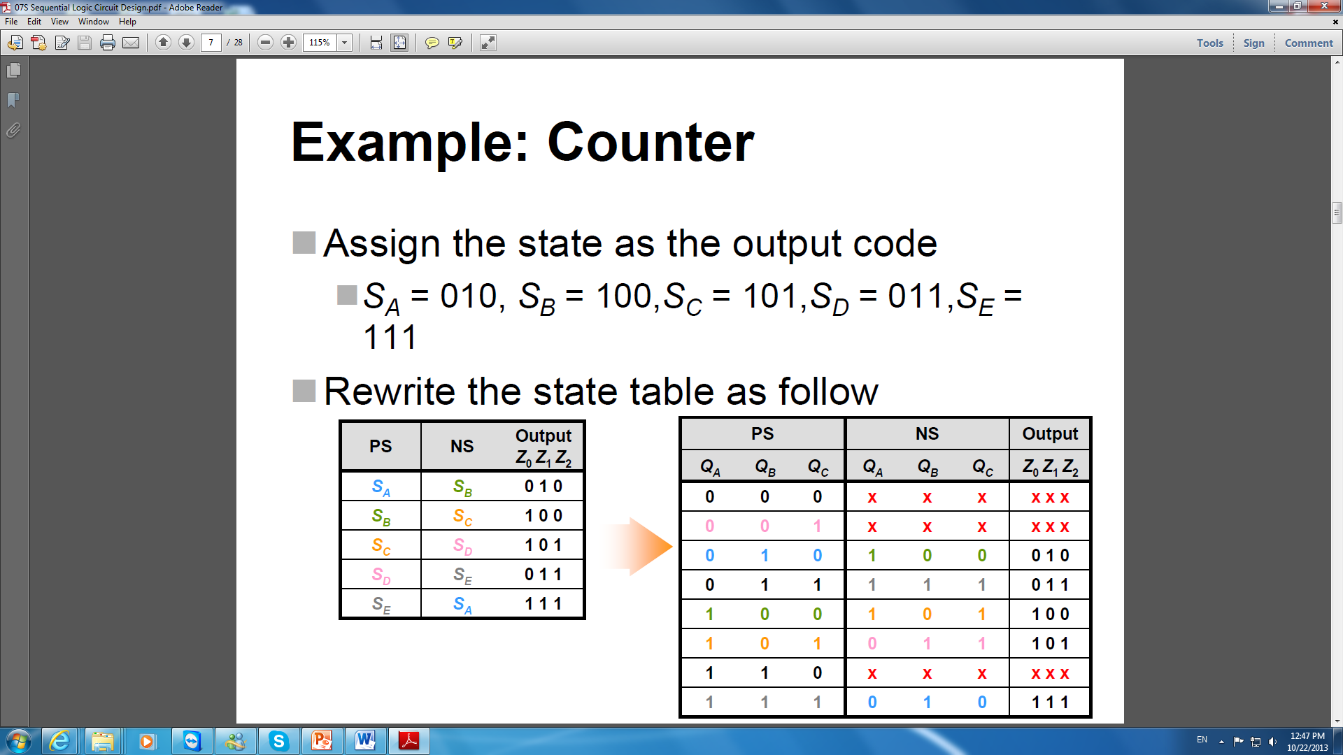
Free-running Counter

Slide 24
Free-running Counter

Slide 25
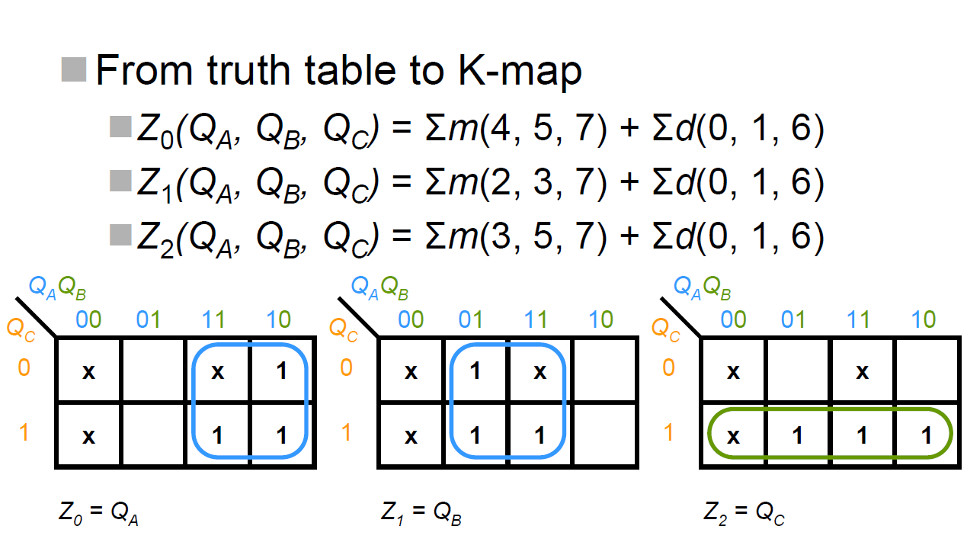
Free-running Counter

Slide 26
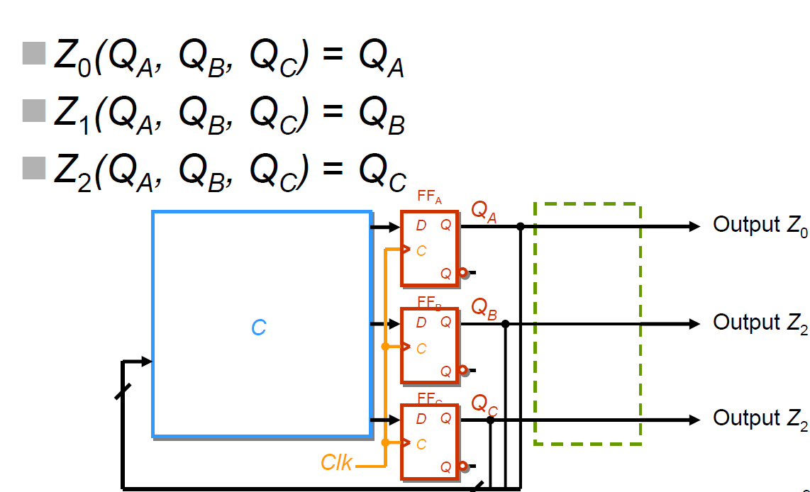
Free-running Counter
Z₁

Slide 27
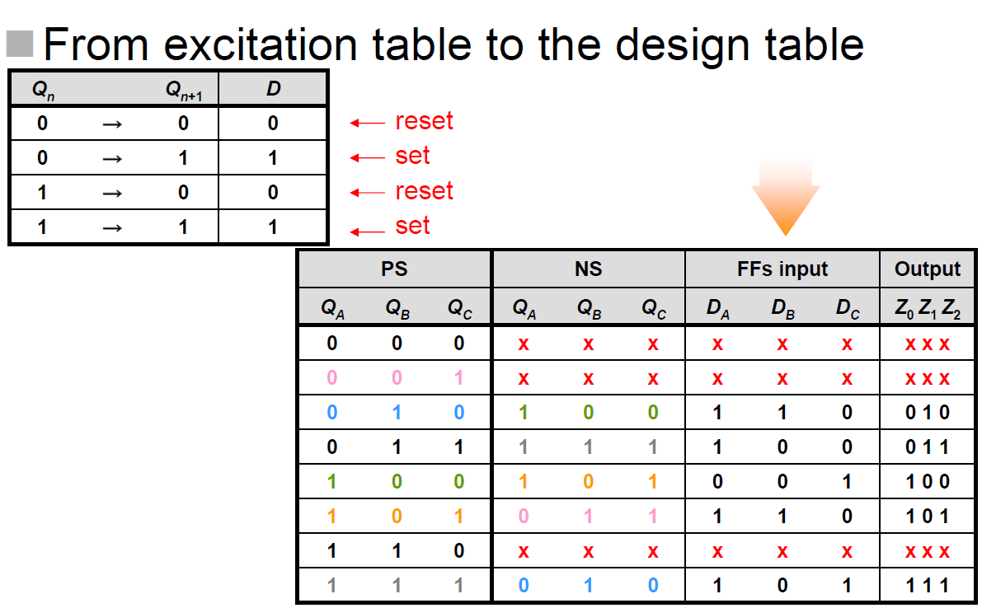
Free-running Counter
Verification required for bit checking!

Slide 28
Free-running Counter
Verification required for bit checking!
0
1
1
1
0
1
0
1
0

Slide 29
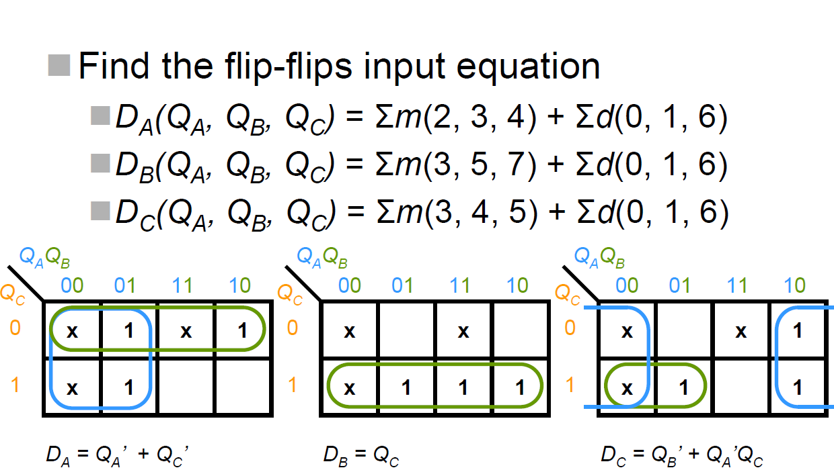
Free-running Counter

Slide 30
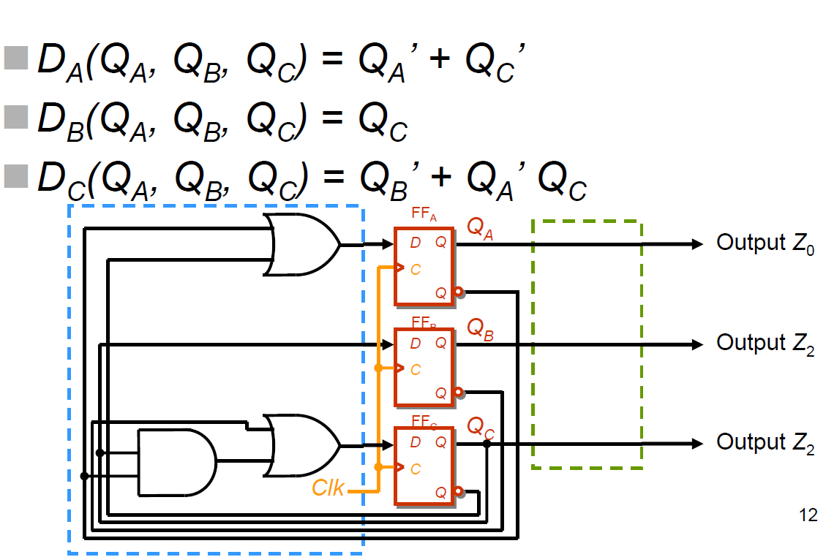
Free-running Counter
Z₁

Slide 31
7.2 Sequential Circuit Analysis
To analysis a sequential circuit
- To verify the circuit
- To determine its state model
- To obtain its state diagram
- To obtain its state table
- To obtain its state equation

Slide 32
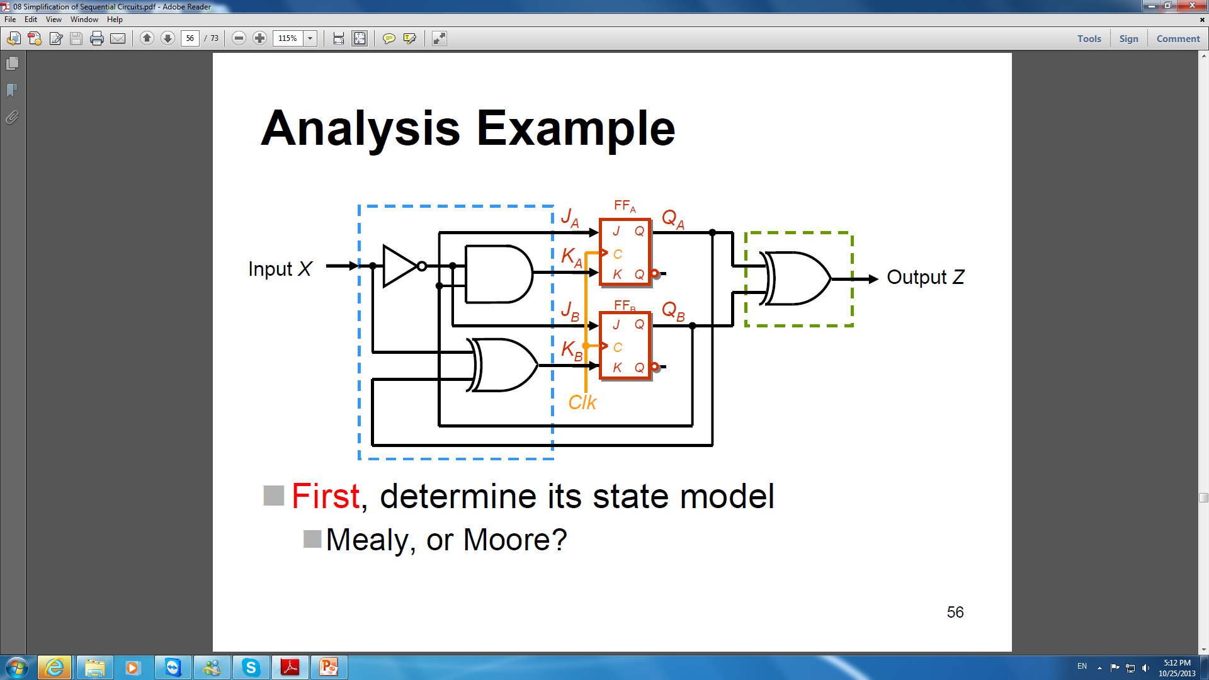
Analysis Example

Slide 33
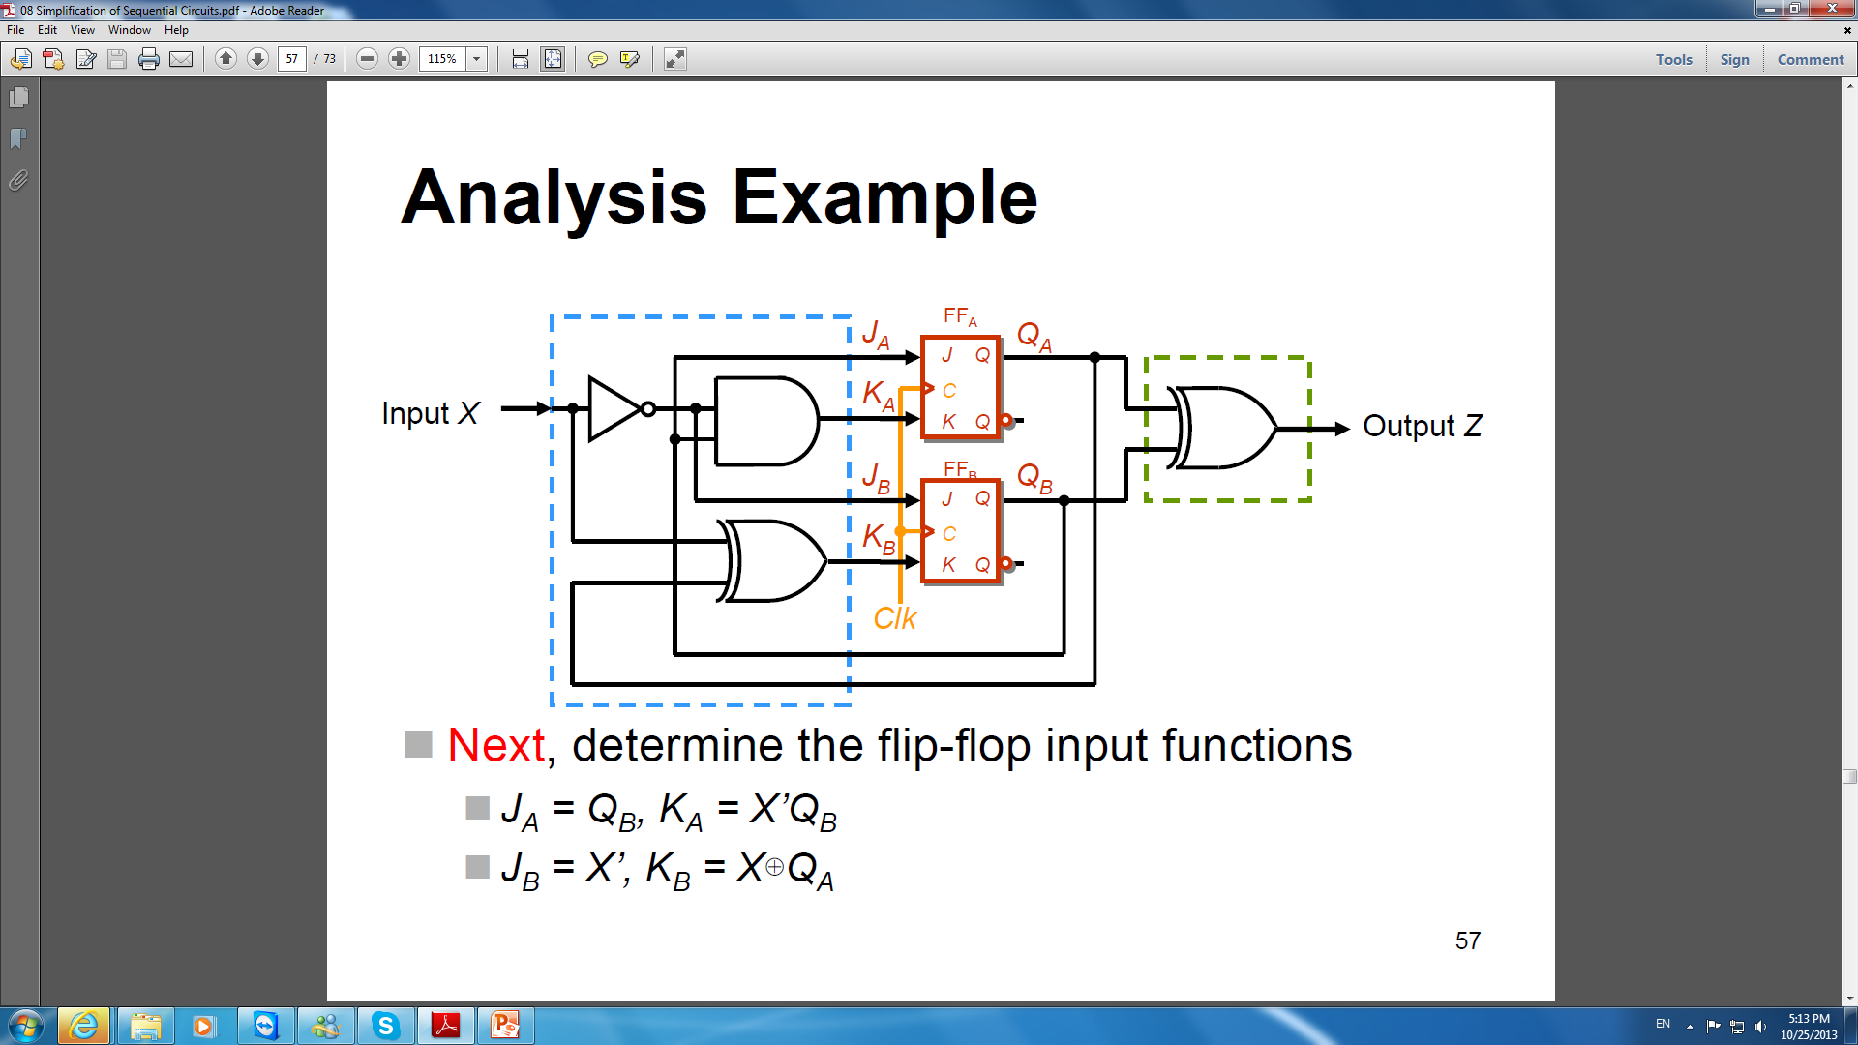
Analysis Example

Slide 34

Analysis Example

Slide 35


Write the Analysis Table

Slide 36
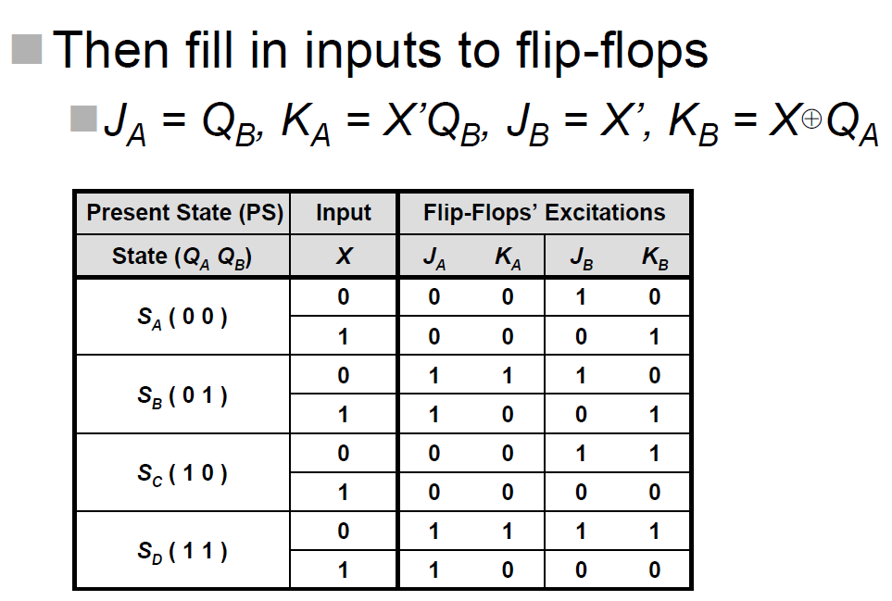
Write the Analysis Table

Slide 37
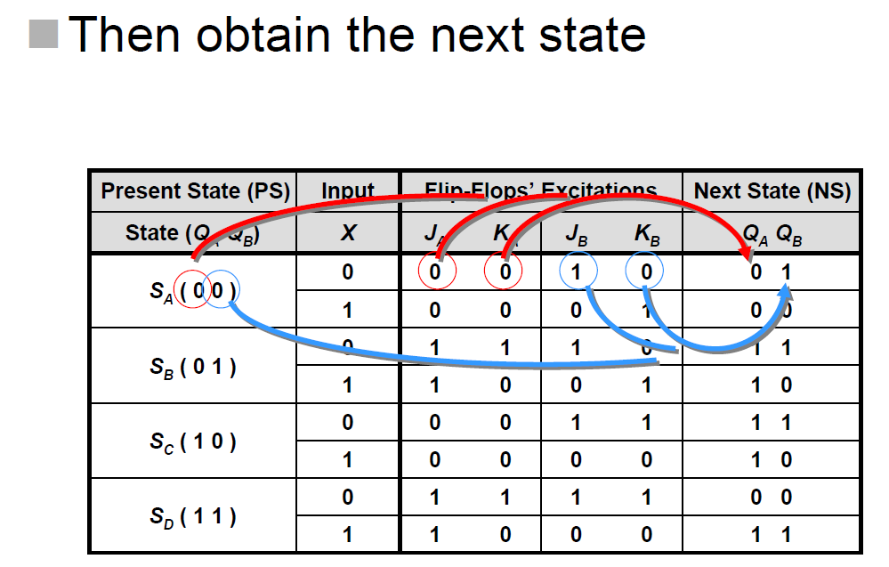
Write the Analysis Table

Slide 38
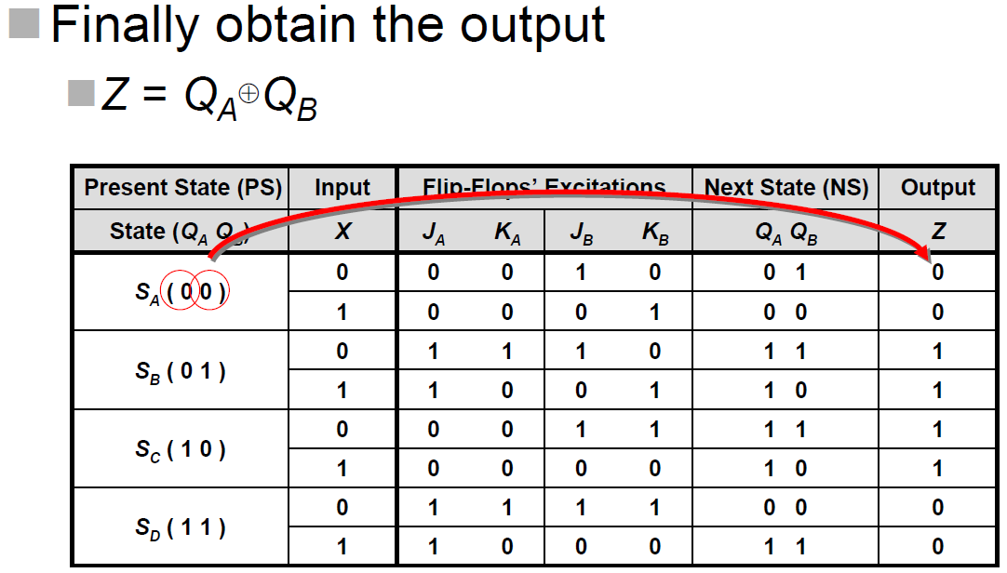
Write the Analysis Table

Slide 39
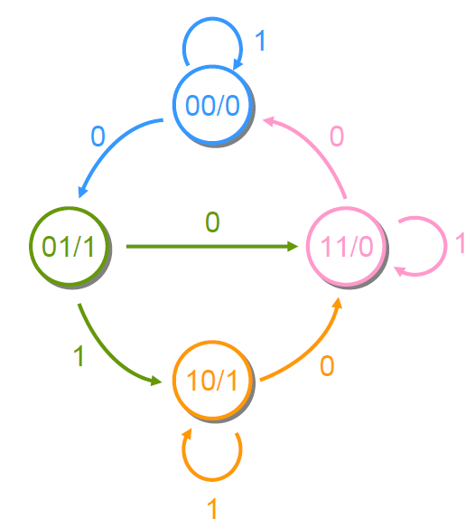
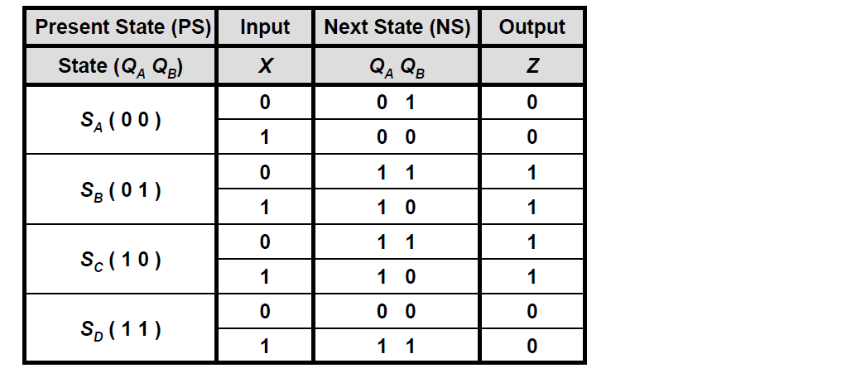
State Table and State Diagram

Slide 40
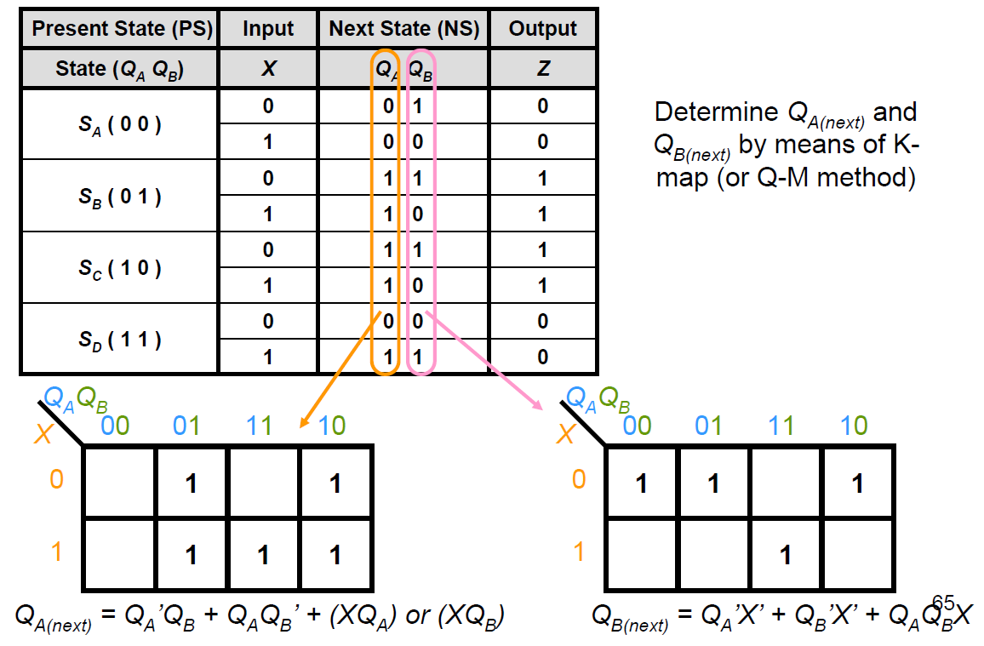
State Equation

