Slide 1
Lecture 7: Files and Hash Files
CS3402 Database Systems

Slide 2
Storage Medium for Databases
Memory hierarchy
  CPU cache > main memory > flash memory/Phase change memory > magnetic disks/optical disks
  Slower in access delay but larger in memory size (less expensive)
Primary storage (volatile)
  The storage media that can be operated directly by the CPU
  Include main memory and cache memory
Secondary and tertiary storage (non-volatile)
  Slower in access
  Include magnetic disks, optical disks and flash memory
A database could be huge in size (several hundred GB or even larger)
  Need to be resided in secondary/tertiary storage (non-volatile/persistent storage)

Slide 3
Disk Storage Devices (1/3)
Preferred secondary storage device for high storage capacity and low cost
Data are stored as magnetized areas on magnetic disk surfaces
A disk pack contains several magnetic disks connected to a rotating spindle
Disks are divided into concentric circular tracks on each disk surface
  Track capacities vary typically from 4 to 50 Kbytes or more
A track is divided into fixed size sectors and then into blocks
  Typical block sizes range from B=512 bytes to B=4096 bytes
  Whole blocks are transferred between disk and main memory for processing
Disk → Track → Sectors → Blocks

Slide 4
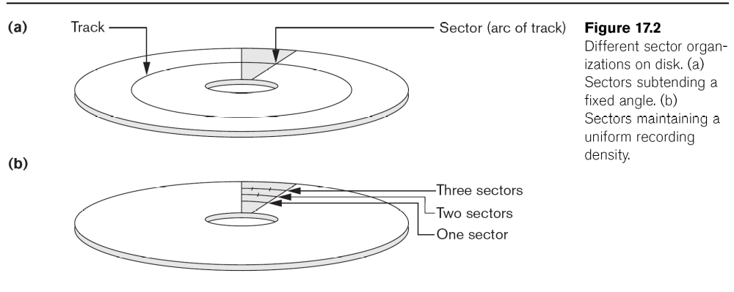
Disk Storage Devices (2/3)

Slide 5
Disk Storage Devices (3/3)
A read-write head moves to the track that contains the block to be transferred
  Disk rotation moves the block under the read-write head for reading or writing
To access a physical disk block:
  The identified track number (seek time, e.g., 3 to 8ms)
  The block number (within the cylinder) (rotational delay, e.g., 2ms)
  Get the block data (transfer delay)
Disk access delay = seek time + rotational delay + transfer delay
Reading or writing a disk block is time consuming because of the seek time and rotational delay (latency)
Double buffering can be used to speed up the transfer of contiguous disk blocks

Slide 6
Double Buffering (1/2)
Problem
  Have a file with a sequence of n blocks, B₁, B₂, …, B_{n}
  Have a program that processes B₁, B₂, …, B_{n}
  Let R be the time to read 1 block to buffer and P be the time to process 1 block
Single buffer solution
  Read B₁ to Buffer
  Process Data in Buffer
  Read B₂ to Buffer
  Process data in Buffer
  …
  Total time = n(R+P)
R B₁
P B₁
R B₂
P B₂
…
R B_{n}
P B_{n}
Time

Slide 7
Double Buffering (2/2)
Double buffer solution
  Read B₁ to Buffer
  Process Data in Buffer and Read B₂ to Buffer
  Read B₂ to Buffer and Read B₃ to buffer
  …
  Assume that P ≥ R
  Total time = R+nP
R B₂
R B₃
R B_{n}
R B₁
P B₁
P B₂
…
P B_{n}
Time

Slide 8
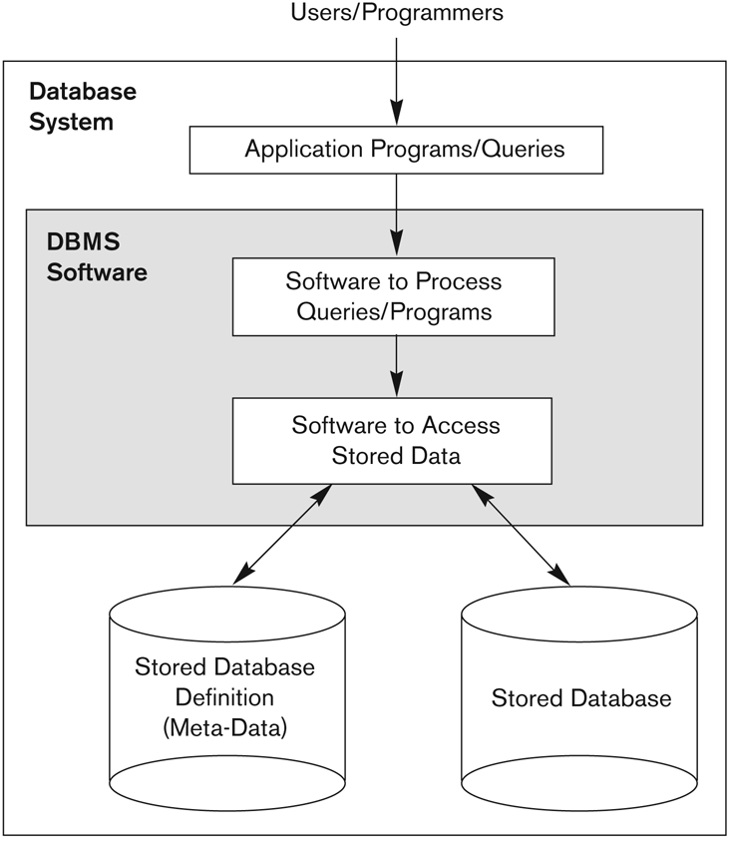
Simplified Database System Environment
DBMS is a collection of programs that enables users to create and maintain a database
DBMS is a general-purpose software that facilitates the process of defining constructing and manipulating databases for various applications
Database System = DBMS Software + Database

Slide 9
Database Records (1/2)
Database: data file (records) + meta-data
Fixed and variable length records
Records contain fields (attributes)
Fields may be fixed length or variable length (e.g., Varchar)
Variable length fields can be mixed into one record
  Separator characters or length fields are needed so that the record can be “parsed”

Slide 10
Database Records (2/2)

Slide 11
Database Records: Blocking
Refer to storing a number of records into one block on the disk
Blocking factor (bfr) refers to the number of records per block
There may be empty space in a block if an integral number of records do not fit into one block
Suppose the block size is B. For fixed-length records of size R with B>= R,
  Blocking factor (bfr) = B/R round down
  The unused space in each block = B – (bfr x R) bytes

Slide 12
Files of Records (1/3)
A file (e.g., table) is a sequence of records (e.g., tuples), where each record is a collection of data values (fields)
A file can have fixed-length records or variable-length records
A file descriptor (or file header) includes information that describes the file, such as the field names and their data types, and the addresses of the file blocks on disk
File records are stored on disk blocks

Slide 13
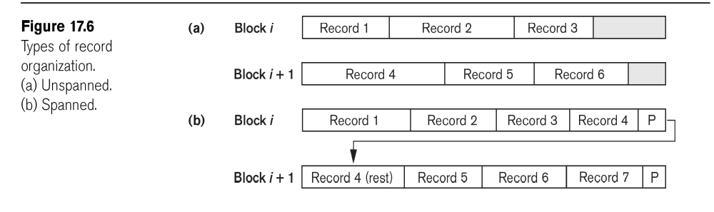
Files of Records (2/3)
The physical disk blocks that are allocated to hold the records of a file can be contiguous (one by one), linked (using pointers), or indexed (a table to describe their locations)
File records can be unspanned or spanned
  Unspanned: no record can span two blocks
  Spanned: a record can be stored in more than one block
Unspanned
Spanned

Slide 14
Files of Records (3/3)
In a file of fixed-length records, all records have the same format. Usually, unspanned blocking is use
Files of variable-length records require additional information to be stored in each record, such as separator characters
  Usually spanned blocking is used with such files

Slide 15
Typical Operations on Files (1/2)
OPEN: makes the file ready for access, and associates a pointer that will refer to a current file record at each point in time
FIND: searches for the first file record that satisfies a certain condition, and makes it the current file record
FINDNEXT: searches for the next file record (from the current record) that satisfies a certain condition, and makes it the current file record
READ: reads the current file record into a program variable
INSERT: inserts a new record into the file, and makes it the current file record

Slide 16
Typical Operations on Files (2/2)
DELETE: removes the current file record from the file, usually by marking the record to indicate that it is no longer valid
MODIFY: changes the values of some fields of the current file record
CLOSE: terminates access to the file
REORGANIZE: reorganizes the file records. For example, the records marked “deleted” are physically removed from the file or a new organization of the file records is created
READ_ORDERED: reads the file blocks in order of a specific field of the file

Slide 17
Unordered Files
Also called a heap file (records are unordered)
New records are inserted at the end of the file
  Arranged in their insertion sequence
A linear search through the file records is necessary to search for a record
  This requires reading and searching half the file blocks on average, and is hence quite expensive (i.e., n/2)
  Worst case, all records (i.e., n)
Record insertion is efficient (add to the end)
Reading the records in order of a particular field requires sorting the file records
9
16
50
2
10
4
8
12
60
100

Slide 18
Ordered Files (1/2)
Also called a sequential file (records are ordered)
File records are kept sorted by the values of an ordering field
Insertion is expensive: records must be inserted in the correct order
  It is common to keep a separate unordered overflow file for new records to improve insertion efficiency; this is periodically merged with the main ordered file
A binary search can be used to search for a record on its ordering field value
  This requires reading and searching log₂n of the file blocks on the average, an improvement over linear search
Reading the records in order of the ordering field is quite efficient
2
4
8
9
10
12
16
50
60
100

Slide 19
Ordered Files (2/2)
2
4
8
9
10
12
16
50
60
100
Ordered file
18
20
11
46
71
Unordered overflow buffer
Merge
2
4
8
9
10
11
12
16
18
20
46
50
60
71
100
Ordered file

Slide 20
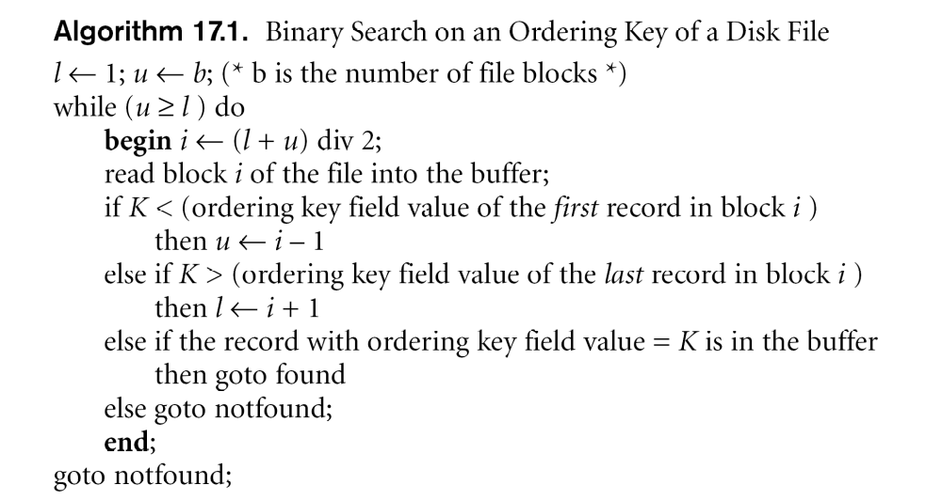
Binary Search

Slide 21
Binary Tree Data Structures
In a binary tree, every node has two links (pointers).
root
class TreeNode
{
private:
int info;
TreeNode* left;
TreeNode* right;
};
class Mytree
{
private:
TreeNode* root;
}
left
A
right
left
B
right
left
C
right
left
E
right
left
F
right
left
G
right
__
_
_
__
_
_
__
_
_
__
_
_
__
_
_
__
_
_
__
_
_

Slide 22
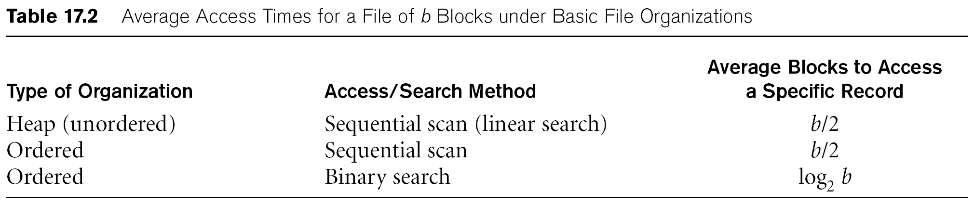
Average Access Times
The following table shows the average access time to access a specific record for a given type of file

Slide 23
Hashed Files (1/2)
Hashing for disk files is called External Hashing (files on disk)
The file blocks are divided into M equal-sized buckets, numbered bucket₀, bucket₁, ..., bucket_{M-1}
One of the file fields is designated to be the hash key of the file
Suppose there is a hash function that takes a hash key as an argument to compute an integer in the range 0 to B – 1 where B is the number of buckets
A bucket array (an array index) from 0 to B – 1 holds the headers of B lists, one for each bucket of the array
If a record has search key K, we store the record by linking it to the bucket list for the bucket numbered h(K) where h is the hash function
  h(K) → 0 to B – 1

Slide 24
Hashed Files (2/2)
Key value (k)
h(k) = k mod 4
4, 8
5, 13
2, 6,
10, 14
Bucket 0
Bucket 1
Bucket 2
Bucket 3

Slide 25
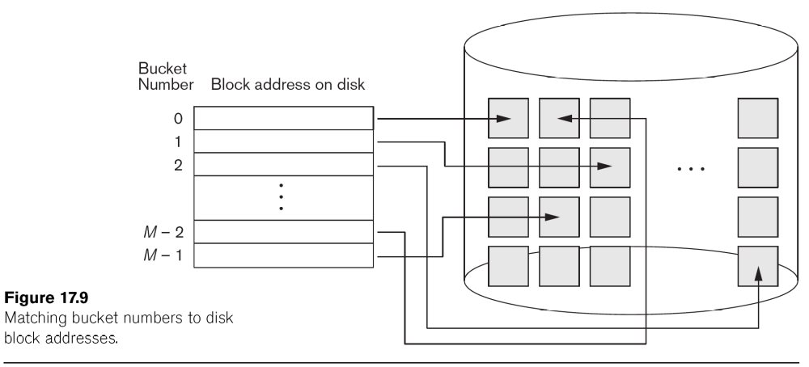
External Hashed Files

Slide 26
Example Hashed Tables
We assume a block can hold two records and B = 4, i.e., the hash function h returns values from 0 to 3
Suppose we add to the hash table a record with key g and h(g) = 1. Then we add the new record to the bucket numbered 1
Collisions occur when a new record hashes to a bucket that is already full
0 | d
1 | e
 | c
2 | b
3 | a
 | f

Slide 27
Hashed Files: Collision Resolution (1/4)
Open addressing: proceeding from the occupied position specified by the hash address, the program checks the subsequent positions in order until an unused (empty) position is found.
  Linear Probing: If collide, try Bucket_id+1, Bucket_id+2, …, Bucket_id+n
  Quadratic Probing: If collide, try Bucket_id+1, Bucket_id+4,…, Bucket_id+n²

Slide 28
Hashed Files: Collision Resolution (2/4)
Assume h(x)=x%10 (take the last digit), and every slot is a bucket
954,323
0
1
2
Full
Full
5
6
7
8
9
Linear Probing
954,323
0
1
2
Full
Full
5
6
7
8
9
Quadratic Probing

Slide 29
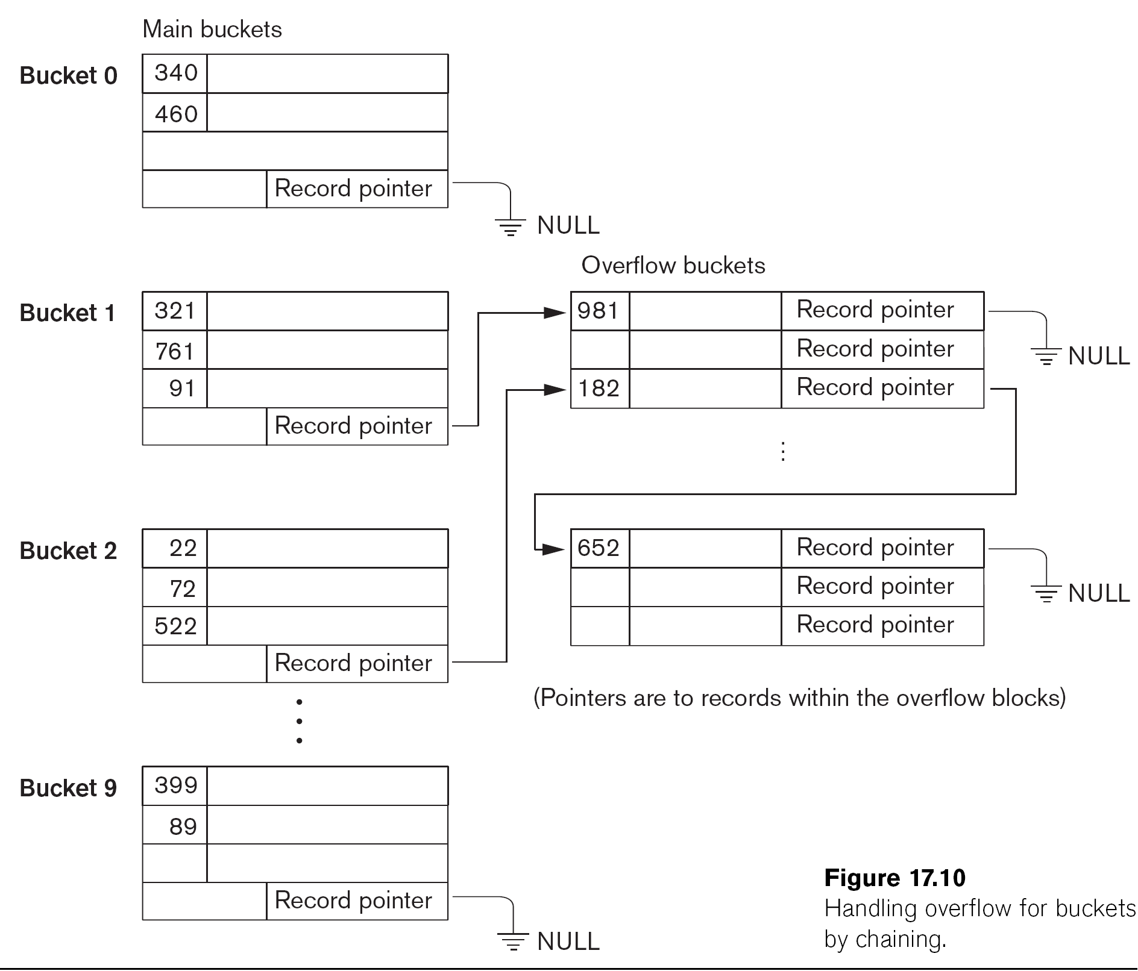
Hashed Files: Collision Resolution (3/4)
Chaining:
  For this method, various overflow locations are kept, usually by extending the array with a number of overflow positions
  In addition, a pointer field is added to each bucket
  A collision is resolved by placing the new record in an unused overflow bucket and setting the pointer of the occupied hash address bucket to the address of that overflow bucket

Slide 30
Hashed Files: Collision Resolution (4/4)
Multiple hashing:
  The program applies a second hash function if the first results in a collision
  If another collision results, the program uses open addressing or applies a third hash function and then uses open addressing if necessary

Slide 31
Hashed Files
To reduce the number of overflow, a hash file is typically kept 70-80% full
The hash function h should distribute the records uniformly among the buckets
  Otherwise, search time will be increased because many overflow records will exist
  Searching overflow records are more expensive
Main disadvantages of static external hashing:
  Fixed number of buckets M is a problem if the number of records in the file grows or shrinks
  Ordered access on the hash key is quite inefficient (requires sorting the records)

Slide 32
Extendible and Dynamic Hashing (1/2)
Dynamic and Extendible Hashing Techniques
  Hashing techniques are extended to allow dynamic growth and shrinking of the number of file records
  These techniques include the following: dynamic hashing and extendible hashing
Both dynamic and extendible hashing use the binary representation (e.g., 1100…) of the hash value h(K) in order to access a directory
  In dynamic hashing the directory is a binary tree
  In extendible hashing the directory is an array of size 2^{d} where d is called the global depth

Slide 33
Extendible and Dynamic Hashing (2/2)
The directories can be stored on disk, and they expand or shrink dynamically
  Directory entries point to the disk blocks that contain the stored records
An insertion in a disk block that is full causes the block to split into two blocks and the records are redistributed among the two blocks
  The directory is updated appropriately

Slide 34
Extendible Hashing (1/2)
A directory consisting of an array of 2^{d} bucket addresses is maintained
d is called the global depth of the directory
The integer value corresponding to the first (high-order) d bits of a hash value is used as an index to the array to determine a directory entry and the address in that entry determines the bucket storing the records
A location d’ (called, local depth stored with each bucket) specifies the number of bits on which the bucket contents are based
The value of d’ can be increased or decreased by one at a time to handle overflow or underflow respectively

Slide 35
Extendible Hashing (2/2)

Slide 36
Extendible Hashing Example (1/2)
Suppose d = 4, i.e., the hash function produces a sequence of four bits
At the moment, only one of these bits is used as illustrated by i = 1 (d’ = 1) in the box above the bucket array
The bucket array therefore has only two entries and points to two blocks
  The first holds all the current records whose search keys hash to a bit sequence beginning with 0
  The second holds all those whose search keys hash to a sequence beginning with 1
Suppose we insert a record whose key hash to the sequence 1010
Since the first bit is 1, it belongs in the second block
However, the second block is full. It needs to be split by setting d’ to 2

Slide 37
Extendible Hashing Example (2/2)
The two entries beginning with 0 each point to the block for records whose hashed keys begin with 0 and the block still has the integer 1 in its “nub” to indicate that only the first bit determines membership in the block
The blocks for records beginning with 1 needs to be split into 10 and 11
1
0001
1
0001
d’ = 1
d’ = 2
1001
2
0
1
00
01
10
11
1010
1
1101
1100
2
1100

Slide 38
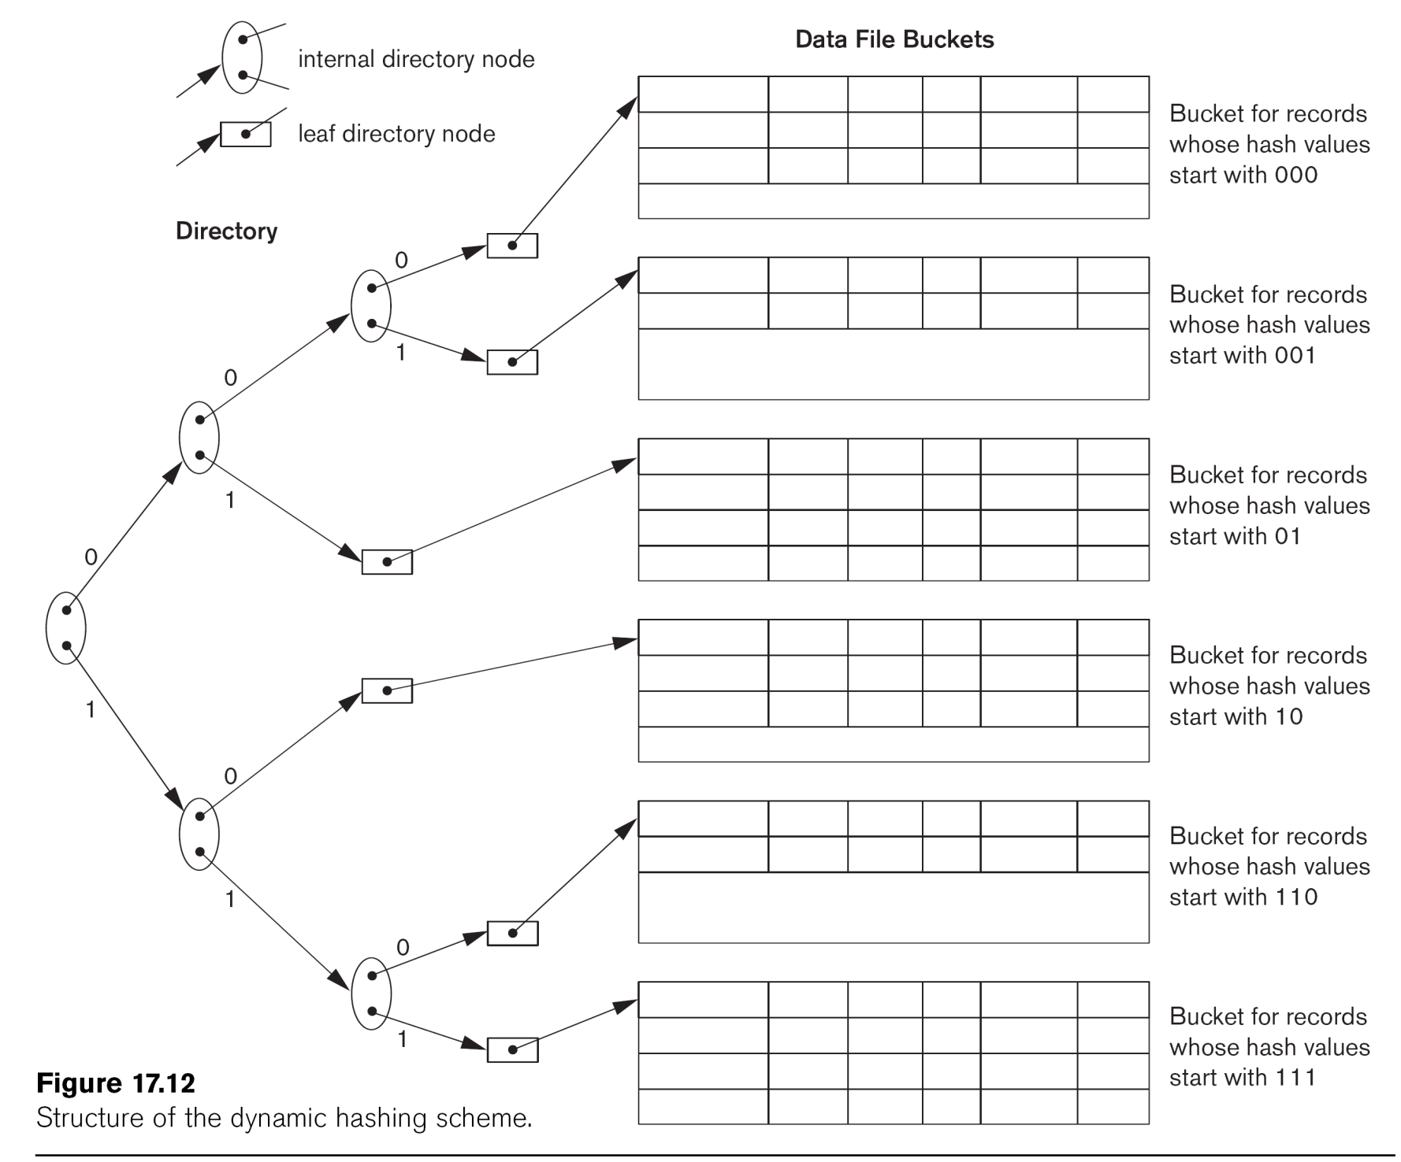
Dynamic Hashing
Dynamic and extendible hashing do not require an overflow area in general
Dynamic hashing maintains tree-structured directory with two types of nodes
  Internal nodes that have two pointers: the left pointer corresponding to the 0 bit (in the hash address) and a right pointer corresponding to the 1 bit
  Leaf nodes: these hold a pointer to the actual bucket with records

