Slide 1
EE3114 Systems and Control
Tutorial - 7
Semester B, 2018-19
2018-10-24

Slide 2
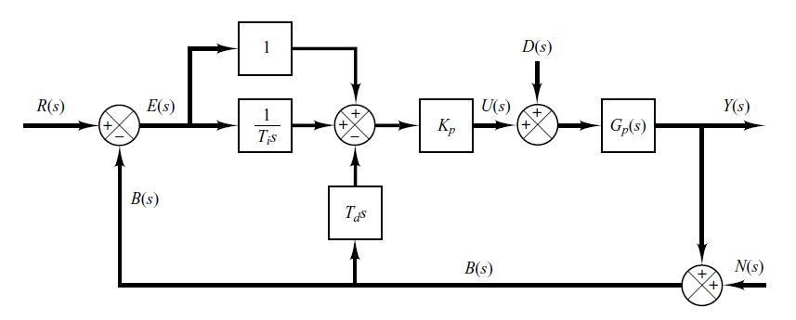
PI + D Control System
D(s) --- Disturbance to the plant
N(s) --- Noise to the measurement feedback

Slide 3
Let $N\left(s\right)=D(s)=0.$Find the Transfer Function $\frac{Y(s)}{R(s)}= ?$

Slide 4
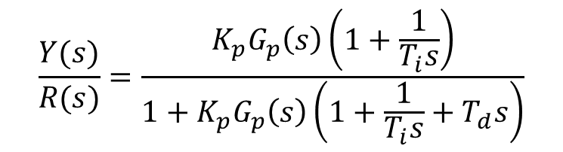
Let $N\left(s\right)=D\left(s\right)=0.$Find the Transfer Function $\frac{Y(s)}{R(s)}= ?$
Solution:
$$\frac{Y(s)}{R(s)}=\frac{K_{p}G_{p}\left(s\right)\left(1+\frac{1}{T_{i}s}\right)}{1+K_{p}G_{p}\left(s\right)\left(1+\frac{1}{T_{i}s}+T_{d}s\right)}$$

Slide 5
Disturbance Rejection

Slide 6
(i) Let N$\left(s\right)=R(s)=0.$Find the Transfer Function $\frac{Y(s)}{D(s)}= ?$
(5 minutes)

Slide 7
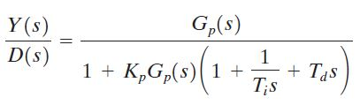
(i) Let N$\left(s\right)=R(s)=0.$Find the Transfer Function $\frac{Y(s)}{D(s)}= ?$
Solution:

Slide 8
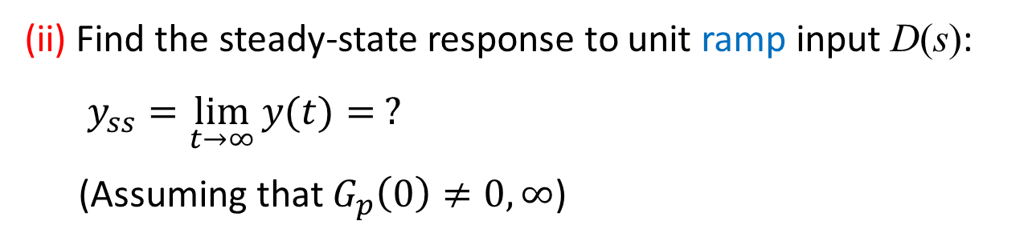
(ii) Find the steady-state response to unit ramp input D(s):
$y_{ss}=\lim_{t→∞}{y(t)}= ?$
(Assuming that $G_{p}\left(0\right)≠0,∞$)
(5 minutes)

Slide 9
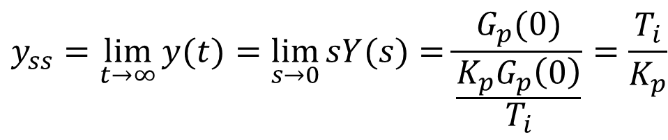
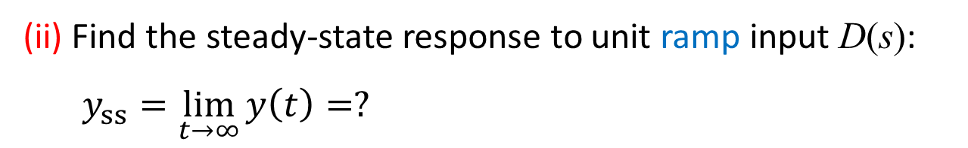
(ii) Find the steady-state response to unit ramp input D(s):
$y_{ss}=\lim_{t→∞}{y\left(t\right)=?}$
Solution:
$$\underset{ }{y_{ss}}{=\lim_{t→∞}{y(t)}=\lim_{s→0}{sY(s)}=\frac{G_{p}(0)}{\frac{K_{p}G_{p}\left(0\right)}{T_{i}}}=\frac{T_{i}}{K_{p}} }$$
(iii) Comment on the ability in disturbance rejection of
the PI+D controller (3 minutes)

Slide 10
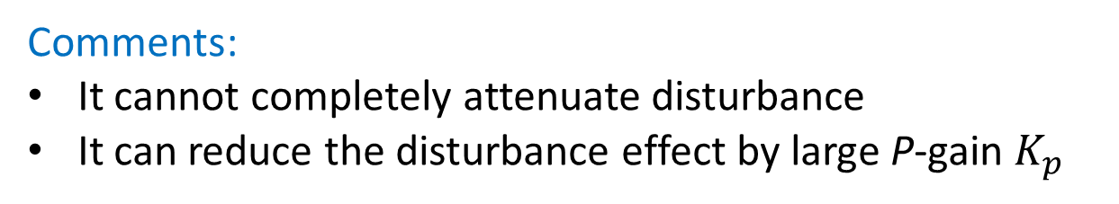
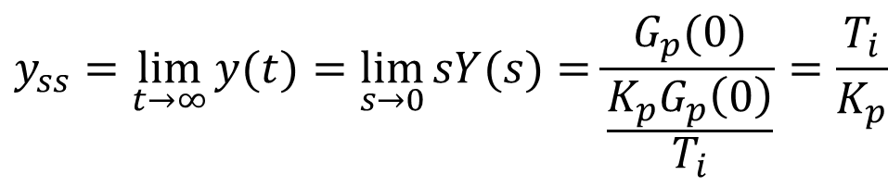

(ii) Find the steady-state response to unit ramp input D(s):
$y_{ss}=\lim_{t→∞}{y(t)}= ?$
$$\underset{ }{y_{ss}}{=\lim_{t→∞}{y(t)}=\lim_{s→0}{sY(s)}=\frac{G_{p}(0)}{\frac{K_{p}G_{p}\left(0\right)}{T_{i}}}=\frac{T_{i}}{K_{p}} }$$
Solution:
(iii) Comment on the ability in disturbance rejection of
the PI+D controller
Comments:
It cannot completely attenuate disturbance
It can reduce the disturbance effect by large P-gain $K_{p}$

Slide 11
Noise Rejection

Slide 12
(i) Let $D\left(s\right)=R(s)=0.$Find the Transfer Function $\frac{Y(s)}{N(s)}= ?$
(5 minutes)

Slide 13
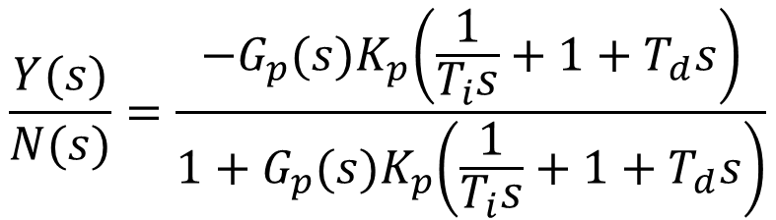
(i) Let $D\left(s\right)=R\left(s\right)=0.$Find the Transfer Function $\frac{Y(s)}{N(s)}= ?$
Solution:
$$\frac{Y(s)}{N(s)}=\frac{{−G}_{p}{(s)K}_{p}\left(\frac{1}{T_{i}s}+1+T_{d}s\right)}{1+G_{p}{(s)K}_{p}\left(\frac{1}{T_{i}s}+1+T_{d}s\right)}$$

Slide 14
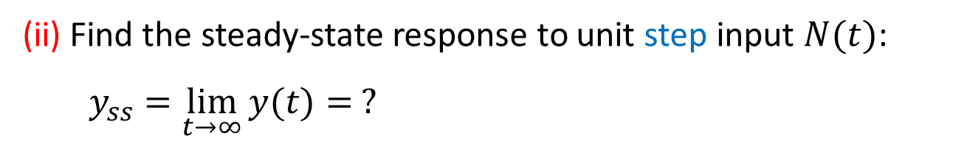
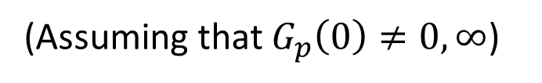
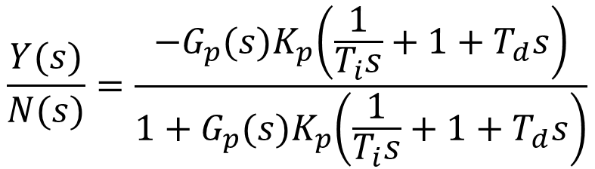
$$\frac{Y(s)}{N(s)}=\frac{{−G}_{p}{(s)K}_{p}\left(\frac{1}{T_{i}s}+1+T_{d}s\right)}{1+G_{p}{(s)K}_{p}\left(\frac{1}{T_{i}s}+1+T_{d}s\right)}$$
(ii) Find the steady-state response to unit step input $N(t)$:
$y_{ss}=\lim_{t→∞}{y(t)}= ?$
(5 minutes)
(Assuming that $G_{p}\left(0\right)≠0,∞$)

Slide 15
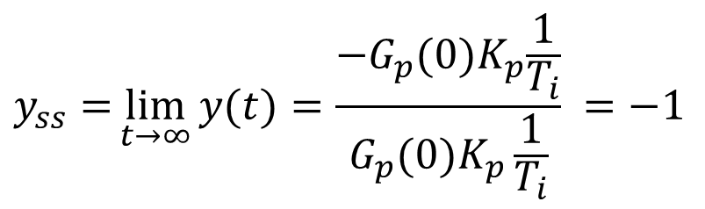
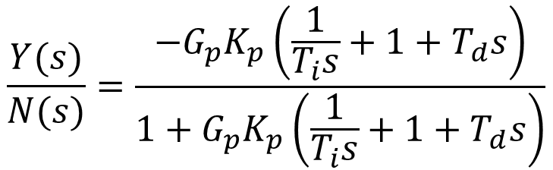
$$\frac{Y(s)}{N(s)}=\frac{−G_{p}K_{p}\left(\frac{1}{T_{i}s}+1+T_{d}s\right)}{1+G_{p}K_{p}\left(\frac{1}{T_{i}s}+1+T_{d}s\right)}$$
(ii) Find the steady-state response to unit step input $N(t)$:
$y_{ss}=\lim_{t→∞}{y(t)}= ?$
$$y_{ss}={\lim_{t→∞}{y(t)}=\frac{{−G}_{p}{(0)K}_{p}\frac{1}{T_{i}}}{G_{p}(0)K_{p}\frac{1}{T_{i}}} =−1}$$
Solution:
(iii) Comment on the ability in noise rejection (filtering) of
the PI+D controller (3 minutes)

Slide 16
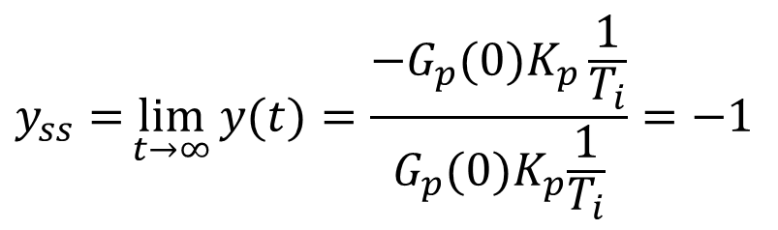
$$\frac{Y(s)}{N(s)}=\frac{{−G}_{p}K_{p}\left(\frac{1}{T_{i}s}+1+T_{d}s\right)}{1+G_{p}K_{p}\left(\frac{1}{T_{i}s}+1+T_{d}s\right)}$$
(ii) Find the steady-state response to unit step input $N(t)$:
$y_{ss}=\lim_{t→∞}{y(t)}= ?$
$$y_{ss}={\lim_{t→∞}{y(t)}=\frac{{−G}_{p}(0)K_{p}\frac{1}{T_{i}}}{G_{p}{(0)K}_{p}\frac{1}{T_{i}}}=−1}$$
Solution:
(iii) Comment on the ability in noise rejection (filtering) of
the PI+D controller
Comments:
PI+D controller has no effect on step noise input

Slide 17
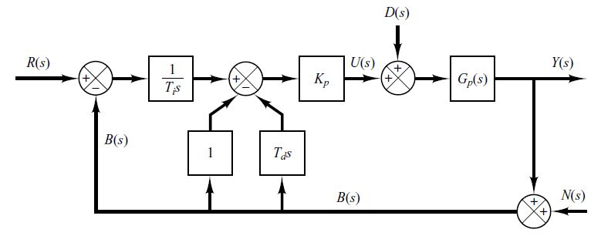
I + PD Control System
D(s) --- Disturbance to the plant
N(s) --- Noise to the measurement feedback

Slide 18
Let $N\left(s\right)=D(s)=0.$Find the Transfer Function $\frac{Y(s)}{R(s)}= ?$

Slide 19
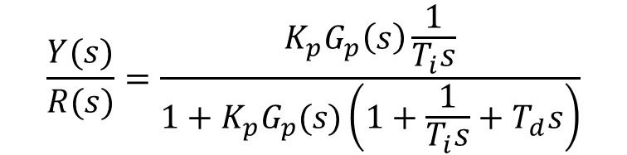
Let $N\left(s\right)=D(s)=0.$Find the Transfer Function $\frac{Y(s)}{R(s)}= ?$
Solution:
$$\frac{Y(s)}{R(s)}=\frac{K_{p}G_{p}\left(s\right)\frac{1}{T_{i}s}}{1+K_{p}G_{p}(s)\left(1+\frac{1}{T_{i}s}+T_{d}s\right)}$$

Slide 20
Disturbance Rejection

Slide 21
(i) Let $N\left(s\right)=R(s)=0.$Find the Transfer Function $\frac{Y(s)}{D(s)}= ?$
(5 minutes)

Slide 22
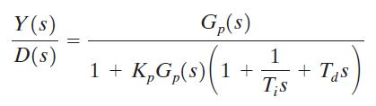
(i) Let $N\left(s\right)=R(s)=0.$Find the Transfer Function $\frac{Y(s)}{D(s)}= ?$
Solution:

Slide 23
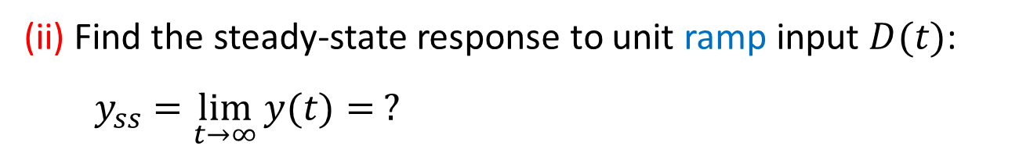

(ii) Find the steady-state response to unit ramp input $D(t)$:
$y_{ss}=\lim_{t→∞}{y(t)}= ?$
(5 minutes)
(Assuming that $G_{p}\left(0\right)≠0,∞$)

Slide 24
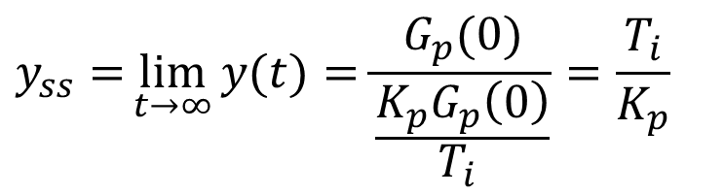
(ii) Find the steady-state response to unit ramp input $D(t)$:
$y_{ss}=\lim_{t→∞}{y(t)}= ?$
$$y_{ss}={\lim_{t→∞}{y(t)}=\frac{G_{p}(0)}{\frac{K_{p}G_{p}\left(0\right)}{T_{i} }}=\frac{T_{i}}{K_{p}}}$$
Solution:
(iii) Comment on the ability in disturbance rejection of
the I+PD controller (3 minutes)

Slide 25
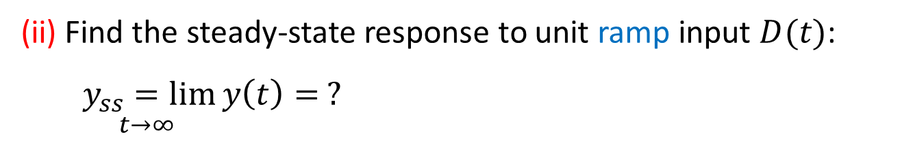
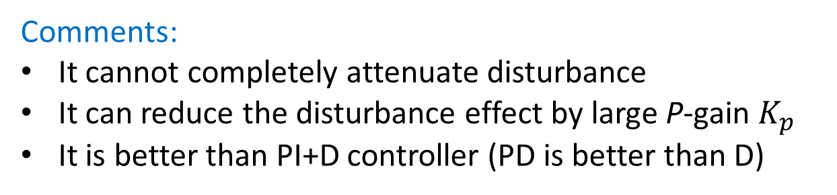
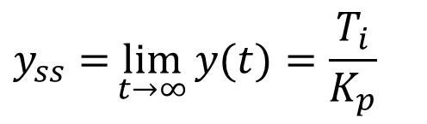
(ii) Find the steady-state response to unit ramp input $D(t)$:
$\underset{t→∞ }{y_{ss}=lim}{y\left(t\right)= ?}$
Solution:
$$y_{ss}={\lim_{t→∞}{y(t)}=\frac{T_{i}}{K_{p}}}$$
(iii) Comment on the ability in disturbance rejection of
the I+PD controller
Comments:
It cannot completely attenuate disturbance
It can reduce the disturbance effect by large P-gain $K_{p}$
It is better than PI+D controller (PD is better than D)

Slide 26
Noise Rejection

Slide 27
(i) Let D$\left(s\right)=R(s)=0.$Find the Transfer Function $\frac{Y(s)}{N(s)}= ?$
(5 minutes)

Slide 28
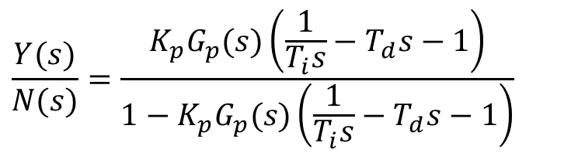
(i) Let D$\left(s\right)=R(s)=0.$Find the Transfer Function $\frac{Y(s)}{N(s)}= ?$
Solution:
$$\frac{Y(s)}{N(s)}=\frac{K_{p}G_{p}(s)\left(\frac{1}{T_{i}s}−T_{d}s−1\right)}{1−K_{p}G_{p}(s)\left(\frac{1}{T_{i}s}−T_{d}s−1\right)}$$

Slide 29
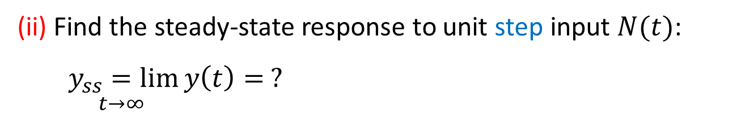

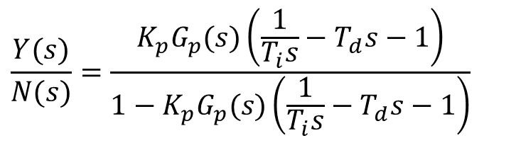
$$\frac{Y(s)}{N(s)}=\frac{K_{p}G_{p}(s)\left(\frac{1}{T_{i}s}−T_{d}s−1\right)}{1−K_{p}G_{p}(s)\left(\frac{1}{T_{i}s}−T_{d}s−1\right)}$$
(ii) Find the steady-state response to unit step input $N(t)$:
$\underset{t→∞ }{y_{ss}=lim}{y\left(t\right)= ?}$
(5 minutes)
(Assuming that $G_{p}\left(0\right)≠0,∞$)

Slide 30

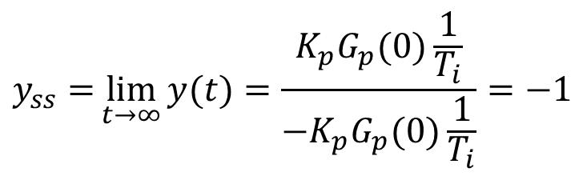
$$\frac{Y(s)}{N(s)}=\frac{K_{p}G_{p}(s)\left(\frac{1}{T_{i}s}−T_{d}s−1\right)}{1−K_{p}G_{p}(s)\left(\frac{1}{T_{i}s}−T_{d}s−1\right)}$$
(ii) Find the steady-state response to unit step input $N(t)$:
$y_{ss}=\lim_{t→∞}{y(t)}= ?$
$$y_{ss}={\lim_{t→∞}{y(t)}=\frac{K_{p}G_{p}(0)\frac{1}{T_{i}}}{−K_{p}G_{p}(0)\frac{1}{T_{i}}}=−1}$$
Solution:
(iii) Comment on the ability in noise rejection of
the I+PD controller
(3 minutes)

Slide 31
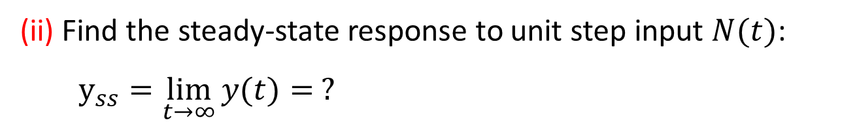
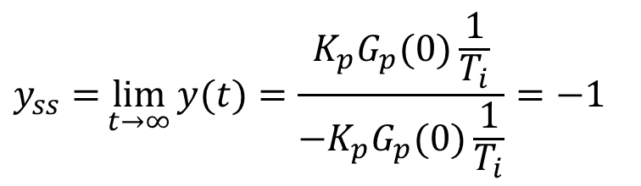
$$\frac{Y(s)}{N(s)}=\frac{K_{p}G_{p}(s)\left(\frac{1}{T_{i}s}−T_{d}s−1\right)}{1−K_{p}G_{p}(s)\left(\frac{1}{T_{i}s}−T_{d}s−1\right)}$$
(ii) Find the steady-state response to unit step input $N(t)$:
$y_{ss}=\lim_{t→∞}{y(t)}= ?$
$$y_{ss}={\lim_{t→∞}{y(t)}=\frac{K_{p}G_{p}(0)\frac{1}{T_{i}}}{−K_{p}G_{p}(0)\frac{1}{T_{i}}}=−1}$$
Solution:
(iii) Comment on the ability in noise rejection of
the I+PD controller
Comments:
It has no effect on step noise input
It is similar to the PI+D controller

Slide 32
END

