Slide 1
EE3122: Analogue Circuit Fundamentals
Oscillator
Department of Electrical Engineering
City University of Hong Kong
Prof. Arindam BASU

Slide 2
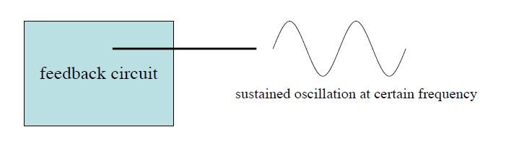
Stability of Feedback Systems
A feedback system is said to be stable if it does not oscillate by itself at any frequency under a given circuit condition.
The issue of stability can be investigated in terms of the possibility of sustained oscillation.

Slide 3
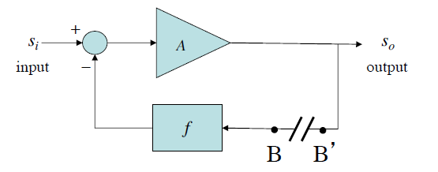

Why and How does it Oscillate?
The feedback system oscillates because of the simple fact that it has a closed loop in which signals can combine constructively.
If no input signal:
Signal at B, as it goes around the loop, will be multiplied by f and A, and also –1.

Slide 4
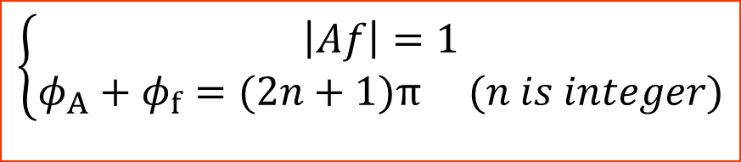

Why and How does it Oscillate?
if S_{B’} and S_{B} are same in magnitude and have a 360º phase difference, then the closed loop will oscillate by itself.
Oscillation criteria (Barkhausen criteria):
$$\left\{\begin{aligned}\left|Af\right|=1 \\ φ_{A}+φ_{f}=(2n+1)\text{π} (n is integer)\end{aligned}\right.$$
$$Af＝−1$$
If the signal, after making a round trip through A and f, has a gain of 1 and a phase shift of exactly 360º, then it oscillates.
But, in the negative feedback system, there is already a 180º phase shift.
Therefore, the phase shift caused by A and f together will only need to be 180º (or (2n+1)* 180º) to cause oscillation.

Slide 5
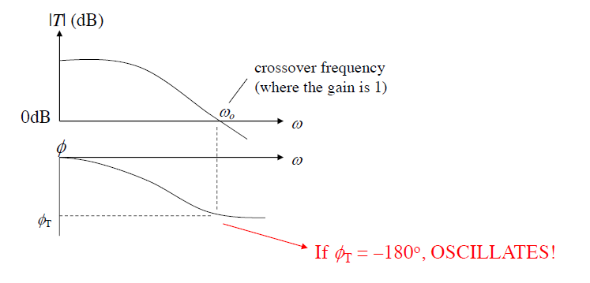
Loop Gain & Stability Criteria
An important parameter to test stability is the loop gain, usually denoted by T (T = Af).

Slide 6

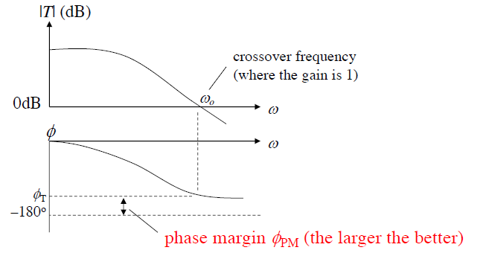
Phase Margin
Phase margin is an important parameter to evaluate how stable the system is.

Slide 7
Oscillation
In designing feedback amplifiers, we want to make sure that oscillation does not occur, that is, we want stable operation.
However, oscillation is needed to make an oscillator.
The same feedback structure can be used to make an oscillator. In other words, we construct a feedback amplifier, but try to make it satisfy the Barkhausen criteria.
In practice, T is a function of frequency, and the Barkhausen criteria is satisfied for one particular frequency. This frequency is the oscillation frequency.

Slide 8
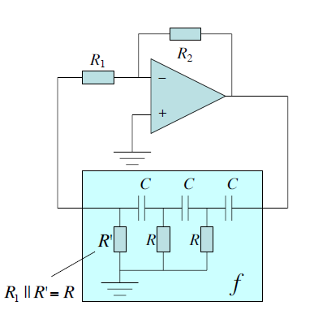
Phase Shift Oscillator
The phase-shift network consisting of resistors and capacitors in a ladder network.
The feedback network 'shifts' the phase of the amplifier output by 180 degrees at the oscillation frequency to give positive feedback.
Phase-shift oscillators are often used at audio frequency as audio oscillators.

Slide 9
Appendix

Slide 10
Sustained oscillation (Self-oscillation)
There are two problems!
  How does oscillation start? Noise!
  How can oscillation be maintained? If | T | is slightly bigger than 1, oscillation amplitude will grow and go to infinity. But if | T | is slightly less than 1, oscillation subsides.

Slide 11





Sustained oscillation (Self-oscillation)
We need a control that changes | T | continuously. Typically, this is done by a nonlinear amplitude stabilizing circuit, for example, an amplifier whose gain drops when its output increases, and rises when its output decreases.

