Slide 1
EE 3114 Systems and Control
8. State-Space Modeling
Semester B, 2018-19

Slide 2
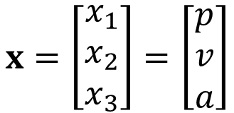
State-Space Representation
Dynamical Relationship
A state is a set of internal variables that define completely the dynamical behavior of the system
For example, the states of a moving object include:
Position
Velocity
Acceleration
$$x=\left[\begin{matrix}x_{1} \\ x_{2} \\ x_{3}\end{matrix}\right]=\left[\begin{matrix}p \\ v \\ a\end{matrix}\right]$$
State vector State variables (components)

Slide 3
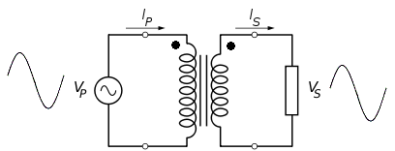
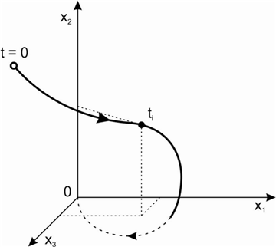
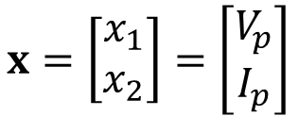
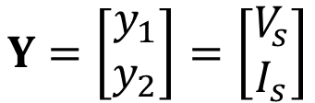
Another example, the states of a transformer:
Voltage
Current
$$x=\left[\begin{matrix}x_{1} \\ x_{2}\end{matrix}\right]=\left[\begin{matrix}V_{p} \\ I_{p}\end{matrix}\right]$$
$$Y=\left[\begin{matrix}y_{1} \\ y_{2}\end{matrix}\right]=\left[\begin{matrix}V_{s} \\ I_{s}\end{matrix}\right]$$
State vector State variables
State and
State Space

Slide 4
Formal Definition of “State”
Definition: A state of a dynamic system is a set of variables which, if specified at the time t = t₀, provide all the necessary information to find the behavior of the output at any time t > t₀, given the input to the system on interval [t₀, t).
Note:
The input-output relationship is unique
But a definition of the state is not unique

Slide 5
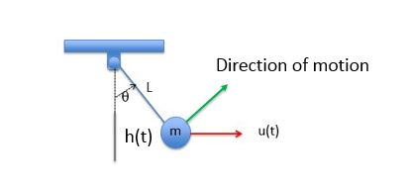
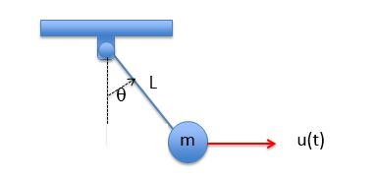


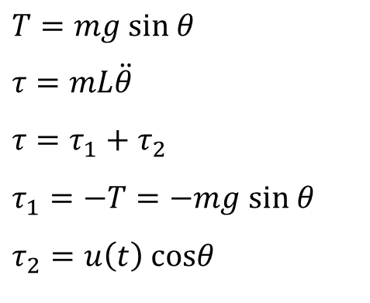


Example: Pendulum
Mass: m
Input: force u(t)
Output: horizontal displacement h(t) (measurement)
Direction of motion
$$τ$$
$$T=mg sin θ$$
$$τ=mL\ddot{θ}$$
$$τ=τ_{1}+τ_{2}$$
$$τ_{1}=−T=−mg sin θ$$
$$τ_{2}=u\left(t\right) cosθ$$
h(t)
$$θ$$
T
$$mg$$
$$mL\ddot{θ}=−mg sinθ+u cosθ$$

Slide 6
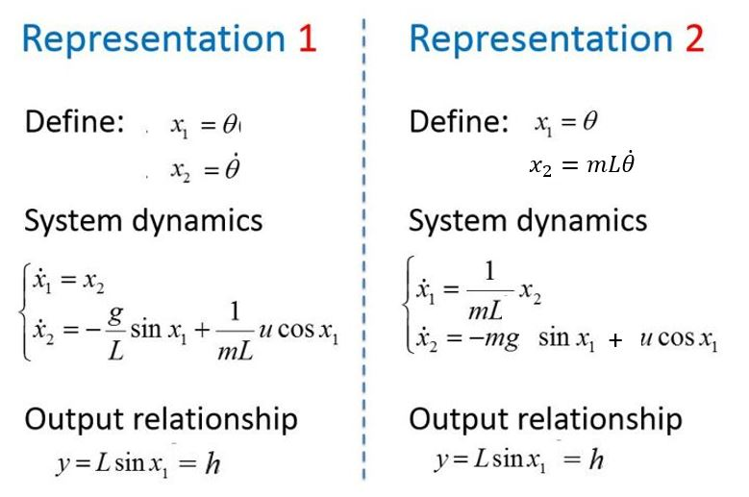

$$mL\ddot{θ}=−mg sinθ+u cosθ$$
(Not unique)

Slide 7
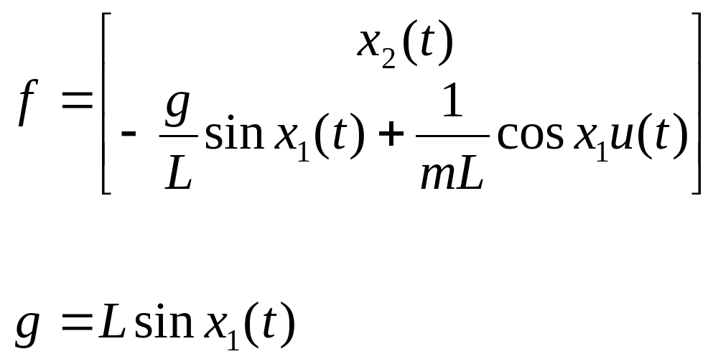
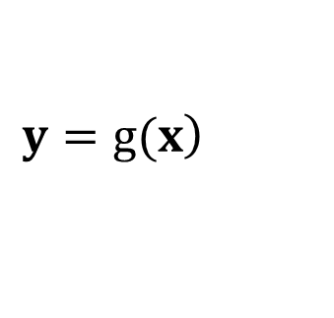

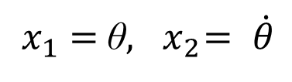
Pendulum: Representation 1
$$\dot{x}=f(x,u)$$
$$\left.y=g(x\right)$$
$x_{1}=$θ$, { x}_{2}= \dot{θ}$
h(t)
Notes:
NONLINEAR!

Slide 8
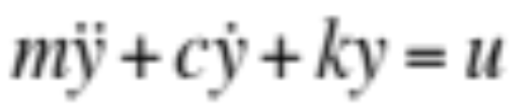
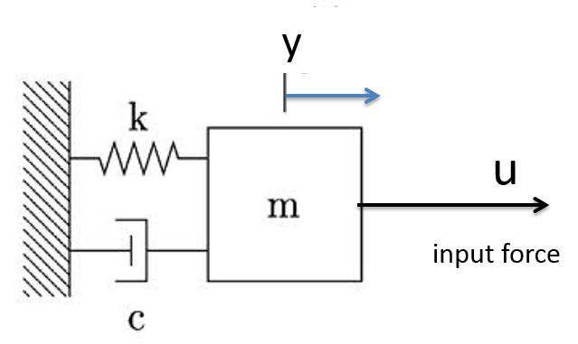
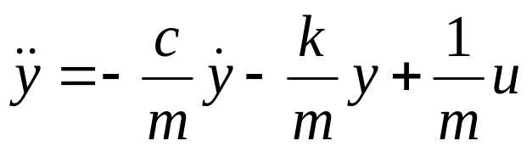
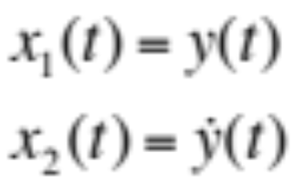
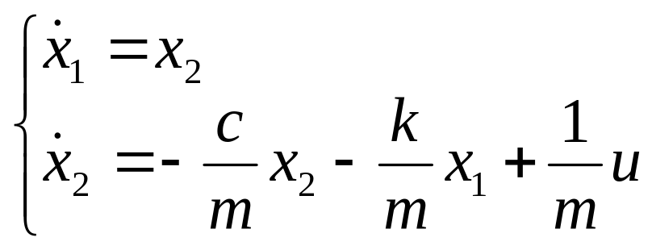
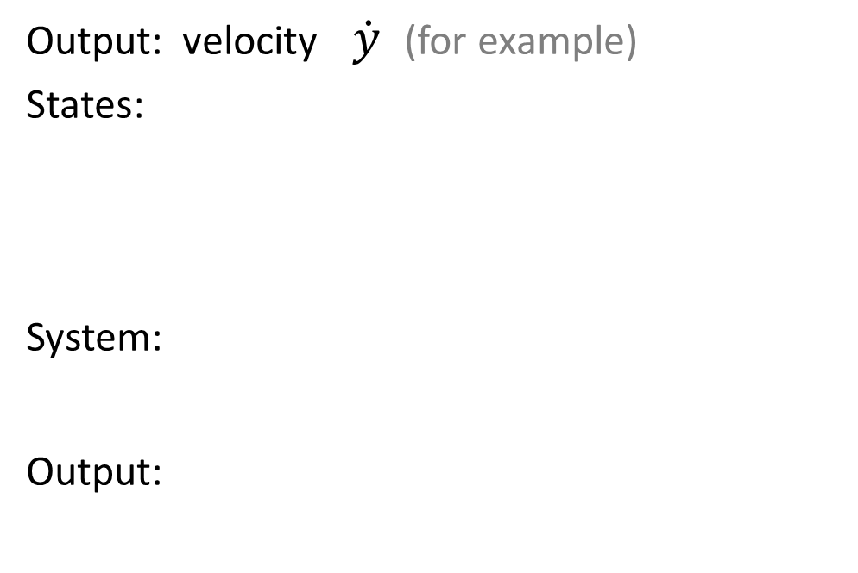

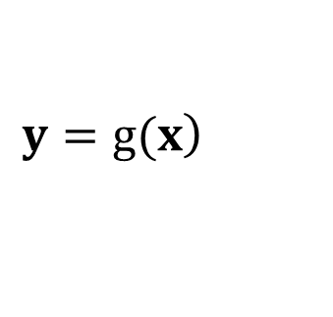

Example: Mass-Spring-Damper System
Output: velocity $\dot{y}$ (for example)
States:
System:
Output:
Displacement
Velocity
$$\dot{x}=f(x,u)$$
$$\left.y=g(x\right)$$
$z$ $=\dot{y}=x_{2}$
Output State

Slide 9
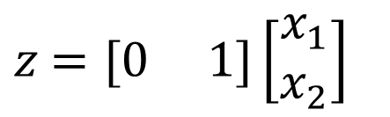
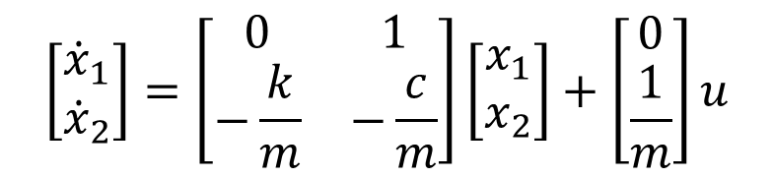
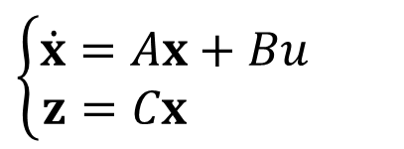

State Space Formulation
$z$ $=\dot{y}=x_{2}$
$$\left\{\begin{aligned}\dot{x}=Ax+Bu \\ z=Cx \end{aligned}\right.$$
$$\left[\begin{matrix}{\dot{x}}_{1} \\ {\dot{x}}_{2}\end{matrix}\right]=\left[\begin{matrix}0 & 1 \\ −\frac{k}{m} & −\frac{c}{m}\end{matrix}\right]\left[\begin{matrix}x_{1} \\ x_{2}\end{matrix}\right]+\left[\begin{matrix}0 \\ \frac{1}{m}\end{matrix}\right]u$$
$z$ $=[0 1]\left[\begin{matrix}x_{1} \\ x_{2}\end{matrix}\right]$

Slide 10
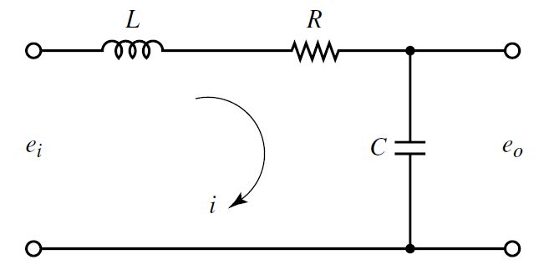
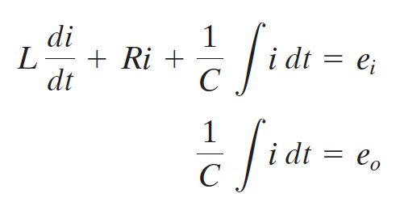
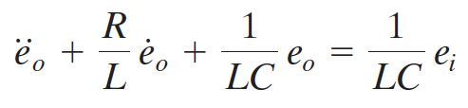
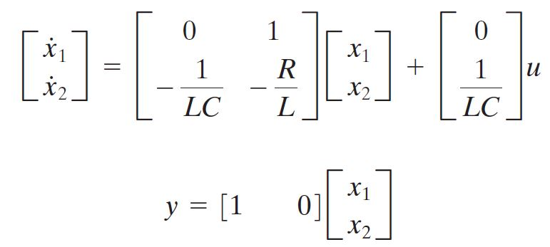
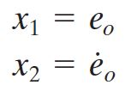
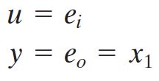
Example: LRC Circuit
Define:

Slide 11
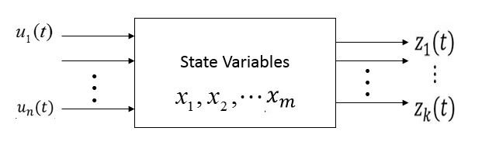
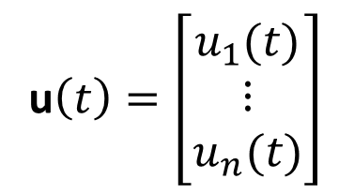
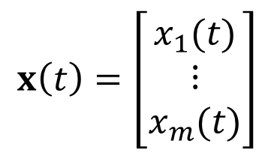
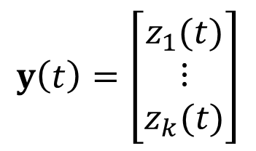
In general
$$x\left(t\right)=\left[\begin{matrix}x_{1}(t) \\ ⋮ \\ x_{m}(t)\end{matrix}\right]$$
For example:
Position
Velocity
Acceleration
State vector
Control vector
Output vector
u$\left(t\right)=\left[\begin{matrix}u_{1}(t) \\ ⋮ \\ u_{n}(t)\end{matrix}\right]$
For example:
Voltage
Current
$$y\left(t\right)=\left[\begin{matrix}z_{1}(t) \\ ⋮ \\ z_{k}(t)\end{matrix}\right]$$
For example:
Displacement
Speed

Slide 12
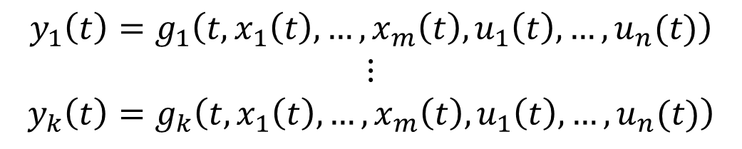
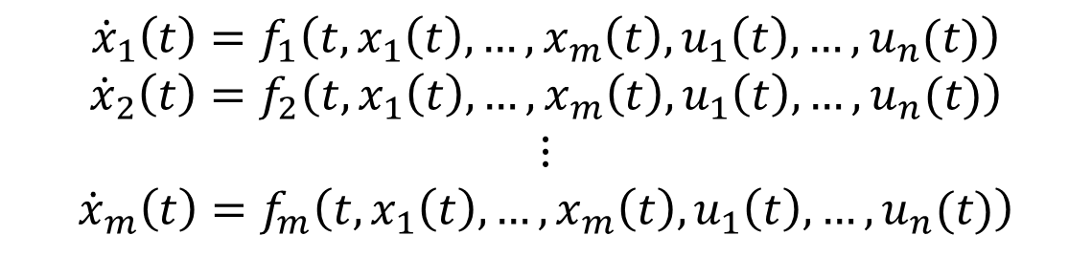
In general, state equations can be written as
State equations
$${\dot{x}}_{1}\left(t\right)=f_{1}\left(t,x_{1}\left(t\right),…,x_{m}\left(t\right),u_{1}\left(t\right),…,u_{n}(t)\right)$$
$${\dot{x}}_{2}\left(t\right)=f_{2}\left(t,x_{1}\left(t\right),…,x_{m}\left(t\right),u_{1}\left(t\right),…,u_{n}(t)\right)$$
$$⋮$$
$${\dot{x}}_{m}\left(t\right)=f_{m}\left(t,x_{1}\left(t\right),…,x_{m}\left(t\right),u_{1}\left(t\right),…,u_{n}(t)\right)$$
Output equations
$$y_{1}\left(t\right)=g_{1}\left(t,x_{1}\left(t\right),…,x_{m}\left(t\right),u_{1}\left(t\right),…,u_{n}(t)\right)$$
$$⋮$$
$$y_{k}\left(t\right)=g_{k}\left(t,x_{1}\left(t\right),…,x_{m}\left(t\right),u_{1}\left(t\right),…,u_{n}(t)\right)$$

Slide 13
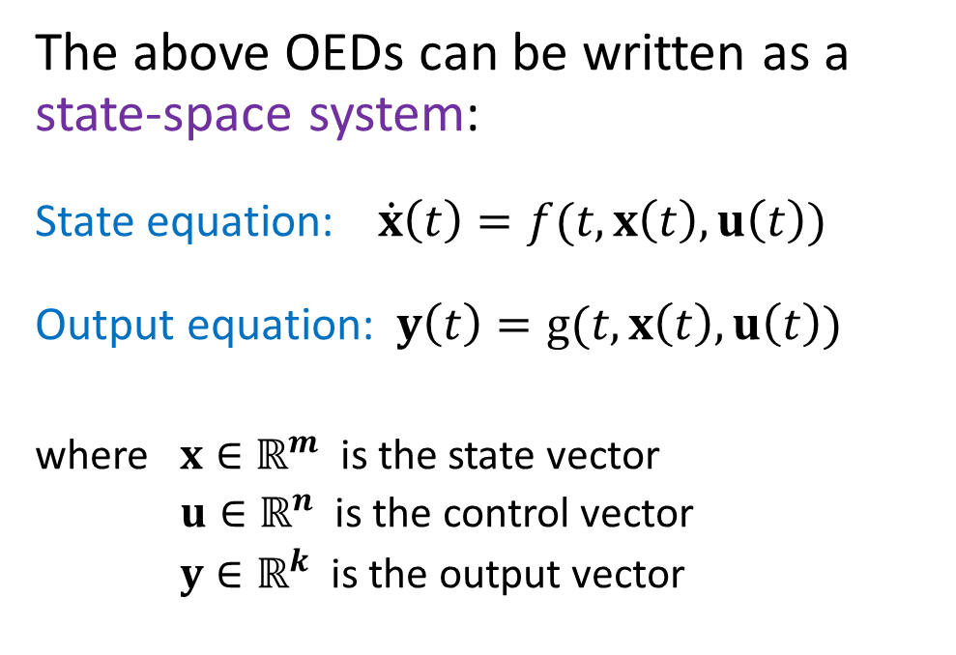
State-Space System
The above OEDs can be written as a state-space system:
State equation: $\dot{x}\left(t\right)=f(t,x\left(t\right),u\left(t\right))$
Output equation: $y\left(t\right)=g(t,x\left(t\right),u\left(t\right))$
where $x∈ℝ^{m}$ is the state vector
$u∈ℝ^{n}$ is the control vector
$y∈ℝ^{k}$ is the output vector

Slide 14
Note:
Only systems described by a finite number of states will be considered
The order of the system is the minimal number of states required to describe its dynamics
This number can be found by determining the number of initial conditions required

Slide 15

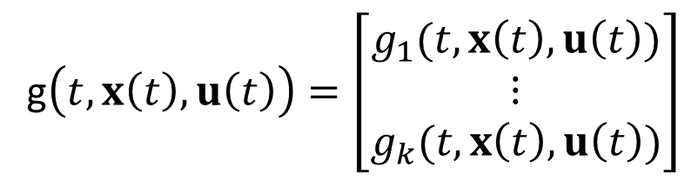
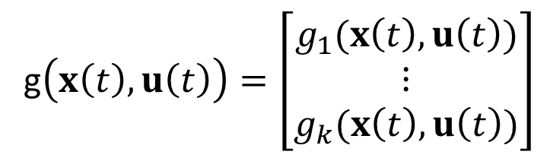
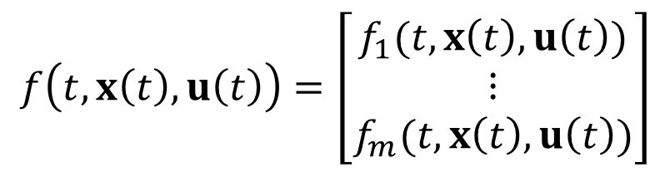
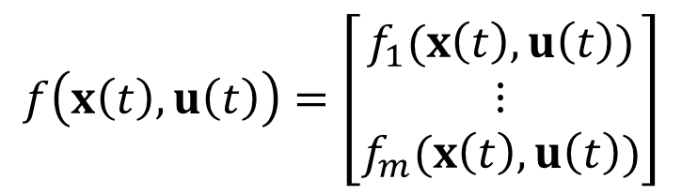
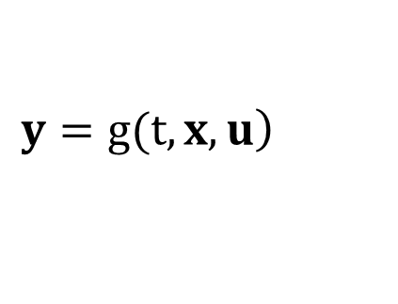

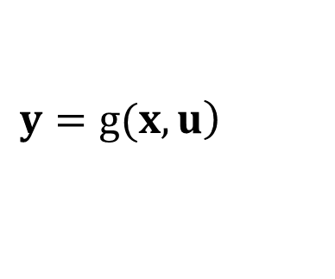
General (Nonlinear) State-Space System
$$f\left(t,x\left(t\right),u\left(t\right)\right)=\left[\begin{matrix}f_{1}(t,x\left(t\right),u\left(t\right)) \\ ⋮ \\ f_{m}(t,x\left(t\right),u\left(t\right))\end{matrix}\right]$$
Time-Varying:
$$\dot{x}=f(t,x,u)$$
$$\left.y=g(t,x,u\right)$$
g$\left(t,x\left(t\right),u\left(t\right)\right)=\left[\begin{matrix}g_{1}(t,x\left(t\right),u\left(t\right)) \\ ⋮ \\ g_{k}(t,x\left(t\right),u\left(t\right))\end{matrix}\right]$
Time-Invariant:
$$f\left(x\left(t\right),u\left(t\right)\right)=\left[\begin{matrix}f_{1}(x\left(t\right),u\left(t\right)) \\ ⋮ \\ f_{m}(x\left(t\right),u\left(t\right))\end{matrix}\right]$$
$$\dot{x}=f(x,u)$$
$$\left.y=g(x,u\right)$$
g$\left(x\left(t\right),u\left(t\right)\right)=\left[\begin{matrix}g_{1}(x\left(t\right),u\left(t\right)) \\ ⋮ \\ g_{k}(x\left(t\right),u\left(t\right))\end{matrix}\right]$

Slide 16
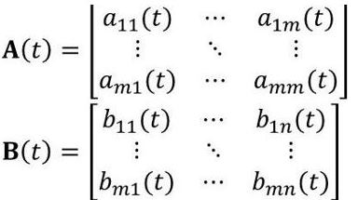
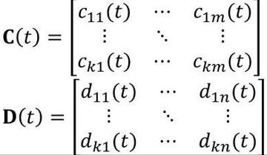
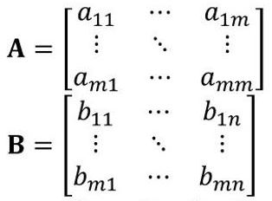
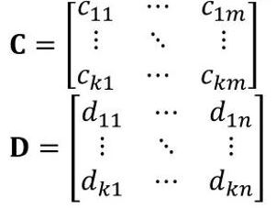




General (Linear) State-Space System
Time-Varying:
$$\dot{x}=A(t)x+B(t)u$$
$$y=C(t)x+D(t)u$$
Time-Invariant:
$$\dot{x}=Ax+Bu$$
$$y=Cx+Du$$

Slide 17
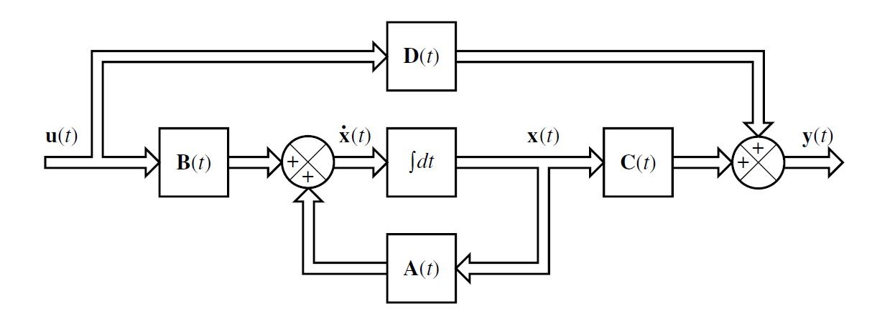
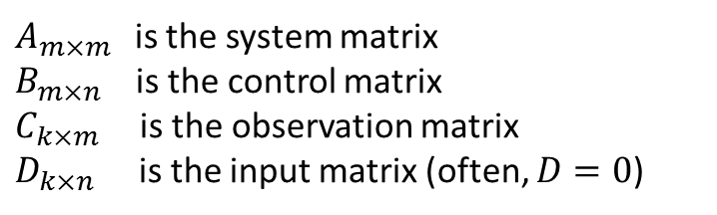

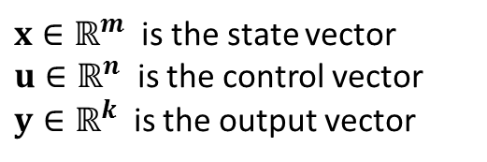

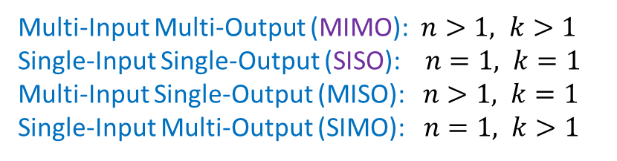
Block Diagram of State-Space Systems
$$\dot{x}=A(t)x+B(t)u$$
$$y=C(t)x+D(t)u$$
$x∈ℝ^{m}$ is the state vector
$u∈ℝ^{n}$ is the control vector
$y∈ℝ^{k}$ is the output vector
$A_{m×m }$ is the system matrix
$B_{m×n}$ is the control matrix
$C_{k×m }$ is the observation matrix
$D_{k×n}$ is the input matrix (often, $D=0$)
Multi-Input Multi-Output (MIMO): $n>1, k>1$
Single-Input Single-Output (SISO): $n=1, k=1$
Multi-Input Single-Output (MISO): $n>1, k=1$
Single-Input Multi-Output (SIMO): $n=1, k>1$

Slide 18
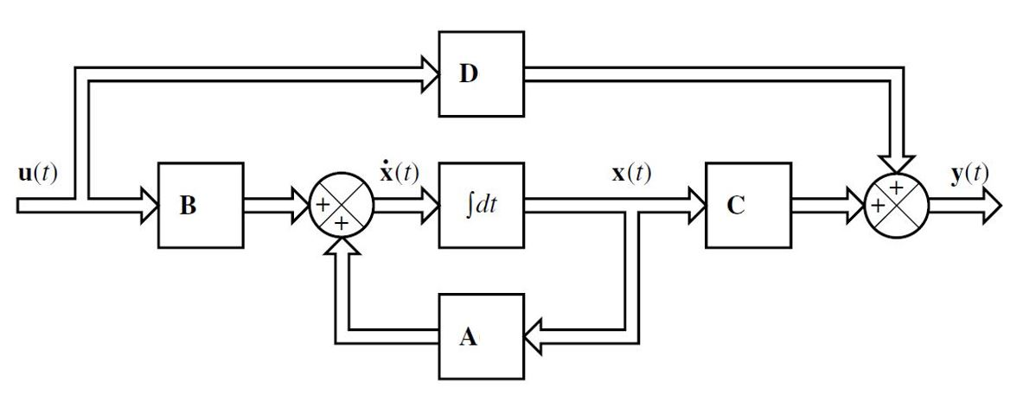


Linear Time-Invariant (LTI) Systems
This course only considers LTI systems, unless otherwise indicated
$$\dot{x}=Ax+Bu$$
$$y=Cx+Du$$

Slide 19


Example: Mass-Spring-Damper System
Laplace Transform →
$\left(ms^{2}+cs+k\right)Y\left(s\right)=U(s)$

Slide 20




Recall: State-Space Formulation
$$\dot{x}=Ax+Bu$$
$$y=Cx+Du$$
z
The matrices A, B, C, D are time-invariant
This is an SISO linear time-invariant (LTI) system

Slide 21


Block Diagram: Mass-Spring-Damper System

Slide 22




Transfer Function and State-Space Equation
Laplace Transform →

Slide 23






Consider: $\dot{x}=Ax$ ($B=0$)
Laplace Transform → $sX\left(s\right)−X\left(0\right)=AX(s)$
→ $\left(sI−A\right)X\left(s\right)=X\left(0\right)$
→ $X\left(s\right)={\left(sI−A\right)}^{−1} X\left(0\right)$
Inverse Laplace Transform
→ $x\left(t\right)=L^{−1}\left\{{\left(sI−A\right)}^{−1}\right\}X(0)$
:= $Φ\left(t\right)X\left(0\right)$
Here, $Φ(t)$ is called the State Transition Matrix
$Φ\left(t\right)=L^{−1}\left\{{\left(sI−A\right)}^{−1}\right\}=e^{At}$ ← (next page)
=

Slide 24




Recall:
$$\frac{1}{1−x}=1+x+x^{2}+x^{3}+ . . .$$
$$=e^{At}$$
Recall:
%MatLab code
ss2tf(A,B,C,D) %state space to transfer function
tf2ss(num,den) %transfer function to state space

Slide 25



Consider: $\dot{x}=Ax+Bu$
Laplace Transform →
$sX\left(s\right)−X\left(0\right)=AX\left(s\right)+BU(s)$
→ $\left(sI−A\right)X\left(s\right)=X\left(0\right)+BU(s)$
→ $X\left(s\right)={\left(sI−A\right)}^{−1} X\left(0\right)+{\left(sI−A\right)}^{−1}BU\left(s\right)$
Inverse Laplace Transform →
$x\left(t\right)=L^{−1}\left\{{\left(sI−A\right)}^{−1}\right\}X\left(0\right)+L^{−1}\left\{{\left(sI−A\right)}^{−1}\right\}BU(s)$
= $Φ\left(t\right)x\left(0\right)+\int_{0}^{t}{Φ\left(t−τ\right)Bu\left(τ\right)dτ}$
Convolution

Slide 26





Example: (MIMO LTI System)
%MatLab code
A=[0 1 0; 0 -4 3; -1 -1 -2];
B=[0 0 ; 1 0; 0 1];
C=[1 0 0; 0 0 1];
D=[0 0; 0 0];
G=ss(A,B,C,D);
G2tf=tf(G)
$$s^{3}+6s^{2}+11s+3$$
$$G\left(s\right)=C{\left(sI−A\right)}^{−1}B+D$$

Slide 27



Recall:
State-Space Systems: Canonical Form (1)
z
General form:
$$\ddot{y}+a_{1}\dot{y}+a_{2}y=u$$
$$x_{1}=y$$
$$x_{2}={\dot{y}=\dot{x}}_{1}$$
$$\left[\begin{matrix}{\dot{x}}_{1} \\ {\dot{x}}_{2}\end{matrix}\right]=\left[\begin{matrix}0 & 1 \\ −a_{2} & −a_{1}\end{matrix}\right]\left[\begin{matrix}x_{1} \\ x_{2}\end{matrix}\right]+\left[\begin{matrix}0 \\ 1\end{matrix}\right]u$$
$z=[\begin{matrix}1 & 0\end{matrix}]\left[\begin{matrix}x_{1} \\ x_{2}\end{matrix}\right]$

Slide 28



State-Space Systems: Canonical Form (1)
General ODE (SISO system):
Define:

Slide 29




State-Space Systems: Canonical Form (1)
Exactly same y →

Slide 30


State-Space Systems: Canonical Form (2)
Define:
with
Also, define:

Slide 31


State-Space Systems: Canonical Form (2)
Here:

Slide 32

Summary: State-Space Systems: Canonical Form (2)

Slide 33



Transfer Function → State-Space
Example:
Canonical Form →

Slide 34


Transfer Function → State-Space
Example:
%MatLab code
num = [1 0];
den = [1 14 56 160];
[A,B,C,D] = tf2ss(num,den)
MatLab
→ Another Form:

Slide 35



State-Space → Transfer Function
Recall:
Example:
%MatLab code
A = [0 1 0; 0 0 1; -5 -25 -5];
B = [0; 25; -120];
C = [1 0 0];
D = [0];
[num,den] = ss2tf(A,B,C,D)

Slide 36






Sate-Space Forms are not unique, but their Transfer Functions are the same
p is nonsingular

Slide 37

p is nonsingular
These two LTI systems are equivalent

Slide 38


Zero-Pole Cancellation and Stability
Consider an LTI system with the Transfer Function
All poles are on LHP → system is stable
$N(s)$ and $D\left(s\right)$ may have zero-pole cancellations
Example:
$$H\left(s\right)=\frac{N(s)}{D(s)}=\frac{s−1}{s^{2}+2s−3}=\frac{s−1}{(s+2)(s−1)}=\frac{1}{s+2}$$
unstable
stable
Important: Determine stability before pole-zero cancellation !

Slide 39




Recall: Second-order Transfer Function: $\frac{K}{as^{2}+bs+c}$ ($a≠0$)
Characteristic equation: $as^{2}+bs+c=0$
$b^{2}−4ac>0$:
Two distinct real poles: $r_{1}≠r_{2}$ → $y\left(t\right)= {C_{1}e}^{r_{1}t }+C_{2}e^{r_{2}t}$
Both poles $r_{1}<0, { r}_{2}<0$ → $y\left(t\right)→0$ as $t→∞$ → system stable
$b^{2}−4ac<0$:
Two complex conjugate poles: $r_{1,2}=σ±jω_{d}$
→ $y\left(t\right)=C_{0}e^{σt}(C_{1}\cos{(ω_{d}t)+C_{2}sin⁡(ω_{d}t))}$
Both poles have $σ <0$ → $y\left(t\right)→0$ as $t→∞$ → system stable
$b^{2}−4ac=0$:
Two same real poles: $r_{1}=r_{2}=r$ → $y\left(t\right)= {C_{1}e}^{rt }+C_{2}{te}^{rt}$
Both poles $r_{1}={ r}_{2}<0$ → $y\left(t\right)→0$ as $t→∞$ → system stable

Slide 40








Example:
Laplace Transform with Initial Conditions →
Assume: $y\left(0\right)=y_{0}≠0, \dot{y}\left(0\right)=0, u\left(0\right)=0,$U(s) = 0
$→0$ $→∞$
But
$$\frac{s−1}{s^{2}+2s−3}=\frac{s−1}{(s+2)(s−1)}=\frac{1}{s+2}$$
${y_{0}e}^{−2t}→0$ as $t→∞$

Slide 41
END

