Slide 1
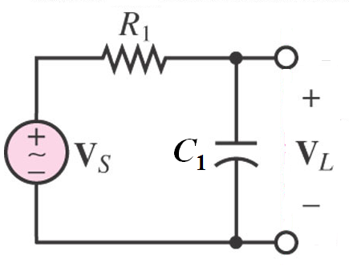
RC filter
The decibel (dB). If the magnitude ratio is denoted by G, then in terms of dB it will be:
20*log₁₀G dB
At f_{c} where the magnitude drops to 1/√2 of max:
20*log10*(1/√2) = -3 dB
Hence the cut off frequency (f_{c}) is also known as the -3dB turnover frequency
When ω >> ω_{c}, increasing ω by 10 times reduces |V_{L}/V_{S}| by roughly 10 times and increasing ω by 100 times reduces |V_{L}/V_{S}| by roughly 100 times

Slide 2


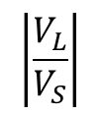
Bode Plot
$$\left|\frac{V_{L}}{V_{S}}\right|$$
1
$$ω$$
$$ω_{c}$$

Slide 3
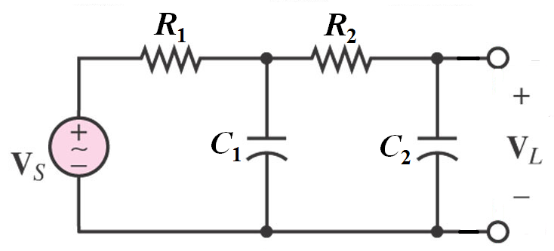
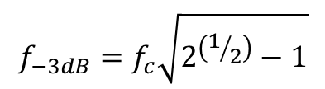
RC 2nd order filter
We can cascade the filters to make the cut off effect even greater
Note that when that impedance of R₂ & C₂ when connected across C₁ will lower v₁.
Choose R₂ = 10R₁ and C₂ = 0.1C₁ ⇨ We want: X ~ 1/ωC
$$f_{−3dB}=f_{c}\sqrt{2^{\left(1/2\right)}−1}$$
When ω >> ω_{c}, increasing ω by 10 times reduces |V_{L}/V_{S}| by roughly 10² times

Slide 4
Bode Plot
$$\left|\frac{V_{L}}{V_{S}}\right|$$
1
$$ω$$
$$ω_{c}$$

