Slide 1
GE1202 Managing Your Personal Finance
Lecture 7
Investment

Slide 2
Investment
Investment
  A long-term perspective
  A process of purchasing securities wherein stability of value and level of return are somewhat predictable
Speculation
  Short-term buying and selling of securities in which future value and expected return are highly uncertain

Slide 3
Requirements for Investing
Investment capital
  Money you have accumulated above and beyond basic emergency savings
Knowledge
  Never invest in something you don’t understand
  Learn as much as you can about
    Types of securities
    The market
    Trading strategies
    Yourself
Experience
  Paper trades

Slide 4
Investment Capital
The amount of money you will have to put into your investment program largely depends on how much you can earn from your investments
  The higher their rate of return, the less you will have to put up
A projected rate of return
  Look at what the market has done over the past and then use the average return performance over various historical periods as your estimates
Two ways of coming up with the capital needed to reach a targeted sum of money
  Make a lump-sum investment up front and let that amount grow over time
  Set up a systematic savings plan and put away a certain amount of money each year

Slide 5
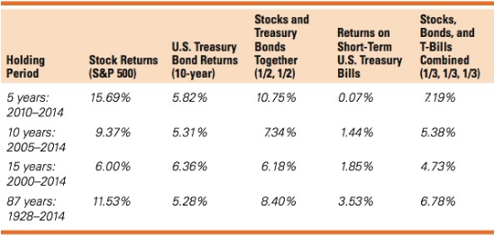

Slide 6
Types of Securities
Common Stock
  A form of equity
    Represent an ownership interest in a corporation
  A share of stock typically entitles the holder to equal participation in the corporation’s earnings and dividends as well as an equal vote to elect the management of the corporation
  The return to stockholders
    Dividends
    Appreciation in share price
  Greater potential returns with a higher level of risk
  No maturity date

Slide 7
Types of Securities
Bonds
  Liabilities
  IOUs of the issuer
  Issuer
    Governments and corporations
  Pay a stated return
    Interest
  Stable returns with a lower level of risk
  Fixed maturity date
    Can be bought or sold prior to maturity at a price that may differ from its face value
    Face values inversely related to changes in market interest rates

Slide 8
Types of Securities
Preferreds and Convertibles
  Hybrid securities
    A single financial security that combines two or more different financial instruments, generally combine both debt and equity characteristics
  Preferred securities
    Represent an equity position in a corporation
    A stated (fixed) dividend rate that is paid before the dividends to holders of common stock
  Convertible security
    A fixed-income obligation
    Permitting the investor to con vert it into common stock
    Provides income and possible price appreciation

Slide 9
Types of Securities
Mutual Funds, Exchange-Traded Funds, and Exchange Traded Notes
  Mutual fund
    Professionally managed portfolio by an investment company
    Returns and risk depend on portfolio
    Can be bought or sold only at the end of the day
  Exchange-traded funds (ETFs)
    Portfolios of securities
    Designed to track a basket or index of equity securities
    Investors can trade ETFs throughout the trading day
  Exchange-traded notes (ETNs)
    Senior, unsecured, unsubordinated debt securities issued by an underwriting bank
    Have a maturity date
    Backed only by the credit of the issuer

Slide 10
Types of Securities
Real Estate
  Investments in real estate can take many forms
    Raw land speculation
    Limited-partnership shares in commercial property
    Real estate mutual funds
  Returns on real estate
    Rents
    Capital gains
    Tax benefits

Slide 11
Securities Markets
Securities Markets
  The marketplace in which stocks, bonds, and other financial instruments are traded
  Capital vs Money; Primary vs Secondary
Capital Market
  Long-term securities with maturities >1 year
  Stocks and bonds
Money Market
  Low-risk
  Short-term securities with maturities < 1 year
  Commercial paper and negotiable certificates of deposit

Slide 12
Securities Markets
Primary Markets
  New securities are sold to the public
    Initial Public Offering (IPO)
  Issued by a corporation or a governmental body
  Investment banking firm
    Underwriting new security issues
  Prospectus
    A document made available to prospective security buyers that describe the firm and a new security issue

Slide 13
Securities Markets
Secondary Markets
  Old (outstanding) securities
  A market for investors
  Does not generate cash for the underlying company (issuer)
  Consists of two parts
    Broker Markets
    Dealer Markets

Slide 14
Securities Markets
Broker Markets
  The buyer and the seller are brought together
  Party A sells his securities directly to Party B
  With the help of a broker, the securities change hands on the floor of the exchange
  Example
    New York Stock Exchange (NYSE)

Slide 15
Securities Markets
Dealer Markets
  The buyer and seller are never brought together directly
  Party A sells his securities indirectly to Party B
  Buy/sell orders are executed separately through securities dealers
    Market makers
    Party A sells his securities to one dealer, and Party B buys her securities from the same dealer or another dealer
  Doesn’t have centralized trading floors
  Example
    NASDAQ
    OTC markets

Slide 16
Securities Markets
Financial terms used in securities markets
  Bid Price
    Price at which investor can sell a security
    The highest price offered to purchase a given security
  Ask Price
    Price at which investor can buy a security
    The lowest price at which the security is offered for sale
  Bull Market
    Rising securities prices for extended time period
  Bear Market
    Falling securities prices for extended time period

Slide 17
Making Transactions In The Securities Markets
Stockbrokers
  Account executives or financial consultants
  A person who buys and sells securities on behalf of clients and gives them investment advice and information
  Must be licensed by the exchanges and must abide by the ethical guidelines of the exchanges and SFC regulations
  Full-service broker
    A broker offers a full array of brokerage services
  Discount broker
    Low overhead operations, charges low commissions, offers little or no services to investors
  Online broker

Slide 18
Making Transactions In The Securities Markets
Selecting a Broker
  Full-service broker
  Select someone who understands your investment objectives
  A good broker is someone who’s more interested in your investments than in his or her own commissions
Brokerage Fees
  Brokerage firms receive commissions for executing orders
  Differ from one brokerage firm to another
  Typically charge a minimum fee

Slide 19
Making Transactions In The Securities Markets
Investor Protection
  Protection against the loss of securities or cash held by your broker
Lots
  Security transactions can be made in either odd or round lots
  Odd lot
    Consists of fewer than 100 shares of stock
  Round lot
    Represents a 100-share unit or multiples thereof

Slide 20
Making Transactions In The Securities Markets
Investors may choose from several different kinds of orders when buying or selling securities
Market Order
  An order to buy or sell a security at the best price available at the time it is placed
Limit order
  An order to either buy a security at a specified or lower price or to sell a security at or above a specified price
Stop-Loss Order
  An order to sell a stock when the market price reaches or drops below a specified level

Slide 21
Making Transactions In The Securities Markets
You can buy securities by putting up your own money or by borrowing some of the money
  Buying on margin
  Magnifying both profits and losses
Margin requirements
  Specify the amount of equity that an investor must put up when buying securities
  Maximum margin is around 40%
Maintenance margin
  Minimum amount equity in trading can be before additional funds must be put into the account
Margin call
  Notification from broker you must put up additional funds

Slide 22
Making Transactions In The Securities Markets
Example
You plan to buy 1000 shares of “CityU” at $70. Given that the initial margin is 50% and maintenance margin is 40%. What is your initial position?
Initial Position
  Stock value = $70,000
  Borrowed = $35,000
  Equity = $35,000

Slide 23
Making Transactions In The Securities Markets
How will your position change if the stock price falls to $60 per share?
New Position
  Stock value = $60,000
  Borrowed = $35,000
  Equity = $25,000
  Margin% = $25,000/$60,000 = 41.67%
  No margin call yet

Slide 24
Making Transactions In The Securities Markets
Investors can go long or short when they trade stocks
Long transactions
  Anticipating the stock prices will go up, buying at low and selling at high
  Maximum gain is unlimited; maximum loss is limited
Short sale
  Selling borrowed securities with the expectation that they can be replaced at a lower price at some future date
  Maximum gain is limited to the purchase price; maximum loss is unlimited
  Example
    If you short-sells 100 shares of stock at $50 a share and then some time later, after the price of the stock has dropped, buys them back at $30 a share
    then you will generate a profit of $20 a share, or $2,000 in total

Slide 25
Know Yourself
Investment plan is unique to an individual
The plan has to be setup according to the characteristics of the investor
  Investment Objectives
  Attitude to Risk
Investment decisions are very often affected by the investor’s emotion rather than rationality
  Behaviour bias

Slide 26
Investment Objectives
An investment plan is a way of translating an abstract investment target into a specific investment program
  Find a way to obtain the targeted rate of return on your money
  To specify the kinds of investment vehicles you intend to use
Your goals tend to set the tone for your investment program, and they play a major role in determining how conservative (or aggressive) you are likely to be in making investment decisions
  Your goals define the purpose for your investments

Slide 27
Investment Objectives
The most frequent investment objectives
  Accumulate funds for retirement
    Review the amounts of income you can realistically expect to receive from Social Security and your employee pension plan
    Based on your retirement goals, determine whether it is adequate to meet your needs
  Save for a major purchase
    Once you know about how much money you’re going to need to attain one of these goals, you can specify the types of investment vehicles that you intend to use
  Enhance current income
    Want to live off their investment income
  Seek shelter from taxes
    Deductions against certain sources of income

Slide 28
Risk
An important factor that needs to be considered when undertaking personal financial planning is an individual’s attitude to risk
There are some risks affecting the general investment environment
  Inflation risk
    Inflation erodes the value of savings and investments
  Interest rates risk
    Floating interest rate vs Fixed interest rate
  Political risk
    Governments and policies change
  Market risk
    One type of asset is affected by particular circumstances and the value of all the assets in that market will be liable to change in a similar way

Slide 29
Risk
Some risks associated to a specific business or investor
  Business risk
    Uncertainty associated with a firm’s cash flows and with its subsequent ability to meet its operating expenses on time
  Financial risk
    Associated with the amount of debt used to finance the firm and its ability to meet these obligation on time
  Liquidity risk
    Inability to liquidate an investment conveniently and at a reasonable price
  Risk of a specific event
    Some major, unexpected event that occur that leads to a sudden and substantial change in the value of an investment

Slide 30
Attitude to Risk
Attitudes to risk are linked to personality, age and personal circumstances
  Risk-lover – people who likes to take more risk
  Risk-averser – people who will avoid risk
Will you take the following offer?
  Flipping a fair coin, if a head is shown up, you win and I pay you $20; if a tail is shown, I win and you pay me $20
Different people have different risk tolerance
  Character
  Age
  Goal
http://njaes.rutgers.edu:8080/money/riskquiz/

Slide 31
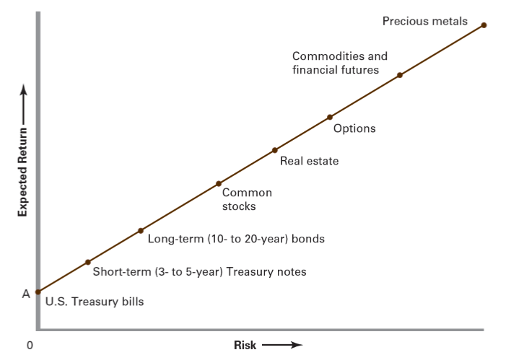
Risk and Return
General principle
  The greater the potential rate of return to be offered the riskier a financial product is
If you want greater return you will most likely have to accept greater risk
Risk-free rate of return

Slide 32
Managing Your Investment Holdings
Build a diversified portfolio based on goals and personal situation
  Portfolio
    A collection of securities assembled for the purpose of meeting common investment goals
  Diversification
    The process of choosing securities with dissimilar risk-return characteristics in order to create a portfolio that provides an acceptable level of return and an acceptable exposure to risk
Allocate assets according to objectives

Slide 33
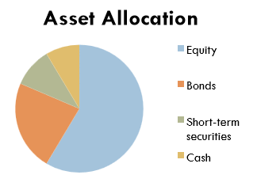
Portfolio Management
Asset allocation
  A plan for dividing a portfolio among different classes of securities in order to preserve capital by protecting the portfolio against negative market developments
  Asset allocation deals in broad categories and does not tell you which individual securities to buy or sell

Slide 34
Portfolio Management
The total return on a portfolio is influenced by its asset allocation than by specific security selections
Track investments
  How they have performed over time?
  Whether they have lived up to your expectations?
Rebalance portfolio as needed

Slide 35
Emotional Mind
Eight Common Behavioural Bias
  Representativeness
  Disposition effect
  Familiarity bias
  Confirmation bias
  Anchoring
  Self-attribution bias
  Hindsight bias
  Trend-chasing bias

Slide 36
  Representativeness
Investors labeling an investment as good or bad based on its recent performance
  Buy stocks after prices have risen expecting those increases to continue
  Ignore stocks when their prices are below their intrinsic values
Investors will evaluate an asset base on the most available information.

Slide 37
Disposition Effect
The tendency of selling stocks that have appreciated in price since purchase (“winners”) too early and holding on to losing stocks (“losers”) too long
Regret (loss) aversion
  People often feel the pain of loss more than the joy of gains
Investor reluctance to sell “losing” investments because it gives them feedback that they have made bad decisions
Cut your losses and let your profits run” enables investors to engage in disciplined investment management that can generate higher returns

Slide 38
Familiarity Bias
Investors have a preference for familiar investments despite the seemingly obvious gains from diversification
Local bias
  Investors display a preference for local assets with which they are more familiar
Home bias
  Portfolios tilted toward domestic securities
Investors hold suboptimal portfolios
Cast a wider net and expand their portfolio allocation decisions to gain wider diversification and risk reduction

Slide 39
Confirmation Bias
People are often drawn to information or ideas that validate existing beliefs and opinions
An investor may have a belief about market conditions and gravitate toward information sources that confirm that belief
Reduces diversification
  Investing too much in the stock of a company
To consider information from multiple sources

Slide 40
Anchoring
The tendency to hold on to a belief and then apply it as a subjective reference point for making future judgments
When an individual lets a specific piece of information control his cognitive decision-making process
People often base their decisions on the first source of information to which they are exposed (e.g., an initial purchase price of a stock) and have difficulty adjusting or changing their views to new information

Slide 41
Self-attribution Bias
Attribute successful outcomes to their own actions and bad outcomes to external factors
A means of self-protection or self-enhancement
Become overconfident
Keeping track of personal mistakes and successes and developing accountability mechanisms
  Seeking constructive feedback from others

Slide 42
Hindsight Bias
“I knew that would happen.”
Humans tend to overestimate the accuracy of their predictions
A false sense security when making investment decisions
Excessive risk-taking behaviour

Slide 43
Trend-chasing Bias
Investors often chase past performance in the mistaken belief that historical returns predict future investment performance
Herd mentality
  A person does not want to be left out of a trend or a movement
Mutual funds take advantage of investors by increasing advertising when past performance is high to attract new investors
Ask yourself why you are making this financial decision, and looking to see if it aligns with your financial plan

Slide 44
Becoming an Informed Investor
First rule of investing
  Never start an investment program, or buy an investment vehicle, unless you thoroughly understand what you are getting into!
Before making any major investment decision, thoroughly investigate the security and its merits
  Formulate some basic expectations about its future performance
  Gain an understanding of the sources of risk and return
Four types of investment information that you should follow on a regular basis
  Economic developments and current events
  Alternative investment vehicles
  Current interest rates and prices
  Personal investment strategies

Slide 45
Where to Get the Information?
Annual stockholders’ report
  Includes a variety of financial and descriptive information about a firm’s operations in the recent past
  Every publicly traded corporation is required to provide its stockholders and other interested parties
  Describe the firm’s business activities, recent developments, and future plans and outlook
  Financial ratios describing past performance

Slide 46
Where to Get the Information?
Common sources of financial news
  The Internet and the local newspaper
The Financial Press
  The Financial Times, The Wall Street Journal
  SCMP, HK Economic Times, HK Economic Journal
  The behavior of the economy, the market, various industries, and individual companies

Slide 47
Where to Get the Information?
Market Data
  Describe the general behavior of the securities markets
  The averages and indexes
    HSI, DJIA, S&P500, NASDAQ, Nikkei, FTSE, DAX, CAC 40
    Used to capture the overall performance of the market as a whole
  Follow one or more to get a feel for how the market is doing over time and an indication of what lies ahead
  The absolute level of the index at a specific time is far less important than what has been happening to that index over a given period

Slide 48
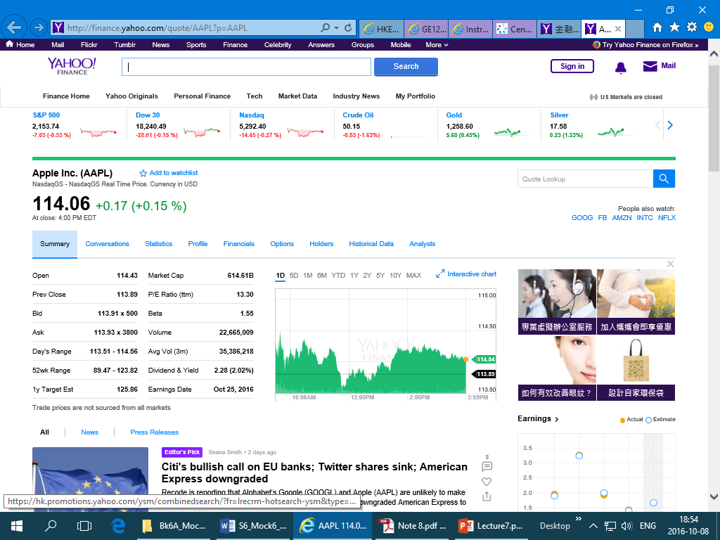
Where to Get the Information?
Stock Quotes
  https://hk.finance.yahoo.com/

Slide 49
Where to Get the Information?
Brokerage Reports
  Reports produced by the research staffs of major (full-service) brokerage firms
  Economic and market analyses to industry and company reports, news of special situations, and reports on interest rates and the bond market
  Recommendations for the type of investment returns expected and whether to buy, hold, or sell specific securities
Advisory Services
  Subscription advisory services provide information and recommendations on various industries and specific securities

