Slide 1
EE3122: Analogue Circuit Fundamentals
Differential Amplifiers
Department of Electrical Engineering
City University of Hong Kong
Prof. Arindam BASU

Slide 2
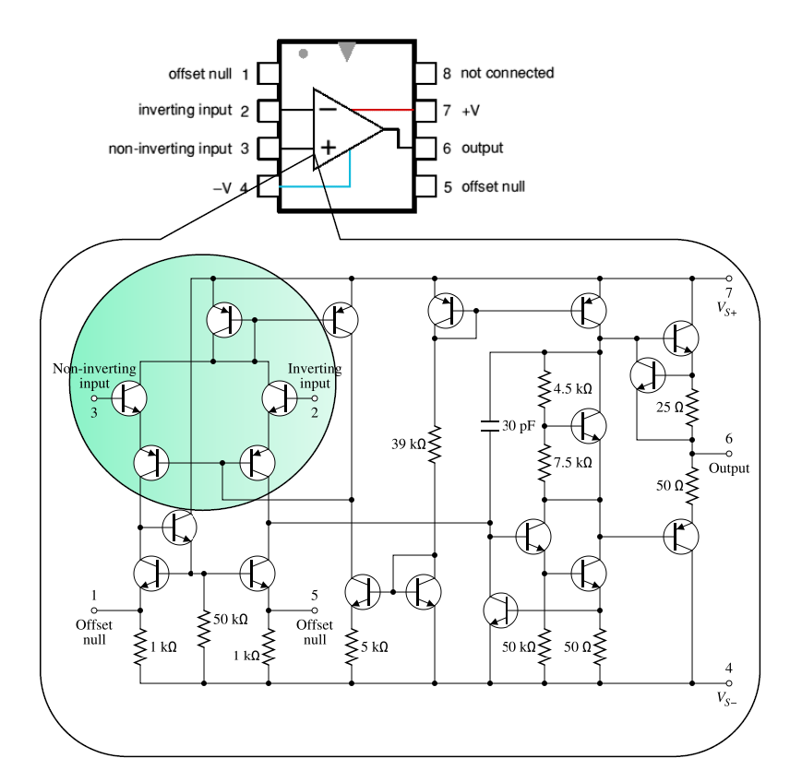
Operational Amplifier Core
Previous amplifiers – 1 input, 1 output
Op-amps – 2 input → Differential amplifier!

Slide 3
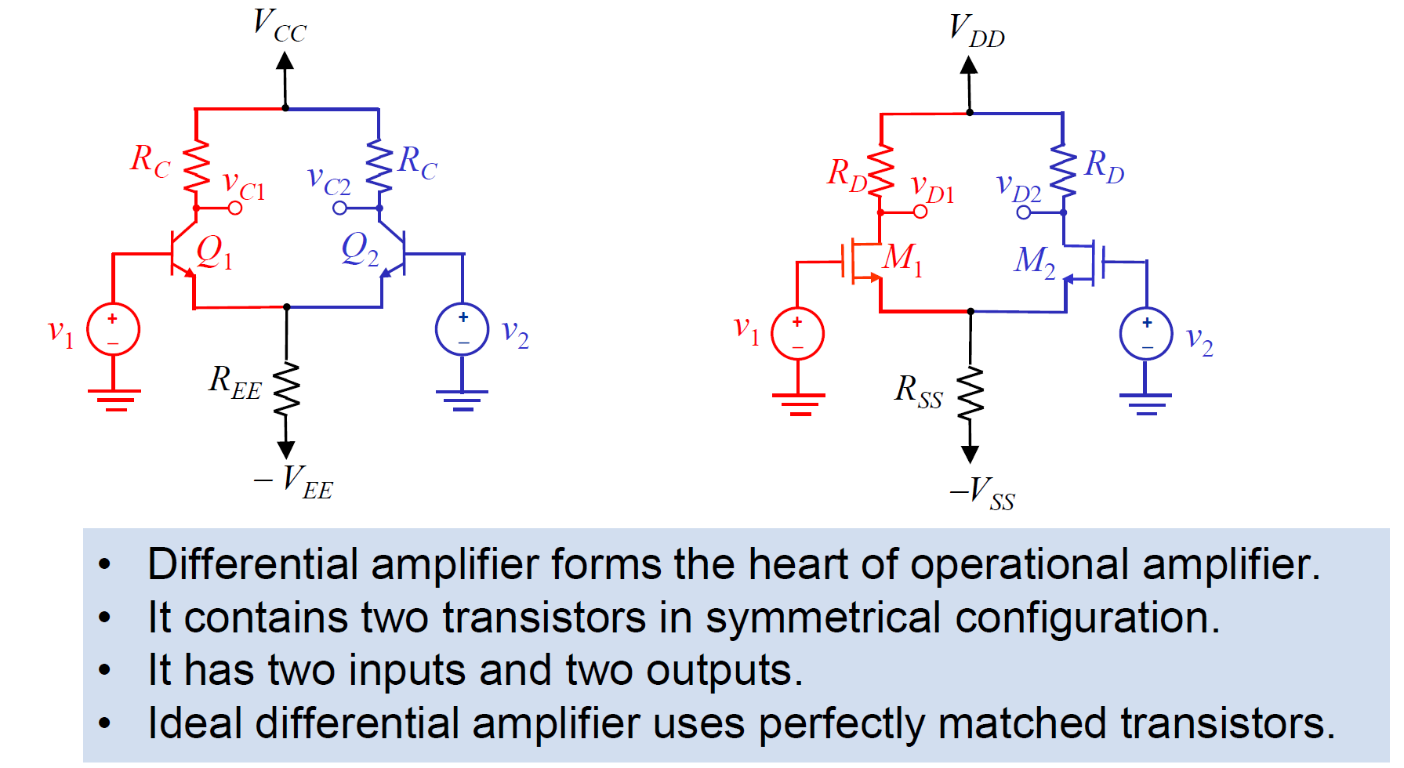
Differential Amplifiers

Slide 4
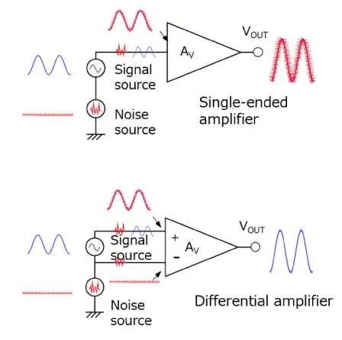
Why Differential Amplifiers
https://toshiba.semicon-storage.com/ap-en/semiconductor/knowledge/faq/linear_opamp/what-is-the-purpose-of-using-a-differential-amplifier.html

Slide 5
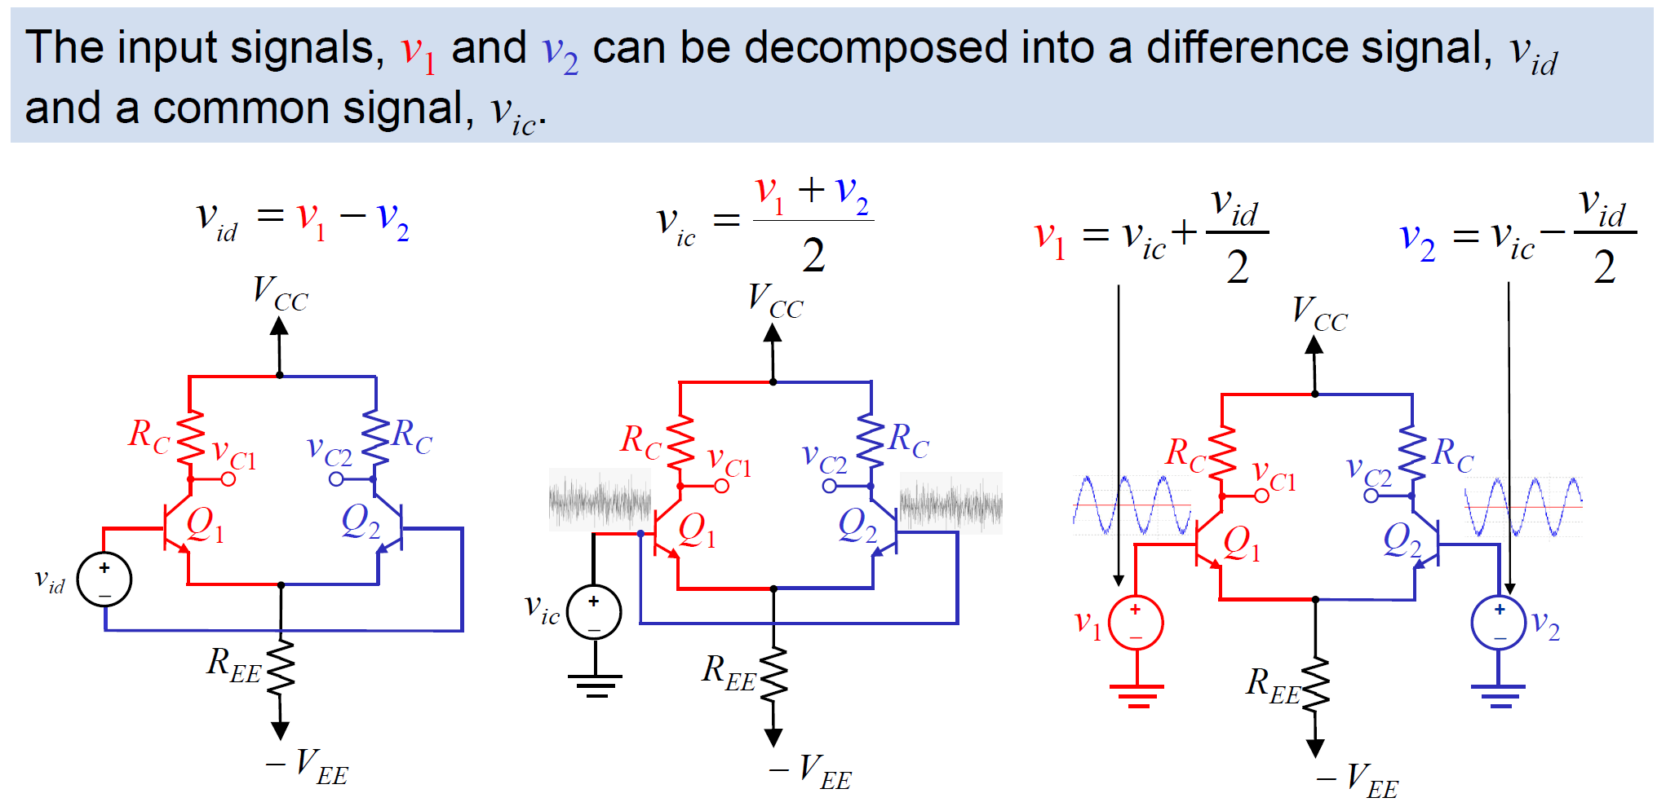
Differential and Common Mode operations

Slide 6
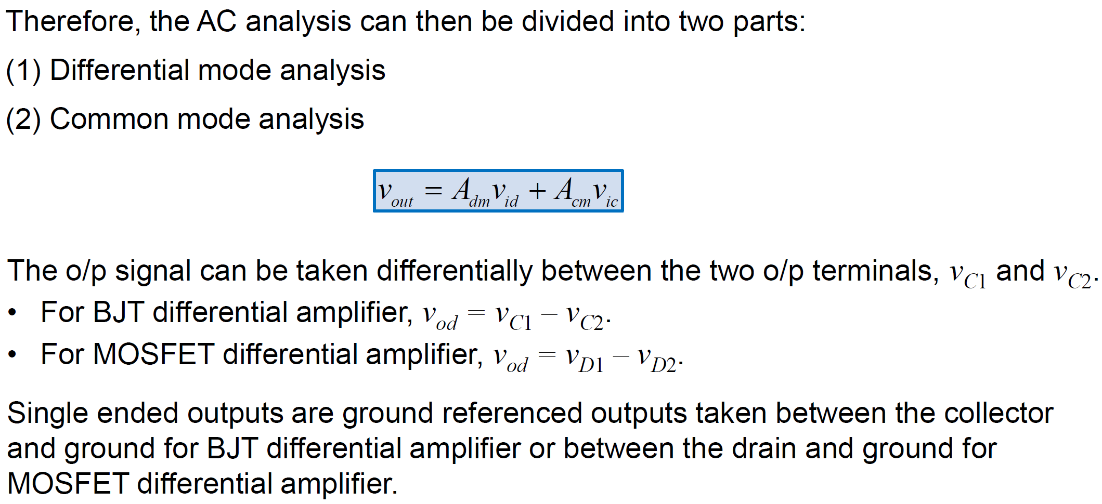
Differential and Common Mode operations

Slide 7
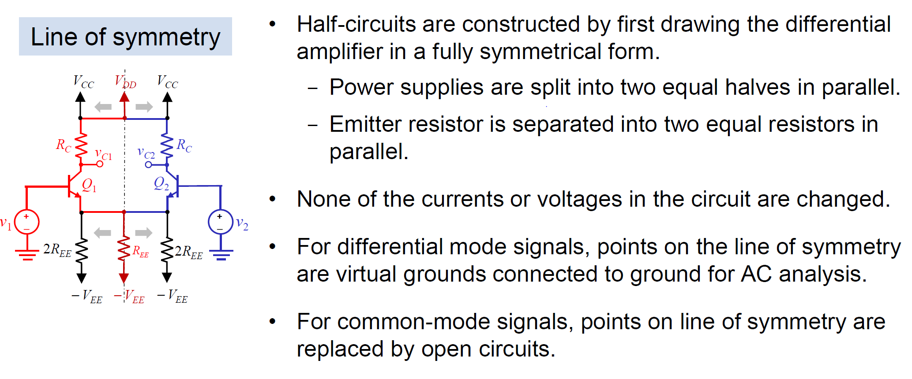
Half Circuit Analysis

Slide 8
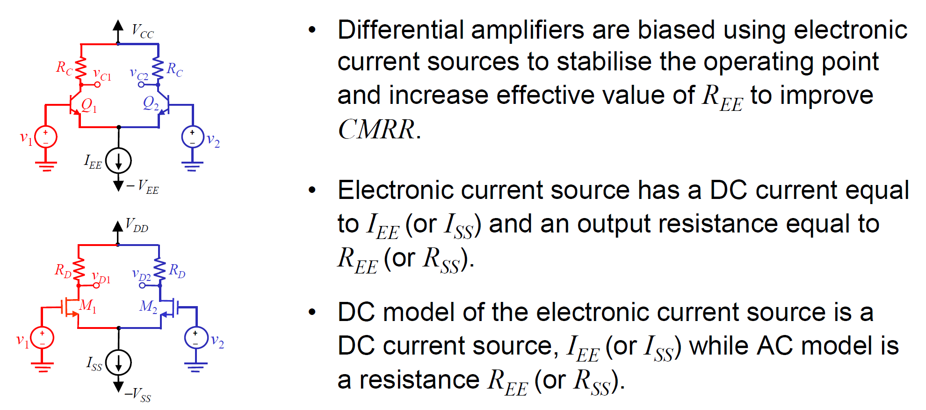
Biasing With Electronic Current Source

Slide 9
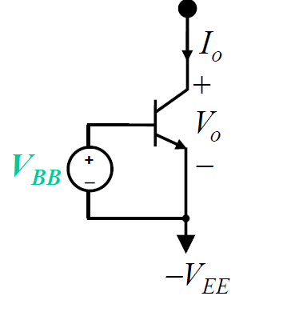
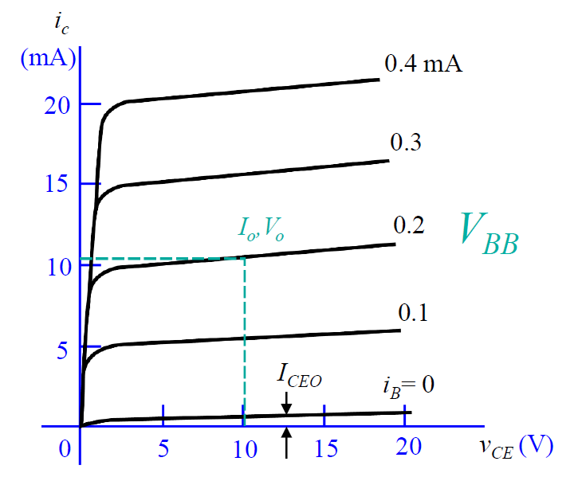
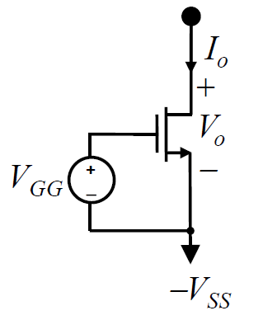
Example of Electronic Current Source
DC current: I_{ss}
AC resistance: r_{o}

Slide 10
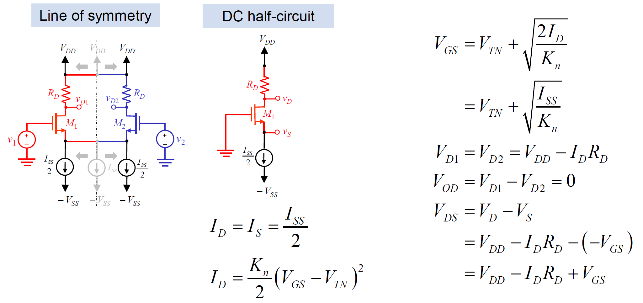
MOS Differential Amplifier: DC Analysis
DC Half Circuit = Common-Mode

Slide 11
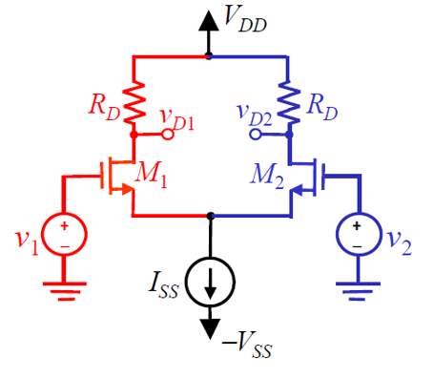
MOS Differential Amplifier: AC Analysis
v_{od} = v_{D1} - v_{D2} (output differential)
v_{id} = v₁ – v₂ (input differential)
Input of 2 types: dm (differential mode) OR cm (common mode)
Output of 2 types: diff (v_{D1} - v_{D2} ) OR se (single ended: v_{D1} )
4 possible gain definition
Input
 | dm | cm
diff | A_{dm-diff} | A_{cm-diff}
se | A_{dm-se} | A_{cm-se}
Output

Slide 12
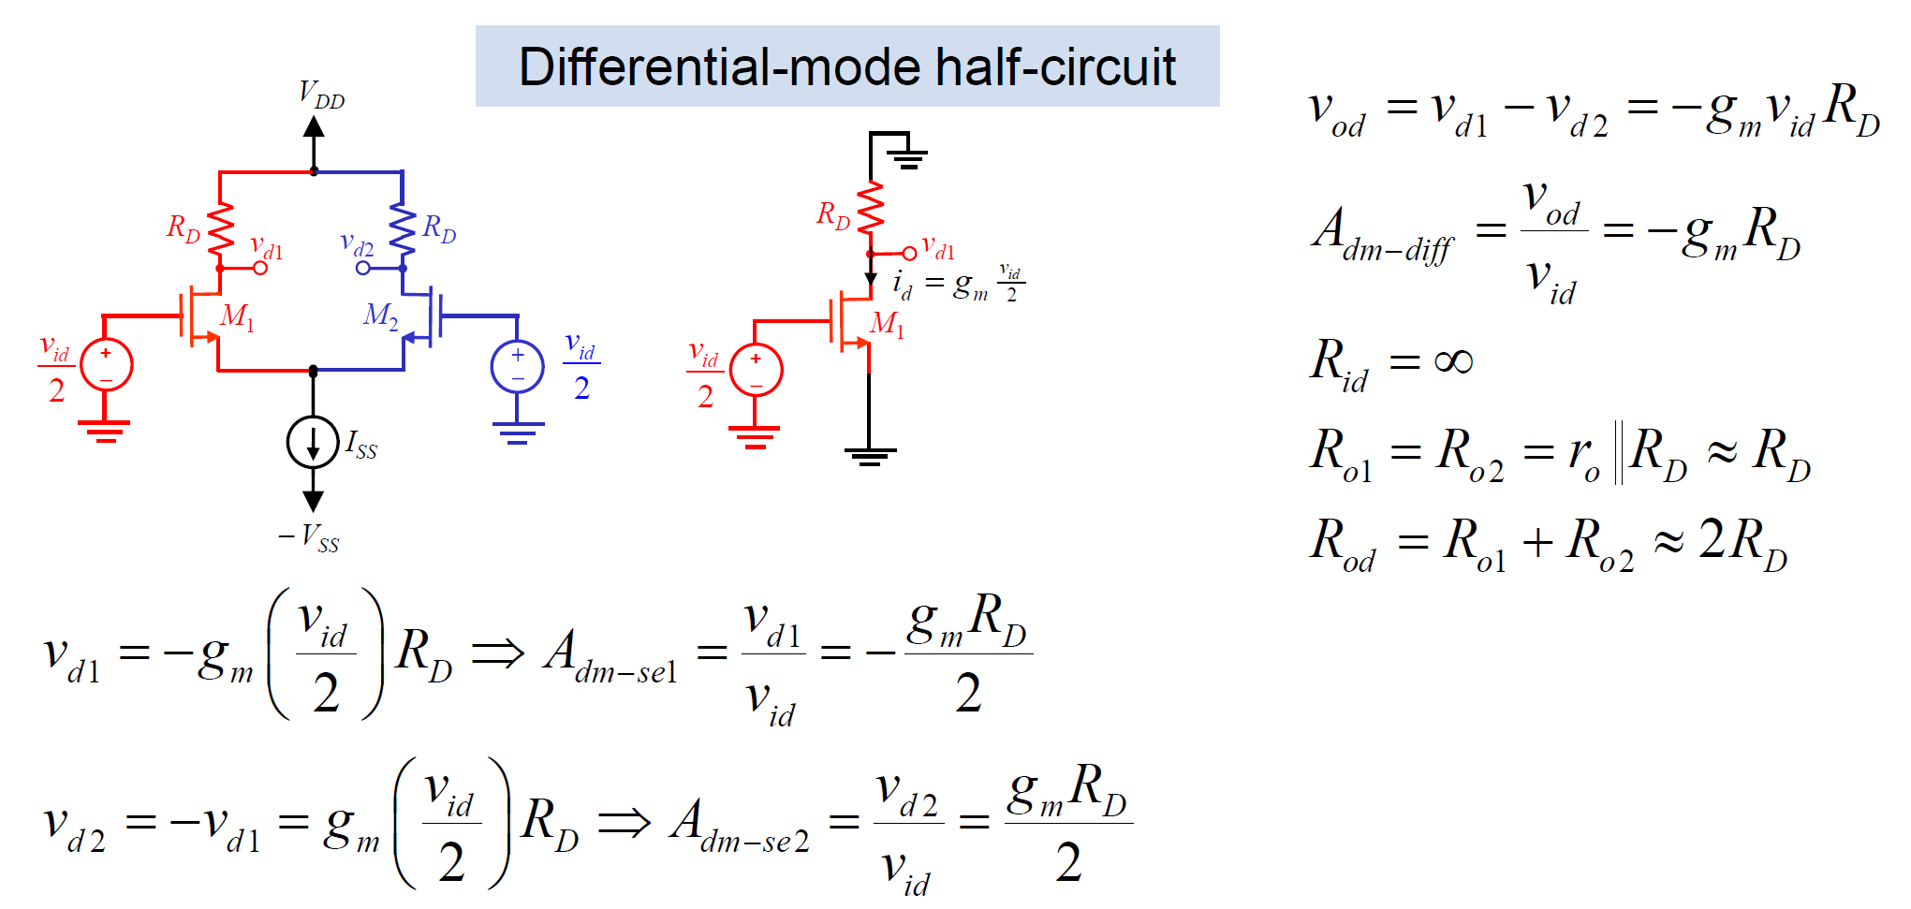
MOS Differential Amplifier: AC Analysis
-

Slide 13
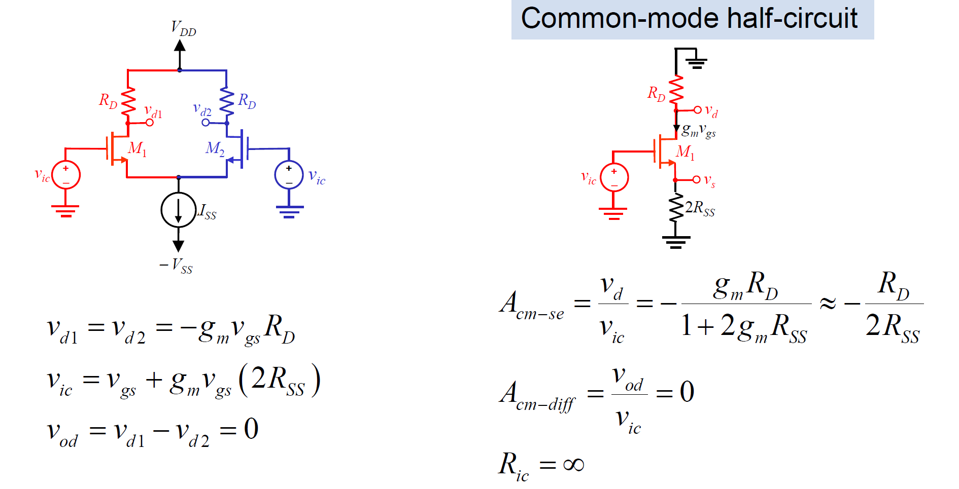
MOS Differential Amplifier: AC Analysis

Slide 14
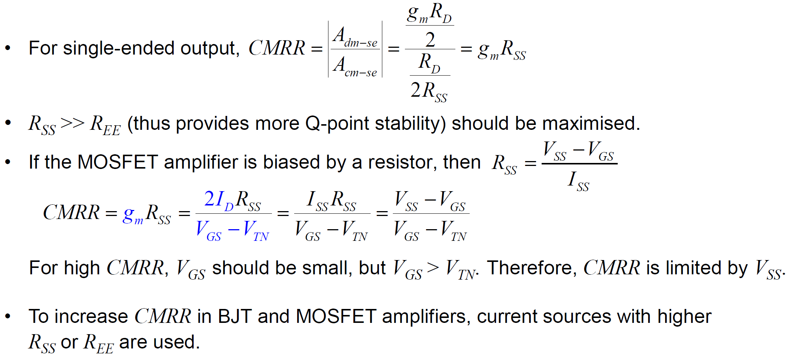
Common Mode Rejection Ratio (CMRR)

Slide 15
Appendix

Slide 16
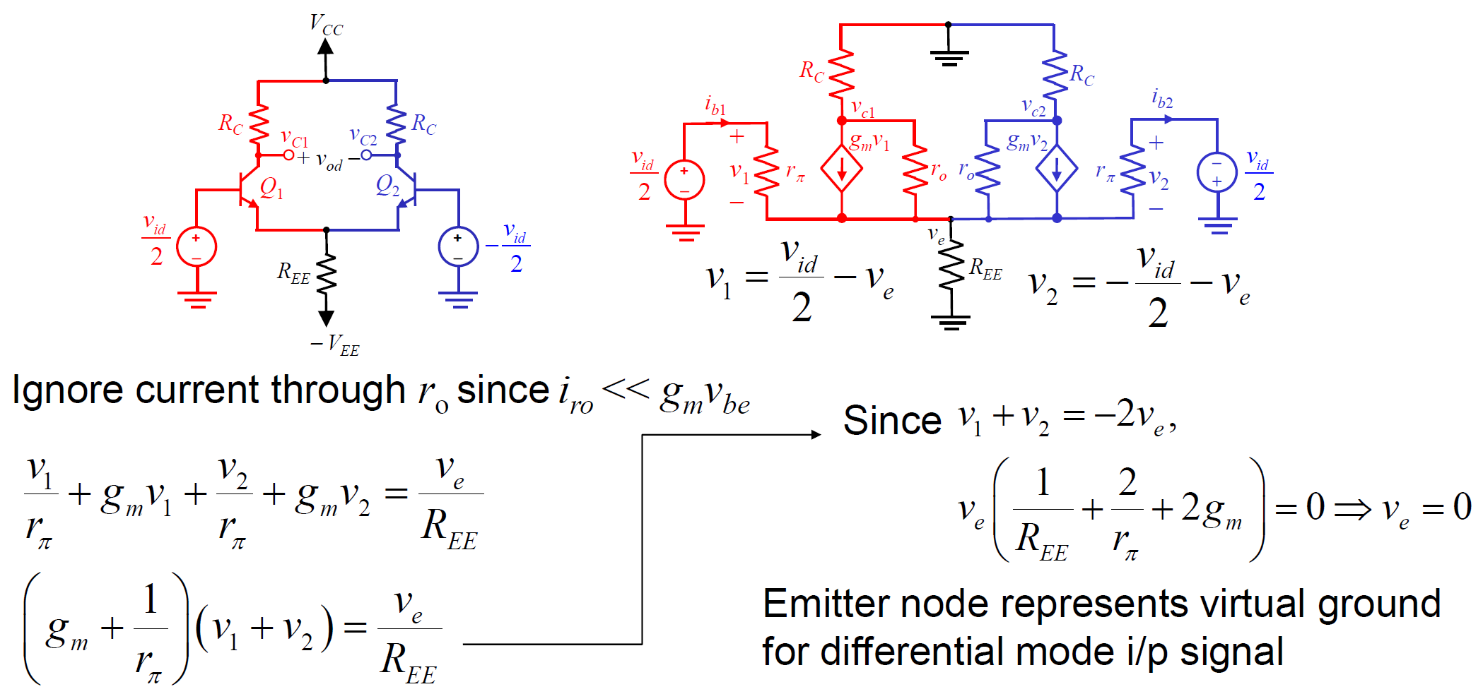
Differential Amplifier: Proof of Virtual GND

