Slide 1
GE2262 Business Statistics
Topic 1
Introduction to Statistics
Reference
Levine, D.M., Krehbiel, T.C. and Berenson, M.L., Business Statistics: A First Course, Pearson Education Ltd, Chapter 1 & 2 & 3
Liu, K. I., To K. M., Speaking of Statistics, Pearson Education Ltd, Chapter 1

Slide 2
Outline
Introduction
  What is/are Statistics?
  Why Study Statistics?
  Types of Variables
  Organizing and Visualizing Data
  Use and Misuse of Statistics
Descriptive Statistics
  Measures of Central Tendency
  Measures of Variation
  Distribution Shape
  Use of Excel in Organizing Data
  Use of Excel in Descriptive Statistics

Slide 3
What is/are Statistics?
Of what?
What types?
Statistics
The branch of mathematics that transforms data into useful information for decision makers.
Difference?
Descriptive Statistics
Collecting, summarizing, and describing data
Inferential Statistics
Drawing conclusions and/or making decisions concerning a population based only on sample data
How to summarize data with tables & charts?
What measures of central tendency & variation to use?
What is the shape of the distribution?
What is the difference between sample & population? What is the difference between sample statistics and population parameters?

Slide 4
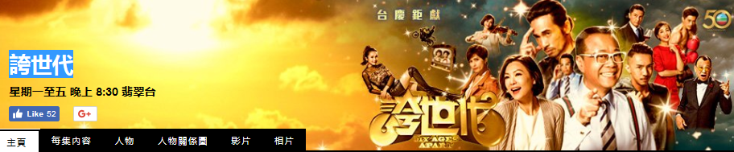
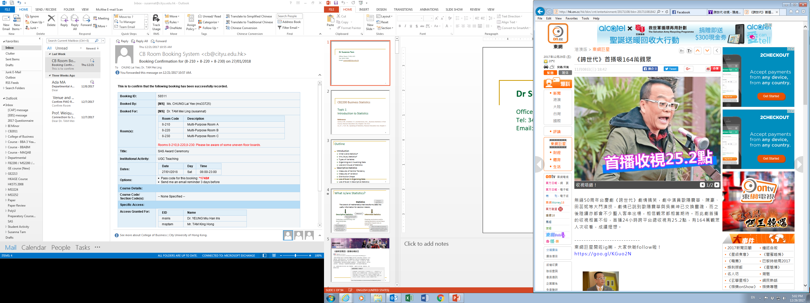
Source: http://hk.on.cc/hk/bkn/cnt/entertainment/20171108/bkn-20171108184206247-1108_00862_001.html

Slide 5
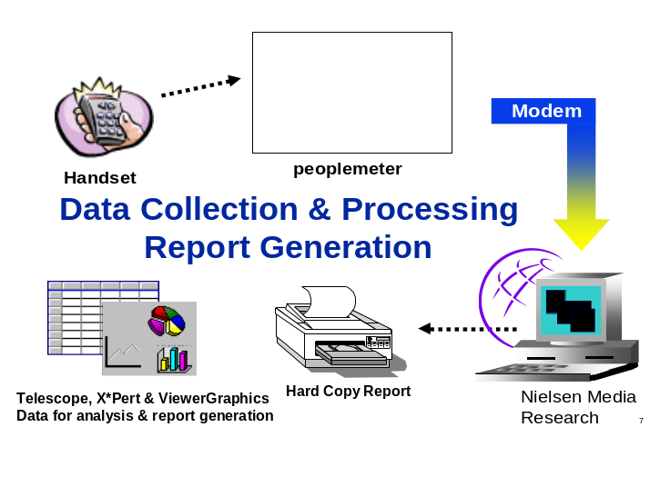
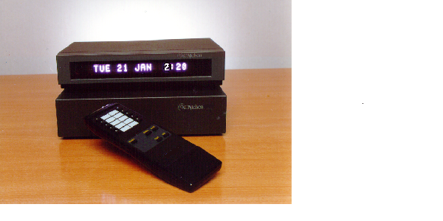
How to estimate the number of people watching a TV programme?
Cont’d
  Nielsen Media Research uses a “People Meter” device to record the viewing behavior of members of a sample of households (minute level viewing information)
In USA, 5,000 homes (13,000 individuals) are selected; in Hong Kong, 815 households (2,300 individuals) are selected

Slide 6
How to estimate the number of people watching a TV programme?
Cont’d
People Meter Data
Panel_ID | Member Number | Eff_Date | Channel Code | Start Time | End Time
1124339 | 2 | 2016-4-19 | 99 | 776 | 806
1124339 | 2 | 2016-4-19 | 1 | 1108 | 1262
1124339 | 3 | 2016-4-19 | 1 | 1185 | 1262
…. | …. | …. | …. | …. | ….
It’s a STATISTICAL STUDY!
Start time = 776 means 12:56 pm and End time = 806 means 1:26 pm etc. Channel Code = 1 means watching TVB Jade; Channel Code = 99 means watching Viu TV
Hence, on “19 April 2016”, the individual “2” of household “1124339” watched channel “99” (Viu TV) from 12:56 pm (“776”) to 1:26 pm (“806”)

Slide 7
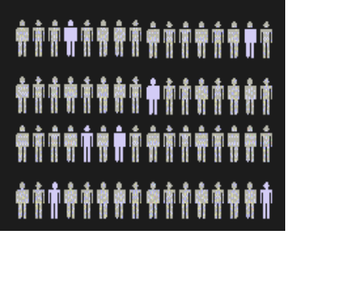
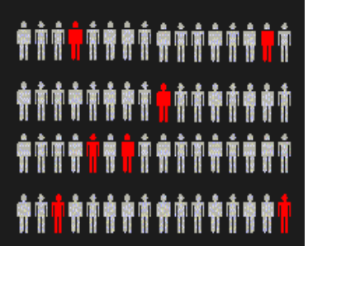
Basic Steps in a Statistical Study
Step 1: State the goal of your study precisely; that is, determine the population you want to study and exactly what you’d like to learn about it (population parameters).
Step 2: Choose a sample from the population. (Be sure to use an appropriate sampling technique)
Step 3. Collect raw data from the sample and summarize these data by finding sample statistics of interest.
Step 4. Use the sample statistics to make inference about the population.
Step 5. Draw conclusions; determine what you learned and whether you achieved your goal.
Population
Sample
Measures used to describe the population are called parameters
Measures computed from sample data are called statistics

Slide 8
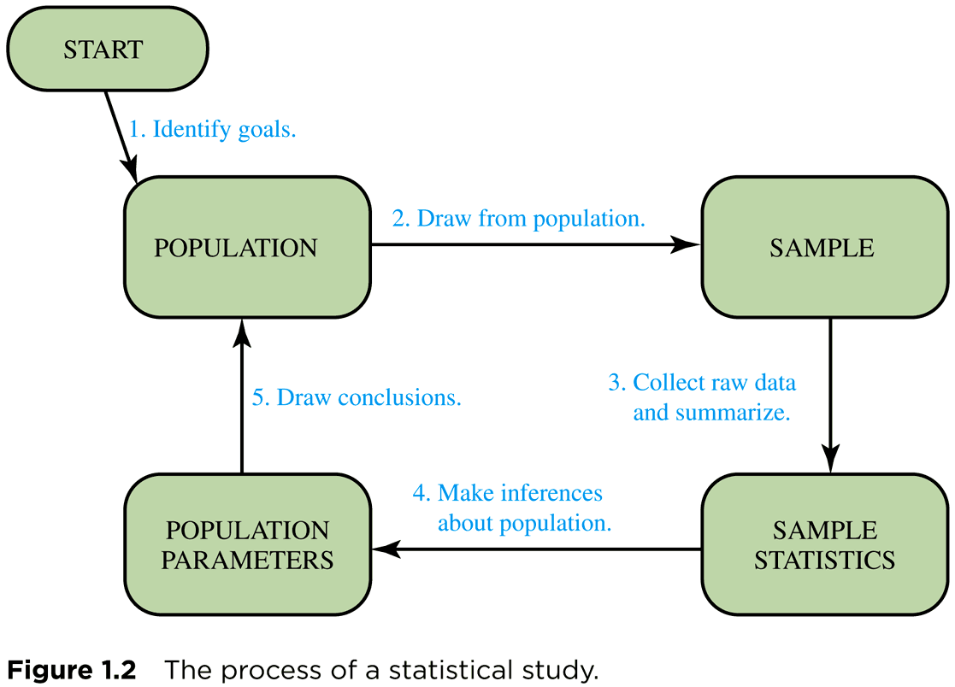
Process of a Statistical Study
Cont’d

Slide 9
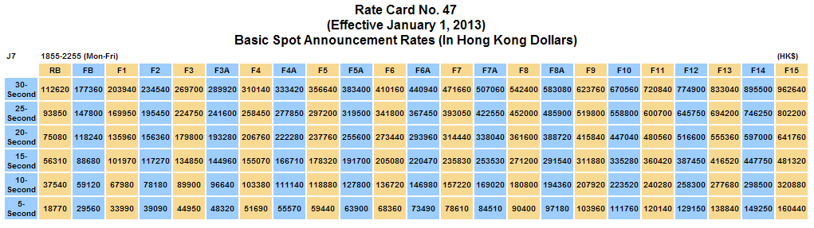
Why use Nielsen Media Research?
Nielsen Media Research earns money by charging television stations and networks for its services. For example, TVB pays Nielsen to provide ratings for its television shows. Why doesn’t TVB simply do its own ratings, instead of paying a company like Nielsen to do them?
Cost of Advertising in TVB Jade
Notes:
The cost of advertising on a television show depends on the show’s ratings. The higher the ratings, the more the network can charge for advertising—which means NBC would have a clear bias if it conducted its own ratings. Advertisers therefore would not trust ratings that NBC produced on its own

Slide 10
Statistical Study – Exercise
Cont’d
Describe how you would apply the five basic steps in a statistical study to estimate the average time that local CityU students use to travel from home to campus.
  Step 1:
  Step 2:
  Step 3:
  Step 4:
  Step 5:

Slide 11

How to Make Money Nowadays?
Walmart put all its checkout-counter data into a giant digital warehouse and set the disk drives spinning.
Out popped a most unexpected correlation: diapers and beer at the same cart usually on Fridays.
Any relationship?

Slide 12
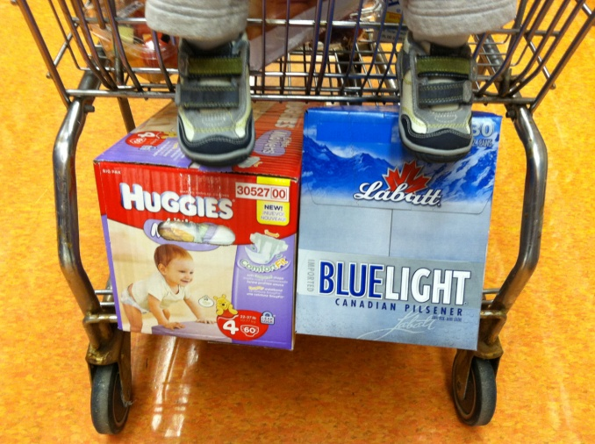
How to Make Money Nowadays?
Cont’d
With statistical analysis, Walmart found that young mothers always ask fathers to purchase diapers for babies after work
Evidently, young fathers would make a late-night run to the store to pick up Huggies and get some Blue Light while they were there
Capitalizing on the discovery, the store
  placed the disparate items together
  placed high-price diapers besides beer (as males don’t concern the price)
Sales zoomed!!!

Slide 13
Why Study Statistics?
  Knowing how to do statistics can lead to become a well recognized and respected profession: Statistician
  “I don’t like numbers. Statistics are not for me!!!
    Unfortunately, statistics are there for everybody, like it or not!
      “Smaller average pay rise of 3.8% likely to hit Hong Kong workers next year (2016).” The Institute of Human Resources Management
      “The fresh graduate’s average expected monthly salary in 2014 is HK$17,314.” APAC at Universum
      “TVB’s ratings of weekday programmes from 8:00pm – 10:30pm losing some 10,000 viewers compared with a week ago.” SCMP, 16 April 2016
      “Chief Executive Leung Chun-Ying’s popularity rating is 37.5 in January 2016. ” The University of Hong Kong

Slide 14
Why Study Statistics?
Accounting
Cont’d
Information Technology
Marketing
Economics
Finance

Slide 15
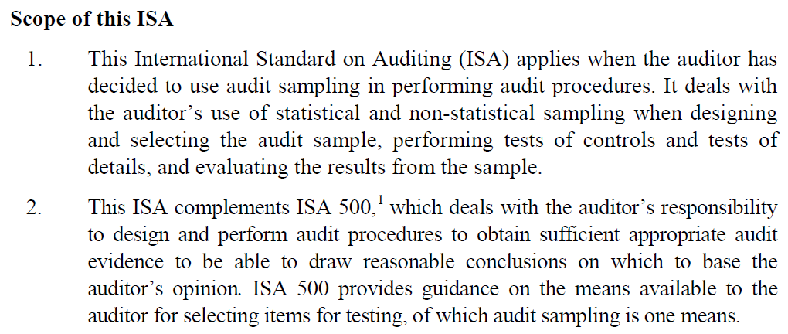

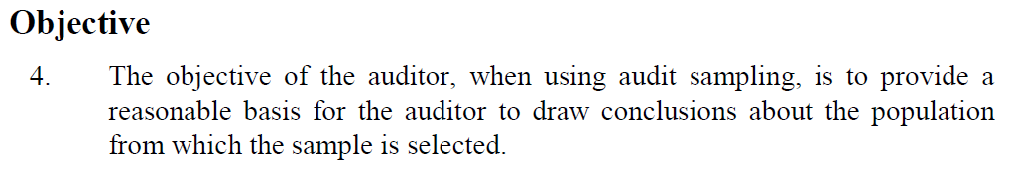
Why Study Statistics?
Accounting
Audit Sampling
  The application of audit procedures to less than 100% of items within a population of audit relevance such that all sampling units have a chance of selection in order to provide the auditor with a reasonable basis on which to draw conclusions about the entire population
  The auditor shall determine a sample size sufficient to reduce sampling risk to an acceptably low level
How to obtain a sufficient SAMPLE SIZE?
Source: http://www.ifac.org/sites/default/files/publications/files/A028%202012%20IAASB%20Handbook%20ISA%20530.pdf

Slide 16
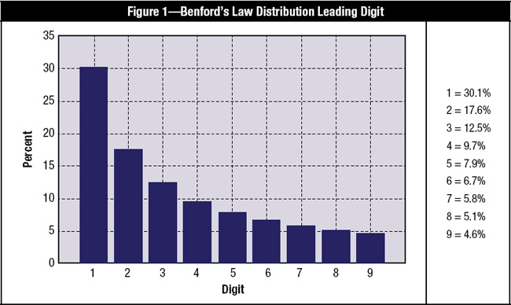
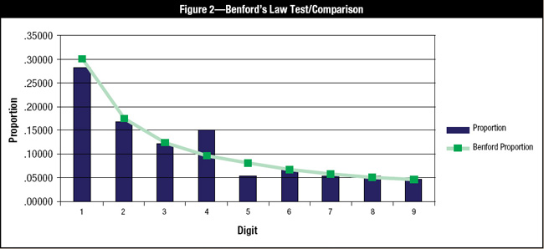
Why Study Statistics?
Information Technology
IT Auditing
  Almost all computer-assisted audit tools (CAATs) have a command for Benford’s Law
  Benford’s Law holds true for a data set that grows exponentially, but also appears to hold true for many cases in which an exponential growth pattern is not obvious
  Beneficial tool for fraud detection, e.g. credit card transactions, purchase orders, loan data, customer refunds, …
  Example
    If a bank’s policy is to refer loans at or above
    US $50,000 to a loan committee, looking just below that approval threshold gives a loan officer the potential to discover loan frauds.
    Note that 4 is aberrantly high in occurrence, and
    5 is too low, indicating the possible manipulation of the natural occurrence of loans beginning with 5 (US $50,000 loans) possibly being switched to just under the cutoff or indicating that the suspect could be issuing a lot of $49,999.99 loans fictitiously to embezzle funds.
How to obtain a PROBABILITY DISTRIBUTION?
Source: http://www.isaca.org/Journal/Past-Issues/2011/Volume-3/Pages/Understanding-and-Applying-Benfords-Law.aspx

Slide 17
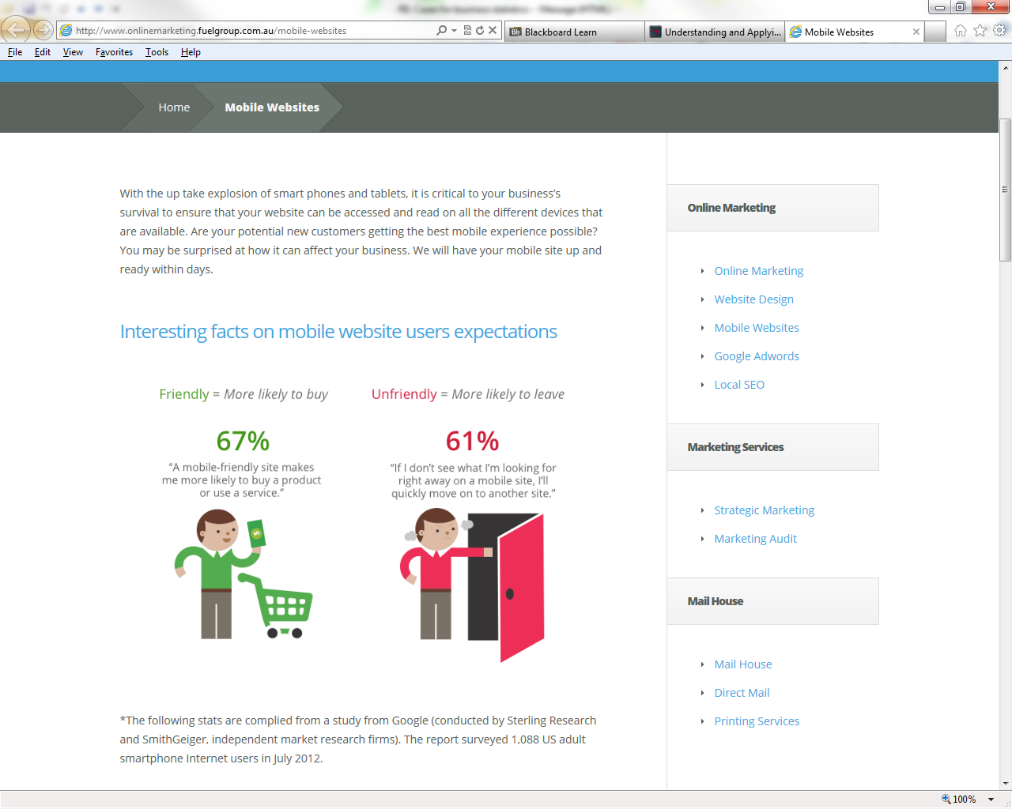

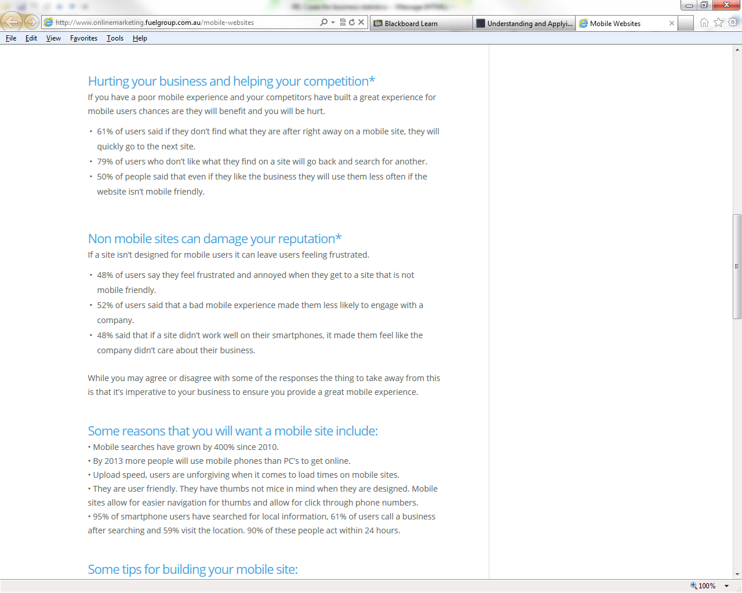
Why Study Statistics?
Marketing
How to draw conclusions on the needs of a POPULATION based only on SAMPLE data?
Marketing Research
  Construction of questionnaires and scales
  Understand the needs of individuals in marketplace, to create marketing strategies and plans
Source: http://www.onlinemarketing.fuelgroup.com.au/mobile-websites

Slide 18
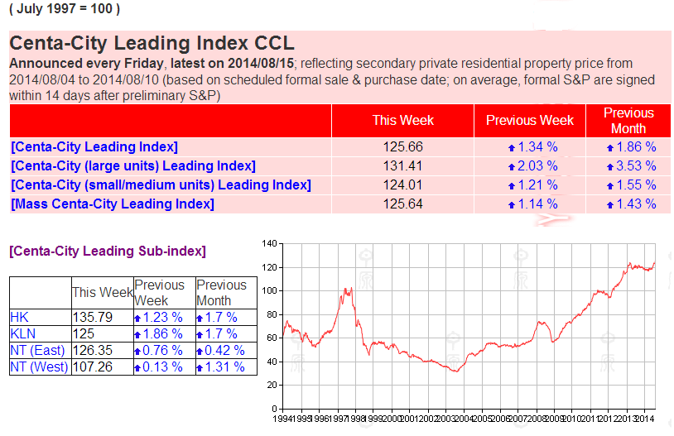
Why Study Statistics?
Economics
Economics Indicators
  Allow analysis of economic performance and predictions of future performance
How to construct ECONOMICS INDEX?
Source: http://hk.centadata.com/cci/cci_e.htm

Slide 19
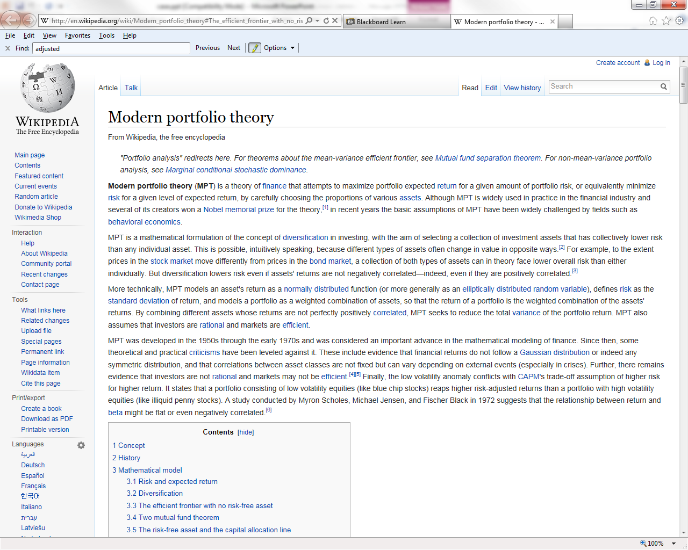
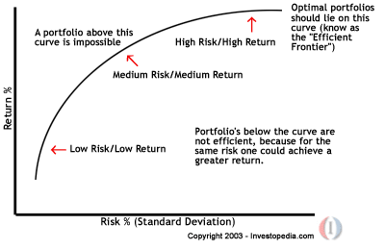
Why Study Statistics?
Finance
Risk and Portfolio Management
  Use statistical models to analyze the market
  Efficient frontier of portfolio (a basket of stocks)
How to measure the portfolio EXPECTED RETURN and RISK?
Source: http://en.wikipedia.org/wiki/Modern_portfolio_theory#The_efficient_frontier_with_no_risk-free_asset

Slide 20
Why Study Statistics?
Big DATA
Cont’d
In May 2011, McKinsey published “Big data: The next frontier for innovation, competition, and productivity”. By 2018, the United States alone could face a shortage of 140,000 to 190,000 people with deep analytical skills as well as 1.5 million managers and analysts with the know-how to use the analysis of big data to make effective decisions
In March 2012, the Obama administration announced the Big Data Research and Development Initiative, which explored how big data could be used to address important problems faced by the government
The White House announced a national "Big Data Initiative" that consisted of six Federal departments and agencies committing more than $200 million to big data research projects

Slide 21
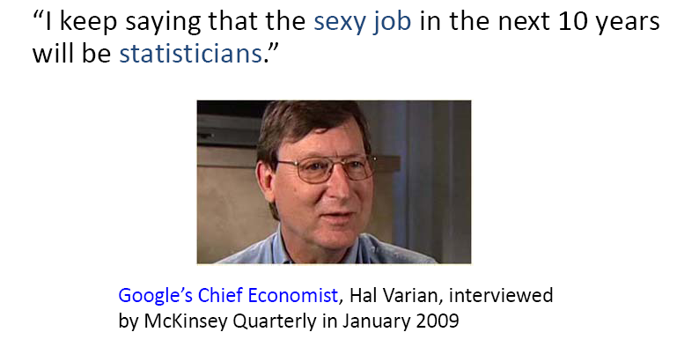
Why Study Statistics?
Cont’d
Statisticians – Dream job of the next decade

Slide 22
More Than Just Numbers
8.32, 7.91, 9.64, 9.18, 10.33, 7.46
As just numbers, this list is uninteresting, but what can you say if this list represents:
  Weight of a newborn puppy?
  Minutes to run a mile?

Slide 23
Variables
A variable is any characteristic, number, or quantity that can be measured or counted
E.g.
  A person’s gender
  The weight of a newborn puppy
  The concentration of CO₂ in the atmosphere
  People’s income
  Examination grade
  Vehicle type

Slide 24
Data
Data are the values measured or observed for each variable of each object
Data can be numeric or categorical
  Numeric data takes numeric values and work well for statistics
    Satisfaction rating ranging from 1 to 10
    Number of students attending the lecture
    People’s income
  Categorical data
    People’s gender
    Examination grade
    Vehicle type

Slide 25
Types of Variables
Variables
Categorical Variables
describes qualities
of the objects of interest
Numerical Variables
describes quantities
of the objects of interest
Discrete
Continuous
Examples:
Marital Status
Political Party
Eye Color
(Defined categories)
Examples:
Number of Children
Defects per hour
(Counted items)
Examples:
Weight
Voltage
(Measured characteristics)

Slide 26
Types of Variables – Exercise
Cont’d
Age | Gender | Major | Credits | District | GPA
18 | Male | Management Sciences | 16 | Hong Kong Island | 3.6
21 | Male | Accountancy | 18 | New Territories | 3.1
20 | Female | Marketing Information Mgt | 16 | Kowloon | 2.8
Numerical
Categorical

Slide 27
Numerical or Categorical?
Why are you in college? Answer:
1. Personal Growth 2. Career Opportunities
3. Parental Pressure 4. Personal Networking
Results: 1, 4, 3, 2, 2, 1, 2, 3, 3, 1, 4, 2
Coding categorical data with numbers: Although the above data values are numbers, the variable is still categorical
Reason for coding: Easier to input into a computer

Slide 28
Coding Yes/No Questions
Use 0 for “No” and 1 for “Yes”
Useful for data with only two possible values
  True or False
  Black or White
  Success or Failure
  Dead or Alive

Slide 29
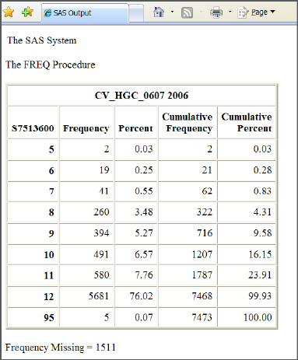
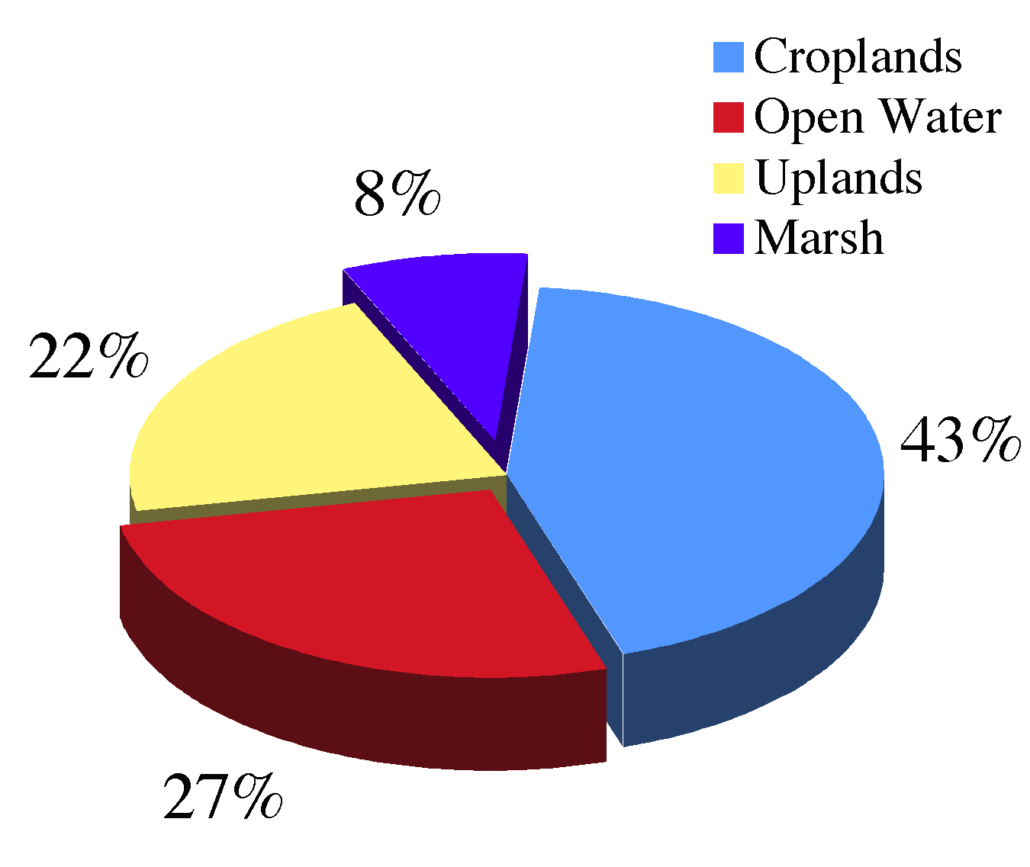
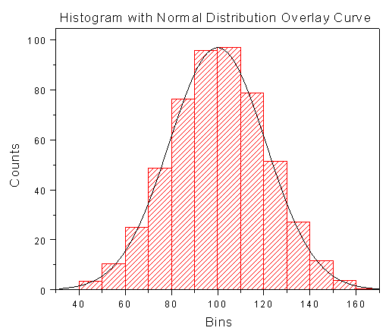
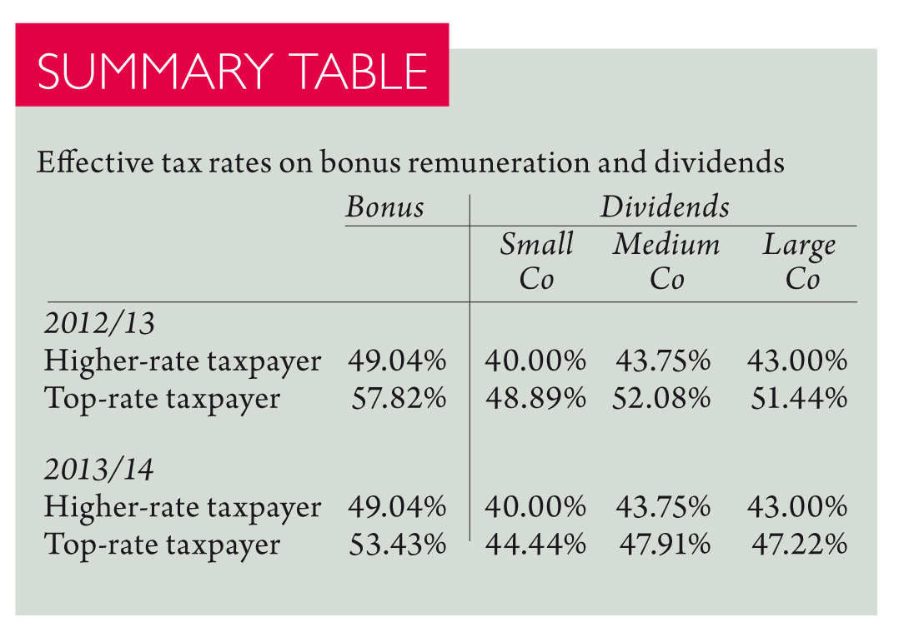
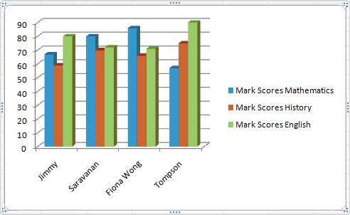
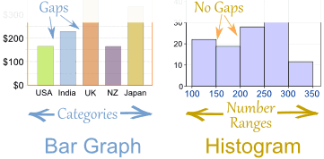
Organizing and Visualizing Data
Variables
Categorical Variables
describes qualities
of the objects of interest
Numerical Variables
describes quantities
of the objects of interest
Summary Table
Bar Chart
Pie Chart
Frequency Distribution
Histogram

Slide 30
Organizing and Visualizing Data
Cont’d
Organizing Categorical Data
  Suppose you asked 60 customers to pick which of the three colours, say green, red, or blue they like best for a product
    The data might look like this: green, red, green, green, red, red, blue, blue, green, red, green, blue, red, blue, green, green, blue, green, green, blue, green, blue, green, red, blue, green, green, green, green, red, red, red, blue, green, green, green, green, blue, red, red, green, green, red, blue, green, red, green, green, blue, red, green, red, green, blue, blue, blue, green, green, green, green

Slide 31
Organizing and Visualizing Data
Cont’d
A natural way to describe the data is counting how many of each colour you have got
A summary table:
  It is accustomed to list the values of the variable in alphabetical order of the category, or in descending (or ascending) order of the count
  In statistical context, the proper name for count is called frequency
Colour | Number of Customers
blue | 15
green | 30
red | 15
Total | 60

Slide 32
Organizing and Visualizing Data
Cont’d
You cannot tell from the table which customer picked what colour. This information is often unimportant in reporting
The table tells us
  15 customers picked blue, 30 customers picked green, and 15 customers picked red
  More customers picked green than the other two colours
  About the same number of customers picked the two other colours

Slide 33
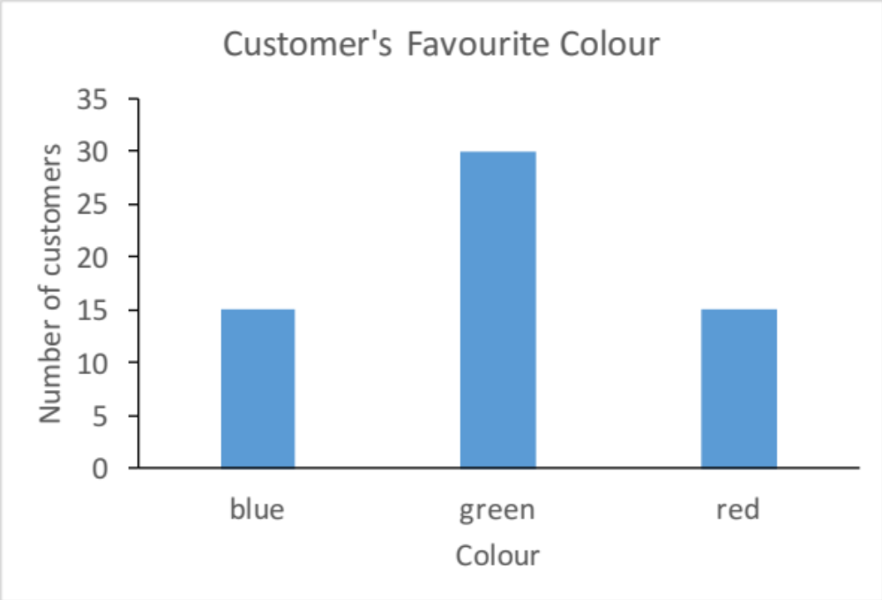
Organizing and Visualizing Data
Cont’d
  (Frequency) Bar Chart

Slide 34
Organizing and Visualizing Data
Cont’d
  Features of a Bar Chart
  It is accustomed to arrange the bars in the alphabetical order of the categories of the variable, or in descending (or in ascending) order of the count
  It is up to you to decide the gap between two bars, as long as the gaps are the same
  It is up to you to decide the width of each bar, as long as they all have the same width
    Keeping the widths of the bars equal ensuring the area of each bar proportional to the number of individuals in that category
  The height of each bar is proportional to the number of individuals in that category

Slide 35
Organizing and Visualizing Data
Cont’d
The proportion of each category can also be included in the summary table and bar chart
  In statistical context, percent is called relative frequency
Colour | Number of Customers | Percent of Customers
blue | 15 | 25%
green | 30 | 50%
red | 15 | 25%
Total | 60 | 100%

Slide 36
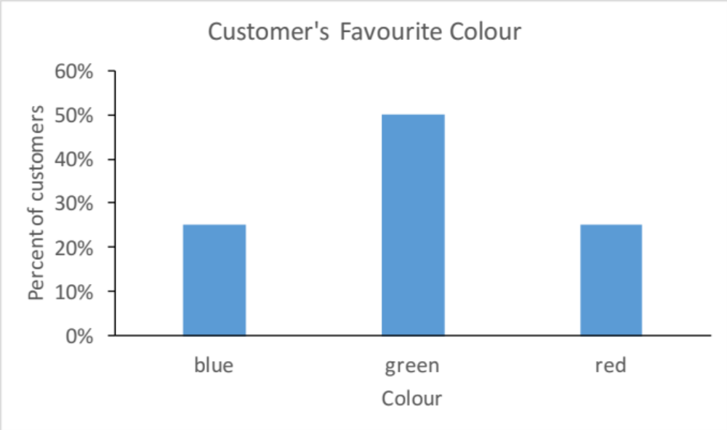
Organizing and Visualizing Data
Cont’d
  (Relative Frequency) Bar Chart

Slide 37
Organizing and Visualizing Data
Cont’d
The two bar charts, frequency and relative frequency, looks the same if the vertical scales are removed
In fact, the sizes of the bars depend on percent, not on exactly how many
  The bar chart would look the same if you had started out with 150 blue, 300 green, and 150 red

Slide 38
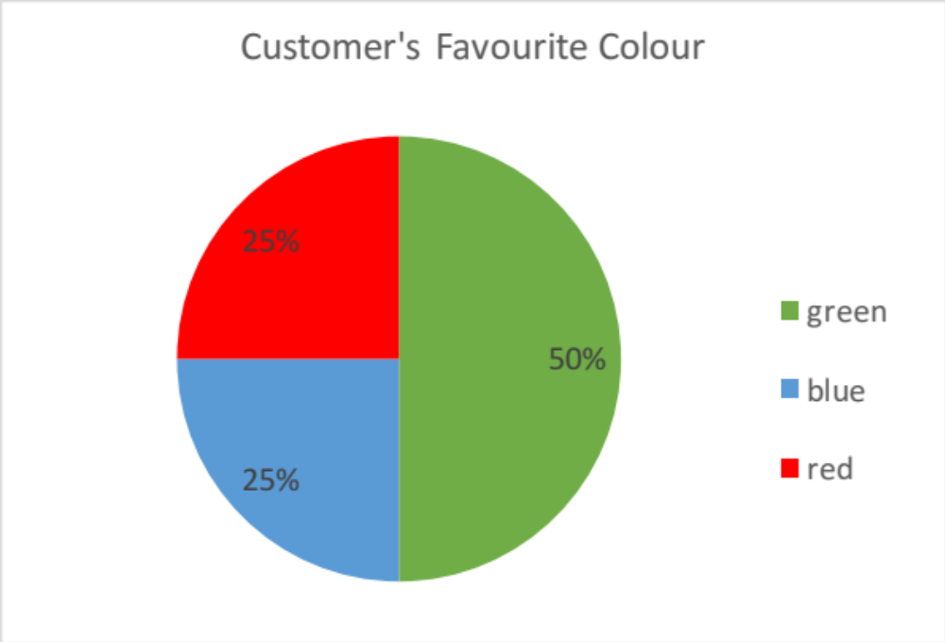
Organizing and Visualizing Data
Cont’d
  Pie Chart

Slide 39
Organizing and Visualizing Data
Cont’d
Features of a Pie Chart
  It shows the size relationship between the categories of the variable and the variable itself
  The slices are mutually exclusive. The sum of all slices equal to 100 percent
  It is accustomed to arrange the slices in the alphabetical order of the categories of the variable, or in descending (or in ascending) order of the count
  Slices of very low percent may need to be combined with others
  Numbers (percent or count) should be shown as it is difficult to compare slices of similar size

Slide 40
Organizing and Visualizing Data
Cont’d
Organizing Numerical Data
  Suppose you asked 100 people about the amount they spent in their last visit to supermarket
    The data might look like this: 44.8, 230.5, 303.6, 70.8, 534.4, 166.2, 466, 85.1, 63, 47.8 36.5, 35.7, 12.7, 11.9, 297.5, 74.1, 77.1, 251.2, 127.1, 118.6, 211.2, 221.9, 49.1, 349.1, 556.6, 768, 231.7, 247.2, 87.4, 304.3, 311.3, 825.8, 15.9, 526, 5.2, 156.7, 65.2, 143.3, 138.5, 478.4, 124.2, 205.1, 90.8, 3.1, 334.8, 7.4, 113.8, 79.2, 128.8, 26.6, 15.2, 554.4, 2.9, 70.2, 540.7, 36.4, 588.9, 151.5, 14.2, 235.7, 13.7, 187.4, 817.8, 140.3, 114.9, 219.5, 31.4, 99.4, 47.3, 111.8, 230.2, 478.2, 4.6, 783.5, 483.5, 99.3, 92.8, 464.2, 172.9, 380.1, 234.5, 120.2, 100.3, 109.8, 276.1, 157.7, 192.9, 13.1, 62.2, 44.2, 35.9, 239.9, 193.8, 591.9, 249.1, 17.9, 89.3, 369.1, 38.2, 154.3

Slide 41
Organizing and Visualizing Data
Cont’d
Similar to categorical data, numerical data can be presented in the form of table. It is called frequency distribution
  The frequency distribution is a summary table in which the data are arranged into numerically ordered classes
Amount Spent ($) | Frequency
0 - < 100 | 40
100 - < 200 | 22
200 - < 300 | 15
300 - < 400 | 7
400 - < 500 | 5
500 - < 600 | 7
600 - < 700 | 0
700 - < 800 | 2
800 - < 900 | 2
900 - < 1000 | 0
Total | 100

Slide 42
Organizing and Visualizing Data
Cont’d
Steps to construct a frequency distribution
  Sort data in ascending order: 2.9, 3.1, 4.6, 5.2, 7.4, …
  Find the range: 825.8 – 2.9 = 822.9
  Select the number of classes: 10
  Compute the class interval (width): 822.9 / 10 = 82.29
    Round up to a convenient number, say 100
  Determine class boundaries (limits):
    Class 1: 0 but less than 100
    Class 2: 100 but less than 200
    …
  Assign the observation to each class and count the number of observations

Slide 43
Organizing and Visualizing Data
Cont’d
Features of frequency distribution
  Exact value of each observation is lost
  The width of each interval is identical
    Width can be unequal. However, it should be done so only under very special circumstances, such as the data is sparsely distributed, or have a very long tail at one or both ends
  The lower value of the first class interval is often the smallest value in the data, or a smaller value which is selected for the reason of convenience, such as 0
  Class boundaries include the left endpoint, but not the right
    Other endpoint policy can be adopted, but need to be consistent

Slide 44
Organizing and Visualizing Data
Cont’d
Features of frequency distribution
  The number of classes depends on the number of values in the data
    Large data range and high number of observations allow a larger number of class. In general, 5 to 15 classes will be sufficient
  The width of a class depends on the number of classes adopted and the data range
    To determine the width of a class, you divide the range (highest value – lowest value) of the data by the number of classes desired

Slide 45
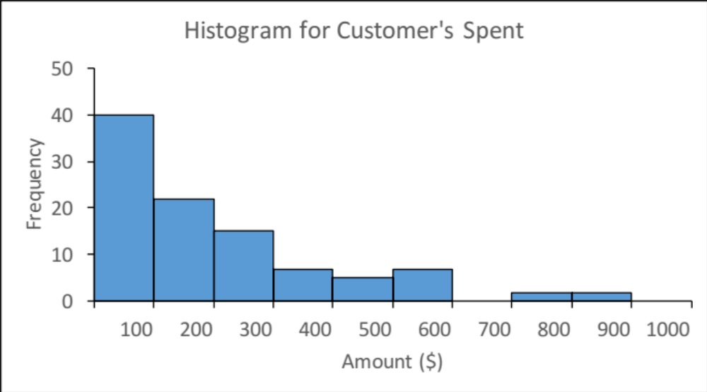
Organizing and Visualizing Data
Cont’d
Histogram
  A histogram is a bar chart for grouped numerical data in which the frequencies of each group of numerical data are represented as individual vertical bars
  For example:

Slide 46
Organizing and Visualizing Data
Cont’d
Features of a histogram
  The chart is made from the constructed frequency distribution
  The height of the bars is in proportion to the frequency of intervals
  There is no gap between bars
    If an interval has 0 frequency, the height of the bar in the histogram is 0
  The width of the bars must be identical because the width of the intervals are identical
  The bar must be drawn in the same sequence as of the intervals in the frequency distribution

Slide 47
Organizing and Visualizing Data
Cont’d
  The proportion of each class can also be displayed in frequency distribution (or histogram)
Amount Spent ($) | Frequency | Relative Frequency
0 - < 100 | 40 | 0.40
100 - < 200 | 22 | 0.22
200 - < 300 | 15 | 0.15
300 - < 400 | 7 | 0.07
400 - < 500 | 5 | 0.05
500 - < 600 | 7 | 0.07
600 - < 700 | 0 | 0.00
700 - < 800 | 2 | 0.02
800 - < 900 | 2 | 0.02
900 - < 1000 | 0 | 0.00
Total | 100 | 1.00

Slide 48

Faulty Graphs:
Chart Junk
✓
Bad Presentation
Good Presentation
Nominal Wage Index in Hong Kong
(Sept 1992=100)
2009: 157.9
2010: 163.1
2011: 178.3
2012: 187.5

Slide 49
Faulty Graphs:
No Relative Basis
Cont’d
✓
Bad Presentation
Good Presentation

Slide 50
Faulty Graphs:
Compressing the Vertical Axis
Cont’d
✓
Bad Presentation
Good Presentation

Slide 51
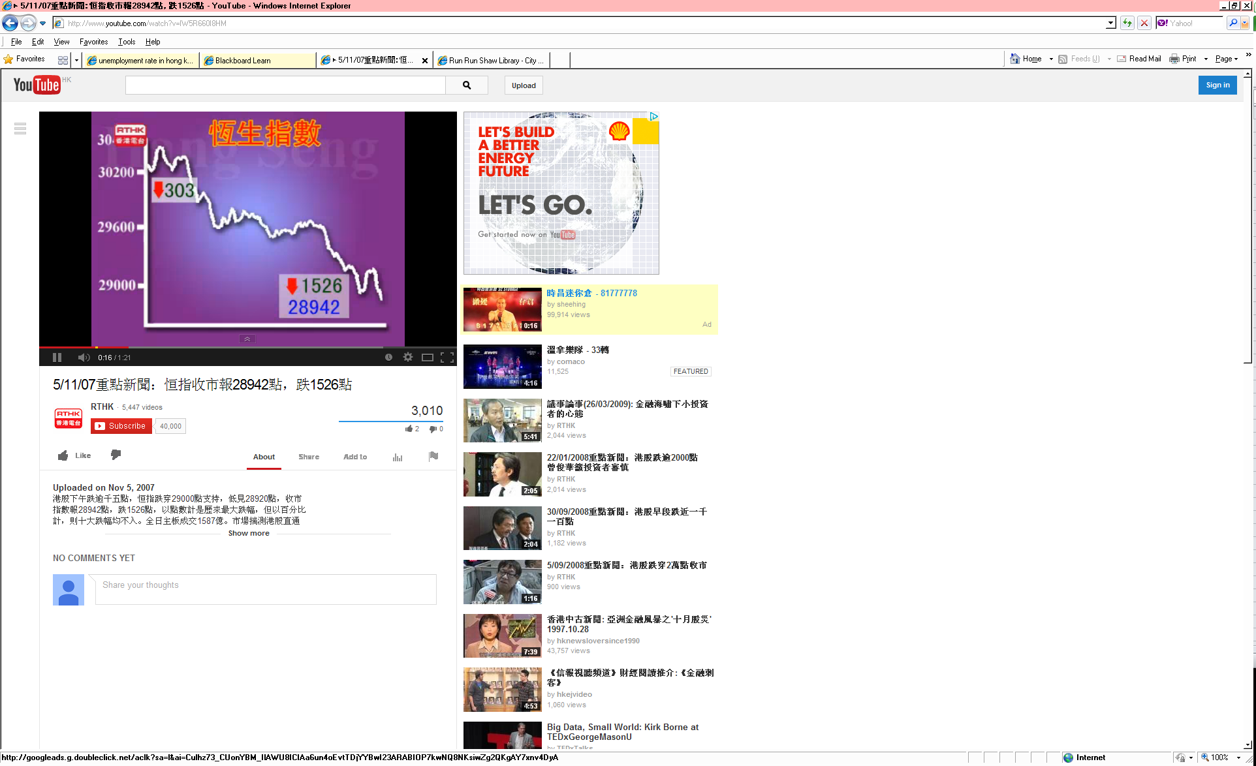
Faulty Graphs:
No Zero Point on the Vertical Axis
Cont’d
✓
Bad Presentation
Good Presentation

Slide 52
Principles of Excellent Graphs
The graph should not distort the data
The graph should not contain unnecessary adornments (sometimes referred to as chart junk)
The scale on the vertical axis should begin at zero
All axes should be properly labeled
The graph should contain a title
The simplest possible graph should be used for a given set of data

Slide 53
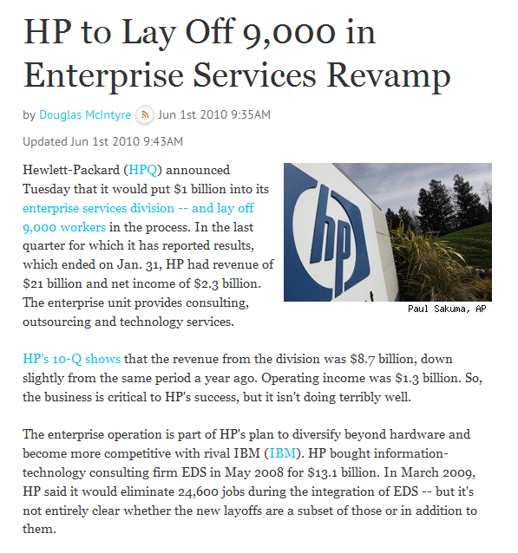
Use and Misuse of Statistics
Notes:
HP to Lay Off 9000 in Enterprise Services Revamp
It appears that HP was laying off a massive amount of staff members. For the sake of comparison, the total number of students in UGC-funded programs in CityU was only 8518 in 2010. However, we have yet to see the entire picture. In mathematics, we cannot say a number is huge or tiny by looking at the number of digits, since huge and tiny are relative concepts. If we want to know whether a change is significant, it is more effective to show the percentage change, which demonstrates a relative change in quantity. The definition of percentage change is:

Slide 54
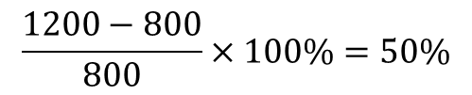
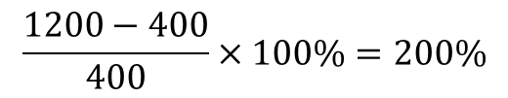
Use and Misuse of Statistics:
Faulty Percentages
Cont’d
Election Committee for
Chief Executive Election
in Hong Kong
1996
2008
2012
400
800
1200
$$\frac{1200−400}{400}×100\%=200\%$$
$$\frac{1200−800}{800}×100\%=50\%$$

Slide 55
Summary Definitions
The central tendency is the extent to which all the data values group around a typical or central value
The variation is the amount of dispersion or scattering of values
The shape is the pattern of the distribution of values from the lowest value to the highest value

Slide 56
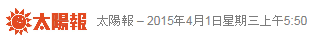
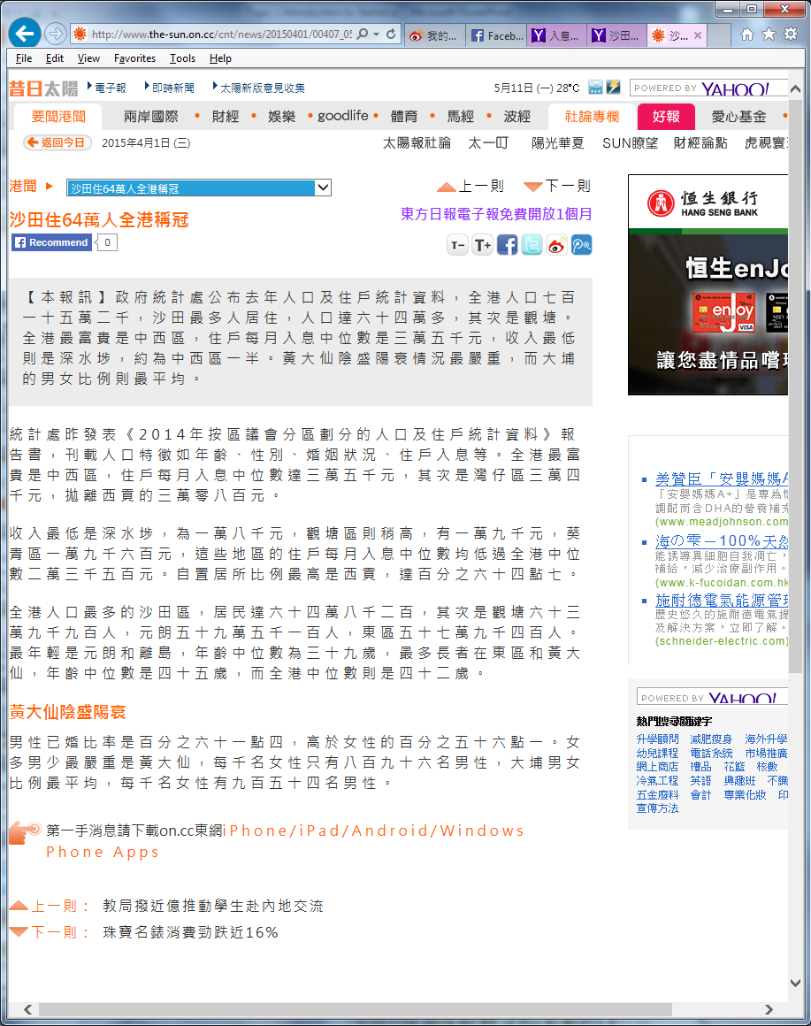
Measures of Central Tendency
Cont’d
What is Median? Why it is used?

Slide 57
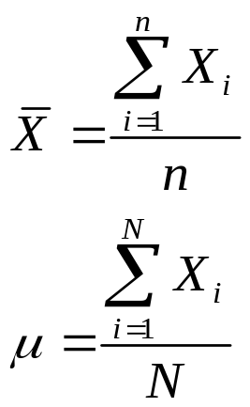
Measures of Central Tendency
Cont’d
Central Tendency
Mean
Median
Mode
middle value in the ordered array
most frequently observed value

Slide 58
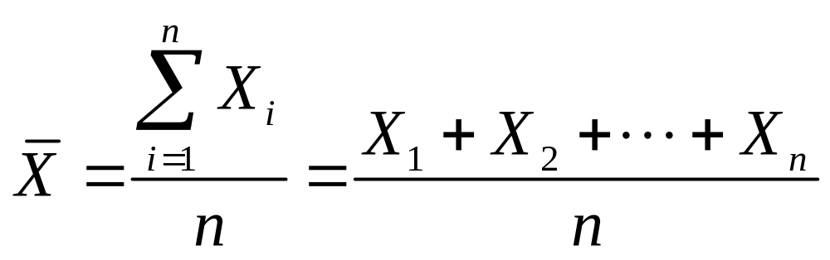
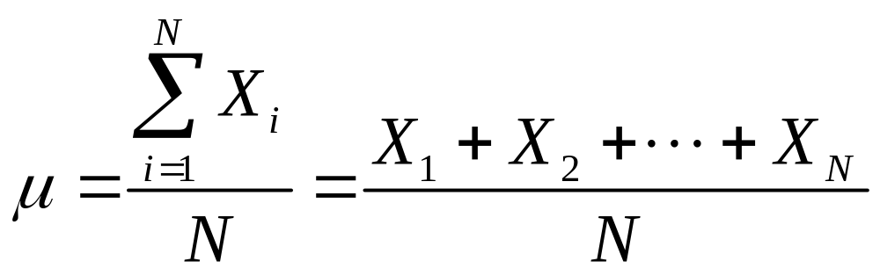
Measures of Central Tendency:
The Mean
Cont’d
Sample mean
pronounced x-bar
Sample Size
Population mean
pronounced mu
Population Size

Slide 59
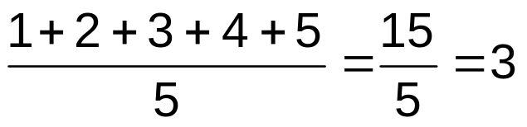
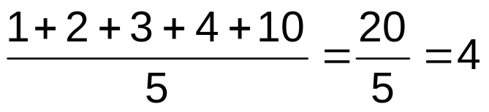
Measures of Central Tendency:
The Mean
Cont’d
The most common measure of central tendency
Affected by extreme values (outliers)
0 1 2 3 4 5 6 7 8 9 10
0 1 2 3 4 5 6 7 8 9 10
Mean = 3
Mean = 4

Slide 60
Measures of Central Tendency:
The Median
Cont’d
Robust measure of central tendency
In an ordered array, the median is the “middle” number (50% above, 50% below)
  If n or N is odd, the median is the middle number
  If n or N is even, the median is the average of the 2 middle numbers
Not affected by extreme values (outliers)
0 1 2 3 4 5 6 7 8 9 10
0 1 2 3 4 5 6 7 8 9 10
Median = 3
Median = 3

Slide 61
Measures of Central Tendency:
The Mode
Cont’d
Value that occurs most often
Not affected by extreme values (outliers)
Used for both numerical and categorical data
There may be no mode
There may be several modes
0 1 2 3 4 5 6 7 8 9 10 11 12 13 14
0 1 2 3 4 5 6
No Mode
Mode = 9

Slide 62
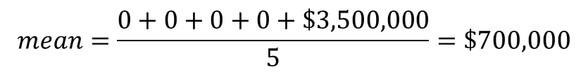
Effects of Outliers
Imagine that the five graduating seniors on a college basketball team receive the following first-year contract offers to play in the National Basketball Association (zero indicates that the player did not receive a contract offer):
0 0 0 0 $3,500,000
The mean contract offer is:
Is it therefore fair to say that the average senior on this basketball team received a $700,000 contract offer?
$$mean=\frac{0+0+0+0+\$3,500,000}{5}=\$700,000$$
Why Census & Statistics Department reported the median household income?
When the Hong Kong Housing Authority revises the rent of public housing, they need a reference for the average income of tenants. Should they consider the mean or the median?

Slide 63
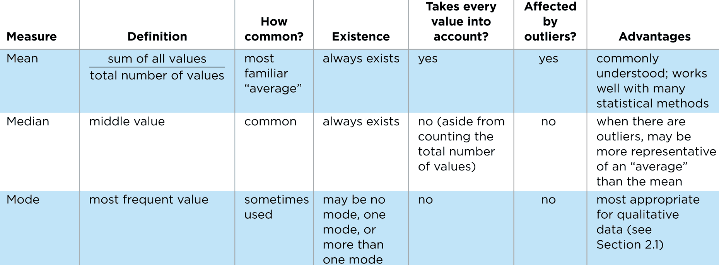
Comparison of Mean, Median & Mode

Slide 64
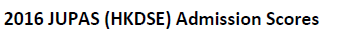
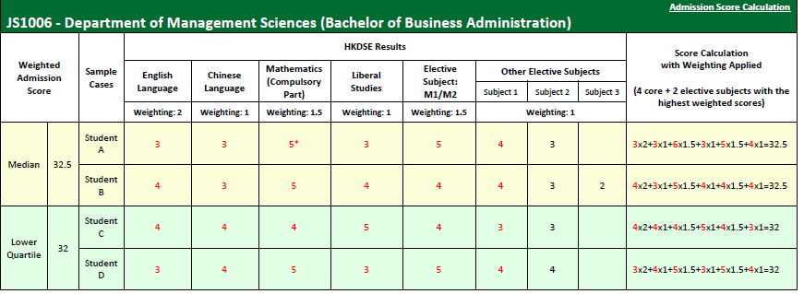
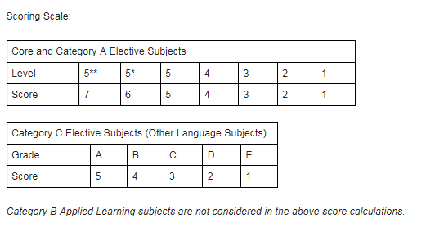
Measures of Variation
What is Lower Quartile? Why we need it?

Slide 65
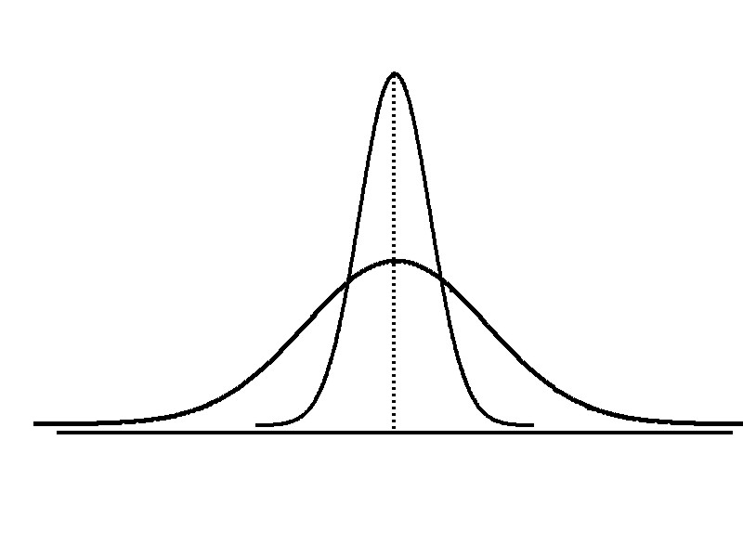
Measures of Variation
Cont’d
Variation
Range
Interquartile Range
Variance
Standard Deviation
Measures of variation give information on the spread or variability or dispersion of the data values
same center, different variation

Slide 66
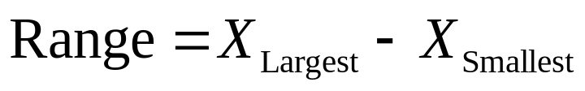
Measures of Variation:
The Range
Cont’d
Simplest measure of variation
Difference between the largest and the smallest values
Ignores the way in which data are distributed
7 8 9 10 11 12
7 8 9 10 11 12
Range = 12 - 7 = 5
Range = 12 - 7 = 5
Sensitive to outliers
1,1,1,1,1,1,1,1,1,1,1,2,2,2,2,2,2,2,2,3,3,3,3,4,5
Range = 5 - 1 = 4
1,1,1,1,1,1,1,1,1,1,1,2,2,2,2,2,2,2,2,3,3,3,3,4,120
Range = 120 - 1 = 119

Slide 67
Quartiles
Quartiles split the ranked data into 4 segments with an equal number of values per segment
25%
25%
25%
25%
Q₁
Q₂
Q₃
  The first quartile, Q₁, is the value for which 25% of the observations are smaller and 75% are larger
  Q₂ is the same as the median (50% of the observations are smaller and 50% are larger)
  Only 25% of the observations are greater than the third quartile, Q₃

Slide 68
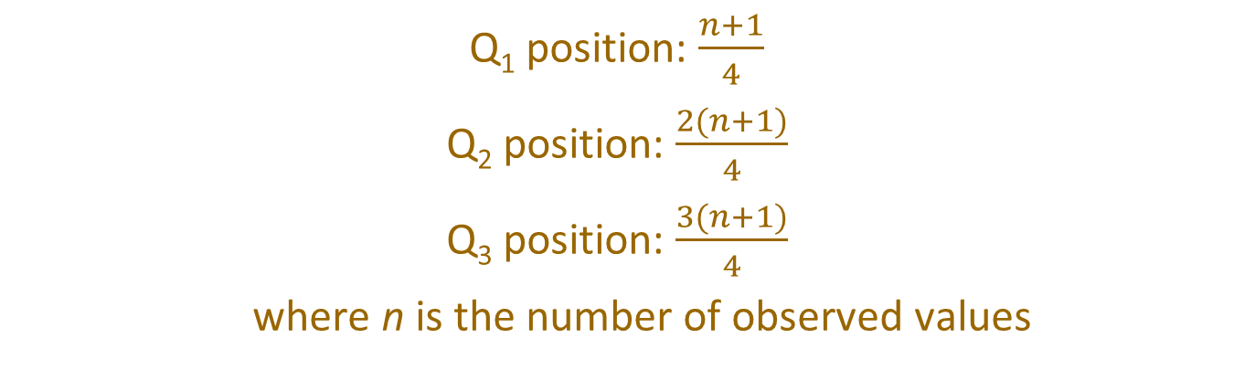
Quartiles
Cont’d
Q₁ position: $\frac{n+1}{4}$
Q₂ position: $\frac{2(n+1)}{4}$
Q₃ position: $\frac{3(n+1)}{4}$
where n is the number of observed values
When calculating the ranked position, use the following rules:
If the result is a whole number, it is the ranked position to use
If the result is a fractional half (e.g. 2.5, 8.5, …), average the two corresponding data values
If the result is not a whole number or a fractional half, round the result to the nearest integer to find the ranked position

Slide 69
Quartiles
Cont’d
Sample Data in Ordered Array: 11 12 13 16 16 17 18 21 22
Q₁ is in the (9+1)/4 = 2.5 position of the ranked data,
so Q₁ = (12+13)/2 = 12.5
Q₂ is in the (9+1)/2 = 5th position of the ranked data,
so Q₂ = median = 16
Q₃ is in the 3(9+1)/4 = 7.5 position of the ranked data,
so Q₃ = (18+21)/2 = 19.5

Slide 70
Quartiles – Exercise
Cont’d
Data in ordered array:
3 6 7 7 9 12

Slide 71
Measures of Variation:
Interquartile Range
Cont’d
Quartiles split the ranked data into 4 segments with an equal number of values per segment
25%
25%
25%
25%
Q₁
Q₂
Q₃
Interquartile Range
  Interquartile range is Q₃ – Q₁ and measures the spread in the middle 50% of the data
  Interquartile range is also called the midspread because it covers the middle 50% of the data
  Not influenced by outliers or extreme values

Slide 72
Measures of Variation:
Interquartile Range
Cont’d
Sample Data in Ordered Array: 11 12 13 16 16 17 18 21 22
Q₁ is in the (9+1)/4 = 2.5 position of the ranked data,
so Q₁ = (12+13)/2 = 12.5
Q₂ is in the (9+1)/2 = 5th position of the ranked data,
so Q₂ = median = 16
Q₃ is in the 3(9+1)/4 = 7.5 position of the ranked data,
so Q₃ = (18+21)/2 = 19.5
Interquartile range = 19.5 – 12.5 = 7

Slide 73
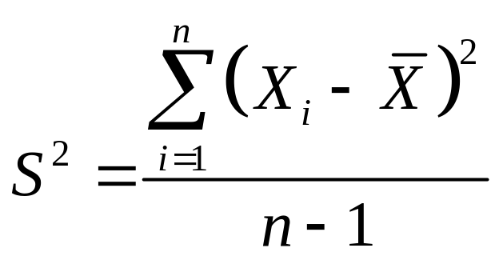
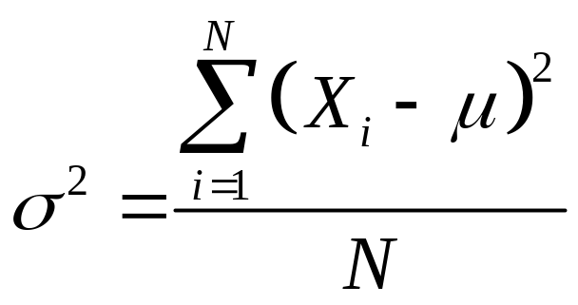
Measures of Variation:
Variance
Cont’d
Important measure of variation
Shows variation about the mean
  Sample Variance
  Population Variance
pronounced sigma squared

Slide 74


Measures of Variation:
Standard Deviation
Cont’d
Important measure of variation
Shows variation about the mean
Square-root of variance
Has the same units as the original data
  Sample Standard Deviation
  Population Standard Deviation
pronounced sigma

Slide 75
Measures of Variation:
Standard Deviation
Cont’d
Smaller standard deviation
Larger standard deviation

Slide 76

Measures of Variation:
Standard Deviation
Cont’d
Note: All the data set are random samples from the population
Data A
= 15.5
s = 3.338
11 12 13 14 15 16 17 18 19 20 21
Data B
= 15.5
s = 0.926
11 12 13 14 15 16 17 18 19 20 21
Data C
= 15.5
s = 4.570
11 12 13 14 15 16 17 18 19 20 21

Slide 77
Measures of Variation
Cont’d
The more the data are spread out, the greater the range, variance, and standard deviation
The more the data are concentrated, the smaller the range, variance, and standard deviation
If the values are all the same (no variation), all these measures will be zero
None of these measures are ever negative

Slide 78
Distribution Shape
Data sets may have similar central tendency measures, similar standard deviations, but different in shape

Slide 79
Distribution Shape
Cont’d
The Skewness
  The skewness measures the extent to which data values are not symmetrical
  The skewness equals to 0 if the distribution of the variable is symmetrical
  The skewness lesser than 0 if the distribution is left skewed, larger than 0 if the distribution is right skewed
  The skewness can help us to decide which type of central tendency is appropriate to use

Slide 80
Distribution Shape
Cont’d
Symmetric or skewed
  If data are skewed, the median may be a more appropriate measure of central tendency
Left-Skewed
Symmetric
Right-Skewed
Mean < Median
Mean = Median
Median < Mean
Skewness
Statistic
< 0 0 > 0

Slide 81
The Five Number Summary and Boxplot
The five numbers that help describe the center, spread and shape of data are
X_{smallest} -- Q₁ -- Median -- Q₃ -- X_{largest}
Boxplot
25% of data 25% 25% 25% of data
of data of data
X_{smallest} Q₁ Median Q₃ X_{largest}

Slide 82



Distribution Shape and Boxplot
Cont’d
X
X
smallest
largest
If A = B, then Symmetric
If A > B, then Left-Skewed If A < B, then Right-Skewed
A
B
If C = D, then Symmetric
If C > D, then Left-Skewed If C < D, then Right-Skewed
C
D
If E = F, then Symmetric
If E > F, then Left-Skewed If E < F, then Right-Skewed
E
F

Slide 83
Distribution Shape and Boxplot
Cont’d
Left-Skewed
Symmetric
Right-Skewed
Q₁
Q₂
Q₃
Q₁
Q₂
Q₃
Q₁
Q₂
Q₃

Slide 84

Boxplot Example
Cont’d
0 2 2 2 3 3 4 5 5 9 27
X_{smallest} Q₁ Q₂ Q₃ X_{largest}
0 2 3 5 27
The data are right skewed, as the plot depicts

Slide 85
Use of Excel in Organizing Data
PivotTable
  PivotTable can be used to create summary table for categorical variables
  Steps to create a pivot table manually
    1. Click Pivot Table in Insert ribbon. In Create PivotTable dialog box, enter or confirm the address in the Table Range as the data that you want to analyze. Choose Existing worksheet and specify a location (A1, say) for the PivotTable report to be placed

Slide 86

Use of Excel in Organizing Data
Cont’d
    2. Drag Age to the Row Labels area, and Age to Values area to create the frequency table
      The default reported value for categorical value is Count. This can be changed from the dropdown list under Values area
      Grand Total is included by default

Slide 87



Use of Excel in Organizing Data
Cont’d
    3. If the relative frequency is also wanted, drag Age into the Values field again. From the dropdown list of Count of Age 2, select Value Field Setting, then set Show Value As % of Grand Total. Enter "% of Total" into the Custom Name box
    If you do not see the Field List, click FieldList in Show group under the Analyze ribbon of PivotTable Tools

Slide 88

Calculating Descriptive Statistics in Excel
The preparation time for the examination of 12 randomly selected students (in days):
5 21 18 9 4 17 11 28 19 2 18 22
Mean | =average(A1:A12)
Median | =median(A1:A12)
Mode | =mode(A1:A12)
Sample Standard Deviation | =stdev.sA1:A12)
Sample Variance | =var.s(A1:A12)
Population Standard Deviation | =stdev.p(A1:A12)
Population Variance | =var.p(A1:A12)
Maximum | =max(A1:A12)
Minimum | =min(A1:A12)
Range | =max(A1:A12)-min(A1:A12)
Sum | =sum(A1:A12)
Count | =count(A1:A12)

Slide 89


Calculating Descriptive Statistics in Excel
Cont’d
Use of Excel “Data Analysis” Add-Ins tool to find descriptive measures
  File → Options → Add-Ins → Click “Go” at the bottom → Check “Analysis ToolPak” and click “OK”
  You can find “Data Analysis” in the “Data” menu bar
  Choose “Descriptive Statistics” at “Data Analysis” browser

Slide 90


Calculating Descriptive Statistics in Excel
Cont’d
Use of Excel “Data Analysis” Add-Ins tool to find descriptive measures
Data Cells
Output Cell
Generate Descriptive Statistics

Slide 91

Calculating Descriptive Statistics in Calculator (For Casio fx-50F)

