Slide 1
EE3114 Systems and Control
Tutorial - 10
Semester A, 2019-20
2018-11-21

Slide 2
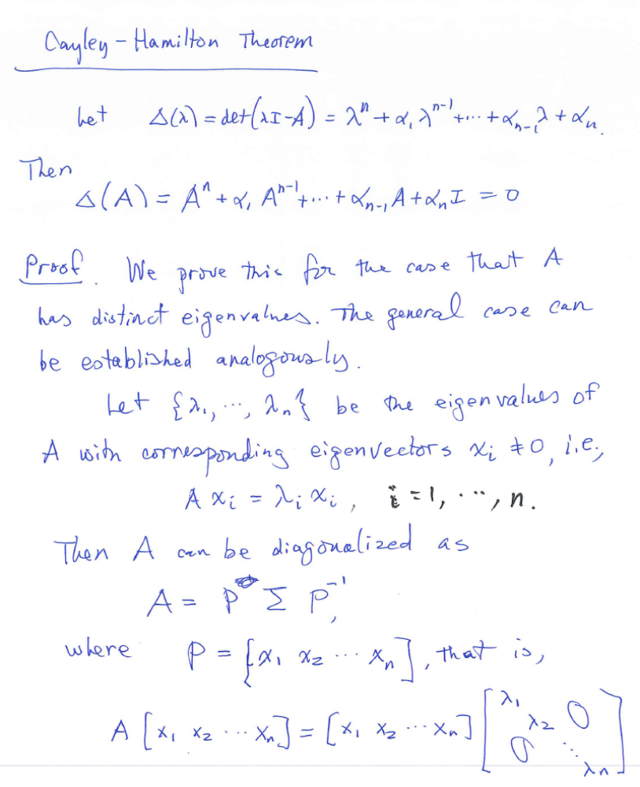

Slide 3
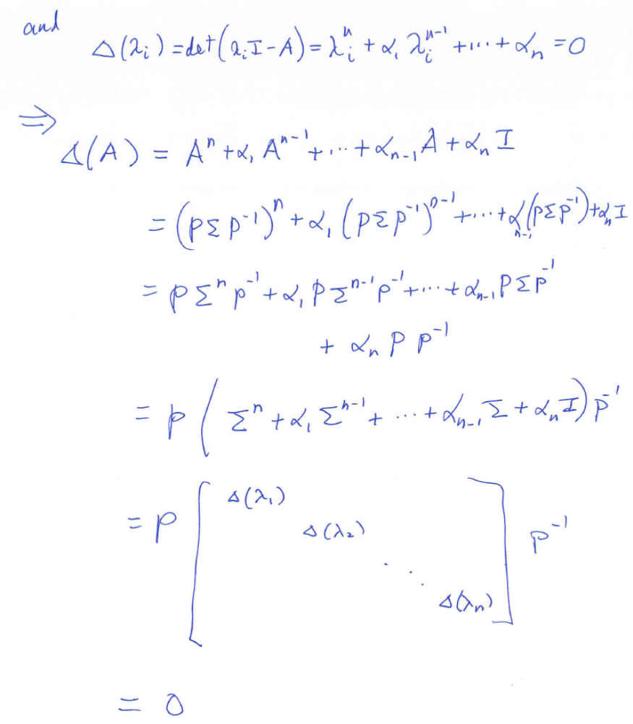

Slide 4
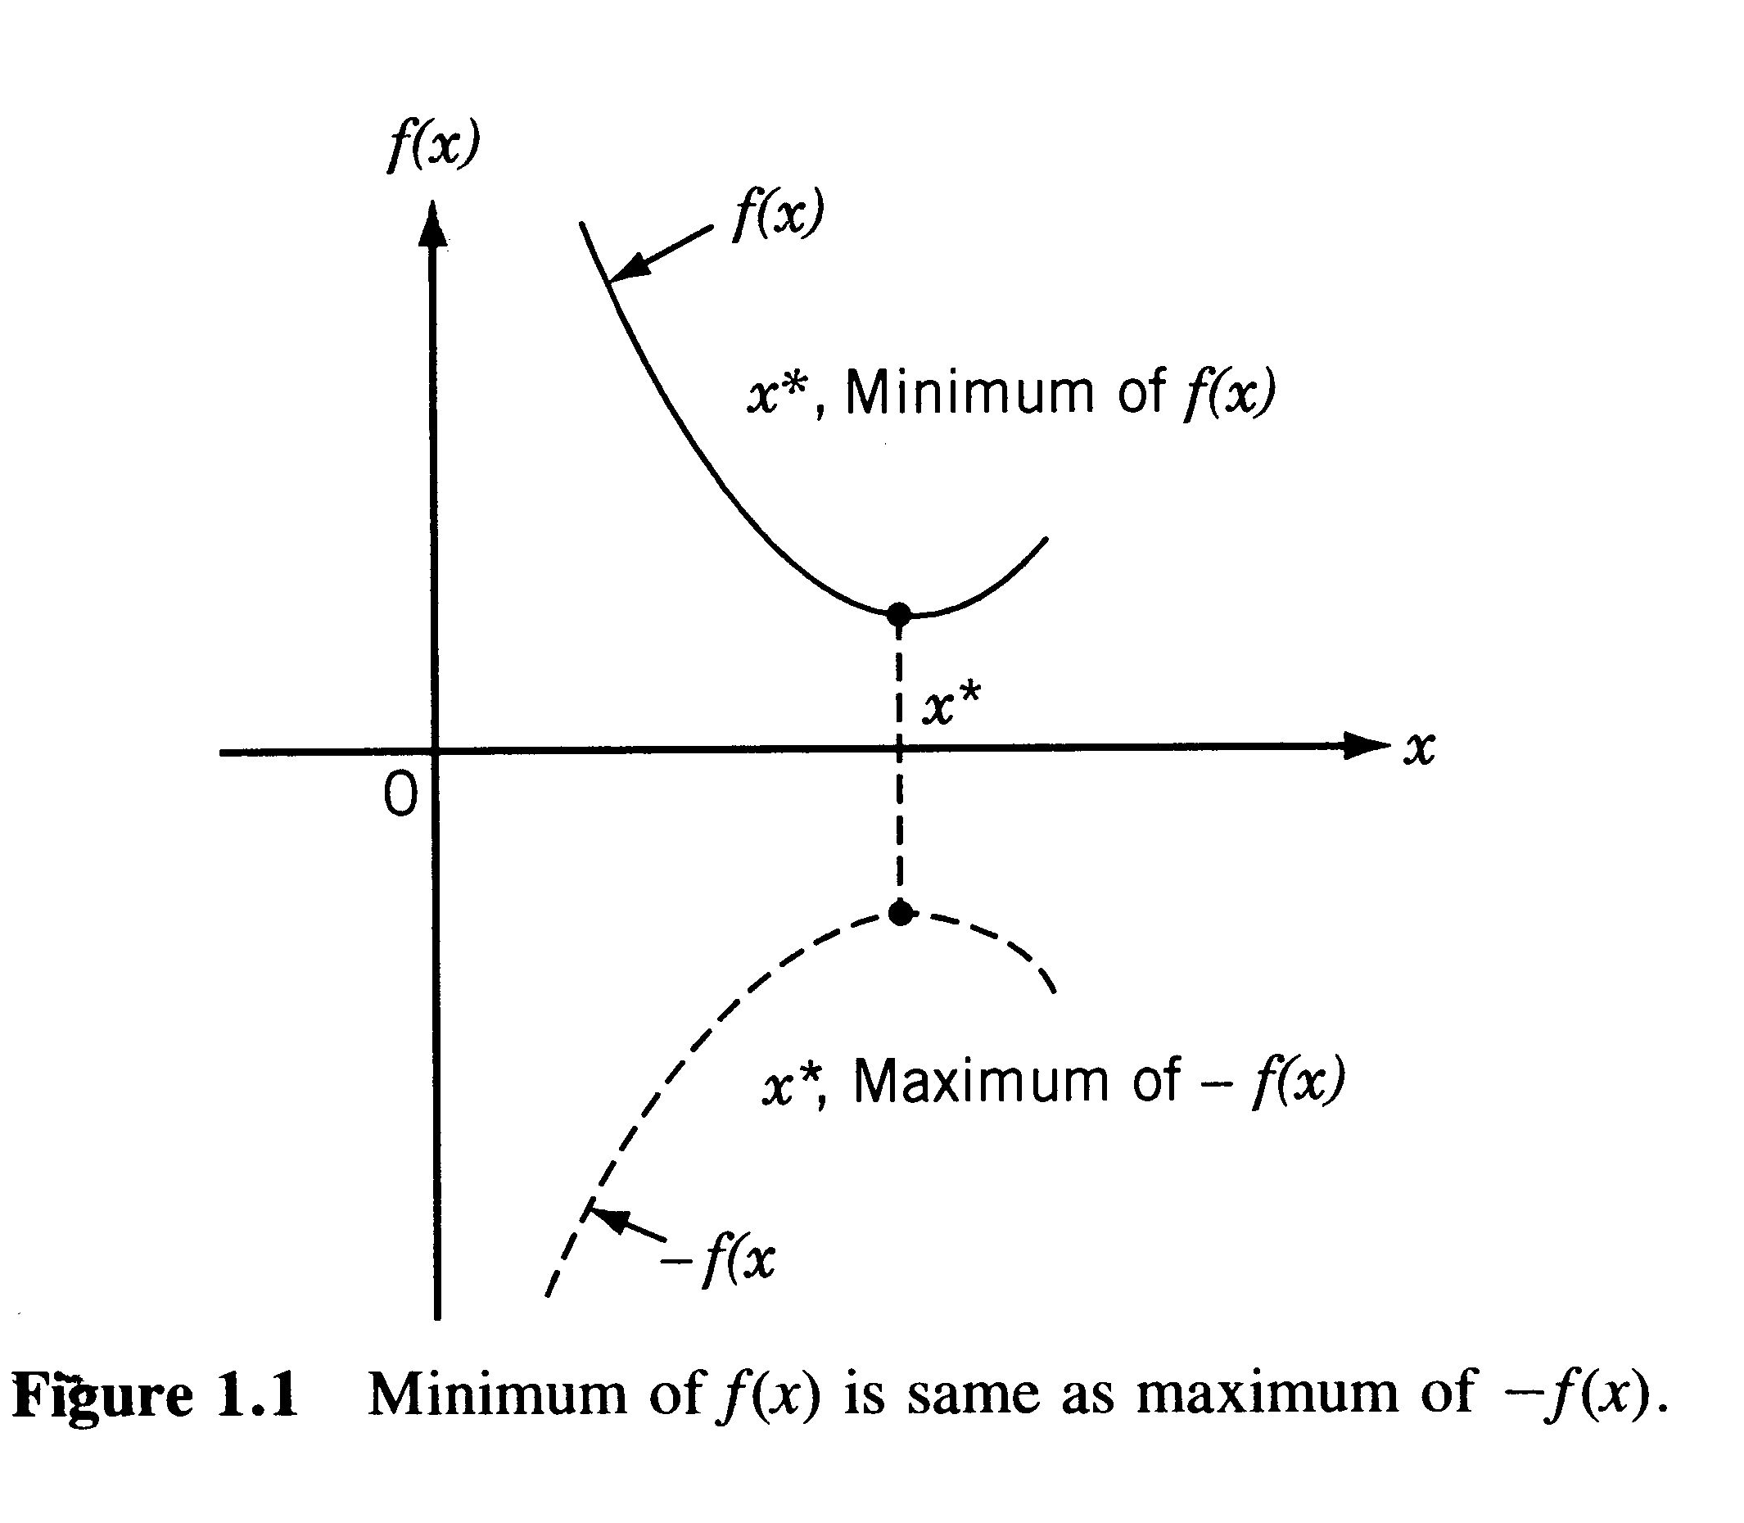
Optimization
Optimization: minimization or maximization
→ We will only discuss “minimization” below

Slide 5
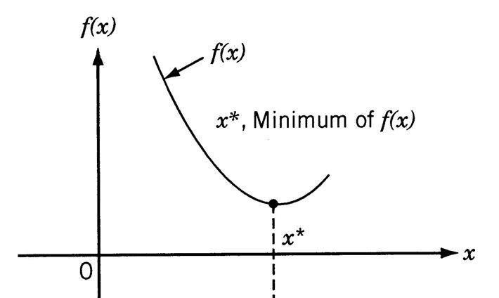


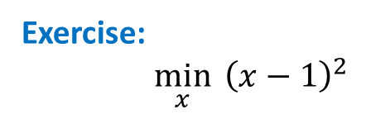
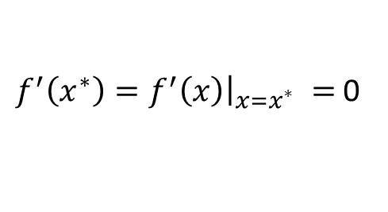
Example:
$$\min_{x}{f(x)}$$
How to find solution $x^{∗}$ ?
$f^{′}\left(x^{∗}\right)=f^{′}\left(x\right){\left.​\right|}_{x=x^{∗}} =$ 0
Exercise:
$\min_{x}{{ \left(x−1\right)}^{2}}$
(3 minutes)

Slide 6
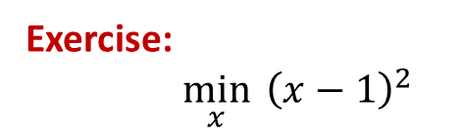

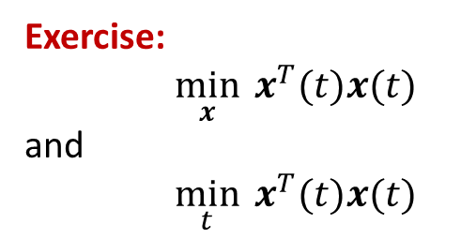
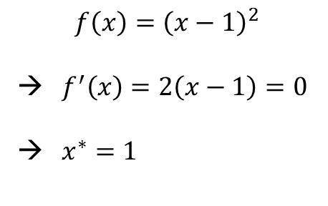
Exercise:
$\min_{x}{{ \left(x−1\right)}^{2}}$
Solution:
$$f\left(x\right)={\left(x−1\right)}^{2}$$
→ $f^{′}\left(x\right)=2\left(x−1\right)=0$
→ $x^{∗}=1$
Exercise:
$\min_{x}{x^{T}(t)x(t)}$
and
$\min_{t}{x^{T}(t)x(t)}$
($x$ is a vector function) (5 minutes)

Slide 7
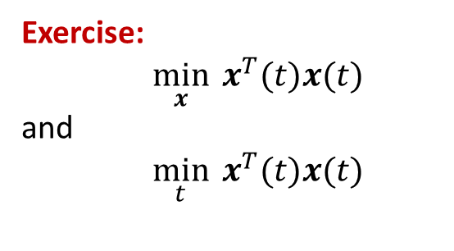
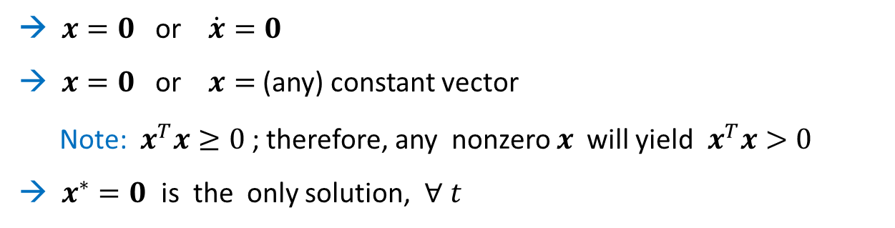

Exercise:
$\min_{x}{x^{T}(t)x(t)}$
and
$\min_{t}{x^{T}(t)x(t)}$
($x(t)$ is a vector function)
Solution:
$\frac{d}{dx}x^{T}\left(t\right)x\left(t\right)=2x\left(t\right)=0$ → $x(t)≡0$ $∀ t$
and
$\frac{d}{dt}x^{T}(t)x(t)={\dot{x}}^{T}(t)x(t)+x^{T}(t)\dot{x}(t)=0$ $∀ t$
→ $x=0$ or $\dot{x}=0$
→ $x=0$ or $x=$ (any) constant vector
Note: $x^{T}x≥0$ ; therefore, any nonzero $x$ will yield $x^{T}x>0$
→ $x^{∗}=0$ is the only solution, $∀ t$

Slide 8
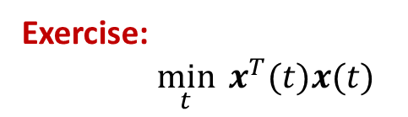

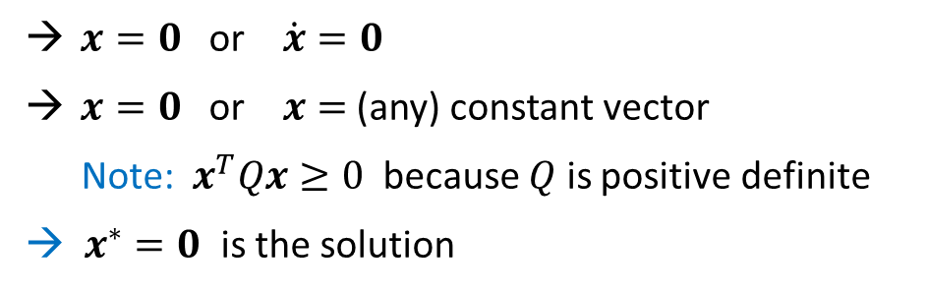
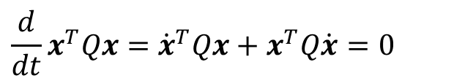
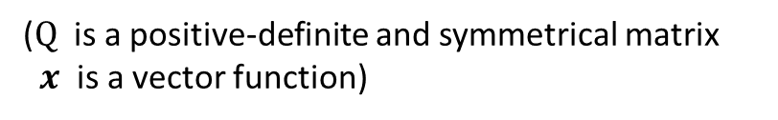
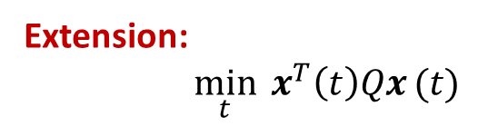

Exercise:
$\min_{t}{x^{T}(t)x(t)}$
($x(t)$ is a vector function)
Solution: $x^{∗}=0$
Extension:
$\min_{t}{x^{T}\left(t\right)Qx}(t)$
($Q$ is a positive-definite and symmetrical matrix
$x$ is a vector function)
Solution:
$$\frac{d}{dt}x^{T}Qx={\dot{x}}^{T}Qx+x^{T}Q\dot{x}=0$$
$x=0$ or $\dot{x}=0$
$x=0$ or $x=$ (any) constant vector
Note: $x^{T}Qx≥0$ because $Q$ is positive definite
→ $x^{∗}=0$ is the solution

Slide 9
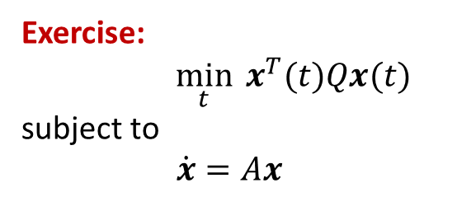

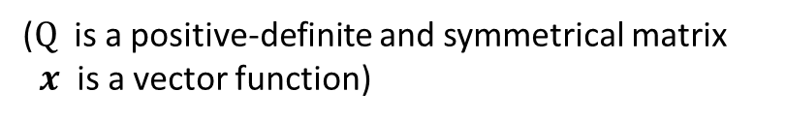
Exercise:
$\min_{t}{x^{T}(t)Qx(t)}$
subject to
$\dot{x}=Ax$
($Q$ is a positive-definite and symmetrical matrix
$x$ is a vector function)
Find: Optimal solution $x^{∗}= ?$ (5 minutes)

Slide 10
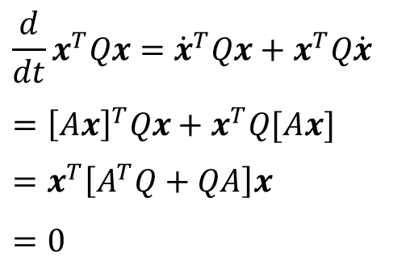
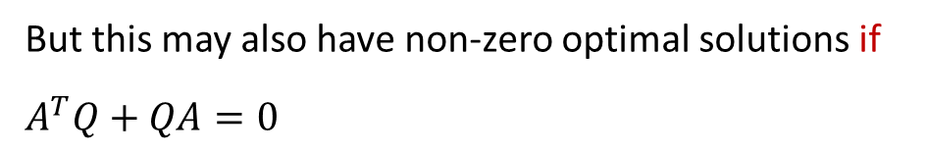

Exercise:
$\min_{t}{x^{T}(t)Qx(t)}$
subject to
$\dot{x}=Ax$
($Q$ is a positive-definite and symmetrical matrix
$x$ is a vector function)
Solution:
$$\frac{d}{dt}x^{T}Qx={\dot{x}}^{T}Qx+x^{T}Q\dot{x}$$
$$={\left[Ax\right]}^{T}Qx+x^{T}Q[Ax]$$
$$=x^{T}\left[A^{T}Q+QA\right]x$$
$$=0$$
→ $x^{∗}=0$
But this may also have non-zero optimal solutions if
$$A^{T}Q+QA=0$$
(Lyapunov equation)

Slide 11
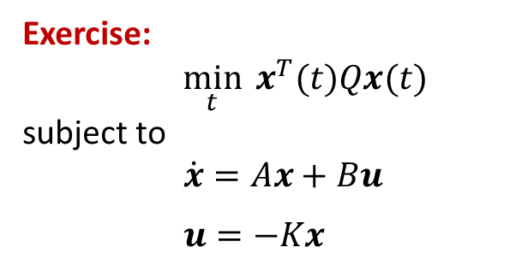
Exercise:
$\min_{t}{x^{T}(t)Qx(t)}$
subject to
$\dot{x}=Ax+Bu$
$u=−Kx$
($Q$ is a positive-definite and symmetrical matrix
$x$ is a vector function)
Under what condition can this problem have non-zero solutions?
(10 minutes)

Slide 12
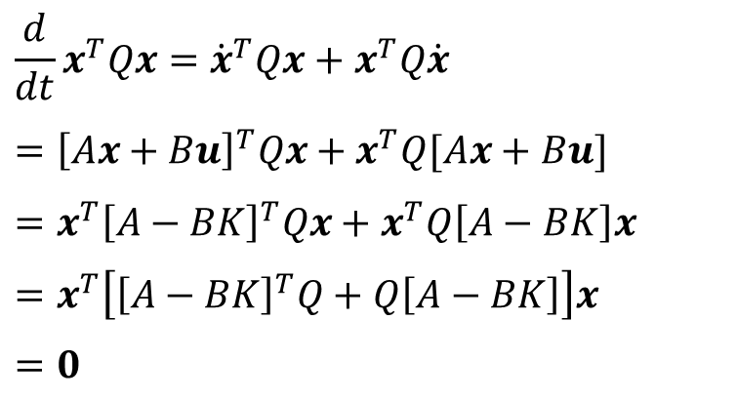



Exercise:
$\min_{t}{x^{T}(t)Qx(t)}$
subject to
$\dot{x}=Ax+Bu$
$u=−Kx$
Solution:
$$\frac{d}{dt}x^{T}Qx={\dot{x}}^{T}Qx+x^{T}Q\dot{x}$$
$$={\left[Ax+Bu\right]}^{T}Qx+x^{T}Q[Ax+Bu]$$
$$=x^{T}{\left[A−BK\right]}^{T}Qx+x^{T}Q\left[A−BK\right]x$$
$$=x^{T}\left[{\left[A−BK\right]}^{T}Q+Q\left[A−BK\right]\right]x$$
$$=0$$
→ $x^{∗}=0$
Note: It can have non-zero solutions (used for other tasks), if
$${\left[A−BK\right]}^{T}Q+Q\left[A−BK\right]=0$$
(Lyapunov equation)

Slide 13
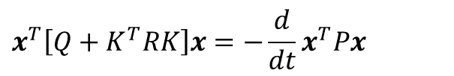
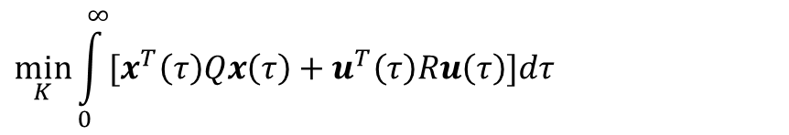
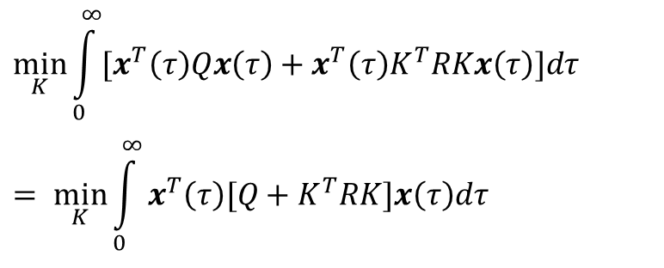
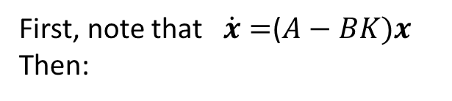
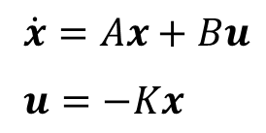
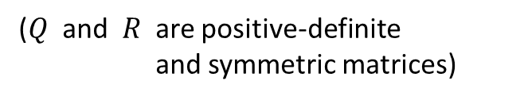
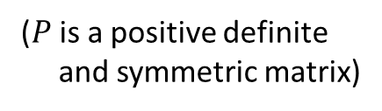
Example:
$$\min_{K}{\int_{0}^{∞}{[x^{T}\left(τ\right)Qx\left(τ\right)+u^{T}\left(τ\right)Ru\left(τ\right)]dτ}}$$
Subject to
$\dot{x}=Ax+Bu$
$$u=−Kx$$
($Q$ and $R$ are positive-definite
and symmetric matrices)
Solution:
First, note that $\dot{x}=$($A−BK)x$
Then:
$$\min_{K}{\int_{0}^{∞}{[x^{T}\left(τ\right)Qx\left(τ\right)+x^{T}\left(τ\right)K^{T}RKx\left(τ\right)]dτ}}$$
$$= \min_{K}{\int_{0}^{∞}{x^{T}\left(τ\right)[Q+K^{T}RK]x\left(τ\right)dτ}}$$
Set
$$x^{T}\left[Q+K^{T}RK\right]x=−\frac{d}{dt}x^{T}Px$$
($P$ is a positive definite
and symmetric matrix)

Slide 14

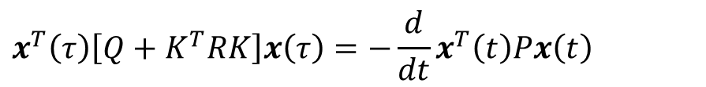
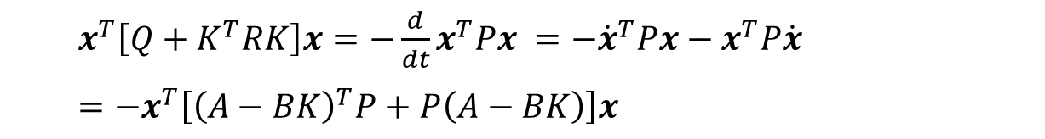

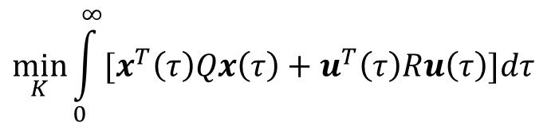

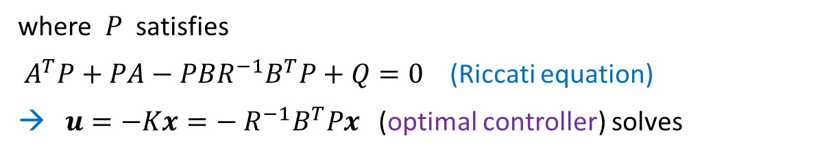
$$\dot{x}=Ax+Bu$$
$$u(t)=−Kx(t)$$
$$x^{T}\left(τ\right)\left[Q+K^{T}RK\right]x\left(τ\right)=−\frac{d}{dt}x^{T}\left(t\right)Px\left(t\right)$$
$x^{T}\left[Q+K^{T}RK\right]x=−\frac{d}{dt}x^{T}Px =−{\dot{x}}^{T}Px−x^{T}P\dot{x}$
$=−x^{T}\left[{\left(A−BK\right)}^{T}P+P\left(A−BK\right)\right]x$
$${\left(A−BK\right)}^{T}P+P\left(A−BK\right)=−(Q+K^{T}RK)$$
→
$$K=R^{−1}B^{T}P$$
where $P$ satisfies
$A^{T}P+PA−PBR^{−1}B^{T}P+Q=0$ (Riccati equation)
→ $u=−Kx={− R}^{−1}B^{T}Px$ (optimal controller) solves
$$\min_{K}{\int_{0}^{∞}{[x^{T}\left(τ\right)Qx\left(τ\right)+u^{T}\left(τ\right)Ru\left(τ\right)]dτ}}$$

Slide 15

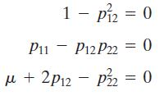




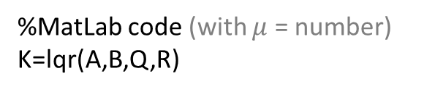
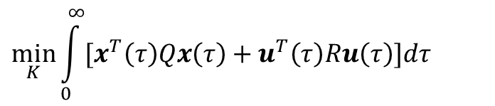


Example:
$$\dot{x}=Ax+Bu$$
$$\min_{K}{\int_{0}^{∞}{[x^{T}\left(τ\right)Qx\left(τ\right)+u^{T}\left(τ\right)Ru\left(τ\right)]dτ}}$$
$$u(t)=−Kx(t)$$
$A=\left[\begin{matrix}0 & 1 \\ 0 & 0\end{matrix}\right]$, $B=\left[\begin{matrix}0 \\ 1\end{matrix}\right]$, $Q=\left[\begin{matrix}1 & 0 \\ 0 & μ\end{matrix}\right],$ $R=[1]$
(Riccati equation)
$A^{T}P+PA−PBR^{−1}B^{T}P+Q=0$ $P=\left[\begin{matrix}p_{11} & p_{12} \\ p_{12} & p_{22}\end{matrix}\right]$
$$K=R^{−1}B^{T}P=1⋅\left[0 1\right]⋅P=[1 \sqrt{μ+2}]$$
%MatLab code (with $μ$ = number)
K=lqr(A,B,Q,R)

Slide 16
END

