Slide 1
CB2201 PALSI Class 6
Topics to be covered:
Demand & Revenue Management
Sourcing & Supply Chain
This PowerPoint was prepared base on the lecture slides
of CB2201 prepared by the course lecturer, Stephen Shum

Slide 2
Demand & Revenue Management
Forecasting
Quantitative Management
Qualitative Management
Component of demand

Slide 3
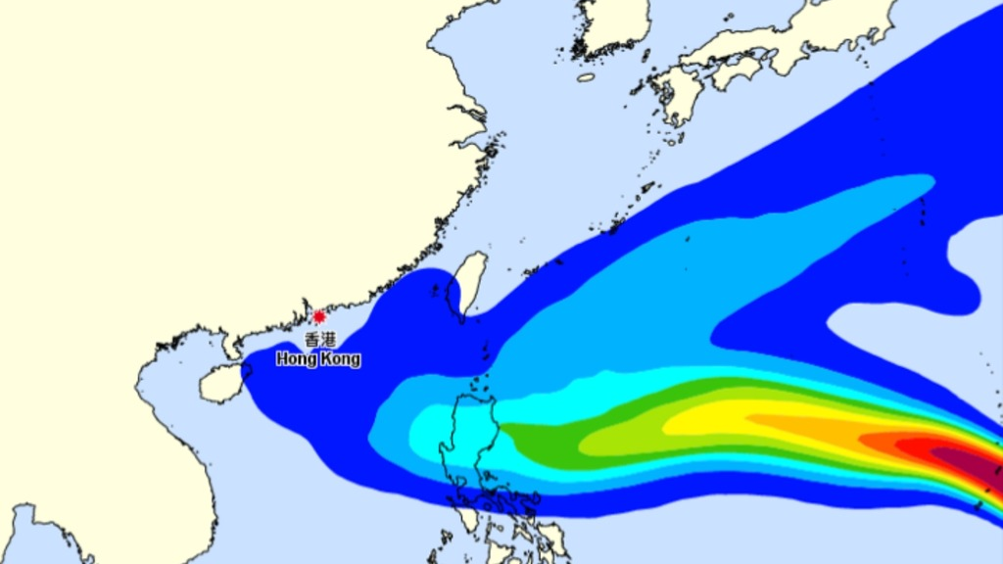
Demand Forecasting – Basic Concept
No perfect forecasting, errors unavoidably presents
Inaccuracy rises as we forecasts further in the future
Aggregate demand forecast is more accurate

Slide 4
Zara’s Business Model
Zara, as a fast fashion retailer, their lead time is obviously shorter than the traditional one
Hence they only need to forecast the demand of a shorter period of time.
Therefore, the impact forecast error will be less significant for Zara

Slide 5

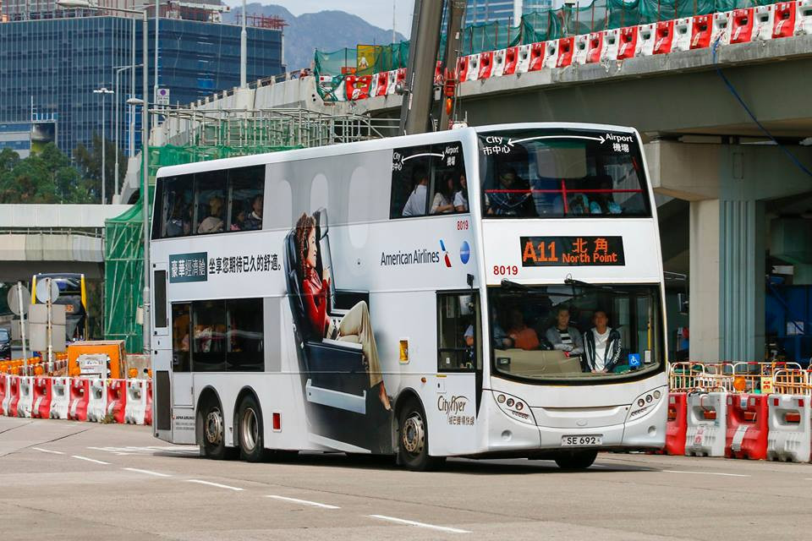
Quantitative VS Qualitative Forecast
 | Quantitative Forecast | Qualitative Forecast
Relatively | Subjective | Objective
Use when | New Situations | When historical data available
Relies on | Judgement | Data
Relies on | Characteristics | Statistical Models
Notes:
Quan+Qual = existing+new

Slide 6
Demand forecasting – Quantitative Method
Personal Insight
Relies on the single insight > weakness of highly subjective
Panel Consensus
Multiple experts for forecasting
Weakness: influences of the experts may not equal
Delphi Method
No dominating individuals as they are answering to a survey in multiple rounds
Notes:
Delphi Method: not enough discussion may make wrong decision

Slide 7
Demand forecasting – Demand Components
Trend
Long term + same direction of movement
Seasonal
Periodic changes
Cynical
Up-and-down changes, but the repeating time is not that regular
Irregular

Slide 8
Demand & Revenue Management
Revenue Management
Basic Concept of Revenue Management
Variable Pricing
Operational Pricing

Slide 9
Revenue Management
Law of demand
The higher price, the lower demand
Revenue in differential pricing > that in uniform pricing
Notes:
MTR/bus elasticity low
Cinema elasticity high

Slide 10
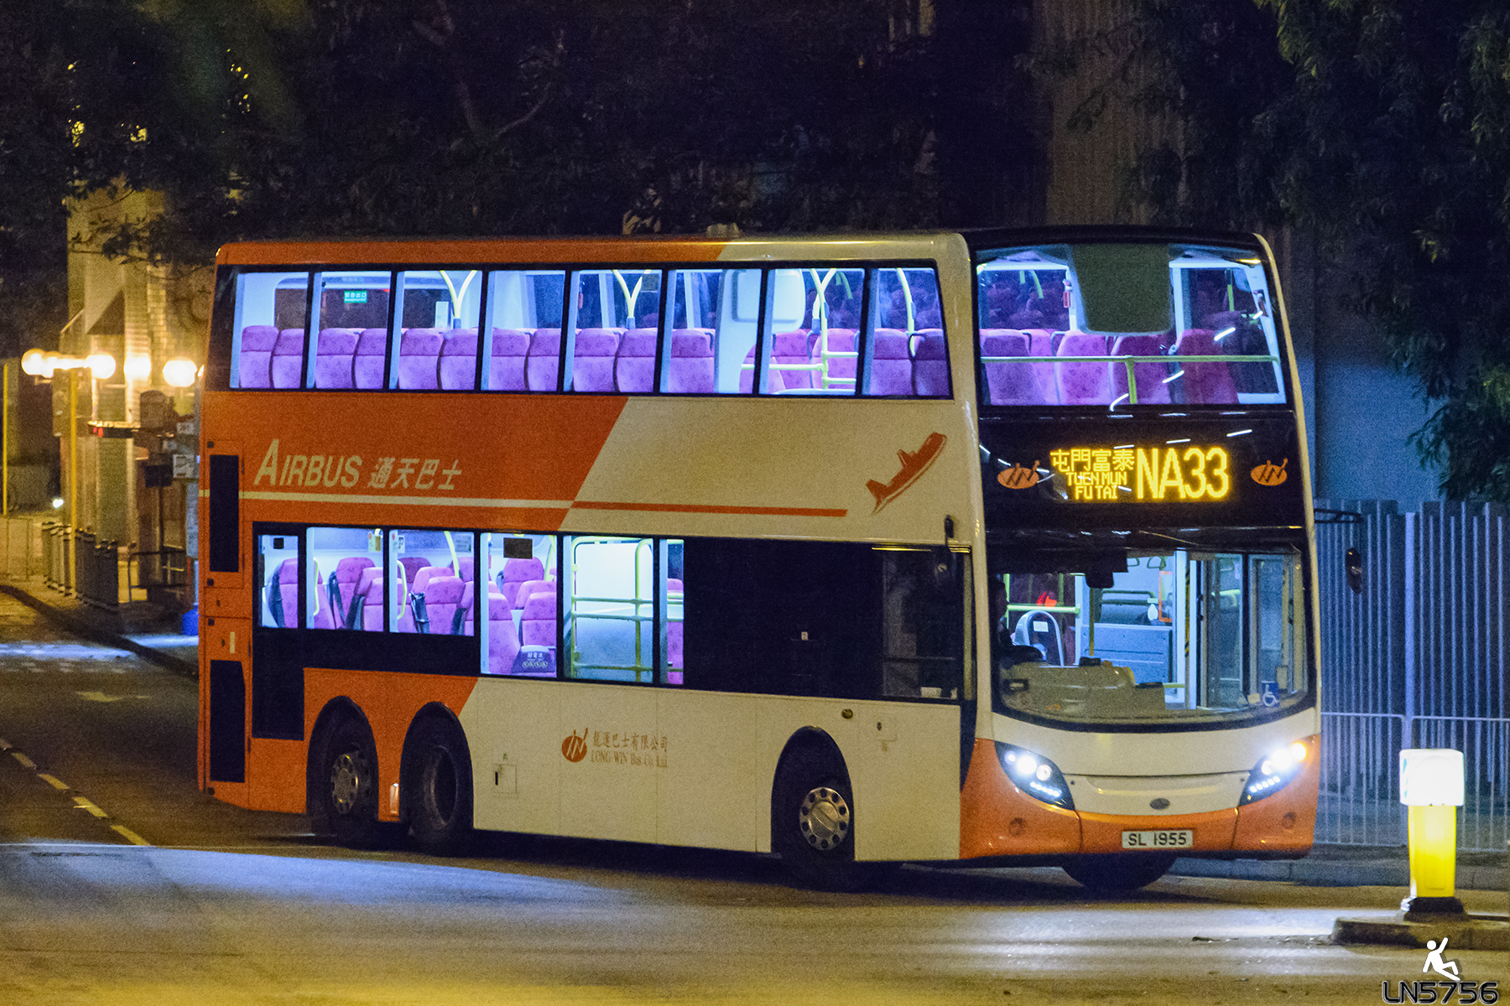


Revenue Management - Concepts
Moving away from cost-based pricing
Manage demand > better utilize the capacity
Cost based pricing VS Market-based pricing

Slide 11
Revenue Management - Concepts
Variable Pricing
Operational Pricing

Slide 12
Airline Example of Operational Pricing
Limited capacity
Mainly fixed cost
Exist of no-show
Protection Capacity
Treatment of overbooking
Notes:
Protection Capacity = Capacity (plane) – Optimum output (full fare ticket)
Underage Cost = Full – discount (loss of potential gain)
Overage Cost = discount

Slide 13
Outsourcing and Supply Chain
Outsource VS In-house
Dual-sourcing
Bull-whip effect

Slide 14
Outsource VS In-house
Why outsourcing?
Price > cheaper labor? Competitive strength?
Improvement > Specialization? Competitive strength?
Organization > Flexibility? Core competencies?

Slide 15
Core Competency
Which make the firm outstanding in the marketplace
Providing value to customers
Provide access to a variety of markets
Difficult for competitors to imitate

Slide 16
Make or buy?
2 factors to be considered
Exclusively of use
Consistency with the business focus

Slide 17
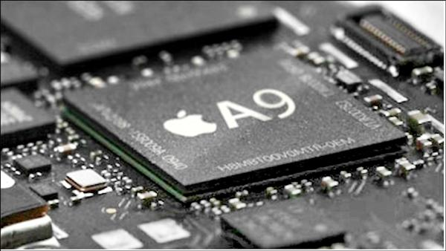
Dual-sourcing
Component parts sourced from 2 or more separated suppliers
Benefits – More stable supply
Risk – Quality differences / Market response / Operational difficulties
Notes:
Benefits: Lowered cost

Slide 18
Bullwhip-effect
Order variability amplifies up the supply chain
Hence:
Uneven capacity utilization
More inventory
Shortages and delays
Poor planning due to distorted demand information

Slide 19
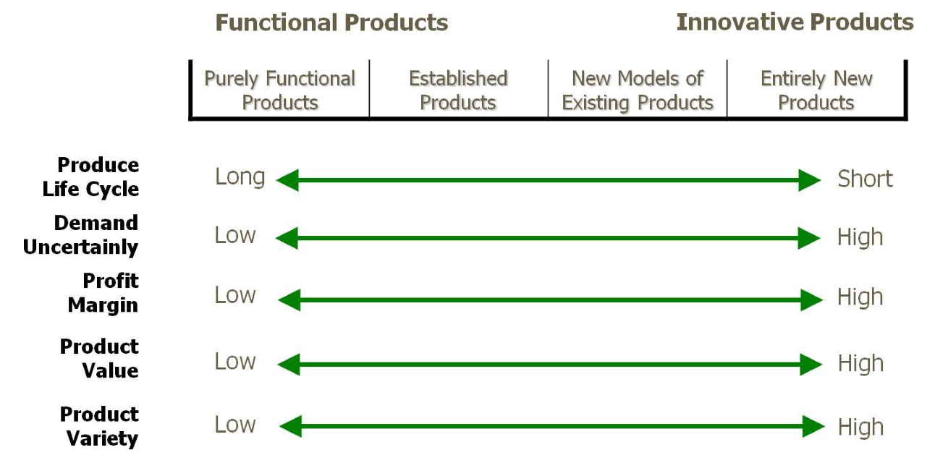
Supply Chain
Functional VS Innovative Products

Slide 20
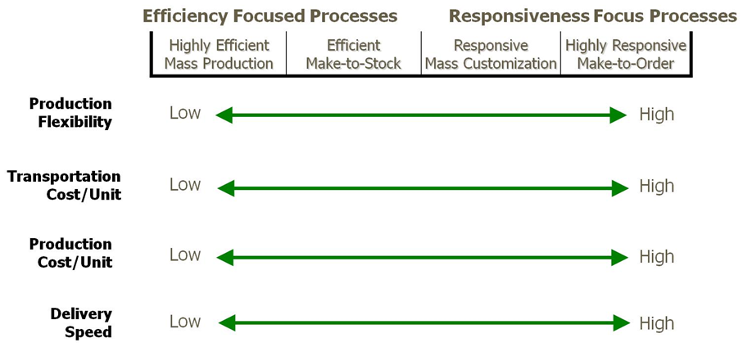

Slide 21
Mass customization
Putting the customization process at last
Or after the most time consuming process
Transfer of make-to-stock to assemble-to-order
Hence, production is based on aggregate forecast of demand > less error
Notes:
Shorten lead time

