Slide 1
GE1202 Managing Your Personal Finance
Week 2 Tutorial
Introduction to Personal Finance Management

Slide 2
Question 1 True/False
Explain whether the statements are true or false.
  Personal financial planning is a process that should be carried out on a regular five-yearly basis.
  The whole financial planning process should be revisited on regular basis.
  Or when personal or economic circumstances change
False

Slide 3
Question 1 True/False
  It is far more important for older people to engage with personal financial planning, than younger people.
Personal financial planning is important to people who have financial goals but limited financial resources.
Both young people and older people face the same situation.
False

Slide 4
Question 1 True/False
  If inflation is measured at 3% per annum and a savings account is paying interest at 3% per annum, the purchasing power of the savings made will remain unchanged.
% △ Real value = % △ Nominal value – Inflation%
0%
3%
3%
True

Slide 5
Question 1 True/False
False
  Career planning is not a part of financial planning.
  Eight major personal financial planning areas
    Obtaining – the receipt of income and other financial resources
    Planning – actions to determine future financial directions
    Saving – set aside funds for expected and unexpected expenses
    Borrowing – appropriate use of short-and-long-term credit plans
    Spending – analysis of purchasing decisions for wise money use
    Managing Risk – insurance and other methods to reduce financial uncertainty
    Investing – accumulation of funds for long-term financial security
    Retirement and Estate Planning – efforts to provide for post-career years and transfer of assets

Slide 6
Question 1 True/False
  Once you have set your financial goals, you should try to achieve them by all means.
Financial goals should take a SMART approach
If the goal is unrealistic, it is very unlikely for you to achieve it
Six-step financial planning process
False
Determine your current financial situation
  Review and revise the plan
  Develop your financial goals
  Create and implement your plan
  Evaluate alternatives
  Identify alternative courses of actions

Slide 7
Question 2 Calculation
Your friend is now working in an insurance company. He is prompting an investment project of his company to you:
“Our company is now offering a plan, which is a very good project. You just need to pay $3000 at the end of each month from January 2017 for ten years. Then you can get back HK$1million on 31st December 2046.”

Slide 8
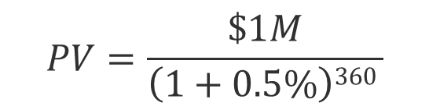
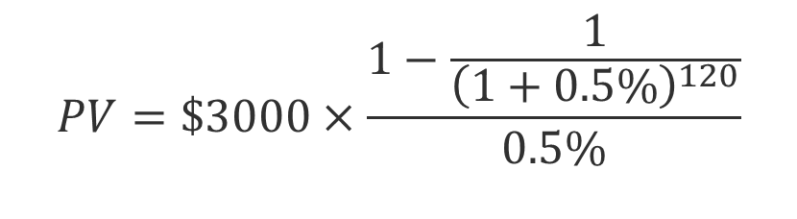
Question 2 Calculation
Assume that the market interest rate is 6%p.a. and is stable during the period, will you consider the project?
PV of your investment
PV of the return
$$PV=\$3000×\frac{1−\frac{1}{{\left(1+0.5\%\right)}^{120}}}{0.5\%}$$
= $270,220
$$PV=\frac{\$1M}{\left(1+0.5\%\right)360 }$$
= $166,042
NO!!!

