Slide 1
EE2203 Modelling Techniques
Week 9
Multiple Regression
Generalized Linear Models

Slide 2
Multiple regression

Slide 3
The Model
Mean of Y values at any given X: α + β1X1+ …+ βpXp
Variance of Y values at any X: σ² (same for all X)
Y values are normally distributed at any given X (need for inference)

Slide 4
Types of X variables
Fixed: selected in advance
Variable: more often in health science studies
X’s can be continuous or discrete (categorical)
X’s can be transformations of other X’s e.g. polynomial regression

Slide 5
Analysis
Estimates of α, β1, …. βp using least-squares
  Partial regression coefficients
Residual mean square (S²) is estimate of variance σ²
  Square root of RMS = SE of the estimate
Confidence intervals for mean of Y
Prediction intervals for individual Y

Slide 6
Tests of hypotheses
For individual coefficients
  t = B/SE(B)
  Caution: multiple tests
  Solution: Multiple comparisons e.g. Bonferroni Method
    Multiply P-values by number of tests, then compare to nominal significance level
    E.g. Test 3 hypotheses
    P-values: 0.014, 0.036, 0.075
    Nominal significance level = 0.05→first two are statistically significant
    Bonferroni-adjusted p-values: multiply by 3 = 0.042, 0.108, 0.225→ only first is significant

Slide 7
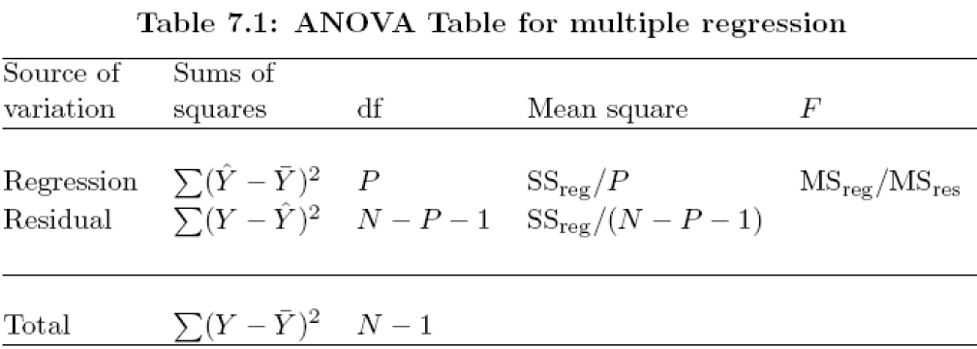
Analysis of variance
Does regression plane help in predicting values of Y?
Test hypothesis that all βi’s = 0

Slide 8
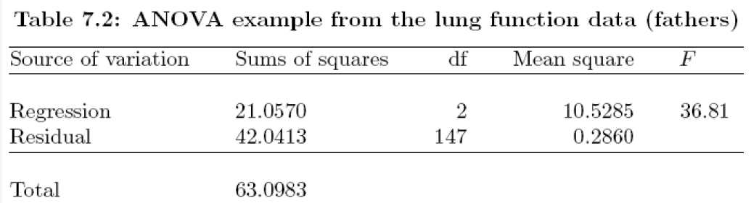
Example:
Regression of FEV1 on height and weight
F = 36.81; df = 2, 147; p-value < .0001
R command to calculate p-value for F-statistics:
>pf(36.81, 2, 147, lower.tail=F)
[1] 1.09629e-13

Slide 9
Correlation Coefficient and
Coefficient determination
The multiple correlation coefficient (R) measures the strength of association between Y and the set of X’s in the population
We estimate it as the simple correlation coefficient between the Y’s and their predicted values (Y hats)
R² = Coefficient of determination
= SS due to regression/SS total
R² = reduction in variance of Y associated with X’s divided by original variance of Y
100 R² = % of variance of Y “associated with X’s” or “explained by X’s” * Caution: association vs. causation *
100(1- ρ²)^{1/2} = % of standard deviation NOT “explained” by X

Slide 10
Example of Interpretation of R
R | % of variance “explained” | % of variance not “explained” | % of SD “explained” | % of SD not “explained”
0.3 | 9% | 91% | 5% | 95%
0.5 | 25% | 75% | 13% | 87%
0.71 | 50% | 50% | 29% | 71%
0.95 | 90% | 10% | 69% | 31%

Slide 11
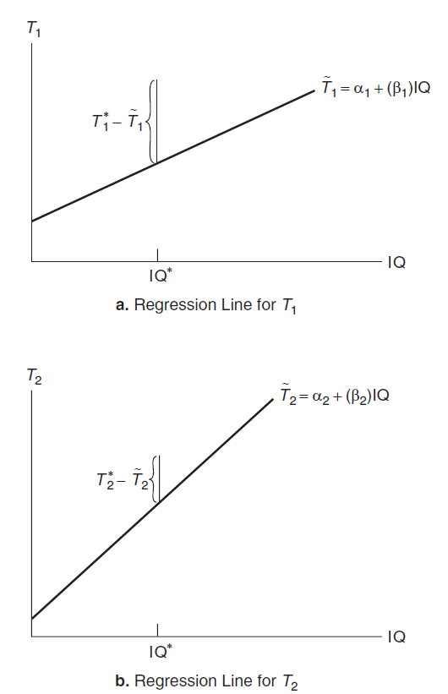
Partial correlation
The correlation coefficient measuring the degree of dependence between two variables…
  After adjusting for the linear effect of one or more of the other X variables
E.g. T₁ and T₂ are test scores
  Want partial R between T₁ and T₂ after adjusting for IQ
Hypothetical Population Regressions of T1 and
T2 Scores illustrating the computation of a partial
correlation coefficient
Partial R is the simple R between the two residuals

Slide 12
Interpretation of regression coefficients
In the model: α + β1X1+ …. +βpXp say ρ is the partial correlation between Y and X1 given X2, …..Xp
Then, testing that β1 = 0 is equivalent to testing that ρ = 0
* That’s why βi is called the partial regression coefficient of Y on Xi given X2, …..Xp*

Slide 13
Values of regression coefficients
Problem: Values of Bi’s are NOT directly comparable
Solution: Standardized coefficients:
  Standardized Bi = Bi * (SD of Xi / SD of Y)
Values of standardized Bi ‘s are directly comparable

Slide 14
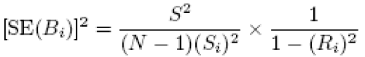
Multicollinearity
Occurs when some of the X variables are highly intercorrelated
Affects estimates and their SE’s
Look at tolerance, and its inverse, the Variance Inflation Factor (VIF)
Need tolerance < 0.01, or VIF > 100
Solution: use variable selection to delete some X variables
Alternatively, use Principal Components

Slide 15
Correlation can mislead
Example (Lung Function data): FEV1 vs. height and age
Depends on gender
Total vs. stratified correlation:
Gender | Correlation between FEV1 and:
 | Height | Age
Total | 0.739 | -0.073
Male | 0.504 | -0.310
Female | 0.465 | -0.267

Slide 16
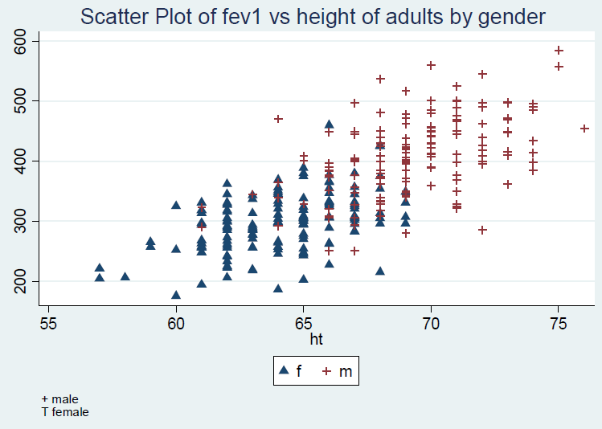
FEV1 vs. height

Slide 17
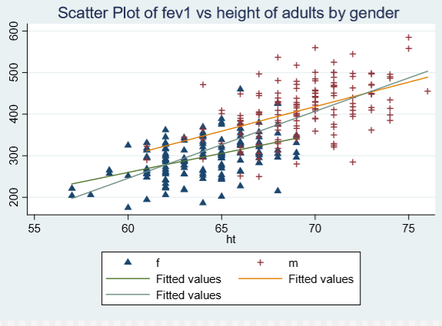
Regression line:
FEV1 vs. height

Slide 18
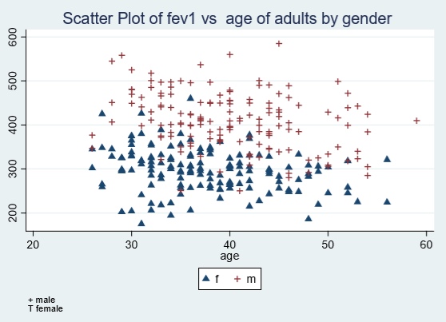
FEV1 vs. age

Slide 19
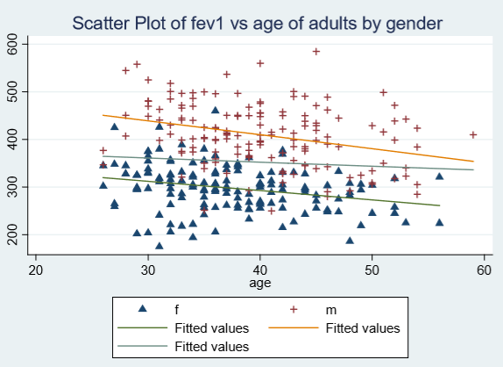
Regression lines:
FEV1 vs. age

Slide 20
Residual Analysis, Outliers, and Influence measures
Same rule applies for multiple regression
Refer to these sections discussed in the Simple Regression lecture

Slide 21
What to watch out for
Same cautions for simple regression applies for multiple regression
Need representative samples
Violations of assumptions, outliers
Multicollinearity: coefficient of any one variable can vary widely, depending on what others are included in the model
Missing values
Number of observations in sample should be large enough relative to number of variables in model

Slide 22
Generalized Linear Models: A Summary

Slide 23
Concept
Simple and multiple regression: special cases of the Generalized Linear Model (GLM)
GLM has three components:
  A random component: outcome variable, Y
  The covariates X1, …Xp we use to predict Y, and
  A link function g

Slide 24
The Model
Assume a distribution of Y
For a given individual, denote by µ the expected value of Y
  µ = E(Y)
Choose a link function g(µ) and express it as a linear function of the covariates, i.e. we assume:
  g(µ) = α + β₁X₁ + β₂X₂ + …+ β_{p}X_{p}

Slide 25
Inference
Depending on the application, we proceed with:
  An exact or an approximate procedure to estimate the parameters, and
  An exact or an approximate procedure to derive CI’s and tests of hypotheses

Slide 26
Multiple Linear Regression
Assume the distance of Y to be normal, and the link function to be the “identity” function, i.e.
  g(µ) = α + β₁X₁ + β₂X₂ + …+ β_{p}X_{p}
The exact estimation procedure is least squares and the exact test procedure is the F or t test
Exact t procedure for CI
In R:
  lm()
  glm()

Slide 27
Logistic Regression
Y = outcome = 1 (event) or 0 (not)
E(Y|X’s) = µ = P(1|X’s)
Take g(µ) = log(odds) = logit function, i.e.
  g(µ) = ln[µ/(1-µ)] = α + β₁X₁ + β₂X₂ + …+ β_{p}X_{p}
Use iterative reweighted LS to estimate z for CI’s and χ² for tests of hypotheses
In R: glm() with family=binomial()

Slide 28
Multinomial Logistic Regression
Y (nominal) has k values (1, 2, …, k) – assume multinomial distribution and choose 1 as reference category
Take g(µ) = log(“odds”), i.e.
  g(µ) = ln[P(i)/P(1)] = α + β₁X₁ + β₂X₂ + …+ β_{p}X_{p}
Use iterative procedure to estimate z for CI’s and χ² for tests of hypotheses
In R: glm() with family=binomial()

Slide 29
Ordinal Logistic Regression
Y (ordinal) has k values (1, 2, …, k) – assume proportional odds model
Take g(µ) = log(“odds”), i.e.
  g(µ) = ln[P(Y≤i)/P(Y>i)] = α + β₁X₁ + β₂X₂ + …+ β_{p}X_{p}
Use iterative procedure to estimate z for CI’s and χ² for tests of hypotheses
In R: glm() with family=binomial()

Slide 30
Poisson Regression
Y can take any integer value (0, 1, 2,…) – assume Poisson distribution
Take g(µ) = ln(µ), i.e.
  g(µ) = ln(µ)= α + β₁X₁ + β₂X₂ + …+ β_{p}X_{p}
In R: glm() with family=possion()

Slide 31
Extensions
For any distribution, can use any link function
For example, in logistic regression, instead of:
  g(µ) = log(odds), use
  g(µ) = ln[P(Y=1)], i.e. g(µ) = ln[risk]
Change in interpretation:
  β = ln(OR)
  β = ln(RR)

Slide 32
Acknowledgement
Textbook: Chapter 6-7, Abdelmonem Afifi, Susanne May, Virginia A. Clark. Practical Multivariate Analysis. Fifth Edition. CRC Press Taylor & Francis Group
Thanks Professor Afifi for his courtesy to share the materials

