Slide 1
EE3114 Systems and Control
7. Controllers Design
Semester B, 2018-19
2018-10-24

Slide 2
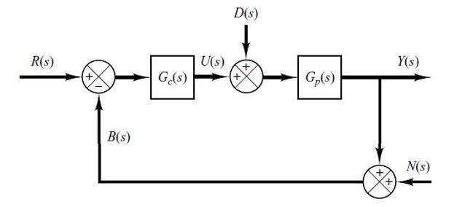
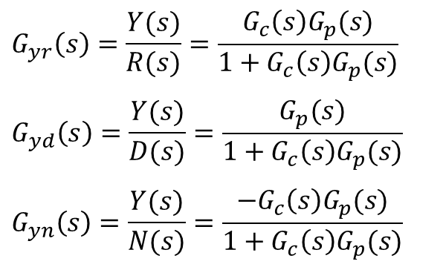

1-DoF and 2-DoF PID Controllers
Example:
$G_{p}\left(s\right)$ is given and fixed
Closed-loop Transfer Functions:
$$G_{yr}\left(s\right)=\frac{Y(s)}{R(s)}=\frac{G_{c}\left(s\right)G_{p}(s)}{1+G_{c}\left(s\right)G_{p}(s)}$$
$$G_{yd}\left(s\right)=\frac{Y(s)}{D(s)}=\frac{G_{p}(s)}{1+G_{c}\left(s\right)G_{p}(s)}$$
$$G_{yn}\left(s\right)=\frac{Y(s)}{N(s)}=\frac{{−G}_{c}\left(s\right)G_{p}(s)}{1+G_{c}\left(s\right)G_{p}(s)}$$
How many of these are independent?
– Degree of Freedom (DoF)

Slide 3
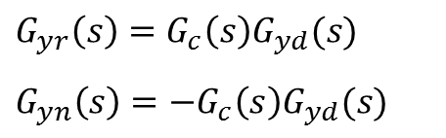
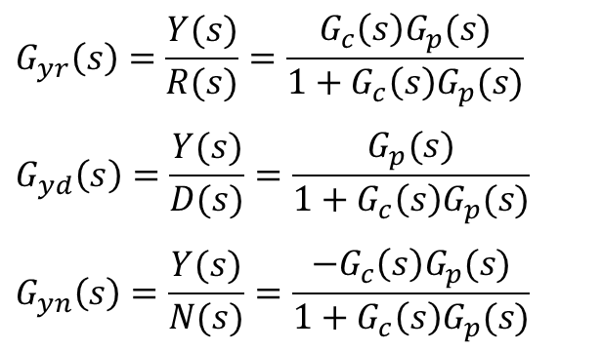
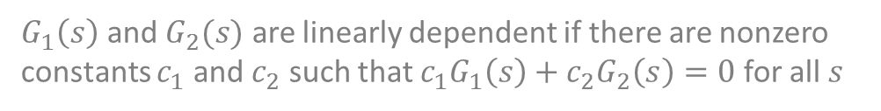

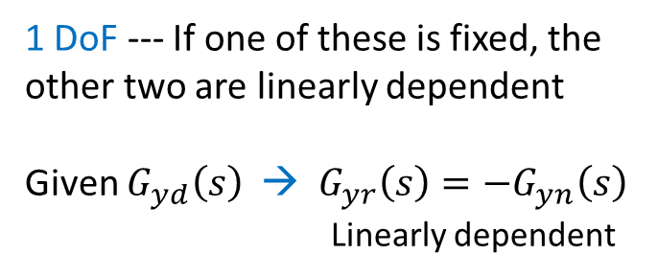
Closed-loop Transfer Functions:
$$G_{yr}\left(s\right)=\frac{Y(s)}{R(s)}=\frac{G_{c}\left(s\right)G_{p}(s)}{1+G_{c}\left(s\right)G_{p}(s)}$$
$$G_{yd}\left(s\right)=\frac{Y(s)}{D(s)}=\frac{G_{p}(s)}{1+G_{c}\left(s\right)G_{p}(s)}$$
$$G_{yn}\left(s\right)=\frac{Y(s)}{N(s)}=\frac{{−G}_{c}\left(s\right)G_{p}(s)}{1+G_{c}\left(s\right)G_{p}(s)}$$
How many of these are independent?
→ Degree of Freedom (DoF)
$$G_{yr}\left(s\right)=G_{c}\left(s\right)G_{yd}(s)$$
$$G_{yn}\left(s\right)={−G}_{c}\left(s\right)G_{yd}(s)$$
1 DoF --- If one of these is fixed, the other two are linearly dependent
Given $G_{yd}\left(s\right)$ → $G_{yr}\left(s\right)=−G_{yn}\left(s\right)$
Linearly dependent
$$G_{yr}\left(s\right)=−G_{yn}\left(s\right)$$
$G_{1}\left(s\right)$ and $G_{2}(s)$ are linearly dependent if there are nonzero constants $c_{1}$ and $c_{2}$ such that $c_{1}G_{1}\left(s\right)+c_{2}G_{2}\left(s\right)=0$ for all $s$

Slide 4
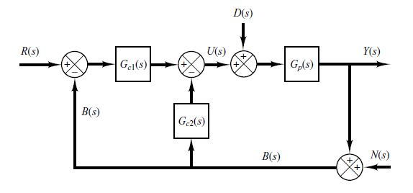
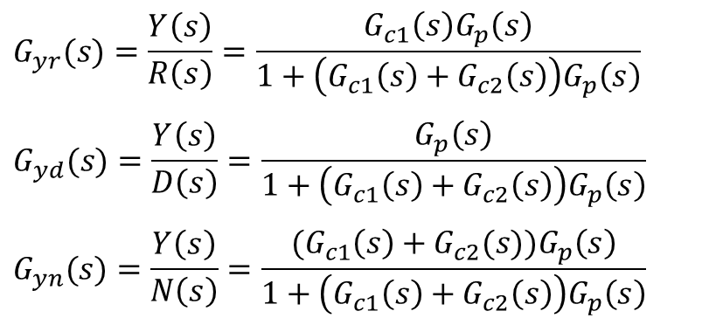
Example:
$$G_{yr}(s)=\frac{Y\left(s\right)}{R\left(s\right)}=\frac{G_{c1}\left(s\right)G_{p}\left(s\right)}{1+\left(G_{c1}\left(s\right)+G_{c2}\left(s\right)\right)G_{p}\left(s\right)}$$
$$G_{yd}(s)=\frac{Y\left(s\right)}{D\left(s\right)}=\frac{G_{p}\left(s\right)}{1+\left(G_{c1}\left(s\right)+G_{c2}\left(s\right)\right)G_{p}\left(s\right)}$$
$$G_{yn}(s)=\frac{Y\left(s\right)}{N\left(s\right)}=\frac{{(G}_{c1}\left(s\right)+G_{c2}(s))G_{p}\left(s\right)}{1+\left(G_{c1}\left(s\right)+G_{c2}\left(s\right)\right)G_{p}\left(s\right)}$$

Slide 5
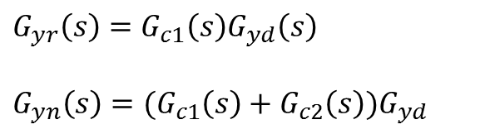
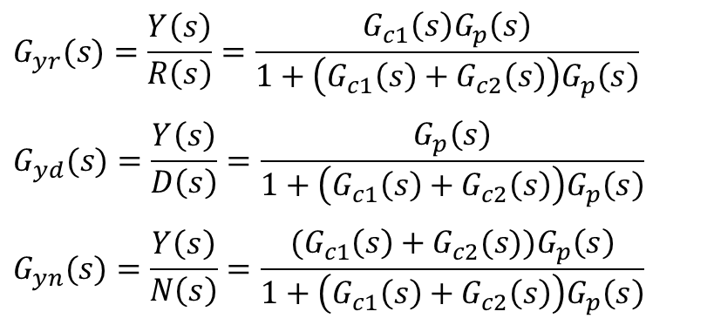
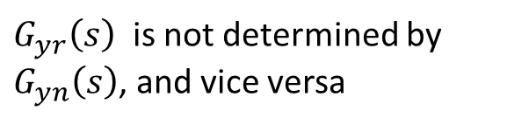
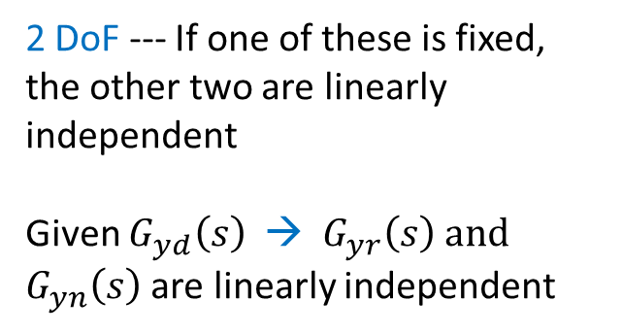
$$G_{yr}(s)=\frac{Y\left(s\right)}{R\left(s\right)}=\frac{G_{c1}\left(s\right)G_{p}\left(s\right)}{1+\left(G_{c1}\left(s\right)+G_{c2}\left(s\right)\right)G_{p}\left(s\right)}$$
$$G_{yd}(s)=\frac{Y\left(s\right)}{D\left(s\right)}=\frac{G_{p}\left(s\right)}{1+\left(G_{c1}\left(s\right)+G_{c2}\left(s\right)\right)G_{p}\left(s\right)}$$
$$G_{yn}(s)=\frac{Y\left(s\right)}{N\left(s\right)}=\frac{{(G}_{c1}\left(s\right)+G_{c2}(s))G_{p}\left(s\right)}{1+\left(G_{c1}\left(s\right)+G_{c2}\left(s\right)\right)G_{p}\left(s\right)}$$
$$G_{yr}\left(s\right)=G_{c1}\left(s\right)G_{yd}\left(s\right)$$
$$G_{yn}\left(s\right)={(G}_{c1}\left(s\right)+G_{c2}\left(s\right){)G}_{yd}$$
2 DoF --- If one of these is fixed, the other two are linearly independent
Given $G_{yd}\left(s\right)$ → $G_{yr}\left(s\right)$ and $G_{yn}\left(s\right)$ are linearly independent
$G_{yr}\left(s\right)$ is not determined by $G_{yn}\left(s\right)$, and vice versa

Slide 6
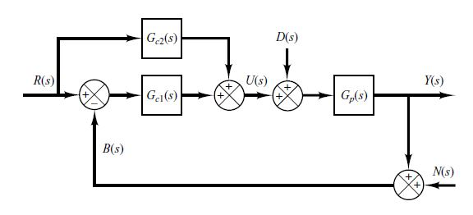
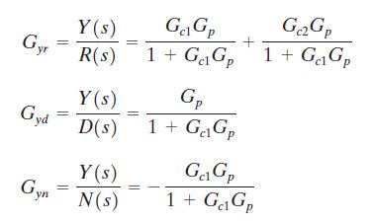
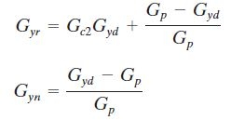
Example:
2 DoF :

Slide 7
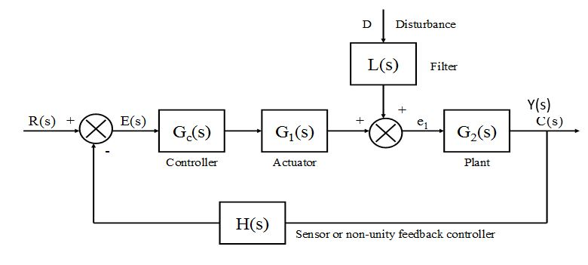
Advantages of Feedback
To study controller performance under imperfect conditions:
disturbance, noise, uncertainty, … …
.
Y(s)

Slide 8
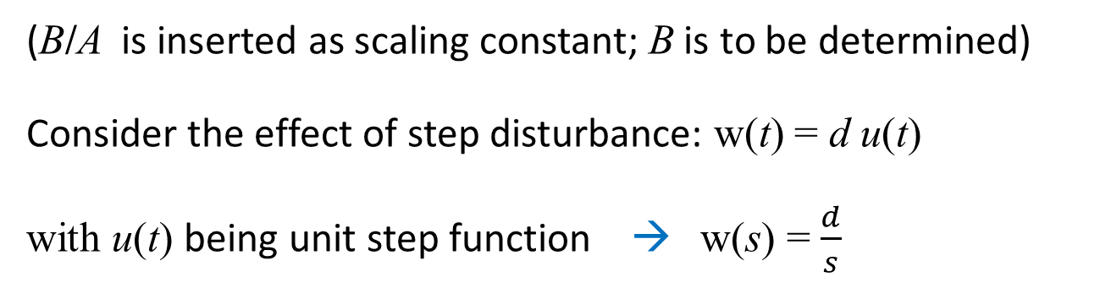
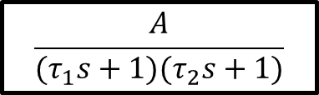
Presence of Disturbance
Example: Load disturbance w(t) on the torque
Disturbance w
B/A
+
Plant
r
+
y
K
+
$$\frac{A}{(τ_{1}s+1)(τ_{2}s+1)}$$
(B/A is inserted as scaling constant; B is to be determined)
Consider the effect of step disturbance: w(t) = d u(t)
with u(t) being unit step function → w(s) = $\frac{d}{s}$

Slide 9
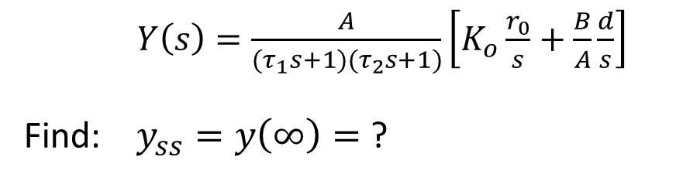



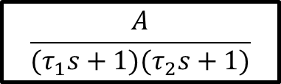
Open-Loop Control
Load, w
w(s) = $\frac{d}{s}$
B/A
+
Plant
$$r=r_{0}u(t)$$
+
r
K
+
$$\frac{A}{(τ_{1}s+1)(τ_{2}s+1)}$$
y
Step input
$Y\left(s\right)=\frac{A}{(τ_{1}s+1)(τ_{2}s+1)}\left[K_{o}\frac{r_{0}}{s}+\frac{B}{A}\frac{d}{s}\right]$
Find: $y_{ss}=y\left(∞\right)=$ ?
($K_{o}$ is open-loop $K$)
(5 minutes)

Slide 10
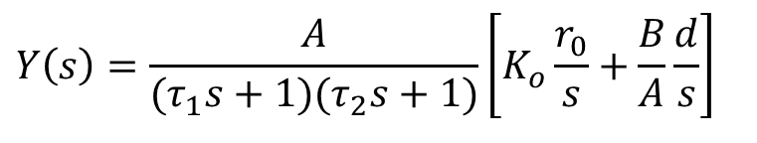

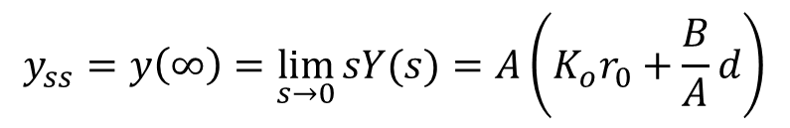
Open-Loop Control
Load, w
w(s) = $\frac{d}{s}$
B/A
+
Plant
$$r=r_{0}u(t)$$
+
r
r
K
+
$$\frac{A}{(τ_{1}s+1)(τ_{2}s+1)}$$
y
Step input
$$Y\left(s\right)=\frac{A}{(τ_{1}s+1)(τ_{2}s+1)}\left[K_{o}\frac{r_{0}}{s}+\frac{B}{A}\frac{d}{s}\right]$$
Solution:
$$y_{ss}=y\left(∞\right)=\lim_{s→0}{sY(s)}=A\left(K_{o}r_{0}+\frac{B}{A}d\right)$$

Slide 11



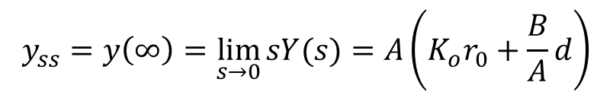
Open-Loop Control
Disturbance w
w(s) = $\frac{d}{s}$
B/A
+
Plant
$$r=r_{0}u(t)$$
+
r
r
K
+
$$\frac{A}{(τ_{1}s+1)(τ_{2}s+1)}$$
y
Step input
$$Y\left(s\right)=\frac{A}{(τ_{1}s+1)(τ_{2}s+1)}\left[K_{o}\frac{r_{0}}{s}+\frac{B}{A}\frac{d}{s}\right]$$
$$y_{ss}=y\left(∞\right)=\lim_{s→0}{sY(s)}=A\left(K_{o}r_{0}+\frac{B}{A}d\right)$$
Open-loop design → $K_{o}=\frac{1}{A}$ → $y\left(∞\right)=r_{0}+Bd$
→ y(∞) deviates from the reference value r₀ by e_{o}(∞) = Bd
( If no disturbance, d = 0, then e_{o}(∞) = 0 )

Slide 12

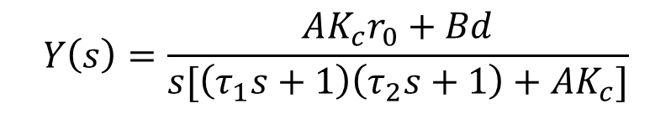

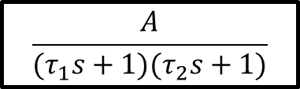



Closed-Loop Control
$$\frac{d}{s}$$
Load, w
B/A
w(s)
+
Plant
$$r=r_{0}u(t)$$
r
+
r
K
+
$$\frac{A}{(τ_{1}s+1)(τ_{2}s+1)}$$
y
+
$$−$$
$R\left(s\right)=\frac{r_{0}}{s}$ , $w\left(t\right)=\frac{B}{A}d u(t)$
$$Y\left(s\right)=\frac{AK_{c}r_{0}+Bd}{s[\left(τ_{1}s+1\right)\left(τ_{2}s+1\right)+{AK}_{c}]}$$
($K_{c}$ is closed-loop $K$)

Slide 13
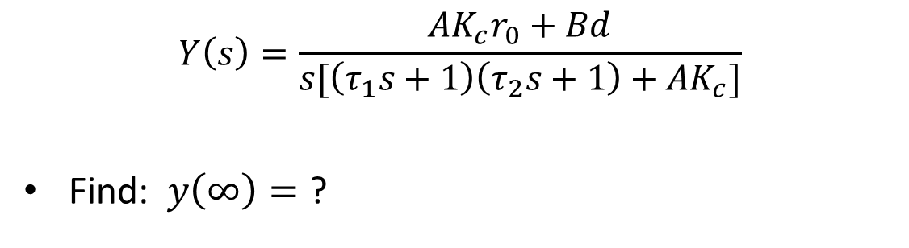
Closed-Loop Control
$$Y\left(s\right)=\frac{AK_{c}r_{0}+Bd}{s[\left(τ_{1}s+1\right)\left(τ_{2}s+1\right)+{AK}_{c}]}$$
Find: $y\left(∞\right)=$ ?
(5 minutes)

Slide 14
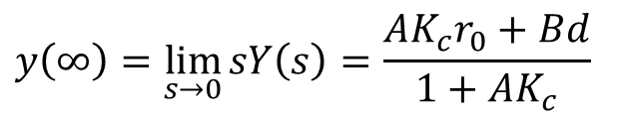

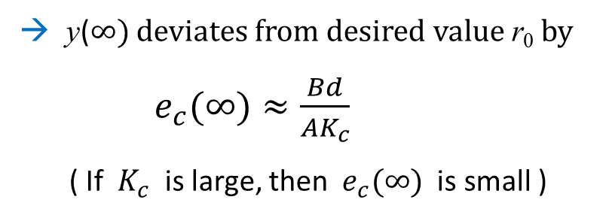
Closed-Loop Control
$$Y\left(s\right)=\frac{AK_{c}r_{0}+Bd}{s[\left(τ_{1}s+1\right)\left(τ_{2}s+1\right)+{AK}_{c}]}$$
Solution:
$$y\left(∞\right)=\lim_{s→0}{sY\left(s\right)=\frac{{AK_{c}r}_{0}+Bd}{1+{AK}_{c}}}$$
Closed-loop design → $AK_{c}≫1$ → $y\left(∞\right)≈\frac{{AK_{c}r}_{0}+Bd}{{AK}_{c}}$ =$r_{0}+ \frac{Bd}{AK_{c}}$
→ y(∞) deviates from desired value r₀ by
$e_{c}(∞)≈\frac{Bd}{{AK}_{c}}$
( If $K_{c}$ is large, then ${ e}_{c}(∞)$ is small )

Slide 15


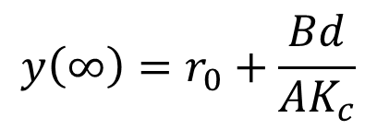
Comparison
Open-loop:
$$y\left(∞\right)=r_{0}+Bd$$
$$y\left(∞\right)=r_{0}+\frac{Bd}{{AK}_{c}}$$
Closed-loop:
$$e_{c}(∞)=\frac{e_{o}\left(∞\right)}{AK_{c}}≪e_{o}(∞) \left(AK_{c}≫1\right)$$

Slide 16
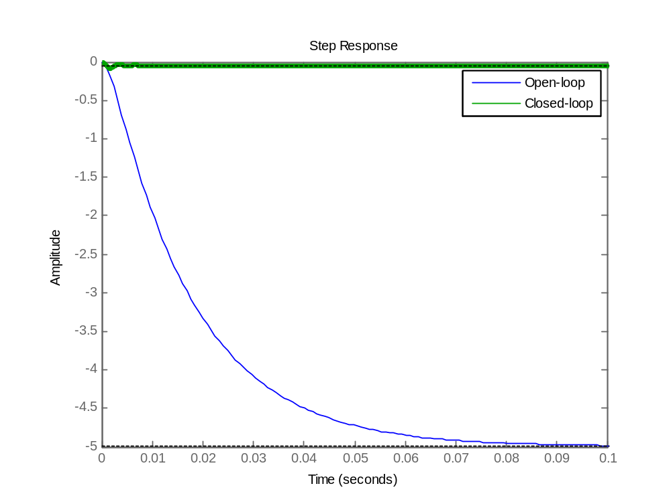

Comparison
Example:
$${ e}_{c}(∞)$$
e_{o}(∞)
%MatLab code
step(zpk([],[-60 -600],-5*60*600),tf(-180000,[1 660 3600000]))
legend('Open-loop','Closed-loop')

Slide 17
System Parameter Variation
Model and/or parameters never exactly match reality, for example:
  Insufficient knowledge about the system
  Fatigue, aging
  Environmental changes
Example: Motor gain A → A + ∆A
(e.g., a change in operating temperature caused the
motor gain to drift from its original value)
Q: How does this uncertainty affect the performance?

Slide 18
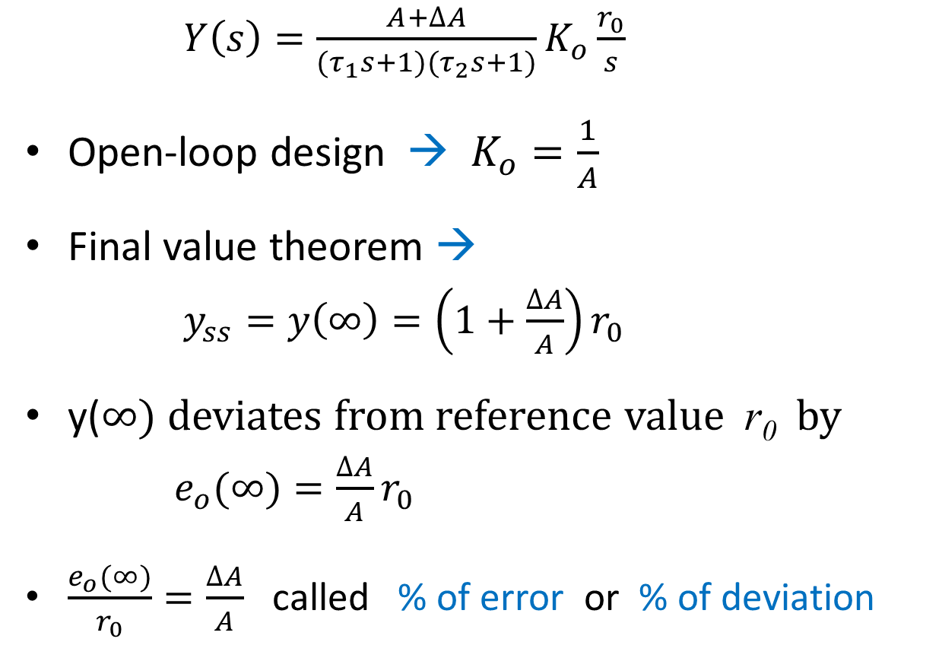
Open-Loop Control
$Y\left(s\right)=\frac{A+∆A}{(τ_{1}s+1)(τ_{2}s+1)}K_{o}\frac{r_{0}}{s}$
Open-loop design → $K_{o}=\frac{1}{A}$
Final value theorem →
$y_{ss}=y\left(∞\right)=\left(1+\frac{∆A}{A}\right)r_{0}$
y(∞) deviates from reference value r₀ by
$e_{o}(∞)=\frac{∆A}{A}r_{0}$
$\frac{e_{o}(∞)}{r_{0}}=\frac{∆A}{A}$ called % of error or % of deviation

Slide 19

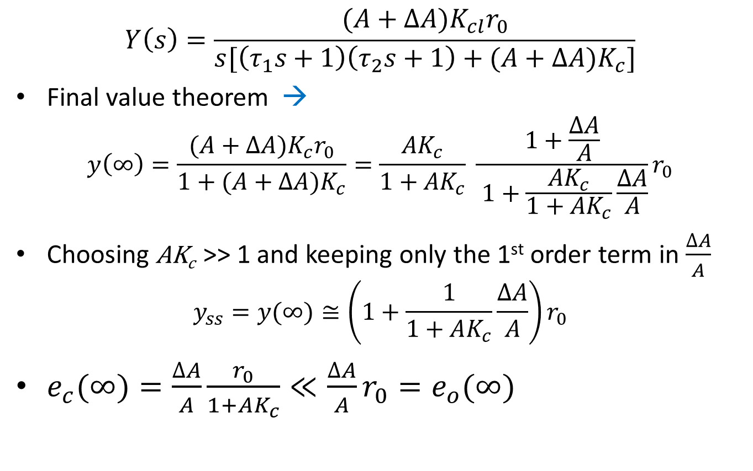
Closed-Loop Control
$$Y\left(s\right)=\frac{(A+∆A)K_{cl}r_{0}}{s[\left(τ_{1}s+1\right)\left(τ_{2}s+1\right)+{(A+∆A)K}_{c}]}$$
Final value theorem →
$$y\left(∞\right)=\frac{(A+∆A)K_{c}r_{0}}{1+{(A+∆A)K}_{c}}=\frac{{AK}_{c}}{1+{AK}_{c}} \frac{1+\frac{∆A}{A}}{ 1+\frac{{AK}_{c}}{1+AK_{c}}\frac{∆A}{A}}r_{0}$$
Choosing AK_{c} >> 1 and keeping only the 1st order term in $\frac{∆A}{A}$
$$y_{ss}=y(∞)≅\left(1+\frac{1}{1+AK_{c}}\frac{∆A}{A}\right)r_{0}$$
$e_{c}(∞)=\frac{∆A}{A}\frac{r_{0}}{1+AK_{c}}≪{\frac{∆A}{A}r_{0}=e}_{o}(∞)$
$$\left(AK_{c}≫1\right)$$

Slide 20
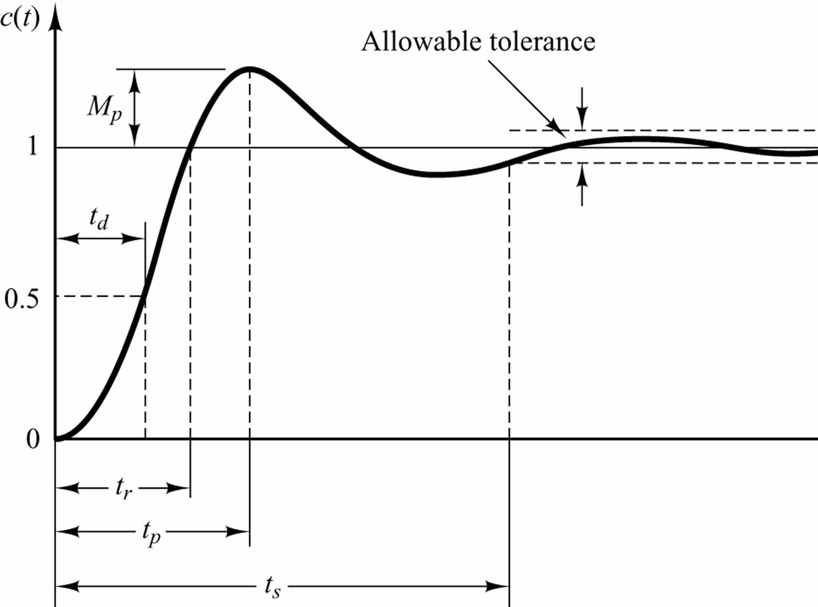
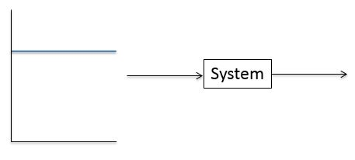
Step Input Transient Response
Can we control it to get a “good” transient response?

Slide 21
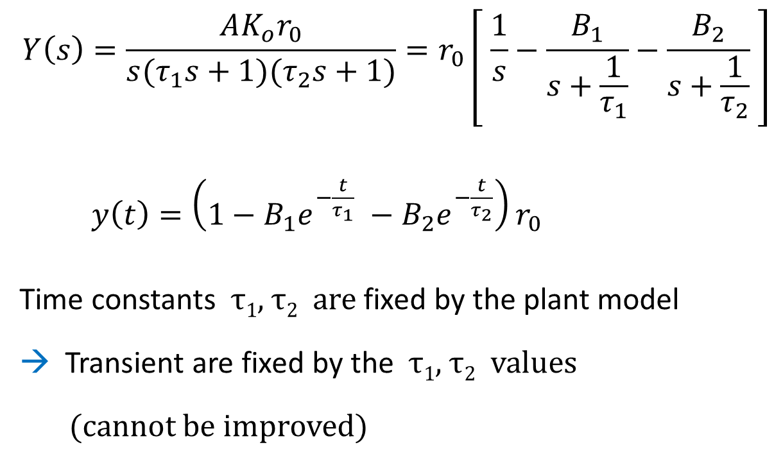
Open-Loop Control
$$Y\left(s\right)=\frac{AK_{o}r_{0}}{s(τ_{1}s+1)(τ_{2}s+1)}=r_{0}\left[ \frac{1}{s}−\frac{B_{1}}{s+\frac{1}{τ_{1}}}−\frac{B_{2}}{s+\frac{1}{τ_{2}}} \right]$$
$y\left(t\right)=\left(1−B_{1}e^{−\frac{t}{τ_{1}}} −B_{2}e^{−\frac{t}{τ_{2}}}\right)r_{0}$
Time constants τ₁, τ₂ are fixed by the plant model
→ Transient are fixed by the τ₁, τ₂ values
(cannot be improved)

Slide 22
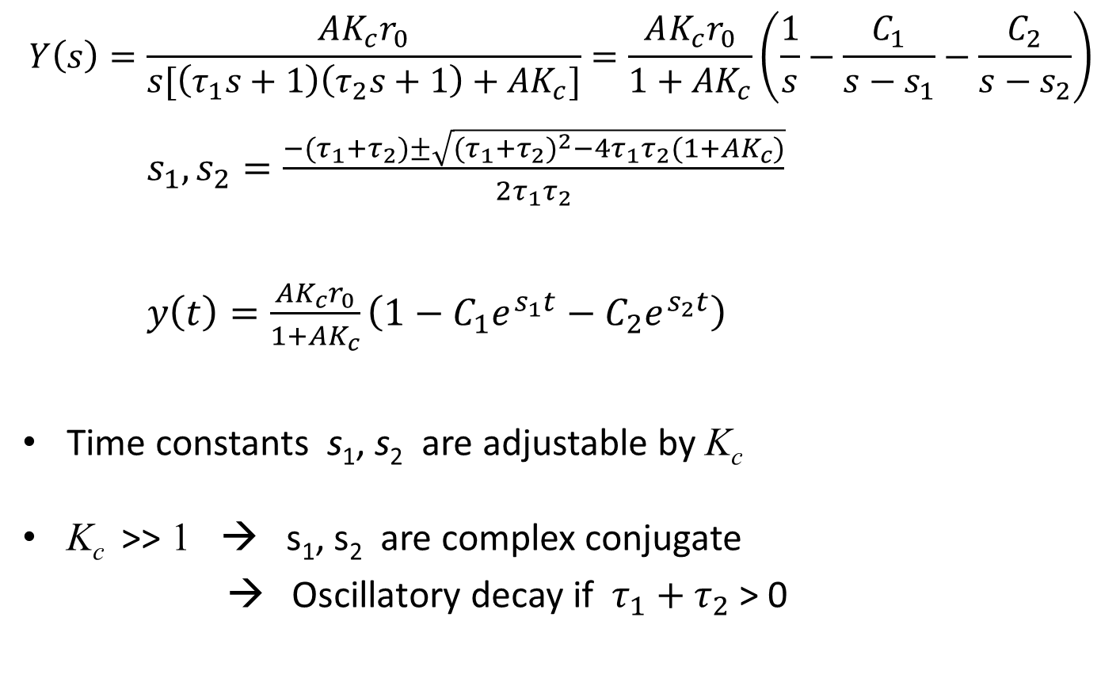
Closed-Loop Control
$$Y\left(s\right)=\frac{AK_{c}r_{0}}{s[\left(τ_{1}s+1\right)\left(τ_{2}s+1\right)+{AK}_{c}]}=\frac{AK_{c}r_{0}}{1+AK_{c}}\left(\frac{1}{s}−\frac{C_{1}}{s−s_{1}}−\frac{C_{2}}{s−s_{2}}\right)$$
$s_{1},s_{2}=\frac{−(τ_{1}+τ_{2})±\sqrt{{(τ_{1}+τ_{2})}^{2}−4τ_{1}τ_{2}(1+AK_{c})}}{2τ_{1}τ_{2}}$
$y\left(t\right)=\frac{AK_{c}r_{0}}{1+AK_{c}}\left(1−C_{1}e^{s_{1}t}−C_{2}e^{s_{2}t}\right)$
Time constants s₁, s₂ are adjustable by K_{c}
K_{c} >> 1 → s₁, s₂ are complex conjugate
→ Oscillatory decay if $τ_{1}+τ_{2}$ > 0

Slide 23
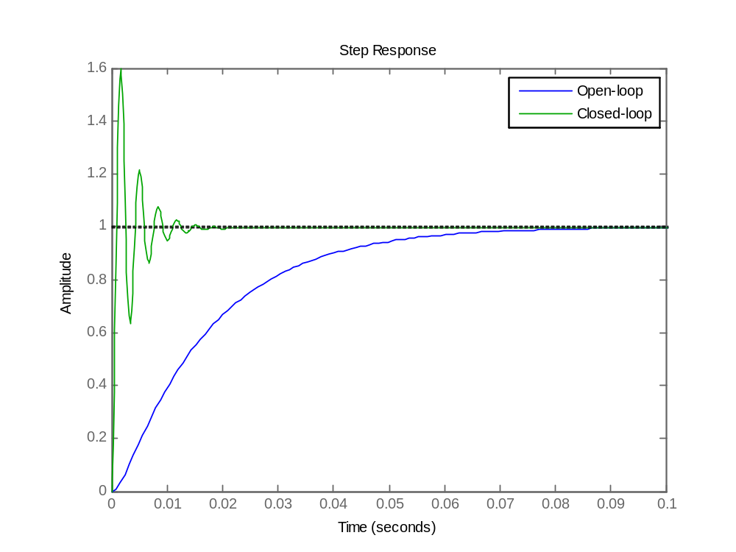
Transient Responses
Unchangeable in open-loop control
Adjustable to achieve desired output in closed-loop control

Slide 24
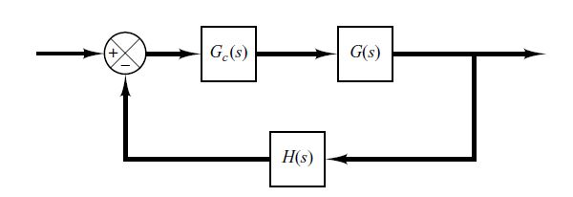
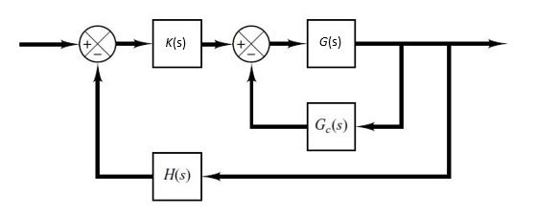
Improving System Performance by Compensation
System transient performance can be improved by using compensator (also called: filter)
Series:
Parallel:

Slide 25



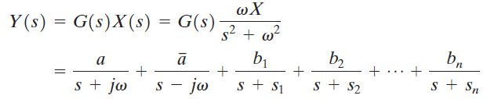


Consider:
$$x\left(t\right)=Xsin(ωt)$$
For a stable system:
+ 0 + … + 0

Slide 26
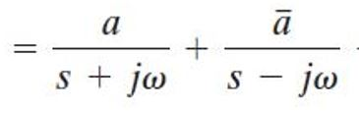






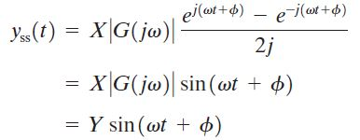

$$Y\left(s\right)$$

Slide 27
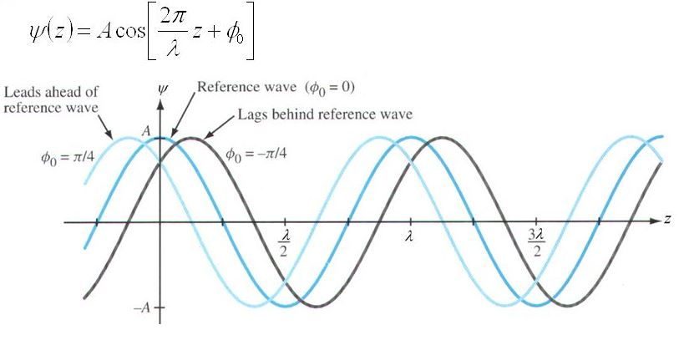
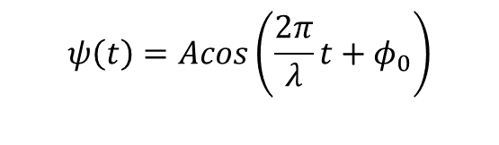
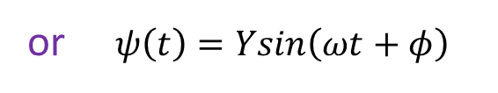
Phase-Lead and Phase-Lag
$$ψ\left(t\right)=Acos\left(\frac{2π}{λ}t+φ_{0}\right)$$
or $ψ\left(t\right)=Ysin\left(ωt+φ\right)$
Positive angle – Phase lead (ahead)
Negative angle – Phase lag (behind)

Slide 28
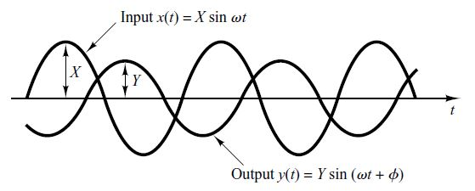
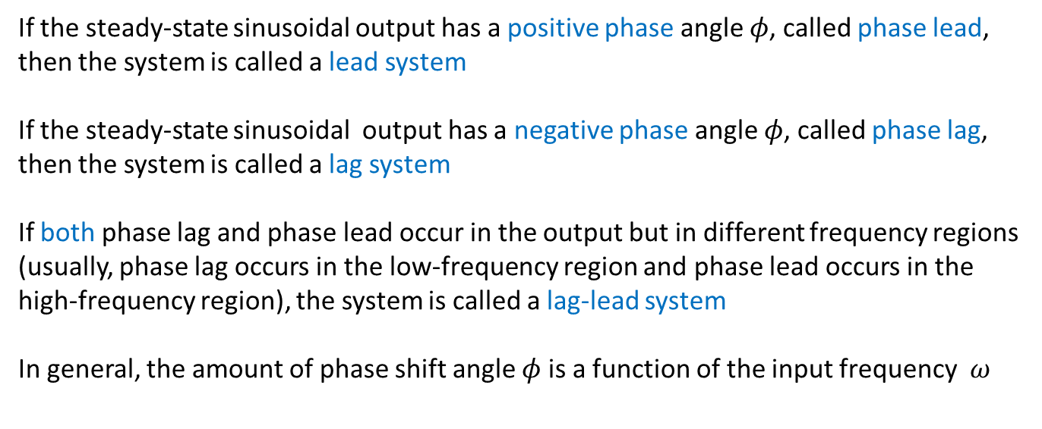
sinusoidal input → sinusoidal output
If the steady-state sinusoidal output has a positive phase angle $φ$, called phase lead, then the system is called a lead system
If the steady-state sinusoidal output has a negative phase angle $φ$, called phase lag, then the system is called a lag system
If both phase lag and phase lead occur in the output but in different frequency regions (usually, phase lag occurs in the low-frequency region and phase lead occurs in the high-frequency region), the system is called a lag-lead system
In general, the amount of phase shift angle $φ$is a function of the input frequency $ω$

Slide 29
A compensator having a characteristic of a lead system, lag system, or lag–lead system is called a lead compensator, lag compensator, or lag–lead compensator, respectively.
Widely used compensators are: lead compensators, lag compensators, lag–lead compensators, and velocity-feedback (tachometer) compensators.
Lead, lag, and lag–lead compensators may be electronic devices (such as circuits using operational amplifiers) or RC networks (electrical, mechanical, pneumatic, hydraulic, or combinations thereof) and amplifiers.

Slide 30





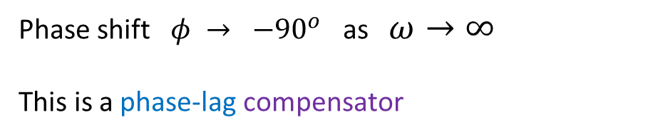


Example:
$$x\left(t\right)=Xsin(ωt)$$
$$y_{ss}\left(t\right)=Ysin(ωt+φ)$$
$G\left(s\right)=\frac{K}{Ts+1}$ → $G\left(jω\right)=\frac{K}{jTω+1}$
Phase shift $φ → −{90}^{o}$ as $ω→∞$
This is a phase-lag compensator

Slide 31

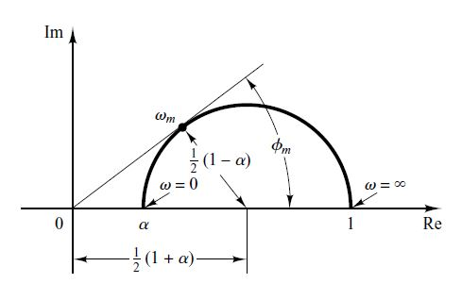
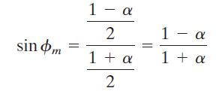

Example (polar plot):
$$G\left(jω\right)=$$
Phase-led angle:

Slide 32






Bode plot $(α=0.1)$
$$G\left(jω\right)=$$
phase
$φ_{m}$ is geometric mean of the two corner frequencies 1/T and 10/T

Slide 33





Lead Compensation
Example:
$$(K=K_{c}α)$$
Determine K to satisfy the required steady-state position $y_{ss}$
Determine the phase-lead angle $φ_{m}$ to be added to the system
Draw the Bode plot of $KG\left(jω\right)$, and compute $α$ by $sin{ φ}_{m}=\frac{1−α}{1+α }$
Determine $ω$where magnitude of un-compensated system $\left|KG\left(jω\right)\right|=−20\log{(\frac{1}{\sqrt{α}})}$
Input phase shift, which yields maximum phase shift: $ω_{m}=1/(\sqrt{α} T)$
Repeat the above until the output phase-lead $≈$ required $φ_{m}$
Compensator gain $K_{c}=\frac{K}{α}$

Slide 34




Lag Compensation
Example:
$$(K=K_{c}β)$$
Determine K to satisfy the required steady-state velocity error ${\dot{y}}_{ss}$
Determine the phase-lag angle $φ_{m}$ to be added to the system
Draw the Bode plot of $KG\left(jω\right)$, and determine $ω_{m}=−{180}^{o}+φ_{m}$
Determine $β$ to bring the magnitude curve down to 0 dB
Input phase shift, which yields maximum phase shift: $ω_{m}=1/(βT)$
Repeat the above until the output phase-lag $≈$ required $φ_{m}$
Compensator gain $K_{c}=\frac{K}{β }$

Slide 35

Graphical Comparison
Fastest
Smallest error
Compromise
Lead-lag compensated

Slide 36
END

